Slide 1
SQL

Slide 2
What will be covered today ?
History and Origin of SQL.
What is SQL and what does it stand for ?
What's a database ?
Types of Databases.
What's a relational database ?
What's MySQL

Slide 3
History of The SQL Language
In the early 1970’s IBM began developing the System R project, which aimed to create a prototype for a relational database management system (RDBMS).
Donald D. Chamberlin and Raymond F. Boyce, two IBM researchers, developed a language called SEQUEL (Structured English Query Language) as part of the System R project. SEQUEL later evolved into SQL.
Over the years, SQL underwent several revisions and enhancements to improve functionality and address industry needs.
SQL gained popularity as the standard language for interacting with relational databases.
Major database vendors, such as Oracle, IBM, Microsoft, and MySQL, implemented SQL in their database management systems, contributing to its widespread adoption.

Slide 4
Definition
SQL is a tool for organizing, managing, and retrieving data stored by a computer database. The name "SQL" is an abbreviation for Structured Query Language.
As the name implies, SQL is a computer language that you use to interact with a database.
A database is an organized collection of structured information, or data, typically stored electronically in a computer system.
To manage and interact with a database you use a Database Management System (DBMS).
A DBMS (Database Management System) is a software application or system that allows users to efficiently organize, store, retrieve, and manipulate data in a database.
It serves as an interface between users and the database, providing a set of tools and functions to manage the data.

Slide 5
TYPES OF DATABASES
There are two main types of data bases relational databases and Non-Relational Databases.
Other types of databases include:
  Object-Oriented Databases (OODBMS): Object-oriented databases store data in the form of objects, similar to object-oriented programming concepts. Examples include db4o,ObjectDB , MongoDb Realm
  Hierarchical Databases: Hierarchical databases organize data in a tree-like structure, where each record has a parent-child relationship.IBM's Information Management System (IMS) is an example of a hierarchical database.
  Network Databases: Network databases are similar to hierarchical databases, but they allow more complex relationships by using a graph-like structure. Eg IDS and IDMS
  Columnar Databases: Columnar databases store data in columns rather than rows, optimizing data storage and query performance for analytical workloads. Examples include Vertica, Apache HBase, and Google Bigtable.

Slide 6
There are several popular DBMSs (Database Management Systems) used in various applications and industries. Here are some examples:
  Oracle Database: Oracle Database is a widely used relational database management system developed by Oracle Corporation.
  MySQL: MySQL is an open-source relational database management system. It is known for its speed, scalability, and ease of use. MySQL is widely used in web applications and is the default database system for popular content management systems like WordPress.
  Microsoft SQL Server: Microsoft SQL Server is a relational database management system developed by Microsoft.
  PostgreSQL: PostgreSQL is a powerful open-source object-relational database management system. It emphasizes standards compliance, extensibility, and data integrity. PostgreSQL is known for its advanced features, such as support for complex queries, indexing options, and extensive data types.
  MongoDB: MongoDB is a popular open-source NoSQL document database. It is designed for flexibility, scalability, and ease of development. MongoDB stores data in flexible JSON-like documents and is commonly used in modern web applications and big data environments.
  IBM Db2: IBM Db2 is a family of relational database management systems developed by IBM. It provides robust data management capabilities and is known for its scalability, high availability, and performance. Db2 is used in enterprise-level applications and data warehouses.
  SQLite: SQLite is a lightweight, embedded relational database management system. It is widely used in mobile and embedded applications due to its small footprint, simplicity, and zero-configuration setup.

Slide 7
RELATIONAL DATABASES
This database uses Structured Query Language (SQL) for performing CRUD operations creating, reading, updating, and deleting data.
They are the most widely used type of database.
They organize data into tables with predefined relationships between them.
RDBMSs(Relational Database Management Systems) use the SQL language for data manipulation and retrieval.
Examples include Oracle, MySQL, Microsoft SQL Server,MariaDb and PostgreSQL.

Slide 8

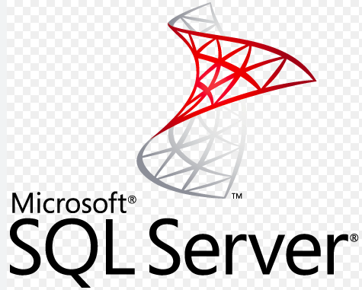
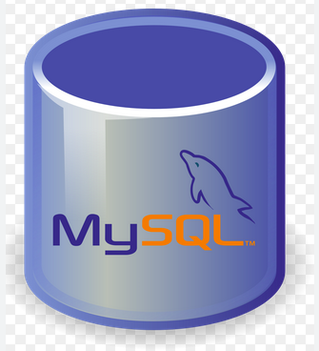




Slide 9
Non-Relational Databases
Most databases can be categorized as either relational or non-relational.
Non-relational databases are sometimes referred to as “NoSQL,” which stands for “Not Only SQL”.
The main difference between them is how they store their information.
A non-relational database stores data in a non-tabular form, and tends to be more flexible than the traditional, SQL-based, relational database structures.
It does not follow the relational model provided by traditional relational database management systems but rather it uses other data structures like documents,json files, key/value pairs , Graph-like data structures.

Slide 10
Examples of Non-Relational Databases
MongoDB: MongoDB is a widely used document database that stores data in JSON-like documents.
Apache Cassandra: Apache Cassandra is a distributed and highly scalable columnar database.
Redis: Redis is an in-memory key-value store that provides fast data retrieval and caching. It supports a wide range of data structures, including strings, lists, sets, and hashes.
Neo4j: Neo4j is a graph database that stores data in nodes and relationships (edges). It is designed for handling highly interconnected data and complex relationships.
Apache HBase: Apache HBase is a distributed columnar database that runs on top of Hadoop.
Amazon DynamoDB: DynamoDB is a fully managed NoSQL database service provided by Amazon Web Services (AWS). It is a key-value store with high scalability, automatic scaling, and low latency.

Slide 11

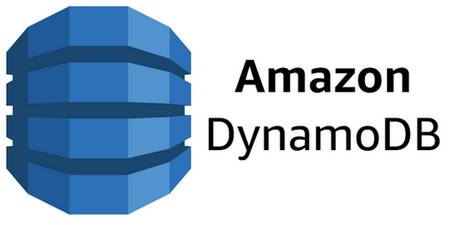




Slide 12
MySQL
MySQL is an open-source relational database management system (RDBMS) that is widely used for managing and storing structured data.
It was developed by a Swedish company called MySQL AB, which was later acquired by Sun Micro systems and subsequently by Oracle Corporation.
MySQL is known for its performance, scalability, ease of use, and robustness
MySQL employs a client-server architecture, where multiple client applications can connect to a central MySQL server to access and manipulate data.
The server handles data storage, retrieval, and management, while clients interact with the server to perform operations on the data.
MySQL includes various tools and utilities for database administration, configuration, and monitoring. These tools simplify tasks such as database setup, performance tuning, backup and recovery, and managing user accounts.

Slide 13
How do Relational Databases Work ?
Relational databases work based on the relational model, which organizes data into many tables and establishes relationships between the tables based on the data in the tables.
The structure and organization of the database is known as schema.
Schema includes the tables, columns and data types, relationships, and constraints that govern the data stored in the database.
To do this effectively we use Queries.
A query refers to a request or instruction to retrieve specific information from a database.
Queries are used to interact with a database management system (DBMS) and extract data based on specific criteria or conditions. They allow users to retrieve, manipulate, filter, and analyze data stored within a database.

Slide 14
Tables
The organizing principle in a relational database is the table, a rectangular, row/column arrangement of data values.
Each table in a database has a unique table name that identifies its contents. The table schema defines the structure and organization of the table, specifying the columns, data types, constraints, and relationships
The components of a table in more detail:
Rows (Records):
A row, also referred to as a record or tuple, represents a single instance of data stored in the table. Each row contains specific data values that correspond to the attributes or columns defined in the table's schema.
Columns (Attributes):
Columns, also known as attributes or fields, represent the individual data elements associated with the entities or concepts represented by the table. Each column has a specific name and data type, defining the kind of data it can store, such as strings, numbers, dates, or binary data.
Primary Key:
A primary key is a column or a combination of columns that uniquely identifies each row in the table.
It ensures the uniqueness and integrity of data within the table, preventing duplicate entries and serving as a reference for establishing relationships with other tables. Examples of primary keys include unique identifiers like employee IDs, customer IDs, or order IDs.
Foreign Key:
A foreign key is a column or a set of columns in a table that references the primary key of another table. It establishes relationships or connections between tables, allowing data to be linked across tables.
Foreign keys enable the representation of complex data relationships in a relational database by connecting related entities.
Data Types:
Each column in a table has a specific data type that determines the kind of data it can store.
Data types can include integers, floating-point numbers, strings, dates, Boolean values, or binary data, among others.

Slide 15
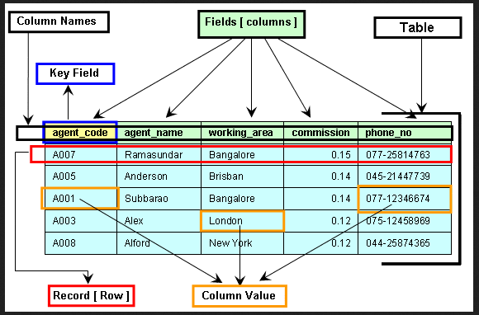

Slide 16
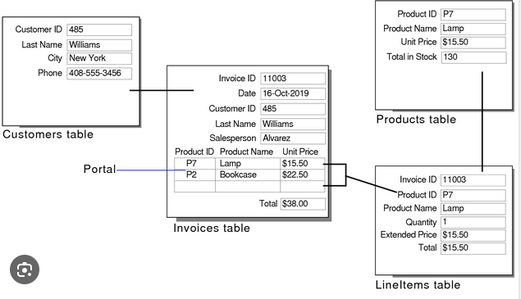
Example of many Tables in a Relational Database

Slide 17
