Slide 1
Data Abstraction, Data Encapsulation, and Information Hiding

Slide 2
Data Abstraction, Data Encapsulation and Information Hiding are often synonymously used in books and tutorials on OOP. However, there is a difference.
Encapsulation is seen as the bundling of data with the methods that operate on that data.
Information hiding on the other hand is the principle that some internal information or data is "hidden", so that it can't be accidentally changed.
Finally, data abstraction is present, if both data hiding and data encapsulation is used. In other words, data abstraction is the broader term:
Data Abstraction = Data Encapsulation + Data Hiding

Slide 3
Public ,Private and Protected attributes
Private attributes are accessed inside of the class definition itself.
Protected (restricted) Attributes should only be used under certain conditions.
Public Attributes can and should be freely used.
Python uses a special naming scheme for attributes to control the accessibility of the attributes.
  First, an attribute name is prefixed with a single leading underscore _.
  This marks the attribute as protected. Only accessed from a subclass
  Second, an attribute name is prefixed with two leading underscores __.
  This marks the attribute as private. Only accessed inside the class definition itself.

Slide 4
Encapsulation is often accomplished by providing two kinds of methods for attributes:
  Getter Methods
  Getter methods are used for retrieving or accessing the values of your attributes. They do not change the values of the attributes rather they just return the values.
  Setter Methods
  Setter methods change the values of your attributes

Slide 5
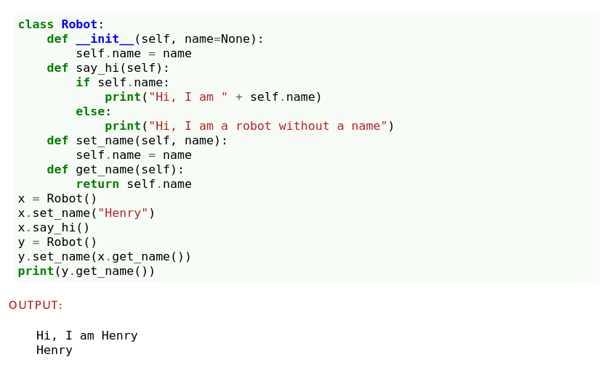

Slide 6
By using "getter" and "setter" methods you are adding an additional layer of control over attribute access, modification, and deletion. This better defines the term properties.
Properties are created using the @property decorator or the property() function.
In summary, attributes are variables associated with an object that store data directly, while
properties are a way to control access to an object's attributes using "getter" and "setter" methods.

Slide 7
INHERITANCE IN PYTHON

Slide 8
One of the core concepts in (OOP) languages is inheritance.
It is a mechanism that allows you to create a hierarchy of classes that share a set of properties and methods by deriving a class from another class.
Inheritance is the capability of one class to derive or inherit the properties from another class.
The class being inherited from is known as :Parent class , also called base class.
The class that inherits from another class is known as :Child class also called derived class.

Slide 9
The syntax of simple inheritance in Python is as follows:
Class BaseClass: #parent class
{Body}
Class DerivedClass(BaseClass): #child subclass
{Body}

Slide 10
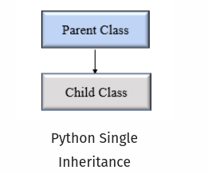
Single Inheritance
# Base class
class Vehicle:
def Vehicle_info(self):
print('Inside Vehicle class')
# Child class
class Car(Vehicle):
def car_info(self):
print('Inside Car class')
# Create object of Car
car = Car()
# access Vehicle's info using car object
car.Vehicle_info()
car.car_info()
In single inheritance, a child class inherits from a single-parent class.

Slide 11
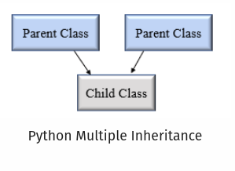
Multiple Inheritance
# Parent class 1
class Person:
def person_info(self, name, age):
print('Inside Person class')
print('Name:', name, 'Age:', age)
# Parent class 2
class Company:
def company_info(self, company_name, location):
print('Inside Company class')
print('Name:', company_name, 'location:', location)
# Child class
class Employee(Person, Company):
def Employee_info(self, salary, skill):
print('Inside Employee class')
print('Salary:', salary, 'Skill:', skill)
# Create object of Employee
emp = Employee()
# access data
emp.person_info('Jessa', 28)
emp.company_info('Google', 'Atlanta')
emp.Employee_info(12000, 'Machine Learning')
In multiple inheritance, one child class can inherit from multiple parent classes.

Slide 12
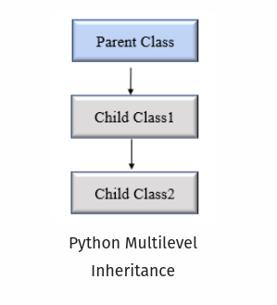
Multilevel inheritance
In multilevel inheritance, a class inherits from a child class or derived class. Suppose three classes A, B, C. A is the superclass, B is the child class of A, C is the child class of B. In other words, we can say a chain of classes is called multilevel inheritance.

Slide 13
# Base class
class Vehicle:
def Vehicle_info(self):
print('Inside Vehicle class')
# Child class
class Car(Vehicle):
def car_info(self):
print('Inside Car class')
# Child class
class SportsCar(Car):
def sports_car_info(self):
print('Inside SportsCar class')
# Create object of SportsCar
s_car = SportsCar()
# access Vehicle's and Car info using SportsCar object
s_car.Vehicle_info()
s_car.car_info()
s_car.sports_car_info()
In this example, we can see there are three classes named
Vehicle, Car, SportsCar.
Vehicle is the superclass,
Car is a child of Vehicle,
SportsCar is a child of Car.

Slide 14
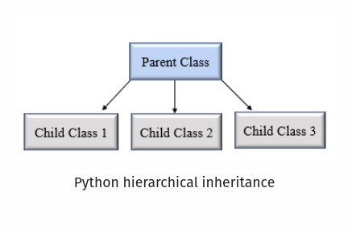
Hierarchical Inheritance
class Vehicle:
def info(self):
print("This is Vehicle")
class Car(Vehicle):
def car_info(self, name):
print("Car name is:", name)
class Truck(Vehicle):
def truck_info(self, name):
print("Truck name is:", name)
obj1 = Car()
obj1.info()
obj1.car_info('BMW')
obj2 = Truck()
obj2.info()
obj2.truck_info('Ford')
In Hierarchical inheritance, more than one child class is derived from a single parent class.
In other words, we can say one parent class and multiple child classes.

Slide 15
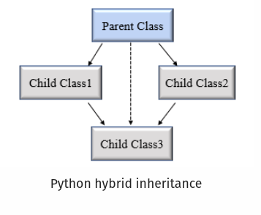
Hybrid Inheritance
class Vehicle:
def vehicle_info(self):
print("Inside Vehicle class")
class Car(Vehicle):
def car_info(self):
print("Inside Car class")
class Truck(Vehicle):
def truck_info(self):
print("Inside Truck class")
# Sports Car can inherits properties of Vehicle and Car
class SportsCar(Car, Vehicle):
def sports_car_info(self):
print("Inside SportsCar class")
# create object
s_car = SportsCar()
s_car.vehicle_info()
s_car.car_info()
s_car.sports_car_info()
When inheritance is consists of multiple types or a combination of different inheritance is called hybrid inheritance

Slide 16
In the example, hierarchical and multiple inheritance exists.
We created, parent class Vehicle and two child classes named Car and Truck this is hierarchical inheritance.
Another is SportsCar inheriting from two parent classes named Car and Vehicle. This is multiple inheritance.

Slide 17
Python super() function
In child class, we can refer to parent class by using the super() function.
The super function returns a temporary object of the parent class that allows us to call a parent class method inside a child class method.
Benefits of using the super() function.
  We are not required to remember or specify the parent class name to access its methods.
  We can use the super() function in both single and multiple inheritances.
  The super() function support code reusability as there is no need to write the entire function

Slide 18
class Company:
def company_name(self):
return 'Google'
class Employee(Company):
def info(self):
# Calling a method from our superclass using super()function
c_name = super().company_name()
print("Jessa works at", c_name)
# Creating object of child class
emp = Employee()
emp.info()

Slide 19
In Python, we can verify whether a particular class is a subclass of another class.
We can use Python built-in function issubclass( ).
This function returns True if the given class is the subclass of the specified class.
Otherwise, it returns False.
Syntax
issubclass(class, classinfo)
Where,
class: class to be checked.
classinfo: a class, type, or a tuple of classes or data types.

Slide 20
class Company:
def fun1(self):
print("Inside parent class")
class Employee(Company):
def fun2(self):
print("Inside child class.")
class Player:
def fun3(self):
print("Inside Player class.")
# Result True
print(issubclass(Employee, Company))
# Result False
print(issubclass(Player, Company))
# Result True
print(issubclass(Employee, (list, Company)))
# Result True
print(issubclass(Company, (list, Company)))

