Slide 1

COURSE SLIDES
AI Vibe Coding for Algorithmic Trading
Course Code: C728
Conducted by Tertiary Infotech Academy Pte Ltd · UEN 201200696W
Version v1.0 · 1 October 2026
© 2026 Tertiary Infotech Academy Pte Ltd. All rights reserved. · www.tertiarycourses.com.sg

Slide 2
COURSE ADMINISTRATION
Welcome & Housekeeping
C728-AI-Vibe-Coding-for-Algorithmic-Trading · C728
© 2026 Tertiary Infotech Academy Pte Ltd
1

Slide 3
WELCOME
Meet your trainer
Trainer
Dr. Alfred Ang
Your experience
Share a Python or finance project.
1
2
Your goal
Name one trading workflow to improve.
Your responsibility
Review assumptions and verify results.
3
4
C728-AI-Vibe-Coding-for-Algorithmic-Trading · C728
© 2026 Tertiary Infotech Academy Pte Ltd
2

Slide 4
ICE-BREAKER
Let's Know Each Other
Your name and organisation / role.
1
Your experience with this subject (if any).
2
What you want to be able to do after this course.
3
C728-AI-Vibe-Coding-for-Algorithmic-Trading · C728
© 2026 Tertiary Infotech Academy Pte Ltd
3

Slide 5
HOUSEKEEPING
Ground Rules
Set your mobile phone to silent mode.
Participate actively — no question is too small.
1
2
Mutual respect: agree to disagree.
One conversation at a time.
3
4
Be punctual; return from breaks on time.
Learn by doing — try every hands-on lab.
5
6
C728-AI-Vibe-Coding-for-Algorithmic-Trading · C728
© 2026 Tertiary Infotech Academy Pte Ltd
4

Slide 6
C728 MATERIALS
Your course toolkit
Slides
Visual concepts and worked examples.
Learner Guide
Detailed lab procedures and troubleshooting.
1
2
Lab folders
Sample Python scripts and prompt PDFs.
Shared package
Use the course Drive folder and GitHub README.
3
4
C728-AI-Vibe-Coding-for-Algorithmic-Trading · C728
© 2026 Tertiary Infotech Academy Pte Ltd
5

Slide 7
SCHEDULE
Lesson Plan — 2 Days, 15 instructional hours
Day 1
Day 2
• Day 1 — From prompt to validated signal
– Topic 1: Getting Started with AI Vibe Coding for Trading (Labs 1–2)
– Topic 2: Analysing Markets with AI (Labs 3–4)
• Day 2 — From backtest to monitored paper bot
– Topic 3: Building and Backtesting Strategies with AI (Labs 5–6)
– Topic 4: Automating and Running Trading with AI (Labs 7–8)
• Daily timing
– 09:00–18:00 · 1-hour lunch · 30 minutes tea breaks
C728-AI-Vibe-Coding-for-Algorithmic-Trading · C728
© 2026 Tertiary Infotech Academy Pte Ltd
6

Slide 8
WHAT YOU'LL ACHIEVE
Learning Outcomes
Prompt and review
Specify, generate and validate Python trading code with an AI assistant.
Data and signals
Validate price data, visualise indicators and construct causal signals.
1
2
Backtest and risk
Backtest with execution delay and costs, and interpret return and risk.
Validate and monitor
Validate parameters chronologically and operate a monitored paper-trading workflow.
3
4
C728-AI-Vibe-Coding-for-Algorithmic-Trading · C728
© 2026 Tertiary Infotech Academy Pte Ltd
7

Slide 9
LEARNING APPROACH
How You'll Learn
1
2
3
4
5
▶
▶
▶
▶
Trainer demonstrates the concept
You build it yourself in the hands-on lab
Verify with the lab's 'Test it' step
Discuss and troubleshoot together
Recap against the learning outcomes
C728-AI-Vibe-Coding-for-Algorithmic-Trading · C728
© 2026 Tertiary Infotech Academy Pte Ltd
8

Slide 10
CORE CONCEPTS
Research before execution
C728-AI-Vibe-Coding-for-Algorithmic-Trading · C728
© 2026 Tertiary Infotech Academy Pte Ltd
9

Slide 11
OVERVIEW
Own the logic
Contract
State data, timing and acceptance checks.
Evidence
Run checks and inspect charts.
1
2
Risk
Model costs and exposure limits.
Control
Paper mode and observable failures.
3
4
C728-AI-Vibe-Coding-for-Algorithmic-Trading · C728
© 2026 Tertiary Infotech Academy Pte Ltd
10

Slide 12
THE BUILDING BLOCKS
The AI review loop
Specify
Describe the smallest useful change.
Generate
Ask for a plan and focused code.
1
2
Inspect
Read assumptions and data access.
Verify
Run known-result tests before accepting.
3
4
C728-AI-Vibe-Coding-for-Algorithmic-Trading · C728
© 2026 Tertiary Infotech Academy Pte Ltd
11

Slide 13
RESEARCH DISCIPLINE
A plausible chart is not proof.
Demand causal signals, reproducible inputs and visible failure handling.
C728-AI-Vibe-Coding-for-Algorithmic-Trading · C728
© 2026 Tertiary Infotech Academy Pte Ltd
12

Slide 14
THE LEARNING ARC
How Every Lab Progresses
Describe → generate → review → run → compare → refine
1
C728-AI-Vibe-Coding-for-Algorithmic-Trading · C728
© 2026 Tertiary Infotech Academy Pte Ltd
13

Slide 15
01
TOPIC 01
Getting Started with AI Vibe Coding for Trading
Python environment · prompt contracts · data ingestion
C728-AI-Vibe-Coding-for-Algorithmic-Trading · C728
© 2026 Tertiary Infotech Academy Pte Ltd
14

Slide 16
KEY CONCEPTS
Key Concepts — Getting Started with AI Vibe Coding for Trading
A trading rule must define instrument, timing, exposure and exit.
AI generates candidates; humans own assumptions, tests and risk.
1
2
A prompt contract states inputs, outputs, constraints and acceptance checks.
Keep secrets and account data out of prompts and Git.
3
4
C728-AI-Vibe-Coding-for-Algorithmic-Trading · C728
© 2026 Tertiary Infotech Academy Pte Ltd
15

Slide 17
ADAPTED FROM REFERENCE · TRADING WORKFLOW
Algorithmic trading: the system
1
2
3
4
5
▶
▶
▶
▶
Price data
Indicators
Decision rule
Execution model
Risk and monitoring
C728-AI-Vibe-Coding-for-Algorithmic-Trading · C728
© 2026 Tertiary Infotech Academy Pte Ltd
16

Slide 18
A TESTABLE CONTRACT
The strategy specification
Universe
One synthetic daily series; long or flat.
Entry / exit
Fast SMA above slow SMA / otherwise flat.
1
2
Timing
Observe close; lag exposure one bar.
Costs
10 bps per unit of exposure turnover.
3
4
C728-AI-Vibe-Coding-for-Algorithmic-Trading · C728
© 2026 Tertiary Infotech Academy Pte Ltd
17

Slide 19
AI PAIR PROGRAMMING
From vague request to prompt contract
VAGUE
REVIEWABLE
• Build a profitable trading bot
– Missing data, timing and failure criteria
• Build a reproducible SMA research pipeline
– Specify schema, lag, costs and fixtures
– Return a plan, focused diff and tests
C728-AI-Vibe-Coding-for-Algorithmic-Trading · C728
© 2026 Tertiary Infotech Academy Pte Ltd
18

Slide 20
AI WORKFLOW · ADAPTED FROM REFERENCE
Human control stays in the loop
1
2
3
4
5
▶
▶
▶
▶
Plan
Generate
Read the diff
Run fixtures
Accept or refine
C728-AI-Vibe-Coding-for-Algorithmic-Trading · C728
© 2026 Tertiary Infotech Academy Pte Ltd
19

Slide 21
TOOL-INDEPENDENT HABITS
Choose your assistant
Cursor
Use project context; inspect proposed edits.
GitHub Copilot
Discuss a focused task and review suggestions.
1
2
Claude
Provide a sanitised contract and minimal context.
Common discipline
Verify API claims against official docs.
3
4
C728-AI-Vibe-Coding-for-Algorithmic-Trading · C728
© 2026 Tertiary Infotech Academy Pte Ltd
20

Slide 22
BEFORE ANY INDICATOR
Data is part of the strategy
Schema
date, close; finite positive price.
Provenance
Symbol, provider, timezone and adjustment policy.
1
2
Continuity
Missing sessions and duplicate dates.
Reproducibility
Keep a source snapshot and configuration.
3
4
C728-AI-Vibe-Coding-for-Algorithmic-Trading · C728
© 2026 Tertiary Infotech Academy Pte Ltd
21

Slide 23
WHAT YOU'LL DO
Hands-On Labs — Getting Started with AI Vibe Coding for Trading
Lab 1
Lab 2
• Environment and AI workflow
• Fetch and validate price data
C728-AI-Vibe-Coding-for-Algorithmic-Trading · C728
© 2026 Tertiary Infotech Academy Pte Ltd
22

Slide 24
TOPIC 01 · HANDS-ON
Environment and AI workflow
LAB 1
Use AI to build and review environment and ai workflow; demonstrate the result with executable evidence.
You'll build
preview.csv
Tools: Python · AI coding assistant · synthetic dataset
C728-AI-Vibe-Coding-for-Algorithmic-Trading · C728
© 2026 Tertiary Infotech Academy Pte Ltd
23

Slide 25
LAB 1 · VERIFY
Environment and AI workflow
✅ Test it
756 observations and environment OK
C728-AI-Vibe-Coding-for-Algorithmic-Trading · C728
© 2026 Tertiary Infotech Academy Pte Ltd
24

Slide 26
TOPIC 01 · HANDS-ON
Fetch and validate price data
LAB 2
Use AI to build and review fetch and validate price data; demonstrate the result with executable evidence.
You'll build
prices.csv
Tools: Python · AI coding assistant · synthetic dataset
C728-AI-Vibe-Coding-for-Algorithmic-Trading · C728
© 2026 Tertiary Infotech Academy Pte Ltd
25

Slide 27
LAB 2 · VERIFY
Fetch and validate price data
✅ Test it
both invalid fixtures rejected
C728-AI-Vibe-Coding-for-Algorithmic-Trading · C728
© 2026 Tertiary Infotech Academy Pte Ltd
26

Slide 28
TOPIC RECAP
Recap — Getting Started with AI Vibe Coding for Trading
You can now: LO1: Specify, generate and validate Python trading code with an AI assistant.
1
C728-AI-Vibe-Coding-for-Algorithmic-Trading · C728
© 2026 Tertiary Infotech Academy Pte Ltd
27

Slide 29
02
TOPIC 02
Analysing Markets with AI
Price data · indicators · signals · AI debugging
C728-AI-Vibe-Coding-for-Algorithmic-Trading · C728
© 2026 Tertiary Infotech Academy Pte Ltd
28

Slide 30
KEY CONCEPTS
Key Concepts — Analysing Markets with AI
Validate ordering, duplicate dates, missing prices and positive values.
Rolling indicators use past and current observations only.
1
2
A signal is a decision; a position is exposure after execution delay.
Use charts and small examples to debug generated code.
3
4
C728-AI-Vibe-Coding-for-Algorithmic-Trading · C728
© 2026 Tertiary Infotech Academy Pte Ltd
29

Slide 31
SMA · ADAPTED FROM REFERENCE
A rolling indicator sees a window
1
2
3
4
5
▶
▶
▶
▶
Older bars
Last 20 closes
Arithmetic mean
Current SMA
Signal decision
C728-AI-Vibe-Coding-for-Algorithmic-Trading · C728
© 2026 Tertiary Infotech Academy Pte Ltd
30

Slide 32
REFERENCE STRATEGIES · COMPARISON
Indicator families
SMA / EMA
Trend smoothing; EMA weights recent observations.
RSI
Relative gains/losses; specify smoothing convention.
1
2
Bollinger bands
Moving mean ± volatility multiple.
MACD
Difference between fast and slow EMAs.
3
4
C728-AI-Vibe-Coding-for-Algorithmic-Trading · C728
© 2026 Tertiary Infotech Academy Pte Ltd
31

Slide 33
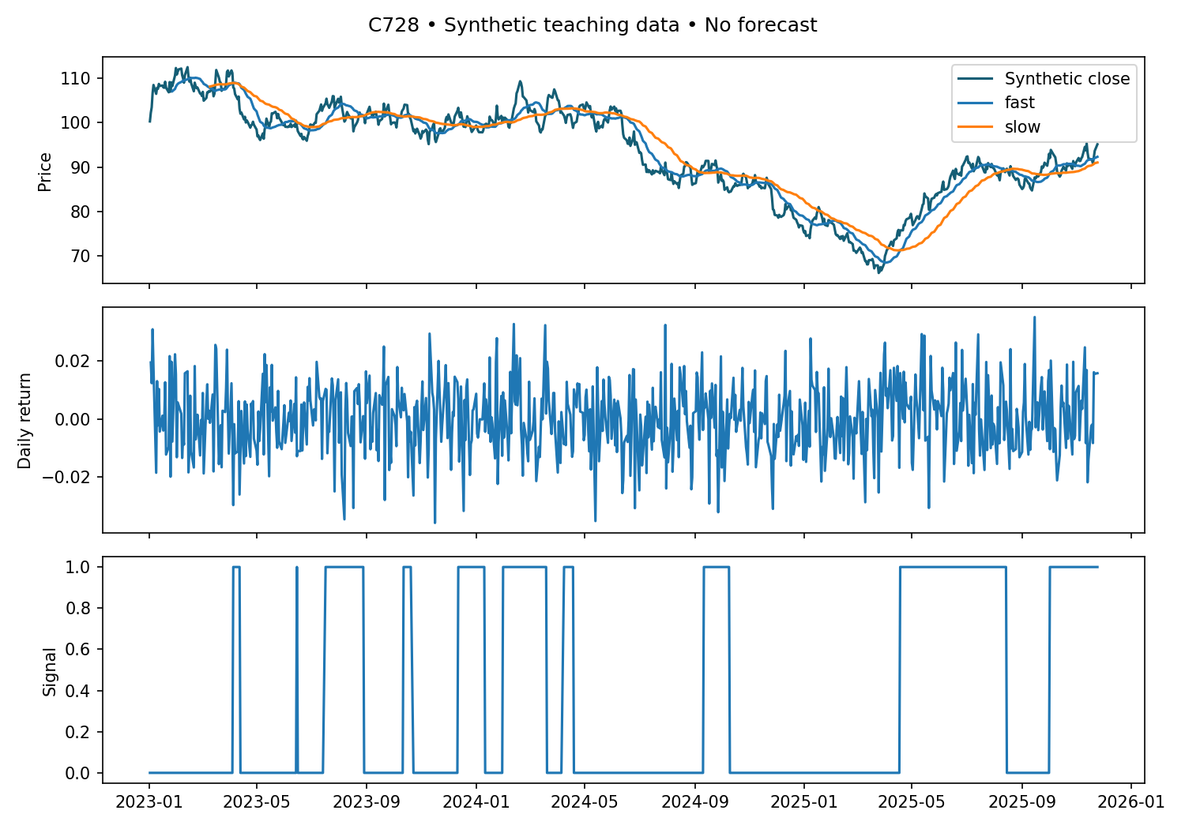
ACTUAL LAB OUTPUT
Price, moving averages and signal
Synthetic data; 20/50-bar means. Warm-up produces no position.
C728-AI-Vibe-Coding-for-Algorithmic-Trading · C728
© 2026 Tertiary Infotech Academy Pte Ltd
32

Slide 34
CAUSAL TIMING
Signals are not positions
DECISION
EXPOSURE
• Signal at close t
– Uses observations through t
– Cannot earn the return already observed
• Position for next interval
– position[t] = signal[t-1]
– First observation remains flat
C728-AI-Vibe-Coding-for-Algorithmic-Trading · C728
© 2026 Tertiary Infotech Academy Pte Ltd
33

Slide 35
AI EXPLANATION MUST MATCH EVIDENCE
Debug with a small fixture
Warm-up
50-bar SMA first appears at row index 49.
Flat prices
Fast and slow means match; signal stays flat.
1
2
Future perturbation
Change future prices; earlier signals stay identical.
Minimal repair
Change one assumption; rerun accepted checks.
3
4
C728-AI-Vibe-Coding-for-Algorithmic-Trading · C728
© 2026 Tertiary Infotech Academy Pte Ltd
34

Slide 36
WHAT YOU'LL DO
Hands-On Labs — Analysing Markets with AI
Lab 3
Lab 4
• Indicators and visual evidence
• Generate and debug trading signals
C728-AI-Vibe-Coding-for-Algorithmic-Trading · C728
© 2026 Tertiary Infotech Academy Pte Ltd
35

Slide 37
TOPIC 02 · HANDS-ON
Indicators and visual evidence
LAB 3
Use AI to build and review indicators and visual evidence; demonstrate the result with executable evidence.
You'll build
indicators.csv and indicators.png
Tools: Python · AI coding assistant · synthetic dataset
C728-AI-Vibe-Coding-for-Algorithmic-Trading · C728
© 2026 Tertiary Infotech Academy Pte Ltd
36

Slide 38
LAB 3 · VERIFY
Indicators and visual evidence
✅ Test it
first valid 20-bar mean matches an independent calculation
C728-AI-Vibe-Coding-for-Algorithmic-Trading · C728
© 2026 Tertiary Infotech Academy Pte Ltd
37

Slide 39
TOPIC 02 · HANDS-ON
Generate and debug trading signals
LAB 4
Use AI to build and review generate and debug trading signals; demonstrate the result with executable evidence.
You'll build
signals.csv
Tools: Python · AI coding assistant · synthetic dataset
C728-AI-Vibe-Coding-for-Algorithmic-Trading · C728
© 2026 Tertiary Infotech Academy Pte Ltd
38

Slide 40
LAB 4 · VERIFY
Generate and debug trading signals
✅ Test it
earlier signals unchanged after future-price perturbation
C728-AI-Vibe-Coding-for-Algorithmic-Trading · C728
© 2026 Tertiary Infotech Academy Pte Ltd
39

Slide 41
TOPIC RECAP
Recap — Analysing Markets with AI
You can now: LO2: Validate price data, visualise indicators and construct causal signals.
1
C728-AI-Vibe-Coding-for-Algorithmic-Trading · C728
© 2026 Tertiary Infotech Academy Pte Ltd
40

Slide 42
03
TOPIC 03
Building and Backtesting Strategies with AI
Strategy design · backtesting · performance · refactoring
C728-AI-Vibe-Coding-for-Algorithmic-Trading · C728
© 2026 Tertiary Infotech Academy Pte Ltd
41

Slide 43
KEY CONCEPTS
Key Concepts — Building and Backtesting Strategies with AI
A backtest is an execution model, not a promise of profit.
Lag close-derived signals by one bar for close-to-close return accounting.
1
2
Turnover incurs transaction costs; compare with buy and hold.
Sharpe and drawdown describe different risks.
3
4
C728-AI-Vibe-Coding-for-Algorithmic-Trading · C728
© 2026 Tertiary Infotech Academy Pte Ltd
42

Slide 44
EXECUTION MODEL
Backtest accounting
1
2
3
4
5
▶
▶
▶
▶
Lagged exposure
Market return
Gross return
Turnover cost
Net equity
C728-AI-Vibe-Coding-for-Algorithmic-Trading · C728
© 2026 Tertiary Infotech Academy Pte Ltd
43

Slide 45
VERIFY BEFORE SCALING
A hand-worked bar
Exposure
Yesterday signal = 1 → position = 1.
Market move
Close rises 100 → 102: return = 2%.
1
2
Cost
Entry turnover 1 × 10 bps = 0.1%.
Net result
2% − 0.1% = 1.9%; equity 1 → 1.019.
3
4
C728-AI-Vibe-Coding-for-Algorithmic-Trading · C728
© 2026 Tertiary Infotech Academy Pte Ltd
44

Slide 46
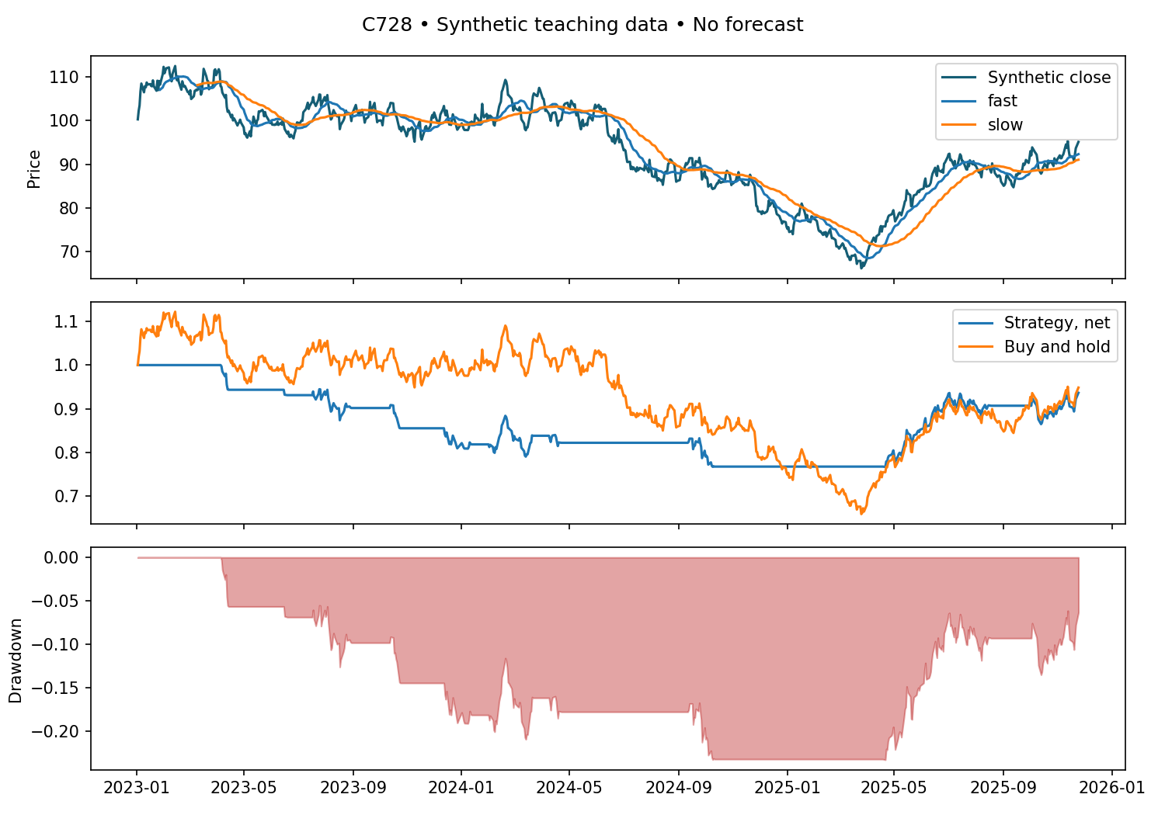
ACTUAL LAB OUTPUT
Strategy, benchmark and drawdown
Net of the stated turnover cost; simplified close-to-close execution.
C728-AI-Vibe-Coding-for-Algorithmic-Trading · C728
© 2026 Tertiary Infotech Academy Pte Ltd
45

Slide 47
ADAPTED FROM REFERENCE · RETURN / SHARPE / MDD
Performance has several dimensions
Total return
Final equity / initial equity − 1.
Sharpe
Mean daily net return / sample standard deviation × √252; risk-free rate = 0.
1
2
Maximum drawdown
Worst equity / running peak − 1.
Turnover
Sum of absolute exposure changes; reveals cost sensitivity.
3
4
C728-AI-Vibe-Coding-for-Algorithmic-Trading · C728
© 2026 Tertiary Infotech Academy Pte Ltd
46

Slide 48
RISK IS PATH-DEPENDENT
Drawdown: a known-result fixture
Start
Equity = 1.00
Peak
Equity = 1.20
1
2
Trough
Equity = 0.90 → drawdown = −25%.
Recovery
Equity = 1.30 → new peak; current drawdown = 0%.
3
4
C728-AI-Vibe-Coding-for-Algorithmic-Trading · C728
© 2026 Tertiary Infotech Academy Pte Ltd
47

Slide 49
AI CODE REVIEW
Review before refactoring
PRESERVE
IMPROVE
• Behaviour contract
– Same inputs → same signals and costs
– Reject invalid dates and prices
• Code improvement
– Extract pure functions and explicit parameters
– Preserve lag, warm-up and fixture results
C728-AI-Vibe-Coding-for-Algorithmic-Trading · C728
© 2026 Tertiary Infotech Academy Pte Ltd
48

Slide 50
MODEL LIMITATIONS
What this backtest omits
Execution
Spread, gaps, partial fills and latency.
Data
Dividends, corporate actions and survivorship.
1
2
Portfolio
Financing, taxes and multi-asset constraints.
Meaning
A teaching simulation; no profitability forecast.
3
4
C728-AI-Vibe-Coding-for-Algorithmic-Trading · C728
© 2026 Tertiary Infotech Academy Pte Ltd
49

Slide 51
WHAT YOU'LL DO
Hands-On Labs — Building and Backtesting Strategies with AI
Lab 5
Lab 6
• Build a cost-aware backtest
• Performance, risk and code review
C728-AI-Vibe-Coding-for-Algorithmic-Trading · C728
© 2026 Tertiary Infotech Academy Pte Ltd
50

Slide 52
TOPIC 03 · HANDS-ON
Build a cost-aware backtest
LAB 5
Use AI to create and review a cost-aware backtest; demonstrate the result with executable evidence.
You'll build
backtest.csv and backtest.png
Tools: Python · AI coding assistant · synthetic dataset
C728-AI-Vibe-Coding-for-Algorithmic-Trading · C728
© 2026 Tertiary Infotech Academy Pte Ltd
51

Slide 53
LAB 5 · VERIFY
Build a cost-aware backtest
✅ Test it
one-bar lag, nonnegative cost deductions and flat equity verified
C728-AI-Vibe-Coding-for-Algorithmic-Trading · C728
© 2026 Tertiary Infotech Academy Pte Ltd
52

Slide 54
TOPIC 03 · HANDS-ON
Performance, risk and code review
LAB 6
Use AI to build and review performance, risk and code review; demonstrate the result with executable evidence.
You'll build
metrics.json and risk.png
Tools: Python · AI coding assistant · synthetic dataset
C728-AI-Vibe-Coding-for-Algorithmic-Trading · C728
© 2026 Tertiary Infotech Academy Pte Ltd
53

Slide 55
LAB 6 · VERIFY
Performance, risk and code review
✅ Test it
known drawdown fixture equals -25%
C728-AI-Vibe-Coding-for-Algorithmic-Trading · C728
© 2026 Tertiary Infotech Academy Pte Ltd
54

Slide 56
TOPIC RECAP
Recap — Building and Backtesting Strategies with AI
You can now: LO3: Backtest with execution delay and costs, and interpret return and risk.
1
C728-AI-Vibe-Coding-for-Algorithmic-Trading · C728
© 2026 Tertiary Infotech Academy Pte Ltd
55

Slide 57
04
TOPIC 04
Automating and Running Trading with AI
Parameter validation · broker API · monitoring
C728-AI-Vibe-Coding-for-Algorithmic-Trading · C728
© 2026 Tertiary Infotech Academy Pte Ltd
56

Slide 58
KEY CONCEPTS
Key Concepts — Automating and Running Trading with AI
Choose parameters on training data; reserve an untouched time holdout.
Compare parameter neighbourhoods rather than one winning setting.
1
2
A broker adapter separates research from order execution.
Monitor stale data, duplicate requests, rejected orders and kill switches.
3
4
C728-AI-Vibe-Coding-for-Algorithmic-Trading · C728
© 2026 Tertiary Infotech Academy Pte Ltd
57

Slide 59
HOLDOUT ONCE
Chronological validation
1
2
3
4
5
▶
▶
▶
▶
First 504 bars
Nine parameter pairs
Choose on training
Freeze parameters
Last 252 bars
C728-AI-Vibe-Coding-for-Algorithmic-Trading · C728
© 2026 Tertiary Infotech Academy Pte Ltd
58

Slide 60
SEARCH IS NOT VALIDATION
Optimisation traps
Leakage
Random time-series split mixes past and future.
Selection bias
Trying more settings can fit noise.
1
2
Instability
An isolated winning pair is fragile.
Discipline
Record all candidates; inspect neighbouring settings.
3
4
C728-AI-Vibe-Coding-for-Algorithmic-Trading · C728
© 2026 Tertiary Infotech Academy Pte Ltd
59

Slide 61
NO LIVE ORDERS IN COURSE LABS
Broker adapter boundary
1
2
3
4
5
▶
▶
▶
▶
Reviewed intent
Exposure / freshness gates
Idempotency key
Paper API
Status log
C728-AI-Vibe-Coding-for-Algorithmic-Trading · C728
© 2026 Tertiary Infotech Academy Pte Ltd
60

Slide 62
OFFICIAL API CONTRACT
Paper API: distinct operations
Connection
Read-only GET /v2/account on the paper endpoint.
Submission
A separate operation; not implemented in sample.py.
1
2
Order state
Accepted does not mean filled; track lifecycle.
Secrets
Paper keys in environment variables; never in prompts.
3
4
C728-AI-Vibe-Coding-for-Algorithmic-Trading · C728
© 2026 Tertiary Infotech Academy Pte Ltd
61

Slide 63
CONCEPTUAL · REAL ADAPTER EXTENSION
An order has a lifecycle
1
2
3
4
5
▶
▶
▶
▶
Intent
Accepted
Partially filled
Filled / cancelled
Reconcile position
C728-AI-Vibe-Coding-for-Algorithmic-Trading · C728
© 2026 Tertiary Infotech Academy Pte Ltd
62

Slide 64
LAB 8 FAILURE FIXTURES
Monitor and stop
Stale data
Block intent when input freshness expires.
Duplicate retry
Use a stable id; reconcile before resubmitting.
1
2
Exposure breach
Reject quantity outside a declared cap.
Kill switch
Block new orders, log state and require review.
3
4
C728-AI-Vibe-Coding-for-Algorithmic-Trading · C728
© 2026 Tertiary Infotech Academy Pte Ltd
63

Slide 65
CONTINUING PRACTICE
Research handover
Reproduce
Data source, dependency versions and configuration.
Explain
Signal logic, execution assumption and costs.
1
2
Observe
Logs, failures, drift and reconciliation.
Improve
One reviewed change at a time; rerun fixtures.
3
4
C728-AI-Vibe-Coding-for-Algorithmic-Trading · C728
© 2026 Tertiary Infotech Academy Pte Ltd
64

Slide 66
WHAT YOU'LL DO
Hands-On Labs — Automating and Running Trading with AI
Lab 7
Lab 8
• Optimise without leaking the future
• Broker API and monitored paper bot
C728-AI-Vibe-Coding-for-Algorithmic-Trading · C728
© 2026 Tertiary Infotech Academy Pte Ltd
65

Slide 67
TOPIC 04 · HANDS-ON
Optimise without leaking the future
LAB 7
Use AI to build and review optimise without leaking the future; demonstrate the result with executable evidence.
You'll build
training-grid.csv and holdout.json
Tools: Python · AI coding assistant · synthetic dataset
C728-AI-Vibe-Coding-for-Algorithmic-Trading · C728
© 2026 Tertiary Infotech Academy Pte Ltd
66

Slide 68
LAB 7 · VERIFY
Optimise without leaking the future
✅ Test it
9 training candidates and 252 holdout observations
C728-AI-Vibe-Coding-for-Algorithmic-Trading · C728
© 2026 Tertiary Infotech Academy Pte Ltd
67

Slide 69
TOPIC 04 · HANDS-ON
Broker API and monitored paper bot
LAB 8
Use AI to build and review broker api and monitored paper bot; demonstrate the result with executable evidence.
You'll build
events.jsonl
Tools: Python · AI coding assistant · synthetic dataset
C728-AI-Vibe-Coding-for-Algorithmic-Trading · C728
© 2026 Tertiary Infotech Academy Pte Ltd
68

Slide 70
LAB 8 · VERIFY
Broker API and monitored paper bot
✅ Test it
duplicate, stale-data, exposure-limit and halt events blocked
C728-AI-Vibe-Coding-for-Algorithmic-Trading · C728
© 2026 Tertiary Infotech Academy Pte Ltd
69

Slide 71
TOPIC RECAP
Recap — Automating and Running Trading with AI
You can now: LO4: Validate parameters chronologically and operate a monitored paper-trading workflow.
1
C728-AI-Vibe-Coding-for-Algorithmic-Trading · C728
© 2026 Tertiary Infotech Academy Pte Ltd
70

Slide 72
WRAP-UP
Course Summary & Next Steps
C728-AI-Vibe-Coding-for-Algorithmic-Trading · C728
© 2026 Tertiary Infotech Academy Pte Ltd
71

Slide 73
LEARNING OUTCOMES
What You Achieved
Prompt and review
Specify, generate and validate Python trading code with an AI assistant.
Data and signals
Validate price data, visualise indicators and construct causal signals.
1
2
Backtest and risk
Backtest with execution delay and costs, and interpret return and risk.
Validate and monitor
Validate parameters chronologically and operate a monitored paper-trading workflow.
3
4
C728-AI-Vibe-Coding-for-Algorithmic-Trading · C728
© 2026 Tertiary Infotech Academy Pte Ltd
72

Slide 74
WRAP-UP
Keep Practising After the Course
Re-run the labs on your own machine — repetition is what makes the skills stick.
Apply the techniques to a real process or project in your own organisation.
1
2
Your course material stays available at https://lms-tms.tertiaryinfotech.com/.
Explore the follow-on courses at www.tertiarycourses.com.sg.
3
4
C728-AI-Vibe-Coding-for-Algorithmic-Trading · C728
© 2026 Tertiary Infotech Academy Pte Ltd
73

Slide 75
THANK YOU FOR ATTENDING
Thank You!
You now have the practical skills from every lab in this course — keep applying them to your own work.
C728-AI-Vibe-Coding-for-Algorithmic-Trading · C728
© 2026 Tertiary Infotech Academy Pte Ltd
74

