Slide 1


PIXEL · PATH
COURSE SLIDES · WSQ
Generative AI (GenAI) Visuals in Photoshop and Firefly
Course code TGS-2024045220
TSC Visual Communication · DSN-COM-4005-1.1
Provider Tertiary Infotech Academy Pte Ltd · 201200789K
Version v7 · 21 August 2026
© 2026 Tertiary Infotech Academy Pte Ltd · TGS-2024045220

Slide 2
MANDATORY WSQ ADMIN
Digital Attendance
Attendance
Identity
Verification
Complete the trainer-displayed electronic attendance for every required session.
Use only your authorised identity.
Remain until the trainer confirms the record.
Generative-AI-Visuals-in-Photoshop-and-Firefly · TGS-2024045220
2

Slide 3
FACILITATOR TEMPLATE
General Trainer Profile
Industry practice
Training practice
?
Relevant Photoshop and digital-imaging experience.
Adult-learning and facilitation credentials.
TRAINER NAME
Course fit
Contact
Insert approved profile photo and professional designation before delivery.
Examples aligned to learner roles and channels.
Approved professional contact route.
Generative-AI-Visuals-in-Photoshop-and-Firefly · TGS-2024045220
3

Slide 4
TRAINER PROFILE
Dr Alfred Ang
Role
Expertise
Facilitation
Principal Trainer · Tertiary Infotech Academy
Digital transformation, courseware and adult learning.
Concept explanation, coached practice and evidence review.
Quality
Learning culture
Contact
Reversible workflows and clear acceptance criteria.
Explain the reason behind every editing choice.
enquiry@tertiaryinfotech.com · +65 6100 0613
Generative-AI-Visuals-in-Photoshop-and-Firefly · TGS-2024045220
4

Slide 5
OPENING DISCUSSION
Your GenAI Visual Context
Role
Channel
Friction
What visuals do you create or manage?
Social, web, presentation, print or campaign?
Which ideation or Photoshop task costs the most time?
Quality
Experience
Evidence
Which visual defect is most visible today?
Which Firefly or Photoshop feature is familiar?
What finished artifact will prove improvement?
Generative-AI-Visuals-in-Photoshop-and-Firefly · TGS-2024045220
5

Slide 6
GROUND RULES
Working Agreements
Participate
Respect
Protect assets
Try the tools and explain choices.
Critique work, not people.
Use permitted sources and retain rights evidence.
Save versions
Share safely
Verify
Preserve originals and name layers/files.
Protect learner work and assessment content.
Reopen exports before delivery.
Generative-AI-Visuals-in-Photoshop-and-Firefly · TGS-2024045220
6

Slide 7
LMS-TMS · LEARNER PACKAGE
Download Course Materials
lms-tms.tertiaryinfotech.com
GenAI Visuals · Photoshop + Firefly
Courseware · v7
PPTX
PDF
LG
LP
10
Trainer deck
Learner slides
Detailed guide
Delivery plan
Lab folders
Outcome · the complete package is available in one authenticated course record.
Generative-AI-Visuals-in-Photoshop-and-Firefly · TGS-2024045220
7

Slide 8
LEARNER-FACING GITHUB COURSEWARE
Access the Ten Lab Folders
Open the course repository, select labs/, then open the numbered folder assigned by your trainer.
Open the learner lab folders
Every folder contains a detailed guide plus supplied PSD/JPEG assets. Keep your outputs inside that folder or the trainer-approved workspace.
Generative-AI-Visuals-in-Photoshop-and-Firefly · TGS-2024045220
8

Slide 9
COURSE FLOW
Two-Day Learning Journey
1
2
3
4
5
Explore
Reference
Compose
Critique
Deliver
OUTCOME
The workflow moves from audience-led exploration to Firefly control, editable Photoshop integration, critique and verified delivery.
Generative-AI-Visuals-in-Photoshop-and-Firefly · TGS-2024045220
9

Slide 10
VISUAL COMMUNICATION
Skills Framework Alignment
TSC
Course
Duration
Visual Communication · DSN-COM-4005-1.1
TGS-2024045220
2 days · 16 hours, including 2 hours of assessment
Knowledge
Abilities
Assessment
K1–K5
A1–A7
WA 60 min · PP 60 min
Generative-AI-Visuals-in-Photoshop-and-Firefly · TGS-2024045220
10

Slide 11
K1–K5
Knowledge Criteria
K1
K2
K3
Elements of typography, logos, visual communication design and information design.
Best practices for visual communication.
Uses of relevant visual-design software packages.
K4
K5
Colour fundamentals and forms.
Techniques for analysing aesthetics.
Generative-AI-Visuals-in-Photoshop-and-Firefly · TGS-2024045220
11

Slide 12
A1–A7
Ability Criteria
A1
A2
A3
Initiate visual communication ideas through exploration.
Develop outputs by integrating media, materials, processes and environments.
Create storyboards and task flows to communicate intentions.
A4
A5
A6
Evaluate design work with stakeholders.
Propose suggestions to enhance visual formats.
Critique own and others' work using explicit criteria.
A7
Develop strategies that strengthen the appeal of visual outputs.
Generative-AI-Visuals-in-Photoshop-and-Firefly · TGS-2024045220
12

Slide 13
WHAT YOU WILL BE ABLE TO DO
Learning Outcomes
LO1
LO2
Initiate visual communication through generative AI in Photoshop and Firefly.
Create storyboards in Firefly for visual narratives and task flows.
LO3
LO4
Propose enhancements through aesthetic analysis and advanced critique in Photoshop.
Formulate generative-AI colour strategies in Photoshop.
Generative-AI-Visuals-in-Photoshop-and-Firefly · TGS-2024045220
13

Slide 14
FOUR CONNECTED TOPICS
Course Outline
Topic 1
Topic 2
GenAI for Visual Communication
Turn an audience need into an intentional, rights-aware visual direction.
LO1 · K1 · K2 · A1 · A2
Firefly Storyboards and Reference Control
Control composition and style, then organise variations into a communicable flow.
LO2 · K3 · A3
Topic 3
Topic 4
Photoshop Generative Editing and Critique
Use selections and generative features to build, evaluate and improve editable composites.
LO3 · K3 · K5 · A4 · A5 · A6
Colour Strategy, Enhancement and Delivery
Build a coherent palette, preserve editability and verify the delivered visual.
LO4 · K4 · K5 · A7
Generative-AI-Visuals-in-Photoshop-and-Firefly · TGS-2024045220
14

Slide 15
BEFORE THE PAPERS BEGIN
Assessment Briefing
Individual work
Approved references
Phones/materials
No discussion, photography or recording of assessment scripts.
Use course materials allowed by the assessor.
Place unapproved items under the table or as directed.
Writing
Time
Outcome
Use black/blue pen for hard copy; no correction fluid or tape.
WA 60 minutes; PP 60 minutes; submit when time is called.
Competent or Not Yet Competent, with reassessment and appeal rights explained.
Generative-AI-Visuals-in-Photoshop-and-Firefly · TGS-2024045220
15

Slide 16
SUMMATIVE EVIDENCE
Assessment Design
1
2
3
4
5
WA · K1–K5
PP · A1/A2
PP · A3/A4
PP · A5/A6
PP · A7
OUTCOME
Five written questions and four connected practical tasks; each instrument is 60 minutes and open book.
Generative-AI-Visuals-in-Photoshop-and-Firefly · TGS-2024045220
16

Slide 17
K2 · K3
Tools, Materials and Workspace
Hardware
Software
Workspace
Laptop, suitable display, mouse/tablet and reliable storage.
Current supported Photoshop desktop release and Adobe Firefly access.
Panels arranged for task focus and sufficient scratch disk.
Sources
Output brief
Safety
Supplied rights-aware PSD/JPEG assets and approved references.
Audience, channel, pixel size, colour space and copy-safe areas.
Backups, reversible editing and verified exports.
Generative-AI-Visuals-in-Photoshop-and-Firefly · TGS-2024045220
17

Slide 18
TOOL CONTEXT
Adobe Tool Scope
Firefly
Photoshop
Not Adobe certification
Prompt-led image exploration, reference controls and storyboard ideation.
Selections, generative edits, compositing, colour and output.
This WSQ course does not certify an Adobe credential.
Interface drift
Responsible AI
Trademark
Models and labels change; decisions and evidence remain durable.
Review outputs, respect rights and retain provenance.
Adobe, Firefly and Photoshop are Adobe trademarks.
Generative-AI-Visuals-in-Photoshop-and-Firefly · TGS-2024045220
18

Slide 19
01
GenAI for Visual Communication
Turn an audience need into an intentional, rights-aware visual direction.
LO1 · K1 · K2 · A1 · A2
Generative-AI-Visuals-in-Photoshop-and-Firefly · TGS-2024045220
19

Slide 20
EDITABLE PROMPT-QUALITY CHART
Prompt Quality Is a System
READ THE CHART
Illustrative review scores show that a vivid subject alone is insufficient; channel fit, composition, constraints and provenance complete the visual brief.
Editable native PowerPoint chart
Generative-AI-Visuals-in-Photoshop-and-Firefly · TGS-2024045220
Adobe Firefly Help
20

Slide 21
CONCEPT 01 · HOW IT WORKS
Human-led GenAI Creative Loop
1
How it works
A human defines the brief, directs generation, selects evidence and remains accountable for publication.
2
Best used for
Fast exploration where intent and judgement matter more than raw variation count.
3
Professional decision
Choose this method when its content model and edge behaviour fit the brief.
4
Quality signal
A decision log connects the selected visual to audience, purpose and acceptance criteria.
Generative-AI-Visuals-in-Photoshop-and-Firefly · TGS-2024045220
Adobe Firefly Help
21

Slide 22
KEY CONTROLS · FAILURE MODE · PROOF
Human-led GenAI Creative Loop · control and judgement
CONTROL MAP
WATCH FOR
QUALITY PROOF
Brief · prompt · variation · critique · edit · verify
Automating the decision as well as the production.
A decision log connects the selected visual to audience, purpose and acceptance criteria.
Decision rule · preserve a baseline, isolate the intended change, then inspect at the delivery size.
Generative-AI-Visuals-in-Photoshop-and-Firefly · TGS-2024045220
Adobe Firefly Help
22

Slide 23
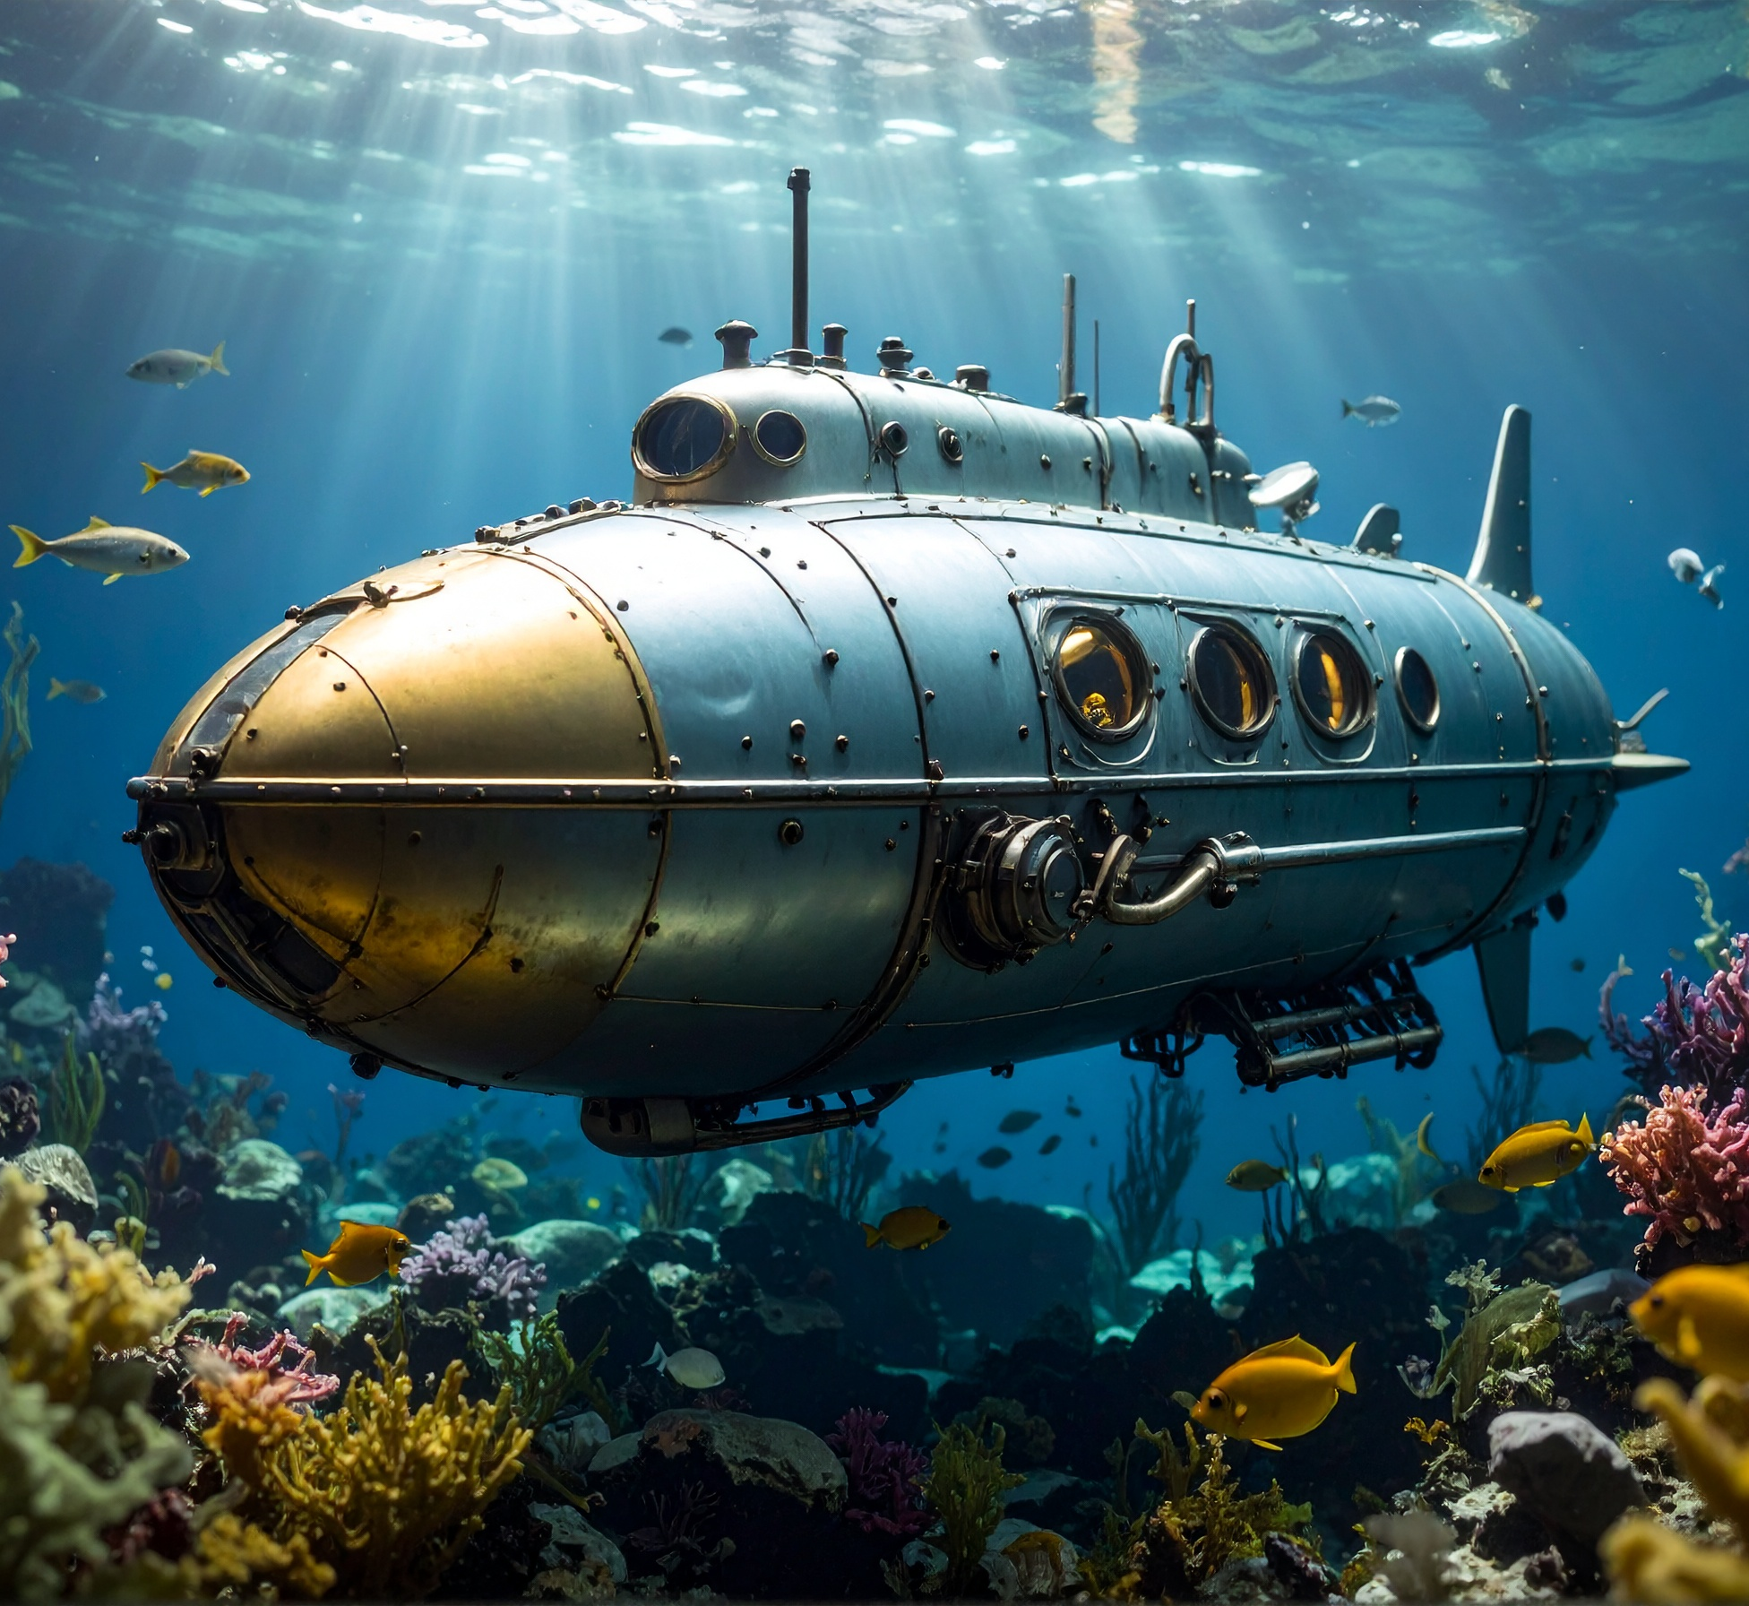
CONCEPT 02 · HOW IT WORKS
GenAI Image Use Cases and Boundaries
1
How it works
Generation, insertion, removal, expansion and translation solve different visual problems and carry different risks.
2
Best used for
Choosing an appropriate AI feature before opening a tool.
3
Professional decision
Choose this method when its content model and edge behaviour fit the brief.
4
Quality signal
The chosen feature and boundary are justified against the brief.
Generative-AI-Visuals-in-Photoshop-and-Firefly · TGS-2024045220
Adobe Photoshop Help
23

Slide 24
KEY CONTROLS · FAILURE MODE · PROOF
GenAI Image Use Cases and Boundaries · control and judgement
CONTROL MAP
WATCH FOR
QUALITY PROOF
Task type · rights · sensitivity · required control · delivery channel
Using generation where faithful documentation is required.
The chosen feature and boundary are justified against the brief.
Decision rule · preserve a baseline, isolate the intended change, then inspect at the delivery size.
Generative-AI-Visuals-in-Photoshop-and-Firefly · TGS-2024045220
Adobe Photoshop Help
24

Slide 25

CONCEPT 03 · HOW IT WORKS
Prompt Anatomy
1
How it works
A useful prompt combines subject, action, setting, visual treatment, composition and constraints.
2
Best used for
Creating a clear starting direction without over-prescribing every pixel.
3
Professional decision
Choose this method when its content model and edge behaviour fit the brief.
4
Quality signal
Prompt components can be traced to visible properties of the result.
Generative-AI-Visuals-in-Photoshop-and-Firefly · TGS-2024045220
Adobe Firefly Help
25

Slide 26
KEY CONTROLS · FAILURE MODE · PROOF
Prompt Anatomy · control and judgement
CONTROL MAP
WATCH FOR
QUALITY PROOF
Subject · action · setting · medium · lighting · camera · exclusions
Contradictory adjectives, vague subjects and accidental text instructions.
Prompt components can be traced to visible properties of the result.
Decision rule · preserve a baseline, isolate the intended change, then inspect at the delivery size.
Generative-AI-Visuals-in-Photoshop-and-Firefly · TGS-2024045220
Adobe Firefly Help
26

Slide 27

CONCEPT 04 · HOW IT WORKS
Prompt Iteration and Variation
1
How it works
Changing one prompt factor at a time makes cause and effect observable.
2
Best used for
Converging from a broad direction to a defensible final candidate.
3
Professional decision
Choose this method when its content model and edge behaviour fit the brief.
4
Quality signal
A contact sheet shows at least three labelled iterations and the selection reason.
Generative-AI-Visuals-in-Photoshop-and-Firefly · TGS-2024045220
Adobe Firefly Help
27

Slide 28
KEY CONTROLS · FAILURE MODE · PROOF
Prompt Iteration and Variation · control and judgement
CONTROL MAP
WATCH FOR
QUALITY PROOF
Baseline · single-variable change · seed/variation · comparison notes
Changing model, prompt, style and composition simultaneously.
A contact sheet shows at least three labelled iterations and the selection reason.
Decision rule · preserve a baseline, isolate the intended change, then inspect at the delivery size.
Generative-AI-Visuals-in-Photoshop-and-Firefly · TGS-2024045220
Adobe Firefly Help
28

Slide 29

CONCEPT 05 · HOW IT WORKS
Visual Hierarchy and Emphasis
1
How it works
Scale, contrast, position, isolation and detail establish what viewers notice first.
2
Best used for
Campaign visuals that need a clear focal point and reading order.
3
Professional decision
Choose this method when its content model and edge behaviour fit the brief.
4
Quality signal
A squint test and thumbnail view preserve the intended reading order.
Generative-AI-Visuals-in-Photoshop-and-Firefly · TGS-2024045220
Legacy trainer slides v6
29

Slide 30
KEY CONTROLS · FAILURE MODE · PROOF
Visual Hierarchy and Emphasis · control and judgement
CONTROL MAP
WATCH FOR
QUALITY PROOF
Primary focal point · secondary cue · supporting detail · CTA space
Competing focal points or an empty area that cannot hold useful copy.
A squint test and thumbnail view preserve the intended reading order.
Decision rule · preserve a baseline, isolate the intended change, then inspect at the delivery size.
Generative-AI-Visuals-in-Photoshop-and-Firefly · TGS-2024045220
Legacy trainer slides v6
30

Slide 31

CONCEPT 06 · HOW IT WORKS
Scale, Balance and Alignment
1
How it works
Relative size signals importance; visual mass and common edges stabilise the composition.
2
Best used for
Combining generated imagery with typography or brand elements.
3
Professional decision
Choose this method when its content model and edge behaviour fit the brief.
4
Quality signal
Guides and a reduced-size review confirm balance across the frame.
Generative-AI-Visuals-in-Photoshop-and-Firefly · TGS-2024045220
Legacy trainer slides v6
31

Slide 32
KEY CONTROLS · FAILURE MODE · PROOF
Scale, Balance and Alignment · control and judgement
CONTROL MAP
WATCH FOR
QUALITY PROOF
Scale ratio · visual weight · grid · edge alignment · safe area
Centred-by-default layouts or tangencies that feel accidental.
Guides and a reduced-size review confirm balance across the frame.
Decision rule · preserve a baseline, isolate the intended change, then inspect at the delivery size.
Generative-AI-Visuals-in-Photoshop-and-Firefly · TGS-2024045220
Legacy trainer slides v6
32

Slide 33

CONCEPT 07 · HOW IT WORKS
Contrast, Repetition and Negative Space
1
How it works
Contrast separates roles, repetition creates coherence and negative space gives the message room to breathe.
2
Best used for
Social tiles, posters and storyboard frames that must scan quickly.
3
Professional decision
Choose this method when its content model and edge behaviour fit the brief.
4
Quality signal
Grayscale and thumbnail checks confirm separation and rhythm.
Generative-AI-Visuals-in-Photoshop-and-Firefly · TGS-2024045220
Legacy trainer slides v6
33

Slide 34
KEY CONTROLS · FAILURE MODE · PROOF
Contrast, Repetition and Negative Space · control and judgement
CONTROL MAP
WATCH FOR
QUALITY PROOF
Value contrast · colour contrast · repeated motif · breathing room
Decorative repetition that overwhelms the subject.
Grayscale and thumbnail checks confirm separation and rhythm.
Decision rule · preserve a baseline, isolate the intended change, then inspect at the delivery size.
Generative-AI-Visuals-in-Photoshop-and-Firefly · TGS-2024045220
Legacy trainer slides v6
34

Slide 35

CONCEPT 08 · HOW IT WORKS
Audience, Story and Responsible Provenance
1
How it works
A visual is credible when its message fits the audience and its source, prompts and edits remain explainable.
2
Best used for
Commercial, organisational and public-facing visual communication.
3
Professional decision
Choose this method when its content model and edge behaviour fit the brief.
4
Quality signal
A provenance note accompanies the editable master and export.
Generative-AI-Visuals-in-Photoshop-and-Firefly · TGS-2024045220
Adobe Content Credentials
35

Slide 36
KEY CONTROLS · FAILURE MODE · PROOF
Audience, Story and Responsible Provenance · control and judgement
CONTROL MAP
WATCH FOR
QUALITY PROOF
Audience need · claim risk · asset rights · prompt log · Content Credentials
Misleading realism, unlicensed references or unsupported claims.
A provenance note accompanies the editable master and export.
Decision rule · preserve a baseline, isolate the intended change, then inspect at the delivery size.
Generative-AI-Visuals-in-Photoshop-and-Firefly · TGS-2024045220
Adobe Content Credentials
36

Slide 37
HANDS-ON APPLICATION · TOPIC 1
Lab 01 · Prompt-to-Image Visual Brief
Translate an audience brief into a controlled Firefly prompt set and selected visual direction.
1
2
3
4
5
Analyse
Choose
Apply
Inspect
Evidence
EVIDENCE
Three prompt/result records, selected JPEG and decision log identifying A1 exploration and A2 integration decisions.
A reading campaign needs an imaginative hero image with clear copy space for a social tile.
Full procedure · Learner Guide / Lab 01
Generative-AI-Visuals-in-Photoshop-and-Firefly · TGS-2024045220
37

Slide 38

HANDS-ON APPLICATION · TOPIC 1
Lab 02 · Design Principles and Prompt Refinement
Use Photoshop layout evidence to refine a generated visual against hierarchy, balance and contrast criteria.
1
2
3
4
5
Analyse
Choose
Apply
Inspect
Evidence
EVIDENCE
Layered PSD, exported JPEG and a short comparison note covering K1/K2 design principles.
A creative studio wants a poster-ready yarn-art visual with one strong headline zone.
Full procedure · Learner Guide / Lab 02
Generative-AI-Visuals-in-Photoshop-and-Firefly · TGS-2024045220
38

Slide 39
EXPLAIN THE DECISION
Topic 1 Checkpoint
Purpose
Method
Control
What does the audience need to notice?
Why does this technique fit the content and edge?
Which setting most changes the outcome?
Failure
Proof
Next
What defect would make the result unacceptable?
Which view and evidence demonstrate quality?
What controlled variation would improve the result?
Generative-AI-Visuals-in-Photoshop-and-Firefly · TGS-2024045220
39

Slide 40
02
Firefly Storyboards and Reference Control
Control composition and style, then organise variations into a communicable flow.
LO2 · K3 · A3
Generative-AI-Visuals-in-Photoshop-and-Firefly · TGS-2024045220
40

Slide 41
EDITABLE COMPARISON CHART
Reference-control Decision
READ THE CHART
Composition and style references solve different control problems. Combine them only after isolating each influence.
Editable native PowerPoint chart
Generative-AI-Visuals-in-Photoshop-and-Firefly · TGS-2024045220
Adobe Firefly Help
41

Slide 42

CONCEPT 09 · HOW IT WORKS
Choosing a Firefly Image Model
1
How it works
Firefly models offer different balances of speed, realism, prompt interpretation and control.
2
Best used for
Matching generation quality and latency to the storyboard purpose.
3
Professional decision
Choose this method when its content model and edge behaviour fit the brief.
4
Quality signal
The selected model is recorded with a visible comparison or reason.
Generative-AI-Visuals-in-Photoshop-and-Firefly · TGS-2024045220
Adobe Firefly Help
42

Slide 43
KEY CONTROLS · FAILURE MODE · PROOF
Choosing a Firefly Image Model · control and judgement
CONTROL MAP
WATCH FOR
QUALITY PROOF
Current model · output intent · speed · detail · available controls
Assuming the newest model behaves identically to an older one.
The selected model is recorded with a visible comparison or reason.
Decision rule · preserve a baseline, isolate the intended change, then inspect at the delivery size.
Generative-AI-Visuals-in-Photoshop-and-Firefly · TGS-2024045220
Adobe Firefly Help
43

Slide 44

CONCEPT 10 · HOW IT WORKS
Content Type and Visual Intensity
1
How it works
Content type steers photo/illustration behaviour while visual intensity adjusts how strongly styling affects the result.
2
Best used for
Moving between documentary-looking and illustrative storyboard frames.
3
Professional decision
Choose this method when its content model and edge behaviour fit the brief.
4
Quality signal
Two controlled variants demonstrate the effect of the setting.
Generative-AI-Visuals-in-Photoshop-and-Firefly · TGS-2024045220
Adobe Firefly Help
44

Slide 45
KEY CONTROLS · FAILURE MODE · PROOF
Content Type and Visual Intensity · control and judgement
CONTROL MAP
WATCH FOR
QUALITY PROOF
Photo/art · auto mode · visual intensity · effects
Treating intensity as a substitute for a clear prompt.
Two controlled variants demonstrate the effect of the setting.
Decision rule · preserve a baseline, isolate the intended change, then inspect at the delivery size.
Generative-AI-Visuals-in-Photoshop-and-Firefly · TGS-2024045220
Adobe Firefly Help
45

Slide 46

CONCEPT 11 · HOW IT WORKS
Colour, Lighting and Camera Controls
1
How it works
Secondary controls guide palette, lighting direction, field of view and depth cues.
2
Best used for
Keeping a sequence visually coherent without copying every frame.
3
Professional decision
Choose this method when its content model and edge behaviour fit the brief.
4
Quality signal
Frames share a documented palette and plausible light direction.
Generative-AI-Visuals-in-Photoshop-and-Firefly · TGS-2024045220
Adobe Firefly Help
46

Slide 47
KEY CONTROLS · FAILURE MODE · PROOF
Colour, Lighting and Camera Controls · control and judgement
CONTROL MAP
WATCH FOR
QUALITY PROOF
Colour/tone · lighting · camera angle · lens/depth cues
A lighting instruction that conflicts with the reference composition.
Frames share a documented palette and plausible light direction.
Decision rule · preserve a baseline, isolate the intended change, then inspect at the delivery size.
Generative-AI-Visuals-in-Photoshop-and-Firefly · TGS-2024045220
Adobe Firefly Help
47

Slide 48
CONCEPT 12 · HOW IT WORKS
Composition Reference
1
How it works
A composition reference transfers spatial arrangement and structural relationships without duplicating the source pixels.
2
Best used for
Maintaining camera position, pose or layout across storyboard alternatives.
3
Professional decision
Choose this method when its content model and edge behaviour fit the brief.
4
Quality signal
Overlay or side-by-side evidence confirms structural similarity.
Generative-AI-Visuals-in-Photoshop-and-Firefly · TGS-2024045220
Adobe Firefly Composition Reference
48

Slide 49
KEY CONTROLS · FAILURE MODE · PROOF
Composition Reference · control and judgement
CONTROL MAP
WATCH FOR
QUALITY PROOF
Reference strength · crop · silhouette · dominant lines · prompt
Using a reference without rights or expecting identity fidelity.
Overlay or side-by-side evidence confirms structural similarity.
Decision rule · preserve a baseline, isolate the intended change, then inspect at the delivery size.
Generative-AI-Visuals-in-Photoshop-and-Firefly · TGS-2024045220
Adobe Firefly Composition Reference
49

Slide 50

CONCEPT 13 · HOW IT WORKS
Style Reference
1
How it works
A style reference guides colour, texture, lighting and rendering character while the prompt controls subject matter.
2
Best used for
Unifying multiple scenes under one art direction.
3
Professional decision
Choose this method when its content model and edge behaviour fit the brief.
4
Quality signal
A contact sheet shows consistent treatment across different subjects.
Generative-AI-Visuals-in-Photoshop-and-Firefly · TGS-2024045220
Adobe Firefly Style Reference
50

Slide 51
KEY CONTROLS · FAILURE MODE · PROOF
Style Reference · control and judgement
CONTROL MAP
WATCH FOR
QUALITY PROOF
Reference strength · visual intensity · effects · prompt specificity
Combining style and composition changes without a baseline.
A contact sheet shows consistent treatment across different subjects.
Decision rule · preserve a baseline, isolate the intended change, then inspect at the delivery size.
Generative-AI-Visuals-in-Photoshop-and-Firefly · TGS-2024045220
Adobe Firefly Style Reference
51

Slide 52
CONCEPT 14 · HOW IT WORKS
Storyboard Architecture
1
How it works
A storyboard converts a narrative into beats with a purpose, frame, transition and evidence for each beat.
2
Best used for
Explaining an experience, campaign sequence or task journey.
3
Professional decision
Choose this method when its content model and edge behaviour fit the brief.
4
Quality signal
Every frame has a caption, purpose and transition note.
Generative-AI-Visuals-in-Photoshop-and-Firefly · TGS-2024045220
Legacy trainer slides v6
52

Slide 53
KEY CONTROLS · FAILURE MODE · PROOF
Storyboard Architecture · control and judgement
CONTROL MAP
WATCH FOR
QUALITY PROOF
Opening · context · action · transformation · outcome · CTA
A gallery of attractive images with no causal sequence.
Every frame has a caption, purpose and transition note.
Decision rule · preserve a baseline, isolate the intended change, then inspect at the delivery size.
Generative-AI-Visuals-in-Photoshop-and-Firefly · TGS-2024045220
Legacy trainer slides v6
53

Slide 54
CONCEPT 15 · HOW IT WORKS
Task Flow for Team Collaboration
1
How it works
A task flow assigns inputs, decisions, hand-offs and review gates so visual work can be repeated by a team.
2
Best used for
Moving from ideation to approved, editable and channel-ready output.
3
Professional decision
Choose this method when its content model and edge behaviour fit the brief.
4
Quality signal
A flow diagram identifies ownership and acceptance at each gate.
Generative-AI-Visuals-in-Photoshop-and-Firefly · TGS-2024045220
Legacy trainer slides v6
54

Slide 55
KEY CONTROLS · FAILURE MODE · PROOF
Task Flow for Team Collaboration · control and judgement
CONTROL MAP
WATCH FOR
QUALITY PROOF
Owner · input · action · decision · output · reviewer
Unowned approval steps or ambiguous version names.
A flow diagram identifies ownership and acceptance at each gate.
Decision rule · preserve a baseline, isolate the intended change, then inspect at the delivery size.
Generative-AI-Visuals-in-Photoshop-and-Firefly · TGS-2024045220
Legacy trainer slides v6
55

Slide 56

CONCEPT 16 · HOW IT WORKS
Text Effects and Template Ideation
1
How it works
Text effects and template-oriented generation can establish art direction, but final copy remains editable in the design tool.
2
Best used for
Exploring campaign style, title treatment and modular layouts.
3
Professional decision
Choose this method when its content model and edge behaviour fit the brief.
4
Quality signal
Final deliverable uses editable type and passes a legibility check.
Generative-AI-Visuals-in-Photoshop-and-Firefly · TGS-2024045220
Adobe Firefly Help
56

Slide 57
KEY CONTROLS · FAILURE MODE · PROOF
Text Effects and Template Ideation · control and judgement
CONTROL MAP
WATCH FOR
QUALITY PROOF
Short display phrase · material/style · legibility · editability
Embedding essential long-form copy inside generated pixels.
Final deliverable uses editable type and passes a legibility check.
Decision rule · preserve a baseline, isolate the intended change, then inspect at the delivery size.
Generative-AI-Visuals-in-Photoshop-and-Firefly · TGS-2024045220
Adobe Firefly Help
57

Slide 58
HANDS-ON APPLICATION · TOPIC 2
Lab 03 · Composition and Style References
Create a controlled Firefly comparison using composition and style references independently and together.
1
2
3
4
5
Analyse
Choose
Apply
Inspect
Evidence
EVIDENCE
Four labelled JPEG conditions, comparison PSD and a reference-control decision note.
A wellness campaign needs varied subjects that retain one composition and art direction.
Full procedure · Learner Guide / Lab 03
Generative-AI-Visuals-in-Photoshop-and-Firefly · TGS-2024045220
58

Slide 59
HANDS-ON APPLICATION · TOPIC 2
Lab 04 · Storyboard and Task Flow
Build a five-frame Firefly storyboard and a team task flow that communicates intent and ownership.
1
2
3
4
5
Analyse
Choose
Apply
Inspect
Evidence
EVIDENCE
Five-frame layered storyboard PSD, exported JPEG, task-flow panel and peer-review note.
A fictional Wellness Week Singapore 2026 campaign needs a short visual journey from stress to restorative action.
Full procedure · Learner Guide / Lab 04
Generative-AI-Visuals-in-Photoshop-and-Firefly · TGS-2024045220
59

Slide 60
EXPLAIN THE DECISION
Topic 2 Checkpoint
Purpose
Method
Control
What does the audience need to notice?
Why does this technique fit the content and edge?
Which setting most changes the outcome?
Failure
Proof
Next
What defect would make the result unacceptable?
Which view and evidence demonstrate quality?
What controlled variation would improve the result?
Generative-AI-Visuals-in-Photoshop-and-Firefly · TGS-2024045220
60

Slide 61
03
Photoshop Generative Editing and Critique
Use selections and generative features to build, evaluate and improve editable composites.
LO3 · K3 · K5 · A4 · A5 · A6
Generative-AI-Visuals-in-Photoshop-and-Firefly · TGS-2024045220
61

Slide 62
EDITABLE DECISION CHART
Reversibility by Technique
READ THE CHART
Scale: 1 = low, 5 = high. Prefer an editable generated layer, mask or Smart Object so critique can lead to a traceable revision.
Editable native PowerPoint chart
Generative-AI-Visuals-in-Photoshop-and-Firefly · TGS-2024045220
Adobe Photoshop Help
62

Slide 63

CONCEPT 17 · HOW IT WORKS
Photoshop Generative AI Feature Map
1
How it works
Photoshop connects Generative Fill, Expand, Background, Harmonize and reference-based generation to selections and layers.
2
Best used for
Selecting the smallest feature that solves the editing problem.
3
Professional decision
Choose this method when its content model and edge behaviour fit the brief.
4
Quality signal
The Layers panel shows the generated content and editable source structure.
Generative-AI-Visuals-in-Photoshop-and-Firefly · TGS-2024045220
Adobe Photoshop Generative AI Overview
63

Slide 64
KEY CONTROLS · FAILURE MODE · PROOF
Photoshop Generative AI Feature Map · control and judgement
CONTROL MAP
WATCH FOR
QUALITY PROOF
Selection · prompt/reference · model · variations · generated layer
Flattening before review or confusing destructive and generated edits.
The Layers panel shows the generated content and editable source structure.
Decision rule · preserve a baseline, isolate the intended change, then inspect at the delivery size.
Generative-AI-Visuals-in-Photoshop-and-Firefly · TGS-2024045220
Adobe Photoshop Generative AI Overview
64

Slide 65
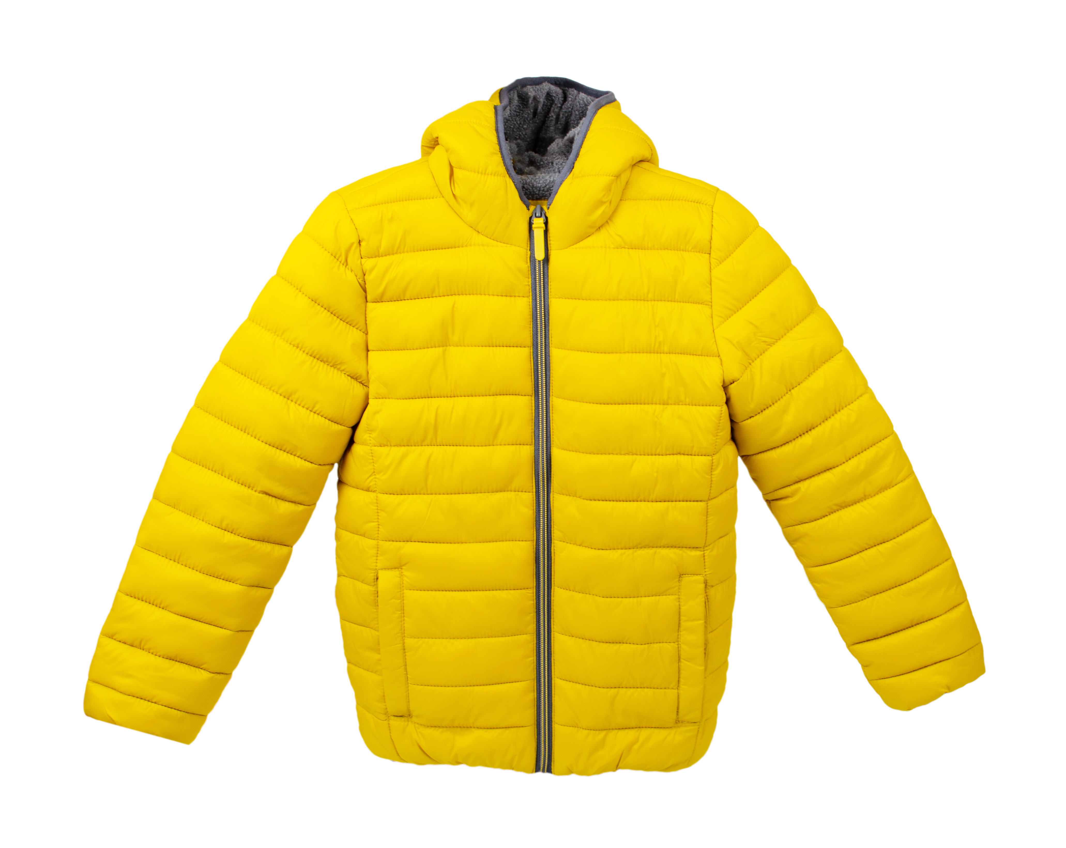
CONCEPT 18 · HOW IT WORKS
Selection as a Generative Instruction
1
How it works
Selection geometry defines where change may occur and gives the model contextual pixels at its boundary.
2
Best used for
Precise insertion, replacement and local repair.
3
Professional decision
Choose this method when its content model and edge behaviour fit the brief.
4
Quality signal
Selection/mask evidence and a 100% edge inspection are retained.
Generative-AI-Visuals-in-Photoshop-and-Firefly · TGS-2024045220
Adobe Photoshop Help
65

Slide 66
KEY CONTROLS · FAILURE MODE · PROOF
Selection as a Generative Instruction · control and judgement
CONTROL MAP
WATCH FOR
QUALITY PROOF
Selection edge · feather · context margin · mask · target layer
Selections that clip shadows or include protected details.
Selection/mask evidence and a 100% edge inspection are retained.
Decision rule · preserve a baseline, isolate the intended change, then inspect at the delivery size.
Generative-AI-Visuals-in-Photoshop-and-Firefly · TGS-2024045220
Adobe Photoshop Help
66

Slide 67

CONCEPT 19 · HOW IT WORKS
Generative Fill
1
How it works
Generative Fill creates non-destructive variations on a new generated layer inside the selected region.
2
Best used for
Adding, replacing or removing local content with contextual blending.
3
Professional decision
Choose this method when its content model and edge behaviour fit the brief.
4
Quality signal
Before/after, selected variation and layered PSD prove the decision.
Generative-AI-Visuals-in-Photoshop-and-Firefly · TGS-2024045220
Adobe Photoshop Generative Fill
67

Slide 68
KEY CONTROLS · FAILURE MODE · PROOF
Generative Fill · control and judgement
CONTROL MAP
WATCH FOR
QUALITY PROOF
Prompt or blank prompt · model · variation · generated layer
Anatomy errors, repeated textures and lighting mismatch.
Before/after, selected variation and layered PSD prove the decision.
Decision rule · preserve a baseline, isolate the intended change, then inspect at the delivery size.
Generative-AI-Visuals-in-Photoshop-and-Firefly · TGS-2024045220
Adobe Photoshop Generative Fill
68

Slide 69

CONCEPT 20 · HOW IT WORKS
Generative Expand
1
How it works
Generative Expand extends the canvas and synthesises contextual pixels beyond the original frame.
2
Best used for
Reframing a master visual for landscape, portrait and square channels.
3
Professional decision
Choose this method when its content model and edge behaviour fit the brief.
4
Quality signal
Three channel crops preserve subject integrity and useful copy space.
Generative-AI-Visuals-in-Photoshop-and-Firefly · TGS-2024045220
Adobe Photoshop Generative Expand
69

Slide 70
KEY CONTROLS · FAILURE MODE · PROOF
Generative Expand · control and judgement
CONTROL MAP
WATCH FOR
QUALITY PROOF
Crop ratio · anchor · prompt/blank · safe area · variation
Extending low-quality edges or moving the focal point unintentionally.
Three channel crops preserve subject integrity and useful copy space.
Decision rule · preserve a baseline, isolate the intended change, then inspect at the delivery size.
Generative-AI-Visuals-in-Photoshop-and-Firefly · TGS-2024045220
Adobe Photoshop Generative Expand
70

Slide 71
CONCEPT 21 · HOW IT WORKS
Generate Background and Harmonize
1
How it works
Background generation replaces the environment; Harmonize adjusts a placed subject to the surrounding tone, colour and light.
2
Best used for
Fast composites that still require realistic integration.
3
Professional decision
Choose this method when its content model and edge behaviour fit the brief.
4
Quality signal
Layered before/after and zoomed edge/shadow evidence pass review.
Generative-AI-Visuals-in-Photoshop-and-Firefly · TGS-2024045220
Adobe Photoshop Generative AI Overview
71

Slide 72
KEY CONTROLS · FAILURE MODE · PROOF
Generate Background and Harmonize · control and judgement
CONTROL MAP
WATCH FOR
QUALITY PROOF
Subject isolation · background prompt · scale · contact shadow · Harmonize
Floating subjects, incorrect perspective or inconsistent light direction.
Layered before/after and zoomed edge/shadow evidence pass review.
Decision rule · preserve a baseline, isolate the intended change, then inspect at the delivery size.
Generative-AI-Visuals-in-Photoshop-and-Firefly · TGS-2024045220
Adobe Photoshop Generative AI Overview
72

Slide 73
CONCEPT 22 · HOW IT WORKS
Reference Image in Generative Fill
1
How it works
A reference image provides additional visual guidance while the prompt and selection define the requested change.
2
Best used for
Improving consistency of an object, material or visual direction.
3
Professional decision
Choose this method when its content model and edge behaviour fit the brief.
4
Quality signal
The reference, selected output and rights record are stored together.
Generative-AI-Visuals-in-Photoshop-and-Firefly · TGS-2024045220
Adobe Photoshop Reference Image
73

Slide 74
KEY CONTROLS · FAILURE MODE · PROOF
Reference Image in Generative Fill · control and judgement
CONTROL MAP
WATCH FOR
QUALITY PROOF
Reference asset · rights · prompt · selection · variation
Expecting an exact copy or using a reference without permission.
The reference, selected output and rights record are stored together.
Decision rule · preserve a baseline, isolate the intended change, then inspect at the delivery size.
Generative-AI-Visuals-in-Photoshop-and-Firefly · TGS-2024045220
Adobe Photoshop Reference Image
74

Slide 75

CONCEPT 23 · HOW IT WORKS
Inpainting and Outpainting
1
How it works
Inpainting changes content inside a boundary; outpainting synthesises beyond an existing boundary.
2
Best used for
Choosing between local repair and frame extension.
3
Professional decision
Choose this method when its content model and edge behaviour fit the brief.
4
Quality signal
A difference review confirms only the intended region changed.
Generative-AI-Visuals-in-Photoshop-and-Firefly · TGS-2024045220
Adobe Photoshop Help
75

Slide 76
KEY CONTROLS · FAILURE MODE · PROOF
Inpainting and Outpainting · control and judgement
CONTROL MAP
WATCH FOR
QUALITY PROOF
Protected area · context overlap · seam location · content continuity
Visible seams, repeated objects or altered protected content.
A difference review confirms only the intended region changed.
Decision rule · preserve a baseline, isolate the intended change, then inspect at the delivery size.
Generative-AI-Visuals-in-Photoshop-and-Firefly · TGS-2024045220
Adobe Photoshop Help
76

Slide 77

CONCEPT 24 · HOW IT WORKS
Aesthetic Critique and Golden-ratio Heuristics
1
How it works
Critique separates description, interpretation, evaluation and recommendation; compositional heuristics are prompts for judgement, not guarantees.
2
Best used for
Explaining why a visual works and proposing an actionable revision.
3
Professional decision
Choose this method when its content model and edge behaviour fit the brief.
4
Quality signal
A criterion-based critique identifies evidence, impact and one testable change.
Generative-AI-Visuals-in-Photoshop-and-Firefly · TGS-2024045220
Legacy trainer slides v6
77

Slide 78
KEY CONTROLS · FAILURE MODE · PROOF
Aesthetic Critique and Golden-ratio Heuristics · control and judgement
CONTROL MAP
WATCH FOR
QUALITY PROOF
Hierarchy · balance · rhythm · focal placement · audience fit · technical finish
Treating a grid or ratio as proof of quality.
A criterion-based critique identifies evidence, impact and one testable change.
Decision rule · preserve a baseline, isolate the intended change, then inspect at the delivery size.
Generative-AI-Visuals-in-Photoshop-and-Firefly · TGS-2024045220
Legacy trainer slides v6
78

Slide 79
HANDS-ON APPLICATION · TOPIC 3
Lab 05 · Generative Fill: Directed Inpainting
Use a controlled selection and Generative Fill to add, replace and remove content non-destructively.
1
2
3
4
5
Analyse
Choose
Apply
Inspect
Evidence
EVIDENCE
Layered PSD, selected variations, final JPEG and zoomed edge/Layers-panel evidence.
An editorial wildlife visual needs a plausible environmental detail without damaging the original subject.
Full procedure · Learner Guide / Lab 05
Generative-AI-Visuals-in-Photoshop-and-Firefly · TGS-2024045220
79

Slide 80
HANDS-ON APPLICATION · TOPIC 3
Lab 06 · Background Replacement and Harmonize
Generate a new background, integrate a placed element and evaluate lighting, perspective and contact.
1
2
3
4
5
Analyse
Choose
Apply
Inspect
Evidence
EVIDENCE
Layered PSD, final JPEG, before/after comparison and criterion-based integration note.
A portrait must be adapted into an outdoor campaign visual while remaining editable.
Full procedure · Learner Guide / Lab 06
Generative-AI-Visuals-in-Photoshop-and-Firefly · TGS-2024045220
80

Slide 81
HANDS-ON APPLICATION · TOPIC 3
Lab 07 · Generative Expand for Channel Ratios
Extend one master visual into square, landscape and portrait variants without losing hierarchy.
1
2
3
4
5
Analyse
Choose
Apply
Inspect
Evidence
EVIDENCE
Master PSD plus three channel JPEGs and a ratio-by-ratio verification checklist.
A campaign hero must work across social, presentation and mobile-story channels.
Full procedure · Learner Guide / Lab 07
Generative-AI-Visuals-in-Photoshop-and-Firefly · TGS-2024045220
81

Slide 82
HANDS-ON APPLICATION · TOPIC 3
Lab 08 · Reference Image and Multi-Prompt Composition
Use a permitted reference image and staged selections to construct a coherent multi-element composition.
1
2
3
4
5
Analyse
Choose
Apply
Inspect
Evidence
EVIDENCE
Layered reference-guided PSD, final JPEG, rights note and four-part critique with revision.
A fashion visual requires an altered garment treatment that follows a supplied material reference.
Full procedure · Learner Guide / Lab 08
Generative-AI-Visuals-in-Photoshop-and-Firefly · TGS-2024045220
82

Slide 83
EXPLAIN THE DECISION
Topic 3 Checkpoint
Purpose
Method
Control
What does the audience need to notice?
Why does this technique fit the content and edge?
Which setting most changes the outcome?
Failure
Proof
Next
What defect would make the result unacceptable?
Which view and evidence demonstrate quality?
What controlled variation would improve the result?
Generative-AI-Visuals-in-Photoshop-and-Firefly · TGS-2024045220
83

Slide 84
04
Colour Strategy, Enhancement and Delivery
Build a coherent palette, preserve editability and verify the delivered visual.
LO4 · K4 · K5 · A7
Generative-AI-Visuals-in-Photoshop-and-Firefly · TGS-2024045220
84

Slide 85
EDITABLE PALETTE-WEIGHTING CHART
Campaign Colour Roles
READ THE CHART
Illustrative shares keep the primary colour dominant while secondary, accent and neutral roles support hierarchy rather than compete with it.
Editable native PowerPoint chart
Generative-AI-Visuals-in-Photoshop-and-Firefly · TGS-2024045220
85

Slide 86
EDITABLE QA CHART
Output Verification Priority
READ THE CHART
A professional hand-off verifies the exported file and its provenance—not only the layered working canvas.
Editable native PowerPoint chart
Generative-AI-Visuals-in-Photoshop-and-Firefly · TGS-2024045220
86

Slide 87

CONCEPT 25 · HOW IT WORKS
Hue, Saturation, Brightness and Value
1
How it works
Hue identifies colour family, saturation its intensity, and value/brightness its light-dark position.
2
Best used for
Diagnosing palette and separation before choosing an adjustment.
3
Professional decision
Choose this method when its content model and edge behaviour fit the brief.
4
Quality signal
A palette swatch and grayscale review support the colour decision.
Generative-AI-Visuals-in-Photoshop-and-Firefly · TGS-2024045220
Adobe Photoshop Help
87

Slide 88
KEY CONTROLS · FAILURE MODE · PROOF
Hue, Saturation, Brightness and Value · control and judgement
CONTROL MAP
WATCH FOR
QUALITY PROOF
Hue relationship · saturation range · value contrast · skin/brand constraints
Increasing saturation when the problem is value separation.
A palette swatch and grayscale review support the colour decision.
Decision rule · preserve a baseline, isolate the intended change, then inspect at the delivery size.
Generative-AI-Visuals-in-Photoshop-and-Firefly · TGS-2024045220
Adobe Photoshop Help
88

Slide 89
CONCEPT 26 · HOW IT WORKS
Adjustment Layers and Masks
1
How it works
Adjustment layers store tonal or colour changes separately; masks control where each adjustment applies.
2
Best used for
Reversible campaign colour work and local corrections.
3
Professional decision
Choose this method when its content model and edge behaviour fit the brief.
4
Quality signal
Named adjustment layers and masks remain editable in the PSD.
Generative-AI-Visuals-in-Photoshop-and-Firefly · TGS-2024045220
Adobe Adjustment Layers
89

Slide 90
KEY CONTROLS · FAILURE MODE · PROOF
Adjustment Layers and Masks · control and judgement
CONTROL MAP
WATCH FOR
QUALITY PROOF
Adjustment type · layer order · mask density · blend mode · opacity
Painting directly on the only copy or leaving masks unnamed.
Named adjustment layers and masks remain editable in the PSD.
Decision rule · preserve a baseline, isolate the intended change, then inspect at the delivery size.
Generative-AI-Visuals-in-Photoshop-and-Firefly · TGS-2024045220
Adobe Adjustment Layers
90

Slide 91

CONCEPT 27 · HOW IT WORKS
Histogram and Levels
1
How it works
The histogram displays tonal distribution; Levels remaps black point, white point and midtones.
2
Best used for
Correcting global tonal range and identifying clipping.
3
Professional decision
Choose this method when its content model and edge behaviour fit the brief.
4
Quality signal
Before/after histograms and highlight/shadow checks show controlled range.
Generative-AI-Visuals-in-Photoshop-and-Firefly · TGS-2024045220
Adobe Photoshop Help
91

Slide 92
KEY CONTROLS · FAILURE MODE · PROOF
Histogram and Levels · control and judgement
CONTROL MAP
WATCH FOR
QUALITY PROOF
Channel · black point · gamma · white point · output levels
Forcing every image to fill the histogram or clipping detail.
Before/after histograms and highlight/shadow checks show controlled range.
Decision rule · preserve a baseline, isolate the intended change, then inspect at the delivery size.
Generative-AI-Visuals-in-Photoshop-and-Firefly · TGS-2024045220
Adobe Photoshop Help
92

Slide 93
CONCEPT 28 · HOW IT WORKS
Curves
1
How it works
Curves remaps input to output values with points that target overall tone or individual colour channels.
2
Best used for
Fine contrast shaping and colour-balance correction.
3
Professional decision
Choose this method when its content model and edge behaviour fit the brief.
4
Quality signal
A labelled Curves layer and before/after comparison show the intended change.
Generative-AI-Visuals-in-Photoshop-and-Firefly · TGS-2024045220
Adobe Curves Help
93

Slide 94
KEY CONTROLS · FAILURE MODE · PROOF
Curves · control and judgement
CONTROL MAP
WATCH FOR
QUALITY PROOF
Anchor points · slope · channel · mask · clipping preview
Too many points, banding or unwanted colour casts.
A labelled Curves layer and before/after comparison show the intended change.
Decision rule · preserve a baseline, isolate the intended change, then inspect at the delivery size.
Generative-AI-Visuals-in-Photoshop-and-Firefly · TGS-2024045220
Adobe Curves Help
94

Slide 95
CONCEPT 29 · HOW IT WORKS
Colour Balance and Hue/Saturation
1
How it works
Colour Balance shifts tonal ranges toward complementary colours; Hue/Saturation targets hue families and intensity.
2
Best used for
Harmonising composite elements and establishing a campaign palette.
3
Professional decision
Choose this method when its content model and edge behaviour fit the brief.
4
Quality signal
Sampled swatches and targeted masks demonstrate controlled application.
Generative-AI-Visuals-in-Photoshop-and-Firefly · TGS-2024045220
Adobe Photoshop Help
95

Slide 96
KEY CONTROLS · FAILURE MODE · PROOF
Colour Balance and Hue/Saturation · control and judgement
CONTROL MAP
WATCH FOR
QUALITY PROOF
Shadows/midtones/highlights · target colour range · saturation · mask
Global shifts that damage skin tones, neutrals or brand colours.
Sampled swatches and targeted masks demonstrate controlled application.
Decision rule · preserve a baseline, isolate the intended change, then inspect at the delivery size.
Generative-AI-Visuals-in-Photoshop-and-Firefly · TGS-2024045220
Adobe Photoshop Help
96

Slide 97
CONCEPT 30 · HOW IT WORKS
Neural Filters and Restoration
1
How it works
Neural Filters provide AI-assisted transformations that can output to a new layer for further review.
2
Best used for
Restoration, colourisation and portrait enhancement where source evidence is incomplete.
3
Professional decision
Choose this method when its content model and edge behaviour fit the brief.
4
Quality signal
Original, AI output and manual corrections remain separately reviewable.
Generative-AI-Visuals-in-Photoshop-and-Firefly · TGS-2024045220
Adobe Neural Filters
97

Slide 98
KEY CONTROLS · FAILURE MODE · PROOF
Neural Filters and Restoration · control and judgement
CONTROL MAP
WATCH FOR
QUALITY PROOF
Filter model · strength · output method · local cleanup · review
Invented detail, identity changes or treating an AI result as historical fact.
Original, AI output and manual corrections remain separately reviewable.
Decision rule · preserve a baseline, isolate the intended change, then inspect at the delivery size.
Generative-AI-Visuals-in-Photoshop-and-Firefly · TGS-2024045220
Adobe Neural Filters
98

Slide 99

CONCEPT 31 · HOW IT WORKS
Campaign Colour Consistency
1
How it works
A campaign palette combines role-based colours, contrast targets and adjustment recipes across assets.
2
Best used for
Keeping storyboard, social and poster outputs recognisably related.
3
Professional decision
Choose this method when its content model and edge behaviour fit the brief.
4
Quality signal
A palette sheet and three channel exports show consistent roles.
Generative-AI-Visuals-in-Photoshop-and-Firefly · TGS-2024045220
Legacy trainer slides v6
99

Slide 100
KEY CONTROLS · FAILURE MODE · PROOF
Campaign Colour Consistency · control and judgement
CONTROL MAP
WATCH FOR
QUALITY PROOF
Primary/secondary/accent roles · value range · accessibility · export profile
Matching hex values while ignoring surrounding colour and output profile.
A palette sheet and three channel exports show consistent roles.
Decision rule · preserve a baseline, isolate the intended change, then inspect at the delivery size.
Generative-AI-Visuals-in-Photoshop-and-Firefly · TGS-2024045220
Legacy trainer slides v6
100

Slide 101
CONCEPT 32 · HOW IT WORKS
Output Verification and Content Credentials
1
How it works
Professional delivery includes export settings, reopen checks, provenance and a retained editable master.
2
Best used for
Hand-off to stakeholders, publication and audit-ready delivery.
3
Professional decision
Choose this method when its content model and edge behaviour fit the brief.
4
Quality signal
PSD, verified JPEG and provenance/read-me record form one evidence package.
Generative-AI-Visuals-in-Photoshop-and-Firefly · TGS-2024045220
Adobe Content Credentials
101

Slide 102
KEY CONTROLS · FAILURE MODE · PROOF
Output Verification and Content Credentials · control and judgement
CONTROL MAP
WATCH FOR
QUALITY PROOF
Format · dimensions · profile · compression · metadata · Content Credentials
Assuming an exported file is correct without reopening it.
PSD, verified JPEG and provenance/read-me record form one evidence package.
Decision rule · preserve a baseline, isolate the intended change, then inspect at the delivery size.
Generative-AI-Visuals-in-Photoshop-and-Firefly · TGS-2024045220
Adobe Content Credentials
102

Slide 103
HANDS-ON APPLICATION · TOPIC 4
Lab 09 · Restoration, Critique and Colour Strategy
Restore a damaged image, evaluate invented detail and develop a reversible colour treatment.
1
2
3
4
5
Analyse
Choose
Apply
Inspect
Evidence
EVIDENCE
Layered restoration PSD, verified JPEG, palette swatches and critique of AI-inferred detail.
An archive image will support a heritage-wellness story but must not imply certainty where AI reconstructs missing detail.
Full procedure · Learner Guide / Lab 09
Generative-AI-Visuals-in-Photoshop-and-Firefly · TGS-2024045220
103

Slide 104
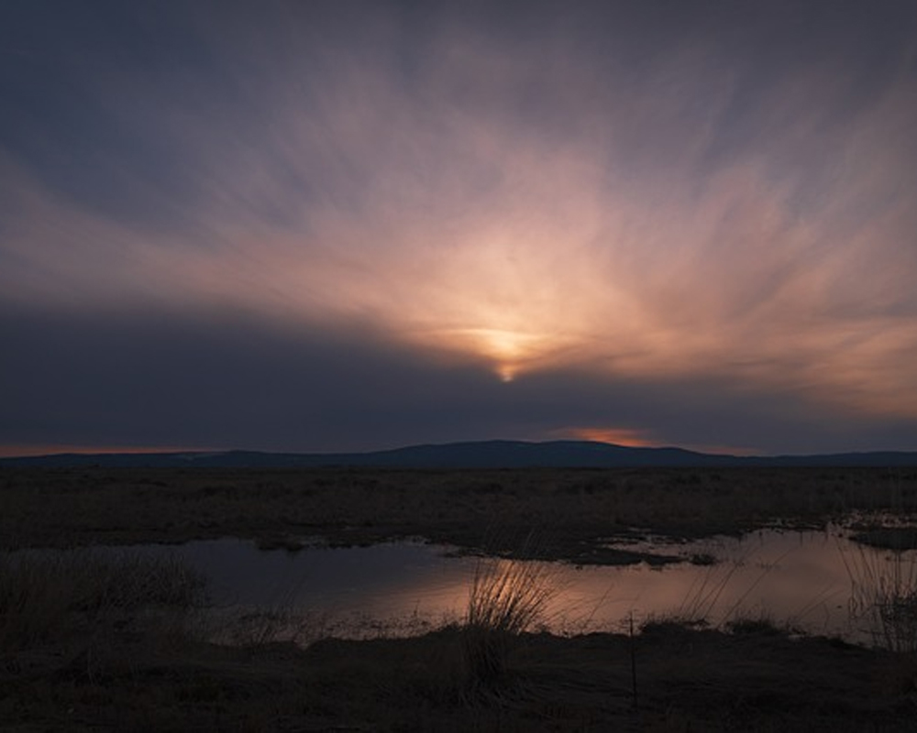
HANDS-ON APPLICATION · TOPIC 4
Lab 10 · Wellness Campaign Capstone
Integrate A1–A7 into an editable campaign visual, storyboard summary, critique and colour-delivery package.
1
2
3
4
5
Analyse
Choose
Apply
Inspect
Evidence
EVIDENCE
Layered master PSD, prompt log, storyboard strip, peer critique, enhancement record, palette and three verified JPEGs.
Fictional Wellness Week Singapore 2026 needs a coherent hero visual and three channel exports for a positive, inclusive message.
Full procedure · Learner Guide / Lab 10
Generative-AI-Visuals-in-Photoshop-and-Firefly · TGS-2024045220
104

Slide 105
EXPLAIN THE DECISION
Topic 4 Checkpoint
Purpose
Method
Control
What does the audience need to notice?
Why does this technique fit the content and edge?
Which setting most changes the outcome?
Failure
Proof
Next
What defect would make the result unacceptable?
Which view and evidence demonstrate quality?
What controlled variation would improve the result?
Generative-AI-Visuals-in-Photoshop-and-Firefly · TGS-2024045220
105

Slide 106
COURSE SYNTHESIS
Professional Editing Loop
Brief
Source
Construct
Clarify purpose, audience, channel and constraints.
Choose sufficient, rights-cleared assets.
Use layers, masks and Smart Objects.
Experiment
Evaluate
Deliver
Vary one factor against a baseline.
Inspect visual, technical and rights criteria.
Export, reopen and retain the master.
Generative-AI-Visuals-in-Photoshop-and-Firefly · TGS-2024045220
106

Slide 107
RESPONSIBLE VISUAL PRACTICE
Copyright and Asset Permission
Ownership
Permission
Scope
Identify the creator/owner.
Public visibility does not grant reuse.
Check modification, commercial and redistribution rights.
People
Attribution
Record
Confirm consent and privacy context.
Credit as the licence requires.
Retain source, licence, consent, date and use.
Generative-AI-Visuals-in-Photoshop-and-Firefly · TGS-2024045220
Adobe Firefly Terms · not legal advice
107

Slide 108
PROVENANCE AND REVIEW
Responsible Generative AI
Inputs
Log
Review
Use only material you may provide.
Record prompt and selected variation.
Check plausibility, bias and artefacts.
Terms
Credentials
Responsibility
Confirm current feature terms.
Retain provenance where appropriate.
The editor owns the publication decision.
Generative-AI-Visuals-in-Photoshop-and-Firefly · TGS-2024045220
108

Slide 109
A4 · DISCUSS THE PROCESS
Peer Review
Describe
Show
Ask
State purpose and key decisions.
Reveal layers, masks and before/after.
Use explicit criteria.
Record
Decide
Revise
Capture what the reviewer noticed.
Accept, adapt or reject with reason.
Make one traceable improvement.
Generative-AI-Visuals-in-Photoshop-and-Firefly · TGS-2024045220
109

Slide 110
AFTER THE COURSE
Support
Email
Telephone
Portal
enquiry@tertiaryinfotech.com
+65 6100 0613
https://lms-tms.tertiaryinfotech.com/
Provider
Website
Privacy
Tertiary Infotech Academy Pte Ltd
www.tertiarycourses.com.sg
Do not send assessment content publicly.
Generative-AI-Visuals-in-Photoshop-and-Firefly · TGS-2024045220
110

Slide 111
WA + PP
Final Assessment
1
2
3
4
5
Briefing
WA · 60 min
Transition
PP · 60 min
Submit
OUTCOME
Complete your own open-book evidence and submit when time is called.
Generative-AI-Visuals-in-Photoshop-and-Firefly · TGS-2024045220
111

Slide 112
COMPETENCY SIGN-OFF
Assessment Flow
1
2
3
4
5
Identity check
WA · K1–K5
PP · A1–A7
Assessor decision
Summary sign-off
OUTCOME
Assessment evidence leads to a Competent or Not Yet Competent decision, feedback and formal sign-off.
Generative-AI-Visuals-in-Photoshop-and-Firefly · TGS-2024045220
112

Slide 113
CLOSING ADMIN
Digital Attendance · Mandatory
Assessment event
Verification
Feedback
Complete the official assessment attendance.
Remain until the trainer verifies the record.
Use the official LMS-TMS/TRAQOM route after attendance.
Generative-AI-Visuals-in-Photoshop-and-Firefly · TGS-2024045220
113

Slide 114
Thank You
Create with intent · preserve options · verify the output
Generative-AI-Visuals-in-Photoshop-and-Firefly · TGS-2024045220
114

