Slide 1


COURSE SLIDES · WSQ
Autodesk Certified Professional (ACP) - AutoCAD Design and Drafting
WSQ Course Code: TGS-2023036004
Conducted by Tertiary Infotech Academy Pte Ltd · UEN 201200696W
v8.0 · 22 August 2026
© 2026 Tertiary Infotech Academy Pte Ltd

Slide 2
COURSE ADMINISTRATION
Welcome & Course Orientation
Autodesk-ACP-AutoCAD-Design-and-Drafting · TGS-2023036004
© 2026 Tertiary Infotech Academy Pte Ltd
1

Slide 3
SSG DIGITAL ATTENDANCE
Digital Attendance — Three Required Check-ins
AM attendance
Scan the SSG QR code at the start of each training day.
PM attendance
Scan again after lunch when prompted by the trainer.
1
2
Assessment attendance
Complete the separate assessment check-in before the final papers.
Eligibility
Maintain at least 75% attendance and complete all prescribed assessments.
3
4
Autodesk-ACP-AutoCAD-Design-and-Drafting · TGS-2023036004
© 2026 Tertiary Infotech Academy Pte Ltd
2

Slide 4
YOUR TRAINER · GENERAL
About the Trainer
NAME
____________________________________________
?
DESIGNATION
____________________________________________
QUALIFICATIONS
____________________________________________
Your Trainer
AUTOCAD EXPERTISE
____________________________________________
General trainer profile template
INDUSTRY EXPERIENCE
____________________________________________
CONTACT
____________________________________________
Autodesk-ACP-AutoCAD-Design-and-Drafting · TGS-2023036004
© 2026 Tertiary Infotech Academy Pte Ltd
3

Slide 5
YOUR TRAINER
About the Trainer
ROLE
Principal trainer and courseware developer at Tertiary Infotech Academy.
AA
QUALIFICATIONS
Doctorate-qualified adult educator with ACTA/DACE training credentials.
Dr Alfred Ang
FOCUS
Professional software workflows, design communication, automation and emerging technologies.
Principal Trainer and Courseware Developer Tertiary Infotech Academy
APPROACH
Connect design intent to measurable standards, practice evidence and stakeholder outcomes.
Autodesk-ACP-AutoCAD-Design-and-Drafting · TGS-2023036004
© 2026 Tertiary Infotech Academy Pte Ltd
4

Slide 6
STUDIO INTRODUCTION
Let's Know Each Other
Role
What kinds of drawings do you create or review?
Experience
Which AutoCAD workflows are already familiar?
1
2
Challenge
Where do revisions, standards or coordination currently fail?
Goal
What professional outcome should this course unlock?
3
4
Autodesk-ACP-AutoCAD-Design-and-Drafting · TGS-2023036004
© 2026 Tertiary Infotech Academy Pte Ltd
5

Slide 7
PROFESSIONAL LEARNING ENVIRONMENT
Ground Rules
Set mobile devices to silent mode.
Participate actively — no question is too small.
1
2
Respect different professional viewpoints.
Use only authorised project files and data.
3
4
Return from breaks on time.
Keep evidence of your own work.
5
6
Autodesk-ACP-AutoCAD-Design-and-Drafting · TGS-2023036004
© 2026 Tertiary Infotech Academy Pte Ltd
6

Slide 8
LMS-TMS.TERTIARYINFOTECH.COM
Download Your Course Materials
1
2
3
4
▶
▶
▶
Open the LMS/TMS course page
Locate the current Courseware section
Download slides, Learner Guide and labs
Open each lab from its own folder
Autodesk-ACP-AutoCAD-Design-and-Drafting · TGS-2023036004
© 2026 Tertiary Infotech Academy Pte Ltd
7

Slide 9
32 HOURS · 4 DAYS
Four-Day Learning Journey
Days 1–2
Days 3–4
• Day 1 — Standards and drawing management
– Units, UCS, layers, properties and advanced objects
– Labs 1–2
• Day 2 — Author, edit and annotate
– Precision editing, blocks, attributes and annotation systems
– Labs 3–6
• Day 3 — Output and collaboration
– Layouts, page setups, publish, eTransmit and Xrefs
– Labs 7–9
• Day 4 — Integrate and demonstrate
– Sink documentation capstone, evidence review, WA and PP
– Lab 10 + final assessment
Autodesk-ACP-AutoCAD-Design-and-Drafting · TGS-2023036004
© 2026 Tertiary Infotech Academy Pte Ltd
8

Slide 10
Design Sketching · BEV-DES-5026-1.1-1
TSC Coverage — Knowledge and Abilities
Knowledge
Abilities
• K1 · Emerging design visualization standards
• K2 · Revision methods for 2D and 3D drawings
• K3 · Storytelling and stakeholder engagement
• K4 · Emerging drawing technologies
• A1 · Define art direction and sketching style
• A2 · Guide drawing capability development
• A3 · Develop organisational drawing standards
• A4 · Lead technology and method selection
• A5 · Inspire traditional and contemporary approaches
Autodesk-ACP-AutoCAD-Design-and-Drafting · TGS-2023036004
© 2026 Tertiary Infotech Academy Pte Ltd
9

Slide 11
WHAT YOU WILL BE ABLE TO DO
Learning Outcomes
LO1
Standards and art direction
LO2
Drawing and revision capability
1
2
LO3
Standards, storytelling and engagement
LO4
Emerging technology integration
3
4
LO5
Exploration and stakeholder inspiration
5
Autodesk-ACP-AutoCAD-Design-and-Drafting · TGS-2023036004
© 2026 Tertiary Infotech Academy Pte Ltd
10

Slide 12
EDITABLE NATIVE POWERPOINT CHART
Autodesk ACP Exam-Domain Weighting
Official Autodesk AutoCAD ACP domain weighting. Use it to balance review effort; WSQ assessment remains K1–K4 and A1–A5.
Autodesk-ACP-AutoCAD-Design-and-Drafting · TGS-2023036004
© 2026 Tertiary Infotech Academy Pte Ltd
11

Slide 13
PROFESSIONAL WORKFLOW
Course Roadmap
1
2
3
4
5
▶
▶
▶
▶
Manage the drawing
Communicate through annotation
Author and revise content
Govern design output
Coordinate and lead change
Autodesk-ACP-AutoCAD-Design-and-Drafting · TGS-2023036004
© 2026 Tertiary Infotech Academy Pte Ltd
12

Slide 14
BEFORE THE FINAL PAPERS
Briefing for Assessment
Individual, open-book assessment using approved course materials.
Place phones and other materials under the table.
1
2
No discussion, photos or recording of assessment scripts.
Use black/blue pen; no liquid paper or correction tape.
3
4
Answer in your own words and submit through LMS/TMS.
C requires competence in every required criterion.
5
6
Autodesk-ACP-AutoCAD-Design-and-Drafting · TGS-2023036004
© 2026 Tertiary Infotech Academy Pte Ltd
13

Slide 15
OPEN BOOK
Final Assessment
Written Assessment
Practical Performance
• Written Assessment (WA-SAQ) — 4 open-ended questions covering K1–K4, 60 minutes, open book.
• Knowledge evidence from slides and Learner Guide.
• Four questions retain the original WA count.
• Practical Performance (PP) — 5 hands-on tasks covering A1–A5, 120 minutes, open book.
• Practical evidence from the sink layout workflow.
• Five tasks retain the original PP count and A1–A5 mapping.
Autodesk-ACP-AutoCAD-Design-and-Drafting · TGS-2023036004
© 2026 Tertiary Infotech Academy Pte Ltd
14

Slide 16
WA → PP → DECISION
Assessment and Sign-off Flow
1
2
3
4
5
▶
▶
▶
▶
Assessment briefing
WA-SAQ · 60 min
PP · 120 min
Assessor decision: C / NYC
Feedback, sign-off or appeal
Autodesk-ACP-AutoCAD-Design-and-Drafting · TGS-2023036004
© 2026 Tertiary Infotech Academy Pte Ltd
15

Slide 17
01
DOMAIN 01
Application and Drawing Management
Standards · units · UCS · layers · properties · drawing health
Autodesk-ACP-AutoCAD-Design-and-Drafting · TGS-2023036004
© 2026 Tertiary Infotech Academy Pte Ltd
16

Slide 18
DRAWING GOVERNANCE
A reliable drawing begins with declared rules.
Units, origin, naming, layers and revision status are part of the design — not afterthoughts.
Autodesk-ACP-AutoCAD-Design-and-Drafting · TGS-2023036004
© 2026 Tertiary Infotech Academy Pte Ltd
17

Slide 19
BEFORE AUTHORING
Project Setup — Six Controls
Purpose
What decision or deliverable must the drawing support?
Units
Length, precision, insertion scale and angle convention.
1
2
Origin
World coordinates plus named project UCS where required.
Layers
Names, properties, plot behaviour and ownership.
3
4
Objects
Fit-for-purpose types with measurable properties.
Revision
Status, filename, change record and evidence.
5
6
Autodesk-ACP-AutoCAD-Design-and-Drafting · TGS-2023036004
© 2026 Tertiary Infotech Academy Pte Ltd
18

Slide 20
THREE DIFFERENT CONTROLS
Units, Scale and Precision
What each controls
Professional checks
• Drawing units describe model-space values.
• Insertion scale controls how referenced content enters.
• Viewport scale controls model-to-paper presentation.
• Check a known dimension before editing.
• Never fix a wrong model scale with a plot-scale workaround.
• Record precision appropriate to the decision.
Autodesk-ACP-AutoCAD-Design-and-Drafting · TGS-2023036004
© 2026 Tertiary Infotech Academy Pte Ltd
19

Slide 21
COORDINATE CONTROL
User Coordinate Systems
1
2
3
4
5
▶
▶
▶
▶
Start in World UCS
Define task orientation
Name and restore the UCS
Create/edit with controlled axes
Return to World and verify
Autodesk-ACP-AutoCAD-Design-and-Drafting · TGS-2023036004
© 2026 Tertiary Infotech Academy Pte Ltd
20

Slide 22
ORGANISE BY FUNCTION AND PURPOSE
Layer Governance
Properties
Colour, linetype, lineweight, transparency and plot style.
Visibility
Off for temporary visibility; Freeze for regeneration/performance.
1
2
Protection
Lock prevents accidental edits while keeping context visible.
Ownership
Xref prefixes and layer naming reveal source and responsibility.
3
4
Filters
Property and group filters focus complex drawings.
States
Named combinations restore review, plot or coordination views.
5
6
Autodesk-ACP-AutoCAD-Design-and-Drafting · TGS-2023036004
© 2026 Tertiary Infotech Academy Pte Ltd
21

Slide 23
TWO LEVELS OF CONTROL
Layer States vs Viewport Overrides
Layer state
Viewport override
• Layer states capture a reusable visibility/property condition.
• Use them for named working, coordination and presentation modes.
• Restore globally or selectively.
• Viewport overrides change presentation in one layout viewport.
• Use them to emphasise sheet-specific information.
• Keep global layer properties intact.
Autodesk-ACP-AutoCAD-Design-and-Drafting · TGS-2023036004
© 2026 Tertiary Infotech Academy Pte Ltd
22

Slide 24
FIND THE RIGHT OBJECTS
Object Queries and Selection
Properties palette
Read and edit complete object properties.
Quick Select
Filter by object type and property.
1
2
Select Similar
Reuse the current object's property pattern.
Filter
Build compound selection criteria.
3
4
LIST / ID / DIST
Verify coordinates, geometry and measurement.
Hide / Isolate
Reduce visual complexity temporarily.
5
6
Autodesk-ACP-AutoCAD-Design-and-Drafting · TGS-2023036004
© 2026 Tertiary Infotech Academy Pte Ltd
23

Slide 25
CONTROLLED CLEANUP
Drawing Health Maintenance
1
2
3
4
5
▶
▶
▶
▶
Inspect warnings
Audit the database
Purge confirmed unused data
Resolve references and paths
Save a new revision and verify
Autodesk-ACP-AutoCAD-Design-and-Drafting · TGS-2023036004
© 2026 Tertiary Infotech Academy Pte Ltd
24

Slide 26
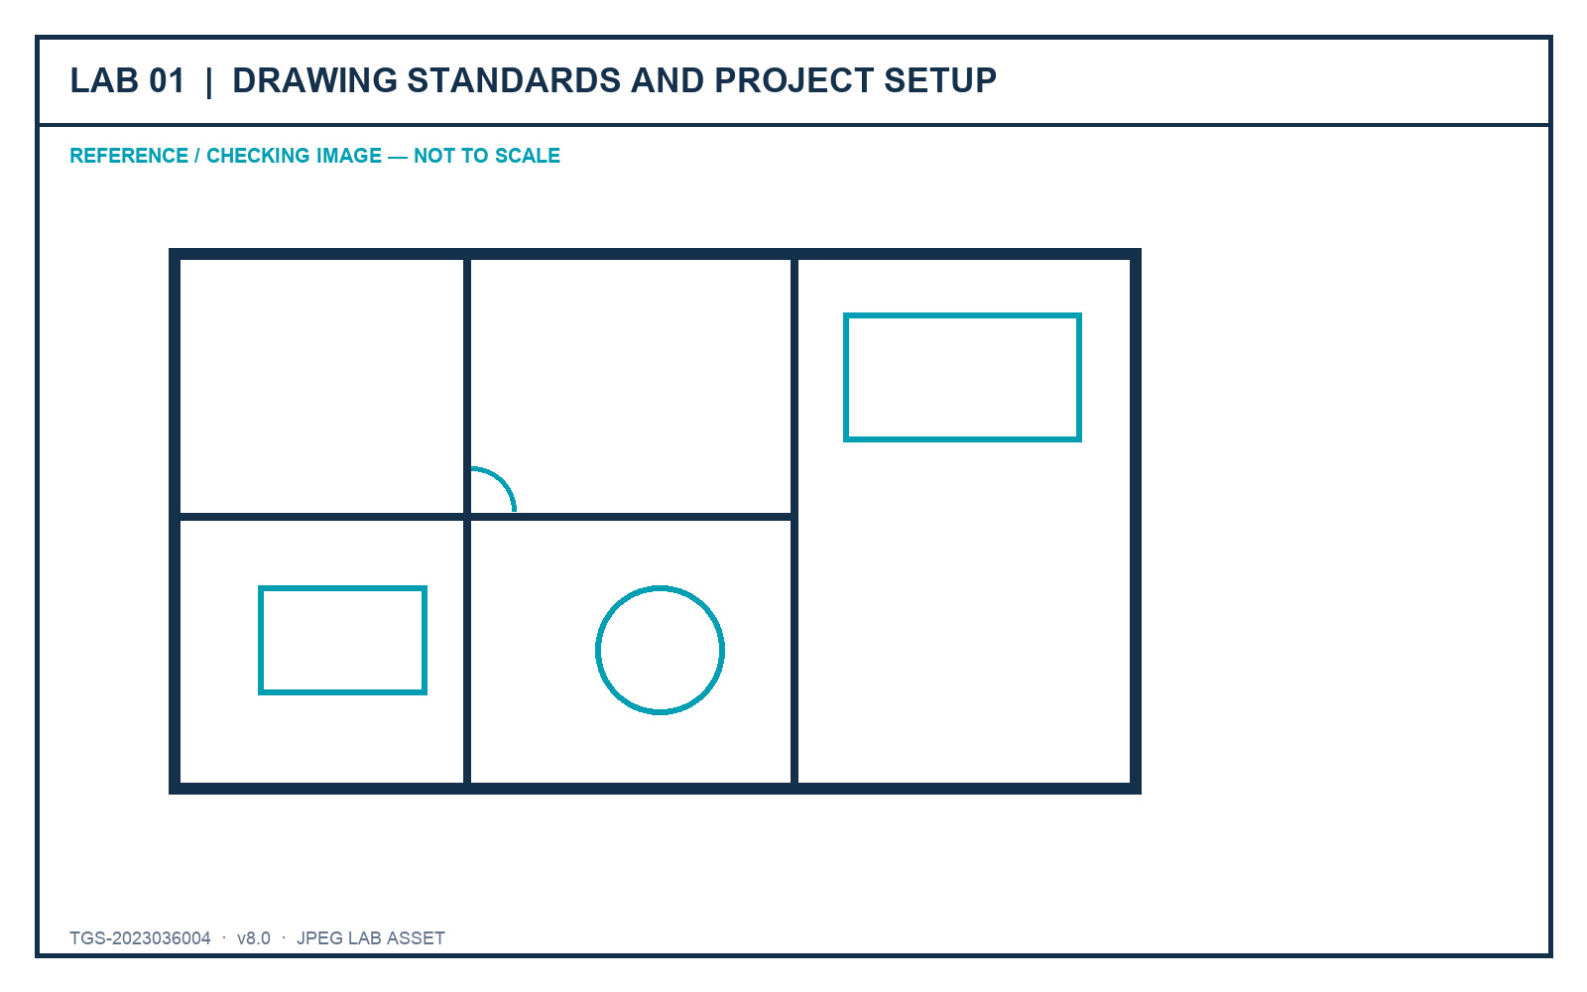
LO1 · K1 · A1
Lab 01 — Drawing Standards and Project Setup
DECISIONS TO PROVE
• Declare units, origin and standards before editing.
• Use measurable checks instead of visual guesswork.
• Submit setup and drawing-health evidence.
Outcome: A standards-ready furniture plan with a completed drawing-standard record and verified setup evidence.
JPEG brief supplied in the individual lab folder
Autodesk-ACP-AutoCAD-Design-and-Drafting · TGS-2023036004
© 2026 Tertiary Infotech Academy Pte Ltd
25

Slide 27
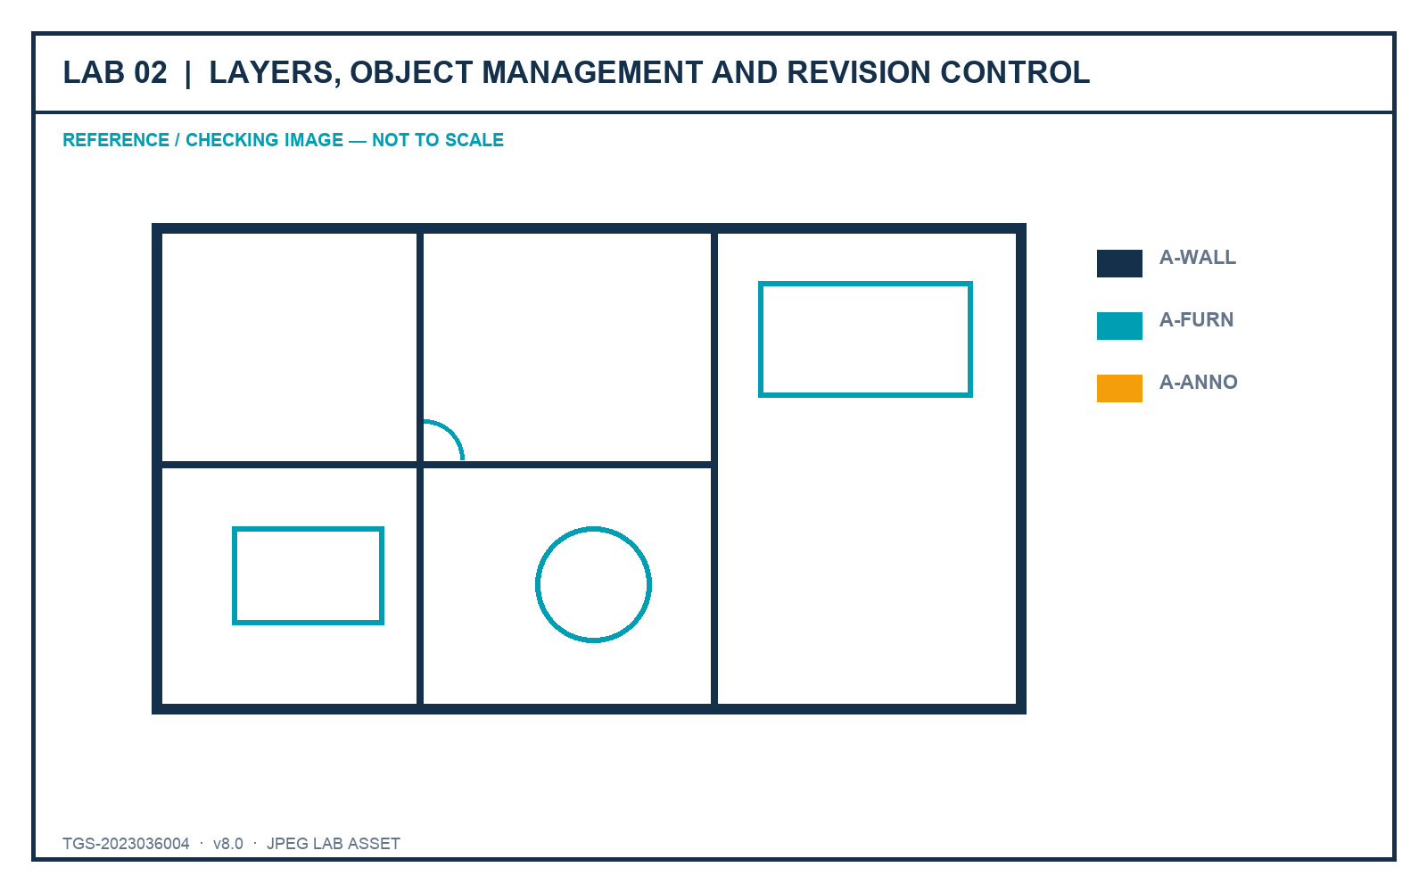
LO2 · K2 · A2
Lab 02 — Layers, Object Management and Revision Control
DECISIONS TO PROVE
• Organise complexity with filters and layer states.
• Use overrides without damaging global standards.
• Record controlled revision evidence.
Outcome: A revised furniture plan with reusable layer states, filters and a change log.
JPEG brief supplied in the individual lab folder
Autodesk-ACP-AutoCAD-Design-and-Drafting · TGS-2023036004
© 2026 Tertiary Infotech Academy Pte Ltd
26

Slide 28
02
DOMAIN 02
Design Annotation and Detailing
Text · dimensions · hatches · multileaders · tables · annotative scale
Autodesk-ACP-AutoCAD-Design-and-Drafting · TGS-2023036004
© 2026 Tertiary Infotech Academy Pte Ltd
27

Slide 29
DESIGN COMMUNICATION
Annotation is the voice of the drawing.
A good sheet controls what the stakeholder notices, understands and decides next.
Autodesk-ACP-AutoCAD-Design-and-Drafting · TGS-2023036004
© 2026 Tertiary Infotech Academy Pte Ltd
28

Slide 30
DRAWING AS STORY
Stakeholder Reading Order
1
2
3
4
5
▶
▶
▶
▶
Orient with title and key view
Read primary dimensions
Follow callouts to decisions
Check schedules and notes
Confirm revision and approval
Autodesk-ACP-AutoCAD-Design-and-Drafting · TGS-2023036004
© 2026 Tertiary Infotech Academy Pte Ltd
29

Slide 31
REUSABLE STANDARDS
The Annotation Style System
Text style
Font, height policy, width and readability.
Dimension style
Units, precision, symbols and placement.
1
2
Multileader style
Arrow, landing and content hierarchy.
Table style
Title, header, data rows and borders.
3
4
Hatch settings
Pattern, scale, angle and origin.
Annotative properties
One object, multiple paper-readable scales.
5
6
Autodesk-ACP-AutoCAD-Design-and-Drafting · TGS-2023036004
© 2026 Tertiary Infotech Academy Pte Ltd
30

Slide 32
MEASUREMENT WITH MEANING
Choose the Dimension by Intent
Linear / aligned
Horizontal, vertical or true-length distances.
Angular
The relationship between lines or features.
1
2
Radial / diameter
Circular geometry and manufacturing intent.
Ordinate
Coordinate-based production control.
3
4
Arc length
Measured curved distance.
Quick Dimension
Efficient chains that still require review.
5
6
Autodesk-ACP-AutoCAD-Design-and-Drafting · TGS-2023036004
© 2026 Tertiary Infotech Academy Pte Ltd
31

Slide 33
TRUSTWORTHY DETAILING
Associativity and Overrides
Keep data connected
Control exceptions
• Associative dimensions update with geometry.
• Reassociate after controlled geometry changes.
• Use fields when text should reflect a live property.
• Avoid typing over measured values.
• Treat exceptions as documented deviations.
• Check every override in plot preview.
Autodesk-ACP-AutoCAD-Design-and-Drafting · TGS-2023036004
© 2026 Tertiary Infotech Academy Pte Ltd
32

Slide 34
CHANGE COMMUNICATION
Hatches, Revision Clouds and Wipeouts
Hatch
Communicate material, section or scope — not decoration.
Origin
Align patterns so similar surfaces read consistently.
1
2
Revision cloud
Make the changed area visible and bounded.
Delta / note
State what changed and why it matters.
3
4
Wipeout
Improve local legibility without concealing required information.
Compare
Confirm added, removed and modified content.
5
6
Autodesk-ACP-AutoCAD-Design-and-Drafting · TGS-2023036004
© 2026 Tertiary Infotech Academy Pte Ltd
33

Slide 35
READABLE ON PAPER
Annotative Scale
How it works
Quality checks
• One text or symbol can support several intended viewport scales.
• The active annotation scale controls what you create and see.
• Add only scales required by the drawing set.
• Review in paper space at the target scale.
• Check viewport annotation visibility.
• Avoid duplicate manual copies with inconsistent text.
Autodesk-ACP-AutoCAD-Design-and-Drafting · TGS-2023036004
© 2026 Tertiary Infotech Academy Pte Ltd
34

Slide 36
FROM OBJECTS TO DECISIONS
Tables and Drawing Data
1
2
3
4
5
▶
▶
▶
▶
Define the information question
Create a table hierarchy
Link fields or attributes
Validate units and ownership
Update and publish
Autodesk-ACP-AutoCAD-Design-and-Drafting · TGS-2023036004
© 2026 Tertiary Infotech Academy Pte Ltd
35

Slide 37
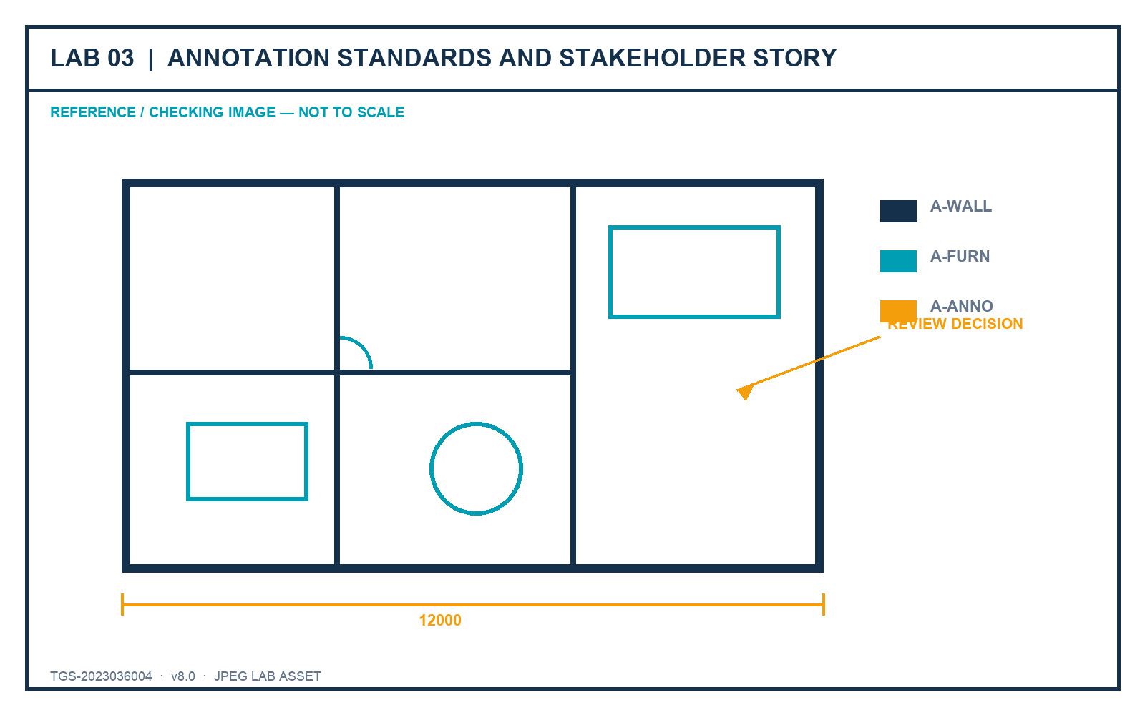
LO3 · K3 · A3
Lab 03 — Annotation Standards and Stakeholder Story
DECISIONS TO PROVE
• Create reusable annotation styles.
• Lead the stakeholder through a deliberate reading order.
• Make one revision visible and reviewable.
Outcome: An annotated plan with text, dimensions, multileaders, hatches and revision communication governed by named styles.
JPEG brief supplied in the individual lab folder
Autodesk-ACP-AutoCAD-Design-and-Drafting · TGS-2023036004
© 2026 Tertiary Infotech Academy Pte Ltd
36

Slide 38
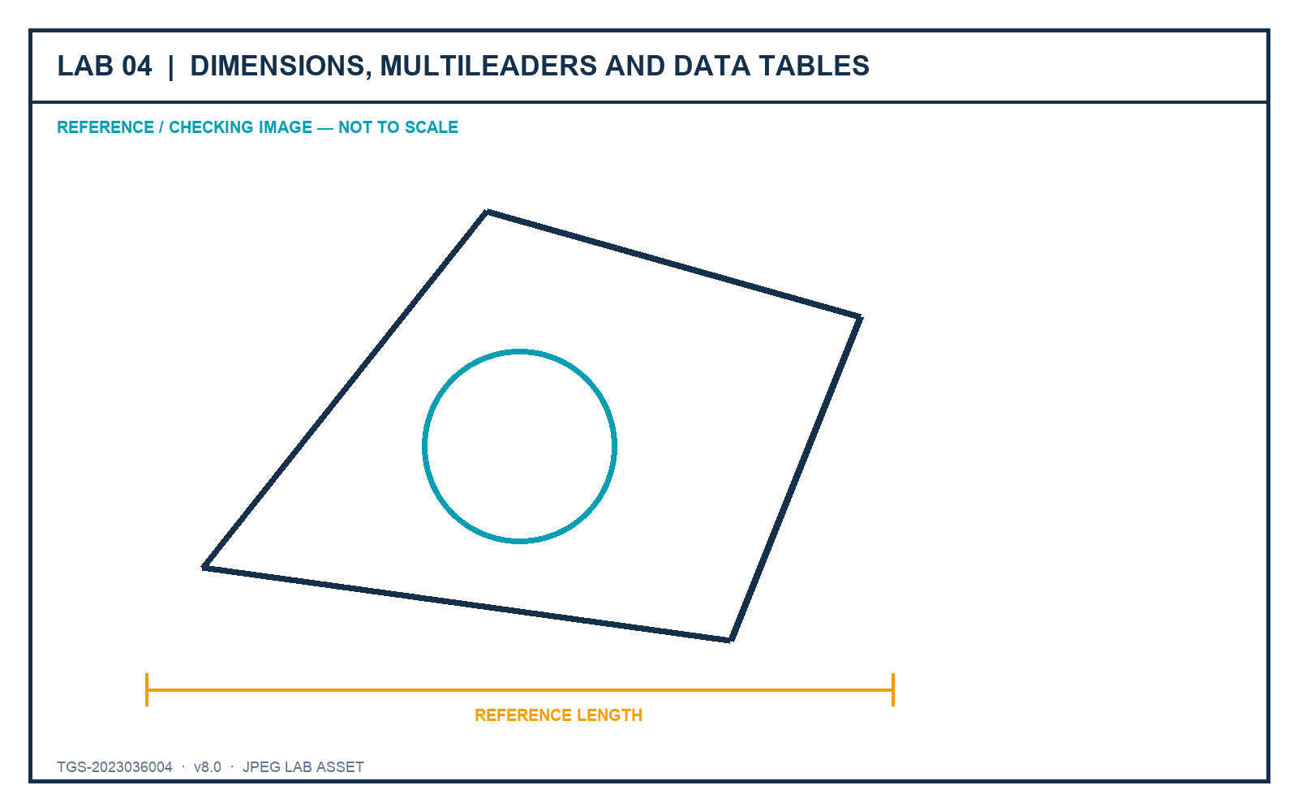
LO3 · K3 · A3
Lab 04 — Dimensions, Multileaders and Data Tables
DECISIONS TO PROVE
• Use fit-for-purpose dimension types.
• Coordinate leaders and component schedules.
• Prove readability in plot preview.
Outcome: A review sheet with validated dimensions, labels and a structured furniture/component table.
JPEG brief supplied in the individual lab folder
Autodesk-ACP-AutoCAD-Design-and-Drafting · TGS-2023036004
© 2026 Tertiary Infotech Academy Pte Ltd
37

Slide 39
03
DOMAIN 03
Author and Edit Drawing Content
Advanced geometry · precision editing · blocks · attributes · reuse
Autodesk-ACP-AutoCAD-Design-and-Drafting · TGS-2023036004
© 2026 Tertiary Infotech Academy Pte Ltd
38

Slide 40
AUTHORING WITH INTENT
Object type is a design decision.
Choose geometry by how it must behave when selected, measured, revised and reused.
Autodesk-ACP-AutoCAD-Design-and-Drafting · TGS-2023036004
© 2026 Tertiary Infotech Academy Pte Ltd
39

Slide 41
CHOOSE BY BEHAVIOUR
Advanced Drawing Objects
Polyline
Connected line/arc segments as one editable object.
Spline
Smooth fit or control-vertex curve for refined profiles.
1
2
Polygon
Regular closed polyline from centre/radius or edge.
Region
Closed 2D area with properties and Boolean operations.
3
4
Xline / Ray
Infinite or semi-infinite construction reference.
Multiline
Parallel elements governed by a named style.
5
6
Autodesk-ACP-AutoCAD-Design-and-Drafting · TGS-2023036004
© 2026 Tertiary Infotech Academy Pte Ltd
40

Slide 42
CONNECTED VS CONTROLLED CURVES
Polylines and Splines
Polyline
Spline
• Polylines stay connected through grip editing.
• Width, arcs and linetype generation live on one object.
• Closed polylines support area, regions and extrusion.
• Fit splines pass through points; CV splines are shaped by a control frame.
• Use fewer, deliberate control points.
• Choose based on revision control, not smooth appearance alone.
Autodesk-ACP-AutoCAD-Design-and-Drafting · TGS-2023036004
© 2026 Tertiary Infotech Academy Pte Ltd
41

Slide 43
ACCURACY IS A SYSTEM
Precision Stack
1
2
3
4
5
▶
▶
▶
▶
Set units and UCS
Choose snap/track modes
Enter coordinates or distances
Edit with grips and constraints
Measure and verify
Autodesk-ACP-AutoCAD-Design-and-Drafting · TGS-2023036004
© 2026 Tertiary Infotech Academy Pte Ltd
42

Slide 44
SELECT THE LEAST DESTRUCTIVE TOOL
Modification Families
Transform
Move, Copy, Rotate, Mirror, Scale and Stretch.
Parallel / boundary
Offset, Trim, Extend, Break and Join.
1
2
Corner
Fillet and Chamfer with deliberate radii/distances.
Pattern
Rectangular, polar and path arrays.
3
4
Structure
Explode only when object structure must change.
Grips
Direct manipulation with object-specific options.
5
6
Autodesk-ACP-AutoCAD-Design-and-Drafting · TGS-2023036004
© 2026 Tertiary Infotech Academy Pte Ltd
43

Slide 45
EDIT RELATIONSHIPS
Associative Arrays and Multifunctional Grips
Associative arrays
Multifunctional grips
• Arrays retain count, spacing, angle or path relationships.
• Edit the array as one parametric collection.
• Explode only for a documented downstream need.
• Grip menus expose object-specific actions.
• Hover to identify Stretch, Add, Remove, Convert and other modes.
• Dynamic input shows values near the cursor.
Autodesk-ACP-AutoCAD-Design-and-Drafting · TGS-2023036004
© 2026 Tertiary Infotech Academy Pte Ltd
44

Slide 46
2D COMPOSITION
Regions and Boolean Operations
1
2
3
4
5
▶
▶
▶
▶
Create closed loops
Convert to regions
Inspect area and centroid
Union, subtract or intersect
Retain a pre-Boolean copy for review
Autodesk-ACP-AutoCAD-Design-and-Drafting · TGS-2023036004
© 2026 Tertiary Infotech Academy Pte Ltd
45

Slide 47
FLAT GEOMETRY · 3D APPEARANCE
2D Isometric Drafting
Isoplane
Left, Top or Right controls the active snap plane.
Cycle
F5 or Ctrl+E changes isoplane.
1
2
Isocircle
Ellipse option available only in isometric drafting.
Limitation
An isometric drawing is 2D representation, not a 3D model.
3
4
Dimensioning
Use aligned/oblique techniques deliberately.
Communication
Apply when a fast pictorial view supports the audience.
5
6
Autodesk-ACP-AutoCAD-Design-and-Drafting · TGS-2023036004
© 2026 Tertiary Infotech Academy Pte Ltd
46

Slide 48
REUSE VS SELECTION
Blocks vs Groups
Block
Group
• A block is one reusable definition with many instances.
• Edit the definition to update its instances.
• Attributes carry instance-specific data.
• A group is a temporary selection relationship between existing objects.
• It does not create a reusable definition.
• Use it for coordinated selection, not standard content.
Autodesk-ACP-AutoCAD-Design-and-Drafting · TGS-2023036004
© 2026 Tertiary Infotech Academy Pte Ltd
47

Slide 49
DRAWING CONTENT AS DATA
Attributes to Data Extraction
1
2
3
4
5
▶
▶
▶
▶
Define the information schema
Create attributes
Insert and populate blocks
Synchronise controlled changes
Extract a schedule and validate
Autodesk-ACP-AutoCAD-Design-and-Drafting · TGS-2023036004
© 2026 Tertiary Infotech Academy Pte Ltd
48

Slide 50
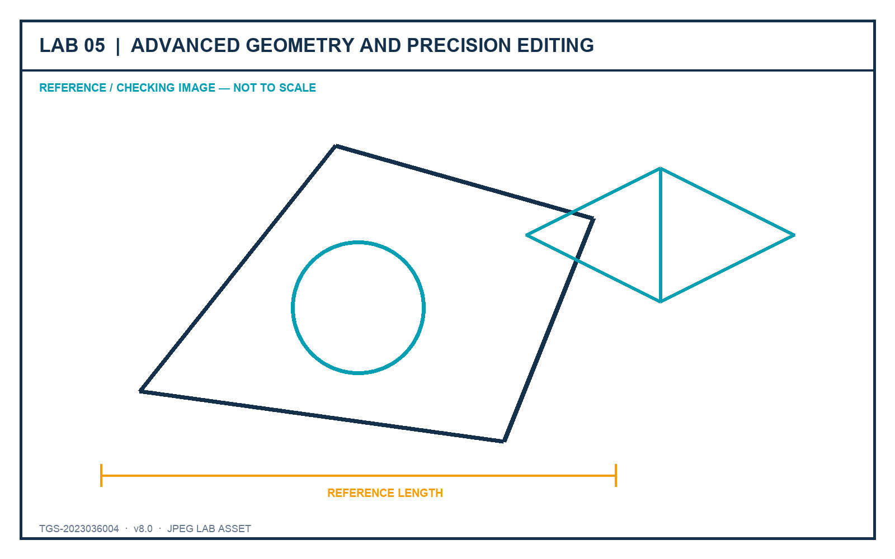
LO1–LO2 · K1, K2 · A1, A2
Lab 05 — Advanced Geometry and Precision Editing
DECISIONS TO PROVE
• Use object types that suit revision behaviour.
• Combine precision tools into a repeatable system.
• Verify the final 2D and isometric geometry.
Outcome: A precise 2D component study plus an isometric view using fit-for-purpose object types.
JPEG brief supplied in the individual lab folder
Autodesk-ACP-AutoCAD-Design-and-Drafting · TGS-2023036004
© 2026 Tertiary Infotech Academy Pte Ltd
49

Slide 51
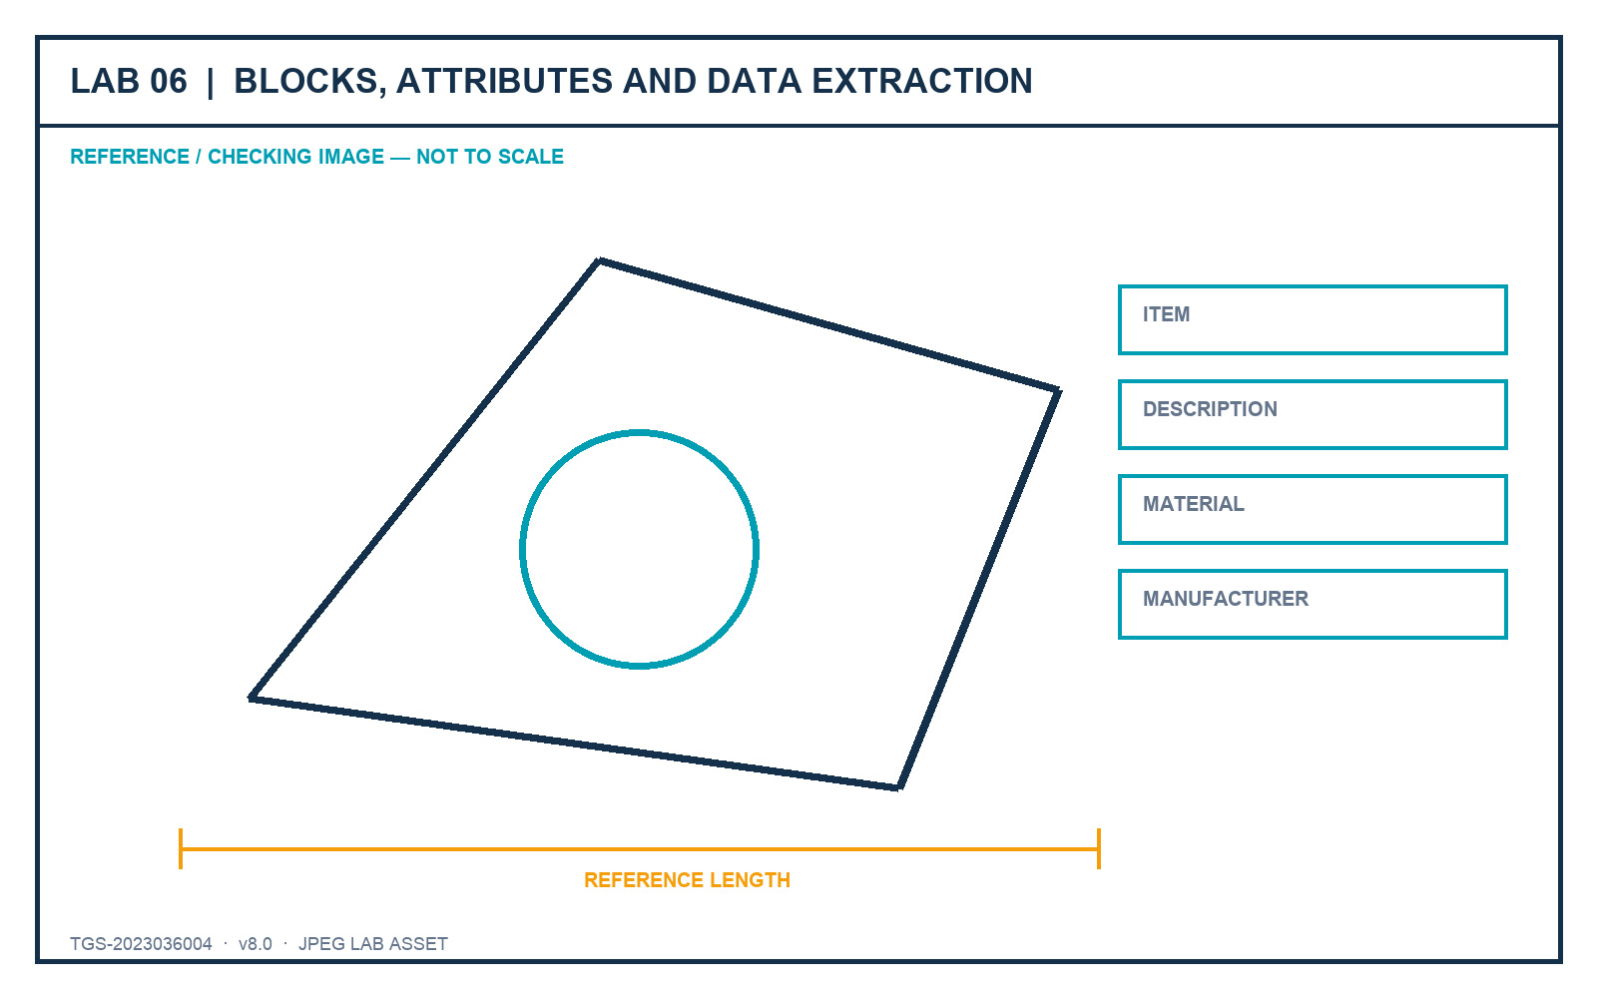
LO4 · K4 · A4
Lab 06 — Blocks, Attributes and Data Extraction
DECISIONS TO PROVE
• Design reusable block definitions.
• Carry instance data through attributes.
• Extract and validate a component schedule.
Outcome: A small furniture block library with attributes and an extracted component schedule.
JPEG brief supplied in the individual lab folder
Autodesk-ACP-AutoCAD-Design-and-Drafting · TGS-2023036004
© 2026 Tertiary Infotech Academy Pte Ltd
50

Slide 52
04
DOMAIN 04
Configure and Manage Design Output
Layouts · viewports · page setup · plotting · publishing · eTransmit
Autodesk-ACP-AutoCAD-Design-and-Drafting · TGS-2023036004
© 2026 Tertiary Infotech Academy Pte Ltd
51

Slide 53
SHEET GOVERNANCE
Model once. Communicate through controlled sheets.
Paper space governs view, scale, title block and output — without duplicating model geometry.
Autodesk-ACP-AutoCAD-Design-and-Drafting · TGS-2023036004
© 2026 Tertiary Infotech Academy Pte Ltd
52

Slide 54
AUTHORING AND COMMUNICATION
Model Space vs Paper Space
Model space
Paper space
• Model at full size in agreed drawing units.
• Create and revise design geometry once.
• Maintain discipline layers and object properties.
• Compose sheets at paper size.
• Control views through scaled viewports.
• Apply title blocks, page setups and sheet-specific emphasis.
Autodesk-ACP-AutoCAD-Design-and-Drafting · TGS-2023036004
© 2026 Tertiary Infotech Academy Pte Ltd
53

Slide 55
REPEATABLE OUTPUT
Layout and Page Setup
1
2
3
4
5
▶
▶
▶
▶
Create/rename layout
Select device or PDF output
Choose paper and orientation
Set plot area, scale and style
Preview and assign
Autodesk-ACP-AutoCAD-Design-and-Drafting · TGS-2023036004
© 2026 Tertiary Infotech Academy Pte Ltd
54

Slide 56
WINDOWS INTO THE MODEL
Viewport Control
View
Top, Front, Right, Isometric or a named view.
Scale
Apply an approved custom or standard scale.
1
2
Visual style
2D wireframe, Hidden, Shaded or Realistic by purpose.
Layer override
Emphasise the sheet without changing the model.
3
4
Lock
Prevent accidental pan/zoom after approval.
Annotation
Confirm readability at the viewport scale.
5
6
Autodesk-ACP-AutoCAD-Design-and-Drafting · TGS-2023036004
© 2026 Tertiary Infotech Academy Pte Ltd
55

Slide 57
EDITABLE NATIVE POWERPOINT CHART
Output Quality Priorities
Conceptual 1–5 quality-impact comparison for discussion; values are instructional, not measured project data.
Autodesk-ACP-AutoCAD-Design-and-Drafting · TGS-2023036004
© 2026 Tertiary Infotech Academy Pte Ltd
56

Slide 58
MULTI-SHEET OUTPUT
Publish a Drawing Set
1
2
3
4
5
▶
▶
▶
▶
Order current layouts
Apply page setups
Configure PDF options
Preview every sheet
Publish and inspect the PDF
Autodesk-ACP-AutoCAD-Design-and-Drafting · TGS-2023036004
© 2026 Tertiary Infotech Academy Pte Ltd
57

Slide 59
COMPLETE HANDOVER
eTransmit a Portable Package
1
2
3
4
5
▶
▶
▶
▶
Resolve dependencies
Choose path handling
Include fonts/plot styles as permitted
Create ZIP and report
Open-test from the package
Autodesk-ACP-AutoCAD-Design-and-Drafting · TGS-2023036004
© 2026 Tertiary Infotech Academy Pte Ltd
58

Slide 60
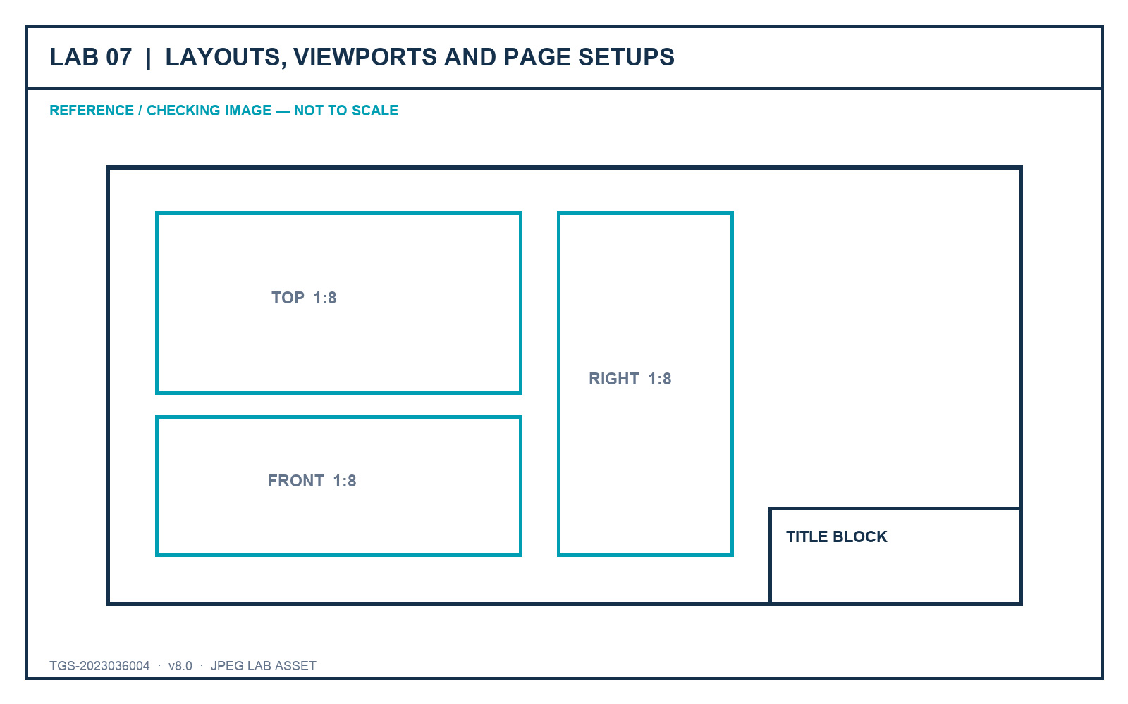
LO3 · K3 · A1, A2, A3
Lab 07 — Layouts, Viewports and Page Setups
DECISIONS TO PROVE
• Create ISO A1, A2 and A3 sheets.
• Control views, scales, visual styles and locks.
• Prove title-block and page-setup consistency.
Outcome: A coordinated three-sheet sink drawing set that mirrors the original practical-assessment workflow.
JPEG brief supplied in the individual lab folder
Autodesk-ACP-AutoCAD-Design-and-Drafting · TGS-2023036004
© 2026 Tertiary Infotech Academy Pte Ltd
59

Slide 61
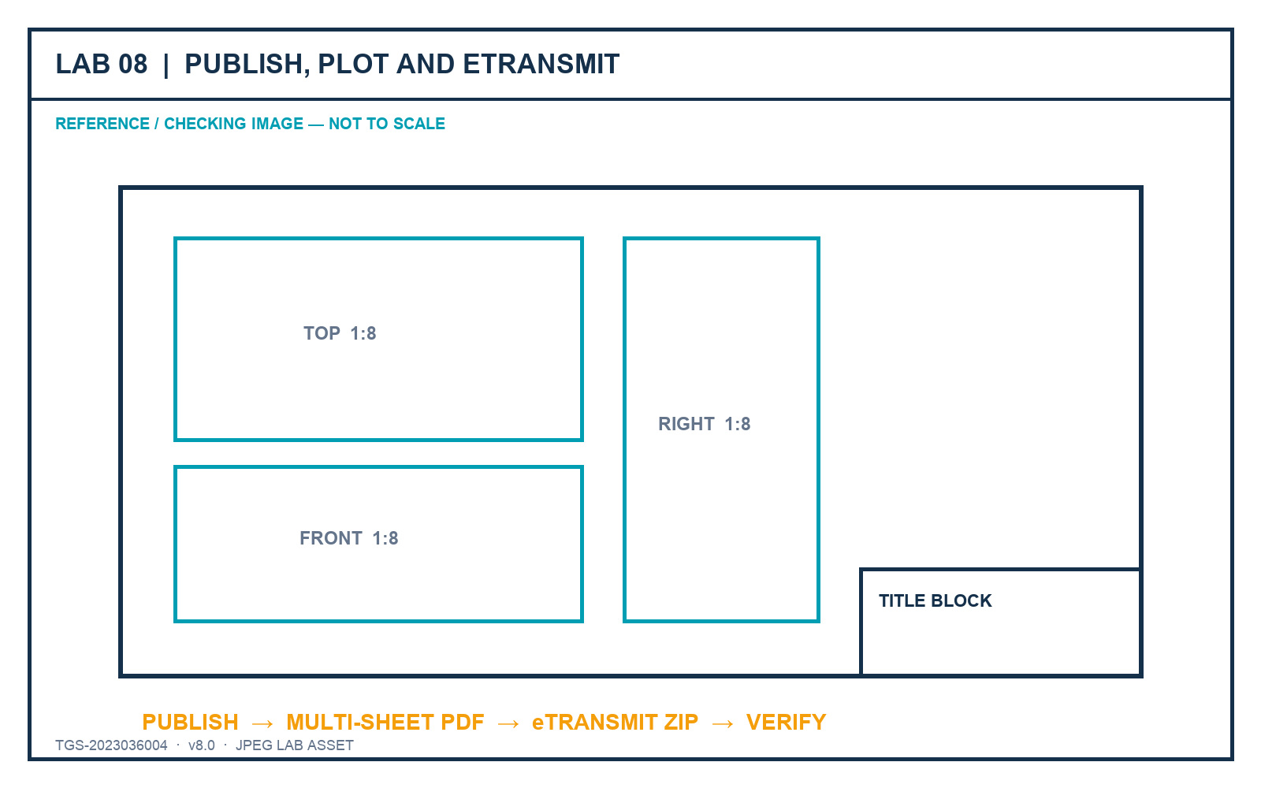
LO3–LO4 · K3, K4 · A3, A4
Lab 08 — Publish, Plot and eTransmit
DECISIONS TO PROVE
• Publish only current, ordered layouts.
• Inspect each PDF sheet at full size.
• Verify the eTransmit inventory and portability.
Outcome: A published PDF sheet set and a verified eTransmit package with a transmittal report.
JPEG brief supplied in the individual lab folder
Autodesk-ACP-AutoCAD-Design-and-Drafting · TGS-2023036004
© 2026 Tertiary Infotech Academy Pte Ltd
60

Slide 62
05
DOMAIN 05
Collaboration and Emerging Workflows
Xrefs · underlays · compare · shared views · tool palettes · automation
Autodesk-ACP-AutoCAD-Design-and-Drafting · TGS-2023036004
© 2026 Tertiary Infotech Academy Pte Ltd
61

Slide 63
COORDINATION
Collaboration works when ownership stays visible.
Reference other teams' work, manage paths and communicate changes without silently duplicating source geometry.
Autodesk-ACP-AutoCAD-Design-and-Drafting · TGS-2023036004
© 2026 Tertiary Infotech Academy Pte Ltd
62

Slide 64
EXTERNAL REFERENCES
Attach vs Overlay
Attach
Overlay
• Attach allows nested references to propagate into the host.
• Use when downstream visibility is intended and controlled.
• Document nesting and ownership.
• Overlay prevents the reference from propagating when the host is referenced again.
• Use to avoid circular or unwanted nesting.
• Often safer for discipline coordination.
Autodesk-ACP-AutoCAD-Design-and-Drafting · TGS-2023036004
© 2026 Tertiary Infotech Academy Pte Ltd
63

Slide 65
PORTABILITY AND CONTROL
Reference Path Strategy
Relative
Portable within a known project folder structure.
Full
Exact location but fragile when moved between machines.
1
2
No path
Search-based and ambiguous outside a disciplined package.
Repath
Repair links without changing insertion or scale.
3
4
Unload / reload
Control performance while retaining the definition.
eTransmit
Package references and document path handling.
5
6
Autodesk-ACP-AutoCAD-Design-and-Drafting · TGS-2023036004
© 2026 Tertiary Infotech Academy Pte Ltd
64

Slide 66
LAYER OWNERSHIP
Coordinate Xref Layers
1
2
3
4
5
▶
▶
▶
▶
Read the source prefix
Keep global ownership intact
Apply host review overrides
Avoid binding without a requirement
Record the coordination decision
Autodesk-ACP-AutoCAD-Design-and-Drafting · TGS-2023036004
© 2026 Tertiary Infotech Academy Pte Ltd
65

Slide 67
REFERENCE, DO NOT DUPLICATE
Underlays and Linked Evidence
PDF underlay
Reference issued sheets without redrawing them.
Raster image
Trace, compare or communicate using controlled imagery.
1
2
Clip
Limit the visible region without modifying the source.
Fade / contrast
Keep context visible without overpowering host content.
3
4
Hyperlink
Connect an object to approved external information.
Path check
Verify links from the final package location.
5
6
Autodesk-ACP-AutoCAD-Design-and-Drafting · TGS-2023036004
© 2026 Tertiary Infotech Academy Pte Ltd
66

Slide 68
CHANGE VISIBILITY
Drawing Compare
1
2
3
4
5
▶
▶
▶
▶
Choose baseline and revision
Generate added/removed/modified overlays
Filter noise
Review decision-critical changes
Record response and close
Autodesk-ACP-AutoCAD-Design-and-Drafting · TGS-2023036004
© 2026 Tertiary Infotech Academy Pte Ltd
67

Slide 69
TECHNOLOGY MUST SERVE THE ORGANISATION
Evaluate Emerging Workflows
Shared Views
Browser-based review without handing over editable source.
Markup Import
Bring review comments back into the drawing context.
1
2
Data extraction
Turn block/attribute data into schedules and QA evidence.
Tool palettes
Standardise approved commands, blocks and hatches.
3
4
Automation
Use scripts and routines for repeatable, governed tasks.
Cloud coordination
Assess permissions, ownership, revision and audit trail.
5
6
Autodesk-ACP-AutoCAD-Design-and-Drafting · TGS-2023036004
© 2026 Tertiary Infotech Academy Pte Ltd
68

Slide 70
A4 · A5 DECISION FRAMEWORK
Technology Selection Scorecard
Risk and quality
Value and growth
• Accuracy and standards fit
• Interoperability and path portability
• Revision traceability
• Security and access control
• Time saved across repeated work
• Learning and support effort
• Evidence and auditability
• Ability to scale with organisational growth
Autodesk-ACP-AutoCAD-Design-and-Drafting · TGS-2023036004
© 2026 Tertiary Infotech Academy Pte Ltd
69

Slide 71
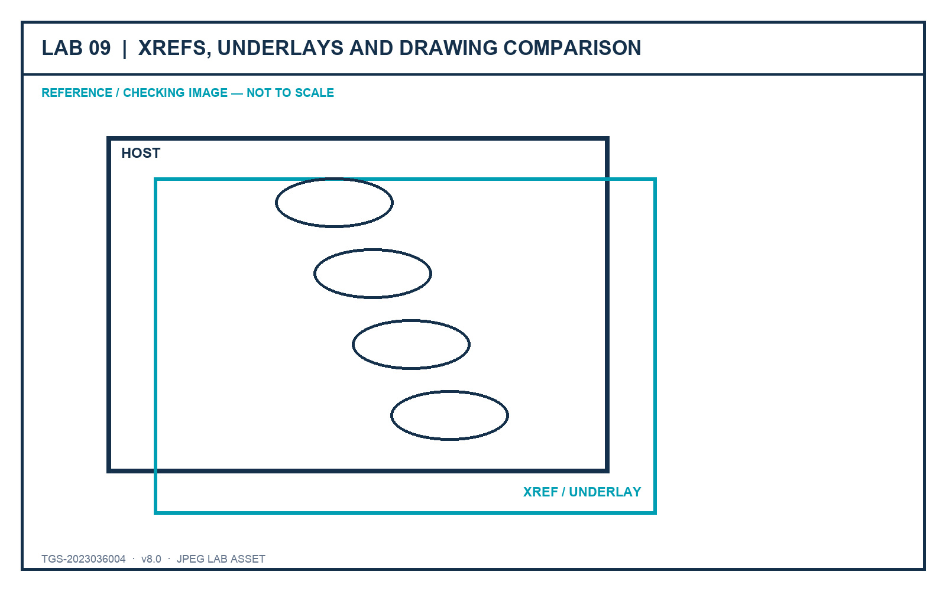
LO4 · K4 · A4
Lab 09 — Xrefs, Underlays and Drawing Comparison
DECISIONS TO PROVE
• Preserve ownership through controlled references.
• Use relative paths and host-only review overrides.
• Classify changes and stakeholder response.
Outcome: A host coordination drawing with controlled Xrefs/underlays and a documented comparison review.
JPEG brief supplied in the individual lab folder
Autodesk-ACP-AutoCAD-Design-and-Drafting · TGS-2023036004
© 2026 Tertiary Infotech Academy Pte Ltd
70

Slide 72
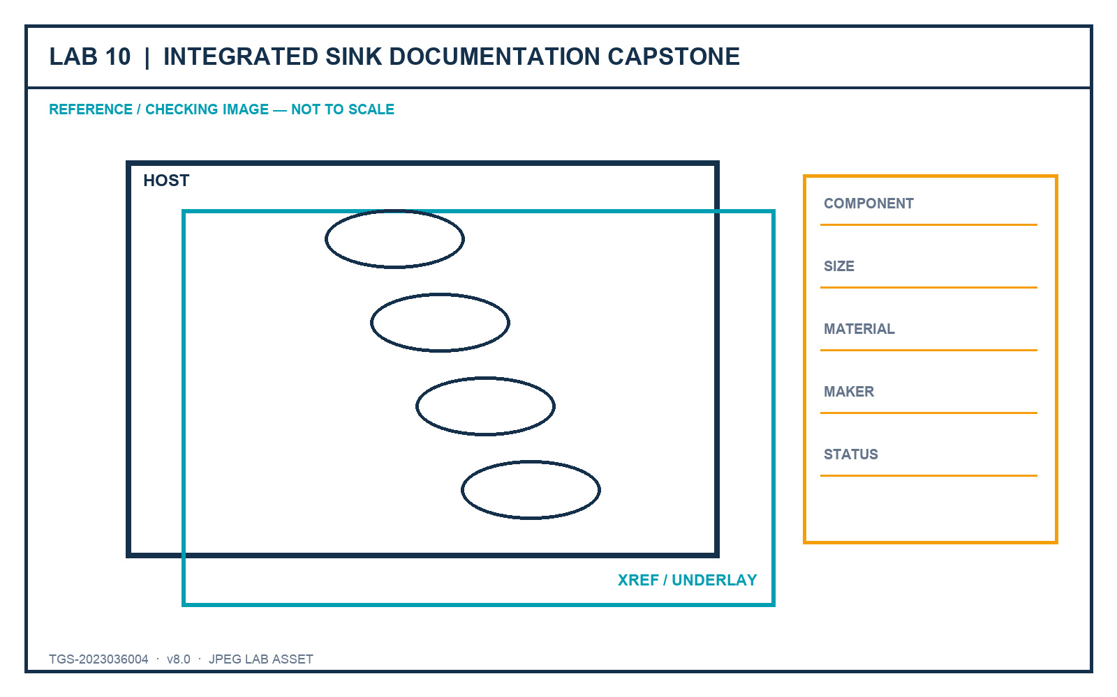
LO1–LO5 · K1–K4 · A1–A5
Lab 10 — Integrated Sink Documentation Capstone
DECISIONS TO PROVE
• Integrate standards, layouts and component data.
• Publish and package a complete sink drawing set.
• Lead a concise stakeholder approval story.
Outcome: A standards-based sink drawing set with layouts, title blocks, viewports, component table, publish package and review evidence.
JPEG brief supplied in the individual lab folder
Autodesk-ACP-AutoCAD-Design-and-Drafting · TGS-2023036004
© 2026 Tertiary Infotech Academy Pte Ltd
71

Slide 73
WRAP-UP
Course Summary and Assessment
Autodesk-ACP-AutoCAD-Design-and-Drafting · TGS-2023036004
© 2026 Tertiary Infotech Academy Pte Ltd
72

Slide 74
FROM BRIEF TO HANDOVER
Integrated Professional Workflow
1
2
3
4
5
▶
▶
▶
▶
Define standards
Author and revise
Annotate and tell the story
Publish controlled sheets
Coordinate, review and improve
Autodesk-ACP-AutoCAD-Design-and-Drafting · TGS-2023036004
© 2026 Tertiary Infotech Academy Pte Ltd
73

Slide 75
PROVE THE WORK
Evidence Quality Checklist
Show the setting and the visible result together.
Use filenames that identify lab, learner and revision.
1
2
Verify units, coordinates, scales and paths explicitly.
Retain current DWG plus published/package outputs.
3
4
Capture acceptance criteria, not every click.
Explain the decision behind the tool choice.
5
6
Autodesk-ACP-AutoCAD-Design-and-Drafting · TGS-2023036004
© 2026 Tertiary Infotech Academy Pte Ltd
74

Slide 76
WA-SAQ + PP
Final Assessment
• Written Assessment (WA-SAQ) — 4 open-ended questions covering K1–K4, 60 minutes, open book.
• Practical Performance (PP) — 5 hands-on tasks covering A1–A5, 120 minutes, open book.
• Question papers retain the original instrument type, counts, timings and K/A coverage.
• Answer keys remain trainer-only and are never linked to the LMS or public GitHub repository.
Autodesk-ACP-AutoCAD-Design-and-Drafting · TGS-2023036004
© 2026 Tertiary Infotech Academy Pte Ltd
75

Slide 77
COMPLETE EVERY STAGE
Assessment and Sign-off Flow
1
2
3
4
5
▶
▶
▶
▶
Assessment attendance
WA-SAQ
Practical Performance
Assessor decision
Feedback, sign-off or appeal
Autodesk-ACP-AutoCAD-Design-and-Drafting · TGS-2023036004
© 2026 Tertiary Infotech Academy Pte Ltd
76

Slide 78
MANDATORY
Digital Attendance — Final Check
AM
Completed for Day 4.
PM
Completed after lunch.
1
2
Assessment
Completed before the final papers.
TRAQOM
Submit the required feedback survey.
3
4
Autodesk-ACP-AutoCAD-Design-and-Drafting · TGS-2023036004
© 2026 Tertiary Infotech Academy Pte Ltd
77

Slide 79
AFTER THE COURSE
Support and Next Learning
Course support
Professional development
• Revisit the detailed Learner Guide and individual lab folders.
• Use only files and references authorised for your project.
• Request post-course consultation through Tertiary Infotech.
• Build a portfolio drawing set with standards evidence.
• Practise explaining design decisions without relying on memorised clicks.
• Continue with related Autodesk design and BIM workflows.
Autodesk-ACP-AutoCAD-Design-and-Drafting · TGS-2023036004
© 2026 Tertiary Infotech Academy Pte Ltd
78

Slide 80
AUTOCAD DESIGN AND DRAFTING
Thank You!
Draft with intent. Revise with control. Publish with confidence.
Autodesk-ACP-AutoCAD-Design-and-Drafting · TGS-2023036004
© 2026 Tertiary Infotech Academy Pte Ltd
79

