Slide 1


COURSE SLIDES · WSQ
Autodesk Certified Professional (ACP) - AutoCAD Design and Drafting
WSQ Course Code: TGS-2023036004
Conducted by Tertiary Infotech Academy Pte Ltd · UEN 201200696W
v9.0 · 22 August 2026
© 2026 Tertiary Infotech Academy Pte Ltd

Slide 2
COURSE ADMINISTRATION
Welcome & Course Orientation
Autodesk-ACP-AutoCAD-Design-and-Drafting · TGS-2023036004
© 2026 Tertiary Infotech Academy Pte Ltd
1

Slide 3
SSG DIGITAL ATTENDANCE
Digital Attendance — Three Required Check-ins
AM attendance
Scan the SSG QR code at the start of each training day.
PM attendance
Scan again after lunch when prompted by the trainer.
1
2
Assessment attendance
Complete the separate assessment check-in before the final papers.
Eligibility
Maintain at least 75% attendance and complete all prescribed assessments.
3
4
Autodesk-ACP-AutoCAD-Design-and-Drafting · TGS-2023036004
© 2026 Tertiary Infotech Academy Pte Ltd
2

Slide 4
YOUR TRAINER · INTRODUCTION
Trainer Introduction — What Learners Need to Know
Role
The trainer's current role and the kinds of drawings or projects they support.
Credentials
Relevant AutoCAD, design, adult-learning and industry qualifications.
1
2
Experience
Examples of production, coordination and output challenges addressed in practice.
Support
How to ask questions, request demonstrations and obtain course follow-up support.
3
4
Autodesk-ACP-AutoCAD-Design-and-Drafting · TGS-2023036004
© 2026 Tertiary Infotech Academy Pte Ltd
3

Slide 5
YOUR TRAINER
About the Trainer
ROLE
Principal trainer and courseware developer at Tertiary Infotech Academy.
AA
QUALIFICATIONS
Doctorate-qualified adult educator with ACTA/DACE training credentials.
Dr Alfred Ang
FOCUS
Professional software workflows, design communication, automation and emerging technologies.
Principal Trainer and Courseware Developer Tertiary Infotech Academy
APPROACH
Connect design intent to measurable standards, practice evidence and stakeholder outcomes.
Autodesk-ACP-AutoCAD-Design-and-Drafting · TGS-2023036004
© 2026 Tertiary Infotech Academy Pte Ltd
4

Slide 6
STUDIO INTRODUCTION
Let's Know Each Other
Role
What kinds of drawings do you create or review?
Experience
Which AutoCAD workflows are already familiar?
1
2
Challenge
Where do revisions, standards or coordination currently fail?
Goal
What professional outcome should this course unlock?
3
4
Autodesk-ACP-AutoCAD-Design-and-Drafting · TGS-2023036004
© 2026 Tertiary Infotech Academy Pte Ltd
5

Slide 7
PROFESSIONAL LEARNING ENVIRONMENT
Ground Rules
Set mobile devices to silent mode.
Participate actively — no question is too small.
1
2
Respect different professional viewpoints.
Use only authorised project files and data.
3
4
Return from breaks on time.
Keep evidence of your own work.
5
6
Autodesk-ACP-AutoCAD-Design-and-Drafting · TGS-2023036004
© 2026 Tertiary Infotech Academy Pte Ltd
6

Slide 8
LMS-TMS.TERTIARYINFOTECH.COM
Download Your Course Materials
1
2
3
4
▶
▶
▶
Open the LMS/TMS course page
Locate the current Courseware section
Download slides, Learner Guide and labs
Open each lab from its own folder
Autodesk-ACP-AutoCAD-Design-and-Drafting · TGS-2023036004
© 2026 Tertiary Infotech Academy Pte Ltd
7

Slide 9
32 HOURS · 4 DAYS
Four-Day Learning Journey
Days 1–2
Days 3–4
• Day 1 — Standards and drawing management
– Units, UCS, layers, properties and advanced objects
– Labs 1–2
• Day 2 — Author, edit and annotate
– Precision editing, blocks, attributes and annotation systems
– Labs 3–6
• Day 3 — Output and collaboration
– Layouts, page setups, publish, eTransmit and Xrefs
– Labs 7–9
• Day 4 — Integrate and demonstrate
– Sink documentation capstone, evidence review, WA and PP
– Lab 10 + final assessment
Autodesk-ACP-AutoCAD-Design-and-Drafting · TGS-2023036004
© 2026 Tertiary Infotech Academy Pte Ltd
8

Slide 10
Design Sketching · BEV-DES-5026-1.1-1
TSC Coverage — Knowledge and Abilities
Knowledge
Abilities
• K1 · Emerging design visualization standards
• K2 · Revision methods for 2D and 3D drawings
• K3 · Storytelling and stakeholder engagement
• K4 · Emerging drawing technologies
• A1 · Define art direction and sketching style
• A2 · Guide drawing capability development
• A3 · Develop organisational drawing standards
• A4 · Lead technology and method selection
• A5 · Inspire traditional and contemporary approaches
Autodesk-ACP-AutoCAD-Design-and-Drafting · TGS-2023036004
© 2026 Tertiary Infotech Academy Pte Ltd
9

Slide 11
WHAT YOU WILL BE ABLE TO DO
Learning Outcomes
LO1
Standards and art direction
LO2
Drawing and revision capability
1
2
LO3
Standards, storytelling and engagement
LO4
Emerging technology integration
3
4
LO5
Exploration and stakeholder inspiration
5
Autodesk-ACP-AutoCAD-Design-and-Drafting · TGS-2023036004
© 2026 Tertiary Infotech Academy Pte Ltd
10

Slide 12
EDITABLE NATIVE POWERPOINT CHART
Autodesk ACP Exam-Domain Weighting
Official Autodesk AutoCAD ACP domain weighting. Use it to balance review effort; WSQ assessment remains K1–K4 and A1–A5.
Autodesk-ACP-AutoCAD-Design-and-Drafting · TGS-2023036004
© 2026 Tertiary Infotech Academy Pte Ltd
11

Slide 13
PROFESSIONAL WORKFLOW
Course Roadmap
1
2
3
4
5
▶
▶
▶
▶
Manage the drawing
Communicate through annotation
Author and revise content
Govern design output
Coordinate and lead change
Autodesk-ACP-AutoCAD-Design-and-Drafting · TGS-2023036004
© 2026 Tertiary Infotech Academy Pte Ltd
12

Slide 14
BEFORE THE FINAL PAPERS
Briefing for Assessment
Individual, open-book assessment using approved course materials.
Place phones and other materials under the table.
1
2
No discussion, photos or recording of assessment scripts.
Use black/blue pen; no liquid paper or correction tape.
3
4
Answer in your own words and submit through LMS/TMS.
C requires competence in every required criterion.
5
6
Autodesk-ACP-AutoCAD-Design-and-Drafting · TGS-2023036004
© 2026 Tertiary Infotech Academy Pte Ltd
13

Slide 15
OPEN BOOK
Final Assessment
Written Assessment
Practical Performance
• Written Assessment (WA-SAQ) — 4 open-ended questions covering K1–K4, 60 minutes, open book.
• Knowledge evidence from slides and Learner Guide.
• Four questions retain the original WA count.
• Practical Performance (PP) — 5 hands-on tasks covering A1–A5, 120 minutes, open book.
• Practical evidence from the sink layout workflow.
• Five tasks retain the original PP count and A1–A5 mapping.
Autodesk-ACP-AutoCAD-Design-and-Drafting · TGS-2023036004
© 2026 Tertiary Infotech Academy Pte Ltd
14

Slide 16
WA → PP → DECISION
Assessment and Sign-off Flow
1
2
3
4
5
▶
▶
▶
▶
Assessment briefing
WA-SAQ · 60 min
PP · 120 min
Assessor decision: C / NYC
Feedback, sign-off or appeal
Autodesk-ACP-AutoCAD-Design-and-Drafting · TGS-2023036004
© 2026 Tertiary Infotech Academy Pte Ltd
15

Slide 17
01
DOMAIN 01
Application and Drawing Management
Standards · units · UCS · layers · properties · drawing health
Autodesk-ACP-AutoCAD-Design-and-Drafting · TGS-2023036004
© 2026 Tertiary Infotech Academy Pte Ltd
16

Slide 18
DECEMBER 2025 AUTODESK ACP ALIGNMENT
Domain 1 Coverage Dashboard
Objective groups
5 groups in the official content outline.
Leaf objectives
14 individually traceable exam objectives.
1
2
Teaching model
Intent → decision controls → applied scenario → quality review.
Evidence model
Visible state, measured result, controlled output and explained decision.
3
4
Autodesk-ACP-AutoCAD-Design-and-Drafting · TGS-2023036004
© 2026 Tertiary Infotech Academy Pte Ltd
17

Slide 19
FROM SOFTWARE FEATURE TO PROFESSIONAL PRACTICE
Professional Judgement Lens — Application and Drawing Management
Decision
Evidence
• Start with the production or stakeholder decision.
• Choose the least destructive control that preserves ownership.
• Keep model, sheet, reference and data responsibilities distinct.
• Verify in the final output context.
• Retain evidence that another reviewer can reproduce.
• Explain why the alternative controls were not selected.
Autodesk-ACP-AutoCAD-Design-and-Drafting · TGS-2023036004
© 2026 Tertiary Infotech Academy Pte Ltd
18

Slide 20
OFFICIAL OBJECTIVE GROUP
1.1 — Create and manage layers
1.1.a
Assign and manage layer properties
1.1.b
Apply layer property overrides in layout viewports
1
2
1.1.c
Create and manage layer filters
1.1.d
Determine the origin of xref layers from prefixes
3
4
Autodesk-ACP-AutoCAD-Design-and-Drafting · TGS-2023036004
© 2026 Tertiary Infotech Academy Pte Ltd
19

Slide 21
AUTODESK EXAM OBJECTIVE · DOMAIN 1
1.1.a — Assign and manage layer properties
What competent practice means
How competence is demonstrated
• Exam intent: Assign and manage layer properties.
• Professional context: A consultant drawing arrives with inconsistent object colours and no reliable plotting hierarchy.
• The objective tests selection and interpretation of the right control, not memorised interface sequences.
• Tools and controls: LAYER · LINETYPE · SETBYLAYER.
• Evidence of control: A layer audit shows approved names, ByLayer objects and predictable plotted lineweights.
• Primary risk: Direct object overrides conceal standards defects and make global changes unreliable.
Autodesk-ACP-AutoCAD-Design-and-Drafting · TGS-2023036004
© 2026 Tertiary Infotech Academy Pte Ltd
20

Slide 22
1.1.a · PROFESSIONAL JUDGEMENT
Decision Controls — Assign and manage layer properties
Control 1
Use functional names that reveal discipline and purpose
Control 2
Load only approved linetypes and apply them ByLayer
1
2
Control 3
Coordinate colour, lineweight, transparency and plot style
Control 4
Separate visibility control from object ownership
3
4
Autodesk-ACP-AutoCAD-Design-and-Drafting · TGS-2023036004
© 2026 Tertiary Infotech Academy Pte Ltd
21

Slide 23
1.1.a · FROM BRIEF TO EVIDENCE
Applied Scenario — Assign and manage layer properties
Situation and decision
Verification and risk
• A consultant drawing arrives with inconsistent object colours and no reliable plotting hierarchy.
• Decision lens: Use functional names that reveal discipline and purpose
• Control boundary: Load only approved linetypes and apply them ByLayer
• Expected evidence: A layer audit shows approved names, ByLayer objects and predictable plotted lineweights.
• Failure mode: Direct object overrides conceal standards defects and make global changes unreliable.
• Review the result in the final drawing context, not only in the authoring view.
Autodesk-ACP-AutoCAD-Design-and-Drafting · TGS-2023036004
© 2026 Tertiary Infotech Academy Pte Ltd
22

Slide 24
1.1.a · ACCEPTANCE CRITERIA
Quality Review — Assign and manage layer properties
Scope
Confirm the drawing, layout, reference or data scope governed by 1.1.a.
Control
Coordinate colour, lineweight, transparency and plot style
1
2
Consistency
Separate visibility control from object ownership
Tool evidence
Use LAYER · LINETYPE · SETBYLAYER as observable controls, then inspect the resulting state.
3
4
Acceptance
A layer audit shows approved names, ByLayer objects and predictable plotted lineweights.
Risk check
Direct object overrides conceal standards defects and make global changes unreliable.
5
6
Autodesk-ACP-AutoCAD-Design-and-Drafting · TGS-2023036004
© 2026 Tertiary Infotech Academy Pte Ltd
23

Slide 25
AUTODESK EXAM OBJECTIVE · DOMAIN 1
1.1.b — Apply layer property overrides in layout viewports
What competent practice means
How competence is demonstrated
• Exam intent: Apply layer property overrides in layout viewports.
• Professional context: A coordination sheet needs structural context muted in one viewport but unchanged everywhere else.
• The objective tests selection and interpretation of the right control, not memorised interface sequences.
• Tools and controls: VPLAYER · Layer Properties · viewport overrides.
• Evidence of control: The target viewport communicates hierarchy while model-space and other viewport properties remain unchanged.
• Primary risk: Global edits made to solve a local presentation issue damage other sheets.
Autodesk-ACP-AutoCAD-Design-and-Drafting · TGS-2023036004
© 2026 Tertiary Infotech Academy Pte Ltd
24

Slide 26
1.1.b · PROFESSIONAL JUDGEMENT
Decision Controls — Apply layer property overrides in layout viewports
Control 1
Override only the presentation needed for one viewport
Control 2
Distinguish VP Freeze from global Freeze
1
2
Control 3
Use colour, linetype and lineweight overrides deliberately
Control 4
Record why the sheet view differs from the model standard
3
4
Autodesk-ACP-AutoCAD-Design-and-Drafting · TGS-2023036004
© 2026 Tertiary Infotech Academy Pte Ltd
25

Slide 27
1.1.b · FROM BRIEF TO EVIDENCE
Applied Scenario — Apply layer property overrides in layout viewports
Situation and decision
Verification and risk
• A coordination sheet needs structural context muted in one viewport but unchanged everywhere else.
• Decision lens: Override only the presentation needed for one viewport
• Control boundary: Distinguish VP Freeze from global Freeze
• Expected evidence: The target viewport communicates hierarchy while model-space and other viewport properties remain unchanged.
• Failure mode: Global edits made to solve a local presentation issue damage other sheets.
• Review the result in the final drawing context, not only in the authoring view.
Autodesk-ACP-AutoCAD-Design-and-Drafting · TGS-2023036004
© 2026 Tertiary Infotech Academy Pte Ltd
26

Slide 28
1.1.b · ACCEPTANCE CRITERIA
Quality Review — Apply layer property overrides in layout viewports
Scope
Confirm the drawing, layout, reference or data scope governed by 1.1.b.
Control
Use colour, linetype and lineweight overrides deliberately
1
2
Consistency
Record why the sheet view differs from the model standard
Tool evidence
Use VPLAYER · Layer Properties · viewport overrides as observable controls, then inspect the resulting state.
3
4
Acceptance
The target viewport communicates hierarchy while model-space and other viewport properties remain unchanged.
Risk check
Global edits made to solve a local presentation issue damage other sheets.
5
6
Autodesk-ACP-AutoCAD-Design-and-Drafting · TGS-2023036004
© 2026 Tertiary Infotech Academy Pte Ltd
27

Slide 29
AUTODESK EXAM OBJECTIVE · DOMAIN 1
1.1.c — Create and manage layer filters
What competent practice means
How competence is demonstrated
• Exam intent: Create and manage layer filters.
• Professional context: A 400-layer drawing must expose only fire-protection layers during review.
• The objective tests selection and interpretation of the right control, not memorised interface sequences.
• Tools and controls: Layer Properties · property filters · group filters.
• Evidence of control: The filter returns the complete intended set and updates correctly when compliant layers are added.
• Primary risk: Ad-hoc hiding creates incomplete reviews and undocumented visibility states.
Autodesk-ACP-AutoCAD-Design-and-Drafting · TGS-2023036004
© 2026 Tertiary Infotech Academy Pte Ltd
28

Slide 30
1.1.c · PROFESSIONAL JUDGEMENT
Decision Controls — Create and manage layer filters
Control 1
Use property filters for rule-based membership
Control 2
Use group filters for curated sets
1
2
Control 3
Search names before building a permanent filter
Control 4
Keep filters aligned to the naming convention
3
4
Autodesk-ACP-AutoCAD-Design-and-Drafting · TGS-2023036004
© 2026 Tertiary Infotech Academy Pte Ltd
29

Slide 31
1.1.c · FROM BRIEF TO EVIDENCE
Applied Scenario — Create and manage layer filters
Situation and decision
Verification and risk
• A 400-layer drawing must expose only fire-protection layers during review.
• Decision lens: Use property filters for rule-based membership
• Control boundary: Use group filters for curated sets
• Expected evidence: The filter returns the complete intended set and updates correctly when compliant layers are added.
• Failure mode: Ad-hoc hiding creates incomplete reviews and undocumented visibility states.
• Review the result in the final drawing context, not only in the authoring view.
Autodesk-ACP-AutoCAD-Design-and-Drafting · TGS-2023036004
© 2026 Tertiary Infotech Academy Pte Ltd
30

Slide 32
1.1.c · ACCEPTANCE CRITERIA
Quality Review — Create and manage layer filters
Scope
Confirm the drawing, layout, reference or data scope governed by 1.1.c.
Control
Search names before building a permanent filter
1
2
Consistency
Keep filters aligned to the naming convention
Tool evidence
Use Layer Properties · property filters · group filters as observable controls, then inspect the resulting state.
3
4
Acceptance
The filter returns the complete intended set and updates correctly when compliant layers are added.
Risk check
Ad-hoc hiding creates incomplete reviews and undocumented visibility states.
5
6
Autodesk-ACP-AutoCAD-Design-and-Drafting · TGS-2023036004
© 2026 Tertiary Infotech Academy Pte Ltd
31

Slide 33
AUTODESK EXAM OBJECTIVE · DOMAIN 1
1.1.d — Determine the origin of xref layers from prefixes
What competent practice means
How competence is demonstrated
• Exam intent: Determine the origin of xref layers from prefixes.
• Professional context: A layer named SITE|A-WALL conflicts with a host layer and the team must locate its owner.
• The objective tests selection and interpretation of the right control, not memorised interface sequences.
• Tools and controls: XREF · Layer Properties · BIND/INSERT.
• Evidence of control: The reviewer identifies the source file and whether the content remains live or has been bound.
• Primary risk: Editing the wrong source or binding without intent destroys coordination ownership.
Autodesk-ACP-AutoCAD-Design-and-Drafting · TGS-2023036004
© 2026 Tertiary Infotech Academy Pte Ltd
32

Slide 34
1.1.d · PROFESSIONAL JUDGEMENT
Decision Controls — Determine the origin of xref layers from prefixes
Control 1
Read the vertical-bar prefix as source drawing ownership
Control 2
Distinguish live xref layers from bound names
1
2
Control 3
Avoid renaming away ownership clues
Control 4
Trace a layer back to its reference before editing
3
4
Autodesk-ACP-AutoCAD-Design-and-Drafting · TGS-2023036004
© 2026 Tertiary Infotech Academy Pte Ltd
33

Slide 35
1.1.d · FROM BRIEF TO EVIDENCE
Applied Scenario — Determine the origin of xref layers from prefixes
Situation and decision
Verification and risk
• A layer named SITE|A-WALL conflicts with a host layer and the team must locate its owner.
• Decision lens: Read the vertical-bar prefix as source drawing ownership
• Control boundary: Distinguish live xref layers from bound names
• Expected evidence: The reviewer identifies the source file and whether the content remains live or has been bound.
• Failure mode: Editing the wrong source or binding without intent destroys coordination ownership.
• Review the result in the final drawing context, not only in the authoring view.
Autodesk-ACP-AutoCAD-Design-and-Drafting · TGS-2023036004
© 2026 Tertiary Infotech Academy Pte Ltd
34

Slide 36
1.1.d · ACCEPTANCE CRITERIA
Quality Review — Determine the origin of xref layers from prefixes
Scope
Confirm the drawing, layout, reference or data scope governed by 1.1.d.
Control
Avoid renaming away ownership clues
1
2
Consistency
Trace a layer back to its reference before editing
Tool evidence
Use XREF · Layer Properties · BIND/INSERT as observable controls, then inspect the resulting state.
3
4
Acceptance
The reviewer identifies the source file and whether the content remains live or has been bound.
Risk check
Editing the wrong source or binding without intent destroys coordination ownership.
5
6
Autodesk-ACP-AutoCAD-Design-and-Drafting · TGS-2023036004
© 2026 Tertiary Infotech Academy Pte Ltd
35

Slide 37
OFFICIAL OBJECTIVE GROUP
1.2 — Manage user coordinate systems
1.2.a
Create and restore a named UCS
1.2.b
Manage UCS origin and rotation
1
2
Autodesk-ACP-AutoCAD-Design-and-Drafting · TGS-2023036004
© 2026 Tertiary Infotech Academy Pte Ltd
36

Slide 38
AUTODESK EXAM OBJECTIVE · DOMAIN 1
1.2.a — Create and restore a named UCS
What competent practice means
How competence is demonstrated
• Exam intent: Create and restore a named UCS.
• Professional context: An angled building wing needs repeated orthogonal drafting without rotating the model.
• The objective tests selection and interpretation of the right control, not memorised interface sequences.
• Tools and controls: UCS · UCSMAN · PLAN.
• Evidence of control: The named UCS restores the correct origin and axes and produces repeatable coordinates.
• Primary risk: An unnamed temporary UCS is easy to lose and can contaminate later geometry.
Autodesk-ACP-AutoCAD-Design-and-Drafting · TGS-2023036004
© 2026 Tertiary Infotech Academy Pte Ltd
37

Slide 39
1.2.a · PROFESSIONAL JUDGEMENT
Decision Controls — Create and restore a named UCS
Control 1
Name coordinate systems by workface or project purpose
Control 2
Restore a UCS before precision drafting
1
2
Control 3
Pair a UCS with an intentional plan view
Control 4
Retire obsolete UCS definitions
3
4
Autodesk-ACP-AutoCAD-Design-and-Drafting · TGS-2023036004
© 2026 Tertiary Infotech Academy Pte Ltd
38

Slide 40
1.2.a · FROM BRIEF TO EVIDENCE
Applied Scenario — Create and restore a named UCS
Situation and decision
Verification and risk
• An angled building wing needs repeated orthogonal drafting without rotating the model.
• Decision lens: Name coordinate systems by workface or project purpose
• Control boundary: Restore a UCS before precision drafting
• Expected evidence: The named UCS restores the correct origin and axes and produces repeatable coordinates.
• Failure mode: An unnamed temporary UCS is easy to lose and can contaminate later geometry.
• Review the result in the final drawing context, not only in the authoring view.
Autodesk-ACP-AutoCAD-Design-and-Drafting · TGS-2023036004
© 2026 Tertiary Infotech Academy Pte Ltd
39

Slide 41
1.2.a · ACCEPTANCE CRITERIA
Quality Review — Create and restore a named UCS
Scope
Confirm the drawing, layout, reference or data scope governed by 1.2.a.
Control
Pair a UCS with an intentional plan view
1
2
Consistency
Retire obsolete UCS definitions
Tool evidence
Use UCS · UCSMAN · PLAN as observable controls, then inspect the resulting state.
3
4
Acceptance
The named UCS restores the correct origin and axes and produces repeatable coordinates.
Risk check
An unnamed temporary UCS is easy to lose and can contaminate later geometry.
5
6
Autodesk-ACP-AutoCAD-Design-and-Drafting · TGS-2023036004
© 2026 Tertiary Infotech Academy Pte Ltd
40

Slide 42
AUTODESK EXAM OBJECTIVE · DOMAIN 1
1.2.b — Manage UCS origin and rotation
What competent practice means
How competence is demonstrated
• Exam intent: Manage UCS origin and rotation.
• Professional context: A fabrication detail is rotated 27 degrees relative to the project grid.
• The objective tests selection and interpretation of the right control, not memorised interface sequences.
• Tools and controls: UCS Origin · Object · Z-axis · 3point.
• Evidence of control: Coordinate readouts and orthogonal input align with the detail while world geometry is preserved.
• Primary risk: Changing axes without a visible control point causes sign and angle errors.
Autodesk-ACP-AutoCAD-Design-and-Drafting · TGS-2023036004
© 2026 Tertiary Infotech Academy Pte Ltd
41

Slide 43
1.2.b · PROFESSIONAL JUDGEMENT
Decision Controls — Manage UCS origin and rotation
Control 1
Move the origin near the work to simplify coordinates
Control 2
Align axes to reliable geometry
1
2
Control 3
Use the least ambiguous UCS construction method
Control 4
Return to World UCS before handover checks
3
4
Autodesk-ACP-AutoCAD-Design-and-Drafting · TGS-2023036004
© 2026 Tertiary Infotech Academy Pte Ltd
42

Slide 44
1.2.b · FROM BRIEF TO EVIDENCE
Applied Scenario — Manage UCS origin and rotation
Situation and decision
Verification and risk
• A fabrication detail is rotated 27 degrees relative to the project grid.
• Decision lens: Move the origin near the work to simplify coordinates
• Control boundary: Align axes to reliable geometry
• Expected evidence: Coordinate readouts and orthogonal input align with the detail while world geometry is preserved.
• Failure mode: Changing axes without a visible control point causes sign and angle errors.
• Review the result in the final drawing context, not only in the authoring view.
Autodesk-ACP-AutoCAD-Design-and-Drafting · TGS-2023036004
© 2026 Tertiary Infotech Academy Pte Ltd
43

Slide 45
1.2.b · ACCEPTANCE CRITERIA
Quality Review — Manage UCS origin and rotation
Scope
Confirm the drawing, layout, reference or data scope governed by 1.2.b.
Control
Use the least ambiguous UCS construction method
1
2
Consistency
Return to World UCS before handover checks
Tool evidence
Use UCS Origin · Object · Z-axis · 3point as observable controls, then inspect the resulting state.
3
4
Acceptance
Coordinate readouts and orthogonal input align with the detail while world geometry is preserved.
Risk check
Changing axes without a visible control point causes sign and angle errors.
5
6
Autodesk-ACP-AutoCAD-Design-and-Drafting · TGS-2023036004
© 2026 Tertiary Infotech Academy Pte Ltd
44

Slide 46
OFFICIAL OBJECTIVE GROUP
1.3 — Query and manage drawing object properties
1.3.a
Analyze and modify objects with the Properties palette
1.3.b
Query geometry with MEASUREGEOM
1
2
1.3.c
Analyze block quantities with COUNT
3
Autodesk-ACP-AutoCAD-Design-and-Drafting · TGS-2023036004
© 2026 Tertiary Infotech Academy Pte Ltd
45

Slide 47
AUTODESK EXAM OBJECTIVE · DOMAIN 1
1.3.a — Analyze and modify objects with the Properties palette
What competent practice means
How competence is demonstrated
• Exam intent: Analyze and modify objects with the Properties palette.
• Professional context: Several selected doors look identical but plot differently.
• The objective tests selection and interpretation of the right control, not memorised interface sequences.
• Tools and controls: PROPERTIES · Quick Properties · SETBYLAYER.
• Evidence of control: The property comparison finds the override and restores the intended inheritance without changing geometry.
• Primary risk: Visual inspection alone misses hidden overrides and object-specific values.
Autodesk-ACP-AutoCAD-Design-and-Drafting · TGS-2023036004
© 2026 Tertiary Infotech Academy Pte Ltd
46

Slide 48
1.3.a · PROFESSIONAL JUDGEMENT
Decision Controls — Analyze and modify objects with the Properties palette
Control 1
Separate geometric properties from display properties
Control 2
Recognize ByLayer and ByBlock inheritance
1
2
Control 3
Use multi-selection to expose common values
Control 4
Treat *VARIES* as a diagnostic signal
3
4
Autodesk-ACP-AutoCAD-Design-and-Drafting · TGS-2023036004
© 2026 Tertiary Infotech Academy Pte Ltd
47

Slide 49
1.3.a · FROM BRIEF TO EVIDENCE
Applied Scenario — Analyze and modify objects with the Properties palette
Situation and decision
Verification and risk
• Several selected doors look identical but plot differently.
• Decision lens: Separate geometric properties from display properties
• Control boundary: Recognize ByLayer and ByBlock inheritance
• Expected evidence: The property comparison finds the override and restores the intended inheritance without changing geometry.
• Failure mode: Visual inspection alone misses hidden overrides and object-specific values.
• Review the result in the final drawing context, not only in the authoring view.
Autodesk-ACP-AutoCAD-Design-and-Drafting · TGS-2023036004
© 2026 Tertiary Infotech Academy Pte Ltd
48

Slide 50
1.3.a · ACCEPTANCE CRITERIA
Quality Review — Analyze and modify objects with the Properties palette
Scope
Confirm the drawing, layout, reference or data scope governed by 1.3.a.
Control
Use multi-selection to expose common values
1
2
Consistency
Treat *VARIES* as a diagnostic signal
Tool evidence
Use PROPERTIES · Quick Properties · SETBYLAYER as observable controls, then inspect the resulting state.
3
4
Acceptance
The property comparison finds the override and restores the intended inheritance without changing geometry.
Risk check
Visual inspection alone misses hidden overrides and object-specific values.
5
6
Autodesk-ACP-AutoCAD-Design-and-Drafting · TGS-2023036004
© 2026 Tertiary Infotech Academy Pte Ltd
49

Slide 51
AUTODESK EXAM OBJECTIVE · DOMAIN 1
1.3.b — Query geometry with MEASUREGEOM
What competent practice means
How competence is demonstrated
• Exam intent: Query geometry with MEASUREGEOM.
• Professional context: A reviewer must validate clearances, curve radii and net floor area without adding dimensions.
• The objective tests selection and interpretation of the right control, not memorised interface sequences.
• Tools and controls: MEASUREGEOM Quick · Distance · Radius · Angle · Area.
• Evidence of control: Recorded values match the intended objects, units and boundary interpretation.
• Primary risk: Snapping to the wrong point or using an open boundary yields persuasive but wrong measurements.
Autodesk-ACP-AutoCAD-Design-and-Drafting · TGS-2023036004
© 2026 Tertiary Infotech Academy Pte Ltd
50

Slide 52
1.3.b · PROFESSIONAL JUDGEMENT
Decision Controls — Query geometry with MEASUREGEOM
Control 1
Choose the query mode that matches the question
Control 2
Use Quick for spatial scanning, not final evidence
1
2
Control 3
Confirm units and precision before interpreting results
Control 4
Cross-check composite areas and boundaries
3
4
Autodesk-ACP-AutoCAD-Design-and-Drafting · TGS-2023036004
© 2026 Tertiary Infotech Academy Pte Ltd
51

Slide 53
1.3.b · FROM BRIEF TO EVIDENCE
Applied Scenario — Query geometry with MEASUREGEOM
Situation and decision
Verification and risk
• A reviewer must validate clearances, curve radii and net floor area without adding dimensions.
• Decision lens: Choose the query mode that matches the question
• Control boundary: Use Quick for spatial scanning, not final evidence
• Expected evidence: Recorded values match the intended objects, units and boundary interpretation.
• Failure mode: Snapping to the wrong point or using an open boundary yields persuasive but wrong measurements.
• Review the result in the final drawing context, not only in the authoring view.
Autodesk-ACP-AutoCAD-Design-and-Drafting · TGS-2023036004
© 2026 Tertiary Infotech Academy Pte Ltd
52

Slide 54
1.3.b · ACCEPTANCE CRITERIA
Quality Review — Query geometry with MEASUREGEOM
Scope
Confirm the drawing, layout, reference or data scope governed by 1.3.b.
Control
Confirm units and precision before interpreting results
1
2
Consistency
Cross-check composite areas and boundaries
Tool evidence
Use MEASUREGEOM Quick · Distance · Radius · Angle · Area as observable controls, then inspect the resulting state.
3
4
Acceptance
Recorded values match the intended objects, units and boundary interpretation.
Risk check
Snapping to the wrong point or using an open boundary yields persuasive but wrong measurements.
5
6
Autodesk-ACP-AutoCAD-Design-and-Drafting · TGS-2023036004
© 2026 Tertiary Infotech Academy Pte Ltd
53

Slide 55
AUTODESK EXAM OBJECTIVE · DOMAIN 1
1.3.c — Analyze block quantities with COUNT
What competent practice means
How competence is demonstrated
• Exam intent: Analyze block quantities with COUNT.
• Professional context: A floor plan needs a reliable workstation quantity for procurement.
• The objective tests selection and interpretation of the right control, not memorised interface sequences.
• Tools and controls: COUNT · Count palette · count boundary.
• Evidence of control: The count identifies the correct block definition, scope and exceptions.
• Primary risk: Exploded or differently named symbols evade the count and understate quantities.
Autodesk-ACP-AutoCAD-Design-and-Drafting · TGS-2023036004
© 2026 Tertiary Infotech Academy Pte Ltd
54

Slide 56
1.3.c · PROFESSIONAL JUDGEMENT
Decision Controls — Analyze block quantities with COUNT
Control 1
Count named blocks rather than visual symbols
Control 2
Use a boundary to isolate scope
1
2
Control 3
Review count errors and overlapping instances
Control 4
Export or record the result with source context
3
4
Autodesk-ACP-AutoCAD-Design-and-Drafting · TGS-2023036004
© 2026 Tertiary Infotech Academy Pte Ltd
55

Slide 57
1.3.c · FROM BRIEF TO EVIDENCE
Applied Scenario — Analyze block quantities with COUNT
Situation and decision
Verification and risk
• A floor plan needs a reliable workstation quantity for procurement.
• Decision lens: Count named blocks rather than visual symbols
• Control boundary: Use a boundary to isolate scope
• Expected evidence: The count identifies the correct block definition, scope and exceptions.
• Failure mode: Exploded or differently named symbols evade the count and understate quantities.
• Review the result in the final drawing context, not only in the authoring view.
Autodesk-ACP-AutoCAD-Design-and-Drafting · TGS-2023036004
© 2026 Tertiary Infotech Academy Pte Ltd
56

Slide 58
1.3.c · ACCEPTANCE CRITERIA
Quality Review — Analyze block quantities with COUNT
Scope
Confirm the drawing, layout, reference or data scope governed by 1.3.c.
Control
Review count errors and overlapping instances
1
2
Consistency
Export or record the result with source context
Tool evidence
Use COUNT · Count palette · count boundary as observable controls, then inspect the resulting state.
3
4
Acceptance
The count identifies the correct block definition, scope and exceptions.
Risk check
Exploded or differently named symbols evade the count and understate quantities.
5
6
Autodesk-ACP-AutoCAD-Design-and-Drafting · TGS-2023036004
© 2026 Tertiary Infotech Academy Pte Ltd
57

Slide 59
OFFICIAL OBJECTIVE GROUP
1.4 — Manage the application environment
1.4.a
Use common palette interface behaviours
1.4.b
Customize user-interface content
1
2
Autodesk-ACP-AutoCAD-Design-and-Drafting · TGS-2023036004
© 2026 Tertiary Infotech Academy Pte Ltd
58

Slide 60
AUTODESK EXAM OBJECTIVE · DOMAIN 1
1.4.a — Use common palette interface behaviours
What competent practice means
How competence is demonstrated
• Exam intent: Use common palette interface behaviours.
• Professional context: A dual-screen workspace must support layer, property and reference review without obscuring the drawing.
• The objective tests selection and interpretation of the right control, not memorised interface sequences.
• Tools and controls: Properties · Layers · Tool Palettes · External References.
• Evidence of control: The workspace keeps critical palettes accessible and the model readable at normal zoom.
• Primary risk: Floating palettes can hide geometry, add unnecessary actions and create inconsistent demonstrations.
Autodesk-ACP-AutoCAD-Design-and-Drafting · TGS-2023036004
© 2026 Tertiary Infotech Academy Pte Ltd
59

Slide 61
1.4.a · PROFESSIONAL JUDGEMENT
Decision Controls — Use common palette interface behaviours
Control 1
Dock persistent controls and auto-hide occasional ones
Control 2
Anchor palettes without covering drawing evidence
1
2
Control 3
Resize for readable names and properties
Control 4
Use transparency only when the underlying geometry remains legible
3
4
Autodesk-ACP-AutoCAD-Design-and-Drafting · TGS-2023036004
© 2026 Tertiary Infotech Academy Pte Ltd
60

Slide 62
1.4.a · FROM BRIEF TO EVIDENCE
Applied Scenario — Use common palette interface behaviours
Situation and decision
Verification and risk
• A dual-screen workspace must support layer, property and reference review without obscuring the drawing.
• Decision lens: Dock persistent controls and auto-hide occasional ones
• Control boundary: Anchor palettes without covering drawing evidence
• Expected evidence: The workspace keeps critical palettes accessible and the model readable at normal zoom.
• Failure mode: Floating palettes can hide geometry, add unnecessary actions and create inconsistent demonstrations.
• Review the result in the final drawing context, not only in the authoring view.
Autodesk-ACP-AutoCAD-Design-and-Drafting · TGS-2023036004
© 2026 Tertiary Infotech Academy Pte Ltd
61

Slide 63
1.4.a · ACCEPTANCE CRITERIA
Quality Review — Use common palette interface behaviours
Scope
Confirm the drawing, layout, reference or data scope governed by 1.4.a.
Control
Resize for readable names and properties
1
2
Consistency
Use transparency only when the underlying geometry remains legible
Tool evidence
Use Properties · Layers · Tool Palettes · External References as observable controls, then inspect the resulting state.
3
4
Acceptance
The workspace keeps critical palettes accessible and the model readable at normal zoom.
Risk check
Floating palettes can hide geometry, add unnecessary actions and create inconsistent demonstrations.
5
6
Autodesk-ACP-AutoCAD-Design-and-Drafting · TGS-2023036004
© 2026 Tertiary Infotech Academy Pte Ltd
62

Slide 64
AUTODESK EXAM OBJECTIVE · DOMAIN 1
1.4.b — Customize user-interface content
What competent practice means
How competence is demonstrated
• Exam intent: Customize user-interface content.
• Professional context: A drafting team repeats the same standards commands across every project.
• The objective tests selection and interpretation of the right control, not memorised interface sequences.
• Tools and controls: CUI · workspaces · Quick Access Toolbar · tool palettes.
• Evidence of control: The approved workspace exposes the workflow consistently and can be restored on another machine.
• Primary risk: Undocumented local customisation disappears during upgrades and fragments team practice.
Autodesk-ACP-AutoCAD-Design-and-Drafting · TGS-2023036004
© 2026 Tertiary Infotech Academy Pte Ltd
63

Slide 65
1.4.b · PROFESSIONAL JUDGEMENT
Decision Controls — Customize user-interface content
Control 1
Customize around repeatable work, not personal novelty
Control 2
Separate workspace layout from command content
1
2
Control 3
Use enterprise-controlled resources where available
Control 4
Document and export critical customisation
3
4
Autodesk-ACP-AutoCAD-Design-and-Drafting · TGS-2023036004
© 2026 Tertiary Infotech Academy Pte Ltd
64

Slide 66
1.4.b · FROM BRIEF TO EVIDENCE
Applied Scenario — Customize user-interface content
Situation and decision
Verification and risk
• A drafting team repeats the same standards commands across every project.
• Decision lens: Customize around repeatable work, not personal novelty
• Control boundary: Separate workspace layout from command content
• Expected evidence: The approved workspace exposes the workflow consistently and can be restored on another machine.
• Failure mode: Undocumented local customisation disappears during upgrades and fragments team practice.
• Review the result in the final drawing context, not only in the authoring view.
Autodesk-ACP-AutoCAD-Design-and-Drafting · TGS-2023036004
© 2026 Tertiary Infotech Academy Pte Ltd
65

Slide 67
1.4.b · ACCEPTANCE CRITERIA
Quality Review — Customize user-interface content
Scope
Confirm the drawing, layout, reference or data scope governed by 1.4.b.
Control
Use enterprise-controlled resources where available
1
2
Consistency
Document and export critical customisation
Tool evidence
Use CUI · workspaces · Quick Access Toolbar · tool palettes as observable controls, then inspect the resulting state.
3
4
Acceptance
The approved workspace exposes the workflow consistently and can be restored on another machine.
Risk check
Undocumented local customisation disappears during upgrades and fragments team practice.
5
6
Autodesk-ACP-AutoCAD-Design-and-Drafting · TGS-2023036004
© 2026 Tertiary Infotech Academy Pte Ltd
66

Slide 68
OFFICIAL OBJECTIVE GROUP
1.5 — Maintain and manage drawing health
1.5.a
Maintain drawings with AUDIT, RECOVER and RECOVERALL
1.5.b
Manage unused content with purge tools
1
2
1.5.c
Restore temporary files with Drawing Recovery Manager
3
Autodesk-ACP-AutoCAD-Design-and-Drafting · TGS-2023036004
© 2026 Tertiary Infotech Academy Pte Ltd
67

Slide 69
AUTODESK EXAM OBJECTIVE · DOMAIN 1
1.5.a — Maintain drawings with AUDIT, RECOVER and RECOVERALL
What competent practice means
How competence is demonstrated
• Exam intent: Maintain drawings with AUDIT, RECOVER and RECOVERALL.
• Professional context: A host drawing crashes on open and contains several external references.
• The objective tests selection and interpretation of the right control, not memorised interface sequences.
• Tools and controls: AUDIT · RECOVER · RECOVERALL.
• Evidence of control: The chosen recovery scope matches the failure and the repaired set reopens with references accounted for.
• Primary risk: Repairing the host alone can leave corrupt dependencies and incomplete evidence.
Autodesk-ACP-AutoCAD-Design-and-Drafting · TGS-2023036004
© 2026 Tertiary Infotech Academy Pte Ltd
68

Slide 70
1.5.a · PROFESSIONAL JUDGEMENT
Decision Controls — Maintain drawings with AUDIT, RECOVER and RECOVERALL
Control 1
Use AUDIT when the drawing opens
Control 2
Use RECOVER when the drawing cannot open normally
1
2
Control 3
Use RECOVERALL when references also need repair
Control 4
Preserve a pre-repair copy and review the log
3
4
Autodesk-ACP-AutoCAD-Design-and-Drafting · TGS-2023036004
© 2026 Tertiary Infotech Academy Pte Ltd
69

Slide 71
1.5.a · FROM BRIEF TO EVIDENCE
Applied Scenario — Maintain drawings with AUDIT, RECOVER and RECOVERALL
Situation and decision
Verification and risk
• A host drawing crashes on open and contains several external references.
• Decision lens: Use AUDIT when the drawing opens
• Control boundary: Use RECOVER when the drawing cannot open normally
• Expected evidence: The chosen recovery scope matches the failure and the repaired set reopens with references accounted for.
• Failure mode: Repairing the host alone can leave corrupt dependencies and incomplete evidence.
• Review the result in the final drawing context, not only in the authoring view.
Autodesk-ACP-AutoCAD-Design-and-Drafting · TGS-2023036004
© 2026 Tertiary Infotech Academy Pte Ltd
70

Slide 72
1.5.a · ACCEPTANCE CRITERIA
Quality Review — Maintain drawings with AUDIT, RECOVER and RECOVERALL
Scope
Confirm the drawing, layout, reference or data scope governed by 1.5.a.
Control
Use RECOVERALL when references also need repair
1
2
Consistency
Preserve a pre-repair copy and review the log
Tool evidence
Use AUDIT · RECOVER · RECOVERALL as observable controls, then inspect the resulting state.
3
4
Acceptance
The chosen recovery scope matches the failure and the repaired set reopens with references accounted for.
Risk check
Repairing the host alone can leave corrupt dependencies and incomplete evidence.
5
6
Autodesk-ACP-AutoCAD-Design-and-Drafting · TGS-2023036004
© 2026 Tertiary Infotech Academy Pte Ltd
71

Slide 73
AUTODESK EXAM OBJECTIVE · DOMAIN 1
1.5.b — Manage unused content with purge tools
What competent practice means
How competence is demonstrated
• Exam intent: Manage unused content with purge tools.
• Professional context: A template-derived drawing is bloated by unused blocks, layers and styles.
• The objective tests selection and interpretation of the right control, not memorised interface sequences.
• Tools and controls: PURGE · -PURGE · Regapps.
• Evidence of control: Cleanup removes unused definitions without affecting visible or referenced content.
• Primary risk: Aggressive purge can remove resources expected later in the production workflow.
Autodesk-ACP-AutoCAD-Design-and-Drafting · TGS-2023036004
© 2026 Tertiary Infotech Academy Pte Ltd
72

Slide 74
1.5.b · PROFESSIONAL JUDGEMENT
Decision Controls — Manage unused content with purge tools
Control 1
Inspect purgeable definitions before removing them
Control 2
Use nested purge when dependencies are understood
1
2
Control 3
Treat registered applications separately
Control 4
Compare size and reopen behaviour after cleanup
3
4
Autodesk-ACP-AutoCAD-Design-and-Drafting · TGS-2023036004
© 2026 Tertiary Infotech Academy Pte Ltd
73

Slide 75
1.5.b · FROM BRIEF TO EVIDENCE
Applied Scenario — Manage unused content with purge tools
Situation and decision
Verification and risk
• A template-derived drawing is bloated by unused blocks, layers and styles.
• Decision lens: Inspect purgeable definitions before removing them
• Control boundary: Use nested purge when dependencies are understood
• Expected evidence: Cleanup removes unused definitions without affecting visible or referenced content.
• Failure mode: Aggressive purge can remove resources expected later in the production workflow.
• Review the result in the final drawing context, not only in the authoring view.
Autodesk-ACP-AutoCAD-Design-and-Drafting · TGS-2023036004
© 2026 Tertiary Infotech Academy Pte Ltd
74

Slide 76
1.5.b · ACCEPTANCE CRITERIA
Quality Review — Manage unused content with purge tools
Scope
Confirm the drawing, layout, reference or data scope governed by 1.5.b.
Control
Treat registered applications separately
1
2
Consistency
Compare size and reopen behaviour after cleanup
Tool evidence
Use PURGE · -PURGE · Regapps as observable controls, then inspect the resulting state.
3
4
Acceptance
Cleanup removes unused definitions without affecting visible or referenced content.
Risk check
Aggressive purge can remove resources expected later in the production workflow.
5
6
Autodesk-ACP-AutoCAD-Design-and-Drafting · TGS-2023036004
© 2026 Tertiary Infotech Academy Pte Ltd
75

Slide 77
AUTODESK EXAM OBJECTIVE · DOMAIN 1
1.5.c — Restore temporary files with Drawing Recovery Manager
What competent practice means
How competence is demonstrated
• Exam intent: Restore temporary files with Drawing Recovery Manager.
• Professional context: AutoCAD closes unexpectedly after substantial unsaved work.
• The objective tests selection and interpretation of the right control, not memorised interface sequences.
• Tools and controls: DRAWINGRECOVERY · autosave · backup files.
• Evidence of control: The chosen recovery file contains the latest valid geometry and is saved without overwriting the last approved revision.
• Primary risk: Selecting by filename alone can restore an older or incomplete state.
Autodesk-ACP-AutoCAD-Design-and-Drafting · TGS-2023036004
© 2026 Tertiary Infotech Academy Pte Ltd
76

Slide 78
1.5.c · PROFESSIONAL JUDGEMENT
Decision Controls — Restore temporary files with Drawing Recovery Manager
Control 1
Distinguish DWG, BAK and SV$ recovery candidates
Control 2
Use timestamps and source paths as evidence
1
2
Control 3
Open and inspect before replacing the production file
Control 4
Save the recovered result under controlled revision naming
3
4
Autodesk-ACP-AutoCAD-Design-and-Drafting · TGS-2023036004
© 2026 Tertiary Infotech Academy Pte Ltd
77

Slide 79
1.5.c · FROM BRIEF TO EVIDENCE
Applied Scenario — Restore temporary files with Drawing Recovery Manager
Situation and decision
Verification and risk
• AutoCAD closes unexpectedly after substantial unsaved work.
• Decision lens: Distinguish DWG, BAK and SV$ recovery candidates
• Control boundary: Use timestamps and source paths as evidence
• Expected evidence: The chosen recovery file contains the latest valid geometry and is saved without overwriting the last approved revision.
• Failure mode: Selecting by filename alone can restore an older or incomplete state.
• Review the result in the final drawing context, not only in the authoring view.
Autodesk-ACP-AutoCAD-Design-and-Drafting · TGS-2023036004
© 2026 Tertiary Infotech Academy Pte Ltd
78

Slide 80
1.5.c · ACCEPTANCE CRITERIA
Quality Review — Restore temporary files with Drawing Recovery Manager
Scope
Confirm the drawing, layout, reference or data scope governed by 1.5.c.
Control
Open and inspect before replacing the production file
1
2
Consistency
Save the recovered result under controlled revision naming
Tool evidence
Use DRAWINGRECOVERY · autosave · backup files as observable controls, then inspect the resulting state.
3
4
Acceptance
The chosen recovery file contains the latest valid geometry and is saved without overwriting the last approved revision.
Risk check
Selecting by filename alone can restore an older or incomplete state.
5
6
Autodesk-ACP-AutoCAD-Design-and-Drafting · TGS-2023036004
© 2026 Tertiary Infotech Academy Pte Ltd
79

Slide 81
TECHNICAL DRAWING FOUNDATION · USER INTERFACE
AutoCAD User Interface — Application Menu
Core concept
Professional application
• The Application button opens the file-level menu: create, open and save drawings.
• Audit, recover and purge a drawing file when it needs repair or cleanup.
• Print or publish a file, and access the Options dialog for system settings.
• Recent documents are listed for quick reopening.
Autodesk-ACP-AutoCAD-Design-and-Drafting · TGS-2023036004
© 2026 Tertiary Infotech Academy Pte Ltd
80

Slide 82
TECHNICAL DRAWING FOUNDATION · USER INTERFACE
Starting a New Drawing
Core concept
Professional application
• Start New Drawing creates a file from the default drawing template (DWT).
• Metric drawings use acadiso.dwt; imperial drawings use acad.dwt.
• The default template is set in the Options dialog.
• Templates carry units, styles, layers and title blocks — start right, draw less.
Autodesk-ACP-AutoCAD-Design-and-Drafting · TGS-2023036004
© 2026 Tertiary Infotech Academy Pte Ltd
81

Slide 83
TECHNICAL DRAWING FOUNDATION · USER INTERFACE
Ribbon Tabs and Panels
Core concept
Professional application
• The ribbon organises tools into tabs (Home, Insert, Annotate, View, Output…).
• Each tab is a set of panels — Draw, Modify, Layers, Annotation and more.
• Panels expand to reveal less-used tools; pin them open while learning.
• Most course commands live on the Home tab's Draw and Modify panels.
Autodesk-ACP-AutoCAD-Design-and-Drafting · TGS-2023036004
© 2026 Tertiary Infotech Academy Pte Ltd
82

Slide 84
TECHNICAL DRAWING FOUNDATION · USER INTERFACE
Status Bar — Precision Drafting Aids
Core concept
Professional application
• The status bar toggles grid, snap, ortho, polar tracking and object snap.
• Ortho constrains the cursor to horizontal/vertical; Polar tracks set angles.
• 2D object snap picks exact endpoints, midpoints, centres and intersections.
• Function keys mirror the toggles: F7 grid · F8 ortho · F9 snap · F10 polar · F3 osnap.
Autodesk-ACP-AutoCAD-Design-and-Drafting · TGS-2023036004
© 2026 Tertiary Infotech Academy Pte Ltd
83

Slide 85
TECHNICAL DRAWING FOUNDATION · USER INTERFACE
Dynamic Input and the Command Window
Core concept
Professional application
• Dynamic input places a command interface beside the cursor as you draw.
• Tooltips show prompts, dimensions and coordinate entry at the crosshair.
• The command window (Ctrl+9) accepts commands and shows every prompt.
• Watch the prompts — AutoCAD always tells you what it expects next.
Autodesk-ACP-AutoCAD-Design-and-Drafting · TGS-2023036004
© 2026 Tertiary Infotech Academy Pte Ltd
84

Slide 86
TECHNICAL DRAWING FOUNDATION · WORKSPACE
Workspaces and the Quick Access Toolbar
Core concept
Professional application
• Workspaces group menus, toolbars and ribbons for a task: Drafting & Annotation, 3D Basics, 3D Modeling.
• This course uses Drafting & Annotation throughout.
• The Quick Access Toolbar sits top-left: New, Open, Save, Undo, Plot.
• Frequently used ribbon tools can be added to the Quick Access Toolbar for a controlled workspace.
Autodesk-ACP-AutoCAD-Design-and-Drafting · TGS-2023036004
© 2026 Tertiary Infotech Academy Pte Ltd
85

Slide 87
TECHNICAL DRAWING FOUNDATION · NAVIGATION
Navigation — Zoom, Pan and the Wheel Mouse
Core concept
Professional application
• The navigation bar provides Pan and the full set of Zoom tools.
• ZOOM (Z): Window, All, Extents, Previous, Scale, Object — know them all.
• The wheel mouse supports continuous zoom, pan and zoom-to-extents navigation.
• Navigation changes your view only — it never moves the geometry.
Autodesk-ACP-AutoCAD-Design-and-Drafting · TGS-2023036004
© 2026 Tertiary Infotech Academy Pte Ltd
86

Slide 88
TECHNICAL DRAWING FOUNDATION · NAVIGATION
ViewCube and 2D/3D Views
Core concept
Professional application
• The ViewCube switches between standard and isometric views of the model.
• Faces, edges and corners provide standard view targets; free orbit supports inspection.
• Set Current View as Home to return to a saved orientation.
• In 2D drafting you will mostly stay on the Top view.
Autodesk-ACP-AutoCAD-Design-and-Drafting · TGS-2023036004
© 2026 Tertiary Infotech Academy Pte Ltd
87

Slide 89
TECHNICAL DRAWING FOUNDATION · SETUP
Drawing Units and Converting Units
Core concept
Professional application
• UNITS sets the length type (Decimal, Architectural, Engineering…) and precision.
• Angles default to decimal degrees measured anticlockwise from east.
• This course draws in millimetres with decimal units.
• To convert a drawing's scale: SCALE → All → base 0,0 → factor (e.g. 25.4).
Autodesk-ACP-AutoCAD-Design-and-Drafting · TGS-2023036004
© 2026 Tertiary Infotech Academy Pte Ltd
88

Slide 90
TECHNICAL DRAWING FOUNDATION · PROPERTIES
Object Properties and the Properties Palette
Core concept
Professional application
• The Home tab's Layers and Properties panels set the most common properties.
• The Properties palette (PR / Ctrl+1) is the complete list for any selection.
• With nothing selected it shows — and sets — the current defaults.
• Keep colour, linetype and lineweight ByLayer so layers stay in control.
Autodesk-ACP-AutoCAD-Design-and-Drafting · TGS-2023036004
© 2026 Tertiary Infotech Academy Pte Ltd
89

Slide 91
TECHNICAL DRAWING FOUNDATION · LAYERS
Layers — Organising Every Drawing
Core concept
Professional application
• Layers organise objects by function: outlines, hidden lines, centrelines, text, dimensions.
• The Layer Properties Manager creates layers and sets colour, linetype, lineweight and plot.
• All new objects are drawn on the current layer (green tick).
• Off vs freeze: frozen layers are skipped entirely and speed up big drawings; lock to view but not edit.
Autodesk-ACP-AutoCAD-Design-and-Drafting · TGS-2023036004
© 2026 Tertiary Infotech Academy Pte Ltd
90

Slide 92
DRAWING GOVERNANCE
A reliable drawing begins with declared rules.
Units, origin, naming, layers and revision status are part of the design — not afterthoughts.
Autodesk-ACP-AutoCAD-Design-and-Drafting · TGS-2023036004
© 2026 Tertiary Infotech Academy Pte Ltd
91

Slide 93
BEFORE AUTHORING
Project Setup — Six Controls
Purpose
What decision or deliverable must the drawing support?
Units
Length, precision, insertion scale and angle convention.
1
2
Origin
World coordinates plus named project UCS where required.
Layers
Names, properties, plot behaviour and ownership.
3
4
Objects
Fit-for-purpose types with measurable properties.
Revision
Status, filename, change record and evidence.
5
6
Autodesk-ACP-AutoCAD-Design-and-Drafting · TGS-2023036004
© 2026 Tertiary Infotech Academy Pte Ltd
92

Slide 94
THREE DIFFERENT CONTROLS
Units, Scale and Precision
What each controls
Professional checks
• Drawing units describe model-space values.
• Insertion scale controls how referenced content enters.
• Viewport scale controls model-to-paper presentation.
• Check a known dimension before editing.
• Never fix a wrong model scale with a plot-scale workaround.
• Record precision appropriate to the decision.
Autodesk-ACP-AutoCAD-Design-and-Drafting · TGS-2023036004
© 2026 Tertiary Infotech Academy Pte Ltd
93

Slide 95
COORDINATE CONTROL
User Coordinate Systems
1
2
3
4
5
▶
▶
▶
▶
Start in World UCS
Define task orientation
Name and restore the UCS
Create/edit with controlled axes
Return to World and verify
Autodesk-ACP-AutoCAD-Design-and-Drafting · TGS-2023036004
© 2026 Tertiary Infotech Academy Pte Ltd
94

Slide 96
ORGANISE BY FUNCTION AND PURPOSE
Layer Governance
Properties
Colour, linetype, lineweight, transparency and plot style.
Visibility
Off for temporary visibility; Freeze for regeneration/performance.
1
2
Protection
Lock prevents accidental edits while keeping context visible.
Ownership
Xref prefixes and layer naming reveal source and responsibility.
3
4
Filters
Property and group filters focus complex drawings.
States
Named combinations restore review, plot or coordination views.
5
6
Autodesk-ACP-AutoCAD-Design-and-Drafting · TGS-2023036004
© 2026 Tertiary Infotech Academy Pte Ltd
95

Slide 97
TWO LEVELS OF CONTROL
Layer States vs Viewport Overrides
Layer state
Viewport override
• Layer states capture a reusable visibility/property condition.
• Use them for named working, coordination and presentation modes.
• Restore globally or selectively.
• Viewport overrides change presentation in one layout viewport.
• Use them to emphasise sheet-specific information.
• Keep global layer properties intact.
Autodesk-ACP-AutoCAD-Design-and-Drafting · TGS-2023036004
© 2026 Tertiary Infotech Academy Pte Ltd
96

Slide 98
FIND THE RIGHT OBJECTS
Object Queries and Selection
Properties palette
Read and edit complete object properties.
Quick Select
Filter by object type and property.
1
2
Select Similar
Reuse the current object's property pattern.
Filter
Build compound selection criteria.
3
4
LIST / ID / DIST
Verify coordinates, geometry and measurement.
Hide / Isolate
Reduce visual complexity temporarily.
5
6
Autodesk-ACP-AutoCAD-Design-and-Drafting · TGS-2023036004
© 2026 Tertiary Infotech Academy Pte Ltd
97

Slide 99
CONTROLLED CLEANUP
Drawing Health Maintenance
1
2
3
4
5
▶
▶
▶
▶
Inspect warnings
Audit the database
Purge confirmed unused data
Resolve references and paths
Save a new revision and verify
Autodesk-ACP-AutoCAD-Design-and-Drafting · TGS-2023036004
© 2026 Tertiary Infotech Academy Pte Ltd
98

Slide 100
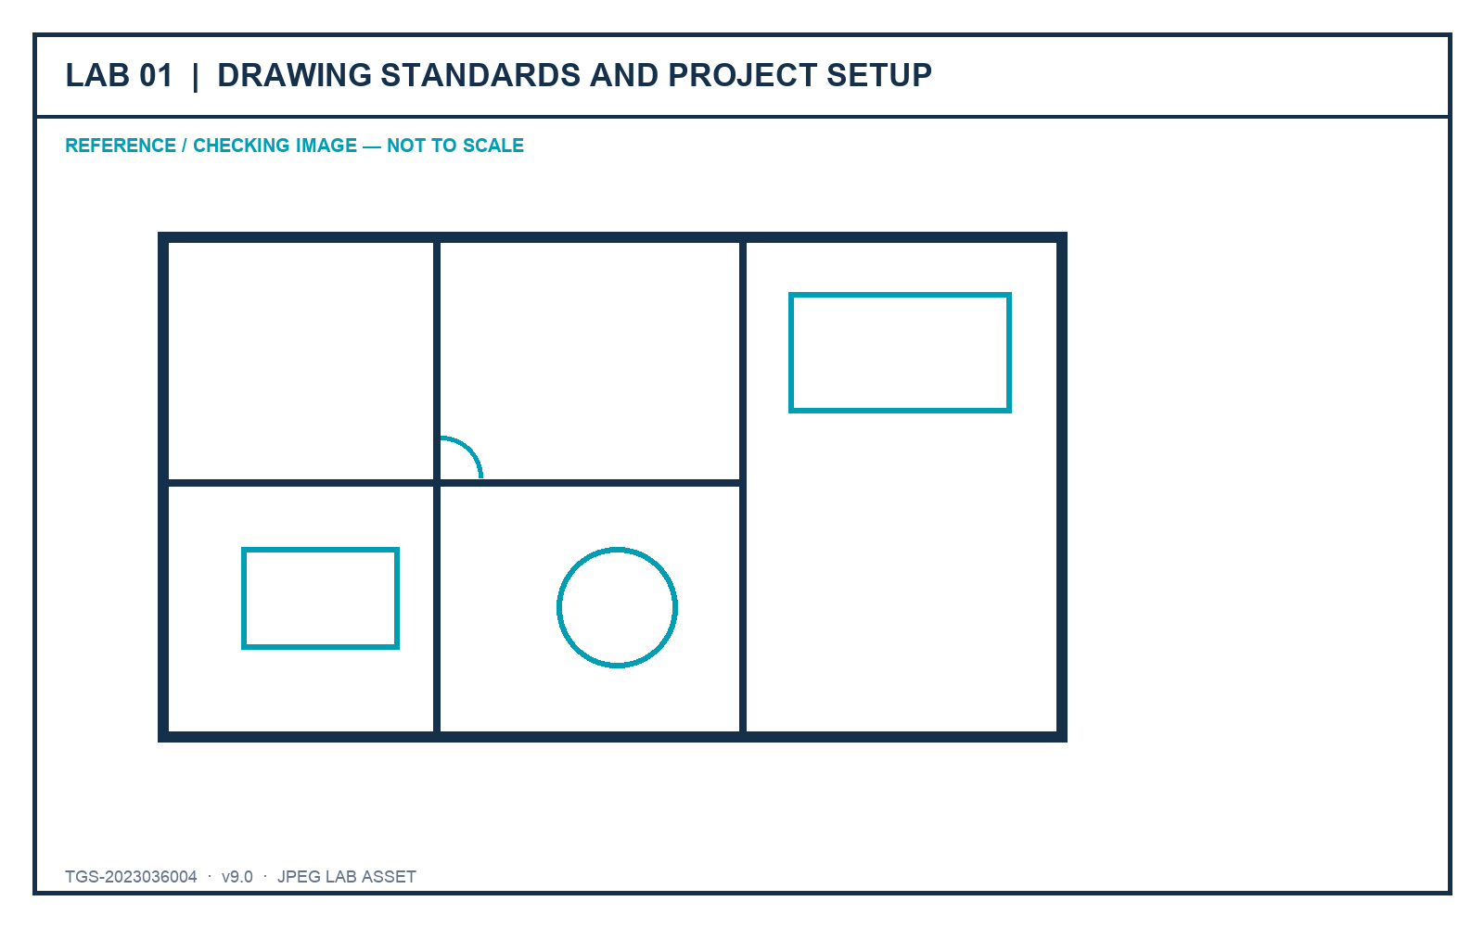
LO1 · K1 · A1
Lab 01 — Drawing Standards and Project Setup
DECISIONS TO PROVE
• Declare units, origin and standards before editing.
• Use measurable checks instead of visual guesswork.
• Submit setup and drawing-health evidence.
Outcome: A standards-ready furniture plan with a completed drawing-standard record and verified setup evidence.
JPEG brief supplied in the individual lab folder
Autodesk-ACP-AutoCAD-Design-and-Drafting · TGS-2023036004
© 2026 Tertiary Infotech Academy Pte Ltd
99

Slide 101
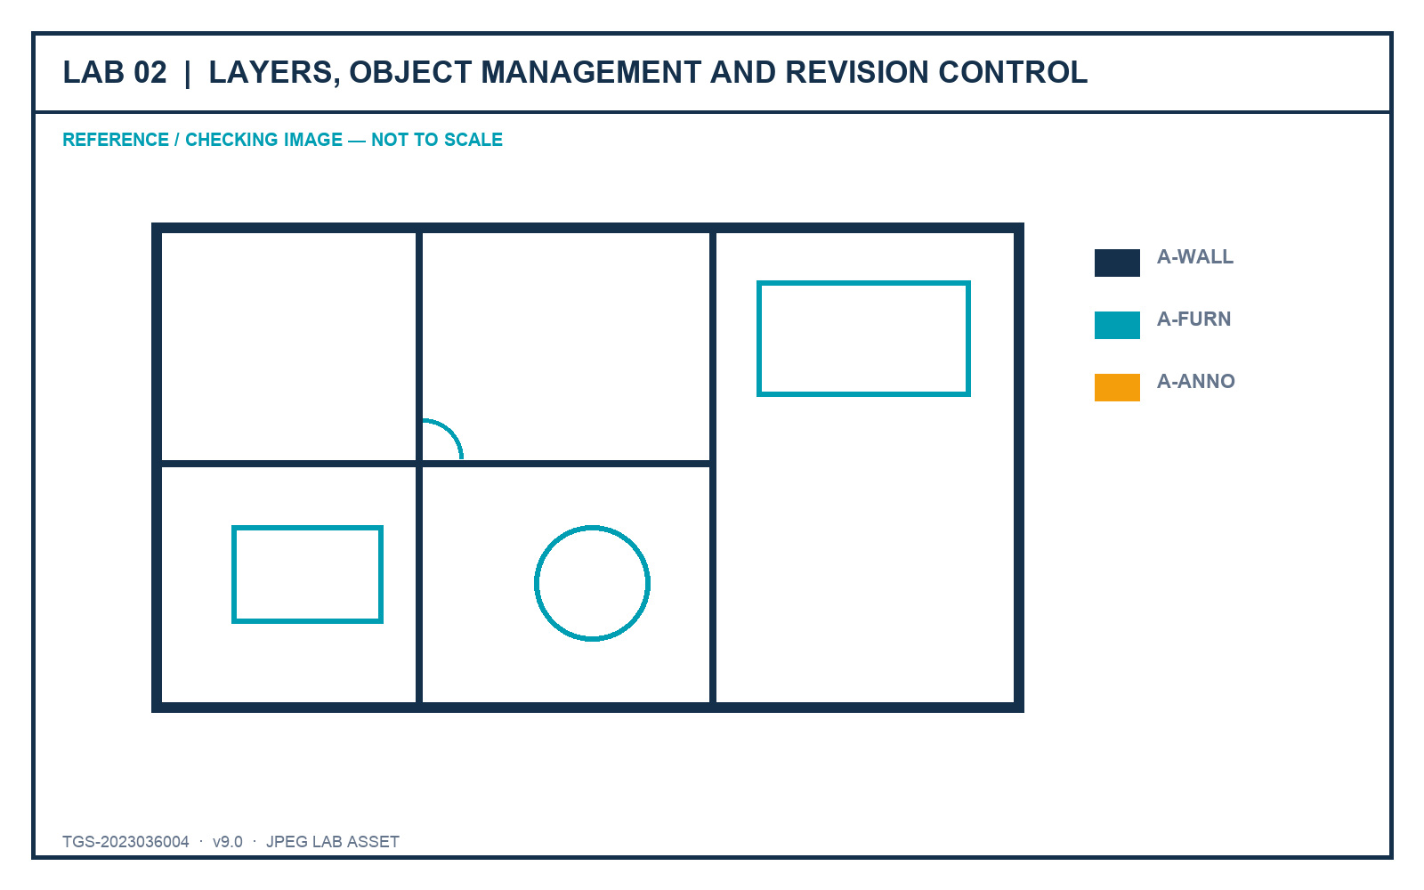
LO2 · K2 · A2
Lab 02 — Layers, Object Management and Revision Control
DECISIONS TO PROVE
• Organise complexity with filters and layer states.
• Use overrides without damaging global standards.
• Record controlled revision evidence.
Outcome: A revised furniture plan with reusable layer states, filters and a change log.
JPEG brief supplied in the individual lab folder
Autodesk-ACP-AutoCAD-Design-and-Drafting · TGS-2023036004
© 2026 Tertiary Infotech Academy Pte Ltd
100

Slide 102
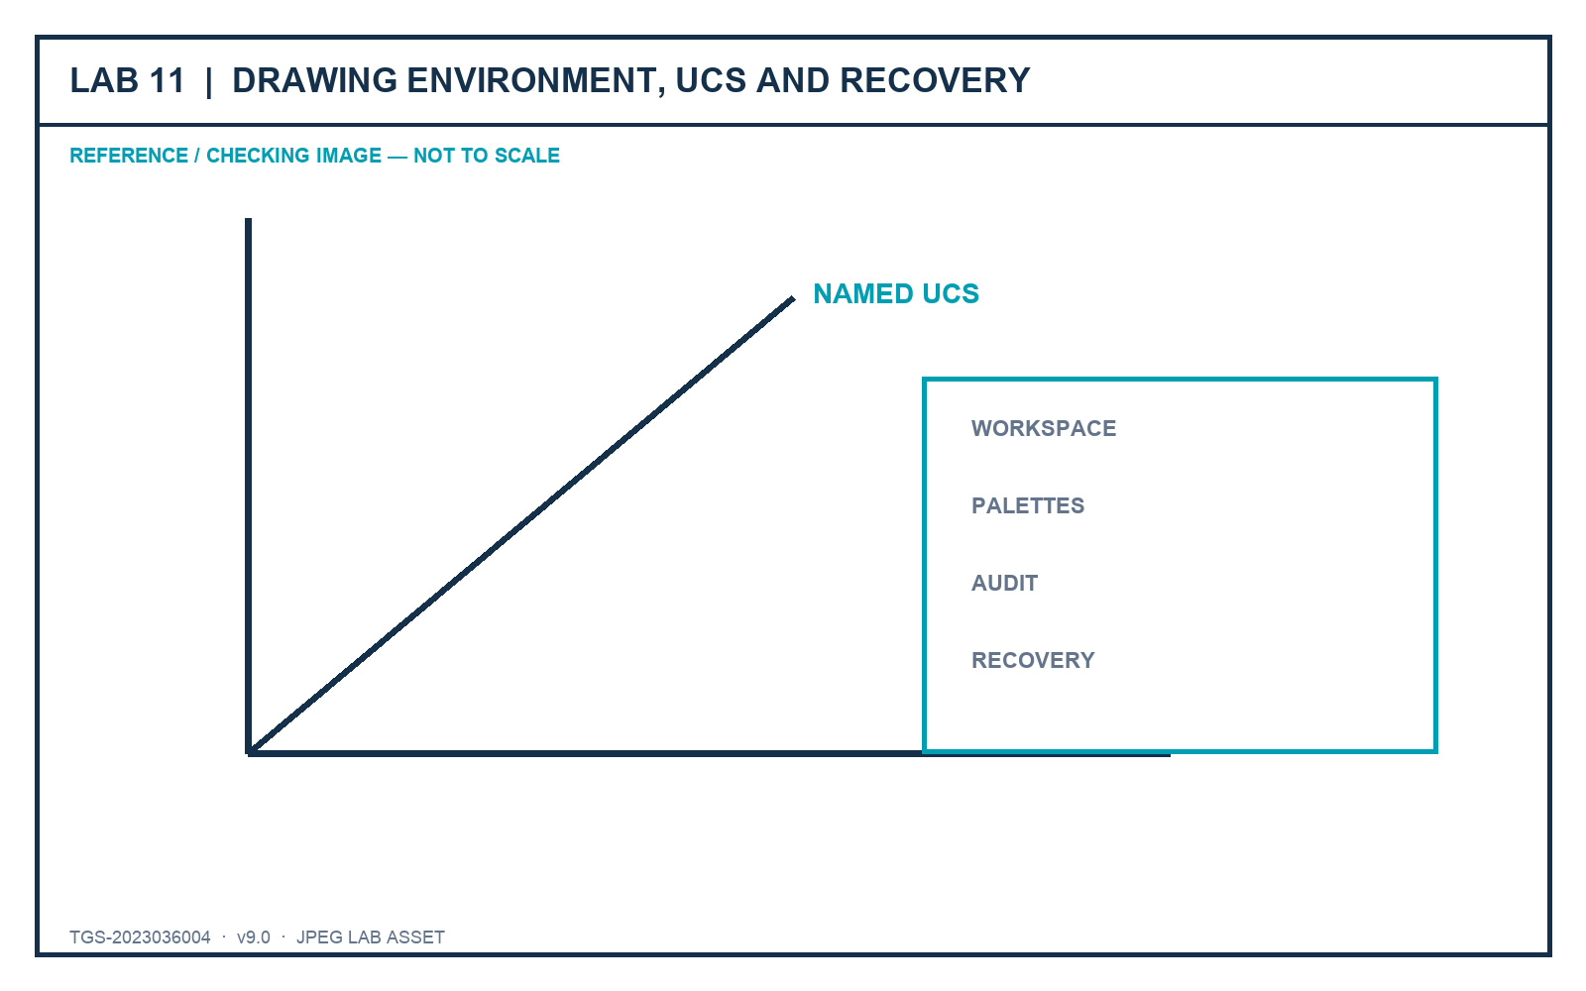
LO1–LO2 · Exam 1.2, 1.4, 1.5 · K1–K2 · A1–A2
Lab 11 — Drawing Environment, UCS and Recovery
DECISIONS TO PROVE
• Configure a repeatable professional workspace.
• Restore named coordinate systems deliberately.
• Recover and audit without overwriting approved work.
Outcome: A documented AutoCAD workspace and UCS set plus a recovered, audited and versioned drawing.
JPEG brief supplied in the individual lab folder
Autodesk-ACP-AutoCAD-Design-and-Drafting · TGS-2023036004
© 2026 Tertiary Infotech Academy Pte Ltd
101

Slide 103
02
DOMAIN 02
Design Annotation and Detailing
Text · dimensions · hatches · multileaders · tables · annotative scale
Autodesk-ACP-AutoCAD-Design-and-Drafting · TGS-2023036004
© 2026 Tertiary Infotech Academy Pte Ltd
102

Slide 104
DECEMBER 2025 AUTODESK ACP ALIGNMENT
Domain 2 Coverage Dashboard
Objective groups
3 groups in the official content outline.
Leaf objectives
8 individually traceable exam objectives.
1
2
Teaching model
Intent → decision controls → applied scenario → quality review.
Evidence model
Visible state, measured result, controlled output and explained decision.
3
4
Autodesk-ACP-AutoCAD-Design-and-Drafting · TGS-2023036004
© 2026 Tertiary Infotech Academy Pte Ltd
103

Slide 105
FROM SOFTWARE FEATURE TO PROFESSIONAL PRACTICE
Professional Judgement Lens — Design Annotation and Detailing
Decision
Evidence
• Start with the production or stakeholder decision.
• Choose the least destructive control that preserves ownership.
• Keep model, sheet, reference and data responsibilities distinct.
• Verify in the final output context.
• Retain evidence that another reviewer can reproduce.
• Explain why the alternative controls were not selected.
Autodesk-ACP-AutoCAD-Design-and-Drafting · TGS-2023036004
© 2026 Tertiary Infotech Academy Pte Ltd
104

Slide 106
OFFICIAL OBJECTIVE GROUP
2.1 — Create and apply annotation styles
2.1.a
Create, manage and apply annotation styles
2.1.b
Create, manage and apply table styles
1
2
Autodesk-ACP-AutoCAD-Design-and-Drafting · TGS-2023036004
© 2026 Tertiary Infotech Academy Pte Ltd
105

Slide 107
AUTODESK EXAM OBJECTIVE · DOMAIN 2
2.1.a — Create, manage and apply annotation styles
What competent practice means
How competence is demonstrated
• Exam intent: Create, manage and apply annotation styles.
• Professional context: A multi-sheet set contains mixed fonts, arrowheads and leader landings.
• The objective tests selection and interpretation of the right control, not memorised interface sequences.
• Tools and controls: STYLE · DIMSTYLE · MLEADERSTYLE.
• Evidence of control: Named styles produce a consistent hierarchy and update dependent annotations predictably.
• Primary risk: Local overrides make standards drift invisible and expensive to correct.
Autodesk-ACP-AutoCAD-Design-and-Drafting · TGS-2023036004
© 2026 Tertiary Infotech Academy Pte Ltd
106

Slide 108
2.1.a · PROFESSIONAL JUDGEMENT
Decision Controls — Create, manage and apply annotation styles
Control 1
Separate text, dimension and multileader governance
Control 2
Use meaningful style names and documented sizes
1
2
Control 3
Prefer style changes over object overrides
Control 4
Validate appearance at intended plotted scales
3
4
Autodesk-ACP-AutoCAD-Design-and-Drafting · TGS-2023036004
© 2026 Tertiary Infotech Academy Pte Ltd
107

Slide 109
2.1.a · FROM BRIEF TO EVIDENCE
Applied Scenario — Create, manage and apply annotation styles
Situation and decision
Verification and risk
• A multi-sheet set contains mixed fonts, arrowheads and leader landings.
• Decision lens: Separate text, dimension and multileader governance
• Control boundary: Use meaningful style names and documented sizes
• Expected evidence: Named styles produce a consistent hierarchy and update dependent annotations predictably.
• Failure mode: Local overrides make standards drift invisible and expensive to correct.
• Review the result in the final drawing context, not only in the authoring view.
Autodesk-ACP-AutoCAD-Design-and-Drafting · TGS-2023036004
© 2026 Tertiary Infotech Academy Pte Ltd
108

Slide 110
2.1.a · ACCEPTANCE CRITERIA
Quality Review — Create, manage and apply annotation styles
Scope
Confirm the drawing, layout, reference or data scope governed by 2.1.a.
Control
Prefer style changes over object overrides
1
2
Consistency
Validate appearance at intended plotted scales
Tool evidence
Use STYLE · DIMSTYLE · MLEADERSTYLE as observable controls, then inspect the resulting state.
3
4
Acceptance
Named styles produce a consistent hierarchy and update dependent annotations predictably.
Risk check
Local overrides make standards drift invisible and expensive to correct.
5
6
Autodesk-ACP-AutoCAD-Design-and-Drafting · TGS-2023036004
© 2026 Tertiary Infotech Academy Pte Ltd
109

Slide 111
AUTODESK EXAM OBJECTIVE · DOMAIN 2
2.1.b — Create, manage and apply table styles
What competent practice means
How competence is demonstrated
• Exam intent: Create, manage and apply table styles.
• Professional context: A component schedule must remain readable after rows are added and data refreshed.
• The objective tests selection and interpretation of the right control, not memorised interface sequences.
• Tools and controls: TABLESTYLE · cell styles · borders.
• Evidence of control: The style preserves hierarchy, alignment and borders across the whole table.
• Primary risk: Manual cell formatting creates inconsistent updates and broken reading order.
Autodesk-ACP-AutoCAD-Design-and-Drafting · TGS-2023036004
© 2026 Tertiary Infotech Academy Pte Ltd
110

Slide 112
2.1.b · PROFESSIONAL JUDGEMENT
Decision Controls — Create, manage and apply table styles
Control 1
Define title, header and data cell roles
Control 2
Control text, fill, alignment and borders by role
1
2
Control 3
Choose table direction for the sheet reading order
Control 4
Keep numeric precision aligned with source data
3
4
Autodesk-ACP-AutoCAD-Design-and-Drafting · TGS-2023036004
© 2026 Tertiary Infotech Academy Pte Ltd
111

Slide 113
2.1.b · FROM BRIEF TO EVIDENCE
Applied Scenario — Create, manage and apply table styles
Situation and decision
Verification and risk
• A component schedule must remain readable after rows are added and data refreshed.
• Decision lens: Define title, header and data cell roles
• Control boundary: Control text, fill, alignment and borders by role
• Expected evidence: The style preserves hierarchy, alignment and borders across the whole table.
• Failure mode: Manual cell formatting creates inconsistent updates and broken reading order.
• Review the result in the final drawing context, not only in the authoring view.
Autodesk-ACP-AutoCAD-Design-and-Drafting · TGS-2023036004
© 2026 Tertiary Infotech Academy Pte Ltd
112

Slide 114
2.1.b · ACCEPTANCE CRITERIA
Quality Review — Create, manage and apply table styles
Scope
Confirm the drawing, layout, reference or data scope governed by 2.1.b.
Control
Choose table direction for the sheet reading order
1
2
Consistency
Keep numeric precision aligned with source data
Tool evidence
Use TABLESTYLE · cell styles · borders as observable controls, then inspect the resulting state.
3
4
Acceptance
The style preserves hierarchy, alignment and borders across the whole table.
Risk check
Manual cell formatting creates inconsistent updates and broken reading order.
5
6
Autodesk-ACP-AutoCAD-Design-and-Drafting · TGS-2023036004
© 2026 Tertiary Infotech Academy Pte Ltd
113

Slide 115
OFFICIAL OBJECTIVE GROUP
2.2 — Apply annotative scaling to design content
2.2.a
Create and manage drawing scales
2.2.b
Manage scales assigned to annotative objects
1
2
2.2.c
Manage scale positions of annotative objects
2.2.d
Display annotative objects correctly in viewports
3
4
Autodesk-ACP-AutoCAD-Design-and-Drafting · TGS-2023036004
© 2026 Tertiary Infotech Academy Pte Ltd
114

Slide 116
AUTODESK EXAM OBJECTIVE · DOMAIN 2
2.2.a — Create and manage drawing scales
What competent practice means
How competence is demonstrated
• Exam intent: Create and manage drawing scales.
• Professional context: A drawing accumulated hundreds of scales from external references.
• The objective tests selection and interpretation of the right control, not memorised interface sequences.
• Tools and controls: SCALELISTEDIT · annotation scale list.
• Evidence of control: The cleaned list retains required metric or imperial ratios and supports current viewports.
• Primary risk: Deleting an active scale or mixing unit conventions breaks annotation display.
Autodesk-ACP-AutoCAD-Design-and-Drafting · TGS-2023036004
© 2026 Tertiary Infotech Academy Pte Ltd
115

Slide 117
2.2.a · PROFESSIONAL JUDGEMENT
Decision Controls — Create and manage drawing scales
Control 1
Keep scales appropriate to project units
Control 2
Remove duplicate or imported xref scales
1
2
Control 3
Separate object scale from viewport scale
Control 4
Name custom scales so their ratio is unambiguous
3
4
Autodesk-ACP-AutoCAD-Design-and-Drafting · TGS-2023036004
© 2026 Tertiary Infotech Academy Pte Ltd
116

Slide 118
2.2.a · FROM BRIEF TO EVIDENCE
Applied Scenario — Create and manage drawing scales
Situation and decision
Verification and risk
• A drawing accumulated hundreds of scales from external references.
• Decision lens: Keep scales appropriate to project units
• Control boundary: Remove duplicate or imported xref scales
• Expected evidence: The cleaned list retains required metric or imperial ratios and supports current viewports.
• Failure mode: Deleting an active scale or mixing unit conventions breaks annotation display.
• Review the result in the final drawing context, not only in the authoring view.
Autodesk-ACP-AutoCAD-Design-and-Drafting · TGS-2023036004
© 2026 Tertiary Infotech Academy Pte Ltd
117

Slide 119
2.2.a · ACCEPTANCE CRITERIA
Quality Review — Create and manage drawing scales
Scope
Confirm the drawing, layout, reference or data scope governed by 2.2.a.
Control
Separate object scale from viewport scale
1
2
Consistency
Name custom scales so their ratio is unambiguous
Tool evidence
Use SCALELISTEDIT · annotation scale list as observable controls, then inspect the resulting state.
3
4
Acceptance
The cleaned list retains required metric or imperial ratios and supports current viewports.
Risk check
Deleting an active scale or mixing unit conventions breaks annotation display.
5
6
Autodesk-ACP-AutoCAD-Design-and-Drafting · TGS-2023036004
© 2026 Tertiary Infotech Academy Pte Ltd
118

Slide 120
AUTODESK EXAM OBJECTIVE · DOMAIN 2
2.2.b — Manage scales assigned to annotative objects
What competent practice means
How competence is demonstrated
• Exam intent: Manage scales assigned to annotative objects.
• Professional context: A note must appear in 1:50 and 1:100 plans but not the 1:20 detail.
• The objective tests selection and interpretation of the right control, not memorised interface sequences.
• Tools and controls: OBJECTSCALE · annotative property.
• Evidence of control: The object displays only in intended viewports at a consistent paper height.
• Primary risk: Indiscriminate scale assignment clutters sheets and multiplies positions.
Autodesk-ACP-AutoCAD-Design-and-Drafting · TGS-2023036004
© 2026 Tertiary Infotech Academy Pte Ltd
119

Slide 121
2.2.b · PROFESSIONAL JUDGEMENT
Decision Controls — Manage scales assigned to annotative objects
Control 1
Assign only the scales at which the object should appear
Control 2
Remove obsolete scales deliberately
1
2
Control 3
Review hatch, text, leaders and multileaders together
Control 4
Avoid using extra scales to compensate for poor placement
3
4
Autodesk-ACP-AutoCAD-Design-and-Drafting · TGS-2023036004
© 2026 Tertiary Infotech Academy Pte Ltd
120

Slide 122
2.2.b · FROM BRIEF TO EVIDENCE
Applied Scenario — Manage scales assigned to annotative objects
Situation and decision
Verification and risk
• A note must appear in 1:50 and 1:100 plans but not the 1:20 detail.
• Decision lens: Assign only the scales at which the object should appear
• Control boundary: Remove obsolete scales deliberately
• Expected evidence: The object displays only in intended viewports at a consistent paper height.
• Failure mode: Indiscriminate scale assignment clutters sheets and multiplies positions.
• Review the result in the final drawing context, not only in the authoring view.
Autodesk-ACP-AutoCAD-Design-and-Drafting · TGS-2023036004
© 2026 Tertiary Infotech Academy Pte Ltd
121

Slide 123
2.2.b · ACCEPTANCE CRITERIA
Quality Review — Manage scales assigned to annotative objects
Scope
Confirm the drawing, layout, reference or data scope governed by 2.2.b.
Control
Review hatch, text, leaders and multileaders together
1
2
Consistency
Avoid using extra scales to compensate for poor placement
Tool evidence
Use OBJECTSCALE · annotative property as observable controls, then inspect the resulting state.
3
4
Acceptance
The object displays only in intended viewports at a consistent paper height.
Risk check
Indiscriminate scale assignment clutters sheets and multiplies positions.
5
6
Autodesk-ACP-AutoCAD-Design-and-Drafting · TGS-2023036004
© 2026 Tertiary Infotech Academy Pte Ltd
122

Slide 124
AUTODESK EXAM OBJECTIVE · DOMAIN 2
2.2.c — Manage scale positions of annotative objects
What competent practice means
How competence is demonstrated
• Exam intent: Manage scale positions of annotative objects.
• Professional context: A multileader clears geometry at 1:50 but collides with a wall at 1:100.
• The objective tests selection and interpretation of the right control, not memorised interface sequences.
• Tools and controls: ANNORESET · ANNOMONITOR · grip positions.
• Evidence of control: Each scale position is intentional, readable and traceable to the same annotation content.
• Primary risk: Moving one representation without checking others leaves hidden sheet defects.
Autodesk-ACP-AutoCAD-Design-and-Drafting · TGS-2023036004
© 2026 Tertiary Infotech Academy Pte Ltd
123

Slide 125
2.2.c · PROFESSIONAL JUDGEMENT
Decision Controls — Manage scale positions of annotative objects
Control 1
Treat each scale position as a controlled presentation
Control 2
Synchronize positions when one approved location should govern
1
2
Control 3
Use separate positions only to prevent collisions
Control 4
Review all supported scales before sign-off
3
4
Autodesk-ACP-AutoCAD-Design-and-Drafting · TGS-2023036004
© 2026 Tertiary Infotech Academy Pte Ltd
124

Slide 126
2.2.c · FROM BRIEF TO EVIDENCE
Applied Scenario — Manage scale positions of annotative objects
Situation and decision
Verification and risk
• A multileader clears geometry at 1:50 but collides with a wall at 1:100.
• Decision lens: Treat each scale position as a controlled presentation
• Control boundary: Synchronize positions when one approved location should govern
• Expected evidence: Each scale position is intentional, readable and traceable to the same annotation content.
• Failure mode: Moving one representation without checking others leaves hidden sheet defects.
• Review the result in the final drawing context, not only in the authoring view.
Autodesk-ACP-AutoCAD-Design-and-Drafting · TGS-2023036004
© 2026 Tertiary Infotech Academy Pte Ltd
125

Slide 127
2.2.c · ACCEPTANCE CRITERIA
Quality Review — Manage scale positions of annotative objects
Scope
Confirm the drawing, layout, reference or data scope governed by 2.2.c.
Control
Use separate positions only to prevent collisions
1
2
Consistency
Review all supported scales before sign-off
Tool evidence
Use ANNORESET · ANNOMONITOR · grip positions as observable controls, then inspect the resulting state.
3
4
Acceptance
Each scale position is intentional, readable and traceable to the same annotation content.
Risk check
Moving one representation without checking others leaves hidden sheet defects.
5
6
Autodesk-ACP-AutoCAD-Design-and-Drafting · TGS-2023036004
© 2026 Tertiary Infotech Academy Pte Ltd
126

Slide 128
AUTODESK EXAM OBJECTIVE · DOMAIN 2
2.2.d — Display annotative objects correctly in viewports
What competent practice means
How competence is demonstrated
• Exam intent: Display annotative objects correctly in viewports.
• Professional context: Annotations visible in model space disappear from one plotted viewport.
• The objective tests selection and interpretation of the right control, not memorised interface sequences.
• Tools and controls: ANNOALLVISIBLE · viewport annotation scale · annotative objects.
• Evidence of control: The viewport shows the intended objects at consistent paper sizes without diagnostic overrides.
• Primary risk: Leaving all-visible enabled masks missing scale assignments.
Autodesk-ACP-AutoCAD-Design-and-Drafting · TGS-2023036004
© 2026 Tertiary Infotech Academy Pte Ltd
127

Slide 129
2.2.d · PROFESSIONAL JUDGEMENT
Decision Controls — Display annotative objects correctly in viewports
Control 1
Match viewport scale to the intended annotation representation
Control 2
Use all-visible only as a diagnostic
1
2
Control 3
Review blocks, hatches, text, leaders and dimensions
Control 4
Lock approved viewports after validation
3
4
Autodesk-ACP-AutoCAD-Design-and-Drafting · TGS-2023036004
© 2026 Tertiary Infotech Academy Pte Ltd
128

Slide 130
2.2.d · FROM BRIEF TO EVIDENCE
Applied Scenario — Display annotative objects correctly in viewports
Situation and decision
Verification and risk
• Annotations visible in model space disappear from one plotted viewport.
• Decision lens: Match viewport scale to the intended annotation representation
• Control boundary: Use all-visible only as a diagnostic
• Expected evidence: The viewport shows the intended objects at consistent paper sizes without diagnostic overrides.
• Failure mode: Leaving all-visible enabled masks missing scale assignments.
• Review the result in the final drawing context, not only in the authoring view.
Autodesk-ACP-AutoCAD-Design-and-Drafting · TGS-2023036004
© 2026 Tertiary Infotech Academy Pte Ltd
129

Slide 131
2.2.d · ACCEPTANCE CRITERIA
Quality Review — Display annotative objects correctly in viewports
Scope
Confirm the drawing, layout, reference or data scope governed by 2.2.d.
Control
Review blocks, hatches, text, leaders and dimensions
1
2
Consistency
Lock approved viewports after validation
Tool evidence
Use ANNOALLVISIBLE · viewport annotation scale · annotative objects as observable controls, then inspect the resulting state.
3
4
Acceptance
The viewport shows the intended objects at consistent paper sizes without diagnostic overrides.
Risk check
Leaving all-visible enabled masks missing scale assignments.
5
6
Autodesk-ACP-AutoCAD-Design-and-Drafting · TGS-2023036004
© 2026 Tertiary Infotech Academy Pte Ltd
130

Slide 132
OFFICIAL OBJECTIVE GROUP
2.3 — Add annotations to designs
2.3.a
Create and modify text, multileaders and dimensions
2.3.b
Create and modify tables
1
2
Autodesk-ACP-AutoCAD-Design-and-Drafting · TGS-2023036004
© 2026 Tertiary Infotech Academy Pte Ltd
131

Slide 133
AUTODESK EXAM OBJECTIVE · DOMAIN 2
2.3.a — Create and modify text, multileaders and dimensions
What competent practice means
How competence is demonstrated
• Exam intent: Create and modify text, multileaders and dimensions.
• Professional context: A fabrication detail needs dimensions, a finish note and a callout to a remote feature.
• The objective tests selection and interpretation of the right control, not memorised interface sequences.
• Tools and controls: MTEXT · MLEADER · DIM · grips.
• Evidence of control: Each annotation type carries the right meaning and remains associative and readable.
• Primary risk: Using text as a substitute for measured or linked annotation weakens revision reliability.
Autodesk-ACP-AutoCAD-Design-and-Drafting · TGS-2023036004
© 2026 Tertiary Infotech Academy Pte Ltd
132

Slide 134
2.3.a · PROFESSIONAL JUDGEMENT
Decision Controls — Create and modify text, multileaders and dimensions
Control 1
Choose the annotation type by communication purpose
Control 2
Anchor dimensions to real geometry
1
2
Control 3
Keep leader landing and reading order clear
Control 4
Edit content without breaking style governance
3
4
Autodesk-ACP-AutoCAD-Design-and-Drafting · TGS-2023036004
© 2026 Tertiary Infotech Academy Pte Ltd
133

Slide 135
2.3.a · FROM BRIEF TO EVIDENCE
Applied Scenario — Create and modify text, multileaders and dimensions
Situation and decision
Verification and risk
• A fabrication detail needs dimensions, a finish note and a callout to a remote feature.
• Decision lens: Choose the annotation type by communication purpose
• Control boundary: Anchor dimensions to real geometry
• Expected evidence: Each annotation type carries the right meaning and remains associative and readable.
• Failure mode: Using text as a substitute for measured or linked annotation weakens revision reliability.
• Review the result in the final drawing context, not only in the authoring view.
Autodesk-ACP-AutoCAD-Design-and-Drafting · TGS-2023036004
© 2026 Tertiary Infotech Academy Pte Ltd
134

Slide 136
2.3.a · ACCEPTANCE CRITERIA
Quality Review — Create and modify text, multileaders and dimensions
Scope
Confirm the drawing, layout, reference or data scope governed by 2.3.a.
Control
Keep leader landing and reading order clear
1
2
Consistency
Edit content without breaking style governance
Tool evidence
Use MTEXT · MLEADER · DIM · grips as observable controls, then inspect the resulting state.
3
4
Acceptance
Each annotation type carries the right meaning and remains associative and readable.
Risk check
Using text as a substitute for measured or linked annotation weakens revision reliability.
5
6
Autodesk-ACP-AutoCAD-Design-and-Drafting · TGS-2023036004
© 2026 Tertiary Infotech Academy Pte Ltd
135

Slide 137
AUTODESK EXAM OBJECTIVE · DOMAIN 2
2.3.b — Create and modify tables
What competent practice means
How competence is demonstrated
• Exam intent: Create and modify tables.
• Professional context: A room schedule combines controlled headings with values maintained in a spreadsheet.
• The objective tests selection and interpretation of the right control, not memorised interface sequences.
• Tools and controls: TABLE · data extraction · data links.
• Evidence of control: The table communicates source ownership and refreshes without losing formatting.
• Primary risk: Copy-pasted values become stale while still looking authoritative.
Autodesk-ACP-AutoCAD-Design-and-Drafting · TGS-2023036004
© 2026 Tertiary Infotech Academy Pte Ltd
136

Slide 138
2.3.b · PROFESSIONAL JUDGEMENT
Decision Controls — Create and modify tables
Control 1
Choose manual, extracted or linked data by ownership
Control 2
Use row and column structure that supports review
1
2
Control 3
Preserve style while inserting or deleting cells
Control 4
Refresh linked content before issue
3
4
Autodesk-ACP-AutoCAD-Design-and-Drafting · TGS-2023036004
© 2026 Tertiary Infotech Academy Pte Ltd
137

Slide 139
2.3.b · FROM BRIEF TO EVIDENCE
Applied Scenario — Create and modify tables
Situation and decision
Verification and risk
• A room schedule combines controlled headings with values maintained in a spreadsheet.
• Decision lens: Choose manual, extracted or linked data by ownership
• Control boundary: Use row and column structure that supports review
• Expected evidence: The table communicates source ownership and refreshes without losing formatting.
• Failure mode: Copy-pasted values become stale while still looking authoritative.
• Review the result in the final drawing context, not only in the authoring view.
Autodesk-ACP-AutoCAD-Design-and-Drafting · TGS-2023036004
© 2026 Tertiary Infotech Academy Pte Ltd
138

Slide 140
2.3.b · ACCEPTANCE CRITERIA
Quality Review — Create and modify tables
Scope
Confirm the drawing, layout, reference or data scope governed by 2.3.b.
Control
Preserve style while inserting or deleting cells
1
2
Consistency
Refresh linked content before issue
Tool evidence
Use TABLE · data extraction · data links as observable controls, then inspect the resulting state.
3
4
Acceptance
The table communicates source ownership and refreshes without losing formatting.
Risk check
Copy-pasted values become stale while still looking authoritative.
5
6
Autodesk-ACP-AutoCAD-Design-and-Drafting · TGS-2023036004
© 2026 Tertiary Infotech Academy Pte Ltd
139

Slide 141
TECHNICAL DRAWING FOUNDATION · ANNOTATION
Text and Text Styles
Core concept
Professional application
• Multiline text (MTEXT) fills a bounding box; single-line text (TEXT) is quick labels.
• A text style names a collection of settings: font, height, spacing, justification.
• Create styles once (STYLE) and every note updates when the style changes.
• Annotative styles size text automatically to the viewport scale.
Autodesk-ACP-AutoCAD-Design-and-Drafting · TGS-2023036004
© 2026 Tertiary Infotech Academy Pte Ltd
140

Slide 142
TECHNICAL DRAWING FOUNDATION · ANNOTATION
Dimensions — The Basic Types
Core concept
Professional application
• Linear and aligned dimensions measure edges; angular measures between lines.
• Radial and diameter dimensions measure arcs and circles, with centre marks.
• Arc-length and ordinate dimensions cover curved lengths and datum offsets.
• Continue chains dimensions end-to-end; Baseline stacks them from one datum.
Autodesk-ACP-AutoCAD-Design-and-Drafting · TGS-2023036004
© 2026 Tertiary Infotech Academy Pte Ltd
141

Slide 143
TECHNICAL DRAWING FOUNDATION · ANNOTATION
Dimension Styles
What a style controls
Arrowheads, extension lines, text placement, units and tolerances — consistently.
Create
DIMSTYLE → New: name it, set fit, text height and precision for your standard.
1
2
Apply
Set the style current before dimensioning; existing dimensions can be updated.
House rule
Never override individual dimension text — fix the style instead.
3
4
Autodesk-ACP-AutoCAD-Design-and-Drafting · TGS-2023036004
© 2026 Tertiary Infotech Academy Pte Ltd
142

Slide 144
TECHNICAL DRAWING FOUNDATION · ANNOTATION
Multileaders and Revision Clouds
Core concept
Professional application
• A multileader is an arrowhead, landing line and note text (or block) in one object.
• MLEADER places it; add/remove leader lines and align multiple leaders neatly.
• Revision clouds flag changed areas for checking and approval.
• Draw a cloud by dragging, corner points — or convert an existing closed object.
Autodesk-ACP-AutoCAD-Design-and-Drafting · TGS-2023036004
© 2026 Tertiary Infotech Academy Pte Ltd
143

Slide 145
TECHNICAL DRAWING FOUNDATION · PART LISTS
Tables and Part Lists
Core concept
Professional application
• TABLE creates a compound object of rows and columns from a table style.
• Type into cells like a spreadsheet; formulas and fields are supported.
• DATAEXTRACTION fills a table from block attributes — the bill of materials.
• Tables can link to external Excel data and update both ways.
Autodesk-ACP-AutoCAD-Design-and-Drafting · TGS-2023036004
© 2026 Tertiary Infotech Academy Pte Ltd
144

Slide 146
TECHNICAL DRAWING FOUNDATION · DETAIL
Hatching and Gradients
Core concept
Professional application
• HATCH fills enclosed areas with patterns (ANSI31 for sections), solids or gradients.
• Pick an internal point — island detection keeps text and holes clear.
• Scale and angle make adjacent parts read distinctly in section views.
• HATCHEDIT changes an existing hatch; hatches stay associative to their boundary.
Autodesk-ACP-AutoCAD-Design-and-Drafting · TGS-2023036004
© 2026 Tertiary Infotech Academy Pte Ltd
145

Slide 147
DESIGN COMMUNICATION
Annotation is the voice of the drawing.
A good sheet controls what the stakeholder notices, understands and decides next.
Autodesk-ACP-AutoCAD-Design-and-Drafting · TGS-2023036004
© 2026 Tertiary Infotech Academy Pte Ltd
146

Slide 148
DRAWING AS STORY
Stakeholder Reading Order
1
2
3
4
5
▶
▶
▶
▶
Orient with title and key view
Read primary dimensions
Follow callouts to decisions
Check schedules and notes
Confirm revision and approval
Autodesk-ACP-AutoCAD-Design-and-Drafting · TGS-2023036004
© 2026 Tertiary Infotech Academy Pte Ltd
147

Slide 149
REUSABLE STANDARDS
The Annotation Style System
Text style
Font, height policy, width and readability.
Dimension style
Units, precision, symbols and placement.
1
2
Multileader style
Arrow, landing and content hierarchy.
Table style
Title, header, data rows and borders.
3
4
Hatch settings
Pattern, scale, angle and origin.
Annotative properties
One object, multiple paper-readable scales.
5
6
Autodesk-ACP-AutoCAD-Design-and-Drafting · TGS-2023036004
© 2026 Tertiary Infotech Academy Pte Ltd
148

Slide 150
MEASUREMENT WITH MEANING
Choose the Dimension by Intent
Linear / aligned
Horizontal, vertical or true-length distances.
Angular
The relationship between lines or features.
1
2
Radial / diameter
Circular geometry and manufacturing intent.
Ordinate
Coordinate-based production control.
3
4
Arc length
Measured curved distance.
Quick Dimension
Efficient chains that still require review.
5
6
Autodesk-ACP-AutoCAD-Design-and-Drafting · TGS-2023036004
© 2026 Tertiary Infotech Academy Pte Ltd
149

Slide 151
TRUSTWORTHY DETAILING
Associativity and Overrides
Keep data connected
Control exceptions
• Associative dimensions update with geometry.
• Reassociate after controlled geometry changes.
• Use fields when text should reflect a live property.
• Avoid typing over measured values.
• Treat exceptions as documented deviations.
• Check every override in plot preview.
Autodesk-ACP-AutoCAD-Design-and-Drafting · TGS-2023036004
© 2026 Tertiary Infotech Academy Pte Ltd
150

Slide 152
CHANGE COMMUNICATION
Hatches, Revision Clouds and Wipeouts
Hatch
Communicate material, section or scope — not decoration.
Origin
Align patterns so similar surfaces read consistently.
1
2
Revision cloud
Make the changed area visible and bounded.
Delta / note
State what changed and why it matters.
3
4
Wipeout
Improve local legibility without concealing required information.
Compare
Confirm added, removed and modified content.
5
6
Autodesk-ACP-AutoCAD-Design-and-Drafting · TGS-2023036004
© 2026 Tertiary Infotech Academy Pte Ltd
151

Slide 153
READABLE ON PAPER
Annotative Scale
How it works
Quality checks
• One text or symbol can support several intended viewport scales.
• The active annotation scale controls what you create and see.
• Add only scales required by the drawing set.
• Review in paper space at the target scale.
• Check viewport annotation visibility.
• Avoid duplicate manual copies with inconsistent text.
Autodesk-ACP-AutoCAD-Design-and-Drafting · TGS-2023036004
© 2026 Tertiary Infotech Academy Pte Ltd
152

Slide 154
FROM OBJECTS TO DECISIONS
Tables and Drawing Data
1
2
3
4
5
▶
▶
▶
▶
Define the information question
Create a table hierarchy
Link fields or attributes
Validate units and ownership
Update and publish
Autodesk-ACP-AutoCAD-Design-and-Drafting · TGS-2023036004
© 2026 Tertiary Infotech Academy Pte Ltd
153

Slide 155
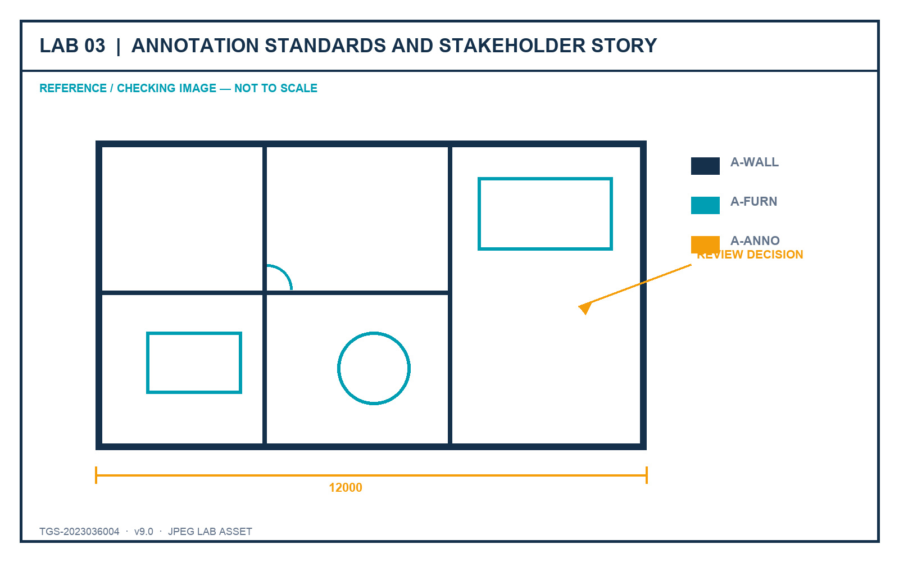
LO3 · K3 · A3
Lab 03 — Annotation Standards and Stakeholder Story
DECISIONS TO PROVE
• Create reusable annotation styles.
• Lead the stakeholder through a deliberate reading order.
• Make one revision visible and reviewable.
Outcome: An annotated plan with text, dimensions, multileaders, hatches and revision communication governed by named styles.
JPEG brief supplied in the individual lab folder
Autodesk-ACP-AutoCAD-Design-and-Drafting · TGS-2023036004
© 2026 Tertiary Infotech Academy Pte Ltd
154

Slide 156
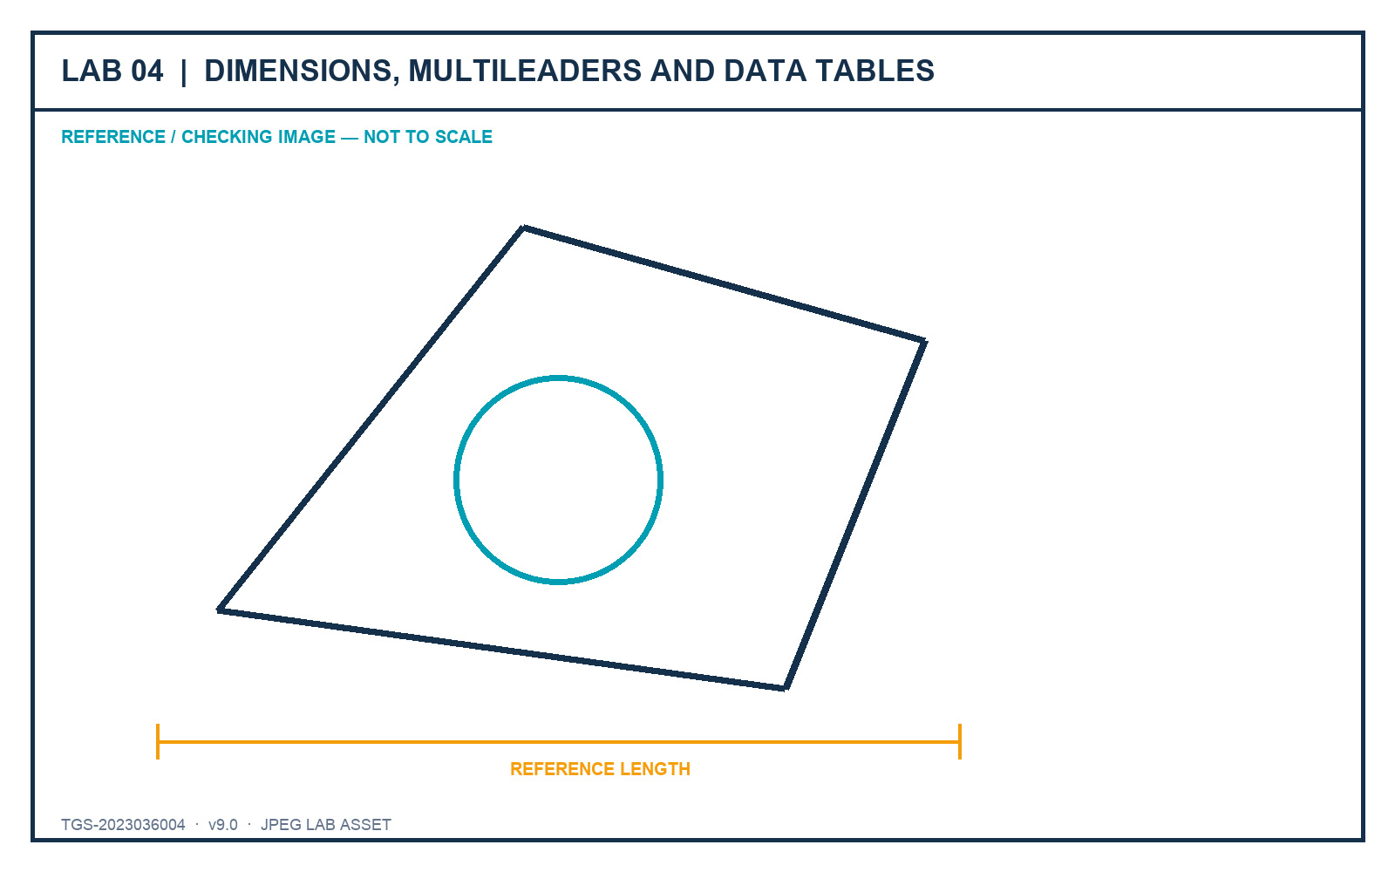
LO3 · K3 · A3
Lab 04 — Dimensions, Multileaders and Data Tables
DECISIONS TO PROVE
• Use fit-for-purpose dimension types.
• Coordinate leaders and component schedules.
• Prove readability in plot preview.
Outcome: A review sheet with validated dimensions, labels and a structured furniture/component table.
JPEG brief supplied in the individual lab folder
Autodesk-ACP-AutoCAD-Design-and-Drafting · TGS-2023036004
© 2026 Tertiary Infotech Academy Pte Ltd
155

Slide 157
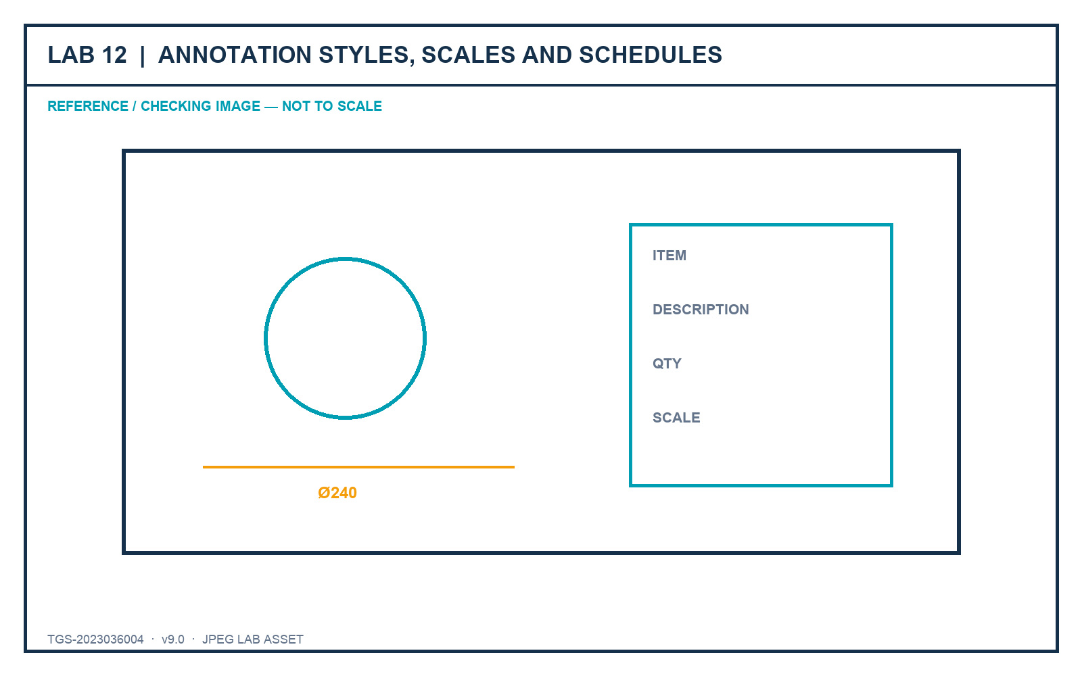
LO3 · Exam 2.1–2.3 · K3 · A3
Lab 12 — Annotation Styles, Scales and Schedules
DECISIONS TO PROVE
• Govern text, dimension, leader and table styles together.
• Control annotative positions at three target scales.
• Verify the final schedule in paper space.
Outcome: A dimensioned and annotated component sheet with named styles, scale-aware objects and a controlled schedule.
JPEG brief supplied in the individual lab folder
Autodesk-ACP-AutoCAD-Design-and-Drafting · TGS-2023036004
© 2026 Tertiary Infotech Academy Pte Ltd
156

Slide 158
03
DOMAIN 03
Author and Edit Drawing Content
Advanced geometry · precision editing · blocks · attributes · reuse
Autodesk-ACP-AutoCAD-Design-and-Drafting · TGS-2023036004
© 2026 Tertiary Infotech Academy Pte Ltd
157

Slide 159
DECEMBER 2025 AUTODESK ACP ALIGNMENT
Domain 3 Coverage Dashboard
Objective groups
4 groups in the official content outline.
Leaf objectives
15 individually traceable exam objectives.
1
2
Teaching model
Intent → decision controls → applied scenario → quality review.
Evidence model
Visible state, measured result, controlled output and explained decision.
3
4
Autodesk-ACP-AutoCAD-Design-and-Drafting · TGS-2023036004
© 2026 Tertiary Infotech Academy Pte Ltd
158

Slide 160
FROM SOFTWARE FEATURE TO PROFESSIONAL PRACTICE
Professional Judgement Lens — Author and Edit Drawing Content
Decision
Evidence
• Start with the production or stakeholder decision.
• Choose the least destructive control that preserves ownership.
• Keep model, sheet, reference and data responsibilities distinct.
• Verify in the final output context.
• Retain evidence that another reviewer can reproduce.
• Explain why the alternative controls were not selected.
Autodesk-ACP-AutoCAD-Design-and-Drafting · TGS-2023036004
© 2026 Tertiary Infotech Academy Pte Ltd
159

Slide 161
OFFICIAL OBJECTIVE GROUP
3.1 — Reuse and leverage existing design content
3.1.a
Create, manage and edit block definitions
3.1.b
Write blocks or objects to an external drawing
1
2
3.1.c
Access blocks and block libraries
3.1.d
Use the clipboard for precise reuse
3
4
Autodesk-ACP-AutoCAD-Design-and-Drafting · TGS-2023036004
© 2026 Tertiary Infotech Academy Pte Ltd
160

Slide 162
AUTODESK EXAM OBJECTIVE · DOMAIN 3
3.1.a — Create, manage and edit block definitions
What competent practice means
How competence is demonstrated
• Exam intent: Create, manage and edit block definitions.
• Professional context: A door symbol needs one governed definition and instance-specific asset data.
• The objective tests selection and interpretation of the right control, not memorised interface sequences.
• Tools and controls: BLOCK · BEDIT · ATTDEF · ATTSYNC.
• Evidence of control: All inserts share the approved geometry while attributes retain correct values after definition changes.
• Primary risk: Redefinition without attribute synchronization leaves inconsistent instances.
Autodesk-ACP-AutoCAD-Design-and-Drafting · TGS-2023036004
© 2026 Tertiary Infotech Academy Pte Ltd
161

Slide 163
3.1.a · PROFESSIONAL JUDGEMENT
Decision Controls — Create, manage and edit block definitions
Control 1
Define a stable base point and insertion behaviour
Control 2
Use ByLayer and ByBlock intentionally
1
2
Control 3
Attach attributes only to data-bearing instances
Control 4
Synchronize changed attribute definitions safely
3
4
Autodesk-ACP-AutoCAD-Design-and-Drafting · TGS-2023036004
© 2026 Tertiary Infotech Academy Pte Ltd
162

Slide 164
3.1.a · FROM BRIEF TO EVIDENCE
Applied Scenario — Create, manage and edit block definitions
Situation and decision
Verification and risk
• A door symbol needs one governed definition and instance-specific asset data.
• Decision lens: Define a stable base point and insertion behaviour
• Control boundary: Use ByLayer and ByBlock intentionally
• Expected evidence: All inserts share the approved geometry while attributes retain correct values after definition changes.
• Failure mode: Redefinition without attribute synchronization leaves inconsistent instances.
• Review the result in the final drawing context, not only in the authoring view.
Autodesk-ACP-AutoCAD-Design-and-Drafting · TGS-2023036004
© 2026 Tertiary Infotech Academy Pte Ltd
163

Slide 165
3.1.a · ACCEPTANCE CRITERIA
Quality Review — Create, manage and edit block definitions
Scope
Confirm the drawing, layout, reference or data scope governed by 3.1.a.
Control
Attach attributes only to data-bearing instances
1
2
Consistency
Synchronize changed attribute definitions safely
Tool evidence
Use BLOCK · BEDIT · ATTDEF · ATTSYNC as observable controls, then inspect the resulting state.
3
4
Acceptance
All inserts share the approved geometry while attributes retain correct values after definition changes.
Risk check
Redefinition without attribute synchronization leaves inconsistent instances.
5
6
Autodesk-ACP-AutoCAD-Design-and-Drafting · TGS-2023036004
© 2026 Tertiary Infotech Academy Pte Ltd
164

Slide 166
AUTODESK EXAM OBJECTIVE · DOMAIN 3
3.1.b — Write blocks or objects to an external drawing
What competent practice means
How competence is demonstrated
• Exam intent: Write blocks or objects to an external drawing.
• Professional context: A tested equipment assembly must become a reusable library component.
• The objective tests selection and interpretation of the right control, not memorised interface sequences.
• Tools and controls: WBLOCK · base point · source selection.
• Evidence of control: The external DWG inserts at the expected scale, orientation and reference point.
• Primary risk: A poor base point or unit mismatch makes every future insertion corrective work.
Autodesk-ACP-AutoCAD-Design-and-Drafting · TGS-2023036004
© 2026 Tertiary Infotech Academy Pte Ltd
165

Slide 167
3.1.b · PROFESSIONAL JUDGEMENT
Decision Controls — Write blocks or objects to an external drawing
Control 1
Decide between block source and selected objects
Control 2
Choose a meaningful world-space base point
1
2
Control 3
Set destination units and ownership
Control 4
Validate the exported file independently
3
4
Autodesk-ACP-AutoCAD-Design-and-Drafting · TGS-2023036004
© 2026 Tertiary Infotech Academy Pte Ltd
166

Slide 168
3.1.b · FROM BRIEF TO EVIDENCE
Applied Scenario — Write blocks or objects to an external drawing
Situation and decision
Verification and risk
• A tested equipment assembly must become a reusable library component.
• Decision lens: Decide between block source and selected objects
• Control boundary: Choose a meaningful world-space base point
• Expected evidence: The external DWG inserts at the expected scale, orientation and reference point.
• Failure mode: A poor base point or unit mismatch makes every future insertion corrective work.
• Review the result in the final drawing context, not only in the authoring view.
Autodesk-ACP-AutoCAD-Design-and-Drafting · TGS-2023036004
© 2026 Tertiary Infotech Academy Pte Ltd
167

Slide 169
3.1.b · ACCEPTANCE CRITERIA
Quality Review — Write blocks or objects to an external drawing
Scope
Confirm the drawing, layout, reference or data scope governed by 3.1.b.
Control
Set destination units and ownership
1
2
Consistency
Validate the exported file independently
Tool evidence
Use WBLOCK · base point · source selection as observable controls, then inspect the resulting state.
3
4
Acceptance
The external DWG inserts at the expected scale, orientation and reference point.
Risk check
A poor base point or unit mismatch makes every future insertion corrective work.
5
6
Autodesk-ACP-AutoCAD-Design-and-Drafting · TGS-2023036004
© 2026 Tertiary Infotech Academy Pte Ltd
168

Slide 170
AUTODESK EXAM OBJECTIVE · DOMAIN 3
3.1.c — Access blocks and block libraries
What competent practice means
How competence is demonstrated
• Exam intent: Access blocks and block libraries.
• Professional context: A team must insert approved furniture symbols across multiple projects.
• The objective tests selection and interpretation of the right control, not memorised interface sequences.
• Tools and controls: Blocks palette · libraries · recent/favourites.
• Evidence of control: Users reach the controlled library and insert the correct definition with predictable units.
• Primary risk: Convenient recent blocks may be outdated or project-specific.
Autodesk-ACP-AutoCAD-Design-and-Drafting · TGS-2023036004
© 2026 Tertiary Infotech Academy Pte Ltd
169

Slide 171
3.1.c · PROFESSIONAL JUDGEMENT
Decision Controls — Access blocks and block libraries
Control 1
Separate current-drawing blocks from governed libraries
Control 2
Use previews as navigation, not approval evidence
1
2
Control 3
Check insertion units and definition source
Control 4
Prefer one trusted definition over near-duplicates
3
4
Autodesk-ACP-AutoCAD-Design-and-Drafting · TGS-2023036004
© 2026 Tertiary Infotech Academy Pte Ltd
170

Slide 172
3.1.c · FROM BRIEF TO EVIDENCE
Applied Scenario — Access blocks and block libraries
Situation and decision
Verification and risk
• A team must insert approved furniture symbols across multiple projects.
• Decision lens: Separate current-drawing blocks from governed libraries
• Control boundary: Use previews as navigation, not approval evidence
• Expected evidence: Users reach the controlled library and insert the correct definition with predictable units.
• Failure mode: Convenient recent blocks may be outdated or project-specific.
• Review the result in the final drawing context, not only in the authoring view.
Autodesk-ACP-AutoCAD-Design-and-Drafting · TGS-2023036004
© 2026 Tertiary Infotech Academy Pte Ltd
171

Slide 173
3.1.c · ACCEPTANCE CRITERIA
Quality Review — Access blocks and block libraries
Scope
Confirm the drawing, layout, reference or data scope governed by 3.1.c.
Control
Check insertion units and definition source
1
2
Consistency
Prefer one trusted definition over near-duplicates
Tool evidence
Use Blocks palette · libraries · recent/favourites as observable controls, then inspect the resulting state.
3
4
Acceptance
Users reach the controlled library and insert the correct definition with predictable units.
Risk check
Convenient recent blocks may be outdated or project-specific.
5
6
Autodesk-ACP-AutoCAD-Design-and-Drafting · TGS-2023036004
© 2026 Tertiary Infotech Academy Pte Ltd
172

Slide 174
AUTODESK EXAM OBJECTIVE · DOMAIN 3
3.1.d — Use the clipboard for precise reuse
What competent practice means
How competence is demonstrated
• Exam intent: Use the clipboard for precise reuse.
• Professional context: A reviewed detail must transfer to a related drawing at the same coordinates.
• The objective tests selection and interpretation of the right control, not memorised interface sequences.
• Tools and controls: COPYCLIP · COPYBASE · PASTEORIG · CUTBASE.
• Evidence of control: The geometry lands at the intended location with no duplicate ownership or scale shift.
• Primary risk: Ordinary paste uses an arbitrary insertion point and invites alignment error.
Autodesk-ACP-AutoCAD-Design-and-Drafting · TGS-2023036004
© 2026 Tertiary Infotech Academy Pte Ltd
173

Slide 175
3.1.d · PROFESSIONAL JUDGEMENT
Decision Controls — Use the clipboard for precise reuse
Control 1
Use a base point when placement relationship matters
Control 2
Use original location for coordinated drawings
1
2
Control 3
Distinguish copy from cut ownership
Control 4
Check units and coordinate systems between files
3
4
Autodesk-ACP-AutoCAD-Design-and-Drafting · TGS-2023036004
© 2026 Tertiary Infotech Academy Pte Ltd
174

Slide 176
3.1.d · FROM BRIEF TO EVIDENCE
Applied Scenario — Use the clipboard for precise reuse
Situation and decision
Verification and risk
• A reviewed detail must transfer to a related drawing at the same coordinates.
• Decision lens: Use a base point when placement relationship matters
• Control boundary: Use original location for coordinated drawings
• Expected evidence: The geometry lands at the intended location with no duplicate ownership or scale shift.
• Failure mode: Ordinary paste uses an arbitrary insertion point and invites alignment error.
• Review the result in the final drawing context, not only in the authoring view.
Autodesk-ACP-AutoCAD-Design-and-Drafting · TGS-2023036004
© 2026 Tertiary Infotech Academy Pte Ltd
175

Slide 177
3.1.d · ACCEPTANCE CRITERIA
Quality Review — Use the clipboard for precise reuse
Scope
Confirm the drawing, layout, reference or data scope governed by 3.1.d.
Control
Distinguish copy from cut ownership
1
2
Consistency
Check units and coordinate systems between files
Tool evidence
Use COPYCLIP · COPYBASE · PASTEORIG · CUTBASE as observable controls, then inspect the resulting state.
3
4
Acceptance
The geometry lands at the intended location with no duplicate ownership or scale shift.
Risk check
Ordinary paste uses an arbitrary insertion point and invites alignment error.
5
6
Autodesk-ACP-AutoCAD-Design-and-Drafting · TGS-2023036004
© 2026 Tertiary Infotech Academy Pte Ltd
176

Slide 178
OFFICIAL OBJECTIVE GROUP
3.2 — Create and edit geometry
3.2.a
Create arcs from direction and values
3.2.b
Create polylines from existing objects
1
2
3.2.c
Offset existing geometry
3.2.d
Define hatch boundaries and boundary sets
3
4
3.2.e
Manage associative rectangular, polar and path arrays
5
Autodesk-ACP-AutoCAD-Design-and-Drafting · TGS-2023036004
© 2026 Tertiary Infotech Academy Pte Ltd
177

Slide 179
AUTODESK EXAM OBJECTIVE · DOMAIN 3
3.2.a — Create arcs from direction and values
What competent practice means
How competence is demonstrated
• Exam intent: Create arcs from direction and values.
• Professional context: A profile arc is defined by endpoints and included angle rather than a known centre.
• The objective tests selection and interpretation of the right control, not memorised interface sequences.
• Tools and controls: ARC methods · centre · chord · angle · direction.
• Evidence of control: The chosen method reproduces the required curve and continuity from the available values.
• Primary risk: Guessing a centre can create a visually plausible but dimensionally wrong arc.
Autodesk-ACP-AutoCAD-Design-and-Drafting · TGS-2023036004
© 2026 Tertiary Infotech Academy Pte Ltd
178

Slide 180
3.2.a · PROFESSIONAL JUDGEMENT
Decision Controls — Create arcs from direction and values
Control 1
Select a construction method from known design information
Control 2
Respect clockwise and counter-clockwise direction
1
2
Control 3
Use tangency only where design intent requires it
Control 4
Verify radius, included angle and endpoints
3
4
Autodesk-ACP-AutoCAD-Design-and-Drafting · TGS-2023036004
© 2026 Tertiary Infotech Academy Pte Ltd
179

Slide 181
3.2.a · FROM BRIEF TO EVIDENCE
Applied Scenario — Create arcs from direction and values
Situation and decision
Verification and risk
• A profile arc is defined by endpoints and included angle rather than a known centre.
• Decision lens: Select a construction method from known design information
• Control boundary: Respect clockwise and counter-clockwise direction
• Expected evidence: The chosen method reproduces the required curve and continuity from the available values.
• Failure mode: Guessing a centre can create a visually plausible but dimensionally wrong arc.
• Review the result in the final drawing context, not only in the authoring view.
Autodesk-ACP-AutoCAD-Design-and-Drafting · TGS-2023036004
© 2026 Tertiary Infotech Academy Pte Ltd
180

Slide 182
3.2.a · ACCEPTANCE CRITERIA
Quality Review — Create arcs from direction and values
Scope
Confirm the drawing, layout, reference or data scope governed by 3.2.a.
Control
Use tangency only where design intent requires it
1
2
Consistency
Verify radius, included angle and endpoints
Tool evidence
Use ARC methods · centre · chord · angle · direction as observable controls, then inspect the resulting state.
3
4
Acceptance
The chosen method reproduces the required curve and continuity from the available values.
Risk check
Guessing a centre can create a visually plausible but dimensionally wrong arc.
5
6
Autodesk-ACP-AutoCAD-Design-and-Drafting · TGS-2023036004
© 2026 Tertiary Infotech Academy Pte Ltd
181

Slide 183
AUTODESK EXAM OBJECTIVE · DOMAIN 3
3.2.b — Create polylines from existing objects
What competent practice means
How competence is demonstrated
• Exam intent: Create polylines from existing objects.
• Professional context: Imported boundary segments must become a reliable area and hatch boundary.
• The objective tests selection and interpretation of the right control, not memorised interface sequences.
• Tools and controls: PEDIT · JOIN · PLINEGEN.
• Evidence of control: The resulting polyline is continuous, correctly closed and displays its linetype as intended.
• Primary risk: A generous join tolerance can bridge unintended gaps and corrupt area results.
Autodesk-ACP-AutoCAD-Design-and-Drafting · TGS-2023036004
© 2026 Tertiary Infotech Academy Pte Ltd
182

Slide 184
3.2.b · PROFESSIONAL JUDGEMENT
Decision Controls — Create polylines from existing objects
Control 1
Join only endpoints within an understood tolerance
Control 2
Use PEDIT when line and arc segments must become one object
1
2
Control 3
Set PLINEGEN for intended linetype continuity
Control 4
Confirm open or closed status explicitly
3
4
Autodesk-ACP-AutoCAD-Design-and-Drafting · TGS-2023036004
© 2026 Tertiary Infotech Academy Pte Ltd
183

Slide 185
3.2.b · FROM BRIEF TO EVIDENCE
Applied Scenario — Create polylines from existing objects
Situation and decision
Verification and risk
• Imported boundary segments must become a reliable area and hatch boundary.
• Decision lens: Join only endpoints within an understood tolerance
• Control boundary: Use PEDIT when line and arc segments must become one object
• Expected evidence: The resulting polyline is continuous, correctly closed and displays its linetype as intended.
• Failure mode: A generous join tolerance can bridge unintended gaps and corrupt area results.
• Review the result in the final drawing context, not only in the authoring view.
Autodesk-ACP-AutoCAD-Design-and-Drafting · TGS-2023036004
© 2026 Tertiary Infotech Academy Pte Ltd
184

Slide 186
3.2.b · ACCEPTANCE CRITERIA
Quality Review — Create polylines from existing objects
Scope
Confirm the drawing, layout, reference or data scope governed by 3.2.b.
Control
Set PLINEGEN for intended linetype continuity
1
2
Consistency
Confirm open or closed status explicitly
Tool evidence
Use PEDIT · JOIN · PLINEGEN as observable controls, then inspect the resulting state.
3
4
Acceptance
The resulting polyline is continuous, correctly closed and displays its linetype as intended.
Risk check
A generous join tolerance can bridge unintended gaps and corrupt area results.
5
6
Autodesk-ACP-AutoCAD-Design-and-Drafting · TGS-2023036004
© 2026 Tertiary Infotech Academy Pte Ltd
185

Slide 187
AUTODESK EXAM OBJECTIVE · DOMAIN 3
3.2.c — Offset existing geometry
What competent practice means
How competence is demonstrated
• Exam intent: Offset existing geometry.
• Professional context: A wall face and a clearance envelope must be derived from a controlled centreline.
• The objective tests selection and interpretation of the right control, not memorised interface sequences.
• Tools and controls: OFFSET Layer · Erase · Through · Multiple.
• Evidence of control: Offsets maintain the specified relationship and land on the intended layers.
• Primary risk: Repeated offsets compound rounding and can produce hidden duplicate geometry.
Autodesk-ACP-AutoCAD-Design-and-Drafting · TGS-2023036004
© 2026 Tertiary Infotech Academy Pte Ltd
186

Slide 188
3.2.c · PROFESSIONAL JUDGEMENT
Decision Controls — Offset existing geometry
Control 1
Use distance when the separation is governed
Control 2
Use Through when a target point governs
1
2
Control 3
Choose source or current layer ownership
Control 4
Use erase and multiple only when the downstream structure is clear
3
4
Autodesk-ACP-AutoCAD-Design-and-Drafting · TGS-2023036004
© 2026 Tertiary Infotech Academy Pte Ltd
187

Slide 189
3.2.c · FROM BRIEF TO EVIDENCE
Applied Scenario — Offset existing geometry
Situation and decision
Verification and risk
• A wall face and a clearance envelope must be derived from a controlled centreline.
• Decision lens: Use distance when the separation is governed
• Control boundary: Use Through when a target point governs
• Expected evidence: Offsets maintain the specified relationship and land on the intended layers.
• Failure mode: Repeated offsets compound rounding and can produce hidden duplicate geometry.
• Review the result in the final drawing context, not only in the authoring view.
Autodesk-ACP-AutoCAD-Design-and-Drafting · TGS-2023036004
© 2026 Tertiary Infotech Academy Pte Ltd
188

Slide 190
3.2.c · ACCEPTANCE CRITERIA
Quality Review — Offset existing geometry
Scope
Confirm the drawing, layout, reference or data scope governed by 3.2.c.
Control
Choose source or current layer ownership
1
2
Consistency
Use erase and multiple only when the downstream structure is clear
Tool evidence
Use OFFSET Layer · Erase · Through · Multiple as observable controls, then inspect the resulting state.
3
4
Acceptance
Offsets maintain the specified relationship and land on the intended layers.
Risk check
Repeated offsets compound rounding and can produce hidden duplicate geometry.
5
6
Autodesk-ACP-AutoCAD-Design-and-Drafting · TGS-2023036004
© 2026 Tertiary Infotech Academy Pte Ltd
189

Slide 191
AUTODESK EXAM OBJECTIVE · DOMAIN 3
3.2.d — Define hatch boundaries and boundary sets
What competent practice means
How competence is demonstrated
• Exam intent: Define hatch boundaries and boundary sets.
• Professional context: A section hatch must fill one component while leaving holes and adjacent parts clear.
• The objective tests selection and interpretation of the right control, not memorised interface sequences.
• Tools and controls: HATCH · boundary set · gap tolerance · island detection.
• Evidence of control: The hatch respects intended islands, remains associative and does not search irrelevant geometry.
• Primary risk: High gap tolerance can bridge real openings and misrepresent the section.
Autodesk-ACP-AutoCAD-Design-and-Drafting · TGS-2023036004
© 2026 Tertiary Infotech Academy Pte Ltd
190

Slide 192
3.2.d · PROFESSIONAL JUDGEMENT
Decision Controls — Define hatch boundaries and boundary sets
Control 1
Limit the boundary set in dense drawings
Control 2
Use gap tolerance only for known small defects
1
2
Control 3
Choose island detection from section meaning
Control 4
Preserve associativity where geometry will change
3
4
Autodesk-ACP-AutoCAD-Design-and-Drafting · TGS-2023036004
© 2026 Tertiary Infotech Academy Pte Ltd
191

Slide 193
3.2.d · FROM BRIEF TO EVIDENCE
Applied Scenario — Define hatch boundaries and boundary sets
Situation and decision
Verification and risk
• A section hatch must fill one component while leaving holes and adjacent parts clear.
• Decision lens: Limit the boundary set in dense drawings
• Control boundary: Use gap tolerance only for known small defects
• Expected evidence: The hatch respects intended islands, remains associative and does not search irrelevant geometry.
• Failure mode: High gap tolerance can bridge real openings and misrepresent the section.
• Review the result in the final drawing context, not only in the authoring view.
Autodesk-ACP-AutoCAD-Design-and-Drafting · TGS-2023036004
© 2026 Tertiary Infotech Academy Pte Ltd
192

Slide 194
3.2.d · ACCEPTANCE CRITERIA
Quality Review — Define hatch boundaries and boundary sets
Scope
Confirm the drawing, layout, reference or data scope governed by 3.2.d.
Control
Choose island detection from section meaning
1
2
Consistency
Preserve associativity where geometry will change
Tool evidence
Use HATCH · boundary set · gap tolerance · island detection as observable controls, then inspect the resulting state.
3
4
Acceptance
The hatch respects intended islands, remains associative and does not search irrelevant geometry.
Risk check
High gap tolerance can bridge real openings and misrepresent the section.
5
6
Autodesk-ACP-AutoCAD-Design-and-Drafting · TGS-2023036004
© 2026 Tertiary Infotech Academy Pte Ltd
193

Slide 195
AUTODESK EXAM OBJECTIVE · DOMAIN 3
3.2.e — Manage associative rectangular, polar and path arrays
What competent practice means
How competence is demonstrated
• Exam intent: Manage associative rectangular, polar and path arrays.
• Professional context: Fasteners repeat around a flange while supports repeat along a curved path.
• The objective tests selection and interpretation of the right control, not memorised interface sequences.
• Tools and controls: ARRAYRECT · ARRAYPOLAR · ARRAYPATH.
• Evidence of control: Each array exposes the parameters that govern the design pattern and updates predictably.
• Primary risk: Exploded copies lose the design relationship and hide inconsistent spacing.
Autodesk-ACP-AutoCAD-Design-and-Drafting · TGS-2023036004
© 2026 Tertiary Infotech Academy Pte Ltd
194

Slide 196
3.2.e · PROFESSIONAL JUDGEMENT
Decision Controls — Manage associative rectangular, polar and path arrays
Control 1
Choose the array type from geometric relationship
Control 2
Retain associativity for controlled repetition
1
2
Control 3
Define count, spacing, fill and alignment deliberately
Control 4
Explode only for a documented downstream need
3
4
Autodesk-ACP-AutoCAD-Design-and-Drafting · TGS-2023036004
© 2026 Tertiary Infotech Academy Pte Ltd
195

Slide 197
3.2.e · FROM BRIEF TO EVIDENCE
Applied Scenario — Manage associative rectangular, polar and path arrays
Situation and decision
Verification and risk
• Fasteners repeat around a flange while supports repeat along a curved path.
• Decision lens: Choose the array type from geometric relationship
• Control boundary: Retain associativity for controlled repetition
• Expected evidence: Each array exposes the parameters that govern the design pattern and updates predictably.
• Failure mode: Exploded copies lose the design relationship and hide inconsistent spacing.
• Review the result in the final drawing context, not only in the authoring view.
Autodesk-ACP-AutoCAD-Design-and-Drafting · TGS-2023036004
© 2026 Tertiary Infotech Academy Pte Ltd
196

Slide 198
3.2.e · ACCEPTANCE CRITERIA
Quality Review — Manage associative rectangular, polar and path arrays
Scope
Confirm the drawing, layout, reference or data scope governed by 3.2.e.
Control
Define count, spacing, fill and alignment deliberately
1
2
Consistency
Explode only for a documented downstream need
Tool evidence
Use ARRAYRECT · ARRAYPOLAR · ARRAYPATH as observable controls, then inspect the resulting state.
3
4
Acceptance
Each array exposes the parameters that govern the design pattern and updates predictably.
Risk check
Exploded copies lose the design relationship and hide inconsistent spacing.
5
6
Autodesk-ACP-AutoCAD-Design-and-Drafting · TGS-2023036004
© 2026 Tertiary Infotech Academy Pte Ltd
197

Slide 199
OFFICIAL OBJECTIVE GROUP
3.3 — Edit geometry with grips and multifunctional grips
3.3.a
Access alternate modify commands with grips
3.3.b
Edit with multiple selected grips
1
2
3.3.c
Combine dynamic input and multifunctional grips
3
Autodesk-ACP-AutoCAD-Design-and-Drafting · TGS-2023036004
© 2026 Tertiary Infotech Academy Pte Ltd
198

Slide 200
AUTODESK EXAM OBJECTIVE · DOMAIN 3
3.3.a — Access alternate modify commands with grips
What competent practice means
How competence is demonstrated
• Exam intent: Access alternate modify commands with grips.
• Professional context: A line endpoint must move while a block insert must rotate about its base point.
• The objective tests selection and interpretation of the right control, not memorised interface sequences.
• Tools and controls: hot grips · grip modes · shortcut menu.
• Evidence of control: The grip action matches the object-specific control and preserves exact values.
• Primary risk: Dragging by eye creates silent geometric error.
Autodesk-ACP-AutoCAD-Design-and-Drafting · TGS-2023036004
© 2026 Tertiary Infotech Academy Pte Ltd
199

Slide 201
3.3.a · PROFESSIONAL JUDGEMENT
Decision Controls — Access alternate modify commands with grips
Control 1
Use the selected grip as the transformation reference
Control 2
Cycle only among commands valid for the object
1
2
Control 3
Enter exact values with dynamic input
Control 4
Prefer command workflows when selection scope is ambiguous
3
4
Autodesk-ACP-AutoCAD-Design-and-Drafting · TGS-2023036004
© 2026 Tertiary Infotech Academy Pte Ltd
200

Slide 202
3.3.a · FROM BRIEF TO EVIDENCE
Applied Scenario — Access alternate modify commands with grips
Situation and decision
Verification and risk
• A line endpoint must move while a block insert must rotate about its base point.
• Decision lens: Use the selected grip as the transformation reference
• Control boundary: Cycle only among commands valid for the object
• Expected evidence: The grip action matches the object-specific control and preserves exact values.
• Failure mode: Dragging by eye creates silent geometric error.
• Review the result in the final drawing context, not only in the authoring view.
Autodesk-ACP-AutoCAD-Design-and-Drafting · TGS-2023036004
© 2026 Tertiary Infotech Academy Pte Ltd
201

Slide 203
3.3.a · ACCEPTANCE CRITERIA
Quality Review — Access alternate modify commands with grips
Scope
Confirm the drawing, layout, reference or data scope governed by 3.3.a.
Control
Enter exact values with dynamic input
1
2
Consistency
Prefer command workflows when selection scope is ambiguous
Tool evidence
Use hot grips · grip modes · shortcut menu as observable controls, then inspect the resulting state.
3
4
Acceptance
The grip action matches the object-specific control and preserves exact values.
Risk check
Dragging by eye creates silent geometric error.
5
6
Autodesk-ACP-AutoCAD-Design-and-Drafting · TGS-2023036004
© 2026 Tertiary Infotech Academy Pte Ltd
202

Slide 204
AUTODESK EXAM OBJECTIVE · DOMAIN 3
3.3.b — Edit with multiple selected grips
What competent practice means
How competence is demonstrated
• Exam intent: Edit with multiple selected grips.
• Professional context: A rectangular opening must widen symmetrically without moving its centreline.
• The objective tests selection and interpretation of the right control, not memorised interface sequences.
• Tools and controls: Shift-select grips · stretch sets · base grip.
• Evidence of control: The selected grip set produces the intended change and leaves protected geometry fixed.
• Primary risk: An extra active grip can distort unrelated edges or break connectivity.
Autodesk-ACP-AutoCAD-Design-and-Drafting · TGS-2023036004
© 2026 Tertiary Infotech Academy Pte Ltd
203

Slide 205
3.3.b · PROFESSIONAL JUDGEMENT
Decision Controls — Edit with multiple selected grips
Control 1
Select grips that define the intended deformation
Control 2
Keep anchored geometry outside the active set
1
2
Control 3
Use a predictable base grip
Control 4
Check connected geometry after the edit
3
4
Autodesk-ACP-AutoCAD-Design-and-Drafting · TGS-2023036004
© 2026 Tertiary Infotech Academy Pte Ltd
204

Slide 206
3.3.b · FROM BRIEF TO EVIDENCE
Applied Scenario — Edit with multiple selected grips
Situation and decision
Verification and risk
• A rectangular opening must widen symmetrically without moving its centreline.
• Decision lens: Select grips that define the intended deformation
• Control boundary: Keep anchored geometry outside the active set
• Expected evidence: The selected grip set produces the intended change and leaves protected geometry fixed.
• Failure mode: An extra active grip can distort unrelated edges or break connectivity.
• Review the result in the final drawing context, not only in the authoring view.
Autodesk-ACP-AutoCAD-Design-and-Drafting · TGS-2023036004
© 2026 Tertiary Infotech Academy Pte Ltd
205

Slide 207
3.3.b · ACCEPTANCE CRITERIA
Quality Review — Edit with multiple selected grips
Scope
Confirm the drawing, layout, reference or data scope governed by 3.3.b.
Control
Use a predictable base grip
1
2
Consistency
Check connected geometry after the edit
Tool evidence
Use Shift-select grips · stretch sets · base grip as observable controls, then inspect the resulting state.
3
4
Acceptance
The selected grip set produces the intended change and leaves protected geometry fixed.
Risk check
An extra active grip can distort unrelated edges or break connectivity.
5
6
Autodesk-ACP-AutoCAD-Design-and-Drafting · TGS-2023036004
© 2026 Tertiary Infotech Academy Pte Ltd
206

Slide 208
AUTODESK EXAM OBJECTIVE · DOMAIN 3
3.3.c — Combine dynamic input and multifunctional grips
What competent practice means
How competence is demonstrated
• Exam intent: Combine dynamic input and multifunctional grips.
• Professional context: A polyline corner requires an exact new segment length and arc conversion.
• The objective tests selection and interpretation of the right control, not memorised interface sequences.
• Tools and controls: dynamic input · multifunction grips · numeric fields.
• Evidence of control: The edit records the intended parameter values and object type.
• Primary risk: Typing into the wrong dynamic field changes angle instead of length.
Autodesk-ACP-AutoCAD-Design-and-Drafting · TGS-2023036004
© 2026 Tertiary Infotech Academy Pte Ltd
207

Slide 209
3.3.c · PROFESSIONAL JUDGEMENT
Decision Controls — Combine dynamic input and multifunctional grips
Control 1
Read which field is active before entering a value
Control 2
Use Tab to move among geometric parameters
1
2
Control 3
Select the grip function from object intent
Control 4
Verify final properties rather than trusting cursor feedback
3
4
Autodesk-ACP-AutoCAD-Design-and-Drafting · TGS-2023036004
© 2026 Tertiary Infotech Academy Pte Ltd
208

Slide 210
3.3.c · FROM BRIEF TO EVIDENCE
Applied Scenario — Combine dynamic input and multifunctional grips
Situation and decision
Verification and risk
• A polyline corner requires an exact new segment length and arc conversion.
• Decision lens: Read which field is active before entering a value
• Control boundary: Use Tab to move among geometric parameters
• Expected evidence: The edit records the intended parameter values and object type.
• Failure mode: Typing into the wrong dynamic field changes angle instead of length.
• Review the result in the final drawing context, not only in the authoring view.
Autodesk-ACP-AutoCAD-Design-and-Drafting · TGS-2023036004
© 2026 Tertiary Infotech Academy Pte Ltd
209

Slide 211
3.3.c · ACCEPTANCE CRITERIA
Quality Review — Combine dynamic input and multifunctional grips
Scope
Confirm the drawing, layout, reference or data scope governed by 3.3.c.
Control
Select the grip function from object intent
1
2
Consistency
Verify final properties rather than trusting cursor feedback
Tool evidence
Use dynamic input · multifunction grips · numeric fields as observable controls, then inspect the resulting state.
3
4
Acceptance
The edit records the intended parameter values and object type.
Risk check
Typing into the wrong dynamic field changes angle instead of length.
5
6
Autodesk-ACP-AutoCAD-Design-and-Drafting · TGS-2023036004
© 2026 Tertiary Infotech Academy Pte Ltd
210

Slide 212
OFFICIAL OBJECTIVE GROUP
3.4 — Draw and edit with precision
3.4.a
Create and edit objects with dynamic input
3.4.b
Use object snaps and tracking
1
2
3.4.c
Specify absolute, relative and polar coordinates
3
Autodesk-ACP-AutoCAD-Design-and-Drafting · TGS-2023036004
© 2026 Tertiary Infotech Academy Pte Ltd
211

Slide 213
AUTODESK EXAM OBJECTIVE · DOMAIN 3
3.4.a — Create and edit objects with dynamic input
What competent practice means
How competence is demonstrated
• Exam intent: Create and edit objects with dynamic input.
• Professional context: A rotated component must be drawn from exact length and angle values near the cursor.
• The objective tests selection and interpretation of the right control, not memorised interface sequences.
• Tools and controls: DYNMODE · point input · dimension input · prompts.
• Evidence of control: The created geometry matches the intended numerical constraints.
• Primary risk: Visual cursor direction can conceal a negative or alternate-angle entry.
Autodesk-ACP-AutoCAD-Design-and-Drafting · TGS-2023036004
© 2026 Tertiary Infotech Academy Pte Ltd
212

Slide 214
3.4.a · PROFESSIONAL JUDGEMENT
Decision Controls — Create and edit objects with dynamic input
Control 1
Distinguish coordinate fields from dimension fields
Control 2
Lock or cycle fields deliberately
1
2
Control 3
Use dynamic prompts to expose command options
Control 4
Confirm values in properties after complex edits
3
4
Autodesk-ACP-AutoCAD-Design-and-Drafting · TGS-2023036004
© 2026 Tertiary Infotech Academy Pte Ltd
213

Slide 215
3.4.a · FROM BRIEF TO EVIDENCE
Applied Scenario — Create and edit objects with dynamic input
Situation and decision
Verification and risk
• A rotated component must be drawn from exact length and angle values near the cursor.
• Decision lens: Distinguish coordinate fields from dimension fields
• Control boundary: Lock or cycle fields deliberately
• Expected evidence: The created geometry matches the intended numerical constraints.
• Failure mode: Visual cursor direction can conceal a negative or alternate-angle entry.
• Review the result in the final drawing context, not only in the authoring view.
Autodesk-ACP-AutoCAD-Design-and-Drafting · TGS-2023036004
© 2026 Tertiary Infotech Academy Pte Ltd
214

Slide 216
3.4.a · ACCEPTANCE CRITERIA
Quality Review — Create and edit objects with dynamic input
Scope
Confirm the drawing, layout, reference or data scope governed by 3.4.a.
Control
Use dynamic prompts to expose command options
1
2
Consistency
Confirm values in properties after complex edits
Tool evidence
Use DYNMODE · point input · dimension input · prompts as observable controls, then inspect the resulting state.
3
4
Acceptance
The created geometry matches the intended numerical constraints.
Risk check
Visual cursor direction can conceal a negative or alternate-angle entry.
5
6
Autodesk-ACP-AutoCAD-Design-and-Drafting · TGS-2023036004
© 2026 Tertiary Infotech Academy Pte Ltd
215

Slide 217
AUTODESK EXAM OBJECTIVE · DOMAIN 3
3.4.b — Use object snaps and tracking
What competent practice means
How competence is demonstrated
• Exam intent: Use object snaps and tracking.
• Professional context: A hole centre must align horizontally with one feature and vertically with another.
• The objective tests selection and interpretation of the right control, not memorised interface sequences.
• Tools and controls: OSNAP · overrides · OTRACK · POLAR.
• Evidence of control: The point is derived from exact tracked relationships and survives measurement.
• Primary risk: Too many running snaps cause cursor capture at the wrong candidate.
Autodesk-ACP-AutoCAD-Design-and-Drafting · TGS-2023036004
© 2026 Tertiary Infotech Academy Pte Ltd
216

Slide 218
3.4.b · PROFESSIONAL JUDGEMENT
Decision Controls — Use object snaps and tracking
Control 1
Keep running snaps limited to frequently needed points
Control 2
Use overrides for exceptional snaps
1
2
Control 3
Acquire tracking points without creating geometry
Control 4
Combine polar and object tracking only when their guides are meaningful
3
4
Autodesk-ACP-AutoCAD-Design-and-Drafting · TGS-2023036004
© 2026 Tertiary Infotech Academy Pte Ltd
217

Slide 219
3.4.b · FROM BRIEF TO EVIDENCE
Applied Scenario — Use object snaps and tracking
Situation and decision
Verification and risk
• A hole centre must align horizontally with one feature and vertically with another.
• Decision lens: Keep running snaps limited to frequently needed points
• Control boundary: Use overrides for exceptional snaps
• Expected evidence: The point is derived from exact tracked relationships and survives measurement.
• Failure mode: Too many running snaps cause cursor capture at the wrong candidate.
• Review the result in the final drawing context, not only in the authoring view.
Autodesk-ACP-AutoCAD-Design-and-Drafting · TGS-2023036004
© 2026 Tertiary Infotech Academy Pte Ltd
218

Slide 220
3.4.b · ACCEPTANCE CRITERIA
Quality Review — Use object snaps and tracking
Scope
Confirm the drawing, layout, reference or data scope governed by 3.4.b.
Control
Acquire tracking points without creating geometry
1
2
Consistency
Combine polar and object tracking only when their guides are meaningful
Tool evidence
Use OSNAP · overrides · OTRACK · POLAR as observable controls, then inspect the resulting state.
3
4
Acceptance
The point is derived from exact tracked relationships and survives measurement.
Risk check
Too many running snaps cause cursor capture at the wrong candidate.
5
6
Autodesk-ACP-AutoCAD-Design-and-Drafting · TGS-2023036004
© 2026 Tertiary Infotech Academy Pte Ltd
219

Slide 221
AUTODESK EXAM OBJECTIVE · DOMAIN 3
3.4.c — Specify absolute, relative and polar coordinates
What competent practice means
How competence is demonstrated
• Exam intent: Specify absolute, relative and polar coordinates.
• Professional context: A profile combines a surveyed start point, orthogonal steps and angled edges.
• The objective tests selection and interpretation of the right control, not memorised interface sequences.
• Tools and controls: x,y · @dx,dy · @distance<angle.
• Evidence of control: Each segment uses the coordinate method that directly represents the available design data.
• Primary risk: Ignoring the active UCS makes correct numbers produce wrong world positions.
Autodesk-ACP-AutoCAD-Design-and-Drafting · TGS-2023036004
© 2026 Tertiary Infotech Academy Pte Ltd
220

Slide 222
3.4.c · PROFESSIONAL JUDGEMENT
Decision Controls — Specify absolute, relative and polar coordinates
Control 1
Use absolute coordinates for project control
Control 2
Use relative Cartesian input for orthogonal offsets
1
2
Control 3
Use relative polar input for direction and distance
Control 4
Relate all methods to the active UCS
3
4
Autodesk-ACP-AutoCAD-Design-and-Drafting · TGS-2023036004
© 2026 Tertiary Infotech Academy Pte Ltd
221

Slide 223
3.4.c · FROM BRIEF TO EVIDENCE
Applied Scenario — Specify absolute, relative and polar coordinates
Situation and decision
Verification and risk
• A profile combines a surveyed start point, orthogonal steps and angled edges.
• Decision lens: Use absolute coordinates for project control
• Control boundary: Use relative Cartesian input for orthogonal offsets
• Expected evidence: Each segment uses the coordinate method that directly represents the available design data.
• Failure mode: Ignoring the active UCS makes correct numbers produce wrong world positions.
• Review the result in the final drawing context, not only in the authoring view.
Autodesk-ACP-AutoCAD-Design-and-Drafting · TGS-2023036004
© 2026 Tertiary Infotech Academy Pte Ltd
222

Slide 224
3.4.c · ACCEPTANCE CRITERIA
Quality Review — Specify absolute, relative and polar coordinates
Scope
Confirm the drawing, layout, reference or data scope governed by 3.4.c.
Control
Use relative polar input for direction and distance
1
2
Consistency
Relate all methods to the active UCS
Tool evidence
Use x,y · @dx,dy · @distance<angle as observable controls, then inspect the resulting state.
3
4
Acceptance
Each segment uses the coordinate method that directly represents the available design data.
Risk check
Ignoring the active UCS makes correct numbers produce wrong world positions.
5
6
Autodesk-ACP-AutoCAD-Design-and-Drafting · TGS-2023036004
© 2026 Tertiary Infotech Academy Pte Ltd
223

Slide 225
TECHNICAL DRAWING FOUNDATION · DRAWING OBJECTS
Lines
Core concept
Professional application
• LINE draws straight segments between picked or typed points.
• Specify the first point, then each next point; every segment is a separate object.
• Combine with object snaps and grid snap for exact geometry.
• Coordinate entry: absolute (100,50) · relative (@50,0) · polar (@50<30).
Autodesk-ACP-AutoCAD-Design-and-Drafting · TGS-2023036004
© 2026 Tertiary Infotech Academy Pte Ltd
224

Slide 226
TECHNICAL DRAWING FOUNDATION · DRAWING OBJECTS
Circles and Rectangles
Core concept
Professional application
• CIRCLE: centre + radius or diameter; 2P/3P through points; TTR tangent-tangent-radius.
• RECTANG creates a closed rectangular polyline from two corners.
• Rectangle options add chamfered or filleted corners and a set width.
• Use dimensions option (@length,width) for exact rectangle sizes.
Autodesk-ACP-AutoCAD-Design-and-Drafting · TGS-2023036004
© 2026 Tertiary Infotech Academy Pte Ltd
225

Slide 227
TECHNICAL DRAWING FOUNDATION · DRAWING OBJECTS
Polygons and Ellipses
Core concept
Professional application
• POLYGON draws regular polygons of 3–1024 sides.
• Inscribed polygons fit inside the reference circle; circumscribed fit outside.
• ELLIPSE uses two axis endpoints then the half-width of the other axis.
• An elliptical arc is an ellipse with start and end angles.
Autodesk-ACP-AutoCAD-Design-and-Drafting · TGS-2023036004
© 2026 Tertiary Infotech Academy Pte Ltd
226

Slide 228
TECHNICAL DRAWING FOUNDATION · DRAWING OBJECTS
Arcs, Polylines and Splines
Core concept
Professional application
• ARC draws by combinations of start, centre, end, radius, angle and direction.
• PLINE creates one object of connected line and arc segments — switch modes as you draw.
• SPLINE fits a smooth curve through or near a set of fit points.
• Closed polylines are the basis for hatching, areas and 3D operations.
Autodesk-ACP-AutoCAD-Design-and-Drafting · TGS-2023036004
© 2026 Tertiary Infotech Academy Pte Ltd
227

Slide 229
TECHNICAL DRAWING FOUNDATION · CONSTRUCTION GEOMETRY
Points, Construction Lines and Rays
Core concept
Professional application
• POINT places node objects; PDMODE and PDSIZE control how they display.
• Points act as snap nodes — DIVIDE and MEASURE place them along objects.
• XLINE creates infinite construction lines for projecting between views.
• RAY starts at a point and extends infinitely in one direction.
Autodesk-ACP-AutoCAD-Design-and-Drafting · TGS-2023036004
© 2026 Tertiary Infotech Academy Pte Ltd
228

Slide 230
TECHNICAL DRAWING FOUNDATION · ISOMETRIC
2D Isometric Drawing with ISODRAFT
Core concept
Professional application
• A 2D isometric drawing is a flat representation of a 3D isometric projection.
• ISODRAFT switches the crosshairs to the isometric axes (30°/90°/150°).
• F5 cycles the three isoplanes: Top, Right and Left.
• Isocircles (ELLIPSE → Isocircle) draw round features on the active isoplane.
Autodesk-ACP-AutoCAD-Design-and-Drafting · TGS-2023036004
© 2026 Tertiary Infotech Academy Pte Ltd
229

Slide 231
TECHNICAL DRAWING FOUNDATION · MODIFY
Relocating and Duplicating Objects
MOVE (M)
Select objects, pick a base point, then the second point — the objects relocate exactly.
COPY (CO)
Same flow as MOVE but leaves the original; Multiple mode places copy after copy.
1
2
ROTATE (RO)
Rotate about a base point by an absolute angle, or use Reference to match geometry.
OFFSET (O)
Creates concentric circles, parallel lines and parallel curves at a set distance.
3
4
Autodesk-ACP-AutoCAD-Design-and-Drafting · TGS-2023036004
© 2026 Tertiary Infotech Academy Pte Ltd
230

Slide 232
TECHNICAL DRAWING FOUNDATION · MODIFY
Offset in Practice
Core concept
Professional application
• An offset is governed by a distance or through-point plus the intended side of the source geometry.
• Through mode offsets through a picked point instead of a distance.
• Offset polylines keep their corners; circles offset concentrically.
• Wall outlines, slots and rims are all one offset away from their centreline.
Autodesk-ACP-AutoCAD-Design-and-Drafting · TGS-2023036004
© 2026 Tertiary Infotech Academy Pte Ltd
231

Slide 233
TECHNICAL DRAWING FOUNDATION · MODIFY
Mirror, Stretch and Scale
MIRROR (MI)
Draw half of a symmetric design, then reflect it across a two-point mirror line.
STRETCH (S)
Select with a crossing window; endpoints inside move, the rest stay anchored.
1
2
SCALE (SC)
Resize about a base point by factor — or Reference to hit an exact length.
Grips
Select first, then drag grips to stretch/move without any command.
3
4
Autodesk-ACP-AutoCAD-Design-and-Drafting · TGS-2023036004
© 2026 Tertiary Infotech Academy Pte Ltd
232

Slide 234
TECHNICAL DRAWING FOUNDATION · MODIFY
Trim and Extend — Two Modes
Quick mode (default)
Standard mode
• Select the objects to be trimmed or extended, one by one or by dragging
• All visible geometry acts as the cutting/boundary edge
• Fastest for everyday cleanup
• First select boundary edges, press Enter, then select objects to trim/extend
• Press Enter at the first prompt to make everything a boundary
• Precise control for crowded drawings
Autodesk-ACP-AutoCAD-Design-and-Drafting · TGS-2023036004
© 2026 Tertiary Infotech Academy Pte Ltd
233

Slide 235
TECHNICAL DRAWING FOUNDATION · MODIFY
Arrays — Rectangular, Polar and Path
Core concept
Professional application
• ARRAY creates copies arranged in a pattern — associative by default.
• Rectangular: rows, columns and levels with set spacing.
• Polar: evenly distributes copies around a centre point or axis.
• Path: distributes copies along a line, polyline or curve.
Autodesk-ACP-AutoCAD-Design-and-Drafting · TGS-2023036004
© 2026 Tertiary Infotech Academy Pte Ltd
234

Slide 236
TECHNICAL DRAWING FOUNDATION · MODIFY
Fillet and Chamfer
Core concept
Professional application
• FILLET rounds the corner between two objects with a set radius.
• Enter r (Radius) first to change the current fillet radius.
• CHAMFER bevels a corner using two distances or a distance and angle.
• Radius 0 / distance 0 are quick ways to square off a corner exactly.
Autodesk-ACP-AutoCAD-Design-and-Drafting · TGS-2023036004
© 2026 Tertiary Infotech Academy Pte Ltd
235

Slide 237
TECHNICAL DRAWING FOUNDATION · MODIFY
Erase, Explode, Break, Divide and Measure
ERASE (E)
Remove selected objects — or select first and press Delete.
EXPLODE (X)
Break a compound object (polyline, block, array) into components.
1
2
BREAK / Break at Point
Split lines, open polylines and arcs at one or two points.
DIVIDE · MEASURE
Place point nodes at equal counts (DIVIDE) or set intervals (MEASURE).
3
4
Autodesk-ACP-AutoCAD-Design-and-Drafting · TGS-2023036004
© 2026 Tertiary Infotech Academy Pte Ltd
236

Slide 238
TECHNICAL DRAWING FOUNDATION · FOCUS
Hide and Isolate Objects
Core concept
Professional application
• Isolate Selected Objects hides everything except your selection.
• Hide Selected Objects removes just the selection from view.
• Both are temporary view states — End Object Isolation restores all.
• The shortcut menu and status-bar isolation control expose the same temporary view state.
Autodesk-ACP-AutoCAD-Design-and-Drafting · TGS-2023036004
© 2026 Tertiary Infotech Academy Pte Ltd
237

Slide 239
TECHNICAL DRAWING FOUNDATION · DIRECT EDITING
Multi-Functional Grips
Core concept
Professional application
• Select with no command running and grips appear at defining points.
• Drag a grip to stretch; press Enter to cycle Stretch → Move → Rotate → Scale → Mirror.
• Hover a grip for its multi-function menu (e.g. add vertex, convert to arc).
• Lines, polylines, arcs, dimensions and viewports all expose smart grips.
Autodesk-ACP-AutoCAD-Design-and-Drafting · TGS-2023036004
© 2026 Tertiary Infotech Academy Pte Ltd
238

Slide 240
TECHNICAL DRAWING FOUNDATION · REUSABLE CONTENT
Blocks, Dynamic Blocks and Attributes
Core concept
Professional application
• BLOCK combines objects into a named, reusable symbol inserted with INSERT.
• Dynamic blocks add parameters and actions — one block, many sizes/states.
• Attributes attach data to a block: part numbers, descriptions, quantities.
• ATTDEF defines the tag, prompt and default; DATAEXTRACTION turns attributes into part-list tables.
Autodesk-ACP-AutoCAD-Design-and-Drafting · TGS-2023036004
© 2026 Tertiary Infotech Academy Pte Ltd
239

Slide 241
AUTHORING WITH INTENT
Object type is a design decision.
Choose geometry by how it must behave when selected, measured, revised and reused.
Autodesk-ACP-AutoCAD-Design-and-Drafting · TGS-2023036004
© 2026 Tertiary Infotech Academy Pte Ltd
240

Slide 242
CHOOSE BY BEHAVIOUR
Advanced Drawing Objects
Polyline
Connected line/arc segments as one editable object.
Spline
Smooth fit or control-vertex curve for refined profiles.
1
2
Polygon
Regular closed polyline from centre/radius or edge.
Region
Closed 2D area with properties and Boolean operations.
3
4
Xline / Ray
Infinite or semi-infinite construction reference.
Multiline
Parallel elements governed by a named style.
5
6
Autodesk-ACP-AutoCAD-Design-and-Drafting · TGS-2023036004
© 2026 Tertiary Infotech Academy Pte Ltd
241

Slide 243
CONNECTED VS CONTROLLED CURVES
Polylines and Splines
Polyline
Spline
• Polylines stay connected through grip editing.
• Width, arcs and linetype generation live on one object.
• Closed polylines support area, regions and extrusion.
• Fit splines pass through points; CV splines are shaped by a control frame.
• Use fewer, deliberate control points.
• Choose based on revision control, not smooth appearance alone.
Autodesk-ACP-AutoCAD-Design-and-Drafting · TGS-2023036004
© 2026 Tertiary Infotech Academy Pte Ltd
242

Slide 244
ACCURACY IS A SYSTEM
Precision Stack
1
2
3
4
5
▶
▶
▶
▶
Set units and UCS
Choose snap/track modes
Enter coordinates or distances
Edit with grips and constraints
Measure and verify
Autodesk-ACP-AutoCAD-Design-and-Drafting · TGS-2023036004
© 2026 Tertiary Infotech Academy Pte Ltd
243

Slide 245
SELECT THE LEAST DESTRUCTIVE TOOL
Modification Families
Transform
Move, Copy, Rotate, Mirror, Scale and Stretch.
Parallel / boundary
Offset, Trim, Extend, Break and Join.
1
2
Corner
Fillet and Chamfer with deliberate radii/distances.
Pattern
Rectangular, polar and path arrays.
3
4
Structure
Explode only when object structure must change.
Grips
Direct manipulation with object-specific options.
5
6
Autodesk-ACP-AutoCAD-Design-and-Drafting · TGS-2023036004
© 2026 Tertiary Infotech Academy Pte Ltd
244

Slide 246
EDIT RELATIONSHIPS
Associative Arrays and Multifunctional Grips
Associative arrays
Multifunctional grips
• Arrays retain count, spacing, angle or path relationships.
• Edit the array as one parametric collection.
• Explode only for a documented downstream need.
• Grip menus expose object-specific actions.
• Hover to identify Stretch, Add, Remove, Convert and other modes.
• Dynamic input shows values near the cursor.
Autodesk-ACP-AutoCAD-Design-and-Drafting · TGS-2023036004
© 2026 Tertiary Infotech Academy Pte Ltd
245

Slide 247
2D COMPOSITION
Regions and Boolean Operations
1
2
3
4
5
▶
▶
▶
▶
Create closed loops
Convert to regions
Inspect area and centroid
Union, subtract or intersect
Retain a pre-Boolean copy for review
Autodesk-ACP-AutoCAD-Design-and-Drafting · TGS-2023036004
© 2026 Tertiary Infotech Academy Pte Ltd
246

Slide 248
FLAT GEOMETRY · 3D APPEARANCE
2D Isometric Drafting
Isoplane
Left, Top or Right controls the active snap plane.
Cycle
F5 or Ctrl+E changes isoplane.
1
2
Isocircle
Ellipse option available only in isometric drafting.
Limitation
An isometric drawing is 2D representation, not a 3D model.
3
4
Dimensioning
Use aligned/oblique techniques deliberately.
Communication
Apply when a fast pictorial view supports the audience.
5
6
Autodesk-ACP-AutoCAD-Design-and-Drafting · TGS-2023036004
© 2026 Tertiary Infotech Academy Pte Ltd
247

Slide 249
REUSE VS SELECTION
Blocks vs Groups
Block
Group
• A block is one reusable definition with many instances.
• Edit the definition to update its instances.
• Attributes carry instance-specific data.
• A group is a temporary selection relationship between existing objects.
• It does not create a reusable definition.
• Use it for coordinated selection, not standard content.
Autodesk-ACP-AutoCAD-Design-and-Drafting · TGS-2023036004
© 2026 Tertiary Infotech Academy Pte Ltd
248

Slide 250
DRAWING CONTENT AS DATA
Attributes to Data Extraction
1
2
3
4
5
▶
▶
▶
▶
Define the information schema
Create attributes
Insert and populate blocks
Synchronise controlled changes
Extract a schedule and validate
Autodesk-ACP-AutoCAD-Design-and-Drafting · TGS-2023036004
© 2026 Tertiary Infotech Academy Pte Ltd
249

Slide 251
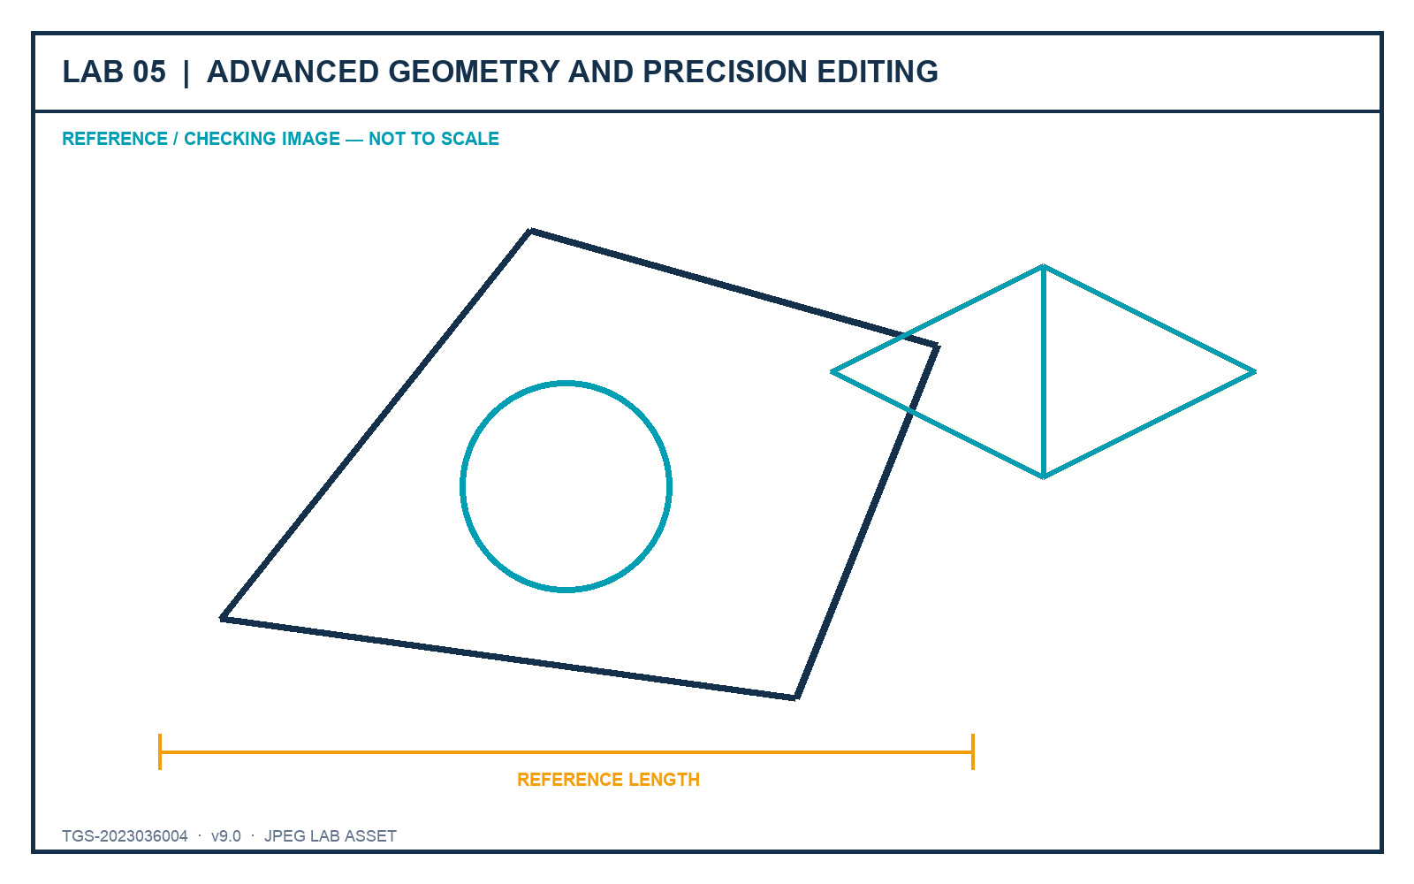
LO1–LO2 · K1, K2 · A1, A2
Lab 05 — Advanced Geometry and Precision Editing
DECISIONS TO PROVE
• Use object types that suit revision behaviour.
• Combine precision tools into a repeatable system.
• Verify the final 2D and isometric geometry.
Outcome: A precise 2D component study plus an isometric view using fit-for-purpose object types.
JPEG brief supplied in the individual lab folder
Autodesk-ACP-AutoCAD-Design-and-Drafting · TGS-2023036004
© 2026 Tertiary Infotech Academy Pte Ltd
250

Slide 252
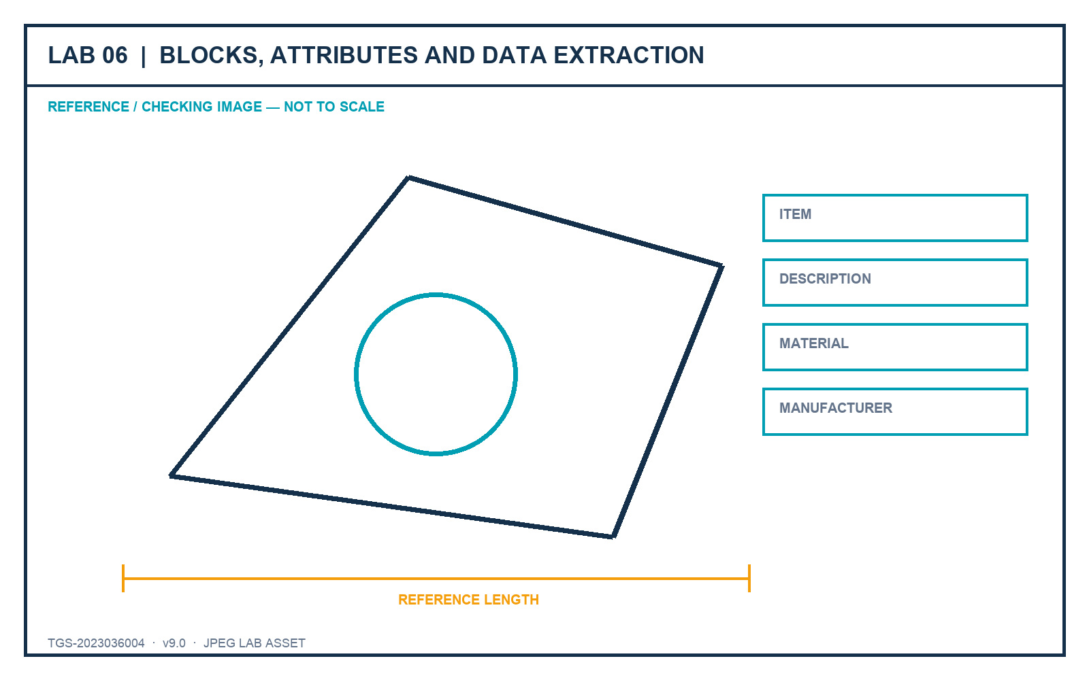
LO4 · K4 · A4
Lab 06 — Blocks, Attributes and Data Extraction
DECISIONS TO PROVE
• Design reusable block definitions.
• Carry instance data through attributes.
• Extract and validate a component schedule.
Outcome: A small furniture block library with attributes and an extracted component schedule.
JPEG brief supplied in the individual lab folder
Autodesk-ACP-AutoCAD-Design-and-Drafting · TGS-2023036004
© 2026 Tertiary Infotech Academy Pte Ltd
251

Slide 253
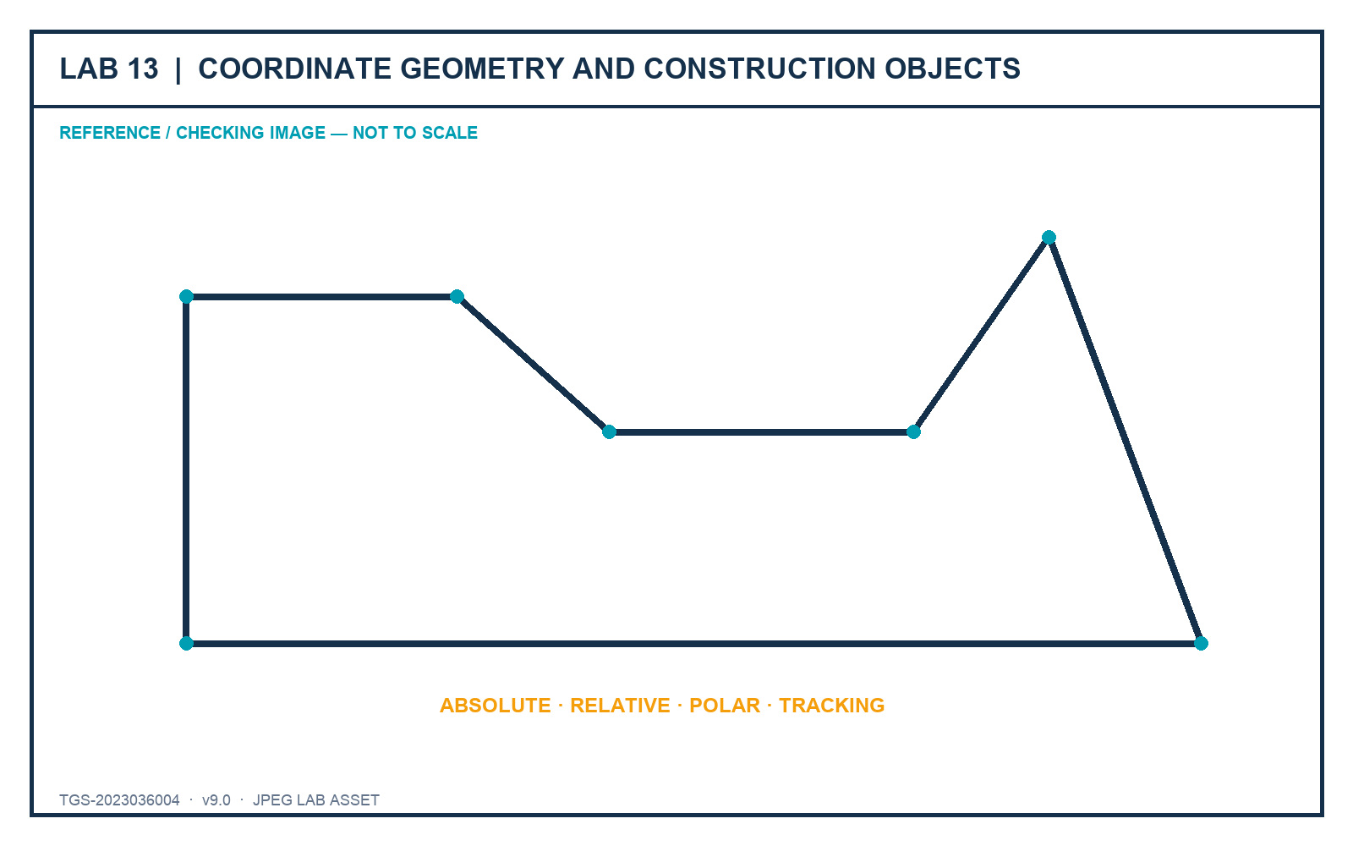
LO1–LO2 · Exam 3.2, 3.4 · K1–K2 · A1–A2
Lab 13 — Coordinate Geometry and Construction Objects
DECISIONS TO PROVE
• Translate drawing-sheet information into coordinate methods.
• Use construction objects without polluting the final output.
• Measure every critical relationship.
Outcome: A closed, dimensionally verified profile combining Cartesian and polar input with appropriate object types.
JPEG brief supplied in the individual lab folder
Autodesk-ACP-AutoCAD-Design-and-Drafting · TGS-2023036004
© 2026 Tertiary Infotech Academy Pte Ltd
252

Slide 254
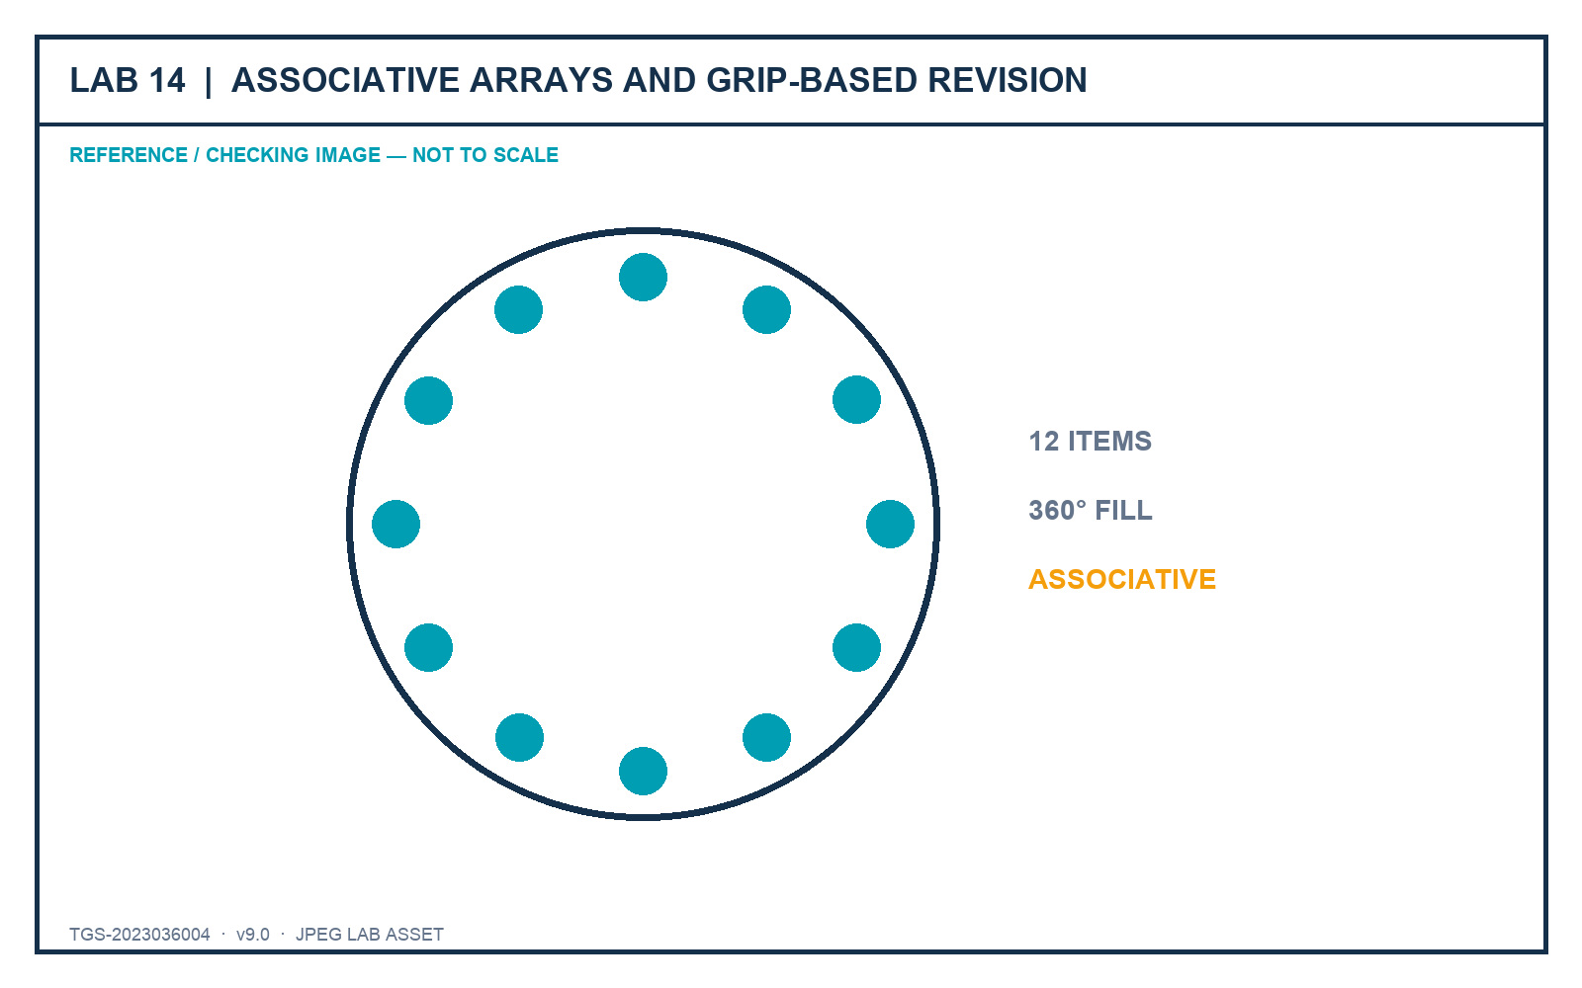
LO2 · Exam 3.2.e, 3.3 · K2 · A2
Lab 14 — Associative Arrays and Grip-Based Revision
DECISIONS TO PROVE
• Retain associative pattern relationships.
• Use exact grip parameters rather than visual dragging.
• Explain why the geometry remains editable.
Outcome: An associative pattern study and a revised technical component with documented grip decisions.
JPEG brief supplied in the individual lab folder
Autodesk-ACP-AutoCAD-Design-and-Drafting · TGS-2023036004
© 2026 Tertiary Infotech Academy Pte Ltd
253

Slide 255
04
DOMAIN 04
Configure and Manage Design Output
Layouts · viewports · page setup · plotting · publishing · eTransmit
Autodesk-ACP-AutoCAD-Design-and-Drafting · TGS-2023036004
© 2026 Tertiary Infotech Academy Pte Ltd
254

Slide 256
DECEMBER 2025 AUTODESK ACP ALIGNMENT
Domain 4 Coverage Dashboard
Objective groups
3 groups in the official content outline.
Leaf objectives
7 individually traceable exam objectives.
1
2
Teaching model
Intent → decision controls → applied scenario → quality review.
Evidence model
Visible state, measured result, controlled output and explained decision.
3
4
Autodesk-ACP-AutoCAD-Design-and-Drafting · TGS-2023036004
© 2026 Tertiary Infotech Academy Pte Ltd
255

Slide 257
FROM SOFTWARE FEATURE TO PROFESSIONAL PRACTICE
Professional Judgement Lens — Configure and Manage Design Output
Decision
Evidence
• Start with the production or stakeholder decision.
• Choose the least destructive control that preserves ownership.
• Keep model, sheet, reference and data responsibilities distinct.
• Verify in the final output context.
• Retain evidence that another reviewer can reproduce.
• Explain why the alternative controls were not selected.
Autodesk-ACP-AutoCAD-Design-and-Drafting · TGS-2023036004
© 2026 Tertiary Infotech Academy Pte Ltd
256

Slide 258
OFFICIAL OBJECTIVE GROUP
4.1 — Configure production drawing output
4.1.a
Configure and manage named page setups
4.1.b
Create layout viewports
1
2
4.1.c
Manage layout viewports
3
Autodesk-ACP-AutoCAD-Design-and-Drafting · TGS-2023036004
© 2026 Tertiary Infotech Academy Pte Ltd
257

Slide 259
AUTODESK EXAM OBJECTIVE · DOMAIN 4
4.1.a — Configure and manage named page setups
What competent practice means
How competence is demonstrated
• Exam intent: Configure and manage named page setups.
• Professional context: Twenty layouts must produce consistent A3 PDFs and office printer proofs.
• The objective tests selection and interpretation of the right control, not memorised interface sequences.
• Tools and controls: PAGESETUP · plotter · CTB/STB · plot area.
• Evidence of control: Named setups can be applied repeatedly and produce predictable media, scale and line hierarchy.
• Primary risk: Layout-by-layout manual settings create hidden output drift.
Autodesk-ACP-AutoCAD-Design-and-Drafting · TGS-2023036004
© 2026 Tertiary Infotech Academy Pte Ltd
258

Slide 260
4.1.a · PROFESSIONAL JUDGEMENT
Decision Controls — Configure and manage named page setups
Control 1
Name setups by output purpose and sheet standard
Control 2
Coordinate device, paper, plot area and orientation
1
2
Control 3
Apply the approved plot-style strategy
Control 4
Test lineweights and options in preview
3
4
Autodesk-ACP-AutoCAD-Design-and-Drafting · TGS-2023036004
© 2026 Tertiary Infotech Academy Pte Ltd
259

Slide 261
4.1.a · FROM BRIEF TO EVIDENCE
Applied Scenario — Configure and manage named page setups
Situation and decision
Verification and risk
• Twenty layouts must produce consistent A3 PDFs and office printer proofs.
• Decision lens: Name setups by output purpose and sheet standard
• Control boundary: Coordinate device, paper, plot area and orientation
• Expected evidence: Named setups can be applied repeatedly and produce predictable media, scale and line hierarchy.
• Failure mode: Layout-by-layout manual settings create hidden output drift.
• Review the result in the final drawing context, not only in the authoring view.
Autodesk-ACP-AutoCAD-Design-and-Drafting · TGS-2023036004
© 2026 Tertiary Infotech Academy Pte Ltd
260

Slide 262
4.1.a · ACCEPTANCE CRITERIA
Quality Review — Configure and manage named page setups
Scope
Confirm the drawing, layout, reference or data scope governed by 4.1.a.
Control
Apply the approved plot-style strategy
1
2
Consistency
Test lineweights and options in preview
Tool evidence
Use PAGESETUP · plotter · CTB/STB · plot area as observable controls, then inspect the resulting state.
3
4
Acceptance
Named setups can be applied repeatedly and produce predictable media, scale and line hierarchy.
Risk check
Layout-by-layout manual settings create hidden output drift.
5
6
Autodesk-ACP-AutoCAD-Design-and-Drafting · TGS-2023036004
© 2026 Tertiary Infotech Academy Pte Ltd
261

Slide 263
AUTODESK EXAM OBJECTIVE · DOMAIN 4
4.1.b — Create layout viewports
What competent practice means
How competence is demonstrated
• Exam intent: Create layout viewports.
• Professional context: A sheet needs one overall plan and a clipped detail around an irregular room.
• The objective tests selection and interpretation of the right control, not memorised interface sequences.
• Tools and controls: MVIEW · polygonal viewport · object viewport · Insert View.
• Evidence of control: The layout contains purposeful view boundaries with clear sheet ownership.
• Primary risk: Viewports on a plotting layer can print unwanted frames.
Autodesk-ACP-AutoCAD-Design-and-Drafting · TGS-2023036004
© 2026 Tertiary Infotech Academy Pte Ltd
262

Slide 264
4.1.b · PROFESSIONAL JUDGEMENT
Decision Controls — Create layout viewports
Control 1
Choose rectangular or non-rectangular boundaries from composition needs
Control 2
Create viewports only in paper space
1
2
Control 3
Use named views where repeatability matters
Control 4
Separate viewport boundary layer from plotted content
3
4
Autodesk-ACP-AutoCAD-Design-and-Drafting · TGS-2023036004
© 2026 Tertiary Infotech Academy Pte Ltd
263

Slide 265
4.1.b · FROM BRIEF TO EVIDENCE
Applied Scenario — Create layout viewports
Situation and decision
Verification and risk
• A sheet needs one overall plan and a clipped detail around an irregular room.
• Decision lens: Choose rectangular or non-rectangular boundaries from composition needs
• Control boundary: Create viewports only in paper space
• Expected evidence: The layout contains purposeful view boundaries with clear sheet ownership.
• Failure mode: Viewports on a plotting layer can print unwanted frames.
• Review the result in the final drawing context, not only in the authoring view.
Autodesk-ACP-AutoCAD-Design-and-Drafting · TGS-2023036004
© 2026 Tertiary Infotech Academy Pte Ltd
264

Slide 266
4.1.b · ACCEPTANCE CRITERIA
Quality Review — Create layout viewports
Scope
Confirm the drawing, layout, reference or data scope governed by 4.1.b.
Control
Use named views where repeatability matters
1
2
Consistency
Separate viewport boundary layer from plotted content
Tool evidence
Use MVIEW · polygonal viewport · object viewport · Insert View as observable controls, then inspect the resulting state.
3
4
Acceptance
The layout contains purposeful view boundaries with clear sheet ownership.
Risk check
Viewports on a plotting layer can print unwanted frames.
5
6
Autodesk-ACP-AutoCAD-Design-and-Drafting · TGS-2023036004
© 2026 Tertiary Infotech Academy Pte Ltd
265

Slide 267
AUTODESK EXAM OBJECTIVE · DOMAIN 4
4.1.c — Manage layout viewports
What competent practice means
How competence is demonstrated
• Exam intent: Manage layout viewports.
• Professional context: A detail viewport must be 1:10, hide ceiling layers and remain stable through review.
• The objective tests selection and interpretation of the right control, not memorised interface sequences.
• Tools and controls: VPCLIP · lock · layer control · viewport scale.
• Evidence of control: Scale, lock, clip and viewport-specific visibility all survive reopen and plot preview.
• Primary risk: Unlocked viewports are easily changed by accidental zooming.
Autodesk-ACP-AutoCAD-Design-and-Drafting · TGS-2023036004
© 2026 Tertiary Infotech Academy Pte Ltd
266

Slide 268
4.1.c · PROFESSIONAL JUDGEMENT
Decision Controls — Manage layout viewports
Control 1
Set and verify exact scale before locking
Control 2
Use viewport layer controls for presentation
1
2
Control 3
Clip only when composition requires it
Control 4
Match annotation scale to viewport scale
3
4
Autodesk-ACP-AutoCAD-Design-and-Drafting · TGS-2023036004
© 2026 Tertiary Infotech Academy Pte Ltd
267

Slide 269
4.1.c · FROM BRIEF TO EVIDENCE
Applied Scenario — Manage layout viewports
Situation and decision
Verification and risk
• A detail viewport must be 1:10, hide ceiling layers and remain stable through review.
• Decision lens: Set and verify exact scale before locking
• Control boundary: Use viewport layer controls for presentation
• Expected evidence: Scale, lock, clip and viewport-specific visibility all survive reopen and plot preview.
• Failure mode: Unlocked viewports are easily changed by accidental zooming.
• Review the result in the final drawing context, not only in the authoring view.
Autodesk-ACP-AutoCAD-Design-and-Drafting · TGS-2023036004
© 2026 Tertiary Infotech Academy Pte Ltd
268

Slide 270
4.1.c · ACCEPTANCE CRITERIA
Quality Review — Manage layout viewports
Scope
Confirm the drawing, layout, reference or data scope governed by 4.1.c.
Control
Clip only when composition requires it
1
2
Consistency
Match annotation scale to viewport scale
Tool evidence
Use VPCLIP · lock · layer control · viewport scale as observable controls, then inspect the resulting state.
3
4
Acceptance
Scale, lock, clip and viewport-specific visibility all survive reopen and plot preview.
Risk check
Unlocked viewports are easily changed by accidental zooming.
5
6
Autodesk-ACP-AutoCAD-Design-and-Drafting · TGS-2023036004
© 2026 Tertiary Infotech Academy Pte Ltd
269

Slide 271
OFFICIAL OBJECTIVE GROUP
4.2 — Plot and publish production drawing output
4.2.a
Define and manage a publish sheet list
4.2.b
Configure an Electronic Transmittal package
1
2
Autodesk-ACP-AutoCAD-Design-and-Drafting · TGS-2023036004
© 2026 Tertiary Infotech Academy Pte Ltd
270

Slide 272
AUTODESK EXAM OBJECTIVE · DOMAIN 4
4.2.a — Define and manage a publish sheet list
What competent practice means
How competence is demonstrated
• Exam intent: Define and manage a publish sheet list.
• Professional context: A 24-sheet issue must produce one ordered PDF using a revised output device.
• The objective tests selection and interpretation of the right control, not memorised interface sequences.
• Tools and controls: PUBLISH · DSD sheet list · page setup override.
• Evidence of control: The sheet list, order and override yield a complete, consistent package.
• Primary risk: One stale layout or missing setup can silently compromise the batch.
Autodesk-ACP-AutoCAD-Design-and-Drafting · TGS-2023036004
© 2026 Tertiary Infotech Academy Pte Ltd
271

Slide 273
4.2.a · PROFESSIONAL JUDGEMENT
Decision Controls — Define and manage a publish sheet list
Control 1
Order sheets for stakeholder reading
Control 2
Apply overrides only to controlled output variants
1
2
Control 3
Validate every source layout before batch output
Control 4
Save reusable sheet lists with project-relative references
3
4
Autodesk-ACP-AutoCAD-Design-and-Drafting · TGS-2023036004
© 2026 Tertiary Infotech Academy Pte Ltd
272

Slide 274
4.2.a · FROM BRIEF TO EVIDENCE
Applied Scenario — Define and manage a publish sheet list
Situation and decision
Verification and risk
• A 24-sheet issue must produce one ordered PDF using a revised output device.
• Decision lens: Order sheets for stakeholder reading
• Control boundary: Apply overrides only to controlled output variants
• Expected evidence: The sheet list, order and override yield a complete, consistent package.
• Failure mode: One stale layout or missing setup can silently compromise the batch.
• Review the result in the final drawing context, not only in the authoring view.
Autodesk-ACP-AutoCAD-Design-and-Drafting · TGS-2023036004
© 2026 Tertiary Infotech Academy Pte Ltd
273

Slide 275
4.2.a · ACCEPTANCE CRITERIA
Quality Review — Define and manage a publish sheet list
Scope
Confirm the drawing, layout, reference or data scope governed by 4.2.a.
Control
Validate every source layout before batch output
1
2
Consistency
Save reusable sheet lists with project-relative references
Tool evidence
Use PUBLISH · DSD sheet list · page setup override as observable controls, then inspect the resulting state.
3
4
Acceptance
The sheet list, order and override yield a complete, consistent package.
Risk check
One stale layout or missing setup can silently compromise the batch.
5
6
Autodesk-ACP-AutoCAD-Design-and-Drafting · TGS-2023036004
© 2026 Tertiary Infotech Academy Pte Ltd
274

Slide 276
AUTODESK EXAM OBJECTIVE · DOMAIN 4
4.2.b — Configure an Electronic Transmittal package
What competent practice means
How competence is demonstrated
• Exam intent: Configure an Electronic Transmittal package.
• Professional context: A consultant must receive a portable package that opens without unresolved dependencies.
• The objective tests selection and interpretation of the right control, not memorised interface sequences.
• Tools and controls: ETRANSMIT · path options · dependency report.
• Evidence of control: The package inventory and test-open confirm all permitted dependencies resolve.
• Primary risk: Sending only the host DWG produces missing references and unreliable output.
Autodesk-ACP-AutoCAD-Design-and-Drafting · TGS-2023036004
© 2026 Tertiary Infotech Academy Pte Ltd
275

Slide 277
4.2.b · PROFESSIONAL JUDGEMENT
Decision Controls — Configure an Electronic Transmittal package
Control 1
Include required references, fonts, plot styles and data links
Control 2
Choose path handling for the recipient environment
1
2
Control 3
Purge only when permitted
Control 4
Review the transmittal report before issue
3
4
Autodesk-ACP-AutoCAD-Design-and-Drafting · TGS-2023036004
© 2026 Tertiary Infotech Academy Pte Ltd
276

Slide 278
4.2.b · FROM BRIEF TO EVIDENCE
Applied Scenario — Configure an Electronic Transmittal package
Situation and decision
Verification and risk
• A consultant must receive a portable package that opens without unresolved dependencies.
• Decision lens: Include required references, fonts, plot styles and data links
• Control boundary: Choose path handling for the recipient environment
• Expected evidence: The package inventory and test-open confirm all permitted dependencies resolve.
• Failure mode: Sending only the host DWG produces missing references and unreliable output.
• Review the result in the final drawing context, not only in the authoring view.
Autodesk-ACP-AutoCAD-Design-and-Drafting · TGS-2023036004
© 2026 Tertiary Infotech Academy Pte Ltd
277

Slide 279
4.2.b · ACCEPTANCE CRITERIA
Quality Review — Configure an Electronic Transmittal package
Scope
Confirm the drawing, layout, reference or data scope governed by 4.2.b.
Control
Purge only when permitted
1
2
Consistency
Review the transmittal report before issue
Tool evidence
Use ETRANSMIT · path options · dependency report as observable controls, then inspect the resulting state.
3
4
Acceptance
The package inventory and test-open confirm all permitted dependencies resolve.
Risk check
Sending only the host DWG produces missing references and unreliable output.
5
6
Autodesk-ACP-AutoCAD-Design-and-Drafting · TGS-2023036004
© 2026 Tertiary Infotech Academy Pte Ltd
278

Slide 280
OFFICIAL OBJECTIVE GROUP
4.3 — Use the Sheet Set Manager
4.3.a
Create sheets within a sheet set
4.3.b
Modify sheet and sheet-set properties
1
2
Autodesk-ACP-AutoCAD-Design-and-Drafting · TGS-2023036004
© 2026 Tertiary Infotech Academy Pte Ltd
279

Slide 281
AUTODESK EXAM OBJECTIVE · DOMAIN 4
4.3.a — Create sheets within a sheet set
What competent practice means
How competence is demonstrated
• Exam intent: Create sheets within a sheet set.
• Professional context: A project adds four detail sheets to an existing discipline subset.
• The objective tests selection and interpretation of the right control, not memorised interface sequences.
• Tools and controls: SHEETSET · import layout · new sheet · subsets.
• Evidence of control: The new sheets appear in the correct subset with controlled names, numbers and layout sources.
• Primary risk: Ad-hoc layouts outside the sheet set evade package coordination.
Autodesk-ACP-AutoCAD-Design-and-Drafting · TGS-2023036004
© 2026 Tertiary Infotech Academy Pte Ltd
280

Slide 282
4.3.a · PROFESSIONAL JUDGEMENT
Decision Controls — Create sheets within a sheet set
Control 1
Use subsets to express package structure
Control 2
Import only layouts that meet sheet standards
1
2
Control 3
Create new sheets from governed templates
Control 4
Maintain unique sheet numbers and names
3
4
Autodesk-ACP-AutoCAD-Design-and-Drafting · TGS-2023036004
© 2026 Tertiary Infotech Academy Pte Ltd
281

Slide 283
4.3.a · FROM BRIEF TO EVIDENCE
Applied Scenario — Create sheets within a sheet set
Situation and decision
Verification and risk
• A project adds four detail sheets to an existing discipline subset.
• Decision lens: Use subsets to express package structure
• Control boundary: Import only layouts that meet sheet standards
• Expected evidence: The new sheets appear in the correct subset with controlled names, numbers and layout sources.
• Failure mode: Ad-hoc layouts outside the sheet set evade package coordination.
• Review the result in the final drawing context, not only in the authoring view.
Autodesk-ACP-AutoCAD-Design-and-Drafting · TGS-2023036004
© 2026 Tertiary Infotech Academy Pte Ltd
282

Slide 284
4.3.a · ACCEPTANCE CRITERIA
Quality Review — Create sheets within a sheet set
Scope
Confirm the drawing, layout, reference or data scope governed by 4.3.a.
Control
Create new sheets from governed templates
1
2
Consistency
Maintain unique sheet numbers and names
Tool evidence
Use SHEETSET · import layout · new sheet · subsets as observable controls, then inspect the resulting state.
3
4
Acceptance
The new sheets appear in the correct subset with controlled names, numbers and layout sources.
Risk check
Ad-hoc layouts outside the sheet set evade package coordination.
5
6
Autodesk-ACP-AutoCAD-Design-and-Drafting · TGS-2023036004
© 2026 Tertiary Infotech Academy Pte Ltd
283

Slide 285
AUTODESK EXAM OBJECTIVE · DOMAIN 4
4.3.b — Modify sheet and sheet-set properties
What competent practice means
How competence is demonstrated
• Exam intent: Modify sheet and sheet-set properties.
• Professional context: A project phase and issue date change across every title block while two sheets are renumbered.
• The objective tests selection and interpretation of the right control, not memorised interface sequences.
• Tools and controls: Sheet Set Manager · custom properties · renumbering.
• Evidence of control: Fields and sheet lists update from governed properties without manual title-block edits.
• Primary risk: Manual text overrides leave contradictory issue data.
Autodesk-ACP-AutoCAD-Design-and-Drafting · TGS-2023036004
© 2026 Tertiary Infotech Academy Pte Ltd
284

Slide 286
4.3.b · PROFESSIONAL JUDGEMENT
Decision Controls — Modify sheet and sheet-set properties
Control 1
Distinguish sheet properties from set-wide properties
Control 2
Use properties as field sources
1
2
Control 3
Renumber with downstream references in mind
Control 4
Regenerate lists and title data after changes
3
4
Autodesk-ACP-AutoCAD-Design-and-Drafting · TGS-2023036004
© 2026 Tertiary Infotech Academy Pte Ltd
285

Slide 287
4.3.b · FROM BRIEF TO EVIDENCE
Applied Scenario — Modify sheet and sheet-set properties
Situation and decision
Verification and risk
• A project phase and issue date change across every title block while two sheets are renumbered.
• Decision lens: Distinguish sheet properties from set-wide properties
• Control boundary: Use properties as field sources
• Expected evidence: Fields and sheet lists update from governed properties without manual title-block edits.
• Failure mode: Manual text overrides leave contradictory issue data.
• Review the result in the final drawing context, not only in the authoring view.
Autodesk-ACP-AutoCAD-Design-and-Drafting · TGS-2023036004
© 2026 Tertiary Infotech Academy Pte Ltd
286

Slide 288
4.3.b · ACCEPTANCE CRITERIA
Quality Review — Modify sheet and sheet-set properties
Scope
Confirm the drawing, layout, reference or data scope governed by 4.3.b.
Control
Renumber with downstream references in mind
1
2
Consistency
Regenerate lists and title data after changes
Tool evidence
Use Sheet Set Manager · custom properties · renumbering as observable controls, then inspect the resulting state.
3
4
Acceptance
Fields and sheet lists update from governed properties without manual title-block edits.
Risk check
Manual text overrides leave contradictory issue data.
5
6
Autodesk-ACP-AutoCAD-Design-and-Drafting · TGS-2023036004
© 2026 Tertiary Infotech Academy Pte Ltd
287

Slide 289
TECHNICAL DRAWING FOUNDATION · WORKSPACE
Model Space and Paper Space
Core concept
Professional application
• Model space is where you design — always draw at 1:1 real-world size.
• Paper space (layouts) is where you compose scaled sheets for printing.
• The UCS icon shows the origin and orientation of the coordinate system.
• Switch between them with the Model and Layout tabs below the drawing area.
Autodesk-ACP-AutoCAD-Design-and-Drafting · TGS-2023036004
© 2026 Tertiary Infotech Academy Pte Ltd
288

Slide 290
TECHNICAL DRAWING FOUNDATION · OUTPUT
Layouts and Viewports
Core concept
Professional application
• A layout is the 2D sheet environment: title block, viewports, annotation.
• MVIEW creates layout viewports — windows into model space.
• Set each viewport's scale exactly (e.g. 1:20), then lock it against accidental zooming.
• One model, many sheets: each layout composes its own views and scales.
Autodesk-ACP-AutoCAD-Design-and-Drafting · TGS-2023036004
© 2026 Tertiary Infotech Academy Pte Ltd
289

Slide 291
TECHNICAL DRAWING FOUNDATION · OUTPUT
Plotting and Printing
Core concept
Professional application
• Plot from the layout: choose plotter, paper size, plot area, scale and orientation.
• DWG To PDF.pc3 publishes the standard submission PDF.
• Page setups save the configuration per layout and import between drawings.
• Preview before plotting — check lineweights, scale and the full sheet.
Autodesk-ACP-AutoCAD-Design-and-Drafting · TGS-2023036004
© 2026 Tertiary Infotech Academy Pte Ltd
290

Slide 292
SHEET GOVERNANCE
Model once. Communicate through controlled sheets.
Paper space governs view, scale, title block and output — without duplicating model geometry.
Autodesk-ACP-AutoCAD-Design-and-Drafting · TGS-2023036004
© 2026 Tertiary Infotech Academy Pte Ltd
291

Slide 293
AUTHORING AND COMMUNICATION
Model Space vs Paper Space
Model space
Paper space
• Model at full size in agreed drawing units.
• Create and revise design geometry once.
• Maintain discipline layers and object properties.
• Compose sheets at paper size.
• Control views through scaled viewports.
• Apply title blocks, page setups and sheet-specific emphasis.
Autodesk-ACP-AutoCAD-Design-and-Drafting · TGS-2023036004
© 2026 Tertiary Infotech Academy Pte Ltd
292

Slide 294
REPEATABLE OUTPUT
Layout and Page Setup
1
2
3
4
5
▶
▶
▶
▶
Create/rename layout
Select device or PDF output
Choose paper and orientation
Set plot area, scale and style
Preview and assign
Autodesk-ACP-AutoCAD-Design-and-Drafting · TGS-2023036004
© 2026 Tertiary Infotech Academy Pte Ltd
293

Slide 295
WINDOWS INTO THE MODEL
Viewport Control
View
Top, Front, Right, Isometric or a named view.
Scale
Apply an approved custom or standard scale.
1
2
Visual style
2D wireframe, Hidden, Shaded or Realistic by purpose.
Layer override
Emphasise the sheet without changing the model.
3
4
Lock
Prevent accidental pan/zoom after approval.
Annotation
Confirm readability at the viewport scale.
5
6
Autodesk-ACP-AutoCAD-Design-and-Drafting · TGS-2023036004
© 2026 Tertiary Infotech Academy Pte Ltd
294

Slide 296
EDITABLE NATIVE POWERPOINT CHART
Output Quality Priorities
Conceptual 1–5 quality-impact comparison for discussion; values are instructional, not measured project data.
Autodesk-ACP-AutoCAD-Design-and-Drafting · TGS-2023036004
© 2026 Tertiary Infotech Academy Pte Ltd
295

Slide 297
MULTI-SHEET OUTPUT
Publish a Drawing Set
1
2
3
4
5
▶
▶
▶
▶
Order current layouts
Apply page setups
Configure PDF options
Preview every sheet
Publish and inspect the PDF
Autodesk-ACP-AutoCAD-Design-and-Drafting · TGS-2023036004
© 2026 Tertiary Infotech Academy Pte Ltd
296

Slide 298
COMPLETE HANDOVER
eTransmit a Portable Package
1
2
3
4
5
▶
▶
▶
▶
Resolve dependencies
Choose path handling
Include fonts/plot styles as permitted
Create ZIP and report
Open-test from the package
Autodesk-ACP-AutoCAD-Design-and-Drafting · TGS-2023036004
© 2026 Tertiary Infotech Academy Pte Ltd
297

Slide 299
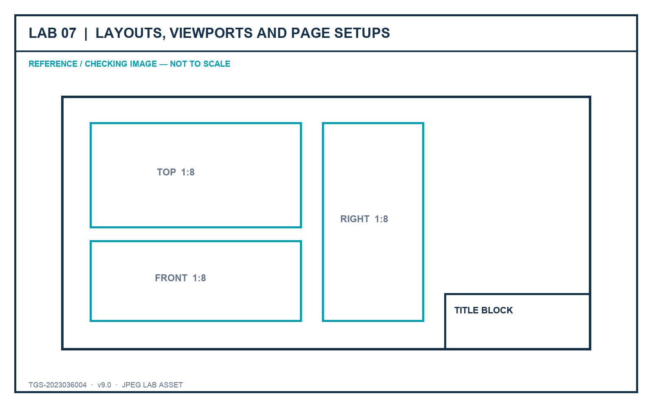
LO3 · K3 · A1, A2, A3
Lab 07 — Layouts, Viewports and Page Setups
DECISIONS TO PROVE
• Create ISO A1, A2 and A3 sheets.
• Control views, scales, visual styles and locks.
• Prove title-block and page-setup consistency.
Outcome: A coordinated three-sheet sink drawing set that mirrors the original practical-assessment workflow.
JPEG brief supplied in the individual lab folder
Autodesk-ACP-AutoCAD-Design-and-Drafting · TGS-2023036004
© 2026 Tertiary Infotech Academy Pte Ltd
298

Slide 300
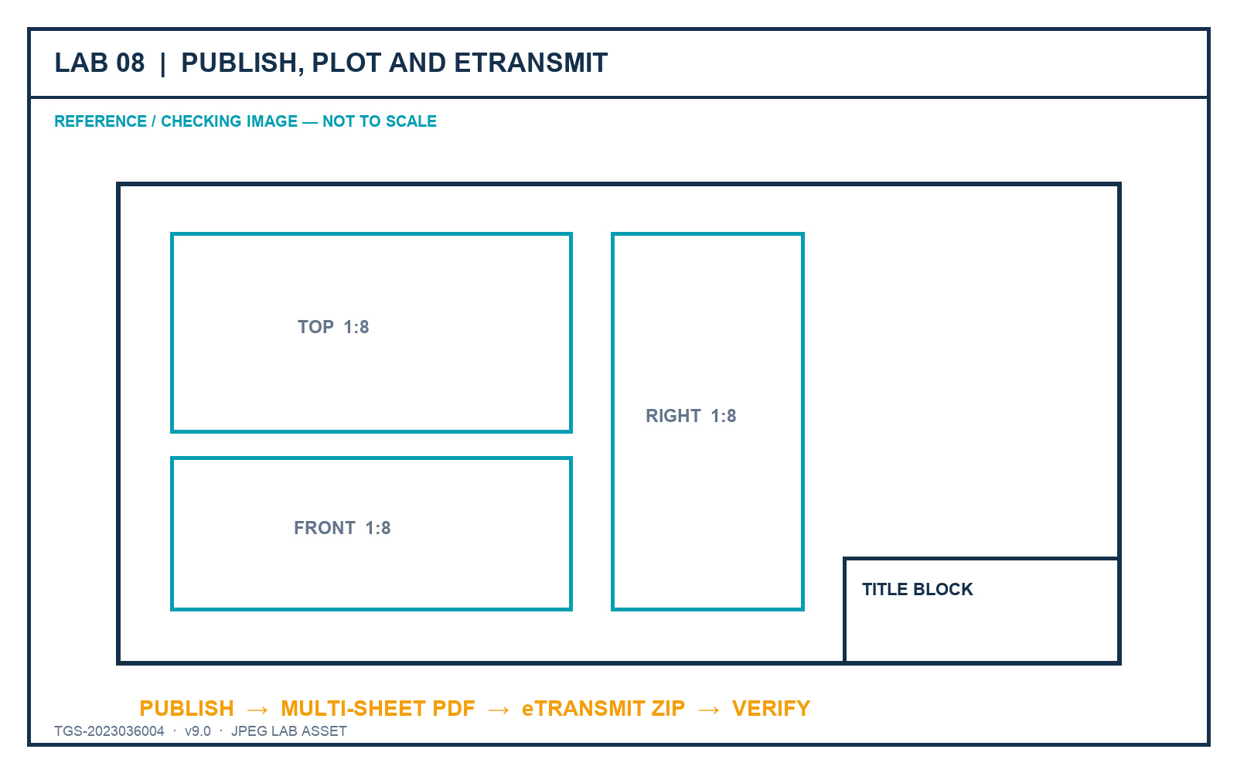
LO3–LO4 · K3, K4 · A3, A4
Lab 08 — Publish, Plot and eTransmit
DECISIONS TO PROVE
• Publish only current, ordered layouts.
• Inspect each PDF sheet at full size.
• Verify the eTransmit inventory and portability.
Outcome: A published PDF sheet set and a verified eTransmit package with a transmittal report.
JPEG brief supplied in the individual lab folder
Autodesk-ACP-AutoCAD-Design-and-Drafting · TGS-2023036004
© 2026 Tertiary Infotech Academy Pte Ltd
299

Slide 301
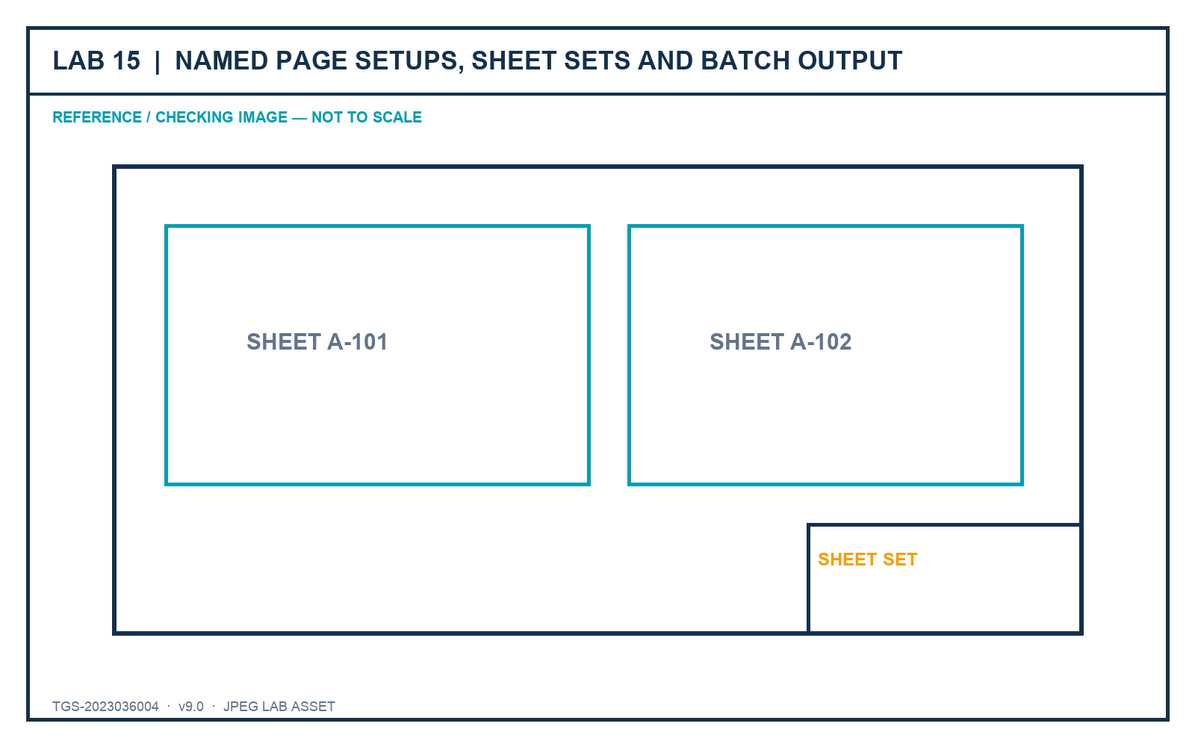
LO3–LO4 · Exam 4.1–4.3 · K3–K4 · A3–A4
Lab 15 — Named Page Setups, Sheet Sets and Batch Output
DECISIONS TO PROVE
• Drive output from named page setups and sheet properties.
• Lock scales and sheet-specific presentation.
• Batch-publish and open-test the package.
Outcome: A governed office drawing sheet set with reusable page setups, sheet metadata and a verified batch PDF.
JPEG brief supplied in the individual lab folder
Autodesk-ACP-AutoCAD-Design-and-Drafting · TGS-2023036004
© 2026 Tertiary Infotech Academy Pte Ltd
300

Slide 302
05
DOMAIN 05
Collaboration and Emerging Workflows
Xrefs · underlays · compare · shared views · tool palettes · automation
Autodesk-ACP-AutoCAD-Design-and-Drafting · TGS-2023036004
© 2026 Tertiary Infotech Academy Pte Ltd
301

Slide 303
DECEMBER 2025 AUTODESK ACP ALIGNMENT
Domain 5 Coverage Dashboard
Objective groups
3 groups in the official content outline.
Leaf objectives
9 individually traceable exam objectives.
1
2
Teaching model
Intent → decision controls → applied scenario → quality review.
Evidence model
Visible state, measured result, controlled output and explained decision.
3
4
Autodesk-ACP-AutoCAD-Design-and-Drafting · TGS-2023036004
© 2026 Tertiary Infotech Academy Pte Ltd
302

Slide 304
FROM SOFTWARE FEATURE TO PROFESSIONAL PRACTICE
Professional Judgement Lens — Collaboration
Decision
Evidence
• Start with the production or stakeholder decision.
• Choose the least destructive control that preserves ownership.
• Keep model, sheet, reference and data responsibilities distinct.
• Verify in the final output context.
• Retain evidence that another reviewer can reproduce.
• Explain why the alternative controls were not selected.
Autodesk-ACP-AutoCAD-Design-and-Drafting · TGS-2023036004
© 2026 Tertiary Infotech Academy Pte Ltd
303

Slide 305
OFFICIAL OBJECTIVE GROUP
5.1 — Provide design feedback
5.1.a
Collaborate with shared drawing files
5.1.b
Create and manage Traces
1
2
5.1.c
Compare drawing versions
3
Autodesk-ACP-AutoCAD-Design-and-Drafting · TGS-2023036004
© 2026 Tertiary Infotech Academy Pte Ltd
304

Slide 306
AUTODESK EXAM OBJECTIVE · DOMAIN 5
5.1.a — Collaborate with shared drawing files
What competent practice means
How competence is demonstrated
• Exam intent: Collaborate with shared drawing files.
• Professional context: A client needs browser-based review without receiving editable production files.
• The objective tests selection and interpretation of the right control, not memorised interface sequences.
• Tools and controls: SHARE · shared views/files · permissions.
• Evidence of control: The shared artifact has appropriate access, scope and revision identification.
• Primary risk: Over-sharing production data creates ownership and confidentiality risk.
Autodesk-ACP-AutoCAD-Design-and-Drafting · TGS-2023036004
© 2026 Tertiary Infotech Academy Pte Ltd
305

Slide 307
5.1.a · PROFESSIONAL JUDGEMENT
Decision Controls — Collaborate with shared drawing files
Control 1
Choose a share method that protects source ownership
Control 2
Control who can view, comment or edit
1
2
Control 3
Communicate revision and expiry context
Control 4
Avoid exposing unrelated project data
3
4
Autodesk-ACP-AutoCAD-Design-and-Drafting · TGS-2023036004
© 2026 Tertiary Infotech Academy Pte Ltd
306

Slide 308
5.1.a · FROM BRIEF TO EVIDENCE
Applied Scenario — Collaborate with shared drawing files
Situation and decision
Verification and risk
• A client needs browser-based review without receiving editable production files.
• Decision lens: Choose a share method that protects source ownership
• Control boundary: Control who can view, comment or edit
• Expected evidence: The shared artifact has appropriate access, scope and revision identification.
• Failure mode: Over-sharing production data creates ownership and confidentiality risk.
• Review the result in the final drawing context, not only in the authoring view.
Autodesk-ACP-AutoCAD-Design-and-Drafting · TGS-2023036004
© 2026 Tertiary Infotech Academy Pte Ltd
307

Slide 309
5.1.a · ACCEPTANCE CRITERIA
Quality Review — Collaborate with shared drawing files
Scope
Confirm the drawing, layout, reference or data scope governed by 5.1.a.
Control
Communicate revision and expiry context
1
2
Consistency
Avoid exposing unrelated project data
Tool evidence
Use SHARE · shared views/files · permissions as observable controls, then inspect the resulting state.
3
4
Acceptance
The shared artifact has appropriate access, scope and revision identification.
Risk check
Over-sharing production data creates ownership and confidentiality risk.
5
6
Autodesk-ACP-AutoCAD-Design-and-Drafting · TGS-2023036004
© 2026 Tertiary Infotech Academy Pte Ltd
308

Slide 310
AUTODESK EXAM OBJECTIVE · DOMAIN 5
5.1.b — Create and manage Traces
What competent practice means
How competence is demonstrated
• Exam intent: Create and manage Traces.
• Professional context: A reviewer marks routing changes while the drafter continues production work.
• The objective tests selection and interpretation of the right control, not memorised interface sequences.
• Tools and controls: TRACE · Trace palette · contributor workflow.
• Evidence of control: The trace preserves reviewer intent and can be resolved without contaminating base geometry.
• Primary risk: Redrawing feedback directly into the model loses provenance.
Autodesk-ACP-AutoCAD-Design-and-Drafting · TGS-2023036004
© 2026 Tertiary Infotech Academy Pte Ltd
309

Slide 311
5.1.b · PROFESSIONAL JUDGEMENT
Decision Controls — Create and manage Traces
Control 1
Use a trace as an overlay, not source-geometry replacement
Control 2
Separate contributor feedback from author response
1
2
Control 3
Resolve or retain feedback with status
Control 4
Keep the base drawing authoritative
3
4
Autodesk-ACP-AutoCAD-Design-and-Drafting · TGS-2023036004
© 2026 Tertiary Infotech Academy Pte Ltd
310

Slide 312
5.1.b · FROM BRIEF TO EVIDENCE
Applied Scenario — Create and manage Traces
Situation and decision
Verification and risk
• A reviewer marks routing changes while the drafter continues production work.
• Decision lens: Use a trace as an overlay, not source-geometry replacement
• Control boundary: Separate contributor feedback from author response
• Expected evidence: The trace preserves reviewer intent and can be resolved without contaminating base geometry.
• Failure mode: Redrawing feedback directly into the model loses provenance.
• Review the result in the final drawing context, not only in the authoring view.
Autodesk-ACP-AutoCAD-Design-and-Drafting · TGS-2023036004
© 2026 Tertiary Infotech Academy Pte Ltd
311

Slide 313
5.1.b · ACCEPTANCE CRITERIA
Quality Review — Create and manage Traces
Scope
Confirm the drawing, layout, reference or data scope governed by 5.1.b.
Control
Resolve or retain feedback with status
1
2
Consistency
Keep the base drawing authoritative
Tool evidence
Use TRACE · Trace palette · contributor workflow as observable controls, then inspect the resulting state.
3
4
Acceptance
The trace preserves reviewer intent and can be resolved without contaminating base geometry.
Risk check
Redrawing feedback directly into the model loses provenance.
5
6
Autodesk-ACP-AutoCAD-Design-and-Drafting · TGS-2023036004
© 2026 Tertiary Infotech Academy Pte Ltd
312

Slide 314
AUTODESK EXAM OBJECTIVE · DOMAIN 5
5.1.c — Compare drawing versions
What competent practice means
How competence is demonstrated
• Exam intent: Compare drawing versions.
• Professional context: Two consultant revisions arrive with unclear change notes.
• The objective tests selection and interpretation of the right control, not memorised interface sequences.
• Tools and controls: DWGCOMPARE · import differences · filters.
• Evidence of control: The comparison identifies material changes and records which are accepted.
• Primary risk: Comparing the wrong versions creates false confidence and missed change.
Autodesk-ACP-AutoCAD-Design-and-Drafting · TGS-2023036004
© 2026 Tertiary Infotech Academy Pte Ltd
313

Slide 315
5.1.c · PROFESSIONAL JUDGEMENT
Decision Controls — Compare drawing versions
Control 1
Choose the correct baseline and revision
Control 2
Filter non-material differences
1
2
Control 3
Inspect added, removed and changed objects
Control 4
Import only approved changes and document the decision
3
4
Autodesk-ACP-AutoCAD-Design-and-Drafting · TGS-2023036004
© 2026 Tertiary Infotech Academy Pte Ltd
314

Slide 316
5.1.c · FROM BRIEF TO EVIDENCE
Applied Scenario — Compare drawing versions
Situation and decision
Verification and risk
• Two consultant revisions arrive with unclear change notes.
• Decision lens: Choose the correct baseline and revision
• Control boundary: Filter non-material differences
• Expected evidence: The comparison identifies material changes and records which are accepted.
• Failure mode: Comparing the wrong versions creates false confidence and missed change.
• Review the result in the final drawing context, not only in the authoring view.
Autodesk-ACP-AutoCAD-Design-and-Drafting · TGS-2023036004
© 2026 Tertiary Infotech Academy Pte Ltd
315

Slide 317
5.1.c · ACCEPTANCE CRITERIA
Quality Review — Compare drawing versions
Scope
Confirm the drawing, layout, reference or data scope governed by 5.1.c.
Control
Inspect added, removed and changed objects
1
2
Consistency
Import only approved changes and document the decision
Tool evidence
Use DWGCOMPARE · import differences · filters as observable controls, then inspect the resulting state.
3
4
Acceptance
The comparison identifies material changes and records which are accepted.
Risk check
Comparing the wrong versions creates false confidence and missed change.
5
6
Autodesk-ACP-AutoCAD-Design-and-Drafting · TGS-2023036004
© 2026 Tertiary Infotech Academy Pte Ltd
316

Slide 318
OFFICIAL OBJECTIVE GROUP
5.2 — Manage references and underlays
5.2.a
Manage xref attach and overlay types
5.2.b
Manage reference paths and path types
1
2
5.2.c
Manipulate image and underlay frames
3
Autodesk-ACP-AutoCAD-Design-and-Drafting · TGS-2023036004
© 2026 Tertiary Infotech Academy Pte Ltd
317

Slide 319
AUTODESK EXAM OBJECTIVE · DOMAIN 5
5.2.a — Manage xref attach and overlay types
What competent practice means
How competence is demonstrated
• Exam intent: Manage xref attach and overlay types.
• Professional context: A discipline model must appear in the coordination host but not propagate into every downstream sheet.
• The objective tests selection and interpretation of the right control, not memorised interface sequences.
• Tools and controls: XATTACH · Attach · Overlay.
• Evidence of control: The reference type produces the intended nesting behaviour with no duplication.
• Primary risk: Incorrect Attach use can duplicate references or create circular relationships.
Autodesk-ACP-AutoCAD-Design-and-Drafting · TGS-2023036004
© 2026 Tertiary Infotech Academy Pte Ltd
318

Slide 320
5.2.a · PROFESSIONAL JUDGEMENT
Decision Controls — Manage xref attach and overlay types
Control 1
Use Attach when nested propagation is intended
Control 2
Use Overlay to prevent nesting beyond one host
1
2
Control 3
Choose type from coordination ownership
Control 4
Review the reference tree for circular risk
3
4
Autodesk-ACP-AutoCAD-Design-and-Drafting · TGS-2023036004
© 2026 Tertiary Infotech Academy Pte Ltd
319

Slide 321
5.2.a · FROM BRIEF TO EVIDENCE
Applied Scenario — Manage xref attach and overlay types
Situation and decision
Verification and risk
• A discipline model must appear in the coordination host but not propagate into every downstream sheet.
• Decision lens: Use Attach when nested propagation is intended
• Control boundary: Use Overlay to prevent nesting beyond one host
• Expected evidence: The reference type produces the intended nesting behaviour with no duplication.
• Failure mode: Incorrect Attach use can duplicate references or create circular relationships.
• Review the result in the final drawing context, not only in the authoring view.
Autodesk-ACP-AutoCAD-Design-and-Drafting · TGS-2023036004
© 2026 Tertiary Infotech Academy Pte Ltd
320

Slide 322
5.2.a · ACCEPTANCE CRITERIA
Quality Review — Manage xref attach and overlay types
Scope
Confirm the drawing, layout, reference or data scope governed by 5.2.a.
Control
Choose type from coordination ownership
1
2
Consistency
Review the reference tree for circular risk
Tool evidence
Use XATTACH · Attach · Overlay as observable controls, then inspect the resulting state.
3
4
Acceptance
The reference type produces the intended nesting behaviour with no duplication.
Risk check
Incorrect Attach use can duplicate references or create circular relationships.
5
6
Autodesk-ACP-AutoCAD-Design-and-Drafting · TGS-2023036004
© 2026 Tertiary Infotech Academy Pte Ltd
321

Slide 323
AUTODESK EXAM OBJECTIVE · DOMAIN 5
5.2.b — Manage reference paths and path types
What competent practice means
How competence is demonstrated
• Exam intent: Manage reference paths and path types.
• Professional context: A project folder must move from a local drive to a shared server and later into eTransmit.
• The objective tests selection and interpretation of the right control, not memorised interface sequences.
• Tools and controls: Reference Manager · full · relative · no path.
• Evidence of control: References resolve after relocation using an intentional, documented path strategy.
• Primary risk: Machine-specific full paths fail for collaborators.
Autodesk-ACP-AutoCAD-Design-and-Drafting · TGS-2023036004
© 2026 Tertiary Infotech Academy Pte Ltd
322

Slide 324
5.2.b · PROFESSIONAL JUDGEMENT
Decision Controls — Manage reference paths and path types
Control 1
Use relative paths inside portable project structures
Control 2
Use full paths only for stable shared infrastructure
1
2
Control 3
Use no path when controlled search locations suffice
Control 4
Repath and reload before package issue
3
4
Autodesk-ACP-AutoCAD-Design-and-Drafting · TGS-2023036004
© 2026 Tertiary Infotech Academy Pte Ltd
323

Slide 325
5.2.b · FROM BRIEF TO EVIDENCE
Applied Scenario — Manage reference paths and path types
Situation and decision
Verification and risk
• A project folder must move from a local drive to a shared server and later into eTransmit.
• Decision lens: Use relative paths inside portable project structures
• Control boundary: Use full paths only for stable shared infrastructure
• Expected evidence: References resolve after relocation using an intentional, documented path strategy.
• Failure mode: Machine-specific full paths fail for collaborators.
• Review the result in the final drawing context, not only in the authoring view.
Autodesk-ACP-AutoCAD-Design-and-Drafting · TGS-2023036004
© 2026 Tertiary Infotech Academy Pte Ltd
324

Slide 326
5.2.b · ACCEPTANCE CRITERIA
Quality Review — Manage reference paths and path types
Scope
Confirm the drawing, layout, reference or data scope governed by 5.2.b.
Control
Use no path when controlled search locations suffice
1
2
Consistency
Repath and reload before package issue
Tool evidence
Use Reference Manager · full · relative · no path as observable controls, then inspect the resulting state.
3
4
Acceptance
References resolve after relocation using an intentional, documented path strategy.
Risk check
Machine-specific full paths fail for collaborators.
5
6
Autodesk-ACP-AutoCAD-Design-and-Drafting · TGS-2023036004
© 2026 Tertiary Infotech Academy Pte Ltd
325

Slide 327
AUTODESK EXAM OBJECTIVE · DOMAIN 5
5.2.c — Manipulate image and underlay frames
What competent practice means
How competence is demonstrated
• Exam intent: Manipulate image and underlay frames.
• Professional context: A scanned survey underlay must be selectable while authoring but print without its frame.
• The objective tests selection and interpretation of the right control, not memorised interface sequences.
• Tools and controls: IMAGEFRAME · PDFFRAME · DWF/DGN frames · clip.
• Evidence of control: The underlay remains manageable and plots with the intended boundary treatment.
• Primary risk: Hidden frames can make references impossible to select or audit.
Autodesk-ACP-AutoCAD-Design-and-Drafting · TGS-2023036004
© 2026 Tertiary Infotech Academy Pte Ltd
326

Slide 328
5.2.c · PROFESSIONAL JUDGEMENT
Decision Controls — Manipulate image and underlay frames
Control 1
Control display and plot behaviour separately
Control 2
Keep frames visible during editing when selection is needed
1
2
Control 3
Clip to the useful evidence area
Control 4
Retain enough boundary context for interpretation
3
4
Autodesk-ACP-AutoCAD-Design-and-Drafting · TGS-2023036004
© 2026 Tertiary Infotech Academy Pte Ltd
327

Slide 329
5.2.c · FROM BRIEF TO EVIDENCE
Applied Scenario — Manipulate image and underlay frames
Situation and decision
Verification and risk
• A scanned survey underlay must be selectable while authoring but print without its frame.
• Decision lens: Control display and plot behaviour separately
• Control boundary: Keep frames visible during editing when selection is needed
• Expected evidence: The underlay remains manageable and plots with the intended boundary treatment.
• Failure mode: Hidden frames can make references impossible to select or audit.
• Review the result in the final drawing context, not only in the authoring view.
Autodesk-ACP-AutoCAD-Design-and-Drafting · TGS-2023036004
© 2026 Tertiary Infotech Academy Pte Ltd
328

Slide 330
5.2.c · ACCEPTANCE CRITERIA
Quality Review — Manipulate image and underlay frames
Scope
Confirm the drawing, layout, reference or data scope governed by 5.2.c.
Control
Clip to the useful evidence area
1
2
Consistency
Retain enough boundary context for interpretation
Tool evidence
Use IMAGEFRAME · PDFFRAME · DWF/DGN frames · clip as observable controls, then inspect the resulting state.
3
4
Acceptance
The underlay remains manageable and plots with the intended boundary treatment.
Risk check
Hidden frames can make references impossible to select or audit.
5
6
Autodesk-ACP-AutoCAD-Design-and-Drafting · TGS-2023036004
© 2026 Tertiary Infotech Academy Pte Ltd
329

Slide 331
OFFICIAL OBJECTIVE GROUP
5.3 — Incorporate external design data into project drawings
5.3.a
Create and manage PDF imports
5.3.b
Create and manage tables using data links
1
2
5.3.c
Display dynamic data using fields
3
Autodesk-ACP-AutoCAD-Design-and-Drafting · TGS-2023036004
© 2026 Tertiary Infotech Academy Pte Ltd
330

Slide 332
AUTODESK EXAM OBJECTIVE · DOMAIN 5
5.3.a — Create and manage PDF imports
What competent practice means
How competence is demonstrated
• Exam intent: Create and manage PDF imports.
• Professional context: A legacy vector PDF must seed editable geometry for a renovation plan.
• The objective tests selection and interpretation of the right control, not memorised interface sequences.
• Tools and controls: PDFIMPORT · layers · vector geometry · raster images.
• Evidence of control: Imported objects have verified scale, layers, linework and text treatment.
• Primary risk: Assuming the PDF is dimensionally exact can propagate scan or export distortion.
Autodesk-ACP-AutoCAD-Design-and-Drafting · TGS-2023036004
© 2026 Tertiary Infotech Academy Pte Ltd
331

Slide 333
5.3.a · PROFESSIONAL JUDGEMENT
Decision Controls — Create and manage PDF imports
Control 1
Assess whether the PDF contains usable vectors
Control 2
Map or create layers intentionally
1
2
Control 3
Join collinear segments only when safe
Control 4
Treat imported geometry as untrusted until checked
3
4
Autodesk-ACP-AutoCAD-Design-and-Drafting · TGS-2023036004
© 2026 Tertiary Infotech Academy Pte Ltd
332

Slide 334
5.3.a · FROM BRIEF TO EVIDENCE
Applied Scenario — Create and manage PDF imports
Situation and decision
Verification and risk
• A legacy vector PDF must seed editable geometry for a renovation plan.
• Decision lens: Assess whether the PDF contains usable vectors
• Control boundary: Map or create layers intentionally
• Expected evidence: Imported objects have verified scale, layers, linework and text treatment.
• Failure mode: Assuming the PDF is dimensionally exact can propagate scan or export distortion.
• Review the result in the final drawing context, not only in the authoring view.
Autodesk-ACP-AutoCAD-Design-and-Drafting · TGS-2023036004
© 2026 Tertiary Infotech Academy Pte Ltd
333

Slide 335
5.3.a · ACCEPTANCE CRITERIA
Quality Review — Create and manage PDF imports
Scope
Confirm the drawing, layout, reference or data scope governed by 5.3.a.
Control
Join collinear segments only when safe
1
2
Consistency
Treat imported geometry as untrusted until checked
Tool evidence
Use PDFIMPORT · layers · vector geometry · raster images as observable controls, then inspect the resulting state.
3
4
Acceptance
Imported objects have verified scale, layers, linework and text treatment.
Risk check
Assuming the PDF is dimensionally exact can propagate scan or export distortion.
5
6
Autodesk-ACP-AutoCAD-Design-and-Drafting · TGS-2023036004
© 2026 Tertiary Infotech Academy Pte Ltd
334

Slide 336
AUTODESK EXAM OBJECTIVE · DOMAIN 5
5.3.b — Create and manage tables using data links
What competent practice means
How competence is demonstrated
• Exam intent: Create and manage tables using data links.
• Professional context: A drawing schedule must reflect a controlled spreadsheet maintained by procurement.
• The objective tests selection and interpretation of the right control, not memorised interface sequences.
• Tools and controls: DATALINK · TABLE · Excel link · update.
• Evidence of control: The linked table refreshes the intended range and preserves readable drawing formatting.
• Primary risk: Broken paths or unrefreshed links publish stale data.
Autodesk-ACP-AutoCAD-Design-and-Drafting · TGS-2023036004
© 2026 Tertiary Infotech Academy Pte Ltd
335

Slide 337
5.3.b · PROFESSIONAL JUDGEMENT
Decision Controls — Create and manage tables using data links
Control 1
Define which system owns each value
Control 2
Control ranges, formatting and update direction
1
2
Control 3
Protect linked cells from casual overrides
Control 4
Refresh and record source state before issue
3
4
Autodesk-ACP-AutoCAD-Design-and-Drafting · TGS-2023036004
© 2026 Tertiary Infotech Academy Pte Ltd
336

Slide 338
5.3.b · FROM BRIEF TO EVIDENCE
Applied Scenario — Create and manage tables using data links
Situation and decision
Verification and risk
• A drawing schedule must reflect a controlled spreadsheet maintained by procurement.
• Decision lens: Define which system owns each value
• Control boundary: Control ranges, formatting and update direction
• Expected evidence: The linked table refreshes the intended range and preserves readable drawing formatting.
• Failure mode: Broken paths or unrefreshed links publish stale data.
• Review the result in the final drawing context, not only in the authoring view.
Autodesk-ACP-AutoCAD-Design-and-Drafting · TGS-2023036004
© 2026 Tertiary Infotech Academy Pte Ltd
337

Slide 339
5.3.b · ACCEPTANCE CRITERIA
Quality Review — Create and manage tables using data links
Scope
Confirm the drawing, layout, reference or data scope governed by 5.3.b.
Control
Protect linked cells from casual overrides
1
2
Consistency
Refresh and record source state before issue
Tool evidence
Use DATALINK · TABLE · Excel link · update as observable controls, then inspect the resulting state.
3
4
Acceptance
The linked table refreshes the intended range and preserves readable drawing formatting.
Risk check
Broken paths or unrefreshed links publish stale data.
5
6
Autodesk-ACP-AutoCAD-Design-and-Drafting · TGS-2023036004
© 2026 Tertiary Infotech Academy Pte Ltd
338

Slide 340
AUTODESK EXAM OBJECTIVE · DOMAIN 5
5.3.c — Display dynamic data using fields
What competent practice means
How competence is demonstrated
• Exam intent: Display dynamic data using fields.
• Professional context: Title blocks and callouts must show sheet properties, areas and issue dates without retyping.
• The objective tests selection and interpretation of the right control, not memorised interface sequences.
• Tools and controls: FIELD · object properties · custom properties · sheet-set fields.
• Evidence of control: Displayed values update from their authoritative objects or properties.
• Primary risk: Converted-to-text or broken fields retain old values while appearing valid.
Autodesk-ACP-AutoCAD-Design-and-Drafting · TGS-2023036004
© 2026 Tertiary Infotech Academy Pte Ltd
339

Slide 341
5.3.c · PROFESSIONAL JUDGEMENT
Decision Controls — Display dynamic data using fields
Control 1
Choose a stable data source
Control 2
Use fields for values that must follow revisions
1
2
Control 3
Format units, case and precision consistently
Control 4
Update and inspect fields before output
3
4
Autodesk-ACP-AutoCAD-Design-and-Drafting · TGS-2023036004
© 2026 Tertiary Infotech Academy Pte Ltd
340

Slide 342
5.3.c · FROM BRIEF TO EVIDENCE
Applied Scenario — Display dynamic data using fields
Situation and decision
Verification and risk
• Title blocks and callouts must show sheet properties, areas and issue dates without retyping.
• Decision lens: Choose a stable data source
• Control boundary: Use fields for values that must follow revisions
• Expected evidence: Displayed values update from their authoritative objects or properties.
• Failure mode: Converted-to-text or broken fields retain old values while appearing valid.
• Review the result in the final drawing context, not only in the authoring view.
Autodesk-ACP-AutoCAD-Design-and-Drafting · TGS-2023036004
© 2026 Tertiary Infotech Academy Pte Ltd
341

Slide 343
5.3.c · ACCEPTANCE CRITERIA
Quality Review — Display dynamic data using fields
Scope
Confirm the drawing, layout, reference or data scope governed by 5.3.c.
Control
Format units, case and precision consistently
1
2
Consistency
Update and inspect fields before output
Tool evidence
Use FIELD · object properties · custom properties · sheet-set fields as observable controls, then inspect the resulting state.
3
4
Acceptance
Displayed values update from their authoritative objects or properties.
Risk check
Converted-to-text or broken fields retain old values while appearing valid.
5
6
Autodesk-ACP-AutoCAD-Design-and-Drafting · TGS-2023036004
© 2026 Tertiary Infotech Academy Pte Ltd
342

Slide 344
TECHNICAL DRAWING FOUNDATION · REUSABLE CONTENT
External References (Xrefs)
Core concept
Professional application
• An xref attaches another drawing file into the current drawing — live, not copied.
• The External References palette organises, reloads and repaths every reference.
• Teams share one title block or site plan; edits flow to every host on reload.
• PDFs and images attach the same way as underlays for tracing.
Autodesk-ACP-AutoCAD-Design-and-Drafting · TGS-2023036004
© 2026 Tertiary Infotech Academy Pte Ltd
343

Slide 345
COORDINATION
Collaboration works when ownership stays visible.
Reference other teams' work, manage paths and communicate changes without silently duplicating source geometry.
Autodesk-ACP-AutoCAD-Design-and-Drafting · TGS-2023036004
© 2026 Tertiary Infotech Academy Pte Ltd
344

Slide 346
EXTERNAL REFERENCES
Attach vs Overlay
Attach
Overlay
• Attach allows nested references to propagate into the host.
• Use when downstream visibility is intended and controlled.
• Document nesting and ownership.
• Overlay prevents the reference from propagating when the host is referenced again.
• Use to avoid circular or unwanted nesting.
• Often safer for discipline coordination.
Autodesk-ACP-AutoCAD-Design-and-Drafting · TGS-2023036004
© 2026 Tertiary Infotech Academy Pte Ltd
345

Slide 347
PORTABILITY AND CONTROL
Reference Path Strategy
Relative
Portable within a known project folder structure.
Full
Exact location but fragile when moved between machines.
1
2
No path
Search-based and ambiguous outside a disciplined package.
Repath
Repair links without changing insertion or scale.
3
4
Unload / reload
Control performance while retaining the definition.
eTransmit
Package references and document path handling.
5
6
Autodesk-ACP-AutoCAD-Design-and-Drafting · TGS-2023036004
© 2026 Tertiary Infotech Academy Pte Ltd
346

Slide 348
LAYER OWNERSHIP
Coordinate Xref Layers
1
2
3
4
5
▶
▶
▶
▶
Read the source prefix
Keep global ownership intact
Apply host review overrides
Avoid binding without a requirement
Record the coordination decision
Autodesk-ACP-AutoCAD-Design-and-Drafting · TGS-2023036004
© 2026 Tertiary Infotech Academy Pte Ltd
347

Slide 349
REFERENCE, DO NOT DUPLICATE
Underlays and Linked Evidence
PDF underlay
Reference issued sheets without redrawing them.
Raster image
Trace, compare or communicate using controlled imagery.
1
2
Clip
Limit the visible region without modifying the source.
Fade / contrast
Keep context visible without overpowering host content.
3
4
Hyperlink
Connect an object to approved external information.
Path check
Verify links from the final package location.
5
6
Autodesk-ACP-AutoCAD-Design-and-Drafting · TGS-2023036004
© 2026 Tertiary Infotech Academy Pte Ltd
348

Slide 350
CHANGE VISIBILITY
Drawing Compare
1
2
3
4
5
▶
▶
▶
▶
Choose baseline and revision
Generate added/removed/modified overlays
Filter noise
Review decision-critical changes
Record response and close
Autodesk-ACP-AutoCAD-Design-and-Drafting · TGS-2023036004
© 2026 Tertiary Infotech Academy Pte Ltd
349

Slide 351
TECHNOLOGY MUST SERVE THE ORGANISATION
Evaluate Emerging Workflows
Shared Views
Browser-based review without handing over editable source.
Markup Import
Bring review comments back into the drawing context.
1
2
Data extraction
Turn block/attribute data into schedules and QA evidence.
Tool palettes
Standardise approved commands, blocks and hatches.
3
4
Automation
Use scripts and routines for repeatable, governed tasks.
Cloud coordination
Assess permissions, ownership, revision and audit trail.
5
6
Autodesk-ACP-AutoCAD-Design-and-Drafting · TGS-2023036004
© 2026 Tertiary Infotech Academy Pte Ltd
350

Slide 352
A4 · A5 DECISION FRAMEWORK
Technology Selection Scorecard
Risk and quality
Value and growth
• Accuracy and standards fit
• Interoperability and path portability
• Revision traceability
• Security and access control
• Time saved across repeated work
• Learning and support effort
• Evidence and auditability
• Ability to scale with organisational growth
Autodesk-ACP-AutoCAD-Design-and-Drafting · TGS-2023036004
© 2026 Tertiary Infotech Academy Pte Ltd
351

Slide 353
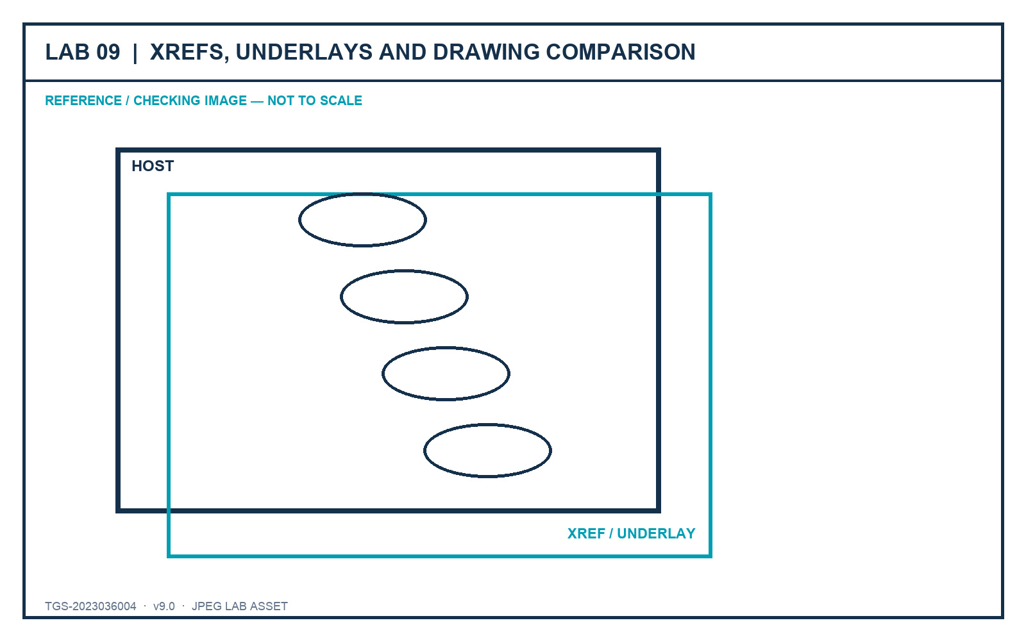
LO4 · K4 · A4
Lab 09 — Xrefs, Underlays and Drawing Comparison
DECISIONS TO PROVE
• Preserve ownership through controlled references.
• Use relative paths and host-only review overrides.
• Classify changes and stakeholder response.
Outcome: A host coordination drawing with controlled Xrefs/underlays and a documented comparison review.
JPEG brief supplied in the individual lab folder
Autodesk-ACP-AutoCAD-Design-and-Drafting · TGS-2023036004
© 2026 Tertiary Infotech Academy Pte Ltd
352

Slide 354
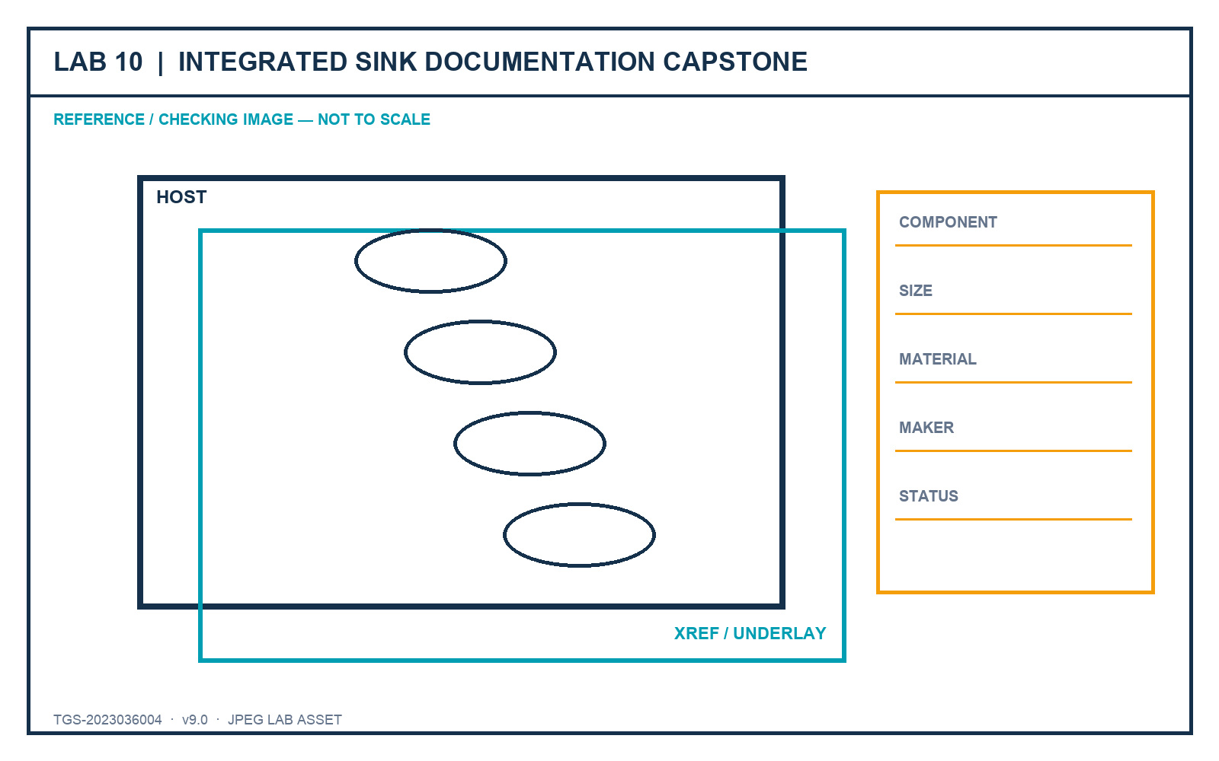
LO1–LO5 · K1–K4 · A1–A5
Lab 10 — Integrated Sink Documentation Capstone
DECISIONS TO PROVE
• Integrate standards, layouts and component data.
• Publish and package a complete sink drawing set.
• Lead a concise stakeholder approval story.
Outcome: A standards-based sink drawing set with layouts, title blocks, viewports, component table, publish package and review evidence.
JPEG brief supplied in the individual lab folder
Autodesk-ACP-AutoCAD-Design-and-Drafting · TGS-2023036004
© 2026 Tertiary Infotech Academy Pte Ltd
353

Slide 355

LO4–LO5 · Exam 5.1–5.3 · K4 · A4–A5
Lab 16 — Shared Review, References and Linked Data
DECISIONS TO PROVE
• Preserve feedback provenance through Traces and Compare.
• Keep references portable and ownership visible.
• Verify imported, linked and field-driven data.
Outcome: A reviewed host drawing with trace evidence, controlled references, verified PDF import and live linked data.
JPEG brief supplied in the individual lab folder
Autodesk-ACP-AutoCAD-Design-and-Drafting · TGS-2023036004
© 2026 Tertiary Infotech Academy Pte Ltd
354

Slide 356
WRAP-UP
Course Summary and Assessment
Autodesk-ACP-AutoCAD-Design-and-Drafting · TGS-2023036004
© 2026 Tertiary Infotech Academy Pte Ltd
355

Slide 357
FROM BRIEF TO HANDOVER
Integrated Professional Workflow
1
2
3
4
5
▶
▶
▶
▶
Define standards
Author and revise
Annotate and tell the story
Publish controlled sheets
Coordinate, review and improve
Autodesk-ACP-AutoCAD-Design-and-Drafting · TGS-2023036004
© 2026 Tertiary Infotech Academy Pte Ltd
356

Slide 358
PROVE THE WORK
Evidence Quality Checklist
Show the setting and the visible result together.
Use filenames that identify lab, learner and revision.
1
2
Verify units, coordinates, scales and paths explicitly.
Retain current DWG plus published/package outputs.
3
4
Capture acceptance criteria, not every interface action.
Explain the decision behind the tool choice.
5
6
Autodesk-ACP-AutoCAD-Design-and-Drafting · TGS-2023036004
© 2026 Tertiary Infotech Academy Pte Ltd
357

Slide 359
WA-SAQ + PP
Final Assessment
• Written Assessment (WA-SAQ) — 4 open-ended questions covering K1–K4, 60 minutes, open book.
• Practical Performance (PP) — 5 hands-on tasks covering A1–A5, 120 minutes, open book.
• Question papers retain the original instrument type, counts, timings and K/A coverage.
• Answer keys remain trainer-only and are never linked to the LMS or public GitHub repository.
Autodesk-ACP-AutoCAD-Design-and-Drafting · TGS-2023036004
© 2026 Tertiary Infotech Academy Pte Ltd
358

Slide 360
COMPLETE EVERY STAGE
Assessment and Sign-off Flow
1
2
3
4
5
▶
▶
▶
▶
Assessment attendance
WA-SAQ
Practical Performance
Assessor decision
Feedback, sign-off or appeal
Autodesk-ACP-AutoCAD-Design-and-Drafting · TGS-2023036004
© 2026 Tertiary Infotech Academy Pte Ltd
359

Slide 361
MANDATORY
Digital Attendance — Final Check
AM
Completed for Day 4.
PM
Completed after lunch.
1
2
Assessment
Completed before the final papers.
TRAQOM
Submit the required feedback survey.
3
4
Autodesk-ACP-AutoCAD-Design-and-Drafting · TGS-2023036004
© 2026 Tertiary Infotech Academy Pte Ltd
360

Slide 362
AFTER THE COURSE
Support and Next Learning
Course support
Professional development
• Revisit the detailed Learner Guide and individual lab folders.
• Use only files and references authorised for your project.
• Request post-course consultation through Tertiary Infotech.
• Build a portfolio drawing set with standards evidence.
• Practise explaining design decisions without relying on memorised interface sequences.
• Continue with related Autodesk design and BIM workflows.
Autodesk-ACP-AutoCAD-Design-and-Drafting · TGS-2023036004
© 2026 Tertiary Infotech Academy Pte Ltd
361

Slide 363
AUTOCAD DESIGN AND DRAFTING
Thank You!
Draft with intent. Revise with control. Publish with confidence.
Autodesk-ACP-AutoCAD-Design-and-Drafting · TGS-2023036004
© 2026 Tertiary Infotech Academy Pte Ltd
362

