Slide 1
01
ACTIVITY 1
Translate a Design Requirement into an AI-Ready 3D Brief
K1 · K3 · A1
Activity 1 · Translate a Design Requirement into an AI-Ready 3D Brief · TGS-2023037544
© Tertiary Infotech Academy Pte Ltd
1

Slide 2
ACTIVITY 1 · FOUNDATION
Translate a Design Requirement into an AI-Ready 3D Brief
ACTIVITY 1
ALIGNMENT
A retail innovation team needs a compact desktop product visual for stakeholder review and later prototyping.
K1 · K3 · A1
OBJECTIVE
DELIVERABLE
Create measurable geometry, appearance and delivery criteria before using AI.
A one-page model brief, prompt specification and acceptance scorecard.
Activity 1 · Translate a Design Requirement into an AI-Ready 3D Brief · TGS-2023037544
© Tertiary Infotech Academy Pte Ltd
2

Slide 3
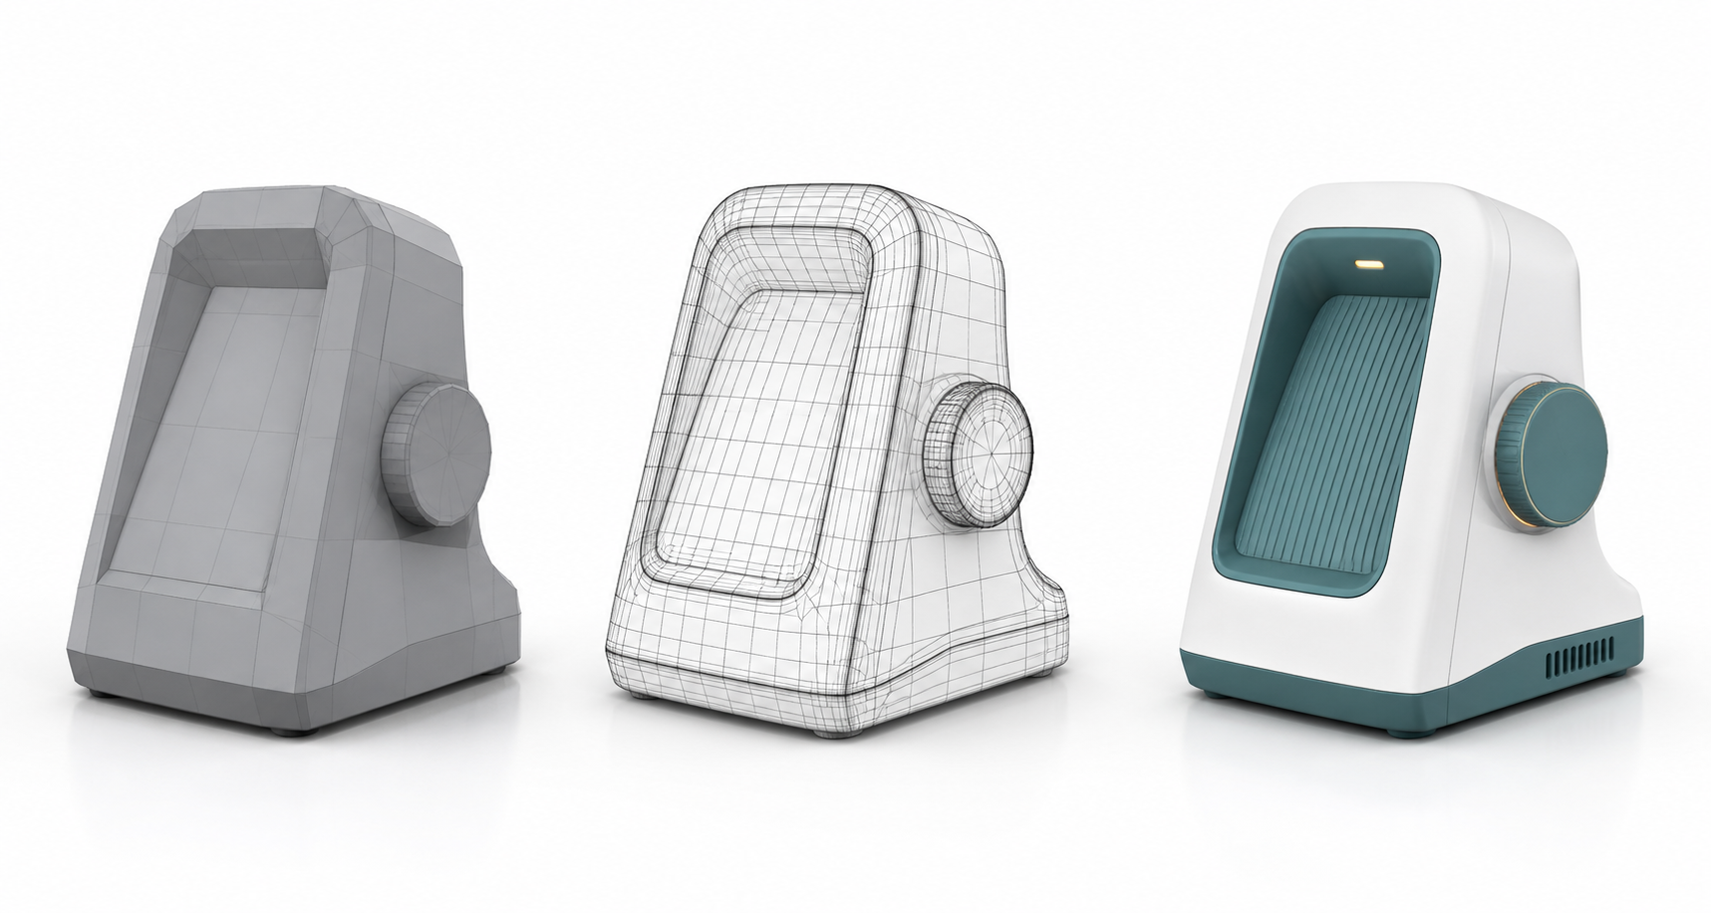
SAMPLE PRESENTATION
Example evidence view
Replace this concept visual with your own Blender screenshot or render. Keep the camera, version and acceptance result visible in the slide notes or caption.
Concept visual — validate against the editable Blender file.
Activity 1 · Translate a Design Requirement into an AI-Ready 3D Brief · TGS-2023037544
© Tertiary Infotech Academy Pte Ltd
3

Slide 4
VERIFY, DOCUMENT, SUBMIT
Activity 1 — acceptance evidence
ACCEPTANCE CHECKS
EVIDENCE TO SUBMIT
Purpose and audience are explicit
Completed model brief
Dimensions and units are stated
Prompt specification
Acceptance scorecard
Editable parts are named
One-slide decision summary
Acceptance criteria are measurable
Delivery formats are defined
Activity 1 · Translate a Design Requirement into an AI-Ready 3D Brief · TGS-2023037544
© Tertiary Infotech Academy Pte Ltd
4

