Slide 1
02
ACTIVITY 2
Generate a Blender Gold-Sphere Scene with AI-Assisted Python
K2 · K6 · A2
Activity 2 · Generate a Blender Gold-Sphere Scene with AI-Assisted Python · TGS-2023037544
© Tertiary Infotech Academy Pte Ltd
1

Slide 2
ACTIVITY 2 · FOUNDATION
Generate a Blender Gold-Sphere Scene with AI-Assisted Python
ACTIVITY 2
ALIGNMENT
The team wants a repeatable proof-of-concept showing how natural-language intent can create named geometry and a material in Blender.
K2 · K6 · A2
OBJECTIVE
DELIVERABLE
Use the video workflow to request, inspect, run and verify a small Blender Python script.
A safe Blender script, a generated gold sphere scene and an execution evidence presentation.
Activity 2 · Generate a Blender Gold-Sphere Scene with AI-Assisted Python · TGS-2023037544
© Tertiary Infotech Academy Pte Ltd
2

Slide 3
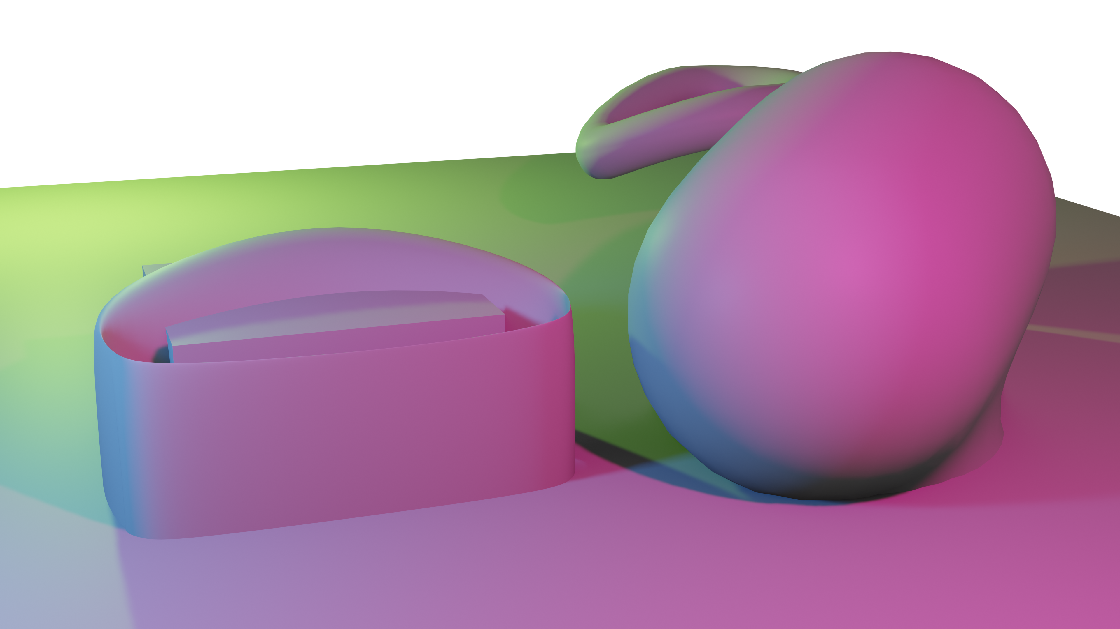
SAMPLE PRESENTATION
Example evidence view
Replace this concept visual with your own Blender screenshot or render. Keep the camera, version and acceptance result visible in the slide notes or caption.
Concept visual — validate against the editable Blender file.
Activity 2 · Generate a Blender Gold-Sphere Scene with AI-Assisted Python · TGS-2023037544
© Tertiary Infotech Academy Pte Ltd
3

Slide 4
VERIFY, DOCUMENT, SUBMIT
Activity 2 — acceptance evidence
ACCEPTANCE CHECKS
EVIDENCE TO SUBMIT
Script targets the installed Blender version
Exact prompt
No automatic file overwrite
Reviewed script
Outliner screenshot
Named sphere and material exist
Rendered result
Scale and placement verified
Completed .blend file
Render and Blender source saved
Activity 2 · Generate a Blender Gold-Sphere Scene with AI-Assisted Python · TGS-2023037544
© Tertiary Infotech Academy Pte Ltd
4

