Slide 1
03
ACTIVITY 3
Iterate and Repair an AI-Generated Blender Script
K2 · K6 · A2
Activity 3 · Iterate and Repair an AI-Generated Blender Script · TGS-2023037544
© Tertiary Infotech Academy Pte Ltd
1

Slide 2
ACTIVITY 3 · FOUNDATION TO INTERMEDIATE
Iterate and Repair an AI-Generated Blender Script
ACTIVITY 3
ALIGNMENT
A generated script fails after a Blender update and leaves partial objects in the scene.
K2 · K6 · A2
OBJECTIVE
DELIVERABLE
Diagnose a controlled script failure and use evidence-driven AI feedback to repair it safely.
A repaired rerunnable script, an error log and a before/after diagnosis.
Activity 3 · Iterate and Repair an AI-Generated Blender Script · TGS-2023037544
© Tertiary Infotech Academy Pte Ltd
2

Slide 3
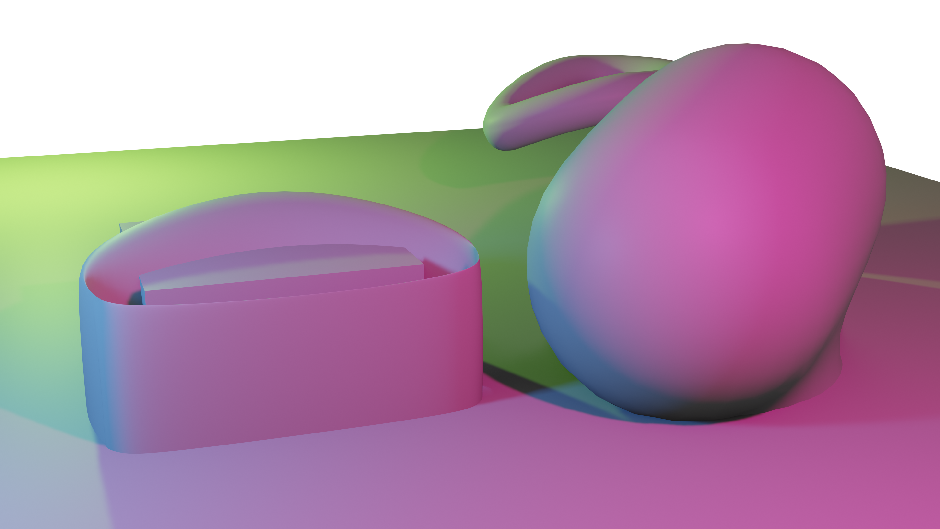
SAMPLE PRESENTATION
Example evidence view
Replace this concept visual with your own Blender screenshot or render. Keep the camera, version and acceptance result visible in the slide notes or caption.
Concept visual — validate against the editable Blender file.
Activity 3 · Iterate and Repair an AI-Generated Blender Script · TGS-2023037544
© Tertiary Infotech Academy Pte Ltd
3

Slide 4
VERIFY, DOCUMENT, SUBMIT
Activity 3 — acceptance evidence
ACCEPTANCE CHECKS
EVIDENCE TO SUBMIT
Full traceback captured
Error screenshot
Root cause classified
Root-cause statement
Before/after code excerpt
Patch is narrowly scoped
Two-run Outliner check
Second run creates no duplicates
Final script and .blend
Expected geometry and modifiers verified
Activity 3 · Iterate and Repair an AI-Generated Blender Script · TGS-2023037544
© Tertiary Infotech Academy Pte Ltd
4

