Slide 1
04
ACTIVITY 4
Develop and Select Three AI-Assisted Product Variants
K1 · K3 · A1 · A5
Activity 4 · Develop and Select Three AI-Assisted Product Variants · TGS-2023037544
© Tertiary Infotech Academy Pte Ltd
1

Slide 2
ACTIVITY 4 · INTERMEDIATE
Develop and Select Three AI-Assisted Product Variants
ACTIVITY 4
ALIGNMENT
Stakeholders want options for the desktop product but need a defendable recommendation, not a gallery of arbitrary shapes.
K1 · K3 · A1 · A5
OBJECTIVE
DELIVERABLE
Generate meaningful design alternatives and select one using weighted acceptance criteria.
Three normalized Blender blockouts, a weighted decision matrix and a selected direction.
Activity 4 · Develop and Select Three AI-Assisted Product Variants · TGS-2023037544
© Tertiary Infotech Academy Pte Ltd
2

Slide 3
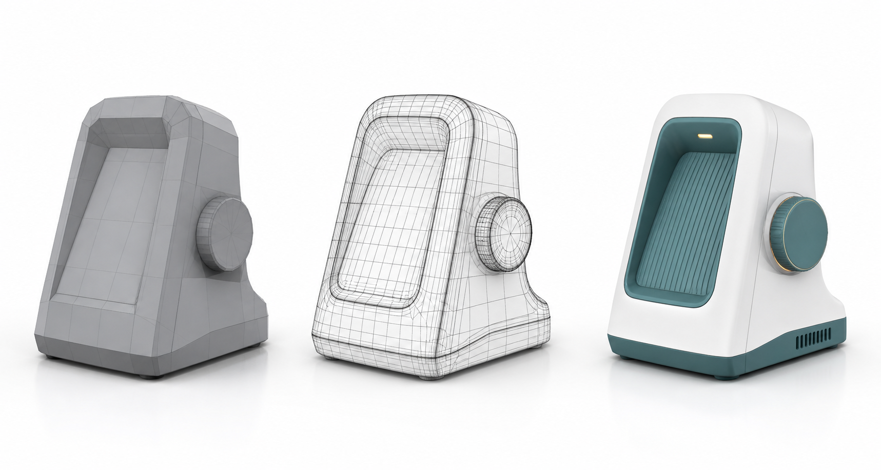
SAMPLE PRESENTATION
Example evidence view
Replace this concept visual with your own Blender screenshot or render. Keep the camera, version and acceptance result visible in the slide notes or caption.
Concept visual — validate against the editable Blender file.
Activity 4 · Develop and Select Three AI-Assisted Product Variants · TGS-2023037544
© Tertiary Infotech Academy Pte Ltd
3

Slide 4
VERIFY, DOCUMENT, SUBMIT
Activity 4 — acceptance evidence
ACCEPTANCE CHECKS
EVIDENCE TO SUBMIT
Three variants differ meaningfully
Nine comparable views
Common camera and lighting used
Weighted matrix
Sensitivity check
Criteria total 100%
Recommendation and mitigation
Scores cite evidence
Variant collections
Recommendation includes trade-off
Activity 4 · Develop and Select Three AI-Assisted Product Variants · TGS-2023037544
© Tertiary Infotech Academy Pte Ltd
4

