Slide 1
06
ACTIVITY 6
Repair Non-Manifold Geometry, Normals and Duplicate Data
K4 · A2 · A3
Activity 6 · Repair Non-Manifold Geometry, Normals and Duplicate Data · TGS-2023037544
© Tertiary Infotech Academy Pte Ltd
1

Slide 2
ACTIVITY 6 · INTERMEDIATE
Repair Non-Manifold Geometry, Normals and Duplicate Data
ACTIVITY 6
ALIGNMENT
The inspected model has a belly seam, flipped faces and doubled vertices that cause shading and export defects.
K4 · A2 · A3
OBJECTIVE
DELIVERABLE
Apply local, reversible repairs and prove that the original failing checks now pass.
A repaired manifold model with before/after evidence and regression results.
Activity 6 · Repair Non-Manifold Geometry, Normals and Duplicate Data · TGS-2023037544
© Tertiary Infotech Academy Pte Ltd
2

Slide 3
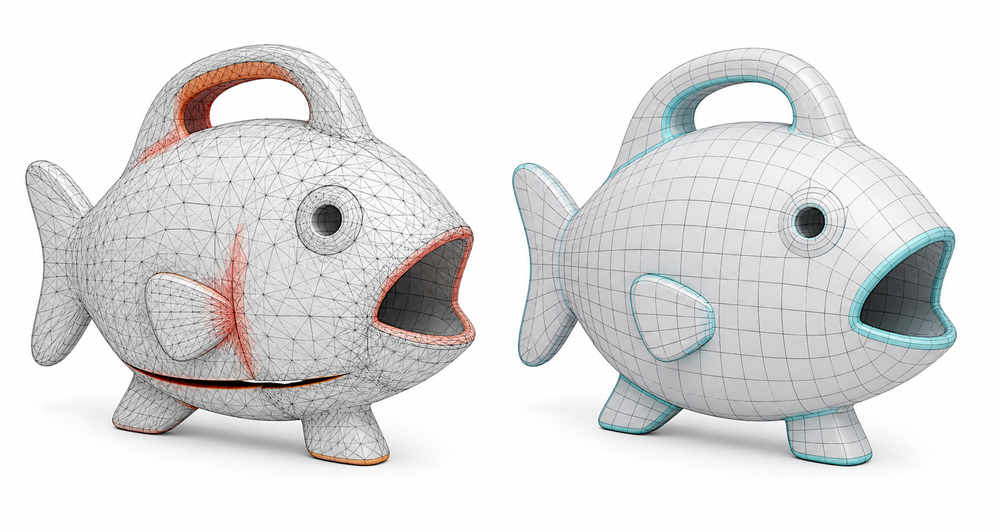
SAMPLE PRESENTATION
Example evidence view
Replace this concept visual with your own Blender screenshot or render. Keep the camera, version and acceptance result visible in the slide notes or caption.
Concept visual — validate against the editable Blender file.
Activity 6 · Repair Non-Manifold Geometry, Normals and Duplicate Data · TGS-2023037544
© Tertiary Infotech Academy Pte Ltd
3

Slide 4
VERIFY, DOCUMENT, SUBMIT
Activity 6 — acceptance evidence
ACCEPTANCE CHECKS
EVIDENCE TO SUBMIT
Baseline remains unchanged
Before/after Face Orientation
Merge threshold documented
Merged-vertex count
Repaired boundary close-up
Boundary repaired locally
Regression table
Normals face outward
Versioned Blender file
Regression checks pass
Activity 6 · Repair Non-Manifold Geometry, Normals and Duplicate Data · TGS-2023037544
© Tertiary Infotech Academy Pte Ltd
4

