Slide 1
07
ACTIVITY 7
Retopologize and Optimize an AI Mesh for Its Target Use
K2 · K4 · A3 · A4
Activity 7 · Retopologize and Optimize an AI Mesh for Its Target Use · TGS-2023037544
© Tertiary Infotech Academy Pte Ltd
1

Slide 2
ACTIVITY 7 · INTERMEDIATE TO ADVANCED
Retopologize and Optimize an AI Mesh for Its Target Use
ACTIVITY 7
ALIGNMENT
A dense generated mesh must become a responsive real-time asset without losing its recognizable silhouette.
K2 · K4 · A3 · A4
OBJECTIVE
DELIVERABLE
Select a retopology approach, meet a polygon budget and preserve critical form.
A target-use retopology, statistics comparison and feature-retention evidence.
Activity 7 · Retopologize and Optimize an AI Mesh for Its Target Use · TGS-2023037544
© Tertiary Infotech Academy Pte Ltd
2

Slide 3
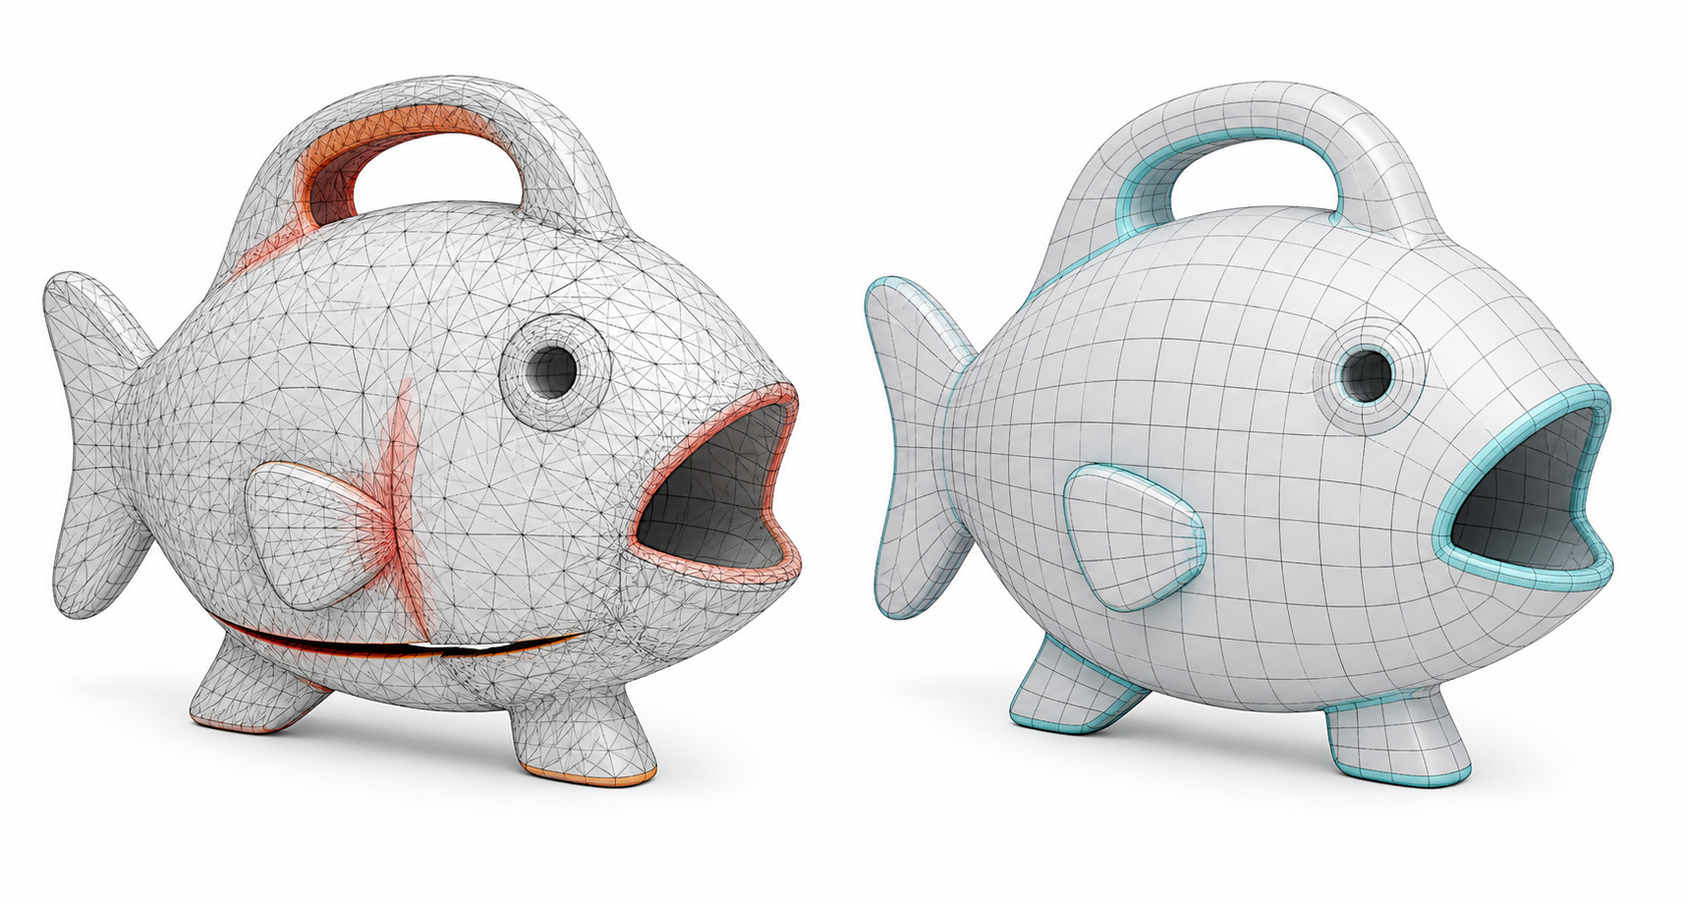
SAMPLE PRESENTATION
Example evidence view
Replace this concept visual with your own Blender screenshot or render. Keep the camera, version and acceptance result visible in the slide notes or caption.
Concept visual — validate against the editable Blender file.
Activity 7 · Retopologize and Optimize an AI Mesh for Its Target Use · TGS-2023037544
© Tertiary Infotech Academy Pte Ltd
3

Slide 4
VERIFY, DOCUMENT, SUBMIT
Activity 7 — acceptance evidence
ACCEPTANCE CHECKS
EVIDENCE TO SUBMIT
Target use and budget stated
High/low overlay
Method justified
Wireframe comparison
Statistics table
Silhouette retained
Triangulated preview
Topology checks pass
Limitations note
Reduction metrics recorded
Activity 7 · Retopologize and Optimize an AI Mesh for Its Target Use · TGS-2023037544
© Tertiary Infotech Academy Pte Ltd
4

