Slide 1
08
ACTIVITY 8
UV-Unwrap and Apply AI-Assisted PBR Materials
K2 · K5 · A3 · A4
Activity 8 · UV-Unwrap and Apply AI-Assisted PBR Materials · TGS-2023037544
© Tertiary Infotech Academy Pte Ltd
1

Slide 2
ACTIVITY 8 · INTERMEDIATE
UV-Unwrap and Apply AI-Assisted PBR Materials
ACTIVITY 8
ALIGNMENT
The optimized asset needs a consistent product finish and texture set suitable for review and export.
K2 · K5 · A3 · A4
OBJECTIVE
DELIVERABLE
Create usable UVs and physically plausible materials from AI-assisted references.
A UV-mapped Blender asset, validated material channels and texture evidence.
Activity 8 · UV-Unwrap and Apply AI-Assisted PBR Materials · TGS-2023037544
© Tertiary Infotech Academy Pte Ltd
2

Slide 3
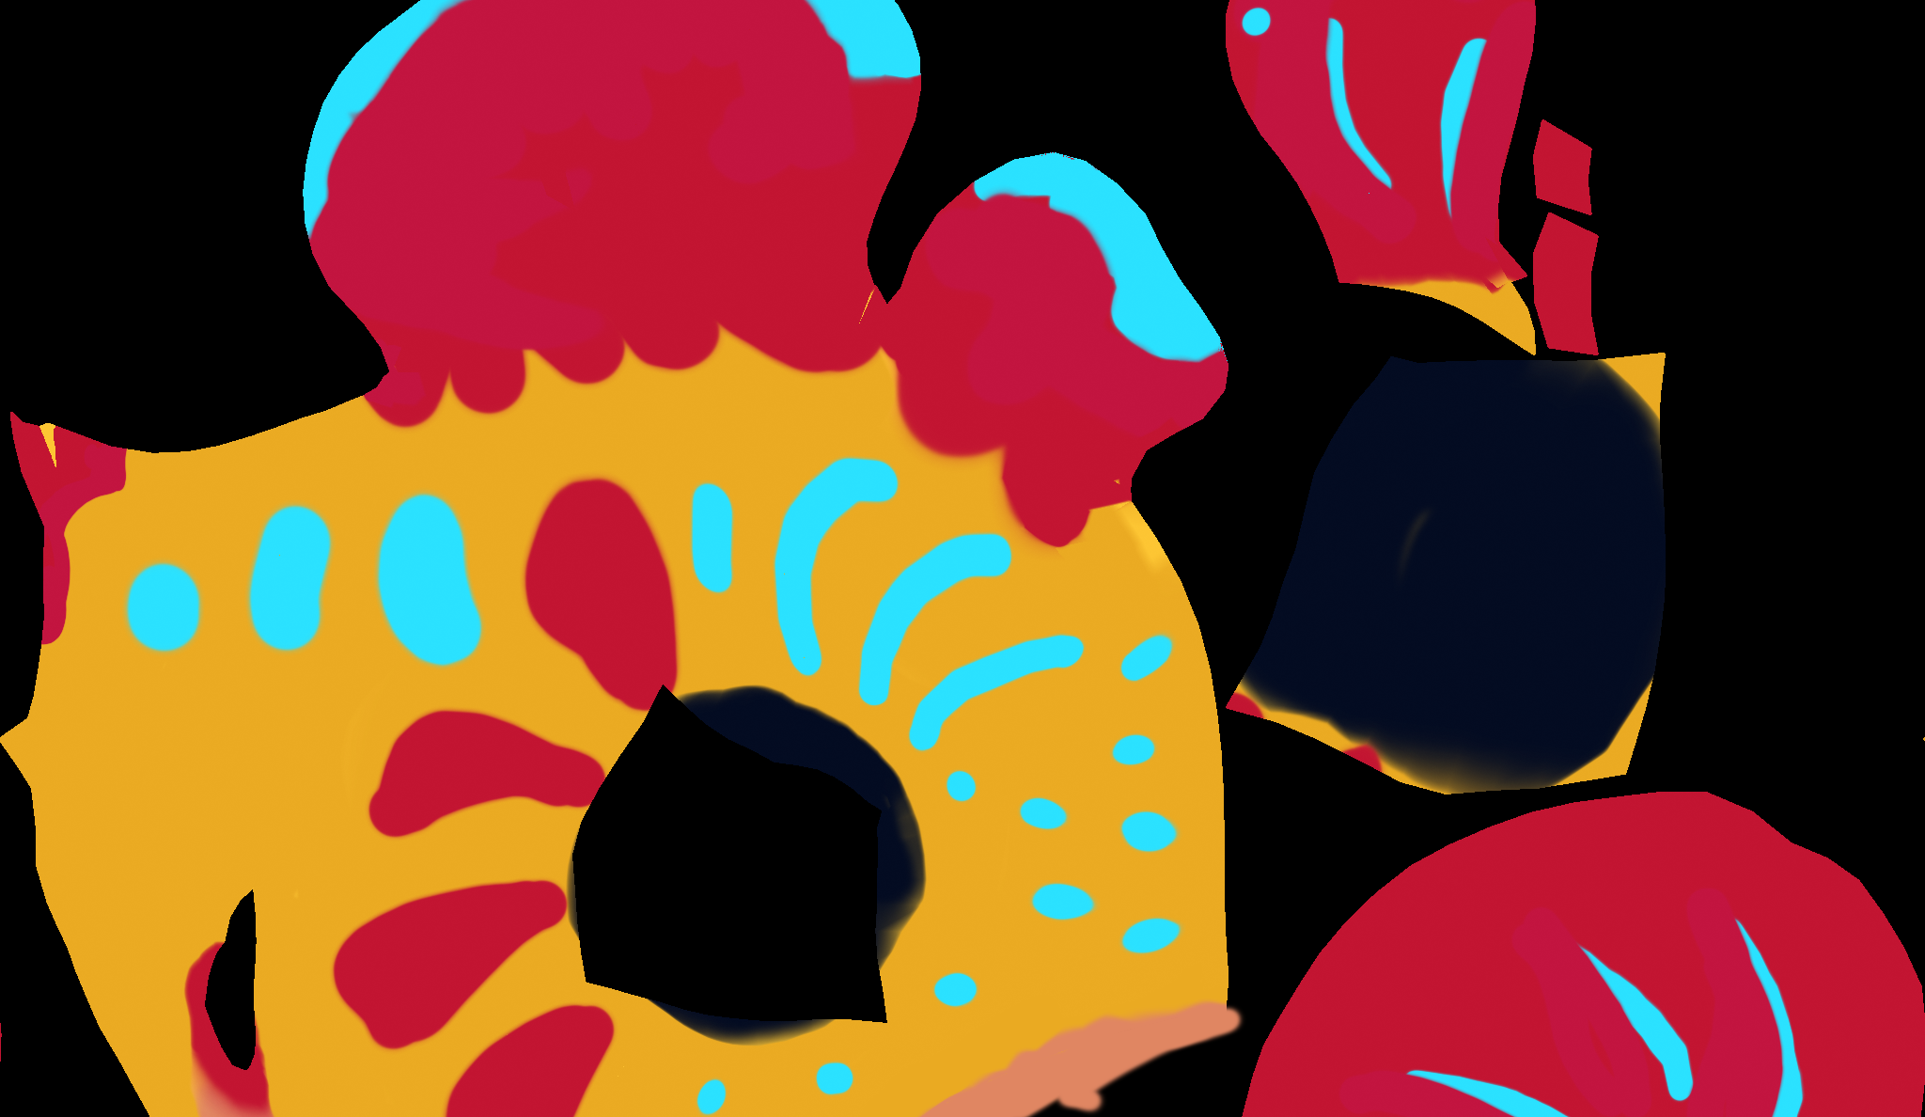
SAMPLE PRESENTATION
Example evidence view
Replace this concept visual with your own Blender screenshot or render. Keep the camera, version and acceptance result visible in the slide notes or caption.
Concept visual — validate against the editable Blender file.
Activity 8 · UV-Unwrap and Apply AI-Assisted PBR Materials · TGS-2023037544
© Tertiary Infotech Academy Pte Ltd
3

Slide 4
VERIFY, DOCUMENT, SUBMIT
Activity 8 — acceptance evidence
ACCEPTANCE CHECKS
EVIDENCE TO SUBMIT
Seams follow logical boundaries
UV layout screenshot
Checker shows acceptable distortion
Checker test
Shader graph
Texel density is consistent
Neutral-light material render
Colour spaces are correct
Texture register
Texture provenance recorded
Activity 8 · UV-Unwrap and Apply AI-Assisted PBR Materials · TGS-2023037544
© Tertiary Infotech Academy Pte Ltd
4

