Slide 1
09
ACTIVITY 9
Create a Neutral Studio Render and Visual QA Set
K3 · K5 · A3
Activity 9 · Create a Neutral Studio Render and Visual QA Set · TGS-2023037544
© Tertiary Infotech Academy Pte Ltd
1

Slide 2
ACTIVITY 9 · INTERMEDIATE
Create a Neutral Studio Render and Visual QA Set
ACTIVITY 9
ALIGNMENT
The design team needs evidence renders that reveal form and surface quality rather than hiding defects with dramatic lighting.
K3 · K5 · A3
OBJECTIVE
DELIVERABLE
Use consistent cameras, lighting and colour settings to create comparable validation evidence.
A four-view neutral render set and a documented render configuration.
Activity 9 · Create a Neutral Studio Render and Visual QA Set · TGS-2023037544
© Tertiary Infotech Academy Pte Ltd
2

Slide 3
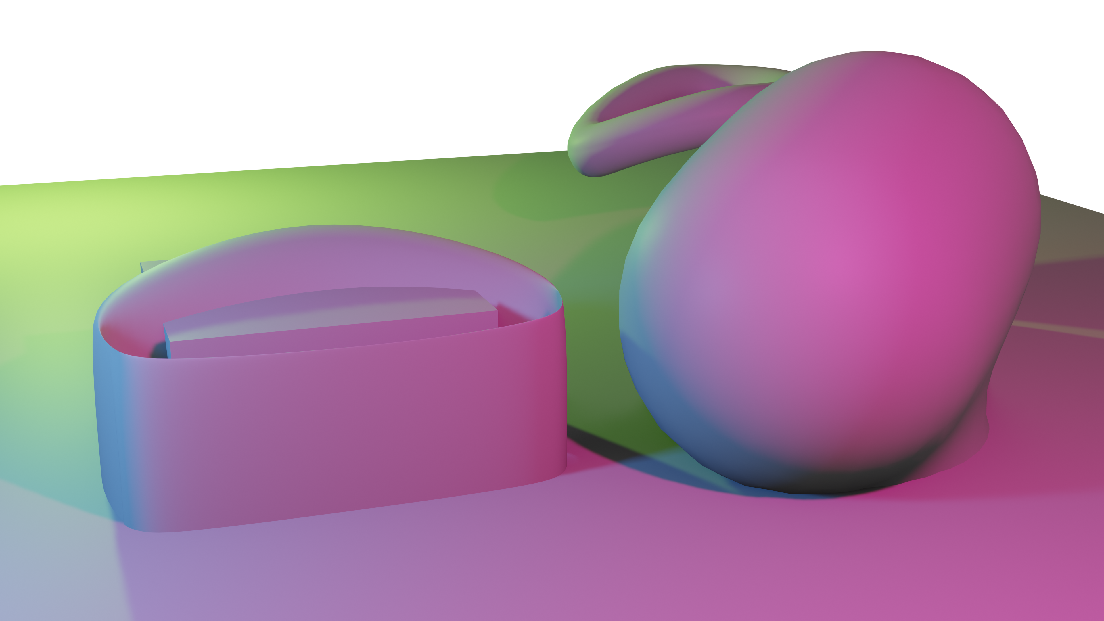
SAMPLE PRESENTATION
Example evidence view
Replace this concept visual with your own Blender screenshot or render. Keep the camera, version and acceptance result visible in the slide notes or caption.
Concept visual — validate against the editable Blender file.
Activity 9 · Create a Neutral Studio Render and Visual QA Set · TGS-2023037544
© Tertiary Infotech Academy Pte Ltd
3

Slide 4
VERIFY, DOCUMENT, SUBMIT
Activity 9 — acceptance evidence
ACCEPTANCE CHECKS
EVIDENCE TO SUBMIT
Four required views complete
Camera setup
Camera and exposure consistent
Lighting diagram
Four-view render set
Neutral lighting reveals form
Settings table
Render settings recorded
Surface QA note
Blocking artefacts resolved
Activity 9 · Create a Neutral Studio Render and Visual QA Set · TGS-2023037544
© Tertiary Infotech Academy Pte Ltd
4

