Slide 1
10
ACTIVITY 10
Prepare and Verify a Game/Visualization Export
K3 · K4 · K6 · A4 · A6
Activity 10 · Prepare and Verify a Game/Visualization Export · TGS-2023037544
© Tertiary Infotech Academy Pte Ltd
1

Slide 2
ACTIVITY 10 · ADVANCED
Prepare and Verify a Game/Visualization Export
ACTIVITY 10
ALIGNMENT
A client needs a GLB asset for a web product viewer with predictable scale, materials and performance.
K3 · K4 · K6 · A4 · A6
OBJECTIVE
DELIVERABLE
Package a model for real-time delivery and verify it through round-trip import.
A validated GLB export, round-trip Blender check and delivery record.
Activity 10 · Prepare and Verify a Game/Visualization Export · TGS-2023037544
© Tertiary Infotech Academy Pte Ltd
2

Slide 3
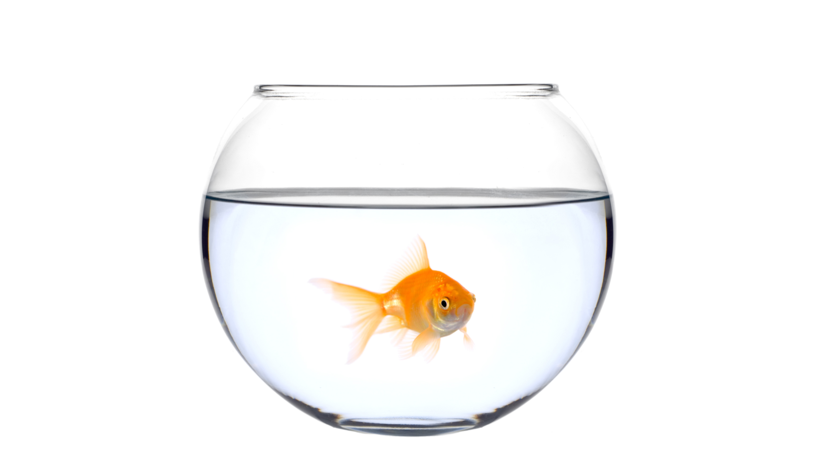
SAMPLE PRESENTATION
Example evidence view
Replace this concept visual with your own Blender screenshot or render. Keep the camera, version and acceptance result visible in the slide notes or caption.
Concept visual — validate against the editable Blender file.
Activity 10 · Prepare and Verify a Game/Visualization Export · TGS-2023037544
© Tertiary Infotech Academy Pte Ltd
3

Slide 4
VERIFY, DOCUMENT, SUBMIT
Activity 10 — acceptance evidence
ACCEPTANCE CHECKS
EVIDENCE TO SUBMIT
Target requirements stated
Export settings
Only approved objects exported
Final statistics
Source/import comparison
Scale and axes correct
Target-viewer screenshot
Materials survive round trip
Delivery package
Triangle budget met
Activity 10 · Prepare and Verify a Game/Visualization Export · TGS-2023037544
© Tertiary Infotech Academy Pte Ltd
4

