Slide 1
11
ACTIVITY 11
Prepare and Verify a 3D-Printable STL
K4 · K5 · A4 · A6
Activity 11 · Prepare and Verify a 3D-Printable STL · TGS-2023037544
© Tertiary Infotech Academy Pte Ltd
1

Slide 2
ACTIVITY 11 · ADVANCED
Prepare and Verify a 3D-Printable STL
ACTIVITY 11
ALIGNMENT
The product concept must be delivered as a small physical prototype for ergonomic review.
K4 · K5 · A4 · A6
OBJECTIVE
DELIVERABLE
Convert a model into a watertight, correctly scaled print candidate with manufacturability evidence.
A millimetre-scale STL, printable-source Blender file and slicer-readiness checklist.
Activity 11 · Prepare and Verify a 3D-Printable STL · TGS-2023037544
© Tertiary Infotech Academy Pte Ltd
2

Slide 3
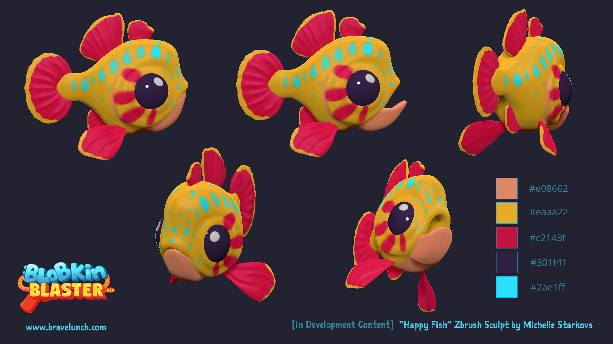
SAMPLE PRESENTATION
Example evidence view
Replace this concept visual with your own Blender screenshot or render. Keep the camera, version and acceptance result visible in the slide notes or caption.
Concept visual — validate against the editable Blender file.
Activity 11 · Prepare and Verify a 3D-Printable STL · TGS-2023037544
© Tertiary Infotech Academy Pte Ltd
3

Slide 4
VERIFY, DOCUMENT, SUBMIT
Activity 11 — acceptance evidence
ACCEPTANCE CHECKS
EVIDENCE TO SUBMIT
Print process and limits stated
Dimension screenshot
Closed manifold volume
Manifold/Face Orientation checks
Wall-thickness evidence
Wall thickness meets target
Re-import comparison
Re-import scale correct
Slicer or readiness report
Slicer warnings resolved or documented
Activity 11 · Prepare and Verify a 3D-Printable STL · TGS-2023037544
© Tertiary Infotech Academy Pte Ltd
4

