Slide 1
12
ACTIVITY 12
Capstone: Deliver an AI-Assisted 3D Asset Review Package
K1–K6 · A1–A6
Activity 12 · Capstone: Deliver an AI-Assisted 3D Asset Review Package · TGS-2023037544
© Tertiary Infotech Academy Pte Ltd
1

Slide 2
ACTIVITY 12 · ADVANCED
Capstone: Deliver an AI-Assisted 3D Asset Review Package
ACTIVITY 12
ALIGNMENT
You are accountable for a complete product-asset handoff that will be reviewed by design, production and business stakeholders.
K1–K6 · A1–A6
OBJECTIVE
DELIVERABLE
Integrate brief, AI assistance, Blender refinement, validation, export and stakeholder recommendation.
A release-candidate Blender asset, target export, validation dashboard and decision-ready presentation.
Activity 12 · Capstone: Deliver an AI-Assisted 3D Asset Review Package · TGS-2023037544
© Tertiary Infotech Academy Pte Ltd
2

Slide 3
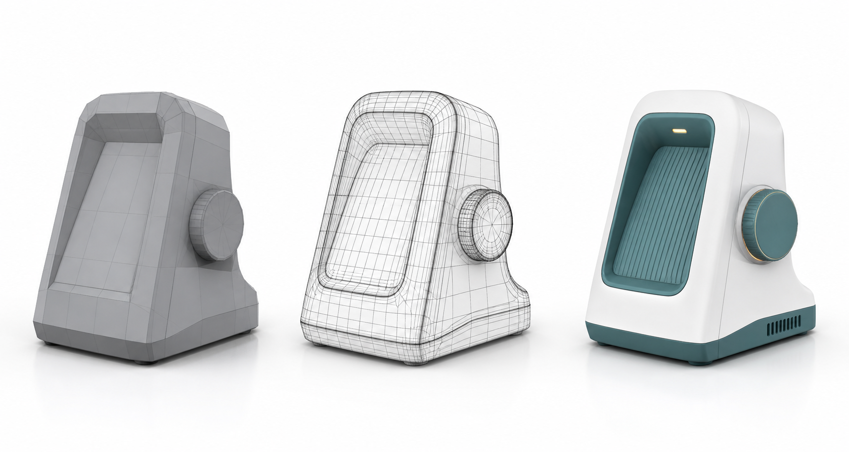
SAMPLE PRESENTATION
Example evidence view
Replace this concept visual with your own Blender screenshot or render. Keep the camera, version and acceptance result visible in the slide notes or caption.
Concept visual — validate against the editable Blender file.
Activity 12 · Capstone: Deliver an AI-Assisted 3D Asset Review Package · TGS-2023037544
© Tertiary Infotech Academy Pte Ltd
3

Slide 4
VERIFY, DOCUMENT, SUBMIT
Activity 12 — acceptance evidence
ACCEPTANCE CHECKS
EVIDENCE TO SUBMIT
All K/A areas evidenced
Brief and provenance
Baseline and versions traceable
Version history
Validation dashboard
Blocking checks passed
Final render set
Round-trip export verified
Round-trip result
Recommendation and limitations clear
Stakeholder presentation
Activity 12 · Capstone: Deliver an AI-Assisted 3D Asset Review Package · TGS-2023037544
© Tertiary Infotech Academy Pte Ltd
4

