Slide 1


WSQ COURSE SLIDES
Electrostatic Discharge (ESD) Control for Lab and Factory Engineers and Managers
TGS-2024051412
TSC: Electrostatic Discharge Control · ELE-OPR-4002-1.1
Tertiary Infotech Academy Pte Ltd · UEN 201200696W
Trainer: Dr Alfred Ang
v3.0 · 19 August 2026

Slide 2
MANDATORY
Digital Attendance (TRAQOM · SSG)
AM attendance
Scan the live QR code shown by the trainer.
PM attendance
Complete the required afternoon record.
1
2
Assessment attendance
Complete before sitting the assessment.
Use the live LMS
Do not reuse a screenshot or old QR code.
3
4
Electrostatic-Discharge-ESD-Control · TGS-2024051412
© Tertiary Infotech Academy Pte Ltd
1

Slide 3
GENERAL TRAINER
About the Trainer
NAME ____________________________________________
?
TITLE / DESIGNATION ____________________________________________
QUALIFICATIONS ____________________________________________
General Trainer
AREAS OF EXPERTISE ____________________________________________
Complete before class
TRAINING & INDUSTRY EXPERIENCE ____________________________________________
CONTACT ____________________________________________
Electrostatic-Discharge-ESD-Control · TGS-2024051412
© Tertiary Infotech Academy Pte Ltd
2

Slide 4
NAMED TRAINER
About the Trainer
NAME Dr Alfred Ang
AA
TITLE / DESIGNATION Founder and principal trainer
QUALIFICATIONS Doctorate · engineering and digital transformation
Dr Alfred Ang
AREAS OF EXPERTISE Technology, quality, process and AI-enabled work
Lead Trainer · Tertiary Infotech Academy
TRAINING & INDUSTRY EXPERIENCE Adult learning and enterprise implementation
CONTACT enquiry@tertiaryinfotech.com
Electrostatic-Discharge-ESD-Control · TGS-2024051412
© Tertiary Infotech Academy Pte Ltd
3

Slide 5
LEARNER INTRODUCTION
Let’s know each other
1
Name and role
2
Lab or factory process you support
3
One ESD challenge you want to solve
4
One measurement or control item you already use
Electrostatic-Discharge-ESD-Control · TGS-2024051412
© Tertiary Infotech Academy Pte Ltd
4

Slide 6
CLASS AGREEMENT
Ground Rules
Participate
Ask, challenge and share evidence.
Respect
One conversation; disagree with ideas, not people.
1
2
Protect confidentiality
Use fictional scenarios; do not expose customer data.
Be punctual
Return from breaks on time.
3
4
Phones silent
Step out quietly for urgent calls.
Safety first
Stop any activity that conflicts with site electrical or process safety.
5
6
Electrostatic-Discharge-ESD-Control · TGS-2024051412
© Tertiary Infotech Academy Pte Ltd
5

Slide 7
LESSON PLAN
Two-day course architecture
1
2
3
Day 1
Day 2
Assessment
ESD fundamentals, failure mechanisms and control implementation.
Standards, measurement, audit, incident response and management control.
1 h WA + 1 h Case Study; open book; submit on LMS.
Electrostatic-Discharge-ESD-Control · TGS-2024051412
© Tertiary Infotech Academy Pte Ltd
6

Slide 8
COURSE OUTCOMES
Learning Outcomes
LO1
Apply control measures to manage ESD generation based on ESD principles.
LO2
Evaluate and recommend actions to improve ESD control effectiveness in accordance with ESD standards.
1
2
Evidence
Eight realistic activities build audit-ready outputs.
Transfer
Every activity mirrors lab/factory decisions.
3
4
Electrostatic-Discharge-ESD-Control · TGS-2024051412
© Tertiary Infotech Academy Pte Ltd
7

Slide 9
ELECTROSTATIC DISCHARGE CONTROL · ELE-OPR-4002-1.1
TSC Knowledge and Abilities
1
K1
Introduction to ESD theory and principles, test models and ESD control items.
2
K2
Static control with respect to established ESD standards.
3
K3
Types of ESD instruments used for checks and measurements.
4
K4
Preventive measures to reduce the risk of ESD generation.
5
A1
Perform control measures to control the generation of ESD.
6
A2
Monitor the effectiveness of employed ESD control measures.
7
A3
Recommend follow-up actions to reduce the risk of ESD generation.
Electrostatic-Discharge-ESD-Control · TGS-2024051412
© Tertiary Infotech Academy Pte Ltd
8

Slide 10
ADMIN
Briefing for Assessment
CANDIDATE CONDUCT
INSTRUMENTS
● Individual work; no discussion.
● WA: 4 open-ended questions, K1–K4, 1 hour.
● Open book: course slides, Learner Guide and approved materials.
● Case Study: 2 open-ended tasks, A1–A3, 1 hour.
● Phones and other materials under the table.
● Submit completed answers on the LMS.
● Use black/blue pen; no correction fluid.
● Reassessment and appeal rights apply.
Electrostatic-Discharge-ESD-Control · TGS-2024051412
© Tertiary Infotech Academy Pte Ltd
9

Slide 11
ADMIN
Assessment and Funding
ELIGIBILITY
OUTCOME
● Minimum 75% SSG digital attendance.
● Assessment evidence must be your own work.
● Complete both assessment instruments.
● Assessor feedback explains the decision.
● Competent outcome required for successful completion.
● Appeal may be lodged through the published process.
Electrostatic-Discharge-ESD-Control · TGS-2024051412
© Tertiary Infotech Academy Pte Ltd
10

Slide 12
ASSESSMENT · OPEN BOOK
Assessment Flow
1
2
3
4
5
▶
▶
▶
▶
TRAQOM digital attendance
Assessment digital attendance
Sit WA then Case Study
Submit answers on the LMS
Sign Assessment Summary Record
Electrostatic-Discharge-ESD-Control · TGS-2024051412
© Tertiary Infotech Academy Pte Ltd
11

Slide 13
HANDS-ON MATERIALS
Access the Course Activities
1
2
3
4
▶
▶
▶
Open the course GitHub repository
Choose Clone or Download ZIP
Open the activities/ folder
Start with the numbered README
Open the course activity repository
Electrostatic-Discharge-ESD-Control · TGS-2024051412
© Tertiary Infotech Academy Pte Ltd
12

Slide 14
REASONING CHECKPOINT 1 OF 3
How to reason about ESD exposure
Recognise the charge source, field and vulnerable item before selecting a control.
1
Detailed execution steps and evidence templates are in the Learner Guide and activity folder.
Electrostatic-Discharge-ESD-Control · TGS-2024051412
© Tertiary Infotech Academy Pte Ltd
13

Slide 15
01
MODULE 1 · K1 · A1
Basics of ESD
Charge generation · discharge paths · HBM/MM/CDM · failure modes · business impact
Electrostatic-Discharge-ESD-Control · TGS-2024051412
© Tertiary Infotech Academy Pte Ltd
14

Slide 16
MODULE 1 · ESDA FUNDAMENTALS PART 1
A sudden charge transfer can damage a device without a visible spark or a felt shock.
Treat every unprotected ESDS item as vulnerable throughout handling, test, storage and service.
Electrostatic-Discharge-ESD-Control · TGS-2024051412
© Tertiary Infotech Academy Pte Ltd
15

Slide 17
MODULE 1 · ESDA FUNDAMENTALS PART 1
The charge–field–discharge chain
1
2
3
4
5
▶
▶
▶
▶
Contact and separation create charge
Charge remains on isolated conductors or insulators
An electric field polarises nearby objects
A conductive path forms
Fast current damages a vulnerable device
Electrostatic-Discharge-ESD-Control · TGS-2024051412
© Tertiary Infotech Academy Pte Ltd
16

Slide 18
MODULE 1 · ESDA FUNDAMENTALS PART 1
Triboelectric charging
Material pair
Different electron affinities drive polarity and magnitude.
Contact area
More intimate contact can transfer more charge.
1
2
Separation
Speed and force affect charge generation.
Environment
Humidity and contamination change surface leakage.
3
4
Electrostatic-Discharge-ESD-Control · TGS-2024051412
© Tertiary Infotech Academy Pte Ltd
17

Slide 19
MODULE 1 · ESDA FUNDAMENTALS PART 1
Conductors, dissipative materials and insulators
PRINCIPLE / USE
RISK / DECISION
● Conductors redistribute charge quickly and can be grounded.
● Insulators retain localised charge and cannot be neutralised by grounding alone.
● Dissipative materials move charge in a controlled manner.
● Low-charging, dissipative and shielding are different material functions.
Electrostatic-Discharge-ESD-Control · TGS-2024051412
© Tertiary Infotech Academy Pte Ltd
18

Slide 20
MODULE 1 · ESDA FUNDAMENTALS PART 1
A metal tool, trolley or fixture can remain charged when it has no verified path to ground.
Bonding removes potential differences; grounding provides a controlled reference path.
Electrostatic-Discharge-ESD-Control · TGS-2024051412
© Tertiary Infotech Academy Pte Ltd
19

Slide 21
MODULE 1 · ESDA FUNDAMENTALS PART 1
Electrostatic induction and polarisation
1
2
3
4
5
▶
▶
▶
▶
Charged object approaches
Field redistributes charge in nearby conductor
Temporary ground connection permits charge flow
Ground is removed
Object retains a net charge after the field leaves
Electrostatic-Discharge-ESD-Control · TGS-2024051412
© Tertiary Infotech Academy Pte Ltd
20

Slide 22
MODULE 1 · ANALOG DEVICES ESD GLOSSARY
Contact discharge versus air discharge
PRINCIPLE / USE
RISK / DECISION
● Contact discharge: differently charged objects touch and charge transfers directly.
● Air discharge: a strong field ionises an air gap before contact.
● Waveform depends on the source, path impedance and contact geometry.
● Visible sparks represent only a subset of damaging ESD events.
Electrostatic-Discharge-ESD-Control · TGS-2024051412
© Tertiary Infotech Academy Pte Ltd
21

Slide 23
MODULE 1 · ESDA FUNDAMENTALS PART 1
What controls discharge severity?
Voltage difference
Stored potential is one risk indicator, not the whole event.
Capacitance
More stored charge can raise available energy.
1
2
Path impedance
Resistance and inductance shape peak current and rise time.
Device sensitivity
Pins, package and internal structures determine failure threshold.
3
4
Electrostatic-Discharge-ESD-Control · TGS-2024051412
© Tertiary Infotech Academy Pte Ltd
22

Slide 24
MODULE 1 · ANALOG DEVICES ESD GLOSSARY
Human Body Model (HBM)
PRINCIPLE / USE
RISK / DECISION
● Represents a charged person discharging through a device pin.
● A laboratory model—not a prediction of every factory event.
● Useful for component qualification and handling robustness.
● Use supplier sensitivity data and the applicable controlled test method.
Electrostatic-Discharge-ESD-Control · TGS-2024051412
© Tertiary Infotech Academy Pte Ltd
23

Slide 25
MODULE 1 · ANALOG DEVICES ESD GLOSSARY
Machine Model (MM): legacy context
PRINCIPLE / USE
RISK / DECISION
● Historically represented charged metal equipment with a low-impedance discharge.
● Do not assume correlation with HBM or CDM.
● Appears in the legacy deck and some older literature.
● Use the test model and revision required by the current product/customer specification.
Electrostatic-Discharge-ESD-Control · TGS-2024051412
© Tertiary Infotech Academy Pte Ltd
24

Slide 26
MODULE 1 · ESDA FUNDAMENTALS PART 1
Charged Device Model (CDM)
1
2
3
4
5
▶
▶
▶
▶
Device package becomes charged
Device approaches grounded metal
One pin makes first contact
Very fast discharge leaves the device
Local current density stresses internal structures
Electrostatic-Discharge-ESD-Control · TGS-2024051412
© Tertiary Infotech Academy Pte Ltd
25

Slide 27
MODULE 1 · ANALOG DEVICES ESD GLOSSARY
HBM, MM and CDM are not interchangeable
1
2
3
HBM
MM
CDM
Charged person → device; handling-oriented component model.
Legacy charged-machine representation; limited correlation.
Charged device → ground; very fast package-dependent event.
Electrostatic-Discharge-ESD-Control · TGS-2024051412
© Tertiary Infotech Academy Pte Ltd
26

Slide 28
MODULE 1 · ESDA FUNDAMENTALS PART 1
Catastrophic failure
Metal melt
Current density damages interconnects.
Junction breakdown
Semiconductor junction no longer meets specification.
1
2
Oxide rupture
Thin dielectric is punctured.
Immediate detection
Device may fail functional or parametric test.
3
4
Electrostatic-Discharge-ESD-Control · TGS-2024051412
© Tertiary Infotech Academy Pte Ltd
27

Slide 29
MODULE 1 · ESDA FUNDAMENTALS PART 1; ANALOG DEVICES
Latent and cumulative degradation
PRINCIPLE / USE
RISK / DECISION
● A degraded device may still pass initial functional test.
● The latent-failure concept is debated; evidence must distinguish ESD from other overstress causes.
● Leakage or margins can shift after an event.
● Repeated mishandling can cumulatively degrade parameters.
Electrostatic-Discharge-ESD-Control · TGS-2024051412
© Tertiary Infotech Academy Pte Ltd
28

Slide 30
MODULE 1 · ESDA FUNDAMENTALS PART 1
ESD versus electrical overstress (EOS)
PRINCIPLE / USE
RISK / DECISION
● ESD: rapid electrostatic charge transfer, usually short duration and fast rise time.
● EOS: broader excessive electrical energy exposure from power, wiring or transients.
● Evidence includes handling history, field sources and microscopic damage pattern.
● Do not label every burnt part as ESD without a disciplined failure analysis.
Electrostatic-Discharge-ESD-Control · TGS-2024051412
© Tertiary Infotech Academy Pte Ltd
29

Slide 31
MODULE 1 · ESDA FUNDAMENTALS PART 1
Where exposure occurs
1
2
3
4
5
▶
▶
▶
▶
Component manufacture
Incoming inspection
Assembly and test
Packaging and logistics
Installation and field service
Electrostatic-Discharge-ESD-Control · TGS-2024051412
© Tertiary Infotech Academy Pte Ltd
30

Slide 32
MODULE 1 · ESDA FUNDAMENTALS PART 1
Which devices may be sensitive?
Semiconductors
ICs, MOSFETs, diodes and precision analog parts.
Assemblies
Populated PCBs and hybrid circuits.
1
2
Sensors
Optoelectronic, microwave, piezoelectric and recording-head devices.
Supplier data
Actual sensitivity comes from product qualification information.
3
4
Electrostatic-Discharge-ESD-Control · TGS-2024051412
© Tertiary Infotech Academy Pte Ltd
31

Slide 33
MODULE 1 · ESDA FUNDAMENTALS PART 1
Economic impact pathway
1
2
3
4
5
▶
▶
▶
▶
Undetected ESD exposure
Yield loss or rework
Escapes and field returns
Warranty and investigation cost
Customer trust and regulatory impact
Electrostatic-Discharge-ESD-Control · TGS-2024051412
© Tertiary Infotech Academy Pte Ltd
32

Slide 34
MODULE 1 · ESDA FUNDAMENTALS PART 1
Risk-based prioritisation
Sensitivity
Lowest credible device withstand level.
Exposure
People, motion, insulators, automation and transport.
1
2
Detectability
Whether damage is caught before shipment.
Consequence
Safety, quality, cost, customer and downtime impact.
3
4
Electrostatic-Discharge-ESD-Control · TGS-2024051412
© Tertiary Infotech Academy Pte Ltd
33

Slide 35

MODULE 1 · OLD PPT PICTURE PROVENANCE
Imported legacy visual reference
Old PPT slide 1 · picture 1.
Imported in full for legacy traceability. Current controlled standards and procedures govern operational decisions.
Electrostatic-Discharge-ESD-Control · TGS-2024051412
© Tertiary Infotech Academy Pte Ltd
34

Slide 36

MODULE 1 · OLD PPT PICTURE PROVENANCE
Imported legacy visual reference
Old PPT slide 4 · picture 1.
Imported in full for legacy traceability. Current controlled standards and procedures govern operational decisions.
Electrostatic-Discharge-ESD-Control · TGS-2024051412
© Tertiary Infotech Academy Pte Ltd
35

Slide 37

MODULE 1 · OLD PPT PICTURE PROVENANCE
Imported legacy visual reference
Old PPT slide 16 · picture 1. Historical QR/screen capture only—use the live LMS.
Imported in full for legacy traceability. Current controlled standards and procedures govern operational decisions.
Electrostatic-Discharge-ESD-Control · TGS-2024051412
© Tertiary Infotech Academy Pte Ltd
36

Slide 38
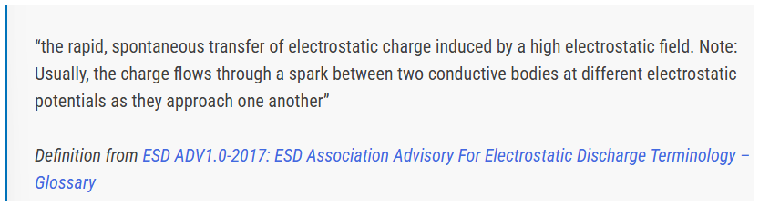
MODULE 1 · OLD PPT PICTURE PROVENANCE
Imported legacy visual reference
Old PPT slide 18 · picture 1.
Imported in full for legacy traceability. Current controlled standards and procedures govern operational decisions.
Electrostatic-Discharge-ESD-Control · TGS-2024051412
© Tertiary Infotech Academy Pte Ltd
37

Slide 39
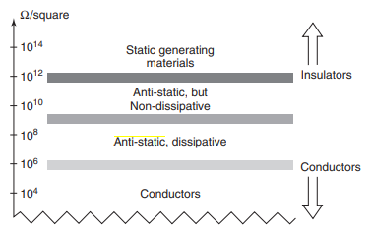
MODULE 1 · OLD PPT PICTURE PROVENANCE
Imported legacy visual reference
Old PPT slide 19 · picture 1.
Imported in full for legacy traceability. Current controlled standards and procedures govern operational decisions.
Electrostatic-Discharge-ESD-Control · TGS-2024051412
© Tertiary Infotech Academy Pte Ltd
38

Slide 40
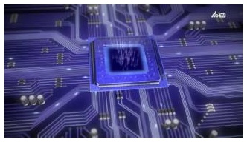
MODULE 1 · OLD PPT PICTURE PROVENANCE
Imported legacy visual reference
Old PPT slide 23 · picture 1.
Imported in full for legacy traceability. Current controlled standards and procedures govern operational decisions.
Electrostatic-Discharge-ESD-Control · TGS-2024051412
© Tertiary Infotech Academy Pte Ltd
39

Slide 41
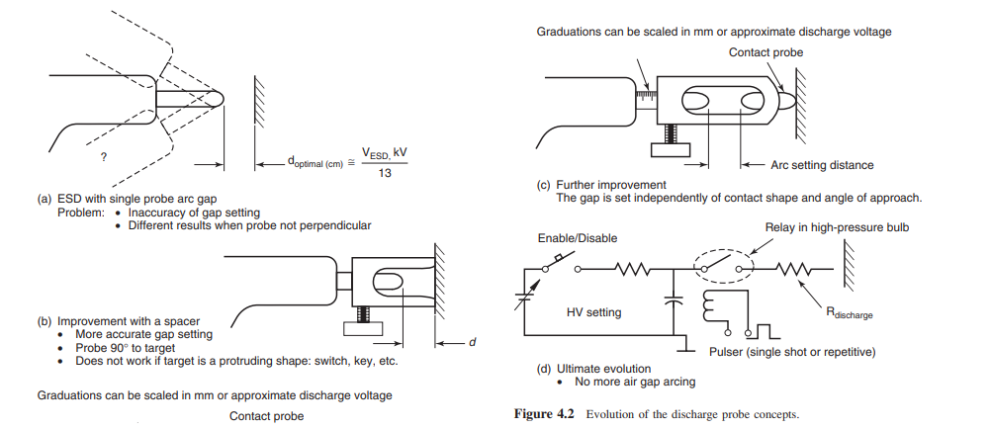
MODULE 1 · OLD PPT PICTURE PROVENANCE
Imported legacy visual reference
Old PPT slide 27 · picture 1.
Imported in full for legacy traceability. Current controlled standards and procedures govern operational decisions.
Electrostatic-Discharge-ESD-Control · TGS-2024051412
© Tertiary Infotech Academy Pte Ltd
40

Slide 42
MODULE 1 · OLD PPT PICTURE PROVENANCE
Imported legacy visual reference
Old PPT slide 28 · picture 1 · duplicate of slide-027-pic-01-9a79567128.png.
Imported in full for legacy traceability. Current controlled standards and procedures govern operational decisions.
Electrostatic-Discharge-ESD-Control · TGS-2024051412
© Tertiary Infotech Academy Pte Ltd
41

Slide 43
MODULE 1 · OLD PPT PICTURE PROVENANCE
Imported legacy visual reference
Old PPT slide 29 · picture 1 · duplicate of slide-027-pic-01-9a79567128.png.
Imported in full for legacy traceability. Current controlled standards and procedures govern operational decisions.
Electrostatic-Discharge-ESD-Control · TGS-2024051412
© Tertiary Infotech Academy Pte Ltd
42

Slide 44
MODULE 1 · OLD PPT PICTURE PROVENANCE
Imported legacy visual reference
Old PPT slide 30 · picture 1 · duplicate of slide-027-pic-01-9a79567128.png.
Imported in full for legacy traceability. Current controlled standards and procedures govern operational decisions.
Electrostatic-Discharge-ESD-Control · TGS-2024051412
© Tertiary Infotech Academy Pte Ltd
43

Slide 45
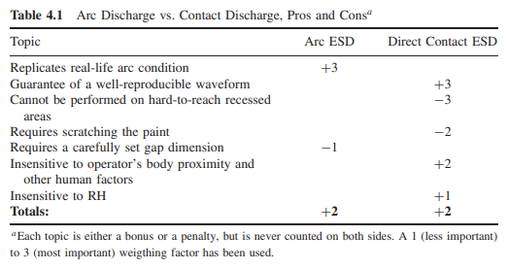
MODULE 1 · OLD PPT PICTURE PROVENANCE
Imported legacy visual reference
Old PPT slide 31 · picture 1.
Imported in full for legacy traceability. Current controlled standards and procedures govern operational decisions.
Electrostatic-Discharge-ESD-Control · TGS-2024051412
© Tertiary Infotech Academy Pte Ltd
44

Slide 46
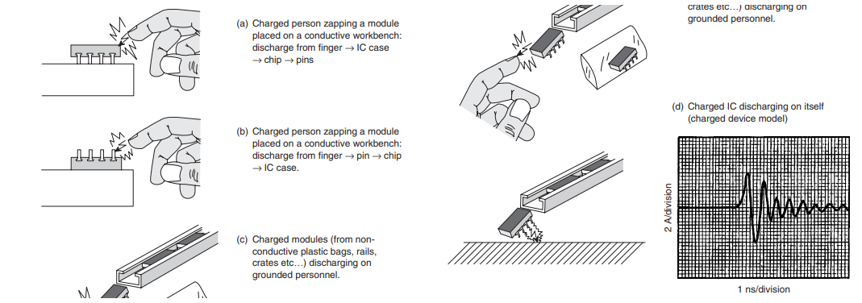
MODULE 1 · OLD PPT PICTURE PROVENANCE
Imported legacy visual reference
Old PPT slide 32 · picture 1.
Imported in full for legacy traceability. Current controlled standards and procedures govern operational decisions.
Electrostatic-Discharge-ESD-Control · TGS-2024051412
© Tertiary Infotech Academy Pte Ltd
45

Slide 47
MODULE 1 · OLD PPT PICTURE PROVENANCE
Imported legacy visual reference
Old PPT slide 33 · picture 1 · duplicate of slide-032-pic-01-5dc26c4294.png.
Imported in full for legacy traceability. Current controlled standards and procedures govern operational decisions.
Electrostatic-Discharge-ESD-Control · TGS-2024051412
© Tertiary Infotech Academy Pte Ltd
46

Slide 48
MODULE 1 · OLD PPT PICTURE PROVENANCE
Imported legacy visual reference
Old PPT slide 34 · picture 1 · duplicate of slide-032-pic-01-5dc26c4294.png.
Imported in full for legacy traceability. Current controlled standards and procedures govern operational decisions.
Electrostatic-Discharge-ESD-Control · TGS-2024051412
© Tertiary Infotech Academy Pte Ltd
47

Slide 49

MODULE 1 · OLD PPT PICTURE PROVENANCE
Imported legacy visual reference
Old PPT slide 35 · picture 1.
Imported in full for legacy traceability. Current controlled standards and procedures govern operational decisions.
Electrostatic-Discharge-ESD-Control · TGS-2024051412
© Tertiary Infotech Academy Pte Ltd
48

Slide 50
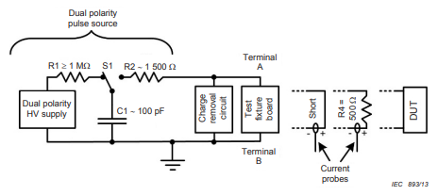
MODULE 1 · OLD PPT PICTURE PROVENANCE
Imported legacy visual reference
Old PPT slide 39 · picture 1.
Imported in full for legacy traceability. Current controlled standards and procedures govern operational decisions.
Electrostatic-Discharge-ESD-Control · TGS-2024051412
© Tertiary Infotech Academy Pte Ltd
49

Slide 51
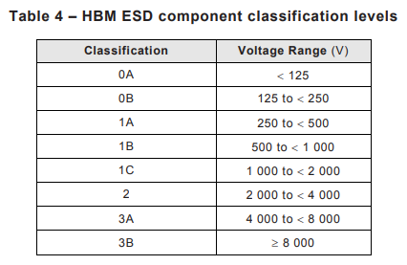
MODULE 1 · OLD PPT PICTURE PROVENANCE
Imported legacy visual reference
Old PPT slide 40 · picture 1.
Imported in full for legacy traceability. Current controlled standards and procedures govern operational decisions.
Electrostatic-Discharge-ESD-Control · TGS-2024051412
© Tertiary Infotech Academy Pte Ltd
50

Slide 52
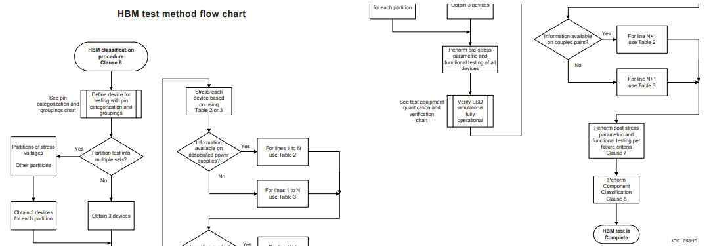
MODULE 1 · OLD PPT PICTURE PROVENANCE
Imported legacy visual reference
Old PPT slide 41 · picture 1.
Imported in full for legacy traceability. Current controlled standards and procedures govern operational decisions.
Electrostatic-Discharge-ESD-Control · TGS-2024051412
© Tertiary Infotech Academy Pte Ltd
51

Slide 53
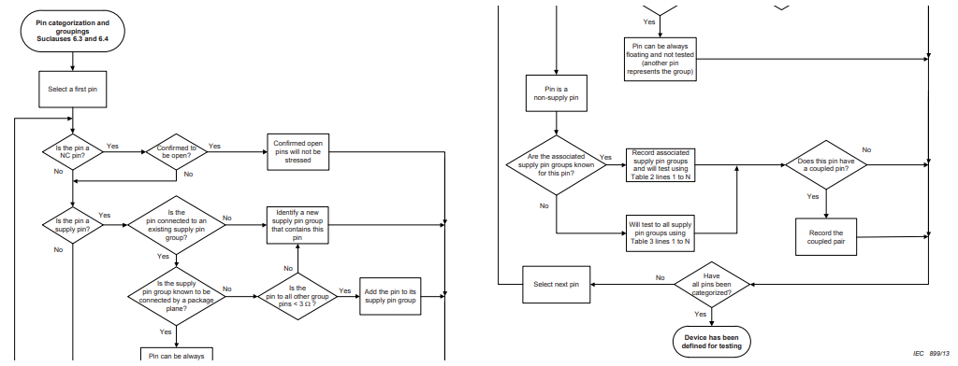
MODULE 1 · OLD PPT PICTURE PROVENANCE
Imported legacy visual reference
Old PPT slide 42 · picture 1.
Imported in full for legacy traceability. Current controlled standards and procedures govern operational decisions.
Electrostatic-Discharge-ESD-Control · TGS-2024051412
© Tertiary Infotech Academy Pte Ltd
52

Slide 54
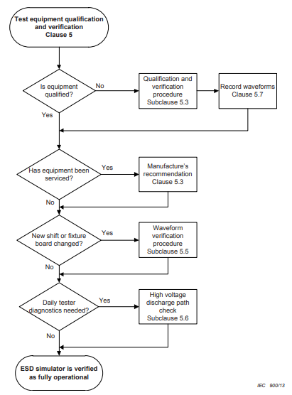
MODULE 1 · OLD PPT PICTURE PROVENANCE
Imported legacy visual reference
Old PPT slide 43 · picture 1.
Imported in full for legacy traceability. Current controlled standards and procedures govern operational decisions.
Electrostatic-Discharge-ESD-Control · TGS-2024051412
© Tertiary Infotech Academy Pte Ltd
53

Slide 55
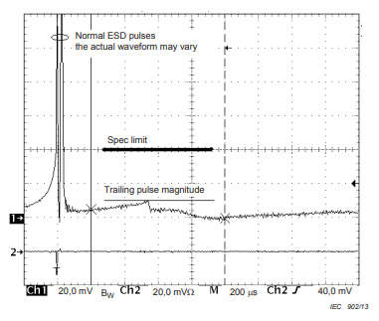
MODULE 1 · OLD PPT PICTURE PROVENANCE
Imported legacy visual reference
Old PPT slide 44 · picture 1.
Imported in full for legacy traceability. Current controlled standards and procedures govern operational decisions.
Electrostatic-Discharge-ESD-Control · TGS-2024051412
© Tertiary Infotech Academy Pte Ltd
54

Slide 56
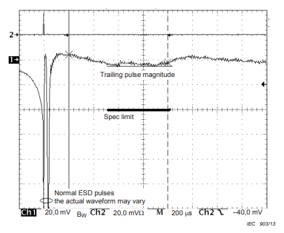
MODULE 1 · OLD PPT PICTURE PROVENANCE
Imported legacy visual reference
Old PPT slide 45 · picture 1.
Imported in full for legacy traceability. Current controlled standards and procedures govern operational decisions.
Electrostatic-Discharge-ESD-Control · TGS-2024051412
© Tertiary Infotech Academy Pte Ltd
55

Slide 57
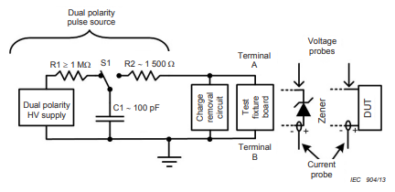
MODULE 1 · OLD PPT PICTURE PROVENANCE
Imported legacy visual reference
Old PPT slide 46 · picture 1.
Imported in full for legacy traceability. Current controlled standards and procedures govern operational decisions.
Electrostatic-Discharge-ESD-Control · TGS-2024051412
© Tertiary Infotech Academy Pte Ltd
56

Slide 58
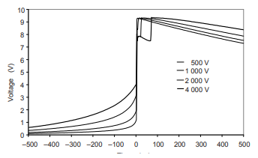
MODULE 1 · OLD PPT PICTURE PROVENANCE
Imported legacy visual reference
Old PPT slide 47 · picture 1.
Imported in full for legacy traceability. Current controlled standards and procedures govern operational decisions.
Electrostatic-Discharge-ESD-Control · TGS-2024051412
© Tertiary Infotech Academy Pte Ltd
57

Slide 59
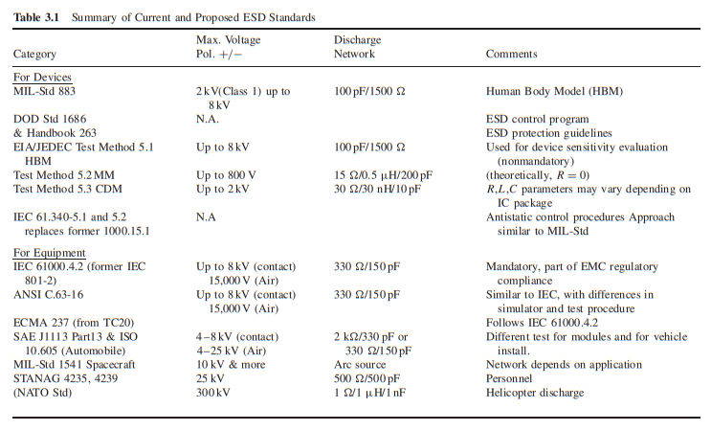
MODULE 1 · OLD PPT PICTURE PROVENANCE
Imported legacy visual reference
Old PPT slide 60 · picture 1.
Imported in full for legacy traceability. Current controlled standards and procedures govern operational decisions.
Electrostatic-Discharge-ESD-Control · TGS-2024051412
© Tertiary Infotech Academy Pte Ltd
58

Slide 60
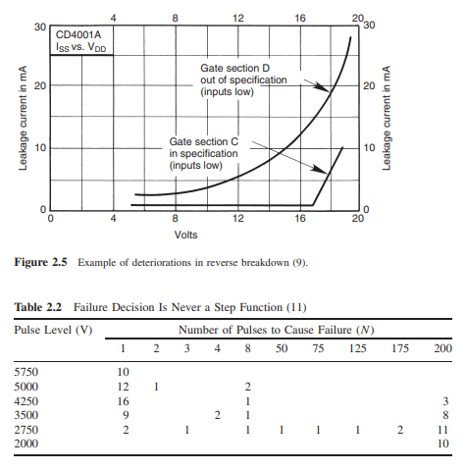
MODULE 1 · OLD PPT PICTURE PROVENANCE
Imported legacy visual reference
Old PPT slide 62 · picture 1.
Imported in full for legacy traceability. Current controlled standards and procedures govern operational decisions.
Electrostatic-Discharge-ESD-Control · TGS-2024051412
© Tertiary Infotech Academy Pte Ltd
59

Slide 61
MODULE 1 · OLD PPT PICTURE PROVENANCE
Imported legacy visual reference
Old PPT slide 63 · picture 1 · duplicate of slide-062-pic-01-dc1d520dc4.png.
Imported in full for legacy traceability. Current controlled standards and procedures govern operational decisions.
Electrostatic-Discharge-ESD-Control · TGS-2024051412
© Tertiary Infotech Academy Pte Ltd
60

Slide 62
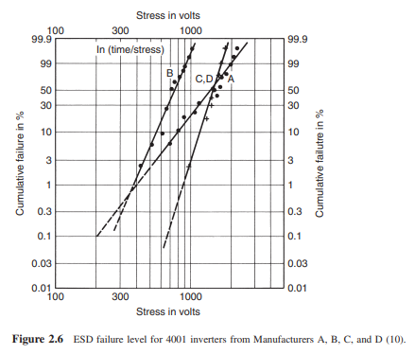
MODULE 1 · OLD PPT PICTURE PROVENANCE
Imported legacy visual reference
Old PPT slide 64 · picture 1.
Imported in full for legacy traceability. Current controlled standards and procedures govern operational decisions.
Electrostatic-Discharge-ESD-Control · TGS-2024051412
© Tertiary Infotech Academy Pte Ltd
61

Slide 63
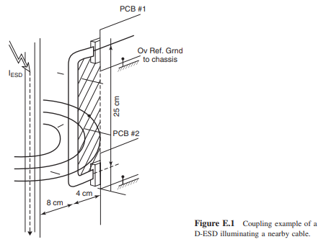
MODULE 1 · OLD PPT PICTURE PROVENANCE
Imported legacy visual reference
Old PPT slide 65 · picture 1.
Imported in full for legacy traceability. Current controlled standards and procedures govern operational decisions.
Electrostatic-Discharge-ESD-Control · TGS-2024051412
© Tertiary Infotech Academy Pte Ltd
62

Slide 64
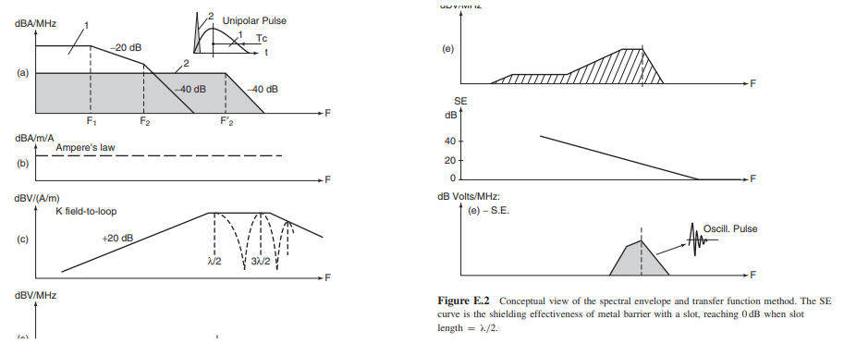
MODULE 1 · OLD PPT PICTURE PROVENANCE
Imported legacy visual reference
Old PPT slide 66 · picture 1.
Imported in full for legacy traceability. Current controlled standards and procedures govern operational decisions.
Electrostatic-Discharge-ESD-Control · TGS-2024051412
© Tertiary Infotech Academy Pte Ltd
63

Slide 65
MODULE 1 · OLD PPT PICTURE PROVENANCE
Imported legacy visual reference
Old PPT slide 67 · picture 1 · duplicate of slide-066-pic-01-b329c72cda.png.
Imported in full for legacy traceability. Current controlled standards and procedures govern operational decisions.
Electrostatic-Discharge-ESD-Control · TGS-2024051412
© Tertiary Infotech Academy Pte Ltd
64

Slide 66
MODULE 1 · OLD PPT PICTURE PROVENANCE
Imported legacy visual reference
Old PPT slide 68 · picture 1 · duplicate of slide-066-pic-01-b329c72cda.png.
Imported in full for legacy traceability. Current controlled standards and procedures govern operational decisions.
Electrostatic-Discharge-ESD-Control · TGS-2024051412
© Tertiary Infotech Academy Pte Ltd
65

Slide 67
MODULE 1 · OLD PPT PICTURE PROVENANCE
Imported legacy visual reference
Old PPT slide 69 · picture 1 · duplicate of slide-066-pic-01-b329c72cda.png.
Imported in full for legacy traceability. Current controlled standards and procedures govern operational decisions.
Electrostatic-Discharge-ESD-Control · TGS-2024051412
© Tertiary Infotech Academy Pte Ltd
66

Slide 68
MODULE 1 · OLD PPT PICTURE PROVENANCE
Imported legacy visual reference
Old PPT slide 70 · picture 1 · duplicate of slide-066-pic-01-b329c72cda.png.
Imported in full for legacy traceability. Current controlled standards and procedures govern operational decisions.
Electrostatic-Discharge-ESD-Control · TGS-2024051412
© Tertiary Infotech Academy Pte Ltd
67

Slide 69
MODULE 1 · OLD PPT PICTURE PROVENANCE
Imported legacy visual reference
Old PPT slide 71 · picture 1 · duplicate of slide-066-pic-01-b329c72cda.png.
Imported in full for legacy traceability. Current controlled standards and procedures govern operational decisions.
Electrostatic-Discharge-ESD-Control · TGS-2024051412
© Tertiary Infotech Academy Pte Ltd
68

Slide 70
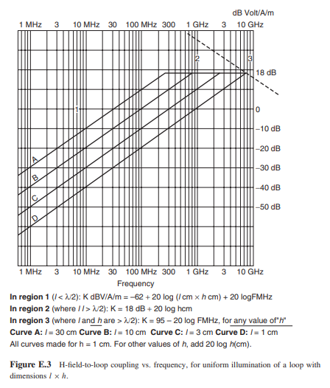
MODULE 1 · OLD PPT PICTURE PROVENANCE
Imported legacy visual reference
Old PPT slide 72 · picture 1.
Imported in full for legacy traceability. Current controlled standards and procedures govern operational decisions.
Electrostatic-Discharge-ESD-Control · TGS-2024051412
© Tertiary Infotech Academy Pte Ltd
69

Slide 71
MODULE 1 · OLD PPT PICTURE PROVENANCE
Imported legacy visual reference
Old PPT slide 72 · picture 2 · duplicate of slide-072-pic-01-21610763b0.png.
Imported in full for legacy traceability. Current controlled standards and procedures govern operational decisions.
Electrostatic-Discharge-ESD-Control · TGS-2024051412
© Tertiary Infotech Academy Pte Ltd
70

Slide 72
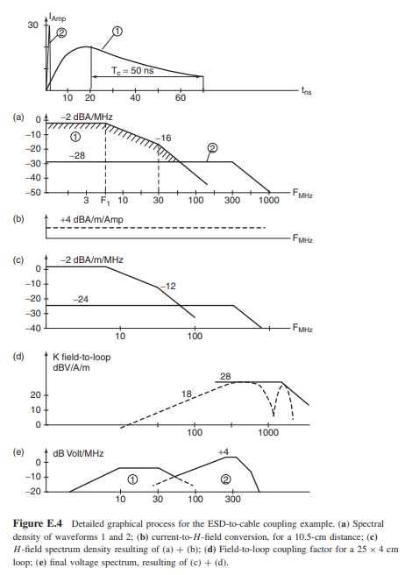
MODULE 1 · OLD PPT PICTURE PROVENANCE
Imported legacy visual reference
Old PPT slide 73 · picture 1.
Imported in full for legacy traceability. Current controlled standards and procedures govern operational decisions.
Electrostatic-Discharge-ESD-Control · TGS-2024051412
© Tertiary Infotech Academy Pte Ltd
71

Slide 73
MODULE 1 · OLD PPT PICTURE PROVENANCE
Imported legacy visual reference
Old PPT slide 74 · picture 1 · duplicate of slide-073-pic-01-af8e03b4a8.png.
Imported in full for legacy traceability. Current controlled standards and procedures govern operational decisions.
Electrostatic-Discharge-ESD-Control · TGS-2024051412
© Tertiary Infotech Academy Pte Ltd
72

Slide 74
MODULE 1 · OLD PPT PICTURE PROVENANCE
Imported legacy visual reference
Old PPT slide 74 · picture 2 · duplicate of slide-073-pic-01-af8e03b4a8.png.
Imported in full for legacy traceability. Current controlled standards and procedures govern operational decisions.
Electrostatic-Discharge-ESD-Control · TGS-2024051412
© Tertiary Infotech Academy Pte Ltd
73

Slide 75
MODULE 1 · OLD PPT PICTURE PROVENANCE
Imported legacy visual reference
Old PPT slide 75 · picture 1 · duplicate of slide-073-pic-01-af8e03b4a8.png.
Imported in full for legacy traceability. Current controlled standards and procedures govern operational decisions.
Electrostatic-Discharge-ESD-Control · TGS-2024051412
© Tertiary Infotech Academy Pte Ltd
74

Slide 76
MODULE 1 · OLD PPT PICTURE PROVENANCE
Imported legacy visual reference
Old PPT slide 76 · picture 1 · duplicate of slide-073-pic-01-af8e03b4a8.png.
Imported in full for legacy traceability. Current controlled standards and procedures govern operational decisions.
Electrostatic-Discharge-ESD-Control · TGS-2024051412
© Tertiary Infotech Academy Pte Ltd
75

Slide 77
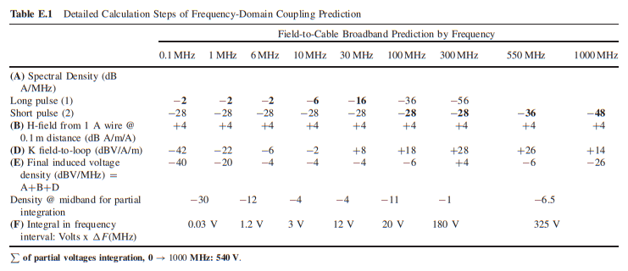
MODULE 1 · OLD PPT PICTURE PROVENANCE
Imported legacy visual reference
Old PPT slide 77 · picture 1.
Imported in full for legacy traceability. Current controlled standards and procedures govern operational decisions.
Electrostatic-Discharge-ESD-Control · TGS-2024051412
© Tertiary Infotech Academy Pte Ltd
76

Slide 78
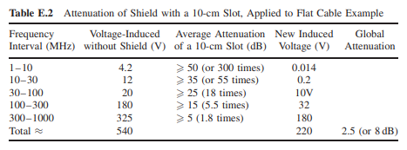
MODULE 1 · OLD PPT PICTURE PROVENANCE
Imported legacy visual reference
Old PPT slide 78 · picture 1.
Imported in full for legacy traceability. Current controlled standards and procedures govern operational decisions.
Electrostatic-Discharge-ESD-Control · TGS-2024051412
© Tertiary Infotech Academy Pte Ltd
77

Slide 79
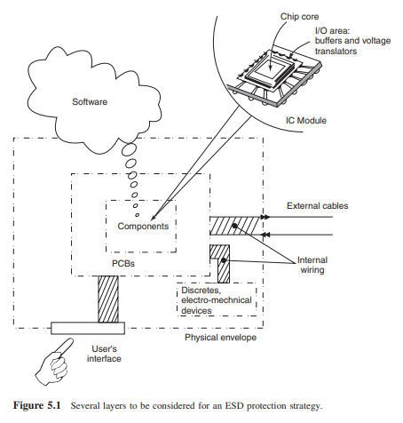
MODULE 1 · OLD PPT PICTURE PROVENANCE
Imported legacy visual reference
Old PPT slide 86 · picture 1.
Imported in full for legacy traceability. Current controlled standards and procedures govern operational decisions.
Electrostatic-Discharge-ESD-Control · TGS-2024051412
© Tertiary Infotech Academy Pte Ltd
78

Slide 80
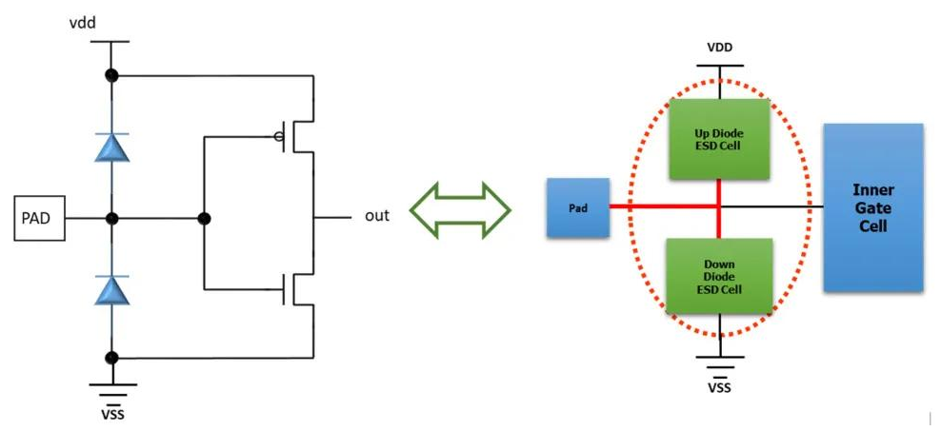
MODULE 1 · OLD PPT PICTURE PROVENANCE
Imported legacy visual reference
Old PPT slide 87 · picture 1.
Imported in full for legacy traceability. Current controlled standards and procedures govern operational decisions.
Electrostatic-Discharge-ESD-Control · TGS-2024051412
© Tertiary Infotech Academy Pte Ltd
79

Slide 81
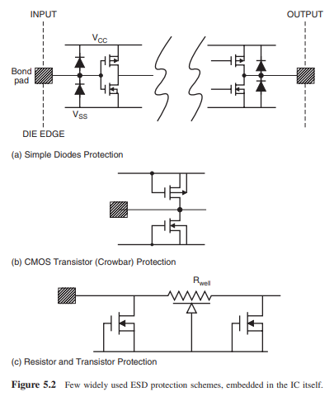
MODULE 1 · OLD PPT PICTURE PROVENANCE
Imported legacy visual reference
Old PPT slide 88 · picture 1.
Imported in full for legacy traceability. Current controlled standards and procedures govern operational decisions.
Electrostatic-Discharge-ESD-Control · TGS-2024051412
© Tertiary Infotech Academy Pte Ltd
80

Slide 82
MODULE 1 · OLD PPT PICTURE PROVENANCE
Imported legacy visual reference
Old PPT slide 89 · picture 1 · duplicate of slide-088-pic-01-0924b8cb1a.png.
Imported in full for legacy traceability. Current controlled standards and procedures govern operational decisions.
Electrostatic-Discharge-ESD-Control · TGS-2024051412
© Tertiary Infotech Academy Pte Ltd
81

Slide 83
MODULE 1 · OLD PPT PICTURE PROVENANCE
Imported legacy visual reference
Old PPT slide 90 · picture 1 · duplicate of slide-088-pic-01-0924b8cb1a.png.
Imported in full for legacy traceability. Current controlled standards and procedures govern operational decisions.
Electrostatic-Discharge-ESD-Control · TGS-2024051412
© Tertiary Infotech Academy Pte Ltd
82

Slide 84
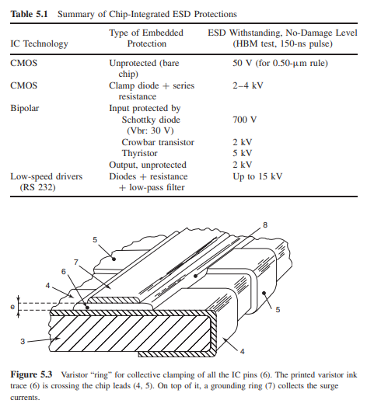
MODULE 1 · OLD PPT PICTURE PROVENANCE
Imported legacy visual reference
Old PPT slide 91 · picture 1.
Imported in full for legacy traceability. Current controlled standards and procedures govern operational decisions.
Electrostatic-Discharge-ESD-Control · TGS-2024051412
© Tertiary Infotech Academy Pte Ltd
83

Slide 85
MODULE 1 · OLD PPT PICTURE PROVENANCE
Imported legacy visual reference
Old PPT slide 92 · picture 1 · duplicate of slide-091-pic-01-3a2617804d.png.
Imported in full for legacy traceability. Current controlled standards and procedures govern operational decisions.
Electrostatic-Discharge-ESD-Control · TGS-2024051412
© Tertiary Infotech Academy Pte Ltd
84

Slide 86
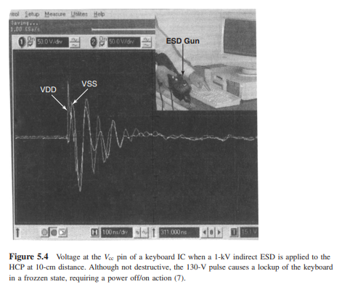
MODULE 1 · OLD PPT PICTURE PROVENANCE
Imported legacy visual reference
Old PPT slide 93 · picture 1.
Imported in full for legacy traceability. Current controlled standards and procedures govern operational decisions.
Electrostatic-Discharge-ESD-Control · TGS-2024051412
© Tertiary Infotech Academy Pte Ltd
85

Slide 87
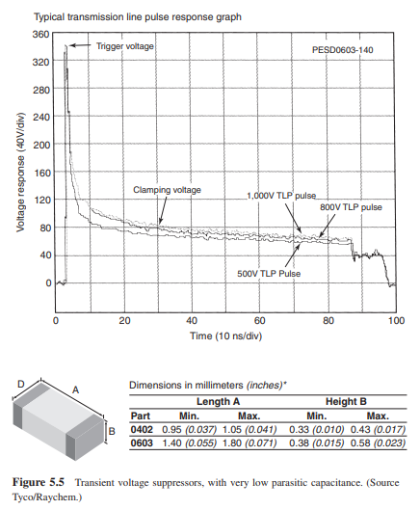
MODULE 1 · OLD PPT PICTURE PROVENANCE
Imported legacy visual reference
Old PPT slide 94 · picture 1.
Imported in full for legacy traceability. Current controlled standards and procedures govern operational decisions.
Electrostatic-Discharge-ESD-Control · TGS-2024051412
© Tertiary Infotech Academy Pte Ltd
86

Slide 88
MODULE 1 · OLD PPT PICTURE PROVENANCE
Imported legacy visual reference
Old PPT slide 95 · picture 1 · duplicate of slide-094-pic-01-3622d33603.png.
Imported in full for legacy traceability. Current controlled standards and procedures govern operational decisions.
Electrostatic-Discharge-ESD-Control · TGS-2024051412
© Tertiary Infotech Academy Pte Ltd
87

Slide 89
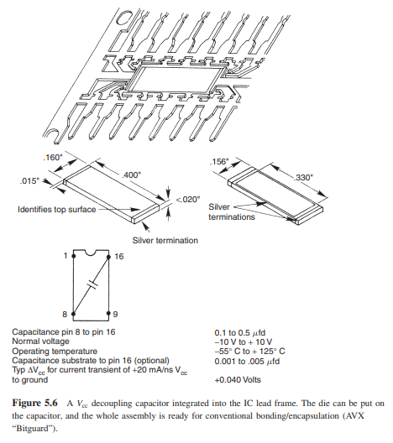
MODULE 1 · OLD PPT PICTURE PROVENANCE
Imported legacy visual reference
Old PPT slide 96 · picture 1.
Imported in full for legacy traceability. Current controlled standards and procedures govern operational decisions.
Electrostatic-Discharge-ESD-Control · TGS-2024051412
© Tertiary Infotech Academy Pte Ltd
88

Slide 90
MODULE 1 · OLD PPT PICTURE PROVENANCE
Imported legacy visual reference
Old PPT slide 97 · picture 1 · duplicate of slide-096-pic-01-1feb30cc17.png.
Imported in full for legacy traceability. Current controlled standards and procedures govern operational decisions.
Electrostatic-Discharge-ESD-Control · TGS-2024051412
© Tertiary Infotech Academy Pte Ltd
89

Slide 91
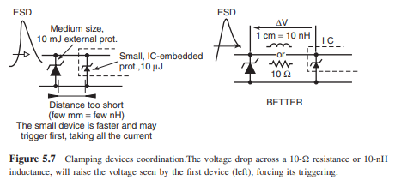
MODULE 1 · OLD PPT PICTURE PROVENANCE
Imported legacy visual reference
Old PPT slide 98 · picture 1.
Imported in full for legacy traceability. Current controlled standards and procedures govern operational decisions.
Electrostatic-Discharge-ESD-Control · TGS-2024051412
© Tertiary Infotech Academy Pte Ltd
90

Slide 92
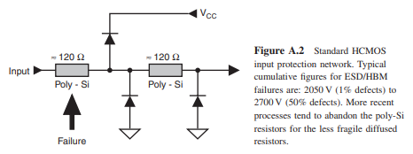
MODULE 1 · OLD PPT PICTURE PROVENANCE
Imported legacy visual reference
Old PPT slide 99 · picture 1.
Imported in full for legacy traceability. Current controlled standards and procedures govern operational decisions.
Electrostatic-Discharge-ESD-Control · TGS-2024051412
© Tertiary Infotech Academy Pte Ltd
91

Slide 93
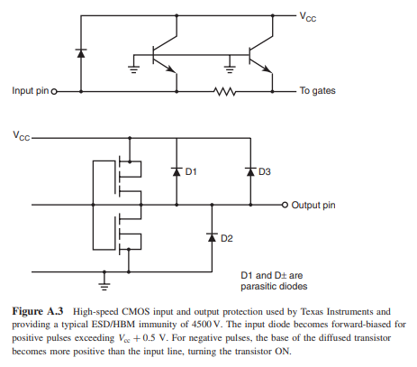
MODULE 1 · OLD PPT PICTURE PROVENANCE
Imported legacy visual reference
Old PPT slide 100 · picture 1.
Imported in full for legacy traceability. Current controlled standards and procedures govern operational decisions.
Electrostatic-Discharge-ESD-Control · TGS-2024051412
© Tertiary Infotech Academy Pte Ltd
92

Slide 94
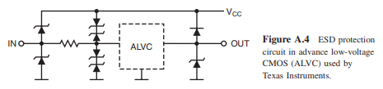
MODULE 1 · OLD PPT PICTURE PROVENANCE
Imported legacy visual reference
Old PPT slide 101 · picture 1.
Imported in full for legacy traceability. Current controlled standards and procedures govern operational decisions.
Electrostatic-Discharge-ESD-Control · TGS-2024051412
© Tertiary Infotech Academy Pte Ltd
93

Slide 95
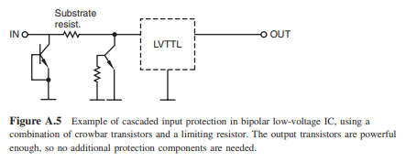
MODULE 1 · OLD PPT PICTURE PROVENANCE
Imported legacy visual reference
Old PPT slide 102 · picture 1.
Imported in full for legacy traceability. Current controlled standards and procedures govern operational decisions.
Electrostatic-Discharge-ESD-Control · TGS-2024051412
© Tertiary Infotech Academy Pte Ltd
94

Slide 96
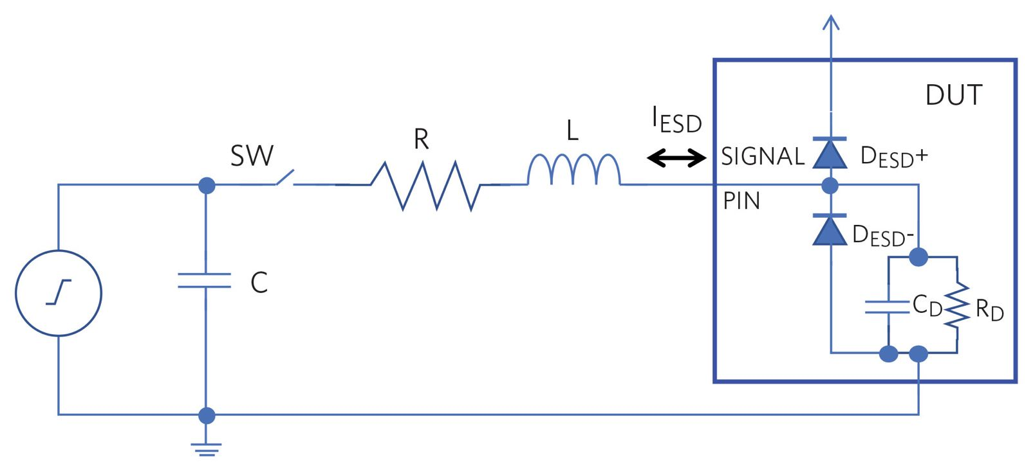
MODULE 1 · OLD PPT PICTURE PROVENANCE
Imported legacy visual reference
Old PPT slide 103 · picture 1.
Imported in full for legacy traceability. Current controlled standards and procedures govern operational decisions.
Electrostatic-Discharge-ESD-Control · TGS-2024051412
© Tertiary Infotech Academy Pte Ltd
95

Slide 97
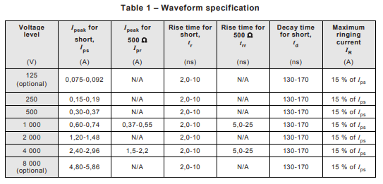
MODULE 1 · OLD PPT PICTURE PROVENANCE
Imported legacy visual reference
Old PPT slide 104 · picture 1.
Imported in full for legacy traceability. Current controlled standards and procedures govern operational decisions.
Electrostatic-Discharge-ESD-Control · TGS-2024051412
© Tertiary Infotech Academy Pte Ltd
96

Slide 98
Lunch Break
45 minutes
Electrostatic-Discharge-ESD-Control · TGS-2024051412
© Tertiary Infotech Academy Pte Ltd
97

Slide 99
ACTIVITY 01 · K1 · A1
Static Hazard Hunt at NovaSense Incoming Inspection
NovaSense receives MEMS sensor trays beside a label printer, stretch-wrap station and wheeled inspection trolley. Failure returns increased after a layout change, but no one has mapped charge-generation and induction risks.
MISSION
Identify credible charge sources, exposed ESDS items, isolated conductors and field-coupling paths, then prioritise controls.
Roles: ESD engineer · incoming-inspection supervisor · quality observer
Electrostatic-Discharge-ESD-Control · TGS-2024051412
© Tertiary Infotech Academy Pte Ltd
98

Slide 100
ACTIVITY 01
Scenario questions
DISCUSS / DECIDE
QUALITY OF REASONING
● Which hazard could damage a device without a visible spark?
● Work from the evidence provided.
● Which metal object could remain charged despite being conductive?
● State assumptions and missing evidence.
● What evidence would distinguish induction risk from direct contact?
● Use current controlled limits and methods.
● Challenge the first explanation before concluding.
Electrostatic-Discharge-ESD-Control · TGS-2024051412
© Tertiary Infotech Academy Pte Ltd
99

Slide 101
ACTIVITY 01 · VERIFY
Evidence and acceptance gate
EVIDENCE TO SUBMIT
ACCEPTANCE CRITERIA
● Annotated hazard map
✓ At least eight credible hazards are identified
● Risk-prioritisation worksheet
✓ Both direct and field-induced pathways are shown
● Three-control proposal
✓ Top risks have evidence-based ratings
● Peer-review note
✓ Controls follow the ESD control hierarchy
Electrostatic-Discharge-ESD-Control · TGS-2024051412
© Tertiary Infotech Academy Pte Ltd
100

Slide 102
ACTIVITY 02 · K1 · A1
Medical Microchip Failure Triage: ESD, EOS or Process Defect?
A medical-device ASIC passes wafer test but shows intermittent leakage after final assembly. A handler alarm occurred during the lot, yet the power-supply log also shows a transient. Management wants a defensible triage before quarantined product is released.
MISSION
Build an evidence-based hypothesis that separates HBM/CDM exposure, EOS and non-electrical process causes.
Roles: reliability engineer · failure-analysis lead · production manager
Electrostatic-Discharge-ESD-Control · TGS-2024051412
© Tertiary Infotech Academy Pte Ltd
101

Slide 103
ACTIVITY 02
Scenario questions
DISCUSS / DECIDE
QUALITY OF REASONING
● Why is a monitor alarm not proof that this device was damaged by ESD?
● Work from the evidence provided.
● Which facts make CDM plausible?
● State assumptions and missing evidence.
● What would make the latent-failure claim weak?
● Use current controlled limits and methods.
● Challenge the first explanation before concluding.
Electrostatic-Discharge-ESD-Control · TGS-2024051412
© Tertiary Infotech Academy Pte Ltd
102

Slide 104
ACTIVITY 02 · VERIFY
Evidence and acceptance gate
EVIDENCE TO SUBMIT
ACCEPTANCE CRITERIA
● Chronology
✓ ESD, EOS and process alternatives remain explicit
● Hypothesis matrix
✓ Evidence needed for each hypothesis is stated
● Containment plan
✓ Containment protects product and evidence
● Decision-gate briefing
✓ Conclusions use calibrated language
Electrostatic-Discharge-ESD-Control · TGS-2024051412
© Tertiary Infotech Academy Pte Ltd
103

Slide 105
RETRIEVAL PRACTICE
Module 1 recap
Risk
Charge generation · discharge paths · HBM/MM/CDM · failure modes · business impact
Knowledge
K1 · A1
1
2
Evidence
Explain the decision and retain traceable records.
Next
Carry the controls into the following module.
3
4
Electrostatic-Discharge-ESD-Control · TGS-2024051412
© Tertiary Infotech Academy Pte Ltd
104

Slide 106
02
MODULE 2 · K1 · K3 · K4 · A1
ESD Control Principles, Equipment and Practices
EPA design · grounding and bonding · personnel controls · ionisation · packaging · maintenance
Electrostatic-Discharge-ESD-Control · TGS-2024051412
© Tertiary Infotech Academy Pte Ltd
105

Slide 107
MODULE 2 · ESDA FUNDAMENTALS PART 1
The ESD control hierarchy
1
2
3
4
5
6
▶
▶
▶
▶
▶
Identify ESDS items and process limits
Remove unnecessary charge generators
Ground and bond conductors
Neutralise essential insulators
Shield during storage and transport
Verify and improve
Electrostatic-Discharge-ESD-Control · TGS-2024051412
© Tertiary Infotech Academy Pte Ltd
106

Slide 108
MODULE 2 · ESDA FUNDAMENTALS PART 1
Electrostatic Protected Area (EPA)
Boundary
A defined area with controlled entry and clear visual identification.
Common point
A known reference for compatible grounding and bonding.
1
2
Approved items
Only qualified materials, tools and equipment inside.
Behaviour
Handling rules, training and compliance verification are enforced.
3
4
Electrostatic-Discharge-ESD-Control · TGS-2024051412
© Tertiary Infotech Academy Pte Ltd
107

Slide 109
MODULE 2 · ESDA FUNDAMENTALS PART 1
Grounding versus bonding
PRINCIPLE / USE
RISK / DECISION
● Grounding connects a conductor to a verified reference.
● Bonding connects conductors so they remain at substantially the same potential.
● Personnel and equipment paths must be compatible with safety requirements.
● Bond isolated metal objects even when they are not intentionally energised.
Electrostatic-Discharge-ESD-Control · TGS-2024051412
© Tertiary Infotech Academy Pte Ltd
108

Slide 110
MODULE 2 · ESDA FUNDAMENTALS PART 1
Common point ground architecture
1
2
3
4
5
▶
▶
▶
▶
Facilities/equipment ground verified
EPA common point established
Mat and fixtures bonded
Personnel grounding connected
Continuity monitored and recorded
Electrostatic-Discharge-ESD-Control · TGS-2024051412
© Tertiary Infotech Academy Pte Ltd
109

Slide 111
MODULE 2 · ESDA FUNDAMENTALS PART 1
Personnel grounding choices
1
2
3
Seated work
Standing/mobile
Continuous monitoring
Wrist strap with tested cord and verified connection.
Foot grounders or qualified footwear/flooring system.
Real-time alarm when the selected path leaves limits.
Electrostatic-Discharge-ESD-Control · TGS-2024051412
© Tertiary Infotech Academy Pte Ltd
110

Slide 112
MODULE 2 · ESDA FUNDAMENTALS PART 1
Wrist-strap control loop
1
2
3
4
5
▶
▶
▶
▶
Inspect band and cord
Test before use
Connect to approved point
Maintain skin contact
Respond immediately to alarm/failure
Electrostatic-Discharge-ESD-Control · TGS-2024051412
© Tertiary Infotech Academy Pte Ltd
111

Slide 113
MODULE 2 · ESDA FUNDAMENTALS PART 1
Footwear and flooring as a system
PRINCIPLE / USE
RISK / DECISION
● Foot grounders/ESD footwear provide the personnel interface.
● Qualified flooring completes the path.
● Correct wear and both-foot coverage matter.
● Contamination, wax, humidity and wear can change performance.
Electrostatic-Discharge-ESD-Control · TGS-2024051412
© Tertiary Infotech Academy Pte Ltd
112

Slide 114
MODULE 2 · ESDA FUNDAMENTALS PART 1
Worksurface and tool control
Dissipative mat
Provides controlled charge decay and a defined work zone.
Grounded fixtures
Prevents isolated conductive metal.
1
2
ESD-safe tools
Tweezers, brushes and dispensers selected for the process.
Housekeeping
Cleaners and residues must not defeat electrical properties.
3
4
Electrostatic-Discharge-ESD-Control · TGS-2024051412
© Tertiary Infotech Academy Pte Ltd
113

Slide 115
MODULE 2 · ESDA FUNDAMENTALS PART 1
Essential insulators
1
2
3
4
5
▶
▶
▶
▶
Identify the process need
Measure field at the actual use distance
Increase separation where possible
Apply ionisation or shielding
Verify after changes
Electrostatic-Discharge-ESD-Control · TGS-2024051412
© Tertiary Infotech Academy Pte Ltd
114

Slide 116
MODULE 2 · ESDA FUNDAMENTALS PART 1
Ionisation
PRINCIPLE / USE
RISK / DECISION
● Balanced positive and negative ions neutralise charges on insulators and isolated conductors.
● Verify offset/balance and decay performance at the work location.
● Use where grounding is ineffective or impossible.
● Airflow, distance, contamination and emitter maintenance affect results.
Electrostatic-Discharge-ESD-Control · TGS-2024051412
© Tertiary Infotech Academy Pte Ltd
115

Slide 117
MODULE 2 · ESDA FUNDAMENTALS PART 1
Electrostatic field shielding
1
2
3
Conductive enclosure
Shielding bag
Continuity
Redistributes external charge and protects contents when closed.
Provides a protective envelope for transport outside the EPA.
Seams, closures and openings determine actual performance.
Electrostatic-Discharge-ESD-Control · TGS-2024051412
© Tertiary Infotech Academy Pte Ltd
116

Slide 118
MODULE 2 · ESDA FUNDAMENTALS PART 1
Packaging functions are different
Low charging
Limits triboelectric generation during contact/separation.
Dissipative
Moves charge in a controlled way.
1
2
Conductive
Rapidly redistributes charge; may need grounding.
Shielding
Attenuates discharge current and electrostatic fields around contents.
3
4
Electrostatic-Discharge-ESD-Control · TGS-2024051412
© Tertiary Infotech Academy Pte Ltd
117

Slide 119
MODULE 2 · ANALOG DEVICES; ELECTROSTATIC-SENSITIVE DEVICE OVERVIEW
Handling ESDS items
1
2
3
4
5
▶
▶
▶
▶
Confirm EPA readiness
Ground the handler
Open shielding package inside EPA
Handle by body/edges
Return to protective packaging before leaving
Electrostatic-Discharge-ESD-Control · TGS-2024051412
© Tertiary Infotech Academy Pte Ltd
118

Slide 120
MODULE 2 · ESDA FUNDAMENTALS PART 1
Garments, gloves and finger cots
PRINCIPLE / USE
RISK / DECISION
● Garments control charge from clothing and help contain personal items.
● Gloves/finger cots may support contamination control but are not automatically ESD-safe.
● Select design and grounding method for the process.
● Qualification and correct use are required.
Electrostatic-Discharge-ESD-Control · TGS-2024051412
© Tertiary Infotech Academy Pte Ltd
119

Slide 121
MODULE 2 · ESDA FUNDAMENTALS PART 1
Carts, racks and material movement
Conductive wheels
Maintain the intended path only when floor contact is suitable.
No loose insulators
Remove ordinary plastic wrap and foam near exposed ESDS items.
1
2
Covered transport
Use closed qualified containers outside EPA boundaries.
Route control
Avoid high-charging areas and unmanaged handoffs.
3
4
Electrostatic-Discharge-ESD-Control · TGS-2024051412
© Tertiary Infotech Academy Pte Ltd
120

Slide 122
MODULE 2 · ESDA FUNDAMENTALS PART 1
Maintenance is part of control
1
2
3
4
5
▶
▶
▶
▶
Define owner and interval
Inspect and clean
Test with calibrated equipment
Record result and disposition
Trend failures and revise interval
Electrostatic-Discharge-ESD-Control · TGS-2024051412
© Tertiary Infotech Academy Pte Ltd
121

Slide 123
MODULE 2 · ESDA FUNDAMENTALS PART 1
Common failure patterns
Disconnected strap
Cord attached to an unverified point or worn over clothing.
Open bag
Shielding package left open or folded incorrectly.
1
2
Insulator creep
Tape, foam, trays or paperwork introduced without review.
Bad response
Alarm bypassed, failed tester ignored or record completed retrospectively.
3
4
Electrostatic-Discharge-ESD-Control · TGS-2024051412
© Tertiary Infotech Academy Pte Ltd
122

Slide 124
MODULE 2 · ESDA FUNDAMENTALS PART 1
Supervisor’s EPA readiness review
1
2
3
People
Place
Product
Training current; grounding tested; behaviour observed.
Boundary, common point, floor, mat and ioniser verified.
Sensitivity known; packaging and process controls matched.
Electrostatic-Discharge-ESD-Control · TGS-2024051412
© Tertiary Infotech Academy Pte Ltd
123

Slide 125
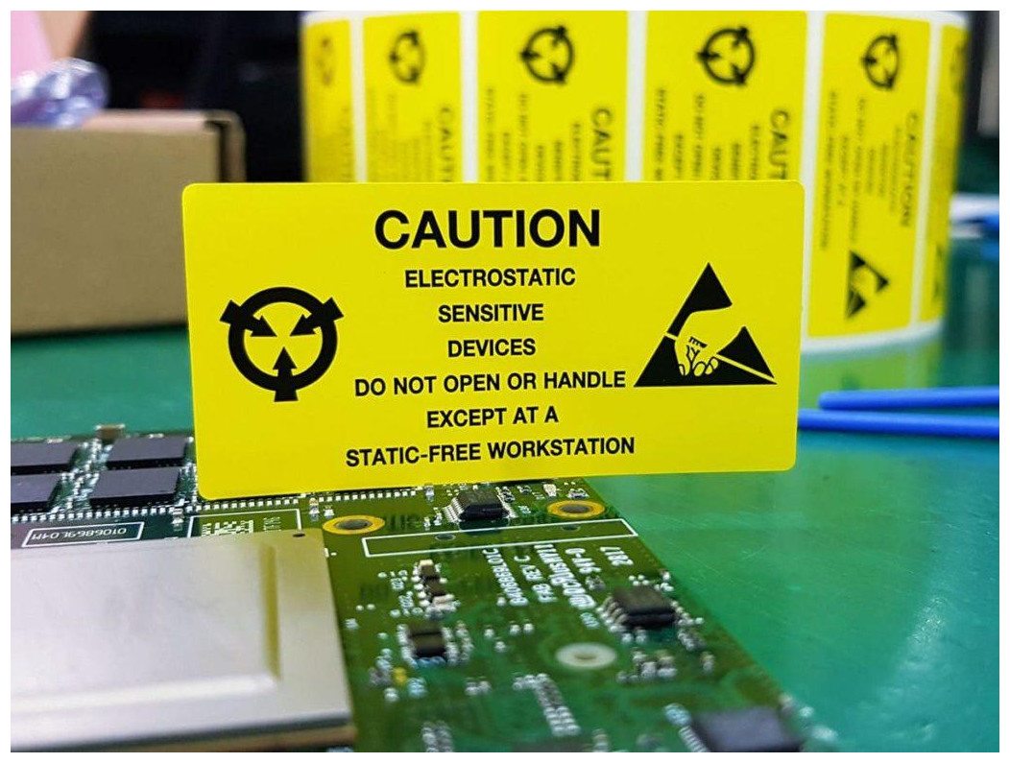
MODULE 2 · OLD PPT PICTURE PROVENANCE
Imported legacy visual reference
Old PPT slide 114 · picture 1.
Imported in full for legacy traceability. Current controlled standards and procedures govern operational decisions.
Electrostatic-Discharge-ESD-Control · TGS-2024051412
© Tertiary Infotech Academy Pte Ltd
124

Slide 126
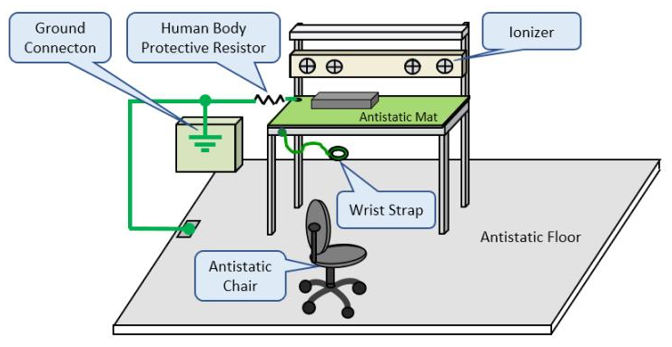
MODULE 2 · OLD PPT PICTURE PROVENANCE
Imported legacy visual reference
Old PPT slide 115 · picture 1.
Imported in full for legacy traceability. Current controlled standards and procedures govern operational decisions.
Electrostatic-Discharge-ESD-Control · TGS-2024051412
© Tertiary Infotech Academy Pte Ltd
125

Slide 127
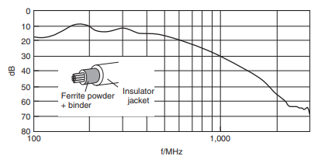
MODULE 2 · OLD PPT PICTURE PROVENANCE
Imported legacy visual reference
Old PPT slide 120 · picture 1.
Imported in full for legacy traceability. Current controlled standards and procedures govern operational decisions.
Electrostatic-Discharge-ESD-Control · TGS-2024051412
© Tertiary Infotech Academy Pte Ltd
126

Slide 128
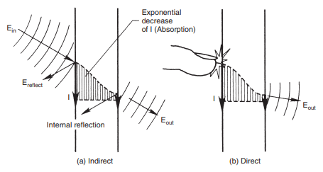
MODULE 2 · OLD PPT PICTURE PROVENANCE
Imported legacy visual reference
Old PPT slide 121 · picture 1.
Imported in full for legacy traceability. Current controlled standards and procedures govern operational decisions.
Electrostatic-Discharge-ESD-Control · TGS-2024051412
© Tertiary Infotech Academy Pte Ltd
127

Slide 129
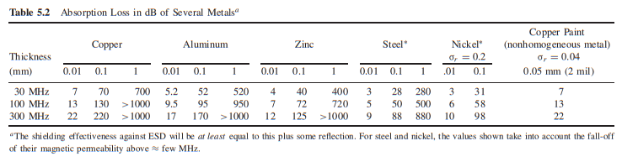
MODULE 2 · OLD PPT PICTURE PROVENANCE
Imported legacy visual reference
Old PPT slide 122 · picture 1.
Imported in full for legacy traceability. Current controlled standards and procedures govern operational decisions.
Electrostatic-Discharge-ESD-Control · TGS-2024051412
© Tertiary Infotech Academy Pte Ltd
128

Slide 130
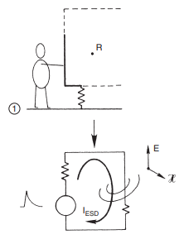
MODULE 2 · OLD PPT PICTURE PROVENANCE
Imported legacy visual reference
Old PPT slide 123 · picture 1.
Imported in full for legacy traceability. Current controlled standards and procedures govern operational decisions.
Electrostatic-Discharge-ESD-Control · TGS-2024051412
© Tertiary Infotech Academy Pte Ltd
129

Slide 131
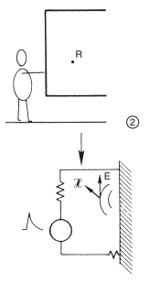
MODULE 2 · OLD PPT PICTURE PROVENANCE
Imported legacy visual reference
Old PPT slide 124 · picture 1.
Imported in full for legacy traceability. Current controlled standards and procedures govern operational decisions.
Electrostatic-Discharge-ESD-Control · TGS-2024051412
© Tertiary Infotech Academy Pte Ltd
130

Slide 132
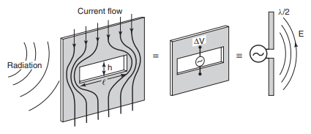
MODULE 2 · OLD PPT PICTURE PROVENANCE
Imported legacy visual reference
Old PPT slide 125 · picture 1.
Imported in full for legacy traceability. Current controlled standards and procedures govern operational decisions.
Electrostatic-Discharge-ESD-Control · TGS-2024051412
© Tertiary Infotech Academy Pte Ltd
131

Slide 133
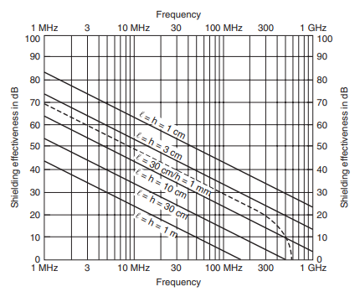
MODULE 2 · OLD PPT PICTURE PROVENANCE
Imported legacy visual reference
Old PPT slide 126 · picture 1.
Imported in full for legacy traceability. Current controlled standards and procedures govern operational decisions.
Electrostatic-Discharge-ESD-Control · TGS-2024051412
© Tertiary Infotech Academy Pte Ltd
132

Slide 134
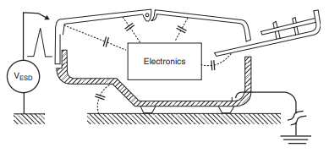
MODULE 2 · OLD PPT PICTURE PROVENANCE
Imported legacy visual reference
Old PPT slide 127 · picture 1.
Imported in full for legacy traceability. Current controlled standards and procedures govern operational decisions.
Electrostatic-Discharge-ESD-Control · TGS-2024051412
© Tertiary Infotech Academy Pte Ltd
133

Slide 135

MODULE 2 · OLD PPT PICTURE PROVENANCE
Imported legacy visual reference
Old PPT slide 159 · picture 1.
Imported in full for legacy traceability. Current controlled standards and procedures govern operational decisions.
Electrostatic-Discharge-ESD-Control · TGS-2024051412
© Tertiary Infotech Academy Pte Ltd
134

Slide 136
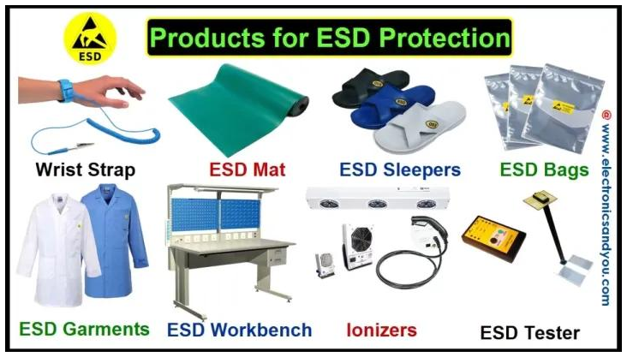
MODULE 2 · OLD PPT PICTURE PROVENANCE
Imported legacy visual reference
Old PPT slide 160 · picture 1.
Imported in full for legacy traceability. Current controlled standards and procedures govern operational decisions.
Electrostatic-Discharge-ESD-Control · TGS-2024051412
© Tertiary Infotech Academy Pte Ltd
135

Slide 137
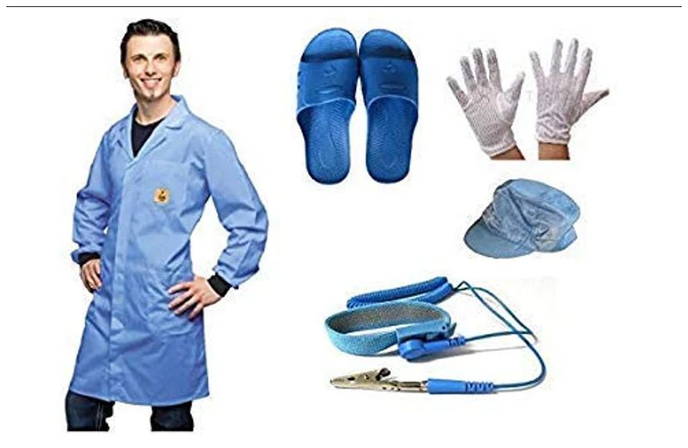
MODULE 2 · OLD PPT PICTURE PROVENANCE
Imported legacy visual reference
Old PPT slide 161 · picture 1.
Imported in full for legacy traceability. Current controlled standards and procedures govern operational decisions.
Electrostatic-Discharge-ESD-Control · TGS-2024051412
© Tertiary Infotech Academy Pte Ltd
136

Slide 138

MODULE 2 · OLD PPT PICTURE PROVENANCE
Imported legacy visual reference
Old PPT slide 162 · picture 1.
Imported in full for legacy traceability. Current controlled standards and procedures govern operational decisions.
Electrostatic-Discharge-ESD-Control · TGS-2024051412
© Tertiary Infotech Academy Pte Ltd
137

Slide 139

MODULE 2 · OLD PPT PICTURE PROVENANCE
Imported legacy visual reference
Old PPT slide 163 · picture 1.
Imported in full for legacy traceability. Current controlled standards and procedures govern operational decisions.
Electrostatic-Discharge-ESD-Control · TGS-2024051412
© Tertiary Infotech Academy Pte Ltd
138

Slide 140

MODULE 2 · OLD PPT PICTURE PROVENANCE
Imported legacy visual reference
Old PPT slide 177 · picture 1.
Imported in full for legacy traceability. Current controlled standards and procedures govern operational decisions.
Electrostatic-Discharge-ESD-Control · TGS-2024051412
© Tertiary Infotech Academy Pte Ltd
139

Slide 141
MODULE 2 · OLD PPT PICTURE PROVENANCE
Imported legacy visual reference
Old PPT slide 178 · picture 1 · duplicate of slide-177-pic-01-47656e2151.png.
Imported in full for legacy traceability. Current controlled standards and procedures govern operational decisions.
Electrostatic-Discharge-ESD-Control · TGS-2024051412
© Tertiary Infotech Academy Pte Ltd
140

Slide 142
MODULE 2 · OLD PPT PICTURE PROVENANCE
Imported legacy visual reference
Old PPT slide 178 · picture 2 · duplicate of slide-177-pic-01-47656e2151.png.
Imported in full for legacy traceability. Current controlled standards and procedures govern operational decisions.
Electrostatic-Discharge-ESD-Control · TGS-2024051412
© Tertiary Infotech Academy Pte Ltd
141

Slide 143
MODULE 2 · OLD PPT PICTURE PROVENANCE
Imported legacy visual reference
Old PPT slide 179 · picture 1 · duplicate of slide-177-pic-01-47656e2151.png.
Imported in full for legacy traceability. Current controlled standards and procedures govern operational decisions.
Electrostatic-Discharge-ESD-Control · TGS-2024051412
© Tertiary Infotech Academy Pte Ltd
142

Slide 144

MODULE 2 · OLD PPT PICTURE PROVENANCE
Imported legacy visual reference
Old PPT slide 180 · picture 1.
Imported in full for legacy traceability. Current controlled standards and procedures govern operational decisions.
Electrostatic-Discharge-ESD-Control · TGS-2024051412
© Tertiary Infotech Academy Pte Ltd
143

Slide 145
ACTIVITY 03 · K3 · K4 · A1
Design and Commission an EPA for Orion Optics
Orion Optics is moving laser-diode assembly into a small shared lab. The proposed bench has a mat and wrist strap but no documented boundary, common point, insulator policy or readiness test.
MISSION
Design an EPA that controls people, place, product and process, then define commissioning evidence.
Roles: ESD engineer · facilities engineer · lab manager
Electrostatic-Discharge-ESD-Control · TGS-2024051412
© Tertiary Infotech Academy Pte Ltd
144

Slide 146
ACTIVITY 03
Scenario questions
DISCUSS / DECIDE
QUALITY OF REASONING
● What makes the area an EPA rather than simply a bench with a mat?
● Work from the evidence provided.
● Which item cannot be made safe by grounding alone?
● State assumptions and missing evidence.
● What evidence authorises production start?
● Use current controlled limits and methods.
● Challenge the first explanation before concluding.
Electrostatic-Discharge-ESD-Control · TGS-2024051412
© Tertiary Infotech Academy Pte Ltd
145

Slide 147
ACTIVITY 03 · VERIFY
Evidence and acceptance gate
EVIDENCE TO SUBMIT
ACCEPTANCE CRITERIA
● EPA layout
✓ Boundary and product flow are unambiguous
● Grounding/bonding diagram
✓ All conductors have a resolved status
● Insulator-control register
✓ Essential insulators have controls
● Commissioning plan and readiness certificate
✓ Commissioning includes method, limit, owner and response
Electrostatic-Discharge-ESD-Control · TGS-2024051412
© Tertiary Infotech Academy Pte Ltd
146

Slide 148
ACTIVITY 04 · K3 · K4 · A1
Select Controls for the Aster Robotics Handling Cell
A robot transfers packaged ICs from plastic tubes to a grounded nest. Operators also perform manual rework. The team proposes more wrist straps, but field readings near the tube exit remain high.
MISSION
Match grounding, ionisation, shielding, handling and monitoring controls to both human and automated exposure pathways.
Roles: automation engineer · ESD specialist · maintenance supervisor
Electrostatic-Discharge-ESD-Control · TGS-2024051412
© Tertiary Infotech Academy Pte Ltd
147

Slide 149
ACTIVITY 04
Scenario questions
DISCUSS / DECIDE
QUALITY OF REASONING
● Why will adding wrist straps not solve the tube-exit field?
● Work from the evidence provided.
● Which controls address CDM risk?
● State assumptions and missing evidence.
● What should happen when an ioniser check fails?
● Use current controlled limits and methods.
● Challenge the first explanation before concluding.
Electrostatic-Discharge-ESD-Control · TGS-2024051412
© Tertiary Infotech Academy Pte Ltd
148

Slide 150
ACTIVITY 04 · VERIFY
Evidence and acceptance gate
EVIDENCE TO SUBMIT
ACCEPTANCE CRITERIA
● Exposure-path map
✓ Controls cover human and automated pathways
● Control-selection matrix
✓ Insulators are addressed by an appropriate method
● Monitoring/stop-condition plan
✓ Monitoring has explicit response actions
● Maintenance plan
✓ Residual risk is stated
Electrostatic-Discharge-ESD-Control · TGS-2024051412
© Tertiary Infotech Academy Pte Ltd
149

Slide 151
RETRIEVAL PRACTICE
Module 2 recap
Risk
EPA design · grounding and bonding · personnel controls · ionisation · packaging · maintenance
Knowledge
K1 · K3 · K4 · A1
1
2
Evidence
Explain the decision and retain traceable records.
Next
Carry the controls into the following module.
3
4
Electrostatic-Discharge-ESD-Control · TGS-2024051412
© Tertiary Infotech Academy Pte Ltd
150

Slide 152
Day 1 Complete
Return on time for Day 2 digital attendance
Electrostatic-Discharge-ESD-Control · TGS-2024051412
© Tertiary Infotech Academy Pte Ltd
151

Slide 153
03
MODULE 3 · K2 · K3 · A2 · A3
ESD Standards, Testing and Auditing
Control programme structure · measurements · compliance verification · evidence · performance metrics
Electrostatic-Discharge-ESD-Control · TGS-2024051412
© Tertiary Infotech Academy Pte Ltd
152

Slide 154
MODULE 3 · ESDA FUNDAMENTALS PART 1
ANSI/ESD S20.20 and IEC 61340-5-1 structure organisational controls for protecting ESDS items.
Use the current controlled copy, customer requirements and product sensitivity data for exact limits and methods.
Electrostatic-Discharge-ESD-Control · TGS-2024051412
© Tertiary Infotech Academy Pte Ltd
153

Slide 155
MODULE 3 · EOS/ESD ASSOCIATION
Control programme architecture
1
2
3
4
5
▶
▶
▶
▶
Scope and responsibilities
Technical requirements
Product qualification
Compliance verification
Records, corrective action and management review
Electrostatic-Discharge-ESD-Control · TGS-2024051412
© Tertiary Infotech Academy Pte Ltd
154

Slide 156
MODULE 3 · ESDA FUNDAMENTALS PART 1
Product qualification versus compliance verification
PRINCIPLE / USE
RISK / DECISION
● Qualification demonstrates that an ESD control item/type is capable of meeting specified requirements.
● Compliance verification checks that installed controls remain effective in routine use.
● Evidence may include supplier data or internal testing.
● It uses defined methods, frequencies, limits and response actions.
Electrostatic-Discharge-ESD-Control · TGS-2024051412
© Tertiary Infotech Academy Pte Ltd
155

Slide 157
MODULE 3 · ESDA FUNDAMENTALS PART 1
Instrument-to-risk map
Resistance meter
Worksurfaces, floors, garments, packaging and ground paths.
Personnel tester
Wrist straps, footwear and person/footwear/floor systems.
1
2
Field meter
Electrostatic field and charged-object screening.
Charge plate monitor
Ioniser decay and offset/balance performance.
3
4
Electrostatic-Discharge-ESD-Control · TGS-2024051412
© Tertiary Infotech Academy Pte Ltd
156

Slide 158
MODULE 3 · ESDA FUNDAMENTALS PART 1
Measurement discipline
1
2
3
4
5
6
▶
▶
▶
▶
▶
Define method and limit
Confirm calibration/status
Condition sample/environment
Measure at specified points
Record result and uncertainty/context
Act on failure
Electrostatic-Discharge-ESD-Control · TGS-2024051412
© Tertiary Infotech Academy Pte Ltd
157

Slide 159
MODULE 3 · ESDA FUNDAMENTALS PART 1
Wrist strap and footwear checks
PRINCIPLE / USE
RISK / DECISION
● Daily/user checks screen the assembled personal grounding path before work.
● Periodic technical checks verify components, testers and flooring systems.
● Failure requires immediate stop, retest and disposition.
● Trend repeated failures by user, device, location and shift.
Electrostatic-Discharge-ESD-Control · TGS-2024051412
© Tertiary Infotech Academy Pte Ltd
158

Slide 160
MODULE 3 · ESDA FUNDAMENTALS PART 1
Surface and point-to-ground resistance
1
2
3
Point-to-point
Point-to-ground
Context
Characterises the path across a surface/material.
Characterises the installed path to the designated ground.
Electrodes, voltage, dwell, humidity and cleanliness influence the reading.
Electrostatic-Discharge-ESD-Control · TGS-2024051412
© Tertiary Infotech Academy Pte Ltd
159

Slide 161
MODULE 3 · ESDA FUNDAMENTALS PART 1
Ioniser performance checks
1
2
3
4
5
6
▶
▶
▶
▶
▶
Inspect placement and airflow
Warm up per procedure
Measure positive/negative decay
Measure offset/balance
Clean or adjust
Repeat and record
Electrostatic-Discharge-ESD-Control · TGS-2024051412
© Tertiary Infotech Academy Pte Ltd
160

Slide 162
MODULE 3 · ESDA FUNDAMENTALS PART 1
Audit evidence pyramid
Observe
Actual behaviour at the workstation.
Measure
Current test results from calibrated instruments.
1
2
Interview
Personnel can explain risk and response.
Records
Training, qualification, maintenance, failures and CAPA are traceable.
3
4
Electrostatic-Discharge-ESD-Control · TGS-2024051412
© Tertiary Infotech Academy Pte Ltd
161

Slide 163
MODULE 3 · ESDA FUNDAMENTALS PART 1
Risk-based audit sampling
PRINCIPLE / USE
RISK / DECISION
● Increase attention where products are most sensitive, exposure is high or process changes are recent.
● Do not let a checklist replace observation and measurement.
● Sample across shifts, people and workstations.
● A single passing sample does not prove the entire system.
Electrostatic-Discharge-ESD-Control · TGS-2024051412
© Tertiary Infotech Academy Pte Ltd
162

Slide 164
MODULE 3 · ESDA FUNDAMENTALS PART 1
Nonconformity grading
1
2
3
Critical
Major
Minor/observation
Immediate product/safety exposure; contain and escalate.
Systemic or repeated breakdown; formal CAPA and verification.
Local weakness or improvement opportunity; track proportionately.
Electrostatic-Discharge-ESD-Control · TGS-2024051412
© Tertiary Infotech Academy Pte Ltd
163

Slide 165
MODULE 3 · ESDA FUNDAMENTALS PART 1
Corrective-action loop
1
2
3
4
5
6
▶
▶
▶
▶
▶
Contain affected product/process
Define problem with evidence
Analyse root and contributing causes
Implement corrective/preventive actions
Verify effectiveness
Standardise and close
Electrostatic-Discharge-ESD-Control · TGS-2024051412
© Tertiary Infotech Academy Pte Ltd
164

Slide 166
MODULE 3 · ESDA FUNDAMENTALS PART 1
Useful ESD performance metrics
Leading
Test completion, first-pass pass rate, overdue calibration, training currency.
Process
EPA audit score, insulator findings, alarm response time.
1
2
Lagging
ESD-attributed escapes, scrap, rework and field returns.
Learning
Repeat causes, CAPA recurrence and time-to-effective closure.
3
4
Electrostatic-Discharge-ESD-Control · TGS-2024051412
© Tertiary Infotech Academy Pte Ltd
165

Slide 167
MODULE 3 · ESDA FUNDAMENTALS PART 1
Management review questions
1
2
3
Effective?
Adequate?
Sustained?
Are controls reducing exposure and failures?
Do changes in products/processes require new controls?
Are verification, training and CAPA completed on time?
Electrostatic-Discharge-ESD-Control · TGS-2024051412
© Tertiary Infotech Academy Pte Ltd
166

Slide 168

MODULE 3 · OLD PPT PICTURE PROVENANCE
Imported legacy visual reference
Old PPT slide 200 · picture 1.
Imported in full for legacy traceability. Current controlled standards and procedures govern operational decisions.
Electrostatic-Discharge-ESD-Control · TGS-2024051412
© Tertiary Infotech Academy Pte Ltd
167

Slide 169

MODULE 3 · OLD PPT PICTURE PROVENANCE
Imported legacy visual reference
Old PPT slide 208 · picture 1.
Imported in full for legacy traceability. Current controlled standards and procedures govern operational decisions.
Electrostatic-Discharge-ESD-Control · TGS-2024051412
© Tertiary Infotech Academy Pte Ltd
168

Slide 170

MODULE 3 · OLD PPT PICTURE PROVENANCE
Imported legacy visual reference
Old PPT slide 209 · picture 1.
Imported in full for legacy traceability. Current controlled standards and procedures govern operational decisions.
Electrostatic-Discharge-ESD-Control · TGS-2024051412
© Tertiary Infotech Academy Pte Ltd
169

Slide 171

MODULE 3 · OLD PPT PICTURE PROVENANCE
Imported legacy visual reference
Old PPT slide 210 · picture 1.
Imported in full for legacy traceability. Current controlled standards and procedures govern operational decisions.
Electrostatic-Discharge-ESD-Control · TGS-2024051412
© Tertiary Infotech Academy Pte Ltd
170

Slide 172
ACTIVITY 05 · K2 · K3 · A2
Execute a Compliance Verification Round
Meridian Electronics has four EPAs on two shifts. Recent records show perfect results but several tester failures were repaired without documented product disposition. You must execute a verification round using a simulated data pack.
MISSION
Plan, execute and record traceable checks for personnel grounding, resistance, electrostatic field and ioniser performance.
Roles: ESD auditor · area owner · instrument custodian
Electrostatic-Discharge-ESD-Control · TGS-2024051412
© Tertiary Infotech Academy Pte Ltd
171

Slide 173
ACTIVITY 05
Scenario questions
DISCUSS / DECIDE
QUALITY OF REASONING
● Why is a retest pass insufficient without investigating the first failure?
● Work from the evidence provided.
● Which contextual data makes a resistance reading defensible?
● State assumptions and missing evidence.
● Where should ioniser performance be checked?
● Use current controlled limits and methods.
● Challenge the first explanation before concluding.
Electrostatic-Discharge-ESD-Control · TGS-2024051412
© Tertiary Infotech Academy Pte Ltd
172

Slide 174
ACTIVITY 05 · VERIFY
Evidence and acceptance gate
EVIDENCE TO SUBMIT
ACCEPTANCE CRITERIA
● Completed measurement log
✓ Every result includes method, units and conditions
● Failure/disposition records
✓ Instrument status is verified
● Metric calculation
✓ First-pass failures remain visible
● Signed evidence package
✓ Product impact and response are documented
Electrostatic-Discharge-ESD-Control · TGS-2024051412
© Tertiary Infotech Academy Pte Ltd
173

Slide 175
ACTIVITY 06 · K2 · A2 · A3
Standards-Based EPA Audit at Helix Assembly
Helix Assembly claims alignment to ANSI/ESD S20.20 and IEC 61340-5-1. A new customer requests evidence that controls are implemented, verified and improved—not merely purchased.
MISSION
Conduct a risk-based audit using observation, measurement, interview and records, then issue graded findings and corrective-action requests.
Roles: lead auditor · ESD programme coordinator · customer observer
Electrostatic-Discharge-ESD-Control · TGS-2024051412
© Tertiary Infotech Academy Pte Ltd
174

Slide 176
ACTIVITY 06
Scenario questions
DISCUSS / DECIDE
QUALITY OF REASONING
● What evidence shows a control is sustained rather than merely installed?
● Work from the evidence provided.
● Why must the exact controlled standard govern numerical limits?
● State assumptions and missing evidence.
● What makes a finding actionable?
● Use current controlled limits and methods.
● Challenge the first explanation before concluding.
Electrostatic-Discharge-ESD-Control · TGS-2024051412
© Tertiary Infotech Academy Pte Ltd
175

Slide 177
ACTIVITY 06 · VERIFY
Evidence and acceptance gate
EVIDENCE TO SUBMIT
ACCEPTANCE CRITERIA
● Audit plan
✓ Sampling is risk-based
● Completed checklist
✓ Findings cite objective evidence
● Evidence register
✓ Critical exposure triggers containment
● Graded findings and follow-up plan
✓ Follow-up tests effectiveness, not only completion
Electrostatic-Discharge-ESD-Control · TGS-2024051412
© Tertiary Infotech Academy Pte Ltd
176

Slide 178
RETRIEVAL PRACTICE
Module 3 recap
Risk
Control programme structure · measurements · compliance verification · evidence · performance metrics
Knowledge
K2 · K3 · A2 · A3
1
2
Evidence
Explain the decision and retain traceable records.
Next
Carry the controls into the following module.
3
4
Electrostatic-Discharge-ESD-Control · TGS-2024051412
© Tertiary Infotech Academy Pte Ltd
177

Slide 179
Afternoon Break
10 minutes
Electrostatic-Discharge-ESD-Control · TGS-2024051412
© Tertiary Infotech Academy Pte Ltd
178

Slide 180
04
MODULE 4 · K4 · A2 · A3
Training, Awareness and Incident Improvement
Competence · behaviour · reporting · root-cause analysis · CAPA · management ownership
Electrostatic-Discharge-ESD-Control · TGS-2024051412
© Tertiary Infotech Academy Pte Ltd
179

Slide 181
MODULE 4 · ESDA FUNDAMENTALS PART 1
Competence is role-specific
Operators
Recognise ESDS items, enter EPA correctly and handle/pack safely.
Technicians
Set up, test, troubleshoot and maintain controls.
1
2
Engineers
Define limits, qualify controls and investigate events.
Managers
Provide resources, review metrics and remove systemic barriers.
3
4
Electrostatic-Discharge-ESD-Control · TGS-2024051412
© Tertiary Infotech Academy Pte Ltd
180

Slide 182
MODULE 4 · ESDA FUNDAMENTALS PART 1
From awareness to reliable behaviour
1
2
3
4
5
▶
▶
▶
▶
Explain the invisible risk
Demonstrate the correct method
Practise with feedback
Observe on the job
Reinforce and requalify
Electrostatic-Discharge-ESD-Control · TGS-2024051412
© Tertiary Infotech Academy Pte Ltd
181

Slide 183
MODULE 4 · ESDA FUNDAMENTALS PART 1
ESD champions and supervision
1
2
3
Coach
Escalate
Learn
Give immediate, specific feedback at the workstation.
Stop unsafe handling and trigger containment when required.
Share incident lessons without normalising blame.
Electrostatic-Discharge-ESD-Control · TGS-2024051412
© Tertiary Infotech Academy Pte Ltd
182

Slide 184
MODULE 4 · ESDA FUNDAMENTALS PART 1
Recognising a possible ESD incident
Product symptom
Sudden failure, parametric shift, intermittent behaviour or unexplained fallout.
Control signal
Monitor alarm, failed tester, ioniser drift or broken ground path.
1
2
Exposure clue
Unprotected handling, ordinary plastic, low humidity or process change.
Caution
Symptoms are not proof; preserve evidence for diagnosis.
3
4
Electrostatic-Discharge-ESD-Control · TGS-2024051412
© Tertiary Infotech Academy Pte Ltd
183

Slide 185
MODULE 4 · ESDA FUNDAMENTALS PART 1
Immediate response
1
2
3
4
5
▶
▶
▶
▶
Stop and protect the process
Segregate potentially affected product
Preserve settings, logs and samples
Notify defined roles
Begin evidence-based triage
Electrostatic-Discharge-ESD-Control · TGS-2024051412
© Tertiary Infotech Academy Pte Ltd
184

Slide 186
MODULE 4 · ESDA FUNDAMENTALS PART 1
Incident evidence set
What/where/when
Product, lot, station, timestamp and sequence.
Environment
Humidity, temperature, nearby motion and insulators.
1
2
Controls
Tester logs, monitor alarms, grounding and ioniser status.
People/process
Who handled it, procedure used and recent changes.
3
4
Electrostatic-Discharge-ESD-Control · TGS-2024051412
© Tertiary Infotech Academy Pte Ltd
185

Slide 187
MODULE 4 · ESDA FUNDAMENTALS PART 1
Root-cause analysis without blame
PRINCIPLE / USE
RISK / DECISION
● Ask why the system allowed exposure: design, maintenance, method, material, measurement or management.
● Avoid stopping at 'operator error'.
● Distinguish root, contributing and detection causes.
● A repeated behaviour usually reflects unclear standards, weak design, workload or ineffective supervision.
Electrostatic-Discharge-ESD-Control · TGS-2024051412
© Tertiary Infotech Academy Pte Ltd
186

Slide 188
MODULE 4 · ESDA FUNDAMENTALS PART 1
Selecting corrective actions
1
2
3
4
5
6
▶
▶
▶
▶
▶
Remove generator/exposure
Engineer a reliable ground or enclosure
Add detection/monitoring
Standardise work and response
Train and verify competence
Measure sustained effectiveness
Electrostatic-Discharge-ESD-Control · TGS-2024051412
© Tertiary Infotech Academy Pte Ltd
187

Slide 189
MODULE 4 · ESDA FUNDAMENTALS PART 1
Communicating ESD risk
1
2
3
Frontline
Engineering
Management
Show the exact handling risk and the stop-work response.
Use measurements, failure evidence and process capability.
Translate risk into yield, customer, compliance and continuity impact.
Electrostatic-Discharge-ESD-Control · TGS-2024051412
© Tertiary Infotech Academy Pte Ltd
188

Slide 190
MODULE 4 · ESDA FUNDAMENTALS PART 1
A sustainable ESD culture
Visible ownership
Named programme coordinator and local owners.
Just reporting
Near misses and failures can be reported without concealment.
1
2
Closed loop
Findings become actions, verified changes and updated standards.
Learning cadence
Metrics, incidents and changes are reviewed regularly.
3
4
Electrostatic-Discharge-ESD-Control · TGS-2024051412
© Tertiary Infotech Academy Pte Ltd
189

Slide 191
MODULE 4 · ESDA FUNDAMENTALS PART 1
Competency certification
PRINCIPLE / USE
RISK / DECISION
● Internal authorisation should match the tasks a person performs.
● External credentials may support development but do not replace site-specific qualification.
● Use knowledge, demonstration and observed-work evidence.
● Reassess after major changes, lapse or repeated nonconformance.
Electrostatic-Discharge-ESD-Control · TGS-2024051412
© Tertiary Infotech Academy Pte Ltd
190

Slide 192

MODULE 4 · OLD PPT PICTURE PROVENANCE
Imported legacy visual reference
Old PPT slide 267 · picture 1. Historical QR/screen capture only—use the live LMS.
Imported in full for legacy traceability. Current controlled standards and procedures govern operational decisions.
Electrostatic-Discharge-ESD-Control · TGS-2024051412
© Tertiary Infotech Academy Pte Ltd
191

Slide 193
ACTIVITY 07 · K4 · A2 · A3
Investigate the PulseMed ESD Incident
PulseMed sees intermittent failures in a safety-relevant control board after a temporary operator used ordinary bubble wrap near final test. A monitor alarm was acknowledged but production continued for 47 minutes.
MISSION
Contain risk, preserve evidence, identify system causes and produce a verified CAPA plan.
Roles: incident lead · production manager · quality/reliability representative
Electrostatic-Discharge-ESD-Control · TGS-2024051412
© Tertiary Infotech Academy Pte Ltd
192

Slide 194
ACTIVITY 07
Scenario questions
DISCUSS / DECIDE
QUALITY OF REASONING
● Which system weakness allowed the alarm to be ignored?
● Work from the evidence provided.
● What evidence must be preserved before resetting the workstation?
● State assumptions and missing evidence.
● How will you prove the CAPA was effective?
● Use current controlled limits and methods.
● Challenge the first explanation before concluding.
Electrostatic-Discharge-ESD-Control · TGS-2024051412
© Tertiary Infotech Academy Pte Ltd
193

Slide 195
ACTIVITY 07 · VERIFY
Evidence and acceptance gate
EVIDENCE TO SUBMIT
ACCEPTANCE CRITERIA
● Containment record
✓ Exposure window and product scope are defined
● Timeline and causal analysis
✓ Causes extend beyond individual blame
● CAPA plan
✓ Actions address root and detection causes
● Effectiveness-verification plan
✓ Effectiveness has measurable evidence
Electrostatic-Discharge-ESD-Control · TGS-2024051412
© Tertiary Infotech Academy Pte Ltd
194

Slide 196
ACTIVITY 08 · K1–K4 · A1–A3
Management Capstone: Build the Apex ESD Control Plan
Apex Microsystems is opening a mixed lab/factory line for sensitive industrial controllers. Management needs an auditable ESD control plan before customer qualification, covering controls, verification, competence, incidents and improvement.
MISSION
Integrate the complete course into a management-ready ESD control plan and defend it under assessment-style questioning.
Roles: ESD programme manager · operations manager · quality manager · customer assessor
Electrostatic-Discharge-ESD-Control · TGS-2024051412
© Tertiary Infotech Academy Pte Ltd
195

Slide 197
ACTIVITY 08
Scenario questions
DISCUSS / DECIDE
QUALITY OF REASONING
● How does the plan demonstrate A1, A2 and A3?
● Work from the evidence provided.
● Which records prove the control programme remains effective?
● State assumptions and missing evidence.
● What management decision is triggered by deteriorating leading indicators?
● Use current controlled limits and methods.
● Challenge the first explanation before concluding.
Electrostatic-Discharge-ESD-Control · TGS-2024051412
© Tertiary Infotech Academy Pte Ltd
196

Slide 198
ACTIVITY 08 · VERIFY
Evidence and acceptance gate
EVIDENCE TO SUBMIT
ACCEPTANCE CRITERIA
● ESD control plan
✓ All K and A criteria are traceable
● Qualification and verification matrices
✓ Controls have owners and evidence
● Competency matrix
✓ Failure response and CAPA are closed-loop
● Metrics dashboard and 90-day roadmap
✓ Plan uses current controlled standards for exact requirements
Electrostatic-Discharge-ESD-Control · TGS-2024051412
© Tertiary Infotech Academy Pte Ltd
197

Slide 199
RETRIEVAL PRACTICE
Module 4 recap
Risk
Competence · behaviour · reporting · root-cause analysis · CAPA · management ownership
Knowledge
K4 · A2 · A3
1
2
Evidence
Explain the decision and retain traceable records.
Next
Carry the controls into the following module.
3
4
Electrostatic-Discharge-ESD-Control · TGS-2024051412
© Tertiary Infotech Academy Pte Ltd
198

Slide 200
COURSE SUMMARY
What You Achieved
Recognise
Explain charge generation, induction, discharge models and damage.
Control
Design an EPA and select grounding, ionisation, shielding and packaging.
1
2
Verify
Choose instruments, evaluate records and audit programme effectiveness.
Improve
Investigate incidents, recommend CAPA and manage competence.
3
4
Electrostatic-Discharge-ESD-Control · TGS-2024051412
© Tertiary Infotech Academy Pte Ltd
199

Slide 201
LMS
Courseware and Assessment on the LMS
1
2
3
4
5
▶
▶
▶
▶
Open the LMS portal
Select this course record
Download current courseware
Complete WA and Case Study
Upload completed answers
Open the LMS portal
Electrostatic-Discharge-ESD-Control · TGS-2024051412
© Tertiary Infotech Academy Pte Ltd
200

Slide 202
END-OF-COURSE REMINDER
Assessment
WA
CASE STUDY
● Written Assessment (SAQ): 1 hour.
● Case Study (CS): 1 hour.
● Four open-ended questions covering K1–K4.
● Two open-ended tasks covering A1–A3.
Electrostatic-Discharge-ESD-Control · TGS-2024051412
© Tertiary Infotech Academy Pte Ltd
201

Slide 203
ASSESSMENT · OPEN BOOK
Assessment Flow · Final Reminder
1
2
3
4
5
▶
▶
▶
▶
TRAQOM digital attendance
Assessment digital attendance
Sit WA then Case Study
Submit answers on the LMS
Sign Assessment Summary Record
Electrostatic-Discharge-ESD-Control · TGS-2024051412
© Tertiary Infotech Academy Pte Ltd
202

Slide 204
SSG · ASSESSMENT
Digital Attendance (Mandatory)
TRAQOM
Scan the live assessment attendance QR code.
Verify
Confirm successful submission before assessment.
1
2
Privacy
Use your own details and device.
Support
Ask the trainer if the live code does not open.
3
4
Electrostatic-Discharge-ESD-Control · TGS-2024051412
© Tertiary Infotech Academy Pte Ltd
203

Slide 205
THANK YOU
ESD control is a system of engineered paths, disciplined behaviour and verified evidence.
Thank you · enquiry@tertiaryinfotech.com · +65 6100 0613
Electrostatic-Discharge-ESD-Control · TGS-2024051412
© Tertiary Infotech Academy Pte Ltd
204

