Slide 1


WSQ COURSE SLIDES
Basic Urban Farming with Hydroponics
Course Code: TGS-2025053916
Version 2.1 · 29 August 2026
Tertiary Infotech Academy Pte Ltd UEN 201200696W
Root-zone control • safe operations • Singapore cases

Slide 2
COURSE BRIEFING
Digital Attendance (TRAQOM · SSG)
ANCHOR: authorised identity → attendance event → confirmation
• Open the TRAQOM attendance link or QR code shown in the LMS.
• Confirm the correct course code and session before submitting.
• TRAQOM records attendance; it is separate from the course-feedback form.
1
2
3
→
→
Open the TRAQOM attendance link or QR code shown in the LMS.
Confirm the correct course code and session before submitting.
TRAQOM records attendance; it is separate from the course-feedback form.
TGS-2025053916 · Basic Urban Farming with Hydroponics
© 2026 Tertiary Infotech Academy Pte Ltd
Source: lms-tms.tertiaryinfotech.com
2

Slide 3
TRAINER PROFILE
Your Trainer
Name and preferred form of address
TA
Relevant urban-farming / hydroponics experience
GENERAL TRAINER PROFILE · COMPLETE BEFORE DELIVERY
Training and Adult Education credentials
Site emergency and escalation role
TGS-2025053916 · Basic Urban Farming with Hydroponics
© 2026 Tertiary Infotech Academy Pte Ltd
3

Slide 4
TRAINER PROFILE
Dr Alfred Ang
WSQ trainer and courseware lead
AA
Focus: mechanisms, measurements and evidence
COURSE LEAD · TERTIARY INFOTECH ACADEMY
Ask about system selection and troubleshooting
Escalation: assessment and course administration
TGS-2025053916 · Basic Urban Farming with Hydroponics
© 2026 Tertiary Infotech Academy Pte Ltd
4

Slide 5
COURSE BRIEFING
Download Course Material
ANCHOR: sign in → open enrolled course → download current files
• Open the LMS using your authorised learner account.
• Select this enrolled course and open the Course Material panel.
• Download the current Learner Guide and Activities; report access errors without sharing credentials.
1
2
3
→
→
Open the LMS using your authorised learner account.
Select this enrolled course and open the Course Material panel.
Download the current Learner Guide and Activities; report access errors without sharing credentials.
TGS-2025053916 · Basic Urban Farming with Hydroponics
© 2026 Tertiary Infotech Academy Pte Ltd
Source: lms-tms.tertiaryinfotech.com
5

Slide 6
COURSE BRIEFING
Learner Introduction
ANCHOR: name + role + growing experience + learning goal
• Share your preferred name and work or community role.
• Describe any hydroponics, gardening, food or facilities experience.
• State one root-zone or system question you want answered today.
1
Share · your · preferred · name · work · community
2
Describe · hydroponics · gardening · food · facilities · experience
3
State · root-zone · system · question · want · answered
TGS-2025053916 · Basic Urban Farming with Hydroponics
© 2026 Tertiary Infotech Academy Pte Ltd
Source: tertiarycourses.com.sg
6

Slide 7
COURSE BRIEFING
Ground Rules
ANCHOR: safe participation + evidence + respect + confidentiality
• Follow farm, equipment, chemical and electrical safety instructions.
• Ask before touching equipment or photographing a farm area.
• Record facts and label inferences; protect personal and commercial information.
• Keep questions constructive and return shared equipment clean and complete.
1
Follow farm, equipment, chemical and electrical safety instructions
2
Ask before touching equipment or photographing a farm area
3
Record facts and label inferences; protect personal and commercial
4
Keep questions constructive and return shared equipment clean and
TGS-2025053916 · Basic Urban Farming with Hydroponics
© 2026 Tertiary Infotech Academy Pte Ltd
Source: tertiarycourses.com.sg
7

Slide 8
COURSE BRIEFING
Course Outline
ANCHOR: root-zone control → systems → production → Singapore cases → activities → aquaponics
• Morning: hydroponic foundations, systems, water, nutrients and crop controls.
• Afternoon: farm tour, hydroponics kit practice and aquaponics theory.
• Assessment: closed-book WA-SAQ followed by observed Practical Performance.
1
2
3
→
→
Morning: hydroponic foundations, systems, water, nutrients and crop controls.
Afternoon: farm tour, hydroponics kit practice and aquaponics theory.
Assessment: closed-book WA-SAQ followed by observed Practical Performance.
TGS-2025053916 · Basic Urban Farming with Hydroponics
© 2026 Tertiary Infotech Academy Pte Ltd
Source: tertiarycourses.com.sg
8

Slide 9
COURSE BRIEFING
Lesson Plan
One-day delivery · 09:00–18:00 · lunch excluded · final assessment 17:00–18:00
09:00
10:45
13:30
14:30
16:15
17:00
Briefing + foundations
Controls + SG cases
Farm tour
Kit practice
Aquaponics
WA 30 min + PP 30 min
Lunch 12:30–13:30 · breaks 10:30–10:45 and 16:00–16:15 · activities use the Farm Tour and Hydroponics Kit checklists.
TGS-2025053916 · Basic Urban Farming with Hydroponics
© 2026 Tertiary Infotech Academy Pte Ltd
Source: tertiarycourses.com.sg
9

Slide 10
COURSE BRIEFING
Learning Outcomes
ANCHOR: knowledge K1–K4 + performance A1–A4
• Explain equipment, operating procedures, GAP/WSH and maintenance controls.
• Prepare and operate a hydroponics kit using measured evidence.
• Comply with safety and hygiene requirements; clean, inspect and return equipment.
1
Explain · equipment · operating · procedures · GAP/WSH · maintenance
2
Prepare · operate · hydroponics · using · measured · evidence
3
Comply · with · safety · hygiene · requirements · clean
TGS-2025053916 · Basic Urban Farming with Hydroponics
© 2026 Tertiary Infotech Academy Pte Ltd
Source: tertiarycourses.com.sg
10

Slide 11
COURSE BRIEFING
Briefing for Assessment
ANCHOR: identity + instructions + permitted resources + evidence + decision
• Read both candidate papers and confirm instructions before the assessment starts.
• The WA-SAQ is closed book; the PP is an observed practical task using assigned equipment.
• Complete assessment attendance, follow assessor directions and use the documented appeal route after feedback.
1
2
3
→
→
Read both candidate papers and confirm instructions before the assessment starts.
The WA-SAQ is closed book; the PP is an observed practical task using assigned equipment.
Complete assessment attendance, follow assessor directions and use the documented appeal route after feedback.
TGS-2025053916 · Basic Urban Farming with Hydroponics
© 2026 Tertiary Infotech Academy Pte Ltd
Source: lms-tms.tertiaryinfotech.com
11

Slide 12
COURSE BRIEFING
Assessment & Funding
ANCHOR: competence evidence is separate from funding administration
• WA-SAQ: four open-ended questions, closed book, 30 minutes.
• Practical Performance: one observed task covering A1–A4, 30 minutes.
• Attendance, subsidy and claim conditions follow the provider's current SSG administration; confirm any eligibility question with course administration.
1
WA-SAQ · four · open-ended · questions · closed · book
2
Practical · Performance · observed · task · covering · A1–A4
3
Attendance · subsidy · claim · conditions · follow · provider's
TGS-2025053916 · Basic Urban Farming with Hydroponics
© 2026 Tertiary Infotech Academy Pte Ltd
Source: tertiarycourses.com.sg
12

Slide 13
COURSE BRIEFING
Assessment Flow
TRAQOM → assessment attendance → closed-book WA → observed PP → LMS submission → signed record
1
2
3
4
5
TRAQOM
Assessment attendance
WA → PP
Submit on LMS
Summary record
Scan the course QR on the LMS
Confirm the assessment event
30 min closed-book WA 30 min observed PP
Upload the required responses and evidence
Review the decision and sign
Assessment sequence: WA-SAQ first, then Practical Performance; follow the candidate instructions and assessor directions.
TGS-2025053916 · Basic Urban Farming with Hydroponics
© 2026 Tertiary Infotech Academy Pte Ltd
Source: lms-tms.tertiaryinfotech.com
13

Slide 14
COURSE BRIEFING
Access the Activities
Use the learner-safe repository for the Farm Tour and Hydroponics Kit activity files
OPEN ONLINE
DOWNLOAD ZIP
Browse the Activities folders and download the required checklist.
Use GitHub Code → Download ZIP when a local copy is needed.
https://github.com/tertiarycourses/TGS-2025053916-Basic-Urban-Farming-with-Hydroponics
TGS-2025053916 · Basic Urban Farming with Hydroponics
© 2026 Tertiary Infotech Academy Pte Ltd
Source: github.com
14

Slide 15
COURSE BRIEFING
Practice Exam / Knowledge Check
ANCHOR: course WA-SAQ + observed PP are the assessed instruments
• This is a non-certification WSQ course; revision centres on K1–K4 and A1–A4.
• Use the trainer-provided hydroponics knowledge check and both activity evidence sheets.
• Optional Tertiary practice portal: https://exams.tertiaryinfotech.com/
1
This · non-certification · course · revision · centres · K1–K4
2
trainer-provided · hydroponics · knowledge · check · both · activity
3
Optional · Tertiary · practice · portal · https://exams.tertiaryinfotech.com/
TGS-2025053916 · Basic Urban Farming with Hydroponics
© 2026 Tertiary Infotech Academy Pte Ltd
Source: exams.tertiaryinfotech.com
15

Slide 16
COURSE BRIEFING
Safety stop conditions
ANCHOR: Stop and notify the trainer when a condition is unsafe or uncontrolled.
• Damaged electrical equipment or water near unprotected power
• Unknown chemical, missing label/SDS/PPE, unstable structure
1
Damaged · electrical · equipment · water · near · unprotected
2
Unknown · chemical · missing · label/SDS/PPE · unstable · structure
TGS-2025053916 · Basic Urban Farming with Hydroponics
© 2026 Tertiary Infotech Academy Pte Ltd
Source: tertiarycourses.com.sg
16

Slide 17
COURSE BRIEFING
Measurement conventions
ANCHOR: Record value, unit, time, instrument and action.
• pH is unitless; EC uses mS/cm or µS/cm
• Temperature and calibration status support interpretation
1
unitless · uses · mS/cm · µS/cm
2
Temperature · calibration · status · support · interpretation
TGS-2025053916 · Basic Urban Farming with Hydroponics
© 2026 Tertiary Infotech Academy Pte Ltd
Source: tertiarycourses.com.sg
17

Slide 18
01
Hydroponic foundations
How water, oxygen, ions and plant demand interact
TGS-2025053916 · Basic Urban Farming with Hydroponics
© 2026 Tertiary Infotech Academy Pte Ltd
18

Slide 19
HYDROPONIC FOUNDATIONS
Hydroponics is a controlled root-zone system
ANCHOR: water + oxygen + ions + support
• Roots obtain mineral ions from a measured nutrient solution, not from soil particles.
• The grower must replace soil's buffering, aeration, anchorage and microbial functions.
• A healthy crop is the output of a balanced root-zone control loop.
1
2
3
→
→
Roots obtain mineral ions from a measured nutrient solution, not from soil particles.
The grower must replace soil's buffering, aeration, anchorage and microbial functions.
A healthy crop is the output of a balanced root-zone control loop.
TGS-2025053916 · Basic Urban Farming with Hydroponics
© 2026 Tertiary Infotech Academy Pte Ltd
Source: rhs.org.uk
19

Slide 20
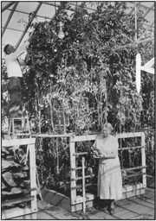
HYDROPONIC FOUNDATIONS
The four root-zone variables
ANCHOR: EC · pH · DO · temperature
• EC estimates total dissolved ionic strength; it does not identify each element.
• pH governs nutrient availability and chemical stability.
• Dissolved oxygen and solution temperature shape respiration and root disease risk.
Legacy visual reused from original slide 22
TGS-2025053916 · Basic Urban Farming with Hydroponics
© 2026 Tertiary Infotech Academy Pte Ltd
Source: extension.unr.edu
20

Slide 21
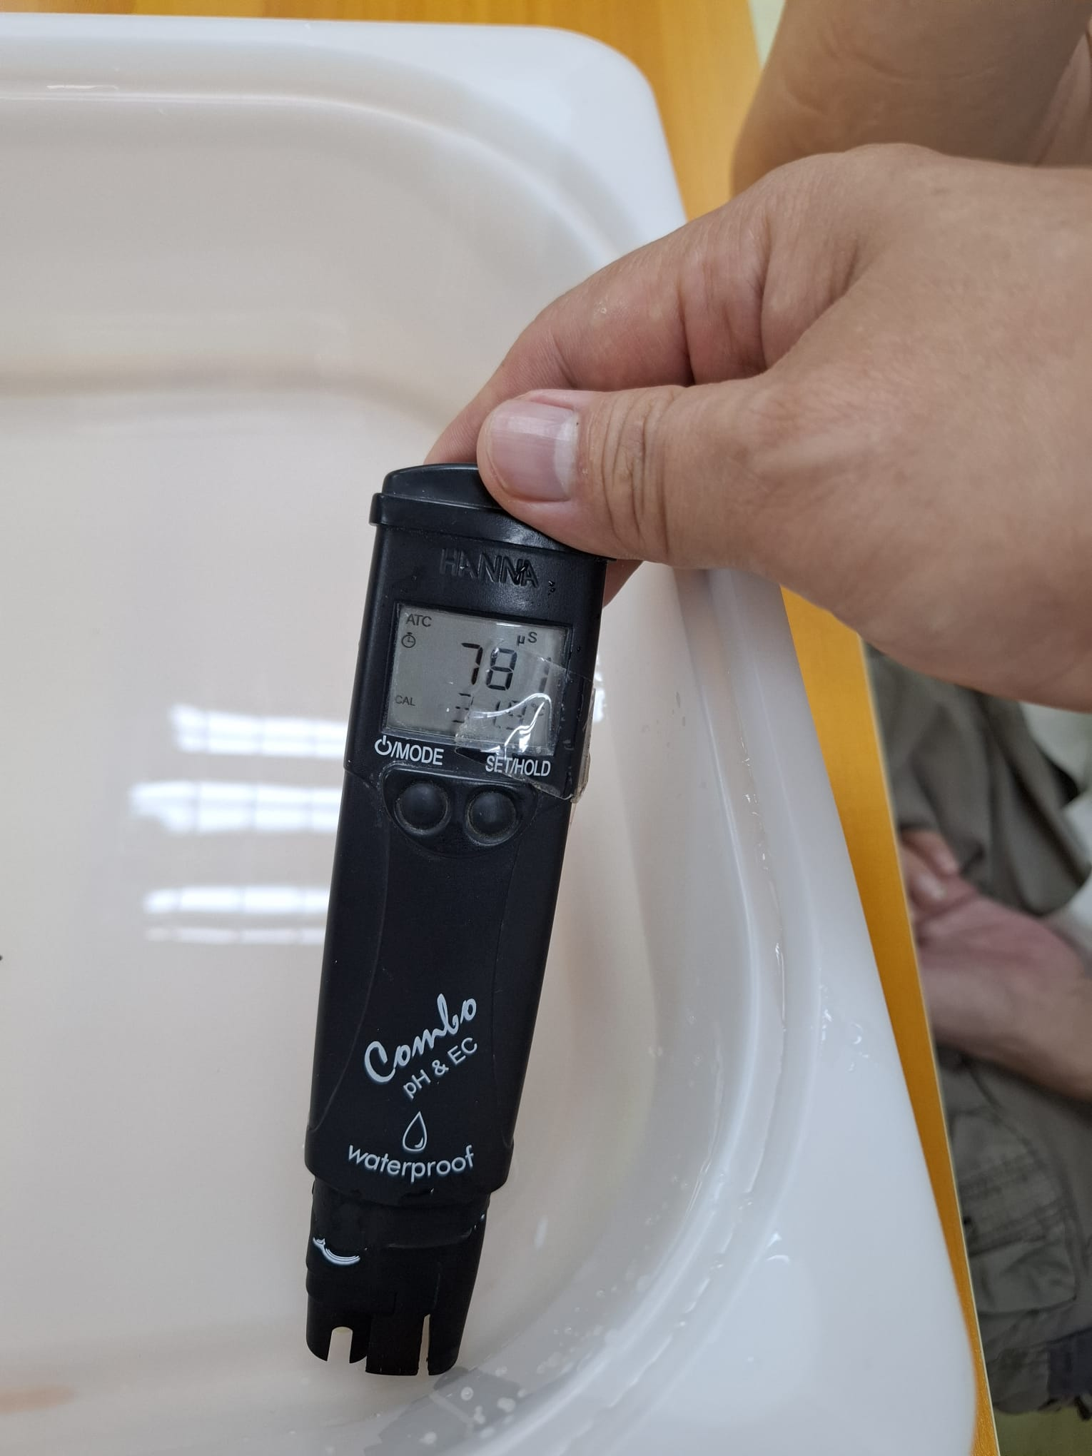
HYDROPONIC FOUNDATIONS
Mass balance explains reservoir drift
ANCHOR: inputs − plant uptake − discharge = change
+
INPUTS
• Water loss through transpiration can raise EC even when no fertiliser is added.
• Selective ion uptake means a stable EC can still hide nutrient imbalance.
• Top-up, correction and periodic replacement are different control actions.
top-up water + nutrients
−
PLANT UPTAKE
water + selective ions
−
DISCHARGE
drain + sampling losses
=
RESERVOIR Δ
volume + ion profile + EC
Local course photo · EC check
Measure trend ≠ diagnose composition
TGS-2025053916 · Basic Urban Farming with Hydroponics
© 2026 Tertiary Infotech Academy Pte Ltd
Source: extension.unr.edu
21

Slide 22
HYDROPONIC FOUNDATIONS
Root respiration sets an oxygen constraint
ANCHOR: warm water holds less dissolved O₂
• Roots consume oxygen to release energy for active ion transport.
• Stagnant warm solution increases hypoxia risk.
• Aeration, return-flow turbulence and lower heat load improve the oxygen margin.
1
2
3
→
→
Roots consume oxygen to release energy for active ion transport.
Stagnant warm solution increases hypoxia risk.
Aeration, return-flow turbulence and lower heat load improve the oxygen margin.
TGS-2025053916 · Basic Urban Farming with Hydroponics
© 2026 Tertiary Infotech Academy Pte Ltd
Source: extension.illinois.edu
22

Slide 23
HYDROPONIC FOUNDATIONS
Capillary and film flow are not interchangeable
ANCHOR: water depth changes air-filled porosity
• A thin nutrient film preserves a moist, oxygen-rich root surface.
• Deep flooding provides thermal mass but needs active aeration.
• Media pores can wick water while maintaining structural support.
1
thin · nutrient · film · preserves · moist · oxygen-rich
2
Deep · flooding · provides · thermal · mass · needs
3
Media · pores · wick · water · while · maintaining
TGS-2025053916 · Basic Urban Farming with Hydroponics
© 2026 Tertiary Infotech Academy Pte Ltd
Source: rhs.org.uk
23

Slide 24
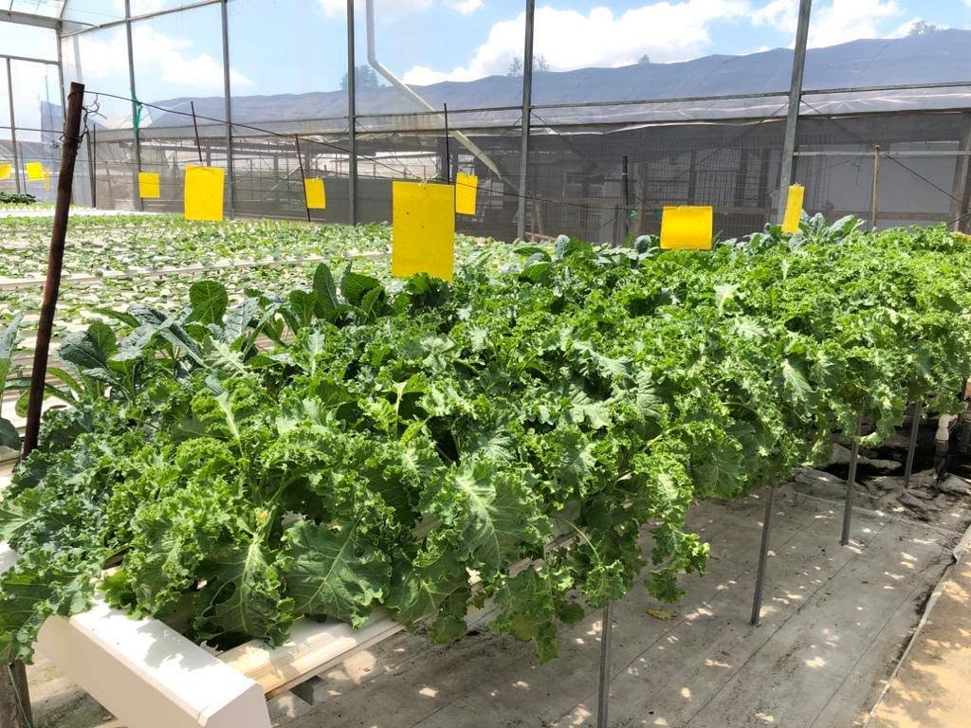
HYDROPONIC FOUNDATIONS
Plant water moves down a potential gradient
ANCHOR: root uptake → xylem → stomata
• Light, heat, humidity and airflow change transpiration demand.
• Roots must supply water fast enough to maintain cell turgor.
• Wilting can occur despite a full reservoir when roots are hypoxic or diseased.
Local farm-tour photo · protected crop water-demand context
TGS-2025053916 · Basic Urban Farming with Hydroponics
© 2026 Tertiary Infotech Academy Pte Ltd
Source: extension.unr.edu
24

Slide 25
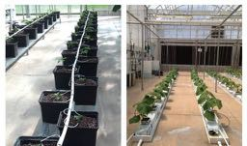
HYDROPONIC FOUNDATIONS
Nutrient ions are not plant food
ANCHOR: photosynthesis supplies carbon energy
• Plants build carbohydrates from CO₂ and water using light energy.
• Mineral ions enable enzymes, structure and osmotic regulation.
• More fertiliser cannot compensate for inadequate light or damaged roots.
Legacy visual reused from original slide 48
TGS-2025053916 · Basic Urban Farming with Hydroponics
© 2026 Tertiary Infotech Academy Pte Ltd
Source: sfa.gov.sg
25

Slide 26
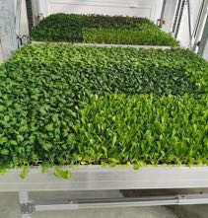
HYDROPONIC FOUNDATIONS
Soil-free does not mean risk-free
ANCHOR: one reservoir can connect every plant
• Recirculation conserves water but can spread a waterborne pathogen rapidly.
• Shared chemistry means one dosing error affects the whole crop.
• Monitoring and sanitation are system controls, not optional housekeeping.
Legacy visual reused from original slide 55
TGS-2025053916 · Basic Urban Farming with Hydroponics
© 2026 Tertiary Infotech Academy Pte Ltd
Source: sfa.gov.sg
26

Slide 27
HYDROPONIC FOUNDATIONS
The production loop is observable
ANCHOR: setpoint → measure → compare → act → verify
• Define an acceptable band before taking a measurement.
• Use a calibrated instrument and a representative sample.
• Record the correction and confirm the value after mixing.
1
2
3
→
→
Define an acceptable band before taking a measurement.
Use a calibrated instrument and a representative sample.
Record the correction and confirm the value after mixing.
TGS-2025053916 · Basic Urban Farming with Hydroponics
© 2026 Tertiary Infotech Academy Pte Ltd
Source: sfa.gov.sg
27

Slide 28
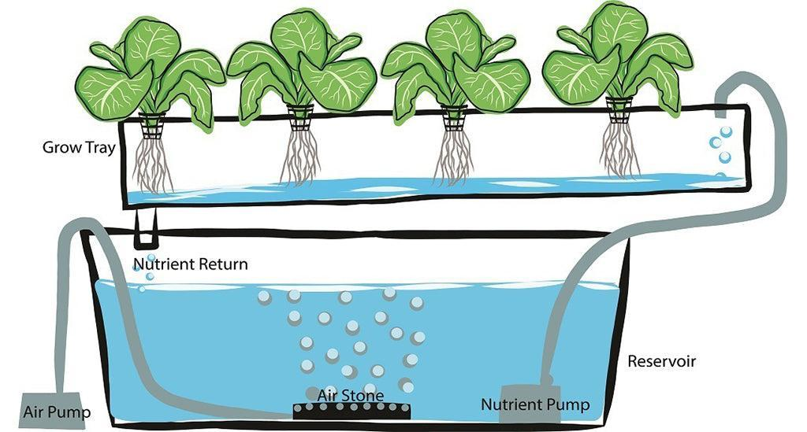
HYDROPONIC FOUNDATIONS
Evidence distinguishes control from guesswork
ANCHOR: time-stamped log + calibration + crop response
• A single reading without time, unit and instrument has weak evidential value.
• Trend data reveals drift before visible symptoms appear.
• Crop photographs should show both canopy and roots, not leaves alone.
Legacy visual reused from original slide 66
TGS-2025053916 · Basic Urban Farming with Hydroponics
© 2026 Tertiary Infotech Academy Pte Ltd
Source: sfa.gov.sg
28

Slide 29
02
Hydroponic systems
Select and diagnose flow, support and failure tolerance
TGS-2025053916 · Basic Urban Farming with Hydroponics
© 2026 Tertiary Infotech Academy Pte Ltd
29

Slide 30
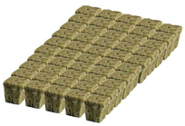
HYDROPONIC SYSTEMS
Nutrient Film Technique (NFT)
ANCHOR: shallow recirculating film
• Channel slope and flow continuity are critical; loss of pumping exposes roots quickly.
• Best fit depends on crop mass, root volume, failure tolerance and operator capability.
• Acceptance evidence: even wetting, unobstructed return and healthy white/cream roots.
Legacy visual reused from original slide 75
TGS-2025053916 · Basic Urban Farming with Hydroponics
© 2026 Tertiary Infotech Academy Pte Ltd
Source: rhs.org.uk
30

Slide 31

HYDROPONIC SYSTEMS
Deep Water Culture (DWC)
ANCHOR: roots suspended in aerated solution
• Air delivery and raft hygiene govern root oxygen and disease risk.
• Best fit depends on crop mass, root volume, failure tolerance and operator capability.
• Acceptance evidence: even wetting, unobstructed return and healthy white/cream roots.
Legacy visual reused from original slide 80
TGS-2025053916 · Basic Urban Farming with Hydroponics
© 2026 Tertiary Infotech Academy Pte Ltd
Source: rhs.org.uk
31

Slide 32

HYDROPONIC SYSTEMS
Kratky passive culture
ANCHOR: static reservoir + deliberate air gap
• A growing air gap supplies oxygen; refilling to the original brim can drown roots.
• Best fit depends on crop mass, root volume, failure tolerance and operator capability.
• Acceptance evidence: even wetting, unobstructed return and healthy white/cream roots.
Legacy visual reused from original slide 87
TGS-2025053916 · Basic Urban Farming with Hydroponics
© 2026 Tertiary Infotech Academy Pte Ltd
Source: rhs.org.uk
32

Slide 33
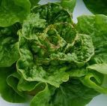
HYDROPONIC SYSTEMS
Ebb-and-flow
ANCHOR: timed flood and drain
• Flood duration wets media; complete drainage restores air-filled porosity.
• Best fit depends on crop mass, root volume, failure tolerance and operator capability.
• Acceptance evidence: even wetting, unobstructed return and healthy white/cream roots.
Legacy visual reused from original slide 91
TGS-2025053916 · Basic Urban Farming with Hydroponics
© 2026 Tertiary Infotech Academy Pte Ltd
Source: rhs.org.uk
33

Slide 34
HYDROPONIC SYSTEMS
Drip hydroponics
ANCHOR: emitter uniformity + drainage fraction
• Emitter blockage and uneven pressure create plant-to-plant variability.
• Best fit depends on crop mass, root volume, failure tolerance and operator capability.
• Acceptance evidence: even wetting, unobstructed return and healthy white/cream roots.
emitter uniformity + drainage fraction
TGS-2025053916 · Basic Urban Farming with Hydroponics
© 2026 Tertiary Infotech Academy Pte Ltd
Source: rhs.org.uk
34

Slide 35
HYDROPONIC SYSTEMS
Aeroponics
ANCHOR: mist droplet delivery to bare roots
• Fine delivery raises oxygen exposure but creates high sensitivity to nozzle or pump failure.
• Best fit depends on crop mass, root volume, failure tolerance and operator capability.
• Acceptance evidence: even wetting, unobstructed return and healthy white/cream roots.
1
2
3
→
→
Fine delivery raises oxygen exposure but creates high sensitivity to nozzle or pump failure.
Best fit depends on crop mass, root volume, failure tolerance and operator capability.
Acceptance evidence: even wetting, unobstructed return and healthy white/cream roots.
TGS-2025053916 · Basic Urban Farming with Hydroponics
© 2026 Tertiary Infotech Academy Pte Ltd
Source: rhs.org.uk
35

Slide 36

HYDROPONIC SYSTEMS
Wick systems
ANCHOR: passive capillary transport
• Low complexity suits small plants; transport rate limits high-demand crops.
• Best fit depends on crop mass, root volume, failure tolerance and operator capability.
• Acceptance evidence: even wetting, unobstructed return and healthy white/cream roots.
Legacy visual reused from original slide 110
TGS-2025053916 · Basic Urban Farming with Hydroponics
© 2026 Tertiary Infotech Academy Pte Ltd
Source: rhs.org.uk
36

Slide 37
HYDROPONIC SYSTEMS
Dutch bucket
ANCHOR: individual media containers + common return
• Isolation aids crop support, while a common return retains shared-solution risk.
• Best fit depends on crop mass, root volume, failure tolerance and operator capability.
• Acceptance evidence: even wetting, unobstructed return and healthy white/cream roots.
individual media containers + common return
TGS-2025053916 · Basic Urban Farming with Hydroponics
© 2026 Tertiary Infotech Academy Pte Ltd
Source: rhs.org.uk
37

Slide 38
HYDROPONIC SYSTEMS
System selection is a constraint decision
ANCHOR: crop × site × utilities × operator
• Fast leafy greens tolerate different support and cycle times from fruiting crops.
• A rooftop site adds heat, wind, loading and access constraints.
• The simplest system that reliably meets the production target is often the best choice.
1
Fast · leafy · greens · tolerate · different · support
2
rooftop · site · adds · heat · wind · loading
3
simplest · system · that · reliably · meets · production
TGS-2025053916 · Basic Urban Farming with Hydroponics
© 2026 Tertiary Infotech Academy Pte Ltd
Source: sfa.gov.sg
38

Slide 39
HYDROPONIC SYSTEMS
Open and recirculating loops trade risk
ANCHOR: discharge loss versus shared-reservoir exposure
• Open drain-to-waste operation simplifies chemistry but loses water and nutrients.
• Recirculation improves resource efficiency and demands stronger monitoring and hygiene.
• Local discharge rules and nutrient recovery should be considered in the SOP.
1
Open · drain-to-waste · operation · simplifies · chemistry · loses
2
Recirculation · improves · resource · efficiency · demands · stronger
3
Local · discharge · rules · nutrient · recovery · should
TGS-2025053916 · Basic Urban Farming with Hydroponics
© 2026 Tertiary Infotech Academy Pte Ltd
Source: sfa.gov.sg
39

Slide 40
HYDROPONIC SYSTEMS
Pump duty must include static and friction head
ANCHOR: duty point = flow at total dynamic head
• A pump's maximum flow is measured near zero head and is not the operating flow.
• Long narrow tubing, elbows and elevation add resistance.
• Measure delivered channel flow instead of relying on the box label.
1
pump's · maximum · flow · measured · near · zero
2
Long · narrow · tubing · elbows · elevation · resistance
3
Measure · delivered · channel · flow · instead · relying
TGS-2025053916 · Basic Urban Farming with Hydroponics
© 2026 Tertiary Infotech Academy Pte Ltd
Source: extension.unr.edu
40

Slide 41
HYDROPONIC SYSTEMS
Return design protects against overflow
ANCHOR: inlet flow ≤ unobstructed drain capacity
• Roots, media and biofilm reduce drainage capacity over time.
• A freeboard and emergency overflow limit water damage.
• Power-off testing reveals siphon and reservoir-capacity hazards.
1
Roots · media · biofilm · reduce · drainage · capacity
2
freeboard · emergency · overflow · limit · water · damage
3
Power-off · testing · reveals · siphon · reservoir-capacity · hazards
TGS-2025053916 · Basic Urban Farming with Hydroponics
© 2026 Tertiary Infotech Academy Pte Ltd
Source: extension.unr.edu
41

Slide 42
HYDROPONIC SYSTEMS
Redundancy is proportional to crop loss exposure
ANCHOR: failure detection time × root drying rate
• NFT may require rapid alarm response because exposed roots dry quickly.
• DWC carries more water reserve but depends on aeration.
• Spare pumps, independent air and tested response actions reduce consequence.
1
require · rapid · alarm · response · because · exposed
2
carries · more · water · reserve · depends · aeration
3
Spare · pumps · independent · tested · response · actions
TGS-2025053916 · Basic Urban Farming with Hydroponics
© 2026 Tertiary Infotech Academy Pte Ltd
Source: sfa.gov.sg
42

Slide 43
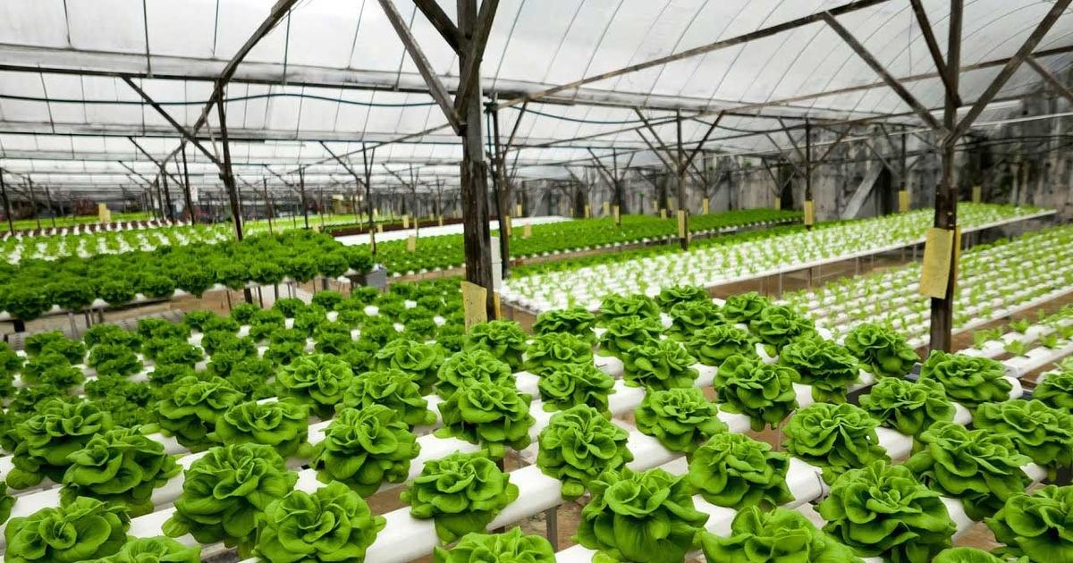
HYDROPONIC SYSTEMS
Media properties drive irrigation strategy
ANCHOR: air-filled porosity · water holding · stability
• Coco coir holds water but requires controlled salt management.
• Perlite increases aeration with low mass and low buffering.
• Rockwool is uniform but demands careful wetness control and disposal planning.
Legacy visual reused from original slide 121
TGS-2025053916 · Basic Urban Farming with Hydroponics
© 2026 Tertiary Infotech Academy Pte Ltd
Source: rhs.org.uk
43

Slide 44
HYDROPONIC SYSTEMS
Food-contact materials need verification
ANCHOR: compatible plastics + cleanable geometry
• Avoid unknown reused containers that may have held chemicals.
• Opaque reservoirs suppress light-driven algae growth.
• Smooth accessible surfaces make cleaning and inspection more reliable.
1
Avoid · unknown · reused · containers · that · have
2
Opaque · reservoirs · suppress · light-driven · algae · growth
3
Smooth · accessible · surfaces · make · cleaning · inspection
TGS-2025053916 · Basic Urban Farming with Hydroponics
© 2026 Tertiary Infotech Academy Pte Ltd
Source: sfa.gov.sg
44

Slide 45
HYDROPONIC SYSTEMS
A system diagram is an operating control
ANCHOR: reservoir → pump → crop → return
• Mark flow direction, valves, sampling point and drain route.
• Identify single points of failure and overflow paths.
• The diagram supports training, troubleshooting and maintenance isolation.
1
2
3
→
→
Mark flow direction, valves, sampling point and drain route.
Identify single points of failure and overflow paths.
The diagram supports training, troubleshooting and maintenance isolation.
TGS-2025053916 · Basic Urban Farming with Hydroponics
© 2026 Tertiary Infotech Academy Pte Ltd
45

Slide 46
03
Water and nutrients
Measure, mix and correct the root-zone chemistry
TGS-2025053916 · Basic Urban Farming with Hydroponics
© 2026 Tertiary Infotech Academy Pte Ltd
46

Slide 47
WATER AND NUTRIENTS
Source water sets the starting chemistry
ANCHOR: alkalinity differs from pH
• pH is the current hydrogen-ion condition; alkalinity resists pH change.
• High bicarbonate water can drive pH upward after correction.
• Record source EC, pH and where relevant alkalinity before formulating.
1
current · hydrogen-ion · condition · alkalinity · resists · change
2
High · bicarbonate · water · drive · upward · after
3
Record · source · where · relevant · alkalinity · before
TGS-2025053916 · Basic Urban Farming with Hydroponics
© 2026 Tertiary Infotech Academy Pte Ltd
Source: sfa.gov.sg
47

Slide 48
WATER AND NUTRIENTS
pH controls chemical availability
ANCHOR: leafy-green working band commonly ~5.5–6.5
• Outside the operating band, some ions become less available or precipitate.
• Adjust in small increments after nutrients are fully mixed.
• Crop-specific SOPs override a generic band.
1
Outside · operating · band · some · ions · become
2
Adjust · small · increments · after · nutrients · fully
3
Crop-specific · SOPs · override · generic · band
TGS-2025053916 · Basic Urban Farming with Hydroponics
© 2026 Tertiary Infotech Academy Pte Ltd
Source: sfa.gov.sg
48

Slide 49
WATER AND NUTRIENTS
EC is a proxy, not a recipe
ANCHOR: mS/cm or µS/cm at a stated temperature
• EC increases with dissolved ions from fertiliser and source water.
• Different ion mixtures can produce a similar EC.
• Use the supplier formulation and crop response together with EC.
1
increases · with · dissolved · ions · from · fertiliser
2
Different · mixtures · produce · similar
3
supplier · formulation · crop · response · together · with
TGS-2025053916 · Basic Urban Farming with Hydroponics
© 2026 Tertiary Infotech Academy Pte Ltd
Source: extension.unr.edu
49

Slide 50
WATER AND NUTRIENTS
Temperature compensation has limits
ANCHOR: conductivity changes with temperature
• ATC helps standardise meter readings but does not protect warm roots.
• Record solution temperature with pH and EC.
• Compare trends at similar times of day where possible.
1
helps · standardise · meter · readings · does · protect
2
Record · solution · temperature · with
3
Compare · trends · similar · times · where · possible
TGS-2025053916 · Basic Urban Farming with Hydroponics
© 2026 Tertiary Infotech Academy Pte Ltd
Source: extension.unr.edu
50

Slide 51
WATER AND NUTRIENTS
Two-part nutrients prevent concentrate reactions
ANCHOR: keep calcium separate from concentrated sulfate/phosphate
• Mix Part A into water before Part B; never combine concentrates directly.
• Allow circulation between additions.
• Precipitate removes nutrients from solution and can block emitters.
1
2
3
→
→
Mix Part A into water before Part B; never combine concentrates directly.
Allow circulation between additions.
Precipitate removes nutrients from solution and can block emitters.
TGS-2025053916 · Basic Urban Farming with Hydroponics
© 2026 Tertiary Infotech Academy Pte Ltd
Source: rhs.org.uk
51

Slide 52
WATER AND NUTRIENTS
Macronutrients build structure and metabolism
ANCHOR: N · P · K · Ca · Mg · S
• Nitrogen supports proteins and chlorophyll; imbalance can drive weak lush growth.
• Potassium regulates water balance and enzyme activity.
• Calcium depends strongly on transport to new tissue.
1
Nitrogen · supports · proteins · chlorophyll · imbalance · drive
2
Potassium · regulates · water · balance · enzyme · activity
3
Calcium · depends · strongly · transport · tissue
TGS-2025053916 · Basic Urban Farming with Hydroponics
© 2026 Tertiary Infotech Academy Pte Ltd
Source: rhs.org.uk
52

Slide 53
WATER AND NUTRIENTS
Micronutrients operate at small concentrations
ANCHOR: Fe · Mn · B · Zn · Cu · Mo · Cl · Ni
• Trace requirement does not mean optional.
• Excess micronutrients can become toxic quickly.
• pH and chelation influence iron availability.
1
Trace · requirement · does · mean · optional
2
Excess · micronutrients · become · toxic · quickly
3
chelation · influence · iron · availability
TGS-2025053916 · Basic Urban Farming with Hydroponics
© 2026 Tertiary Infotech Academy Pte Ltd
Source: rhs.org.uk
53

Slide 54

WATER AND NUTRIENTS
Symptoms are patterns, not diagnoses
ANCHOR: old versus new growth + distribution + roots
• Mobile-element shortages often appear first on older leaves.
• Immobile-element disorders often affect new growth.
• Confirm root health, pH, EC and recent operations before correcting nutrients.
Legacy visual reused from original slide 133
TGS-2025053916 · Basic Urban Farming with Hydroponics
© 2026 Tertiary Infotech Academy Pte Ltd
Source: rhs.org.uk
54

Slide 55
WATER AND NUTRIENTS
Tip burn can occur with calcium present
ANCHOR: calcium transport follows transpiration
• Fast inner-leaf growth, high humidity and weak airflow can limit local calcium delivery.
• Raising EC blindly may worsen water uptake.
• Control growth rate, air movement and root conditions.
1
Fast · inner-leaf · growth · high · humidity · weak
2
Raising · blindly · worsen · water · uptake
3
Control · growth · rate · movement · root · conditions
TGS-2025053916 · Basic Urban Farming with Hydroponics
© 2026 Tertiary Infotech Academy Pte Ltd
Source: rhs.org.uk
55

Slide 56
WATER AND NUTRIENTS
Iron chlorosis needs differential diagnosis
ANCHOR: interveinal yellowing on young leaves
• High root-zone pH can reduce iron availability.
• Root damage and cold/wet stress can mimic nutrient shortage.
• Correct the limiting condition before adding more concentrate.
1
High · root-zone · reduce · iron · availability
2
Root · damage · cold/wet · stress · mimic · nutrient
3
Correct · limiting · condition · before · adding · more
TGS-2025053916 · Basic Urban Farming with Hydroponics
© 2026 Tertiary Infotech Academy Pte Ltd
Source: rhs.org.uk
56

Slide 57
WATER AND NUTRIENTS
Dilution calculation prevents overdosing
ANCHOR: C₁V₁ = C₂V₂
• Use consistent units and confirm the concentrate label.
• Estimate conservatively, mix, measure, then trim.
• Wear required PPE and keep acids/bases labelled and segregated.
1
consistent · units · confirm · concentrate · label
2
Estimate · conservatively · measure · then · trim
3
Wear · required · keep · acids/bases · labelled · segregated
TGS-2025053916 · Basic Urban Farming with Hydroponics
© 2026 Tertiary Infotech Academy Pte Ltd
57

Slide 58
WATER AND NUTRIENTS
Top-up strategy depends on both water and ions
ANCHOR: reservoir level + EC trend + crop stage
• Falling level with rising EC suggests water is leaving faster than ions.
• Falling level with falling EC suggests strong nutrient uptake or dilution history.
• Periodic replacement resets selective-ion drift and accumulated residues.
1
Falling · level · with · rising · suggests · water
2
Falling · level · with · falling · suggests · strong
3
Periodic · replacement · resets · selective-ion · drift · accumulated
TGS-2025053916 · Basic Urban Farming with Hydroponics
© 2026 Tertiary Infotech Academy Pte Ltd
Source: extension.unr.edu
58

Slide 59
WATER AND NUTRIENTS
Meter calibration is part of the measurement
ANCHOR: known standard → rinse → calibrate → verify
• Use fresh, unexpired standards appropriate to the meter.
• Do not pour used standard back into its bottle.
• Record calibration date, standard value and result.
1
fresh · unexpired · standards · appropriate · meter
2
pour · used · standard · back · into · bottle
3
Record · calibration · date · standard · value · result
TGS-2025053916 · Basic Urban Farming with Hydroponics
© 2026 Tertiary Infotech Academy Pte Ltd
Source: sfa.gov.sg
59

Slide 60
WATER AND NUTRIENTS
Sampling location changes the reading
ANCHOR: representative, mixed, bubble-free sample
• A dosing point can read very differently before complete mixing.
• Rinse the cup and probe with sample solution.
• Consistent sampling improves trend comparability.
1
dosing · point · read · very · differently · before
2
Rinse · probe · with · sample · solution
3
Consistent · sampling · improves · trend · comparability
TGS-2025053916 · Basic Urban Farming with Hydroponics
© 2026 Tertiary Infotech Academy Pte Ltd
Source: sfa.gov.sg
60

Slide 61
WATER AND NUTRIENTS
pH correction is a controlled chemical task
ANCHOR: small dose + circulation + remeasurement
• Concentrated acid or alkali can burn skin and roots.
• Add chemical to water as specified; never improvise mixing order.
• Stop if the label, SDS, PPE or correct dosing tool is unavailable.
1
Concentrated · acid · alkali · burn · skin · roots
2
chemical · water · specified · never · improvise · mixing
3
Stop · label · correct · dosing · tool · unavailable
TGS-2025053916 · Basic Urban Farming with Hydroponics
© 2026 Tertiary Infotech Academy Pte Ltd
Source: sfa.gov.sg
61

Slide 62
WATER AND NUTRIENTS
Reservoir sizing buffers change
ANCHOR: litres per plant and refill frequency
• A larger volume changes temperature and EC more slowly.
• Excess volume adds weight and cleaning burden.
• Keep enough free capacity for return water during power-off tests.
1
larger · volume · changes · temperature · more · slowly
2
Excess · volume · adds · weight · cleaning · burden
3
Keep · enough · free · capacity · return · water
TGS-2025053916 · Basic Urban Farming with Hydroponics
© 2026 Tertiary Infotech Academy Pte Ltd
Source: extension.unr.edu
62

Slide 63
WATER AND NUTRIENTS
Light exclusion is an algae control
ANCHOR: photons + nutrients + wet surface = algae opportunity
• Cover reservoirs and unused planting holes.
• Algae competes for oxygen, blocks flow and creates slippery surfaces.
• Clean the root cause rather than relying only on chemical treatment.
1
Cover · reservoirs · unused · planting · holes
2
Algae · competes · oxygen · blocks · flow · creates
3
Clean · root · cause · rather · than · relying
TGS-2025053916 · Basic Urban Farming with Hydroponics
© 2026 Tertiary Infotech Academy Pte Ltd
Source: sfa.gov.sg
63

Slide 64
WATER AND NUTRIENTS
Biofilm changes hydraulics and hygiene
ANCHOR: surface attachment + organic load + time
• Biofilm can harbour organisms and narrow emitters or channels.
• Inspection targets junctions, dead legs and rough surfaces.
• Cleaning must include physical removal, validated chemistry and rinsing.
1
Biofilm · harbour · organisms · narrow · emitters · channels
2
Inspection · targets · junctions · dead · legs · rough
3
Cleaning · must · include · physical · removal · validated
TGS-2025053916 · Basic Urban Farming with Hydroponics
© 2026 Tertiary Infotech Academy Pte Ltd
Source: sfa.gov.sg
64

Slide 65
04
Crop production
Control nursery, environment, hygiene and crop health
TGS-2025053916 · Basic Urban Farming with Hydroponics
© 2026 Tertiary Infotech Academy Pte Ltd
65

Slide 66
CROP PRODUCTION
Crop choice must fit the system envelope
ANCHOR: cycle time · canopy · root volume · support
• Leafy greens suit short cycles and modest structural support.
• Fruiting crops need longer occupancy, pollination and trellising.
• Marketable yield, not plant count, is the production measure.
1
Leafy · greens · suit · short · cycles · modest
2
Fruiting · crops · need · longer · occupancy · pollination
3
Marketable · yield · plant · count · production · measure
TGS-2025053916 · Basic Urban Farming with Hydroponics
© 2026 Tertiary Infotech Academy Pte Ltd
Source: rhs.org.uk
66

Slide 67
CROP PRODUCTION
Seed quality affects the whole batch
ANCHOR: germination % and uniform emergence
• Record cultivar, lot and sowing date.
• Uniform plugs create more even transplant and harvest timing.
• Separate non-germination from later seedling mortality.
1
Record · cultivar · sowing · date
2
Uniform · plugs · create · more · even · transplant
3
Separate · non-germination · from · later · seedling · mortality
TGS-2025053916 · Basic Urban Farming with Hydroponics
© 2026 Tertiary Infotech Academy Pte Ltd
Source: extension.illinois.edu
67

Slide 68
CROP PRODUCTION
Nursery moisture balances water and oxygen
ANCHOR: saturated is not synonymous with healthy
• Overwet media reduces aeration and encourages disease.
• Drying interrupts germination and damages fine roots.
• Use clean water delivery and defined transplant acceptance criteria.
1
Overwet · media · reduces · aeration · encourages · disease
2
Drying · interrupts · germination · damages · fine · roots
3
clean · water · delivery · defined · transplant · acceptance
TGS-2025053916 · Basic Urban Farming with Hydroponics
© 2026 Tertiary Infotech Academy Pte Ltd
Source: sfa.gov.sg
68

Slide 69
CROP PRODUCTION
Transplant timing is a root-and-canopy decision
ANCHOR: established roots + true leaves + intact plug
• Overgrown seedlings suffer root binding and transition stress.
• Weak seedlings create permanent variability in channel performance.
• Reject diseased or mechanically damaged plugs.
1
Overgrown · seedlings · suffer · root · binding · transition
2
Weak · seedlings · create · permanent · variability · channel
3
Reject · diseased · mechanically · damaged · plugs
TGS-2025053916 · Basic Urban Farming with Hydroponics
© 2026 Tertiary Infotech Academy Pte Ltd
Source: sfa.gov.sg
69

Slide 70
CROP PRODUCTION
Light quantity is measured as photons
ANCHOR: PPFD (µmol·m⁻²·s⁻¹) and DLI
• PPFD describes instantaneous photosynthetic photon flux density.
• DLI integrates PPFD over the photoperiod.
• Uniformity matters because the lowest-light positions limit consistent production.
1
PPFD · describes · instantaneous · photosynthetic · photon · flux
2
integrates · PPFD · over · photoperiod
3
Uniformity · matters · because · lowest-light · positions · limit
TGS-2025053916 · Basic Urban Farming with Hydroponics
© 2026 Tertiary Infotech Academy Pte Ltd
Source: sfa.gov.sg
70

Slide 71
CROP PRODUCTION
Daily Light Integral links intensity and time
ANCHOR: DLI = PPFD × seconds ÷ 1,000,000
• Longer photoperiod can partly compensate for lower intensity within crop limits.
• More photons can raise cooling and electricity demand.
• Measure at canopy height across the growing area.
1
Longer · photoperiod · partly · compensate · lower · intensity
2
More · photons · raise · cooling · electricity · demand
3
Measure · canopy · height · across · growing · area
TGS-2025053916 · Basic Urban Farming with Hydroponics
© 2026 Tertiary Infotech Academy Pte Ltd
Source: sfa.gov.sg
71

Slide 72
CROP PRODUCTION
Air temperature and humidity shape demand
ANCHOR: vapour-pressure deficit (VPD)
• Very low evaporative demand can reduce nutrient transport to fast-growing tissue.
• Very high demand can exceed root water supply and close stomata.
• Use crop response with environmental trends, not temperature alone.
1
Very · evaporative · demand · reduce · nutrient · transport
2
Very · high · demand · exceed · root · water
3
crop · response · with · environmental · trends · temperature
TGS-2025053916 · Basic Urban Farming with Hydroponics
© 2026 Tertiary Infotech Academy Pte Ltd
Source: sfa.gov.sg
72

Slide 73
CROP PRODUCTION
Airflow is a boundary-layer control
ANCHOR: leaf movement without mechanical stress
• Gentle circulation supports gas exchange and canopy uniformity.
• Dead zones retain humidity and favour disease.
• Excess wind raises water demand and causes abrasion.
1
Gentle · circulation · supports · exchange · canopy · uniformity
2
Dead · zones · retain · humidity · favour · disease
3
Excess · wind · raises · water · demand · causes
TGS-2025053916 · Basic Urban Farming with Hydroponics
© 2026 Tertiary Infotech Academy Pte Ltd
Source: sfa.gov.sg
73

Slide 74
CROP PRODUCTION
Integrated pest management starts with exclusion
ANCHOR: prevent → monitor → identify → intervene → verify
• Screen openings and inspect incoming plants/materials.
• Use sticky cards and crop scouting to detect change.
• Choose interventions that are lawful, label-compliant and compatible with harvest.
1
2
3
→
→
Screen openings and inspect incoming plants/materials.
Use sticky cards and crop scouting to detect change.
Choose interventions that are lawful, label-compliant and compatible with harvest.
TGS-2025053916 · Basic Urban Farming with Hydroponics
© 2026 Tertiary Infotech Academy Pte Ltd
Source: sfa.gov.sg
74

Slide 75
CROP PRODUCTION
Sticky cards are trend tools
ANCHOR: standard location + interval + count
• Card colour and placement affect which flying pests are captured.
• Counts are comparable only with a consistent method.
• A trap result must be paired with crop inspection and correct identification.
1
Card · colour · placement · affect · which · flying
2
Counts · comparable · only · with · consistent · method
3
trap · result · must · paired · with · crop
TGS-2025053916 · Basic Urban Farming with Hydroponics
© 2026 Tertiary Infotech Academy Pte Ltd
Source: sfa.gov.sg
75

Slide 76
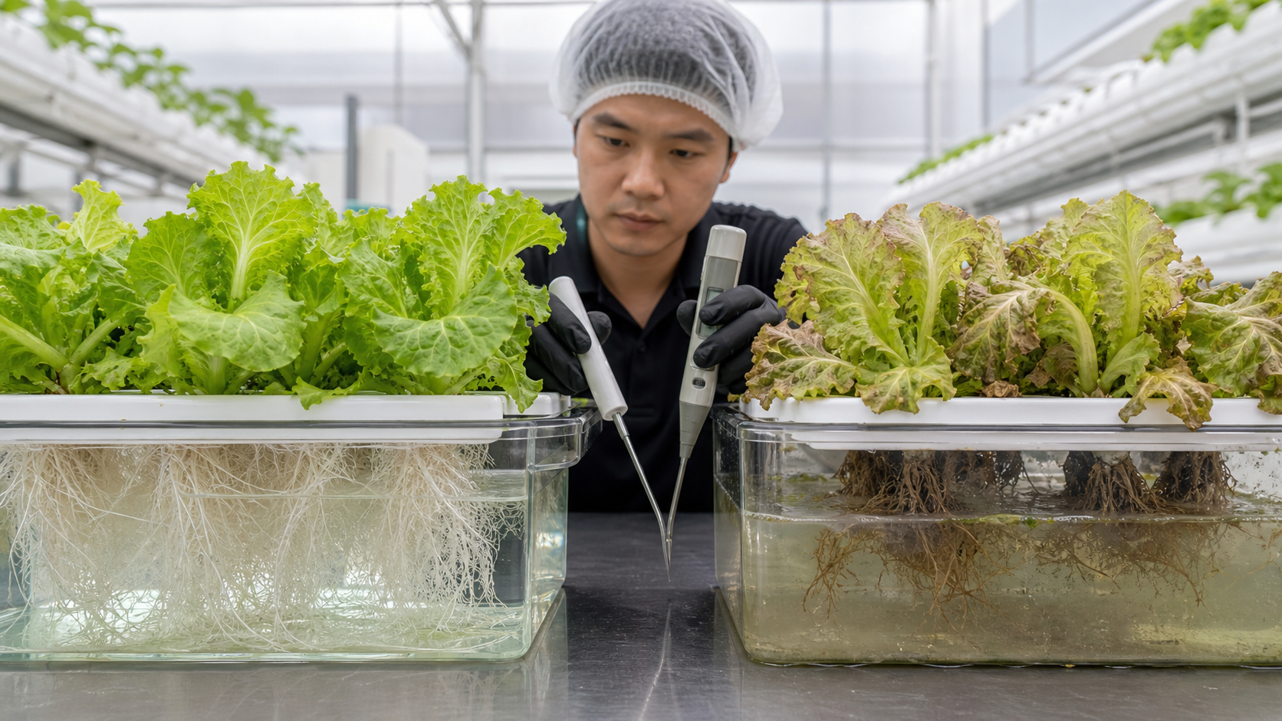
CROP PRODUCTION
Root inspection is non-negotiable
ANCHOR: colour · odour · firmness · branching
• Healthy roots are generally light-coloured and firm, with crop-dependent variation.
• Brown slimy roots and off-odour require rapid investigation.
• Inspect the least vigorous plants and the return end, not only the best canopy.
HEALTHY SIGNAL
RAPID INVESTIGATION
light-coloured · firm · branching
brown · slimy · off-odour
Photorealistic root-zone comparison generated for this course
TGS-2025053916 · Basic Urban Farming with Hydroponics
© 2026 Tertiary Infotech Academy Pte Ltd
Source: sfa.gov.sg
76

Slide 77
CROP PRODUCTION
Harvest hygiene protects ready-to-eat produce
ANCHOR: clean hands/tools + cleanable surfaces + lot traceability
• Separate dirty maintenance tools from harvest equipment.
• Remove damaged or contaminated produce from the marketable lot.
• Record harvest date, crop/lot, quantity and responsible operator.
1
Separate · dirty · maintenance · tools · from · harvest
2
Remove · damaged · contaminated · produce · from · marketable
3
Record · harvest · date · crop/lot · quantity · responsible
TGS-2025053916 · Basic Urban Farming with Hydroponics
© 2026 Tertiary Infotech Academy Pte Ltd
Source: sfa.gov.sg
77

Slide 78
CROP PRODUCTION
Housekeeping controls slips and contamination
ANCHOR: dry walkways + contained chemicals + clear access
• Leaks are production deviations and safety hazards.
• Electrical connections need dry, protected routing.
• Emergency access, labels and SDS must remain visible.
1
Leaks · production · deviations · safety · hazards
2
Electrical · connections · need · protected · routing
3
Emergency · access · labels · must · remain · visible
TGS-2025053916 · Basic Urban Farming with Hydroponics
© 2026 Tertiary Infotech Academy Pte Ltd
Source: tertiarycourses.com.sg
78

Slide 79
CROP PRODUCTION
Cleaning is not the same as disinfection
ANCHOR: soil removal precedes disinfectant contact
• Organic residue shields organisms and consumes disinfectant.
• Correct concentration, contact time and material compatibility are required.
• Rinsing and drying requirements follow the product label/SOP.
1
Organic · residue · shields · organisms · consumes · disinfectant
2
Correct · concentration · contact · time · material · compatibility
3
Rinsing · drying · requirements · follow · product · label/SOP
TGS-2025053916 · Basic Urban Farming with Hydroponics
© 2026 Tertiary Infotech Academy Pte Ltd
Source: sfa.gov.sg
79

Slide 80
CROP PRODUCTION
Maintenance preserves control capability
ANCHOR: inspect → clean → replace → function-test → record
• Pumps, air stones, tubing, filters, probes and timers have different failure modes.
• A spare part is useful only if compatible and accessible.
• Return equipment to service only after a functional verification.
1
2
3
→
→
Pumps, air stones, tubing, filters, probes and timers have different failure modes.
A spare part is useful only if compatible and accessible.
Return equipment to service only after a functional verification.
TGS-2025053916 · Basic Urban Farming with Hydroponics
© 2026 Tertiary Infotech Academy Pte Ltd
Source: tertiarycourses.com.sg
80

Slide 81
05
Singapore hydroponics
Current policy, farms, productivity and technology cases
TGS-2025053916 · Basic Urban Farming with Hydroponics
© 2026 Tertiary Infotech Academy Pte Ltd
81

Slide 82
SINGAPORE HYDROPONICS
Singapore Food Story 2 resets the context
ANCHOR: 2035 capacity targets—20% fibre, 30% protein
• The current policy focuses on resilient production capacity and commercial viability.
• Previous national framing has been superseded by the current 2035 capacity targets.
• Hydroponics contributes mainly to the fibre category through vegetables.
TGS-2025053916 · Basic Urban Farming with Hydroponics
© 2026 Tertiary Infotech Academy Pte Ltd
Source: mse.gov.sg
82

Slide 83
SINGAPORE HYDROPONICS
2025 output shows the remaining fibre gap
ANCHOR: about 8% fibre and 25% protein in 2025
• Local output is only one layer of Singapore's food-resilience strategy.
• Productivity, demand, import diversification and stockpiling interact.
• A technical system must still produce saleable crops at viable cost.
TGS-2025053916 · Basic Urban Farming with Hydroponics
© 2026 Tertiary Infotech Academy Pte Ltd
Source: sfa.gov.sg
83

Slide 84
SINGAPORE HYDROPONICS
Vegetable productivity rose in 2025
ANCHOR: 231.4 → 253.3 tonnes/ha/year
• SFA reported roughly a 10% increase in farm productivity.
• Area-normalised output supports comparison but does not reveal energy or cost.
• Pair yield with grade-out, input use, labour and downtime.
TGS-2025053916 · Basic Urban Farming with Hydroponics
© 2026 Tertiary Infotech Academy Pte Ltd
Source: sfa.gov.sg
84

Slide 85
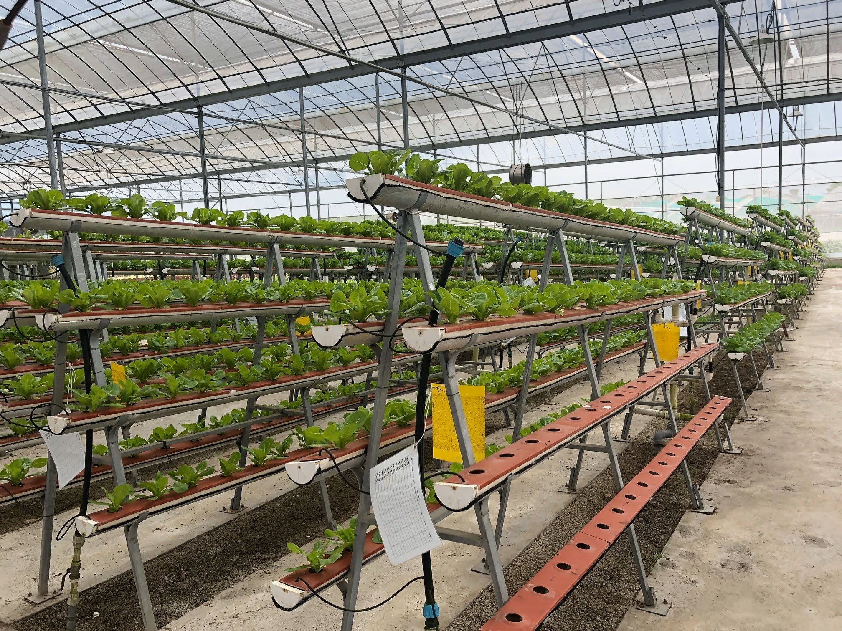
SINGAPORE HYDROPONICS
ComCrop demonstrates rooftop hybrid production
ANCHOR: rooftop hydroponics + sunlight + supplemental light
• SFA describes ComCrop as Singapore's first commercial rooftop farm, established in 2011.
• Sensors support monitoring of water, light and nutrient conditions.
• Manual transplanting, harvesting and cleaning remain important operations.
Local farm-tour photo · protected hydroponics (illustrative; not ComCrop)
TGS-2025053916 · Basic Urban Farming with Hydroponics
© 2026 Tertiary Infotech Academy Pte Ltd
Source: sfa.gov.sg
85

Slide 86
SINGAPORE HYDROPONICS
Sustenir compresses production into controlled space
ANCHOR: NFT + vertical layers + controlled environment
• SFA describes recirculating NFT with temperature, humidity and CO₂ control.
• The farm page reports 3.2 tonnes of lettuce from 54 m² and over 90 tonnes/year.
• Treat site figures as reported case data, not universal performance.
1
describes · recirculating · with · temperature · humidity · control
2
farm · page · reports · tonnes · lettuce · from
3
Treat · site · figures · reported · case · data
TGS-2025053916 · Basic Urban Farming with Hydroponics
© 2026 Tertiary Infotech Academy Pte Ltd
Source: sfa.gov.sg
86

Slide 87
SINGAPORE HYDROPONICS
Singrow targets temperate crops in the tropics
ANCHOR: cultivar + climate control + automation
• The NUS Enterprise case describes proprietary hydroponic strawberries.
• Computer vision, robotics and crop genetics form one production system.
• Higher-value crops may justify complexity that leafy greens cannot.
1
Enterprise · case · describes · proprietary · hydroponic · strawberries
2
Computer · vision · robotics · crop · genetics · form
3
Higher-value · crops · justify · complexity · that · leafy
TGS-2025053916 · Basic Urban Farming with Hydroponics
© 2026 Tertiary Infotech Academy Pte Ltd
Source: enterprise.nus.edu.sg
87

Slide 88
SINGAPORE HYDROPONICS
Greenphyto signals a scale-and-automation bet
ANCHOR: reported 23 m chambers and up to 2,000 t/year
• The Business Times reported an S$80 million multi-storey hydroponic facility in January 2026.
• The report describes automated seeding, dosing, crop movement and climate control.
• Capacity and company claims must be distinguished from verified realised output.
1
Business · Times · reported · S$80 · million · multi-storey
2
report · describes · automated · seeding · dosing · crop
3
Capacity · company · claims · must · distinguished · from
TGS-2025053916 · Basic Urban Farming with Hydroponics
© 2026 Tertiary Infotech Academy Pte Ltd
Source: businesstimes.com.sg
88

Slide 89
SINGAPORE HYDROPONICS
Digital twins turn operations into models
ANCHOR: sensor state → model → prediction → action
• A digital twin is useful only when sensors are calibrated and the model matches the crop process.
• Prediction can support harvest planning, fault detection and energy optimisation.
• Human verification remains necessary when biology departs from the model.
1
2
3
→
→
A digital twin is useful only when sensors are calibrated and the model matches the crop process.
Prediction can support harvest planning, fault detection and energy optimisation.
Human verification remains necessary when biology departs from the model.
TGS-2025053916 · Basic Urban Farming with Hydroponics
© 2026 Tertiary Infotech Academy Pte Ltd
Source: businesstimes.com.sg
89

Slide 90
SINGAPORE HYDROPONICS
Automation changes the job, not the biology
ANCHOR: actuators still depend on trustworthy measurements
• Automated dosing magnifies a bad probe or wrong setpoint.
• Alarms require ownership, escalation and tested response time.
• Operators need crop observation plus technical troubleshooting skills.
1
Automated · dosing · magnifies · probe · wrong · setpoint
2
Alarms · require · ownership · escalation · tested · response
3
Operators · need · crop · observation · plus · technical
TGS-2025053916 · Basic Urban Farming with Hydroponics
© 2026 Tertiary Infotech Academy Pte Ltd
Source: businesstimes.com.sg
90

Slide 91
SINGAPORE HYDROPONICS
ACT Fund 2 supports capability transformation
ANCHOR: new S$70m tranche from 2026
• SFA lists capability upgrading, technology adoption and standards pathways.
• A grant does not remove the need for business and technical feasibility.
• Define measurable production and capability outcomes before procurement.
1
lists · capability · upgrading · technology · adoption · standards
2
grant · does · remove · need · business · technical
3
Define · measurable · production · capability · outcomes · before
TGS-2025053916 · Basic Urban Farming with Hydroponics
© 2026 Tertiary Infotech Academy Pte Ltd
Source: sfa.gov.sg
91

Slide 92
SINGAPORE HYDROPONICS
SG GAP connects production with assurance
ANCHOR: food safety + quality + environmental + worker welfare controls
• Good agricultural practice depends on documented, repeatable controls.
• Records support traceability and corrective action.
• Certification scope and current requirements must be checked with SFA/standards sources.
1
Good · agricultural · practice · depends · documented · repeatable
2
Records · support · traceability · corrective · action
3
Certification · scope · current · requirements · must · checked
TGS-2025053916 · Basic Urban Farming with Hydroponics
© 2026 Tertiary Infotech Academy Pte Ltd
Source: sfa.gov.sg
92

Slide 93
SINGAPORE HYDROPONICS
Land productivity alone can mislead
ANCHOR: yield/m² must be read with kWh, labour, water and grade-out
• Vertical stacking can raise output per floor area.
• Lighting, cooling, pumping and dehumidification add operating load.
• A resilient farm optimises the whole system, not a single headline metric.
1
Vertical · stacking · raise · output · floor · area
2
Lighting · cooling · pumping · dehumidification · operating · load
3
resilient · farm · optimises · whole · system · single
TGS-2025053916 · Basic Urban Farming with Hydroponics
© 2026 Tertiary Infotech Academy Pte Ltd
Source: sfa.gov.sg
93

Slide 94
SINGAPORE HYDROPONICS
Tropical heat is a root-zone design input
ANCHOR: heat gain → warmer solution → lower oxygen margin
• Shade, insulation, reservoir location and operating time influence heat load.
• Cooling can protect crops but adds capital and energy cost.
• Measure the actual daily temperature profile before choosing controls.
1
Shade · insulation · reservoir · location · operating · time
2
Cooling · protect · crops · adds · capital · energy
3
Measure · actual · daily · temperature · profile · before
TGS-2025053916 · Basic Urban Farming with Hydroponics
© 2026 Tertiary Infotech Academy Pte Ltd
Source: sfa.gov.sg
94

Slide 95
SINGAPORE HYDROPONICS
Farm economics start with marketable yield
ANCHOR: revenue = saleable mass × realised price
• High biological yield can coexist with poor grade-out or weak demand.
• Cycle time and space occupancy affect annual throughput.
• Include packaging, logistics, rejects, energy, labour and downtime.
1
High · biological · yield · coexist · with · poor
2
Cycle · time · space · occupancy · affect · annual
3
Include · packaging · logistics · rejects · energy · labour
TGS-2025053916 · Basic Urban Farming with Hydroponics
© 2026 Tertiary Infotech Academy Pte Ltd
Source: sfa.gov.sg
95

Slide 96
SINGAPORE HYDROPONICS
Resilience needs more than local farms
ANCHOR: local capacity + diversified imports + stockpiles + partnerships
• Current Singapore policy uses multiple food-security strategies.
• Hydroponics is a targeted production tool, not a universal substitute for imports.
• System choice should be matched to crops Singapore can produce competitively.
1
2
3
→
→
Current Singapore policy uses multiple food-security strategies.
Hydroponics is a targeted production tool, not a universal substitute for imports.
System choice should be matched to crops Singapore can produce competitively.
TGS-2025053916 · Basic Urban Farming with Hydroponics
© 2026 Tertiary Infotech Academy Pte Ltd
Source: mse.gov.sg
96

Slide 97
06
Farm tour activity
Observe MEOD Farm using evidence-based checklists
TGS-2025053916 · Basic Urban Farming with Hydroponics
© 2026 Tertiary Infotech Academy Pte Ltd
97

Slide 98
—
Lunch break
Resume at the farm-tour assembly point stated by the trainer
TGS-2025053916 · Basic Urban Farming with Hydroponics
© 2026 Tertiary Infotech Academy Pte Ltd
98

Slide 99
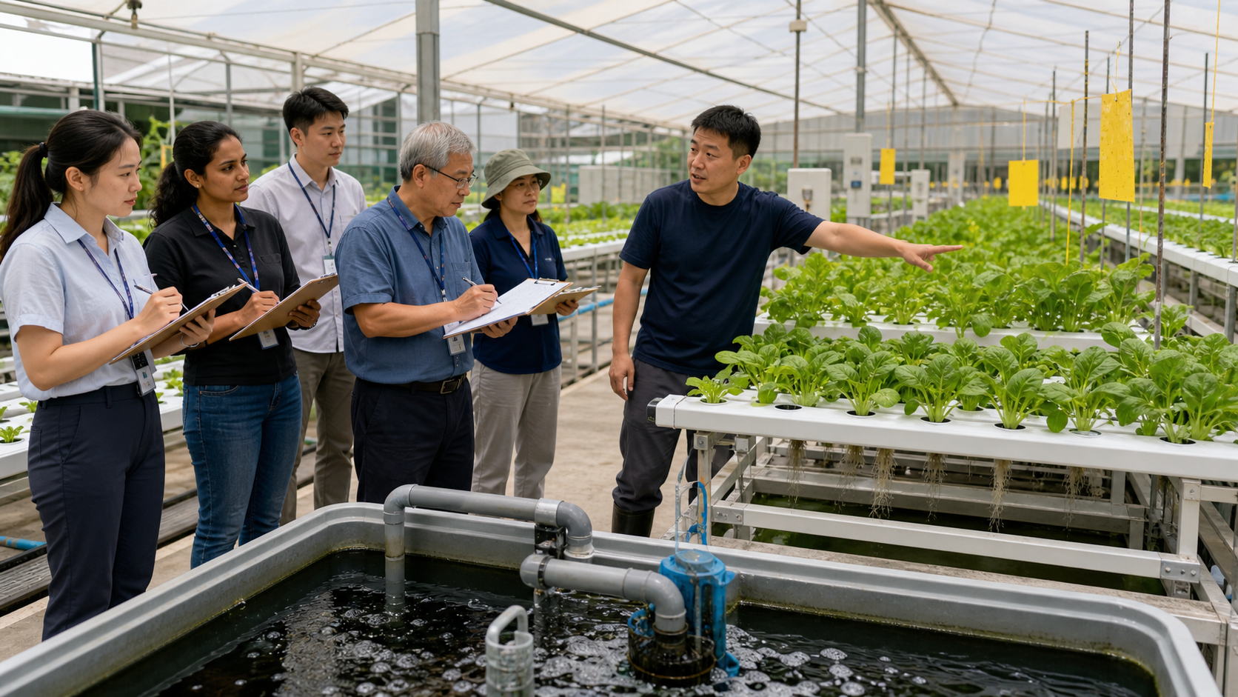
FARM TOUR ACTIVITY
Observe flow before judging appearance
ANCHOR: trace reservoir → delivery → root zone → return
• Identify the system boundary and where water can leave it.
• Locate measurement, dosing, filtration and overflow points.
• Record observations; do not touch equipment without permission.
Visual: generated for this course
TGS-2025053916 · Basic Urban Farming with Hydroponics
© 2026 Tertiary Infotech Academy Pte Ltd
99

Slide 100
FARM TOUR ACTIVITY
Read the crop as a spatial pattern
ANCHOR: inlet/middle/return + upper/lower tier
• Uniform symptoms suggest a shared input; local symptoms suggest position-specific causes.
• Compare canopy colour, size and density across the system.
• Photographs require farm permission and must avoid faces or confidential displays.
1
Uniform · symptoms · suggest · shared · input · local
2
Compare · canopy · colour · size · density · across
3
Photographs · require · farm · permission · must · avoid
TGS-2025053916 · Basic Urban Farming with Hydroponics
© 2026 Tertiary Infotech Academy Pte Ltd
100

Slide 101
FARM TOUR ACTIVITY
Audit water and nutrient controls
ANCHOR: instrument + setpoint + frequency + response
• Ask where and when pH, EC and temperature are measured.
• Look for calibration, dosing and corrective-action records.
• Distinguish observed evidence from an operator explanation.
1
where · when · temperature · measured
2
Look · calibration · dosing · corrective-action · records
3
Distinguish · observed · evidence · from · operator · explanation
TGS-2025053916 · Basic Urban Farming with Hydroponics
© 2026 Tertiary Infotech Academy Pte Ltd
101

Slide 102
FARM TOUR ACTIVITY
Audit WSH and food-safety controls
ANCHOR: hazard → existing control → residual risk
• Observe wet floors, electrical routing, chemical storage and manual handling.
• Look for clean/dirty zoning and harvest-tool control.
• Escalate urgent hazards to the trainer; never intervene in machinery.
1
Observe · floors · electrical · routing · chemical · storage
2
Look · clean/dirty · zoning · harvest-tool · control
3
Escalate · urgent · hazards · trainer · never · intervene
TGS-2025053916 · Basic Urban Farming with Hydroponics
© 2026 Tertiary Infotech Academy Pte Ltd
Source: tertiarycourses.com.sg
102

Slide 103
FARM TOUR ACTIVITY
Map preventive maintenance
ANCHOR: asset ID + interval + completion + function test
• Check pumps, filters, air delivery, sensors, lighting and structural supports.
• Ask how failure is detected and who responds.
• Look for spare-part readiness and documented return-to-service tests.
1
Check · pumps · filters · delivery · sensors · lighting
2
failure · detected · responds
3
Look · spare-part · readiness · documented · return-to-service · tests
TGS-2025053916 · Basic Urban Farming with Hydroponics
© 2026 Tertiary Infotech Academy Pte Ltd
103

Slide 104
FARM TOUR ACTIVITY
Evaluate pest management evidence
ANCHOR: monitoring location + count trend + intervention record
• Identify exclusion barriers, scouting routines and sticky-card placement.
• Ask how pests are identified before treatment.
• Confirm interventions respect label, food-safety and pre-harvest requirements.
1
Identify · exclusion · barriers · scouting · routines · sticky-card
2
pests · identified · before · treatment
3
Confirm · interventions · respect · label · food-safety · pre-harvest
TGS-2025053916 · Basic Urban Farming with Hydroponics
© 2026 Tertiary Infotech Academy Pte Ltd
Source: sfa.gov.sg
104

Slide 105
FARM TOUR ACTIVITY
Separate claim, observation and inference
ANCHOR: C/O/I notation
• Claim: what the guide/operator says.
• Observation: what you directly see, measure or read.
• Inference: your explanation, labelled as provisional until verified.
1
Claim · what · guide/operator · says
2
Observation · what · directly · measure · read
3
Inference · your · explanation · labelled · provisional · until
TGS-2025053916 · Basic Urban Farming with Hydroponics
© 2026 Tertiary Infotech Academy Pte Ltd
105

Slide 106
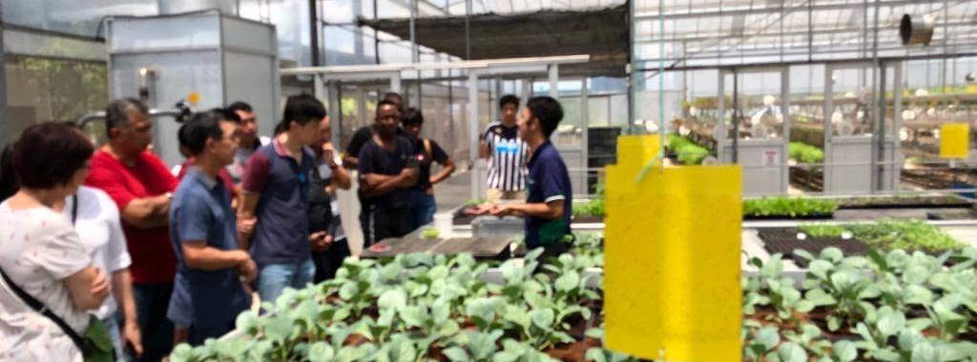
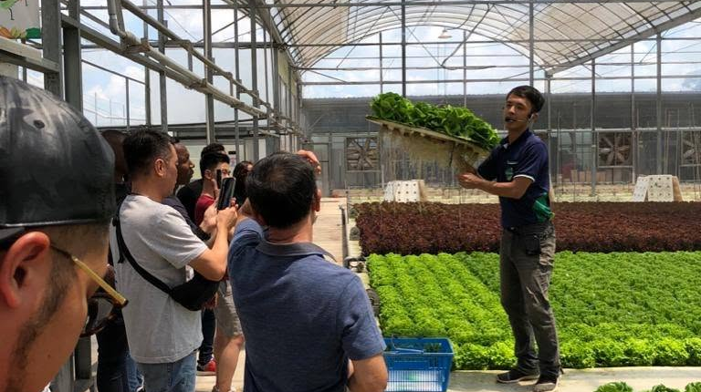
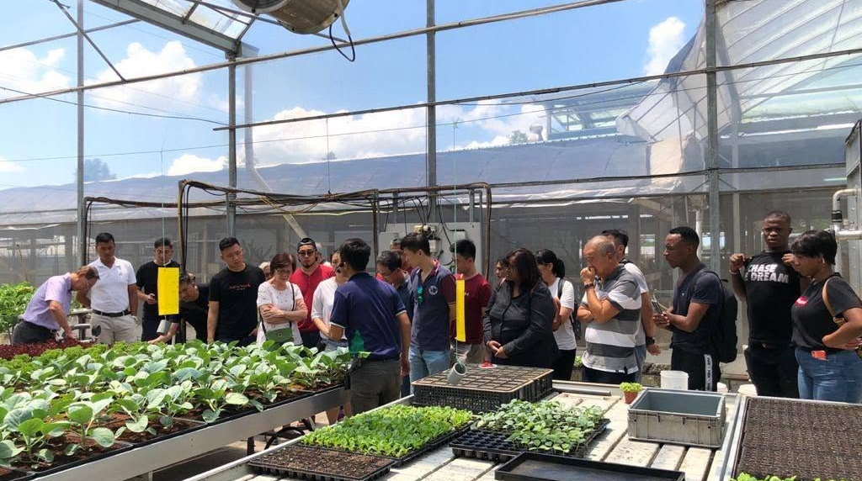
FARM TOUR ACTIVITY
Farm-tour evidence is a checklist package
ANCHOR: completed PDF + permitted photos + one flow sketch
• The activity PDF defines the required evidence.
• Use concise factual notes with location and time.
• Submit no personal data, trade secrets or unsafe photographs.
OBSERVE · crop condition, spatial patterns and controls
ASK · verify the operator explanation
RECORD · location, time and permission
Tertiary Infotech farm tours · blog archive, 15 Feb 2020
TGS-2025053916 · Basic Urban Farming with Hydroponics
© 2026 Tertiary Infotech Academy Pte Ltd
106

Slide 107
07
Hydroponics kit practice
Commission, verify and return a kit to a controlled state
TGS-2025053916 · Basic Urban Farming with Hydroponics
© 2026 Tertiary Infotech Academy Pte Ltd
107

Slide 108
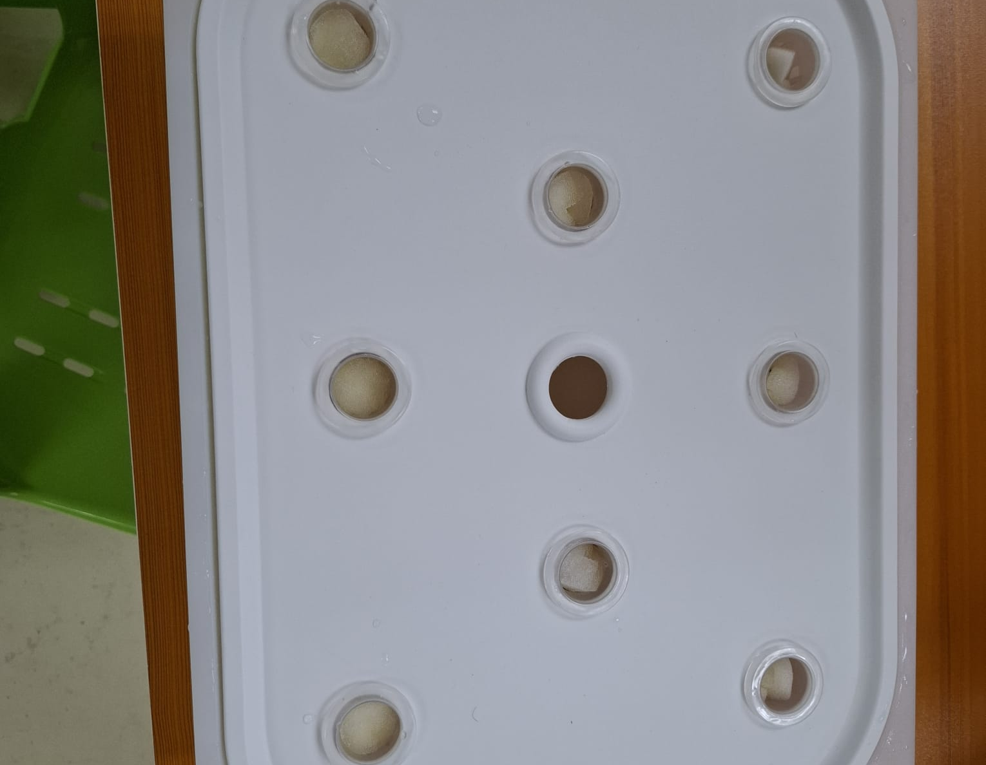
HYDROPONICS KIT PRACTICE
Kit readiness is an acceptance state
ANCHOR: clean · intact · stable · leak-free · electrically safe
• A visual inspection occurs before water or power is applied.
• Tubing must be secured without kinks and returns must be unobstructed.
• Reject damaged cables, unknown containers or unstable structures.
Local practice photo · lid, planting sites and media cups · 14 Mar 2026
TGS-2025053916 · Basic Urban Farming with Hydroponics
© 2026 Tertiary Infotech Academy Pte Ltd
108

Slide 109
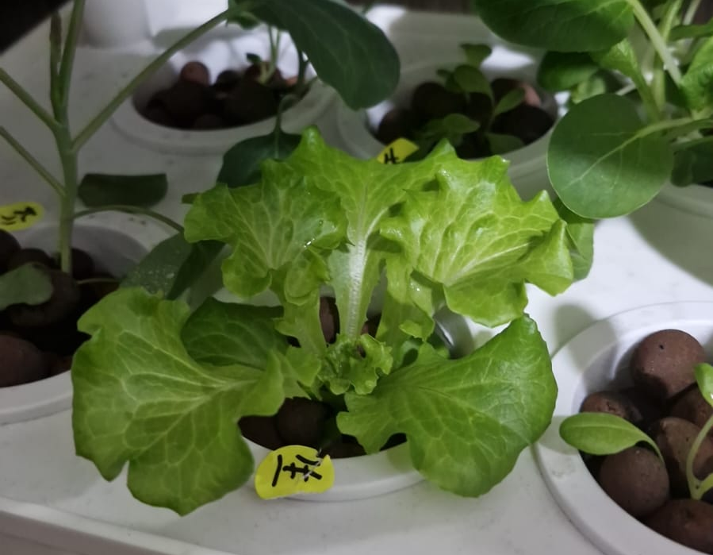
HYDROPONICS KIT PRACTICE
Flow verification uses evidence
ANCHOR: every site wet + return stable + no overflow
• Observe the last planting site, not only the first.
• Confirm pump noise and vibration are normal for the unit.
• A timed-volume check can quantify delivered flow where required.
Local practice photo · operating hydroponic unit and crop positions · 21 Oct 2025
TGS-2025053916 · Basic Urban Farming with Hydroponics
© 2026 Tertiary Infotech Academy Pte Ltd
109

Slide 110
HYDROPONICS KIT PRACTICE
A baseline precedes correction
ANCHOR: source water pH/EC/temperature recorded first
• Baseline data separates source-water contribution from added nutrients.
• Use clean labelled tools to avoid cross-contamination.
• The Learner Guide contains the detailed sequence and safety checks.
Local practice photo · source-water EC measurement · 14 Mar 2026
TGS-2025053916 · Basic Urban Farming with Hydroponics
© 2026 Tertiary Infotech Academy Pte Ltd
110

Slide 111
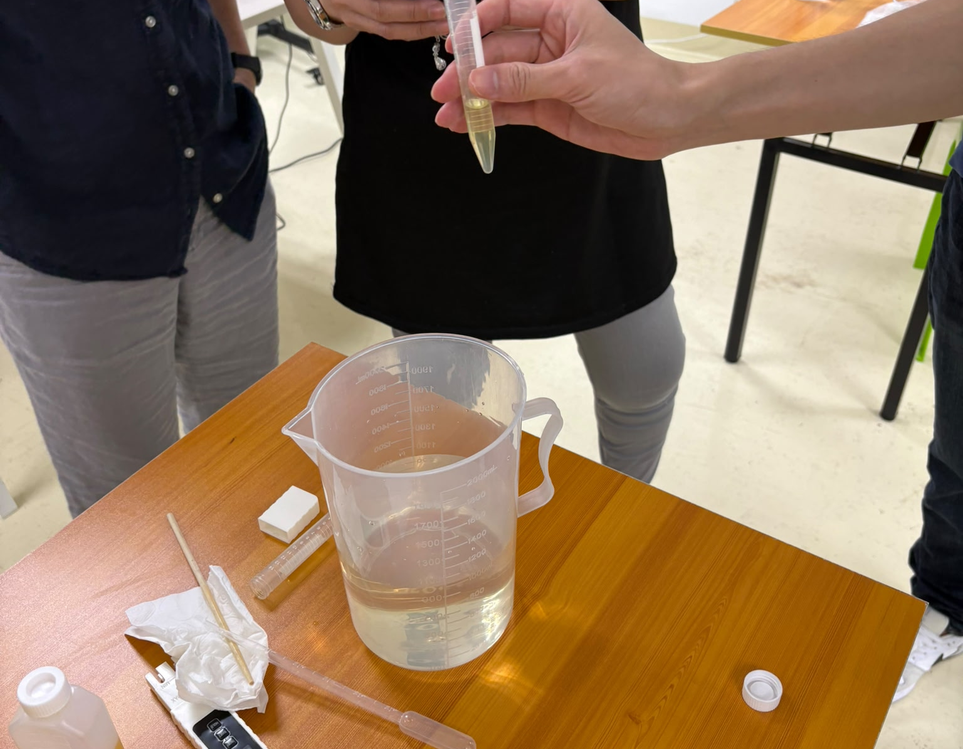
HYDROPONICS KIT PRACTICE
Mixing order protects chemistry
ANCHOR: water → A → circulate → B → circulate → measure
• Concentrates must never contact each other directly.
• The final EC is verified against the activity setpoint supplied by the trainer.
• Any deviation is corrected incrementally and recorded.
Local practice photo · dosing tools, meter and measured sample · 6 Jun 2026
TGS-2025053916 · Basic Urban Farming with Hydroponics
© 2026 Tertiary Infotech Academy Pte Ltd
111

Slide 112
HYDROPONICS KIT PRACTICE
pH adjustment uses a stop condition
ANCHOR: no label/SDS/PPE = no dosing
• Use the trainer-provided product and dedicated dosing tool only.
• Add small amounts, circulate and remeasure.
• Never return excess chemical to the stock container.
1
trainer-provided · product · dedicated · dosing · tool · only
2
small · amounts · circulate · remeasure
3
Never · return · excess · chemical · stock · container
TGS-2025053916 · Basic Urban Farming with Hydroponics
© 2026 Tertiary Infotech Academy Pte Ltd
112

Slide 113
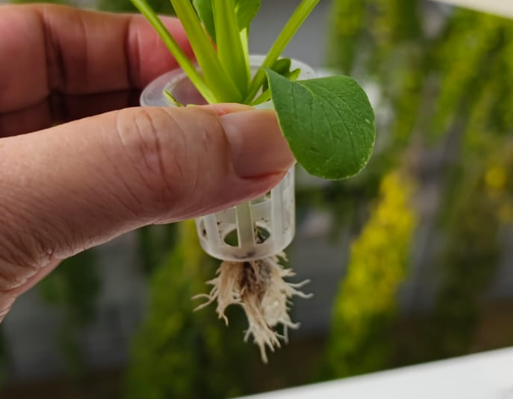
HYDROPONICS KIT PRACTICE
Transplant acceptance protects uniformity
ANCHOR: intact plug + healthy root + centred support + stable crown
• Roots should contact moisture without burying the crown.
• Remove weak or diseased seedlings from the production batch.
• Plant labels preserve cultivar and date traceability.
Local practice photo · accepted seedling, net cup and visible roots · 25 Jul 2025
TGS-2025053916 · Basic Urban Farming with Hydroponics
© 2026 Tertiary Infotech Academy Pte Ltd
Source: sfa.gov.sg
113

Slide 114
HYDROPONICS KIT PRACTICE
Power-off behaviour is part of commissioning
ANCHOR: no siphon overflow + reservoir contains return volume
• Simulated power loss exposes drainage and restart behaviour.
• Restart must restore delivery to every site.
• Do not conduct the test where electrical or spill controls are inadequate.
1
Simulated · power · loss · exposes · drainage · restart
2
Restart · must · restore · delivery · every · site
3
conduct · test · where · electrical · spill · controls
TGS-2025053916 · Basic Urban Farming with Hydroponics
© 2026 Tertiary Infotech Academy Pte Ltd
114

Slide 115
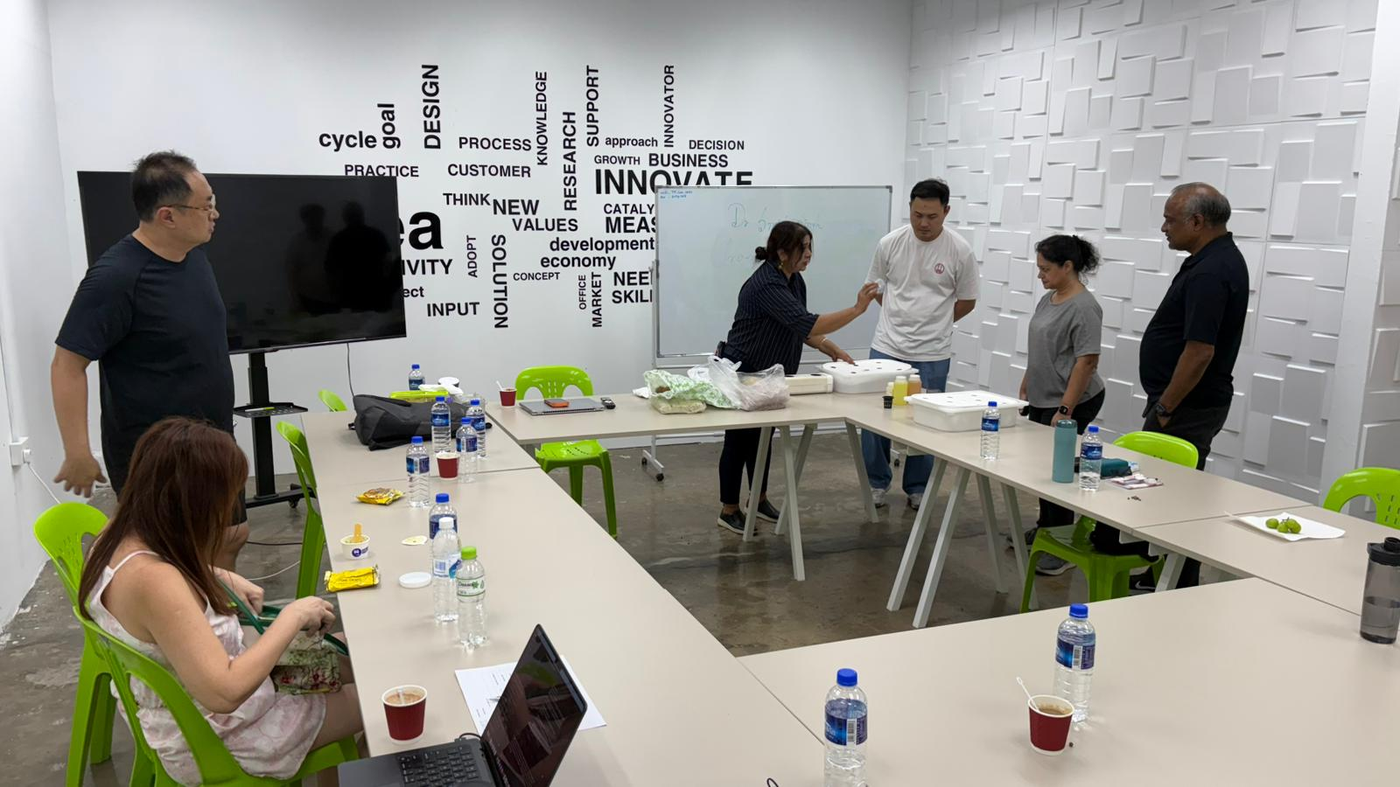
HYDROPONICS KIT PRACTICE
A correction log closes the loop
ANCHOR: before → action → after → operator → time
• Record the reason and exact quantity added.
• Allow adequate mixing before the after-reading.
• Escalate if the value does not respond as expected.
Local practice photo · learners documenting kit setup and evidence · 29 Aug 2026
TGS-2025053916 · Basic Urban Farming with Hydroponics
© 2026 Tertiary Infotech Academy Pte Ltd
115

Slide 116
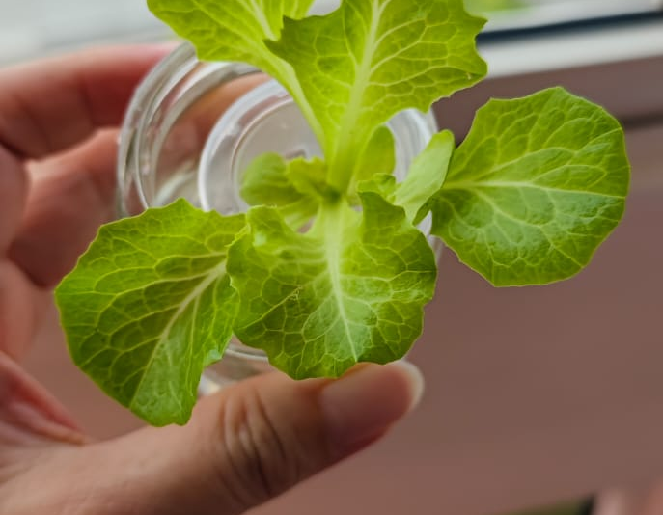
HYDROPONICS KIT PRACTICE
Root-zone diagnosis starts below the canopy
ANCHOR: roots + flow + temperature + chemistry
• Leaf symptoms alone can lead to the wrong correction.
• Inspect for obstruction, low aeration, warmth and odour.
• Isolate suspect plants and protect the shared reservoir where required by SOP.
Local practice photo · root branching and net-cup condition · 25 Jul 2025
TGS-2025053916 · Basic Urban Farming with Hydroponics
© 2026 Tertiary Infotech Academy Pte Ltd
Source: sfa.gov.sg
116

Slide 117
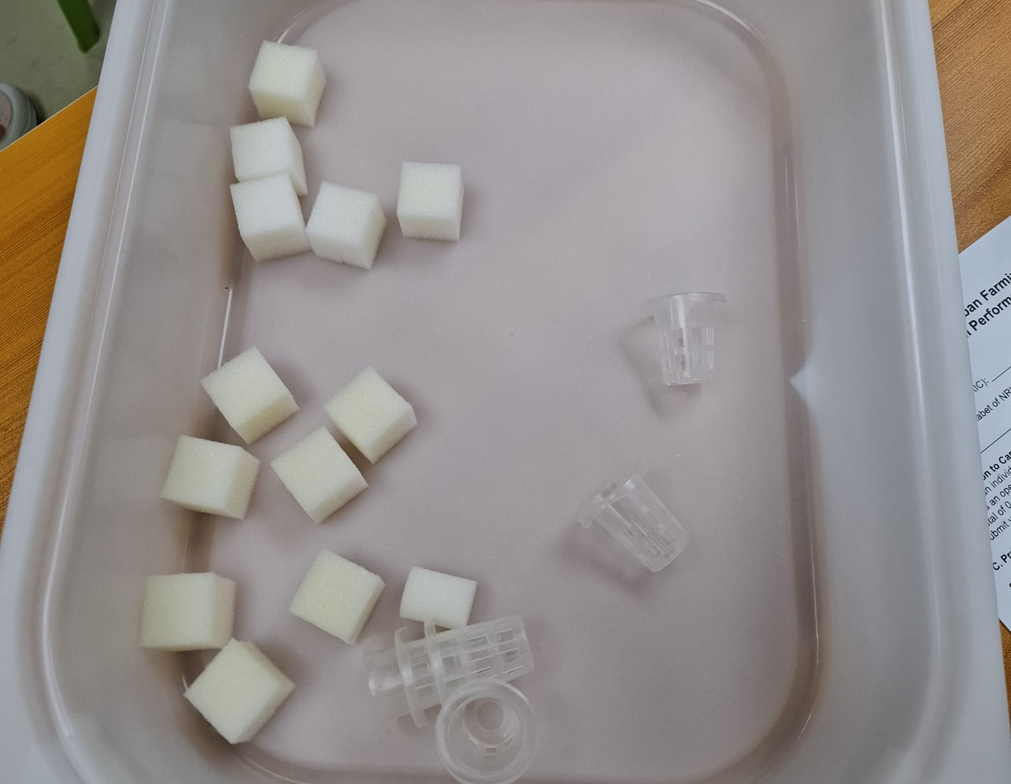
HYDROPONICS KIT PRACTICE
Cleaning returns the kit to a controlled state
ANCHOR: drain → remove residue → clean → rinse → dry → store
• Electrical components are isolated from water.
• Disassemble only parts approved by the equipment SOP.
• Final evidence shows a dry, complete kit with chemicals secured.
Local practice photo · disassembled media cups before cleaning and return · 14 Mar 2026
TGS-2025053916 · Basic Urban Farming with Hydroponics
© 2026 Tertiary Infotech Academy Pte Ltd
117

Slide 118
HYDROPONICS KIT PRACTICE
Practice evidence maps to A1–A4
ANCHOR: prepare · operate · comply · maintain
• A1: materials and equipment ready.
• A2: system operates to target with measured evidence.
• A3: WSH, food safety and housekeeping controls observed.
• A4: cleaning, maintenance check and storage completed.
1
A1: materials and equipment ready
2
A2: system operates to target with measured evidence
3
A3: WSH, food safety and housekeeping controls observed
4
A4: cleaning, maintenance check and storage completed
TGS-2025053916 · Basic Urban Farming with Hydroponics
© 2026 Tertiary Infotech Academy Pte Ltd
Source: tertiarycourses.com.sg
118

Slide 119
08
Aquaponics theory
Balance fish, microbes, plants and water quality
TGS-2025053916 · Basic Urban Farming with Hydroponics
© 2026 Tertiary Infotech Academy Pte Ltd
119

Slide 120
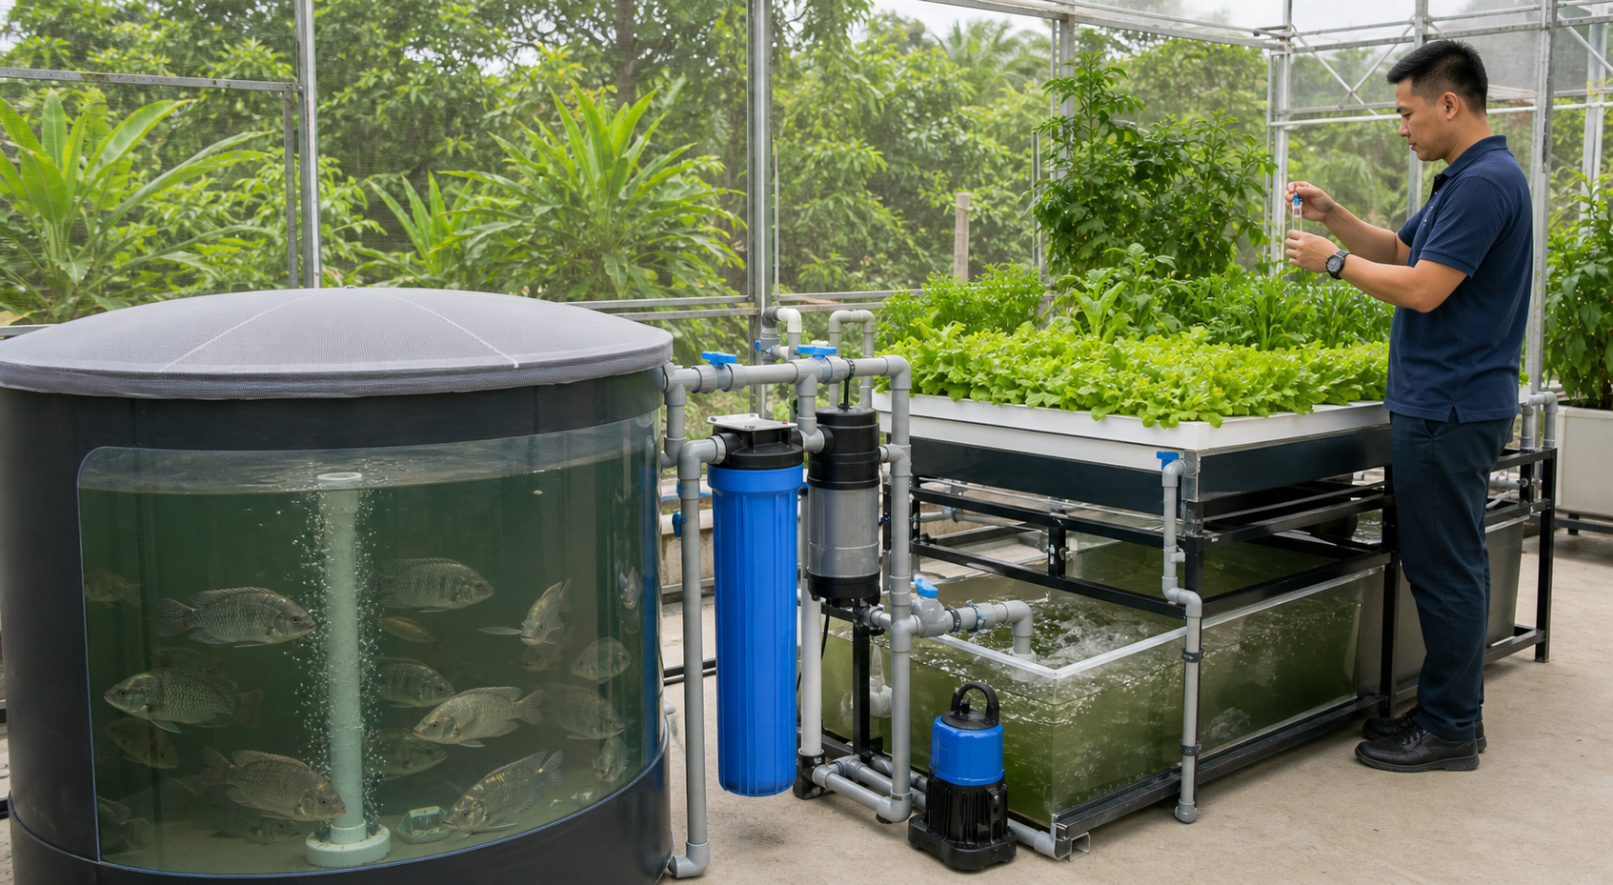
AQUAPONICS THEORY
Aquaponics couples two biological processes
ANCHOR: fish waste → nitrification → plant uptake
• Fish produce ammonia-containing waste.
• Nitrifying microbes convert ammonia to nitrite and then nitrate.
• Plants remove nutrients, while water returns to the culture system.
Visual: generated for this course
TGS-2025053916 · Basic Urban Farming with Hydroponics
© 2026 Tertiary Infotech Academy Pte Ltd
120

Slide 121
AQUAPONICS THEORY
The nitrogen cycle has toxic intermediates
ANCHOR: NH₃/NH₄⁺ → NO₂⁻ → NO₃⁻
• Unionised ammonia toxicity rises with pH and temperature.
• Nitrite interferes with oxygen transport in fish.
• Nitrate is less acutely toxic but still requires system balance.
1
2
3
→
→
Unionised ammonia toxicity rises with pH and temperature.
Nitrite interferes with oxygen transport in fish.
Nitrate is less acutely toxic but still requires system balance.
TGS-2025053916 · Basic Urban Farming with Hydroponics
© 2026 Tertiary Infotech Academy Pte Ltd
121

Slide 122
AQUAPONICS THEORY
Three living groups share one water loop
ANCHOR: fish · microbes · plants
• A setpoint suitable for plants alone may harm fish or biofilter microbes.
• Feeding rate drives nutrient loading and oxygen demand.
• Management aims for an acceptable compromise, not a single-species optimum.
1
setpoint · suitable · plants · alone · harm · fish
2
Feeding · rate · drives · nutrient · loading · oxygen
3
Management · aims · acceptable · compromise · single-species · optimum
TGS-2025053916 · Basic Urban Farming with Hydroponics
© 2026 Tertiary Infotech Academy Pte Ltd
122

Slide 123
AQUAPONICS THEORY
pH is a compromise variable
ANCHOR: fish health + nitrification + nutrient availability
• Nitrification tends to acidify the system over time.
• Very high pH can increase toxic unionised ammonia fraction.
• Corrections must be gradual and compatible with all organisms.
1
Nitrification · tends · acidify · system · over · time
2
Very · high · increase · toxic · unionised · ammonia
3
Corrections · must · gradual · compatible · with · organisms
TGS-2025053916 · Basic Urban Farming with Hydroponics
© 2026 Tertiary Infotech Academy Pte Ltd
123

Slide 124
AQUAPONICS THEORY
Dissolved oxygen supports fish, roots and biofilter
ANCHOR: three simultaneous oxygen demands
• Warm water and high feeding increase risk.
• Aeration failure can become an emergency.
• Independent air delivery and alarms may be justified by stock value and response time.
1
Warm · water · high · feeding · increase · risk
2
Aeration · failure · become · emergency
3
Independent · delivery · alarms · justified · stock · value
TGS-2025053916 · Basic Urban Farming with Hydroponics
© 2026 Tertiary Infotech Academy Pte Ltd
124

Slide 125
AQUAPONICS THEORY
Solids management precedes mineralisation
ANCHOR: settle/filter solids before they foul roots
• Uneaten feed and faecal solids consume oxygen during decomposition.
• Mechanical separation reduces deposition in plant channels.
• Captured nutrients may be mineralised in a controlled process.
1
2
3
→
→
Uneaten feed and faecal solids consume oxygen during decomposition.
Mechanical separation reduces deposition in plant channels.
Captured nutrients may be mineralised in a controlled process.
TGS-2025053916 · Basic Urban Farming with Hydroponics
© 2026 Tertiary Infotech Academy Pte Ltd
125

Slide 126
AQUAPONICS THEORY
Biofilters need surface area and flow
ANCHOR: attached nitrifiers + oxygenated water + alkalinity
• New systems require cycling before full fish loading.
• Disinfectants and sudden chemistry changes can damage the microbial community.
• Monitor ammonia and nitrite during startup and after disturbances.
1
systems · require · cycling · before · full · fish
2
Disinfectants · sudden · chemistry · changes · damage · microbial
3
Monitor · ammonia · nitrite · during · startup · after
TGS-2025053916 · Basic Urban Farming with Hydroponics
© 2026 Tertiary Infotech Academy Pte Ltd
126

Slide 127
AQUAPONICS THEORY
Feeding rate is the nutrient input
ANCHOR: feed mass/day links fish biomass to plant area
• Overfeeding raises waste, oxygen demand and water-quality risk.
• Underfeeding limits fish growth and plant nutrients.
• Use species-, feed- and system-specific design guidance.
1
Overfeeding · raises · waste · oxygen · demand · water-quality
2
Underfeeding · limits · fish · growth · plant · nutrients
3
species- · feed- · system-specific · design · guidance
TGS-2025053916 · Basic Urban Farming with Hydroponics
© 2026 Tertiary Infotech Academy Pte Ltd
127

Slide 128
AQUAPONICS THEORY
Decoupled aquaponics separates optimisation
ANCHOR: controlled transfer between fish and plant loops
• A decoupled design can protect fish from crop-specific corrections.
• It adds tanks, controls, monitoring and operating complexity.
• The value depends on production goals and operator capability.
1
decoupled · design · protect · fish · from · crop-specific
2
adds · tanks · controls · monitoring · operating · complexity
3
value · depends · production · goals · operator · capability
TGS-2025053916 · Basic Urban Farming with Hydroponics
© 2026 Tertiary Infotech Academy Pte Ltd
128

Slide 129
AQUAPONICS THEORY
Biosecurity spans water, animals and plants
ANCHOR: quarantine + source control + sanitation + records
• Do not transfer water, nets or plants between systems without control.
• Fish health and food-safety obligations differ from plant-only hydroponics.
• Mortality, treatment and water-quality records support investigation.
1
transfer · water · nets · plants · between · systems
2
Fish · health · food-safety · obligations · differ · from
3
Mortality · treatment · water-quality · records · support · investigation
TGS-2025053916 · Basic Urban Farming with Hydroponics
© 2026 Tertiary Infotech Academy Pte Ltd
129

Slide 130
AQUAPONICS THEORY
Hydroponics and aquaponics solve different constraints
ANCHOR: formulated nutrients versus biological nutrient generation
• Hydroponics offers direct nutrient formulation and easier crop isolation.
• Aquaponics creates coupled biological value and coupled risk.
• Choose based on production objective, market, regulation and operational skill.
1
Hydroponics · offers · direct · nutrient · formulation · easier
2
Aquaponics · creates · coupled · biological · value · coupled
3
Choose · based · production · objective · market · regulation
TGS-2025053916 · Basic Urban Farming with Hydroponics
© 2026 Tertiary Infotech Academy Pte Ltd
130

Slide 131
AQUAPONICS THEORY
Aquaponics troubleshooting follows the loop
ANCHOR: fish → feed → oxygen → ammonia → biofilter → plant
• Start with animal behaviour and critical water quality.
• Trace flow and aeration before adding chemicals.
• Correct the cause while protecting the most sensitive organism.
1
2
3
→
→
Start with animal behaviour and critical water quality.
Trace flow and aeration before adding chemicals.
Correct the cause while protecting the most sensitive organism.
TGS-2025053916 · Basic Urban Farming with Hydroponics
© 2026 Tertiary Infotech Academy Pte Ltd
131

Slide 132
COURSE CLOSE
What You Achieved
ANCHOR: diagnose the loop + operate safely + verify evidence
• Explain the water–root–canopy mechanism and select a suitable hydroponic system.
• Measure and interpret pH, EC, temperature, flow and crop/root condition.
• Complete the farm-tour and kit-practice evidence to SOP.
1
Explain · water–root–canopy · mechanism · select · suitable · hydroponic
2
Measure · interpret · temperature · flow · crop/root · condition
3
Complete · farm-tour · kit-practice · evidence
TGS-2025053916 · Basic Urban Farming with Hydroponics
© 2026 Tertiary Infotech Academy Pte Ltd
Source: tertiarycourses.com.sg
132

Slide 133
COURSE CLOSE
Courseware & Assessment on the LMS
ANCHOR: current files + candidate papers + secure submission
• Use the enrolled course page to access the current Learner Guide and Activities.
• Open only the candidate assessment files issued for this session.
• Submit the required answers and evidence through the authorised LMS channel.
1
2
3
→
→
Use the enrolled course page to access the current Learner Guide and Activities.
Open only the candidate assessment files issued for this session.
Submit the required answers and evidence through the authorised LMS channel.
TGS-2025053916 · Basic Urban Farming with Hydroponics
© 2026 Tertiary Infotech Academy Pte Ltd
Source: tertiarycourses.com.sg
133

Slide 134
COURSE CLOSE
Completion & Certification
ANCHOR: attendance + completed training + competent assessment decision
• Complete the required training attendance and both assessment instruments.
• A Competent decision requires the approved WA-SAQ and Practical Performance evidence.
• Eligible competent learners receive the WSQ completion credential through the provider's current SSG process.
1
Complete · required · training · attendance · both · assessment
2
Competent · decision · requires · approved · WA-SAQ · Practical
3
Eligible · competent · learners · receive · completion · credential
TGS-2025053916 · Basic Urban Farming with Hydroponics
© 2026 Tertiary Infotech Academy Pte Ltd
Source: tertiarycourses.com.sg
134

Slide 135
COURSE CLOSE
Course Feedback
ANCHOR: reflect → rate → comment → submit
• Open the course-feedback form provided in the LMS after the learning activities.
• Give specific comments on content, facilitation, venue and hands-on support.
• Course feedback is separate from TRAQOM digital attendance.
1
2
3
→
→
Open the course-feedback form provided in the LMS after the learning activities.
Give specific comments on content, facilitation, venue and hands-on support.
Course feedback is separate from TRAQOM digital attendance.
TGS-2025053916 · Basic Urban Farming with Hydroponics
© 2026 Tertiary Infotech Academy Pte Ltd
Source: tertiarycourses.com.sg
135

Slide 136
COURSE CLOSE
Assessment
ANCHOR: WA-SAQ 30 min → Practical Performance 30 min
• Complete the assessment digital-attendance event before starting.
• Sit the closed-book WA-SAQ first, then the observed Practical Performance.
• Submit through the LMS and sign the Assessment Summary Record after feedback.
1
Complete · assessment · digital-attendance · event · before · starting
2
closed-book · WA-SAQ · first · then · observed · Practical
3
Submit · through · sign · Assessment · Summary · Record
TGS-2025053916 · Basic Urban Farming with Hydroponics
© 2026 Tertiary Infotech Academy Pte Ltd
Source: tertiarycourses.com.sg
136

Slide 137
COURSE CLOSE
Assessment Flow
TRAQOM → assessment attendance → closed-book WA → observed PP → LMS submission → signed record
1
2
3
4
5
TRAQOM
Assessment attendance
WA → PP
Submit on LMS
Summary record
Scan the course QR on the LMS
Confirm the assessment event
30 min closed-book WA 30 min observed PP
Upload the required responses and evidence
Review the decision and sign
Assessment sequence: WA-SAQ first, then Practical Performance; follow the candidate instructions and assessor directions.
TGS-2025053916 · Basic Urban Farming with Hydroponics
© 2026 Tertiary Infotech Academy Pte Ltd
Source: lms-tms.tertiaryinfotech.com
137

Slide 138
COURSE CLOSE
Digital Attendance (Mandatory)
ANCHOR: TRAQOM · SSG assessment attendance
• Open the authorised TRAQOM attendance link or QR code shown in the LMS.
• Confirm the assessment event for this course code and session.
• Do not share Singpass, LMS, email credentials or one-time passwords.
1
2
3
→
→
Open the authorised TRAQOM attendance link or QR code shown in the LMS.
Confirm the assessment event for this course code and session.
Do not share Singpass, LMS, email credentials or one-time passwords.
TGS-2025053916 · Basic Urban Farming with Hydroponics
© 2026 Tertiary Infotech Academy Pte Ltd
Source: lms-tms.tertiaryinfotech.com
138

Slide 139
COURSE CLOSE
Thank You
ANCHOR: control the root zone, verify the evidence
• Observe the whole water–root–canopy loop.
• Operate to SOP and stop when controls are missing.
• Use measurements and records to improve the next crop cycle.
1
Observe · whole · water–root–canopy · loop
2
Operate · stop · when · controls · missing
3
measurements · records · improve · next · crop · cycle
TGS-2025053916 · Basic Urban Farming with Hydroponics
© 2026 Tertiary Infotech Academy Pte Ltd
Source: tertiarycourses.com.sg
139

