Slide 1

CKA
Kubernetes
LEARNER GUIDE · COURSE SLIDES
Certified Kubernetes Administrator (CKA) Training
WSQ Course Code: TGS-2025054612
Course: Certified Kubernetes Administrator (CKA)
Conducted by Tertiary Infotech Academy Pte Ltd · UEN 201200696W
Version v6 · Learner Guide Slides
(c) 2026 Tertiary Infotech Academy Pte Ltd. All rights reserved. · www.tertiarycourses.com.sg

Slide 2
COURSE ADMINISTRATION
Welcome & Housekeeping
Certified Kubernetes Administrator (CKA) · TGS-2025054612
© 2026 Tertiary Infotech Academy Pte Ltd
1

Slide 3
COURSE ADMINISTRATION
Download Course Material
https://lms-tms.tertiaryinfotech.com/
1
Sign in
2
Open your course
3
Download
Open the LMS and sign in with your learner account.
Select Certified Kubernetes Administrator (CKA).
Open Course Material and download the learner files.
Keep the downloaded files available for class activities and the open-book assessment.
Certified Kubernetes Administrator (CKA) · TGS-2025054612
© 2026 Tertiary Infotech Academy Pte Ltd
2

Slide 4

TRAQOM · SSG DIGITAL ATTENDANCE
Digital Attendance (Mandatory)
• It is mandatory to take the AM, PM and Assessment digital attendance for WSQ-funded courses.
• The trainer displays the digital attendance QR code from the SSG portal.
• Scan the QR code with your phone camera and submit your attendance.
• A minimum of 75% attendance is required for assessment and funding.
Minimum 75%
attendance required
Certified Kubernetes Administrator (CKA) · TGS-2025054612
© 2026 Tertiary Infotech Academy Pte Ltd
3

Slide 5




YOUR TRAINER
About the Trainer
Name
Title / Designation
?
Qualifications
Areas of expertise
General Trainer
Trainer profile template
Training & industry experience
Contact / Profile
Complete before class
Fill in this template if a different approved trainer conducts the class.
Certified Kubernetes Administrator (CKA) · TGS-2025054612
© 2026 Tertiary Infotech Academy Pte Ltd
4

Slide 6

YOUR TRAINER
About the Trainer
Role
Qualifications
AA
Founder & Principal Trainer Tertiary Infotech Academy
Doctorate-level educator Senior technology trainer
Expertise
Training Focus
Cloud, Kubernetes, cybersecurity, data analytics, automation and AI
Exam-aligned delivery Hands-on lab coaching
Dr Alfred Ang
Founder & Principal Trainer
Industry Experience
Contact / Profile
Professional IT training, consulting and workforce upskilling
Tertiary Infotech Academy www.tertiarycourses.com.sg
Tertiary Infotech Academy
Certified Kubernetes Administrator (CKA) · TGS-2025054612
© 2026 Tertiary Infotech Academy Pte Ltd
5

Slide 7



ICE-BREAKER
Let's Know Each Other
Take a minute to introduce yourself to the class:
Your role
Your experience
Your goal
Your name and organisation / role.
Any experience with Docker, Kubernetes or Linux administration.
Whether you are targeting the CKA exam or production cluster skills.
Certified Kubernetes Administrator (CKA) · TGS-2025054612
© 2026 Tertiary Infotech Academy Pte Ltd
6

Slide 8






HOUSE RULES
Ground Rules
Phones on silent
Participate actively
Mutual respect
Set your phone to silent mode.
No question is too small — ask freely.
One conversation at a time.
Be punctual
Step out quietly
75% attendance
Return from breaks on time.
For calls or short breaks.
Required for funding eligibility.
Certified Kubernetes Administrator (CKA) · TGS-2025054612
© 2026 Tertiary Infotech Academy Pte Ltd
7

Slide 9
SCHEDULE
Lesson Plan — 3½ Days, 8 hours/day
1
Day 1 · Domain 1
2
Day 2 · Domains 1+2+3
Cluster Architecture, Installation & Configuration
· kubeadm bootstrap, CNI, cluster upgrade (Labs 1–4)
· HA etcd, Helm, Kustomize (Labs 5–7)
· RBAC (Lab 8)
CRDs + Workloads & Scheduling + Services start
· CRDs, CRI/CNI/CSI, Deployments, ConfigMaps (Labs 9–13)
· Secrets, HPA, self-healing, scheduling (Labs 14–16)
· Pod connectivity, Service types (Labs 17–18)
3
Day 3 · Domains 3+4+5
4
Day 4 (½ day) · Domain 5
Networking + Storage + Troubleshooting
· Ingress, Gateway API, NetworkPolicy, CoreDNS (Labs 19–22)
· PV/PVC, StorageClass, volume types (Labs 23–25)
· Cluster, node and application troubleshooting (Labs 26–28)
Monitoring + Service triage + RBAC/scheduling debug
· Monitoring, service networking, RBAC failures (Labs 29–31)
· 12:00 PM lunch · 1:00 PM mock-exam practice
· 3:30 PM tea · 3:45 PM final assessment
Daily timing: 9:00am – 6:00pm · 1-hour lunch · short tea breaks within each day
Certified Kubernetes Administrator (CKA) · TGS-2025054612
© 2026 Tertiary Infotech Academy Pte Ltd
8

Slide 10
WHAT YOU'LL ACHIEVE
Learning Outcomes
1
LO1 Bootstrap a Kubernetes cluster with kubeadm, containerd, and a CNI plugin.
2
LO2 Perform cluster upgrades, configure HA etcd, and back up/restore cluster state.
3
LO3 Configure RBAC, Helm, Kustomize, CRDs, and the CNI/CSI/CRI extension interfaces.
4
LO4 Deploy, scale, schedule, and self-heal workloads with HPA, taints, and affinity.
5
LO5 Expose services with ClusterIP, NodePort, Ingress, and Gateway API; write NetworkPolicy.
6
LO6 Provision persistent storage with PV/PVC, StorageClass, and troubleshoot the full cluster stack.
Certified Kubernetes Administrator (CKA) · TGS-2025054612
© 2026 Tertiary Infotech Academy Pte Ltd
9

Slide 11





ASSESSMENT RULES
Briefing for Assessment
Clear your space
No recording
Work individually
Keep only approved materials on the table.
No photos of the assessment.
No discussion during the assessment.
Use the LMS
Open book
Time's up
The assessment is delivered online.
Slides, Learner Guide & kubernetes.io are allowed.
Submit when time is up.
Certified Kubernetes Administrator (CKA) · TGS-2025054612
© 2026 Tertiary Infotech Academy Pte Ltd
10

Slide 12

FINAL ASSESSMENT
Assessment
Final Assessment
Funding & Competency
• Written Assessment (SAQ) and Practical Performance (PP) on the LMS
• Mock-exam practice from 1:00 PM; final assessment from 3:45 PM
• Covers all five CKA domains and the hands-on labs
• Open book — slides, Learner Guide & kubernetes.io
• Must be attempted for SSG funding
Minimum 75% attendance
Based on SSG digital attendance records.
Assessed as Competent
Complete both the SAQ and PP assessments.
Certified Kubernetes Administrator (CKA) · TGS-2025054612
© 2026 Tertiary Infotech Academy Pte Ltd
11

Slide 13
01
DAY 1
Cluster Architecture, Installation & Configuration
Domain 1 (25%) — Labs 1–8 · kubeadm · CNI · upgrade · HA · Helm · Kustomize · RBAC
Certified Kubernetes Administrator (CKA) · TGS-2025054612
© 2026 Tertiary Infotech Academy Pte Ltd
12

Slide 14
TOPIC 1
Kubernetes Architecture
The control plane, worker nodes and their components
Certified Kubernetes Administrator (CKA) · TGS-2025054612
© 2026 Tertiary Infotech Academy Pte Ltd
13

Slide 15
CLUSTER ANATOMY
What Makes a Kubernetes Cluster?
• A Kubernetes cluster is a set of nodes: one or more control-plane nodes and worker nodes.
• The control plane stores cluster state in etcd and runs the scheduler and controller loops.
• Worker nodes run the kubelet (node agent), kube-proxy (service routing), container runtime and CNI plugin.
• The kube-apiserver is the single entry point — all tools (kubectl, controllers, kubelets) talk to it.
Certified Kubernetes Administrator (CKA) · TGS-2025054612
© 2026 Tertiary Infotech Academy Pte Ltd
14

Slide 16
THE BRAIN OF THE CLUSTER
Control Plane Components
kube-apiserver
kube-scheduler
kube-controller-manager
• REST gateway to etcd
• AuthN + AuthZ + admission
• All state changes go here
• Selects a node for each pod
• Evaluates resource requests
• taints, affinity, topology
• Reconciliation loops
• Node, ReplicaSet, Job
• Drives actual → desired state
Certified Kubernetes Administrator (CKA) · TGS-2025054612
© 2026 Tertiary Infotech Academy Pte Ltd
15

Slide 17
DOMAIN 1 · CLUSTER COMPONENTS
Kubernetes Architecture
Control Plane
Worker Node
kube-apiserver
REST gateway, auth, admission
kubelet
manages pods on this node
kube-scheduler
chooses which node for each pod
kube-proxy
iptables / IPVS service routing
kube-controller-manager
reconciliation loops
container runtime
containerd / CRI-O
etcd
key-value store — cluster state
CNI plugin
pod networking (Calico, Cilium)
kubectl
client
Certified Kubernetes Administrator (CKA) · TGS-2025054612
© 2026 Tertiary Infotech Academy Pte Ltd
16

Slide 18
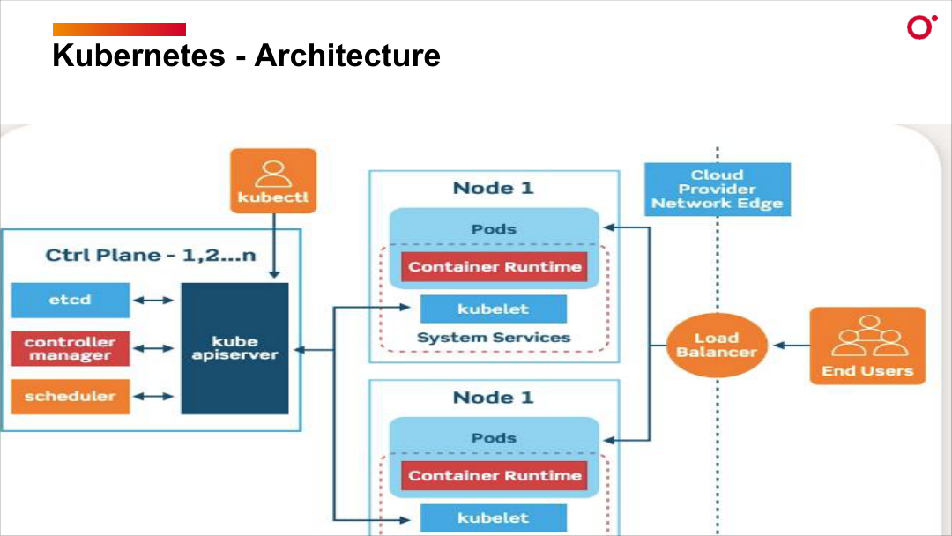
CLUSTER ANATOMY
Kubernetes Architecture — Control Plane & Worker Nodes
Certified Kubernetes Administrator (CKA) · TGS-2025054612
© 2026 Tertiary Infotech Academy Pte Ltd
17

Slide 19
WHERE WORKLOADS RUN
Worker Node Components
• kubelet: the node agent — watches the API server for pods assigned to this node and starts/stops containers.
• kube-proxy: programs iptables or IPVS rules to implement Service ClusterIP and NodePort routing.
• Container runtime: containerd (default) or CRI-O; communicates with kubelet via the CRI gRPC interface.
• CNI plugin: called on every pod create/delete to assign an IP; Calico and Cilium are the most common CKA choices.
Certified Kubernetes Administrator (CKA) · TGS-2025054612
© 2026 Tertiary Infotech Academy Pte Ltd
18

Slide 20
TOPIC 2
kubeadm Installation
Bootstrap a production-grade cluster in minutes
Certified Kubernetes Administrator (CKA) · TGS-2025054612
© 2026 Tertiary Infotech Academy Pte Ltd
19

Slide 21
STEP BY STEP
Install Sequence
• Pre-flight: load overlay + br_netfilter kernel modules; set net.ipv4.ip_forward=1 sysctl; swap off.
• Install containerd with SystemdCgroup=true; then install kubeadm, kubelet and kubectl from pkgs.k8s.io.
• kubeadm init generates the PKI under /etc/kubernetes/pki/, writes static pod manifests and prints the join command.
• Copy /etc/kubernetes/admin.conf to ~/.kube/config; apply a CNI manifest (Calico/Cilium); then kubeadm join on workers.
Certified Kubernetes Administrator (CKA) · TGS-2025054612
© 2026 Tertiary Infotech Academy Pte Ltd
20

Slide 22
DOMAIN 1 · KUBEADM INIT THEN JOIN
kubeadm Bootstrap Flow
control plane ready
cluster usable
kubeadm init
generates PKI (pki/)
writes static pod manifests
prints bootstrap token
kubectl apply CNI
e.g. Calico or Cilium
nodes go Ready
kubeadm join
worker uses token + CA hash
kubelet registers node
Manifests: /etc/kubernetes/manifests/ · PKI: /etc/kubernetes/pki/ · kubeconfig: ~/.kube/config
Certified Kubernetes Administrator (CKA) · TGS-2025054612
© 2026 Tertiary Infotech Academy Pte Ltd
21

Slide 23
DAY 1 · CLUSTER ARCHITECTURE
kubeadm Prerequisites and Container Runtime
LAB 1
Cluster installation
Prepare two clean Ubuntu nodes for a Kubernetes cluster install: load kernel modules, configure sysctls, install containerd as the CRI, and install kubeadm/kubelet/kubectl from the official pkgs.k8s.io repository. CKA tests this sequence in troubleshooting questions where a node is NotReady due to a misconfigured runtime.
You'll build
Configure kernel modules, sysctls, containerd (SystemdCgroup=true), and install pinned Kubernetes packages on both nodes.
Key commands: cat <<EOF · sudo swapoff · sudo apt · » SystemdCgroup · kubeadm version
Certified Kubernetes Administrator (CKA) · TGS-2025054612
© 2026 Tertiary Infotech Academy Pte Ltd
22

Slide 24
LAB 1 · COMMANDS
kubeadm Prerequisites and Container Runtime
Step 1 -- Load kernel modules
cat <<EOF | sudo tee /etc/modules-load.d/k8s.conf
overlay
br_netfilter
EOF
sudo modprobe overlay
sudo modprobe br_netfilter
Step 2 -- Set required sysctls
cat <<EOF | sudo tee /etc/sysctl.d/k8s.conf
net.bridge.bridge-nf-call-iptables = 1
net.bridge.bridge-nf-call-ip6tables = 1
net.ipv4.ip_forward = 1
EOF
sudo sysctl --system
Certified Kubernetes Administrator (CKA) · TGS-2025054612
© 2026 Tertiary Infotech Academy Pte Ltd
23

Slide 25
LAB 1 · COMMANDS
kubeadm Prerequisites and Container Runtime (cont.)
Step 3 -- Disable swap
sudo swapoff -a
sudo sed -i '/ swap / s/^(.*)$/#\1/g' /etc/fstab
Step 4 -- Install containerd
sudo apt update && sudo apt install -y containerd
sudo mkdir -p /etc/containerd
containerd config default | sudo tee /etc/containerd/config.toml
sudo sed -i 's/SystemdCgroup = false/SystemdCgroup = true/' /etc/containerd/config.toml
sudo systemctl restart containerd && sudo systemctl enable containerd
Note SystemdCgroup = true aligns containerd's cgroup driver with kubelet. A mismatch is the #1 cause of 'node NotReady' in fresh clusters.
Certified Kubernetes Administrator (CKA) · TGS-2025054612
© 2026 Tertiary Infotech Academy Pte Ltd
24

Slide 26
LAB 1 · COMMANDS
kubeadm Prerequisites and Container Runtime (cont.)
Step 5 -- Install kubeadm, kubelet, kubectl
sudo apt install -y apt-transport-https ca-certificates curl gpg
sudo mkdir -p /etc/apt/keyrings
curl -fsSL https://pkgs.k8s.io/core:/stable:/v1.35/deb/Release.key | \
sudo gpg --dearmor -o /etc/apt/keyrings/kubernetes-apt-keyring.gpg
echo 'deb [signed-by=/etc/apt/keyrings/kubernetes-apt-keyring.gpg] https://pkgs.k8s.io/core:/stable:/v1.35/deb/ /' | \
sudo tee /etc/apt/sources.list.d/kubernetes.list
sudo apt update && sudo apt install -y kubelet kubeadm kubectl
sudo apt-mark hold kubelet kubeadm kubectl
Step 6 -- Verify
kubeadm version
kubectl version --client
sudo systemctl status containerd --no-pager | head
Certified Kubernetes Administrator (CKA) · TGS-2025054612
© 2026 Tertiary Infotech Academy Pte Ltd
25

Slide 27
LAB 1 · TEST IT
kubeadm Prerequisites and Container Runtime
✅ Test it
kubeadm version shows v1.35.x, containerd is active, and crictl reports the runtime version.
Killercoda: https://killercoda.com/playgrounds/scenario/kubeadm
Certified Kubernetes Administrator (CKA) · TGS-2025054612
© 2026 Tertiary Infotech Academy Pte Ltd
26

Slide 28
DAY 1 · CLUSTER ARCHITECTURE
kubeadm Bootstrap: init, kubeconfig, Worker Join, Cluster PKI
LAB 2
Cluster installation
Run kubeadm init to create the control plane, configure kubectl access via kubeconfig, join a worker node using the bootstrap token, explore the PKI certificates under /etc/kubernetes/pki/, take an etcd snapshot, and inspect static pod manifests. The CKA exam always includes an etcd backup/restore question.
You'll build
Run kubeadm init, copy admin.conf, join worker, explore PKI, take etcd snapshot with etcdctl.
Key commands: kubeadm init · mkdir -p · ls /etc/kubernetes/manifests/ · ls /etc/kubernetes/pki/ · export ETCDCTL_API=3 · » Always · kubeadm toke
Certified Kubernetes Administrator (CKA) · TGS-2025054612
© 2026 Tertiary Infotech Academy Pte Ltd
27

Slide 29
LAB 2 · COMMANDS
kubeadm Bootstrap: init, kubeconfig, Worker Join, Cluster PKI
Step 1 -- Initialize the control plane
kubeadm init \
--kubernetes-version=v1.35.0 \
--pod-network-cidr=192.168.0.0/16 \
--service-cidr=10.96.0.0/12 \
--apiserver-advertise-address=$(hostname -I | awk '{print $1}')
Step 2 -- Configure kubectl
mkdir -p $HOME/.kube
cp -i /etc/kubernetes/admin.conf $HOME/.kube/config
chown $(id -u):$(id -g) $HOME/.kube/config
kubectl get nodes
Step 3 -- Explore static pod manifests
ls /etc/kubernetes/manifests/
grep 'image:' /etc/kubernetes/manifests/kube-apiserver.yaml
Certified Kubernetes Administrator (CKA) · TGS-2025054612
© 2026 Tertiary Infotech Academy Pte Ltd
28

Slide 30
LAB 2 · COMMANDS
kubeadm Bootstrap: init, kubeconfig, Worker Join, Cluster PKI (cont.)
Step 4 -- Explore cluster PKI
ls /etc/kubernetes/pki/
kubeadm certs check-expiration
openssl x509 -in /etc/kubernetes/pki/ca.crt -noout -dates
Step 5 -- Take an etcd snapshot
export ETCDCTL_API=3
export ETCDCTL_ENDPOINTS=https://127.0.0.1:2379
export ETCDCTL_CACERT=/etc/kubernetes/pki/etcd/ca.crt
export ETCDCTL_CERT=/etc/kubernetes/pki/etcd/server.crt
export ETCDCTL_KEY=/etc/kubernetes/pki/etcd/server.key
etcdctl snapshot save /opt/etcd-backup-$(date +%Y%m%d).db
etcdctl snapshot status /opt/etcd-backup-$(date +%Y%m%d).db --write-out=table
Note Always set ETCDCTL_API=3. etcd backup/restore is guaranteed to appear on the CKA exam.
Certified Kubernetes Administrator (CKA) · TGS-2025054612
© 2026 Tertiary Infotech Academy Pte Ltd
29

Slide 31
LAB 2 · COMMANDS
kubeadm Bootstrap: init, kubeconfig, Worker Join, Cluster PKI (cont.)
Step 6 -- Join worker node
# On control plane -- generate join command
kubeadm token create --print-join-command
# Run the output on WORKER NODE
# Back on control plane:
kubectl get nodes -o wide
Certified Kubernetes Administrator (CKA) · TGS-2025054612
© 2026 Tertiary Infotech Academy Pte Ltd
30

Slide 32
LAB 2 · TEST IT
kubeadm Bootstrap: init, kubeconfig, Worker Join, Cluster PKI
✅ Test it
kubectl get nodes shows both nodes (NotReady until CNI installed). etcd snapshot file exists at /opt/.
Killercoda: https://killercoda.com/playgrounds/scenario/kubeadm
Certified Kubernetes Administrator (CKA) · TGS-2025054612
© 2026 Tertiary Infotech Academy Pte Ltd
31

Slide 33
Tea Break
15 minutes

Slide 34
TOPIC 3
CNI — Container Network Interface
Pod networking with Calico and Cilium
Certified Kubernetes Administrator (CKA) · TGS-2025054612
© 2026 Tertiary Infotech Academy Pte Ltd
32

Slide 35
POD NETWORKING
How Pods Get IPs
• CNI is called by the kubelet on every pod creation — the plugin assigns an IP from the pod CIDR.
• Calico uses BGP or VXLAN; Cilium uses eBPF for high-performance networking and advanced observability.
• CNI binaries live in /opt/cni/bin/; configuration files live in /etc/cni/net.d/.
• Without a CNI plugin nodes stay NotReady — applying the CNI manifest is a mandatory post-init step.
Certified Kubernetes Administrator (CKA) · TGS-2025054612
© 2026 Tertiary Infotech Academy Pte Ltd
33

Slide 36
PICK YOUR CNI
CNI Plugin Choices
Calico
Cilium
Flannel
• BGP or VXLAN
• NetworkPolicy support
• Most popular CKA choice
• eBPF dataplane
• Advanced observability
• Kubernetes 1.21+ native
• VXLAN overlay
• Simple, no NetworkPolicy
• Development / lab only
Certified Kubernetes Administrator (CKA) · TGS-2025054612
© 2026 Tertiary Infotech Academy Pte Ltd
34

Slide 37
DOMAIN 1 · CONTAINER NETWORK INTERFACE
CNI — How Pods Get Their IP
CNI ADD call
IP assigned
kubelet
Pod assigned to node
calls CNI plugin via gRPC socket
CNI plugin
/opt/cni/bin/ · /etc/cni/net.d/
Calico · Cilium · Flannel
Pod
IP from pod CIDR
veth pair to node bridge
flat L3 — no NAT
Without a CNI manifest the node stays NotReady — applying it is mandatory after kubeadm init.
Certified Kubernetes Administrator (CKA) · TGS-2025054612
© 2026 Tertiary Infotech Academy Pte Ltd
35

Slide 38
DAY 1 · CNI
Install Calico CNI and Verify Cross-Node Pod Ping
LAB 3
CNI networking
Install Calico as the CNI plugin using the Tigera Operator pattern, watch nodes transition to Ready, deploy test pods on different nodes, and validate cross-node pod-to-pod communication. The pod CIDR in Calico must match the --pod-network-cidr from kubeadm init.
You'll build
Apply tigera-operator.yaml + custom-resources.yaml, watch nodes go Ready, ping across nodes.
Key commands: kubectl get · curl -O · kubectl run · » Kubernetes
Certified Kubernetes Administrator (CKA) · TGS-2025054612
© 2026 Tertiary Infotech Academy Pte Ltd
36

Slide 39
LAB 3 · COMMANDS
Install Calico CNI and Verify Cross-Node Pod Ping
Step 1 -- Confirm nodes are NotReady before CNI
kubectl get nodes -o wide
kubectl get pods -n kube-system
Step 2 -- Install Calico Operator
curl -O https://raw.githubusercontent.com/projectcalico/calico/v3.29.0/manifests/tigera-operator.yaml
curl -O https://raw.githubusercontent.com/projectcalico/calico/v3.29.0/manifests/custom-resources.yaml
kubectl apply -f tigera-operator.yaml
kubectl apply -f custom-resources.yaml
Step 3 -- Watch nodes transition to Ready
kubectl get nodes -w
kubectl get pods -n calico-system
Certified Kubernetes Administrator (CKA) · TGS-2025054612
© 2026 Tertiary Infotech Academy Pte Ltd
37

Slide 40
LAB 3 · COMMANDS
Install Calico CNI and Verify Cross-Node Pod Ping (cont.)
Step 4 -- Test cross-node pod ping
kubectl run pod-cp --image=nicolaka/netshoot -- sleep infinity
kubectl run pod-worker --image=nicolaka/netshoot -- sleep infinity
kubectl get pods -o wide
POD_WORKER_IP=$(kubectl get pod pod-worker -o jsonpath='{.status.podIP}')
kubectl exec pod-cp -- ping -c 4 $POD_WORKER_IP
Note Kubernetes requires a flat pod network -- cross-node pod-to-pod communication without NAT. A failed ping indicates CNI misconfiguration.
Certified Kubernetes Administrator (CKA) · TGS-2025054612
© 2026 Tertiary Infotech Academy Pte Ltd
38

Slide 41
LAB 3 · TEST IT
Install Calico CNI and Verify Cross-Node Pod Ping
✅ Test it
Both nodes are Ready. Cross-node ping returns 0% packet loss. coredns pods are Running.
Killercoda: https://killercoda.com/playgrounds/scenario/kubeadm
Certified Kubernetes Administrator (CKA) · TGS-2025054612
© 2026 Tertiary Infotech Academy Pte Ltd
39

Slide 42
TOPIC 4
Cluster Upgrade
Upgrade control plane then workers with kubeadm
Certified Kubernetes Administrator (CKA) · TGS-2025054612
© 2026 Tertiary Infotech Academy Pte Ltd
40

Slide 43
UPGRADE STRATEGY
Upgrade Strategy
• Upgrades are one minor version at a time — you cannot skip from 1.29 to 1.31 directly.
• Always upgrade the control plane first; then drain, upgrade and uncordon each worker node.
• Use apt-mark unhold / hold around the install step to manage package pins.
• kubeadm upgrade apply for the control plane; kubeadm upgrade node for each worker.
Certified Kubernetes Administrator (CKA) · TGS-2025054612
© 2026 Tertiary Infotech Academy Pte Ltd
41

Slide 44
DOMAIN 1 · CLUSTER UPGRADE
Cluster Upgrade — Step by Step
drain the node
kubectl drain <node> --ignore-daemonsets --delete-emptydir-data
Cordons the node (no new pods) and evicts existing pods safely before upgrade.
upgrade kubeadm
apt-mark unhold kubeadm && apt install kubeadm=v1.35.0-1.1
Run kubeadm upgrade apply v1.35.0 on the control plane; kubeadm upgrade node on workers.
upgrade kubelet + kubectl
apt install kubelet=v1.35.0-1.1 kubectl=v1.35.0-1.1 && systemctl restart kubelet
Verify: kubectl get nodes — the node shows the new version after kubelet restart.
uncordon
kubectl uncordon <node>
Restores scheduling. Repeat drain → upgrade → uncordon for each worker node in turn.
Upgrade control plane first, then each worker. apt-mark hold/unhold kubeadm kubelet kubectl around each step.
Certified Kubernetes Administrator (CKA) · TGS-2025054612
© 2026 Tertiary Infotech Academy Pte Ltd
42

Slide 45
DAY 1 · CLUSTER UPGRADE
Cluster Upgrade: v1.34 to v1.35 with kubeadm drain/uncordon
LAB 4
Cluster upgrade
Upgrade a two-node cluster from v1.34 to v1.35 following the official kubeadm upgrade procedure. The exact sequence: unhold, install kubeadm, upgrade plan, upgrade apply, drain, upgrade kubelet/kubectl, uncordon. Missing any step is a common exam mistake.
You'll build
Upgrade control plane with kubeadm upgrade apply, drain node, upgrade kubelet, uncordon. Repeat for worker.
Key commands: curl -fsSL · apt-mark unhold · kubeadm upgrade · kubectl drain · » The
Certified Kubernetes Administrator (CKA) · TGS-2025054612
© 2026 Tertiary Infotech Academy Pte Ltd
43

Slide 46
LAB 4 · COMMANDS
Cluster Upgrade: v1.34 to v1.35 with kubeadm drain/uncordon
Step 1 -- Add v1.35 apt repository
curl -fsSL https://pkgs.k8s.io/core:/stable:/v1.35/deb/Release.key | \
gpg --dearmor -o /etc/apt/keyrings/kubernetes-apt-keyring.gpg
apt-get update
Step 2 -- Upgrade kubeadm on control plane
apt-mark unhold kubeadm
apt-get install -y kubeadm=1.35.0-*
apt-mark hold kubeadm
kubeadm version
Step 3 -- Run upgrade plan and apply
kubeadm upgrade plan
kubeadm upgrade apply v1.35.0
Certified Kubernetes Administrator (CKA) · TGS-2025054612
© 2026 Tertiary Infotech Academy Pte Ltd
44

Slide 47
LAB 4 · COMMANDS
Cluster Upgrade: v1.34 to v1.35 with kubeadm drain/uncordon (cont.)
Step 4 -- Drain, upgrade kubelet, uncordon control plane
kubectl drain controlplane --ignore-daemonsets --delete-emptydir-data
apt-mark unhold kubelet kubectl
apt-get install -y kubelet=1.35.0-* kubectl=1.35.0-*
apt-mark hold kubelet kubectl
systemctl daemon-reload && systemctl restart kubelet
kubectl uncordon controlplane
Certified Kubernetes Administrator (CKA) · TGS-2025054612
© 2026 Tertiary Infotech Academy Pte Ltd
45

Slide 48
LAB 4 · COMMANDS
Cluster Upgrade: v1.34 to v1.35 with kubeadm drain/uncordon (cont.)
Step 5 -- Upgrade worker node
# On WORKER NODE:
apt-mark unhold kubeadm && apt-get install -y kubeadm=1.35.0-*
kubeadm upgrade node
# On CONTROL PLANE:
kubectl drain worker01 --ignore-daemonsets --delete-emptydir-data
# Back on WORKER:
apt-mark unhold kubelet kubectl
apt-get install -y kubelet=1.35.0-* kubectl=1.35.0-*
systemctl daemon-reload && systemctl restart kubelet
# On CONTROL PLANE:
kubectl uncordon worker01 && kubectl get nodes
Note The VERSION column in 'kubectl get nodes' shows kubelet version, not API server version. systemctl daemon-reload is required after binary update before restarting kubelet.
Certified Kubernetes Administrator (CKA) · TGS-2025054612
© 2026 Tertiary Infotech Academy Pte Ltd
46

Slide 49
LAB 4 · TEST IT
Cluster Upgrade: v1.34 to v1.35 with kubeadm drain/uncordon
✅ Test it
kubectl get nodes shows both nodes as Ready at v1.35.0. kubectl version shows Server v1.35.0.
Killercoda: https://killercoda.com/playgrounds/scenario/kubeadm
Certified Kubernetes Administrator (CKA) · TGS-2025054612
© 2026 Tertiary Infotech Academy Pte Ltd
47

Slide 50
Lunch Break
1 hour

Slide 51
TOPIC 5
High Availability — etcd
Stacked etcd topology and backup/restore
Certified Kubernetes Administrator (CKA) · TGS-2025054612
© 2026 Tertiary Infotech Academy Pte Ltd
48

Slide 52
HA CLUSTERS
HA Cluster Design
• Stacked etcd: each control-plane node runs its own etcd member — simplest HA topology.
• External etcd: separate etcd cluster decoupled from control-plane nodes — more resilient but more infra.
• All CP nodes must point to the same load-balancer endpoint (--control-plane-endpoint).
• Quorum: (N-1)/2 failures tolerated — 3 nodes survive 1; 5 nodes survive 2. Always use odd numbers.
Certified Kubernetes Administrator (CKA) · TGS-2025054612
© 2026 Tertiary Infotech Academy Pte Ltd
49

Slide 53
DOMAIN 1 · HIGH AVAILABILITY
HA Stacked etcd Topology
Control-Plane Nodes (×3) + Stacked etcd
Load Balancer
HAProxy / cloud LB
endpoint :6443
DNS or VIP
CP 1 · kube-apiserver · scheduler · controller-mgr
etcd
CP 2 · kube-apiserver · scheduler · controller-mgr
etcd
Raft sync
CP 3 · kube-apiserver · scheduler · controller-mgr
etcd
Stacked etcd: each CP node runs its own etcd member — state replicated via Raft. 3 CPs tolerate 1 failure (quorum = 2).
Certified Kubernetes Administrator (CKA) · TGS-2025054612
© 2026 Tertiary Infotech Academy Pte Ltd
50

Slide 54
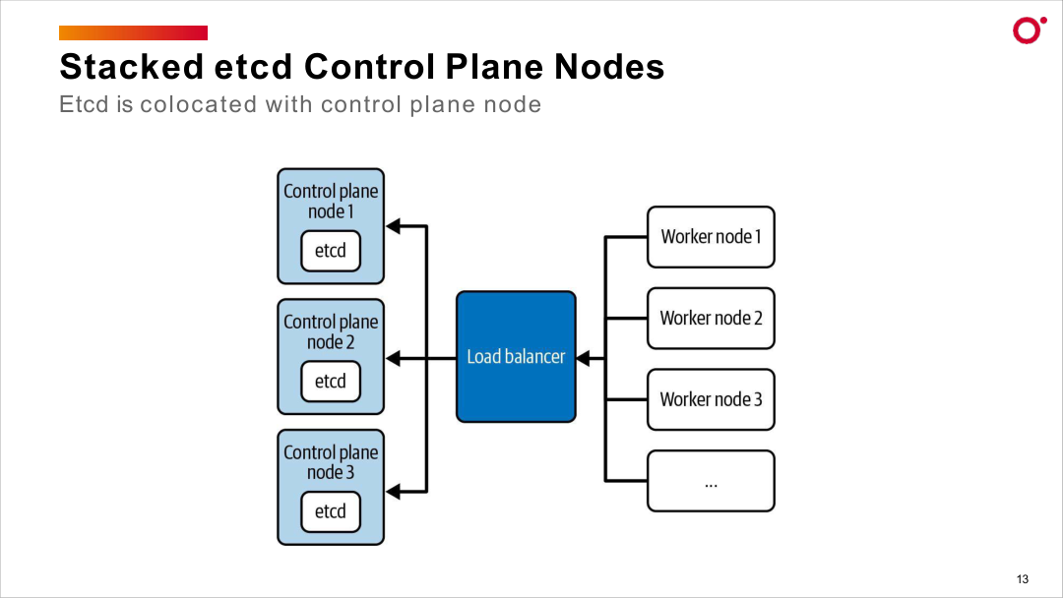
HA CLUSTERS
Stacked etcd — HA Control Plane Topology
Certified Kubernetes Administrator (CKA) · TGS-2025054612
© 2026 Tertiary Infotech Academy Pte Ltd
51

Slide 55
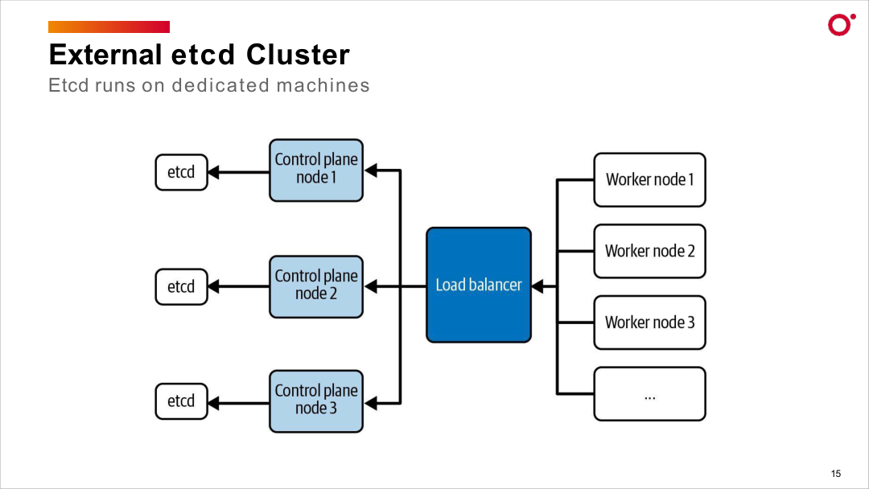
HA CLUSTERS
External etcd Cluster — Dedicated Topology
Certified Kubernetes Administrator (CKA) · TGS-2025054612
© 2026 Tertiary Infotech Academy Pte Ltd
52

Slide 56
DOMAIN 1 · ETCD BACKUP
etcd Backup and Restore
snapshot save
Required etcdctl flags:
--endpoints=https://127.0.0.1:2379
--cacert /etc/kubernetes/pki/etcd/ca.crt
--cert /etc/kubernetes/pki/etcd/server.crt
--key /etc/kubernetes/pki/etcd/server.key
snapshot.db
/backup/etcd.db
etcdctl snapshot status
snapshot restore --data-dir ...
snapshot restore
etcd
After restore: update etcd static pod --data-dir → kubelet auto-restarts etcd. Set ETCDCTL_API=3 before all etcdctl commands.
Certified Kubernetes Administrator (CKA) · TGS-2025054612
© 2026 Tertiary Infotech Academy Pte Ltd
53

Slide 57
DAY 1 · HIGH AVAILABILITY
HA Control Plane: HAProxy + Keepalived VIP and --upload-certs
LAB 5
High availability
Set up a highly available control plane topology using HAProxy as a TCP load balancer and Keepalived to provide a floating VIP. Initialize the first control plane with --control-plane-endpoint pointing to the VIP and --upload-certs to share certs. CKA tests etcd quorum and cluster resilience questions.
You'll build
Configure HAProxy and Keepalived, run kubeadm init with --control-plane-endpoint and --upload-certs, join additional control plane nodes, verify etcd member list.
Key commands: apt-get install · kubeadm init · » --control-plane-endpoint · kubeadm join · kubectl -n
Certified Kubernetes Administrator (CKA) · TGS-2025054612
© 2026 Tertiary Infotech Academy Pte Ltd
54

Slide 58
LAB 5 · COMMANDS
HA Control Plane: HAProxy + Keepalived VIP and --upload-certs
Step 1 -- Install and configure HAProxy
apt-get install -y haproxy
systemctl restart haproxy && systemctl enable haproxy
Step 2 -- Configure Keepalived with VIP
apt-get install -y keepalived
# MASTER: state MASTER, priority 101
# BACKUP: state BACKUP, priority 100
systemctl restart keepalived && systemctl enable keepalived
Step 3 -- Initialize first control plane with VIP
kubeadm init \
--kubernetes-version=v1.35.0 \
--control-plane-endpoint='192.168.1.100:6443' \
--pod-network-cidr=192.168.0.0/16 \
--upload-certs
mkdir -p $HOME/.kube && cp /etc/kubernetes/admin.conf $HOME/.kube/config
Certified Kubernetes Administrator (CKA) · TGS-2025054612
© 2026 Tertiary Infotech Academy Pte Ltd
55

Slide 59
LAB 5 · COMMANDS
HA Control Plane: HAProxy + Keepalived VIP and --upload-certs (cont.)
Note --control-plane-endpoint must point to the VIP address and is baked into all certs/kubeconfigs. --upload-certs stores encrypted certs in a Secret. The --certificate-key expires after 2 hours.
Step 4 -- Join additional control plane nodes
kubeadm join 192.168.1.100:6443 \
--token <token> \
--discovery-token-ca-cert-hash sha256:<hash> \
--control-plane \
--certificate-key <cert-key>
Step 5 -- Verify etcd HA cluster
kubectl -n kube-system exec -it etcd-control-plane-01 -- \
etcdctl --endpoints=https://127.0.0.1:2379 \
--cacert=/etc/kubernetes/pki/etcd/ca.crt \
--cert=/etc/kubernetes/pki/etcd/server.crt \
--key=/etc/kubernetes/pki/etcd/server.key member list
Certified Kubernetes Administrator (CKA) · TGS-2025054612
© 2026 Tertiary Infotech Academy Pte Ltd
56

Slide 60
LAB 5 · TEST IT
HA Control Plane: HAProxy + Keepalived VIP and --upload-certs
✅ Test it
etcdctl member list shows all control plane nodes as healthy. kubectl get nodes shows 3+ nodes. VIP migrates to secondary when primary API server is stopped.
Killercoda: https://killercoda.com/playgrounds/scenario/kubeadm
Certified Kubernetes Administrator (CKA) · TGS-2025054612
© 2026 Tertiary Infotech Academy Pte Ltd
57

Slide 61
TOPIC 6
Helm & Kustomize
Package management and configuration overlays
Certified Kubernetes Administrator (CKA) · TGS-2025054612
© 2026 Tertiary Infotech Academy Pte Ltd
58

Slide 62
HELM
Helm — The Package Manager
• A Helm chart is a bundle of templated YAML; a release is one deployed instance of a chart.
• Workflow: helm repo add → helm install → helm upgrade → helm rollback → helm uninstall.
• --set key=value overrides chart values at install/upgrade time.
• helm history <release> lists every revision; helm get manifest shows what was applied.
Certified Kubernetes Administrator (CKA) · TGS-2025054612
© 2026 Tertiary Infotech Academy Pte Ltd
59

Slide 63
EXAM-TESTED COMMANDS
Helm Commands to Know
Install & Upgrade
Inspect & Debug
Rollback & Remove
• helm repo add <name> <url>
• helm install <rel> <chart>
• helm upgrade <rel> <chart> --set
• helm list / helm history
• helm get manifest <rel>
• helm get values <rel>
• helm rollback <rel> <rev>
• helm uninstall <rel>
• --dry-run for testing
Certified Kubernetes Administrator (CKA) · TGS-2025054612
© 2026 Tertiary Infotech Academy Pte Ltd
60

Slide 64
DOMAIN 1 · THE KUBERNETES PACKAGE MANAGER
Helm — Chart, Release, Revisions
helm install --set
renders & applies
Chart
templates/*.yaml
values.yaml
Chart.yaml
Release: myapp
rev 1 · rev 2 · rev 3
helm history
Kubernetes
Deployment
Service · ConfigMap
helm rollback myapp 1 · helm upgrade
install → upgrade → rollback → uninstall. --set overrides values; helm history shows every revision.
Certified Kubernetes Administrator (CKA) · TGS-2025054612
© 2026 Tertiary Infotech Academy Pte Ltd
61

Slide 65
DAY 1 · HELM
Helm: Install, Upgrade, Rollback, --set, -f values.yaml, helm template
LAB 6
Helm package manager
Master the complete Helm workflow: adding repos, installing charts, overriding values with --set and -f, upgrading releases, rollbacks, and using helm template to render manifests. Helm is explicitly allowed as a reference during the CKA exam at helm.sh/docs.
You'll build
Add bitnami repo, install nginx chart with custom values, upgrade, rollback, use helm template for GitOps-style rendering.
Key commands: curl https://raw.githubusercontent.com/helm/helm/main/scripts/get-helm-3 · helm install · cat <<'EOF' · helm rollback · helm templ
Certified Kubernetes Administrator (CKA) · TGS-2025054612
© 2026 Tertiary Infotech Academy Pte Ltd
62

Slide 66
LAB 6 · COMMANDS
Helm: Install, Upgrade, Rollback, --set, -f values.yaml, helm template
Step 1 -- Install Helm and add repos
curl https://raw.githubusercontent.com/helm/helm/main/scripts/get-helm-3 | bash
helm version
helm repo add bitnami https://charts.bitnami.com/bitnami
helm repo update
Step 2 -- Install a chart with value overrides
helm install my-nginx bitnami/nginx \
--namespace web --create-namespace \
--set service.type=NodePort \
--set replicaCount=2
helm list -n web
helm status my-nginx -n web
Certified Kubernetes Administrator (CKA) · TGS-2025054612
© 2026 Tertiary Infotech Academy Pte Ltd
63

Slide 67
LAB 6 · COMMANDS
Helm: Install, Upgrade, Rollback, --set, -f values.yaml, helm template (cont.)
Step 3 -- Upgrade with -f values.yaml
cat <<'EOF' > my-values.yaml
replicaCount: 3
service:
type: ClusterIP
EOF
helm upgrade my-nginx bitnami/nginx -n web -f my-values.yaml
helm history my-nginx -n web
Step 4 -- Roll back a release
helm rollback my-nginx -n web
helm history my-nginx -n web
Step 5 -- Render manifests without installing
helm template my-nginx bitnami/nginx --set replicaCount=2
helm template my-nginx bitnami/nginx -f my-values.yaml > rendered.yaml
Certified Kubernetes Administrator (CKA) · TGS-2025054612
© 2026 Tertiary Infotech Academy Pte Ltd
64

Slide 68
LAB 6 · COMMANDS
Helm: Install, Upgrade, Rollback, --set, -f values.yaml, helm template (cont.)
Note helm template is used in GitOps workflows. -f values override defaults; --set overrides -f when both are specified.
Certified Kubernetes Administrator (CKA) · TGS-2025054612
© 2026 Tertiary Infotech Academy Pte Ltd
65

Slide 69
LAB 6 · TEST IT
Helm: Install, Upgrade, Rollback, --set, -f values.yaml, helm template
✅ Test it
helm list -n web shows my-nginx deployed. helm history shows at least 2 revisions. helm rollback reverts to the previous version.
Killercoda: https://killercoda.com/playgrounds/scenario/kubernetes
Certified Kubernetes Administrator (CKA) · TGS-2025054612
© 2026 Tertiary Infotech Academy Pte Ltd
66

Slide 70
Tea Break
15 minutes

Slide 71
KUSTOMIZE
Kustomize — Overlays Without Templates
• Kustomize reuses a base set of manifests and applies environment-specific patches on top.
• namePrefix and commonLabels modify every resource in an overlay without touching the base.
• The images block overrides image tags; strategic-merge patches fine-tune individual fields.
• Built into kubectl: kubectl apply -k and kubectl kustomize — no extra binary required.
Certified Kubernetes Administrator (CKA) · TGS-2025054612
© 2026 Tertiary Infotech Academy Pte Ltd
67

Slide 72
BUILD vs APPLY
kubectl apply -k vs kubectl kustomize
apply -k
kustomize (print only)
• kubectl apply -k ./overlay/
• Builds the manifest AND applies it in one step
• Use for deploying to the cluster
• Equivalent to: kustomize build | kubectl apply -f -
• kubectl kustomize ./overlay/
• Prints the rendered YAML to stdout only
• Use to inspect the merged manifest
• Redirect to a file for review or diff
Certified Kubernetes Administrator (CKA) · TGS-2025054612
© 2026 Tertiary Infotech Academy Pte Ltd
68

Slide 73
DOMAIN 1 · REUSE WITHOUT TEMPLATING
Kustomize — Base + Overlays
base/
deployment.yaml
service.yaml
kustomization.yaml
overlay
namePrefix
commonLabels
images (newTag)
patches
dev-web
nginx:1.25 · ×1
prod-web
nginx:1.26 · ×5
kubectl apply -k
One base, many overlays. apply -k and kubectl kustomize are built into kubectl — no extra binary.
Certified Kubernetes Administrator (CKA) · TGS-2025054612
© 2026 Tertiary Infotech Academy Pte Ltd
69

Slide 74
DAY 1 · KUSTOMIZE
Kustomize: Base + Overlays, namePrefix, images, patches, kubectl apply -k
LAB 7
Kustomize
Use Kustomize (built into kubectl) to manage base manifests and environment-specific overlays without file duplication. CKA tests kubectl apply -k, namePrefix, image overrides, and strategic merge patches.
You'll build
Create base (deployment + service + kustomization.yaml), dev overlay with namePrefix and image override, production overlay with replica patch. Apply with kubectl apply -k.
Key commands: kubectl kustomize · mkdir -p · cat <<'EOF' · kubectl create · kubectl diff · » namePrefix
Certified Kubernetes Administrator (CKA) · TGS-2025054612
© 2026 Tertiary Infotech Academy Pte Ltd
70

Slide 75
LAB 7 · COMMANDS
Kustomize: Base + Overlays, namePrefix, images, patches, kubectl apply -k
Step 1 -- Verify kustomize is built into kubectl
kubectl kustomize --help
kubectl version --client -o yaml | grep -i kustomize
Step 2 -- Create base layer
mkdir -p ~/kustomize-lab/base ~/kustomize-lab/overlays/dev
# Create base/deployment.yaml, base/service.yaml
# Create base/kustomization.yaml with resources list
kubectl kustomize ~/kustomize-lab/base
Certified Kubernetes Administrator (CKA) · TGS-2025054612
© 2026 Tertiary Infotech Academy Pte Ltd
71

Slide 76
LAB 7 · COMMANDS
Kustomize: Base + Overlays, namePrefix, images, patches, kubectl apply -k (cont.)
Step 3 -- Dev overlay with namePrefix
cat <<'EOF' > ~/kustomize-lab/overlays/dev/kustomization.yaml
bases:
- ../../base
namePrefix: dev-
namespace: dev
images:
- name: nginx
newTag: '1.25-alpine'
EOF
kubectl kustomize ~/kustomize-lab/overlays/dev
Step 4 -- Apply overlays
kubectl create namespace dev
kubectl apply -k ~/kustomize-lab/overlays/dev
kubectl get deployment -n dev
# NAME: dev-webapp
Certified Kubernetes Administrator (CKA) · TGS-2025054612
© 2026 Tertiary Infotech Academy Pte Ltd
72

Slide 77
LAB 7 · COMMANDS
Kustomize: Base + Overlays, namePrefix, images, patches, kubectl apply -k (cont.)
Step 5 -- Preview changes before applying
kubectl diff -k ~/kustomize-lab/overlays/dev
Note namePrefix automatically updates all cross-references (selectors, labels). kubectl diff -k previews changes before applying -- essential for safe production.
Certified Kubernetes Administrator (CKA) · TGS-2025054612
© 2026 Tertiary Infotech Academy Pte Ltd
73

Slide 78
LAB 7 · TEST IT
Kustomize: Base + Overlays, namePrefix, images, patches, kubectl apply -k
✅ Test it
kubectl get deployment -n dev shows dev-webapp (namePrefix applied). kubectl diff -k shows planned changes without modifying the cluster.
Killercoda: https://killercoda.com/playgrounds/scenario/kubernetes
Certified Kubernetes Administrator (CKA) · TGS-2025054612
© 2026 Tertiary Infotech Academy Pte Ltd
74

Slide 79
TOPIC 7
RBAC — Role-Based Access Control
Who can do what, where
Certified Kubernetes Administrator (CKA) · TGS-2025054612
© 2026 Tertiary Infotech Academy Pte Ltd
75

Slide 80
AUTHORIZATION
Authorisation in Kubernetes
• A Role (namespace) or ClusterRole (cluster-wide) lists allowed verbs on resources.
• A RoleBinding or ClusterRoleBinding ties a Role to a subject: ServiceAccount, user or group.
• ClusterRole + RoleBinding restricts cluster-level role verbs to a single namespace.
• Validate without impersonation: kubectl auth can-i <verb> <resource> --as=<identity>.
Certified Kubernetes Administrator (CKA) · TGS-2025054612
© 2026 Tertiary Infotech Academy Pte Ltd
76

Slide 81
DOMAIN 1 · ROLE-BASED ACCESS CONTROL
RBAC — Role, Binding, Subject
Role / ClusterRole
verbs: get, list, create
resources: pods, deployments
RoleBinding / ClusterRoleBinding
binds role to subject
ns or cluster scope
Subject
ServiceAccount
User / Group
kubectl auth can-i list pods --as=system:serviceaccount:ns:sa
→ yes | no
Certified Kubernetes Administrator (CKA) · TGS-2025054612
© 2026 Tertiary Infotech Academy Pte Ltd
77

Slide 82
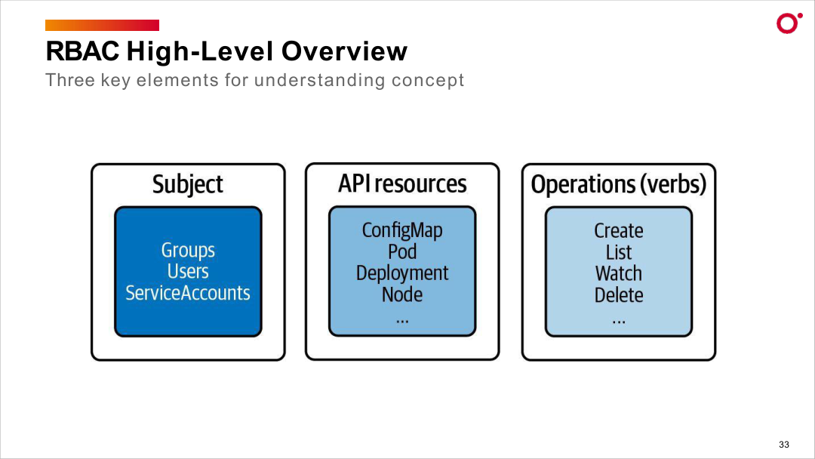
AUTHORIZATION
RBAC — Subject, API Resources and Verbs
Certified Kubernetes Administrator (CKA) · TGS-2025054612
© 2026 Tertiary Infotech Academy Pte Ltd
78

Slide 83
DAY 1 · RBAC
RBAC: Roles, RoleBindings, ServiceAccounts, ClusterRole
LAB 8
RBAC
Create a ServiceAccount for a read-only viewer persona, define a namespaced Role that allows only get/list/watch on Pods, bind the role to the SA, and prove that the SA can read but cannot write. Then extend to ClusterRole for cluster-scoped resources.
You'll build
Create SA + Role + RoleBinding in rbac-demo namespace, test with kubectl auth can-i --as, verify from inside a pod, add ClusterRole for node access.
Key commands: kubectl create · kubectl -n · » Identity
Certified Kubernetes Administrator (CKA) · TGS-2025054612
© 2026 Tertiary Infotech Academy Pte Ltd
79

Slide 84
LAB 8 · COMMANDS
RBAC: Roles, RoleBindings, ServiceAccounts, ClusterRole
Step 1 -- Create namespace and ServiceAccount
kubectl create ns rbac-demo
kubectl -n rbac-demo create serviceaccount viewer
Step 2 -- Create a namespaced Role
kubectl -n rbac-demo create role pod-viewer \
--verb=get,list,watch \
--resource=pods
kubectl -n rbac-demo get role pod-viewer -o yaml
Step 3 -- Bind Role to ServiceAccount
kubectl -n rbac-demo create rolebinding viewer-binding \
--role=pod-viewer \
--serviceaccount=rbac-demo:viewer
Certified Kubernetes Administrator (CKA) · TGS-2025054612
© 2026 Tertiary Infotech Academy Pte Ltd
80

Slide 85
LAB 8 · COMMANDS
RBAC: Roles, RoleBindings, ServiceAccounts, ClusterRole (cont.)
Step 4 -- Test with kubectl auth can-i
kubectl -n rbac-demo auth can-i list pods \
--as=system:serviceaccount:rbac-demo:viewer
kubectl -n rbac-demo auth can-i create pods \
--as=system:serviceaccount:rbac-demo:viewer
# Expected: yes, no
Step 5 -- ClusterRole for cluster-scoped resources
kubectl create clusterrole node-reader --verb=get,list,watch --resource=nodes
kubectl create clusterrolebinding viewer-nodes \
--clusterrole=node-reader \
--serviceaccount=rbac-demo:viewer
Note Identity format for SA: system:serviceaccount:<namespace>:<name>. ClusterRole is for cluster-scoped resources (nodes, PVs); Role is namespace-scoped.
Certified Kubernetes Administrator (CKA) · TGS-2025054612
© 2026 Tertiary Infotech Academy Pte Ltd
81

Slide 86
LAB 8 · TEST IT
RBAC: Roles, RoleBindings, ServiceAccounts, ClusterRole
✅ Test it
kubectl auth can-i list pods --as=SA returns yes; create pods returns no. ClusterRole allows viewer SA to list nodes across all namespaces.
Killercoda: https://killercoda.com/playgrounds/scenario/kubernetes
Certified Kubernetes Administrator (CKA) · TGS-2025054612
© 2026 Tertiary Infotech Academy Pte Ltd
82

Slide 87
WRAP-UP
Day 1 done — you can build and administer a Kubernetes cluster.
Tomorrow: CRDs, workloads, scheduling, services and networking.
Certified Kubernetes Administrator (CKA) · TGS-2025054612
© 2026 Tertiary Infotech Academy Pte Ltd
83

Slide 88
COURSE SLIDES
Certified Kubernetes Administrator (CKA)
WSQ Course Code: TGS-2025054612
Conducted by Tertiary Infotech Academy Pte Ltd · UEN 201200696W
© 2026 Tertiary Infotech Academy Pte Ltd. All rights reserved. · www.tertiarycourses.com.sg

Slide 89
02
DAY 2
Workloads, Scheduling & Services
Domain 1 tools + Domains 2 & 3 start — Labs 9–18
Certified Kubernetes Administrator (CKA) · TGS-2025054612
© 2026 Tertiary Infotech Academy Pte Ltd
84

Slide 90
TRAQOM · SSG DIGITAL ATTENDANCE
Digital Attendance (Mandatory)
• It is mandatory to take the AM, PM and Assessment digital attendance for WSQ-funded courses.
• The trainer displays the digital attendance QR code from the SSG portal.
• Scan the QR code with your phone camera and submit your attendance.
• A minimum of 75% attendance is required for assessment and funding.
Minimum 75%
attendance required
Certified Kubernetes Administrator (CKA) · TGS-2025054612
© 2026 Tertiary Infotech Academy Pte Ltd
85

Slide 91
DAY 2 OBJECTIVES
Recap & Today
• Yesterday (Domain 1): kubeadm cluster bootstrap, CNI, cluster upgrade, HA etcd, Helm, Kustomize and RBAC.
• This morning — Domain 1 tools: CRDs, Operators and the CRI/CNI/CSI extension interfaces.
• Then Domain 2 (15%): Deployments, ConfigMaps, Secrets, HPA, self-healing and pod scheduling.
• Late afternoon — Domain 3 start (20%): pod connectivity, Service types.
Certified Kubernetes Administrator (CKA) · TGS-2025054612
© 2026 Tertiary Infotech Academy Pte Ltd
86

Slide 92
TOPIC 1
CRDs, Operators & Extension Interfaces
Extend Kubernetes without patching it
Certified Kubernetes Administrator (CKA) · TGS-2025054612
© 2026 Tertiary Infotech Academy Pte Ltd
87

Slide 93
API EXTENSIBILITY
Custom Resource Definitions (CRDs)
• A CRD registers a new object kind with the API server — creating, listing and deleting it just like built-in resources.
• openAPIV3Schema in the CRD spec validates the custom resource at admission time.
• kubectl api-resources lists all resources including custom ones (shows APIVERSION column).
• An Operator pairs a CRD with a controller that encodes operational knowledge (install, upgrade, backup).
Certified Kubernetes Administrator (CKA) · TGS-2025054612
© 2026 Tertiary Infotech Academy Pte Ltd
88

Slide 94
THE PLUGIN INTERFACES
CRI, CNI, CSI — The Plugin Interfaces
• CRI (Container Runtime Interface): kubelet talks to containerd or CRI-O via a gRPC socket.
• crictl is the low-level CRI client — use it when kubectl is unavailable because the API server is down.
• CNI (Container Network Interface): /etc/cni/net.d/ configs + /opt/cni/bin/ binaries; called on every pod lifecycle event.
• CSI (Container Storage Interface): kubectl get csidrivers and csinodes; StorageClass references a CSI provisioner.
Certified Kubernetes Administrator (CKA) · TGS-2025054612
© 2026 Tertiary Infotech Academy Pte Ltd
89

Slide 95
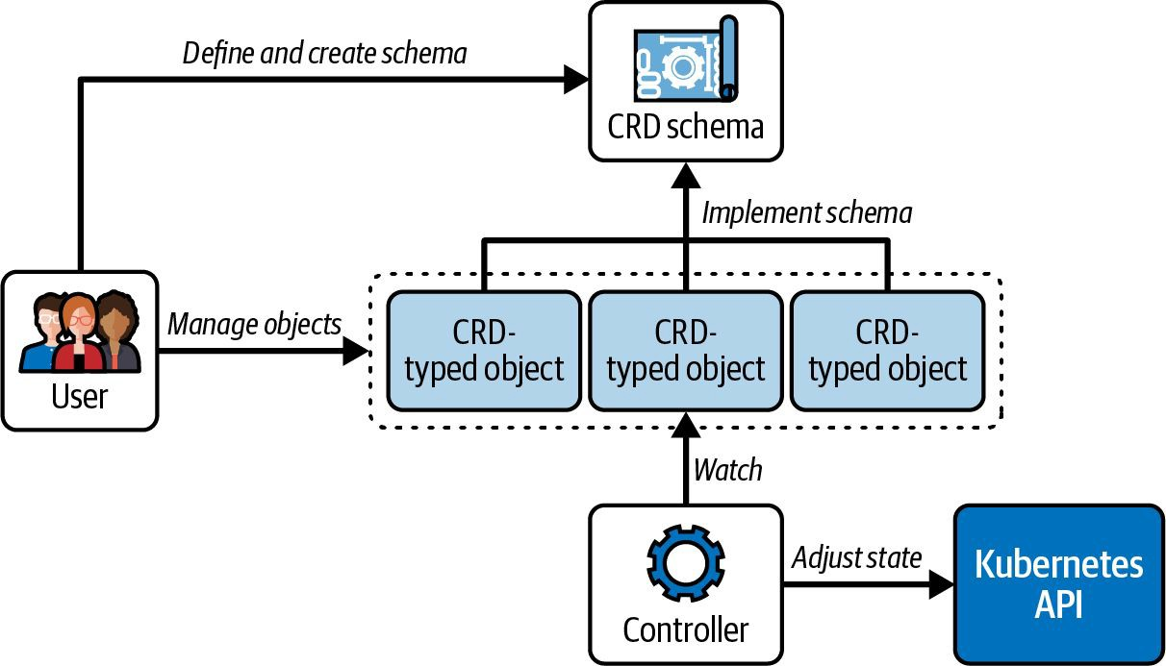
CRDs & OPERATORS
The Operator Pattern — CRD + Controller
Certified Kubernetes Administrator (CKA) · TGS-2025054612
© 2026 Tertiary Infotech Academy Pte Ltd
90

Slide 96
DAY 2 · CRDS & OPERATORS
CRDs and Operators: Schema Validation, cert-manager, Certificate Lifecycle
LAB 9
CRDs and Operators
Define a CRD with OpenAPI schema validation, create custom resources, install the cert-manager operator via Helm, and walk through the TLS certificate lifecycle. CKA tests working with CRDs and operator-managed resources.
You'll build
Create AppDatabase CRD with enum/pattern/required validation, install cert-manager, create self-signed ClusterIssuer, request TLS Certificate, inspect resulting Secret.
Key commands: cat <<'EOF' · kubectl apply · helm repo · » CRDs
Certified Kubernetes Administrator (CKA) · TGS-2025054612
© 2026 Tertiary Infotech Academy Pte Ltd
91

Slide 97
LAB 9 · COMMANDS
CRDs and Operators: Schema Validation, cert-manager, Certificate Lifecycle
Step 1 -- Define a CRD with schema validation
cat <<'EOF' | kubectl apply -f -
apiVersion: apiextensions.k8s.io/v1
kind: CustomResourceDefinition
metadata:
name: appdatabases.storage.example.com
spec:
group: storage.example.com
versions:
- name: v1
served: true
storage: true
schema:
openAPIV3Schema:
type: object
properties:
spec:
type: object
required: ['engine', 'storage']
properties:
engine:
type: string
enum: ['postgresql', 'mysql', 'redis']
scope: Namespaced
names:
plural: appdatabases
singular: appdatabase
kind: AppDatabase
EOF
Certified Kubernetes Administrator (CKA) · TGS-2025054612
© 2026 Tertiary Infotech Academy Pte Ltd
92

Slide 98
LAB 9 · COMMANDS
CRDs and Operators: Schema Validation, cert-manager, Certificate Lifecycle (cont.)
Step 2 -- Create and query custom resources
kubectl apply -f - <<'EOF'
apiVersion: storage.example.com/v1
kind: AppDatabase
metadata:
name: my-postgres
spec:
engine: postgresql
storage: 20Gi
EOF
kubectl get appdatabases
kubectl describe adb my-postgres
Step 3 -- Install cert-manager via Helm
helm repo add jetstack https://charts.jetstack.io && helm repo update
helm install cert-manager jetstack/cert-manager \
--namespace cert-manager --create-namespace \
--version v1.15.0 --set installCRDs=true
kubectl get pods -n cert-manager
Certified Kubernetes Administrator (CKA) · TGS-2025054612
© 2026 Tertiary Infotech Academy Pte Ltd
93

Slide 99
LAB 9 · COMMANDS
CRDs and Operators: Schema Validation, cert-manager, Certificate Lifecycle (cont.)
Step 4 -- Create ClusterIssuer and request certificate
kubectl apply -f - <<'EOF'
apiVersion: cert-manager.io/v1
kind: ClusterIssuer
metadata:
name: selfsigned-issuer
spec:
selfSigned: {}
EOF
kubectl wait --for=condition=Ready clusterissuer/selfsigned-issuer
Note CRDs extend the Kubernetes API with custom resource types. OpenAPI schema validation rejects invalid resources at the API server before they reach etcd.
Certified Kubernetes Administrator (CKA) · TGS-2025054612
© 2026 Tertiary Infotech Academy Pte Ltd
94

Slide 100
LAB 9 · TEST IT
CRDs and Operators: Schema Validation, cert-manager, Certificate Lifecycle
✅ Test it
kubectl get appdatabases shows my-postgres. cert-manager pods are Running. ClusterIssuer is Ready. Invalid engine value (e.g. 'oracle') is rejected by the API server.
Killercoda: https://killercoda.com/playgrounds/scenario/kubernetes
Certified Kubernetes Administrator (CKA) · TGS-2025054612
© 2026 Tertiary Infotech Academy Pte Ltd
95

Slide 101
DAY 2 · CRI/CNI/CSI
Extension Interfaces: CRI (crictl), CNI (/etc/cni/net.d), CSI (kubectl get csidrivers)
LAB 10
CRI/CNI/CSI extension interfaces
Explore the three Kubernetes extension interfaces using native debugging tools: crictl for CRI, config file inspection for CNI, and kubectl for CSI drivers. Critical for troubleshooting pods stuck in ContainerCreating or volume mount failures.
You'll build
Configure crictl.yaml, list containers/images with crictl, inspect CNI config, list CSI drivers, trace a pod network setup with veth pairs.
Key commands: cat <<'EOF' · POD_ID=$(crictl pods · ls -la · kubectl get · » crictl
Certified Kubernetes Administrator (CKA) · TGS-2025054612
© 2026 Tertiary Infotech Academy Pte Ltd
96

Slide 102
LAB 10 · COMMANDS
Extension Interfaces: CRI (crictl), CNI (/etc/cni/net.d), CSI (kubectl get csidrivers)
Step 1 -- Configure and use crictl
cat <<'EOF' > /etc/crictl.yaml
runtime-endpoint: unix:///run/containerd/containerd.sock
image-endpoint: unix:///run/containerd/containerd.sock
timeout: 10
EOF
crictl info && crictl pods && crictl ps && crictl images
Step 2 -- Get container logs with crictl
POD_ID=$(crictl pods --name coredns -q | head -1)
CONTAINER_ID=$(crictl ps --pod $POD_ID -q | head -1)
crictl logs --tail=20 $CONTAINER_ID
Step 3 -- Inspect CNI configuration
ls -la /etc/cni/net.d/
cat /etc/cni/net.d/10-calico.conflist
ls /opt/cni/bin/
Certified Kubernetes Administrator (CKA) · TGS-2025054612
© 2026 Tertiary Infotech Academy Pte Ltd
97

Slide 103
LAB 10 · COMMANDS
Extension Interfaces: CRI (crictl), CNI (/etc/cni/net.d), CSI (kubectl get csidrivers) (cont.)
Step 4 -- Inspect CSI drivers
kubectl get csidrivers
kubectl get csinodes
kubectl get volumeattachments
Note crictl logs works even when kubectl is unavailable (API server down). CNI config: lowest-numbered file in /etc/cni/net.d/ is used. Missing CNI binary in /opt/cni/bin/ causes ContainerCreating to hang indefinitely.
Certified Kubernetes Administrator (CKA) · TGS-2025054612
© 2026 Tertiary Infotech Academy Pte Ltd
98

Slide 104
LAB 10 · TEST IT
Extension Interfaces: CRI (crictl), CNI (/etc/cni/net.d), CSI (kubectl get csidrivers)
✅ Test it
crictl pods lists all running pods. CNI config file exists in /etc/cni/net.d/. kubectl get csidrivers returns available storage drivers.
Killercoda: https://killercoda.com/playgrounds/scenario/kubernetes
Certified Kubernetes Administrator (CKA) · TGS-2025054612
© 2026 Tertiary Infotech Academy Pte Ltd
99

Slide 105
Tea Break
15 minutes

Slide 106
TOPIC 2
Deployments & ReplicaSets
Desired-state workload management
Certified Kubernetes Administrator (CKA) · TGS-2025054612
© 2026 Tertiary Infotech Academy Pte Ltd
100

Slide 107
DESIRED STATE
Why Deployments?
• A bare Pod is not rescheduled if it dies — you need a Deployment to maintain the desired count.
• A Deployment manages a ReplicaSet, which manages Pods — the three-tier ownership chain.
• kubectl scale changes replica count; kubectl set image triggers a rolling rollout.
• Old ReplicaSets are retained for rollback (revisionHistoryLimit default 10); rollout undo reverts in one command.
Certified Kubernetes Administrator (CKA) · TGS-2025054612
© 2026 Tertiary Infotech Academy Pte Ltd
101

Slide 108
THE OWNERSHIP CHAIN
Deployment → ReplicaSet → Pod
Deployment
ReplicaSet
Pod
• You declare desired state
• replicas + Pod template
• Owns one active ReplicaSet
• Keeps N Pods running
• Hash-suffixed name
• Self-heals deleted Pods
• The running workload
• Recreated if it dies
• Never edited directly
Certified Kubernetes Administrator (CKA) · TGS-2025054612
© 2026 Tertiary Infotech Academy Pte Ltd
102

Slide 109
DOMAIN 2 · DEPLOYMENTS AND ROLLOUTS
Rolling Update — Old RS to New RS
kubectl set image
ReplicaSet v1 (old)
nginx:1.24
scales 3 to 0 gradually
old pods terminate
ReplicaSet v2 (new)
nginx:1.25
scales 0 to 3 gradually
takes over traffic
Old ReplicaSet scales down as the new one scales up — maxSurge / maxUnavailable control speed. rollout undo reverts in one step.
Certified Kubernetes Administrator (CKA) · TGS-2025054612
© 2026 Tertiary Infotech Academy Pte Ltd
103

Slide 110
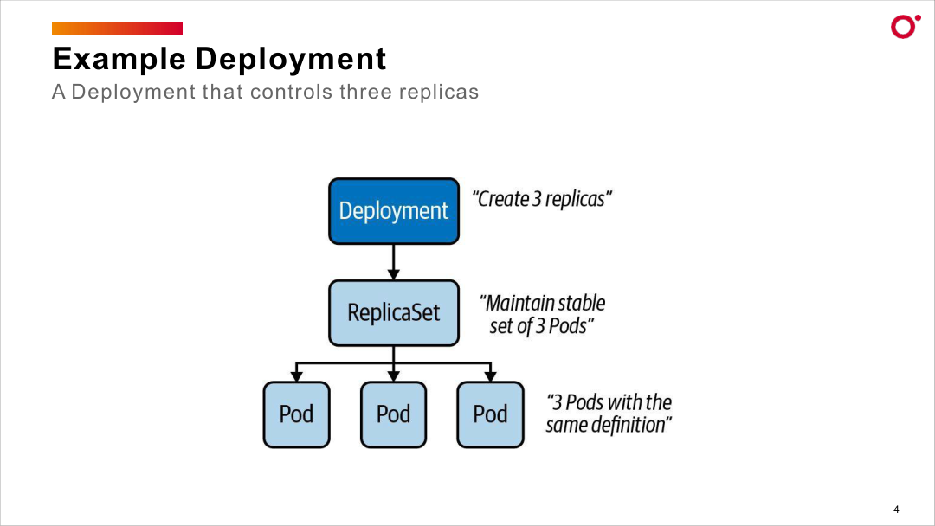
DESIRED STATE
Deployment → ReplicaSet → Pod Hierarchy
Certified Kubernetes Administrator (CKA) · TGS-2025054612
© 2026 Tertiary Infotech Academy Pte Ltd
104

Slide 111
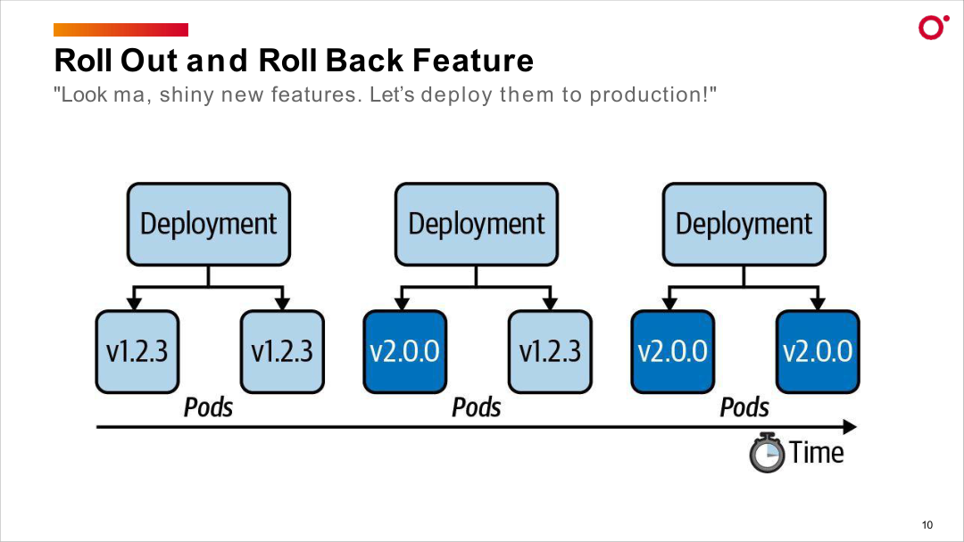
DESIRED STATE
Rolling Update and Rollback — Version Transition Over Time
Certified Kubernetes Administrator (CKA) · TGS-2025054612
© 2026 Tertiary Infotech Academy Pte Ltd
105

Slide 112
DAY 2 · DEPLOYMENTS
Deployments and Rollouts: Rolling Update, Bad Image, rollout undo, pause/resume
LAB 11
Deployments and rollouts
Create a Deployment, perform a rolling update, deliberately introduce a broken image to trigger a failed rollout, roll back using kubectl rollout undo, and use pause/resume to batch multiple changes. Mastering kubectl rollout subcommands is essential for the 15% Workloads & Scheduling domain.
You'll build
Create 4-replica nginx Deployment, update to new image, break it with invalid tag, rollback, roll back to specific revision, pause/resume.
Key commands: kubectl create · kubectl set · kubectl rollout · » Rolling
Certified Kubernetes Administrator (CKA) · TGS-2025054612
© 2026 Tertiary Infotech Academy Pte Ltd
106

Slide 113
LAB 11 · COMMANDS
Deployments and Rollouts: Rolling Update, Bad Image, rollout undo, pause/resume
Step 1 -- Create and expose Deployment
kubectl create deployment webapp --image=nginx:1.25 --replicas=4 --port=80
kubectl expose deployment webapp --port=80
kubectl rollout history deployment webapp
Step 2 -- Perform a rolling update
kubectl set image deployment/webapp webapp=nginx:1.27
kubectl annotate deployment webapp kubernetes.io/change-cause='upgrade to nginx:1.27'
kubectl rollout status deployment webapp
Step 3 -- Simulate a broken rollout
kubectl set image deployment/webapp webapp=nginx:does-not-exist-999
kubectl get pods -l app=webapp
# Old pods Running; new pod ImagePullBackOff
Certified Kubernetes Administrator (CKA) · TGS-2025054612
© 2026 Tertiary Infotech Academy Pte Ltd
107

Slide 114
LAB 11 · COMMANDS
Deployments and Rollouts: Rolling Update, Bad Image, rollout undo, pause/resume (cont.)
Step 4 -- Roll back
kubectl rollout undo deployment webapp
kubectl rollout status deployment webapp
kubectl rollout undo deployment webapp --to-revision=1
Step 5 -- Pause and resume a rollout
kubectl set image deployment/webapp webapp=nginx:1.27
kubectl rollout pause deployment webapp
kubectl set resources deployment webapp --containers=webapp --requests=cpu=100m
kubectl rollout resume deployment webapp
kubectl rollout status deployment webapp
Note Rolling updates are safe: broken image stalls rollout without taking down healthy pods. kubectl rollout undo creates a NEW revision -- the counter always grows.
Certified Kubernetes Administrator (CKA) · TGS-2025054612
© 2026 Tertiary Infotech Academy Pte Ltd
108

Slide 115
LAB 11 · TEST IT
Deployments and Rollouts: Rolling Update, Bad Image, rollout undo, pause/resume
✅ Test it
kubectl rollout history shows multiple revisions. After rollback all pods run previous image. Service continues responding during the bad image period.
Killercoda: https://killercoda.com/playgrounds/scenario/kubernetes
Certified Kubernetes Administrator (CKA) · TGS-2025054612
© 2026 Tertiary Infotech Academy Pte Ltd
109

Slide 116
TOPIC 3
ConfigMaps & Secrets
Decouple configuration from container images
Certified Kubernetes Administrator (CKA) · TGS-2025054612
© 2026 Tertiary Infotech Academy Pte Ltd
110

Slide 117
CONFIGURATION
ConfigMaps — Non-secret Config
• A ConfigMap holds non-sensitive key/value data; create with --from-literal, --from-file or --from-env-file.
• Inject one key with configMapKeyRef, all keys with envFrom: configMapRef, or mount as a file volume.
• Volume-mounted ConfigMaps update live (~60 s); env-var injections are fixed at Pod startup.
• Keep configuration out of the image so the same image runs unchanged in every environment.
Certified Kubernetes Administrator (CKA) · TGS-2025054612
© 2026 Tertiary Infotech Academy Pte Ltd
111

Slide 118
SECRETS
Secrets — Sensitive Data
• Secrets work like ConfigMaps but values are base64-encoded and access is gated by RBAC.
• Types: generic (Opaque), kubernetes.io/tls and kubernetes.io/dockerconfigjson.
• Inject with envFrom: secretRef (all keys) or secretKeyRef (one key); mount with defaultMode: 0400.
• Base64 is encoding, not encryption — enable encryption at rest and restrict access with RBAC.
Certified Kubernetes Administrator (CKA) · TGS-2025054612
© 2026 Tertiary Infotech Academy Pte Ltd
112

Slide 119
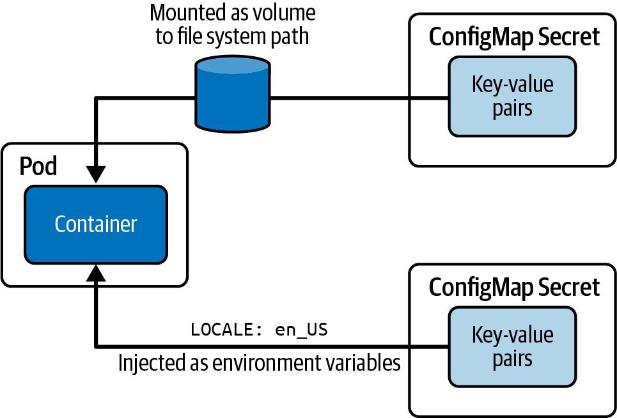
CONFIGURATION
Consuming Configuration Data — ConfigMap & Secret
Certified Kubernetes Administrator (CKA) · TGS-2025054612
© 2026 Tertiary Infotech Academy Pte Ltd
113

Slide 120
DAY 2 · CONFIGMAPS
ConfigMaps: 3 Creation Methods, envFrom, Volume Mount, Live Update Semantics
LAB 12
ConfigMaps
Create ConfigMaps using three methods (literal, file, YAML manifest), inject via envFrom and env.valueFrom, mount as volumes with custom filenames and permissions, and demonstrate the live-update behavior difference. Understanding live vs static updates is a tested CKA concept.
You'll build
Create app-config from literals, file-config from files, manifest-config from YAML. Test envFrom with prefix, selective keys, volume mount, subPath, and live update.
Key commands: kubectl create · envFrom: · volumeMounts: · kubectl patch · » CRITICAL:
Certified Kubernetes Administrator (CKA) · TGS-2025054612
© 2026 Tertiary Infotech Academy Pte Ltd
114

Slide 121
LAB 12 · COMMANDS
ConfigMaps: 3 Creation Methods, envFrom, Volume Mount, Live Update Semantics
Step 1 -- Create ConfigMap three ways
kubectl create configmap app-config \
--from-literal=APP_ENV=production \
--from-literal=LOG_LEVEL=info
kubectl create configmap file-config --from-file=/tmp/nginx.conf
kubectl get configmap app-config -o yaml
Step 2 -- Inject with envFrom
# Pod spec:
envFrom:
- configMapRef:
name: app-config
prefix: 'CONFIG_'
kubectl exec envfrom-pod -- env | grep CONFIG_
Certified Kubernetes Administrator (CKA) · TGS-2025054612
© 2026 Tertiary Infotech Academy Pte Ltd
115

Slide 122
LAB 12 · COMMANDS
ConfigMaps: 3 Creation Methods, envFrom, Volume Mount, Live Update Semantics (cont.)
Step 3 -- Mount as volume
# Pod spec:
volumeMounts:
- name: config-vol
mountPath: /config
volumes:
- name: config-vol
configMap:
name: app-config
kubectl exec volume-mount-pod -- ls /config
kubectl exec volume-mount-pod -- cat /config/LOG_LEVEL
Step 4 -- Live update semantics
kubectl patch configmap app-config --type=merge -p '{"data":{"LOG_LEVEL":"debug"}}'
sleep 90
kubectl exec volume-mount-pod -- cat /config/LOG_LEVEL
# debug -- updated live!
kubectl exec envfrom-pod -- env | grep LOG_LEVEL
# info -- NOT updated
Certified Kubernetes Administrator (CKA) · TGS-2025054612
© 2026 Tertiary Infotech Academy Pte Ltd
116

Slide 123
LAB 12 · COMMANDS
ConfigMaps: 3 Creation Methods, envFrom, Volume Mount, Live Update Semantics (cont.)
Note CRITICAL: Volume-mounted ConfigMaps update automatically (1-2 min delay). Env vars and subPath mounts require pod restart to pick up changes.
Certified Kubernetes Administrator (CKA) · TGS-2025054612
© 2026 Tertiary Infotech Academy Pte Ltd
117

Slide 124
LAB 12 · TEST IT
ConfigMaps: 3 Creation Methods, envFrom, Volume Mount, Live Update Semantics
✅ Test it
volume-mount-pod shows updated LOG_LEVEL=debug after ConfigMap patch. envfrom-pod still shows LOG_LEVEL=info (not live-updated).
Killercoda: https://killercoda.com/playgrounds/scenario/kubernetes
Certified Kubernetes Administrator (CKA) · TGS-2025054612
© 2026 Tertiary Infotech Academy Pte Ltd
118

Slide 125
Lunch Break
1 hour

Slide 126
DAY 2 · SECRETS
Secrets: generic/tls/docker-registry, Env Inject, tmpfs Mount defaultMode 0400
LAB 13
Secrets
Create secrets of three types (generic, TLS, docker-registry), inject via environment variables and volume mounts backed by tmpfs, and apply restrictive permissions with defaultMode 0400. Understand that Secrets are base64-encoded but NOT encrypted by default.
You'll build
Create db-credentials (generic), webapp-tls (TLS with openssl), registry secret. Mount with defaultMode 0400, verify tmpfs, decode with base64 -d.
Key commands: kubectl create · openssl req · volumes: · » Secrets
Certified Kubernetes Administrator (CKA) · TGS-2025054612
© 2026 Tertiary Infotech Academy Pte Ltd
119

Slide 127
LAB 13 · COMMANDS
Secrets: generic/tls/docker-registry, Env Inject, tmpfs Mount defaultMode 0400
Step 1 -- Create and decode generic secret
kubectl create secret generic db-credentials \
--from-literal=DB_USER=admin \
--from-literal=DB_PASSWORD=SuperSecret123!
kubectl get secret db-credentials -o yaml
kubectl get secret db-credentials \
-o jsonpath='{.data.DB_PASSWORD}' | base64 -d
Step 2 -- Create TLS secret
openssl req -x509 -nodes -newkey rsa:2048 \
-keyout /tmp/tls.key -out /tmp/tls.crt -days 365 \
-subj '/CN=webapp.example.com'
kubectl create secret tls webapp-tls --cert=/tmp/tls.crt --key=/tmp/tls.key
Certified Kubernetes Administrator (CKA) · TGS-2025054612
© 2026 Tertiary Infotech Academy Pte Ltd
120

Slide 128
LAB 13 · COMMANDS
Secrets: generic/tls/docker-registry, Env Inject, tmpfs Mount defaultMode 0400 (cont.)
Step 3 -- Mount as tmpfs with defaultMode 0400
# Pod spec volumes:
volumes:
- name: secret-vol
secret:
secretName: db-credentials
defaultMode: 0400
kubectl exec secret-volume-pod -- ls -la /secrets
# -r-------- files
kubectl exec secret-volume-pod -- df -h /secrets
# tmpfs
Note Secrets are base64-encoded (NOT encrypted). Enable etcd encryption at rest for actual security. tmpfs means secrets are never written to node disk. echo -n is critical -- without -n, trailing newline corrupts the base64 value.
Certified Kubernetes Administrator (CKA) · TGS-2025054612
© 2026 Tertiary Infotech Academy Pte Ltd
121

Slide 129
LAB 13 · TEST IT
Secrets: generic/tls/docker-registry, Env Inject, tmpfs Mount defaultMode 0400
✅ Test it
Secret files have permissions -r-------- (0400). df -h /secrets shows tmpfs. base64 -d decodes the password correctly. TLS secret type is kubernetes.io/tls.
Killercoda: https://killercoda.com/playgrounds/scenario/kubernetes
Certified Kubernetes Administrator (CKA) · TGS-2025054612
© 2026 Tertiary Infotech Academy Pte Ltd
122

Slide 130
TOPIC 4
HPA & Self-Healing Workloads
Autoscaling and resilient workload patterns
Certified Kubernetes Administrator (CKA) · TGS-2025054612
© 2026 Tertiary Infotech Academy Pte Ltd
123

Slide 131
AUTOSCALING
Horizontal Pod Autoscaler
• HPA watches metrics-server and adjusts the Deployment replica count to hit a target CPU/memory %.
• Pods must have resources.requests defined for HPA to calculate a utilisation ratio.
• Scale-out is fast; scale-in has a stabilisation window (~5 min) to prevent thrashing.
• Create with: kubectl autoscale deployment <name> --min=2 --max=10 --cpu-percent=50.
Certified Kubernetes Administrator (CKA) · TGS-2025054612
© 2026 Tertiary Infotech Academy Pte Ltd
124

Slide 132
DOMAIN 2 · HPA AND METRICS-SERVER
Horizontal Pod Autoscaler
observed usage
scales
metrics-server
scrapes kubelet cAdvisor
serves metrics.k8s.io
HPA controller
reads current CPU/mem
computes desired replicas
Deployment
replicas adjusted
scale-out and scale-in
HPA requires resources.requests on the Deployment. Scale-in waits ~5 min (stabilization window).
Certified Kubernetes Administrator (CKA) · TGS-2025054612
© 2026 Tertiary Infotech Academy Pte Ltd
125

Slide 133
RESILIENCE
Self-Healing Primitives (DaemonSet, StatefulSet)
• Liveness probe: restarts the container when it hangs or deadlocks (httpGet / tcpSocket / exec).
• Readiness probe: removes the pod from Service endpoints until it can serve traffic — no restart.
• DaemonSet: schedules exactly one pod per matching node — for log collectors, CNI agents, node exporters.
• StatefulSet: stable names (db-0, db-1), ordered start/stop, volumeClaimTemplates — for databases and queues.
Certified Kubernetes Administrator (CKA) · TGS-2025054612
© 2026 Tertiary Infotech Academy Pte Ltd
126

Slide 134
DOMAIN 2 · NODE-WIDE AGENTS vs STABLE-IDENTITY WORKLOADS
DaemonSet vs StatefulSet
DaemonSet — one Pod per node
StatefulSet — ordered, stable names
headless Service (db)
clusterIP: None
agent Pod
node-1
db-0
PVC db-data-db-0
agent Pod
node-2
db-1
PVC db-data-db-1
agent Pod
node-3
db-2
PVC db-data-db-2
DaemonSet scales with the cluster; StatefulSet gives stable network identity and ordered start/stop — essential for databases.
Certified Kubernetes Administrator (CKA) · TGS-2025054612
© 2026 Tertiary Infotech Academy Pte Ltd
127

Slide 135
DAY 2 · HPA
HPA v2: metrics-server, HorizontalPodAutoscaler, Load Test, Watch Scale
LAB 14
Horizontal Pod Autoscaling
Install metrics-server to provide CPU metrics, create an HPA using autoscaling/v2 API, generate CPU load, and watch the HPA scale up then back down. HPA requires resource requests on containers; without them, utilization cannot be calculated.
You'll build
Install metrics-server (with --kubelet-insecure-tls patch), create HPA targeting 50% CPU, run stress test, watch scale-up, wait for scale-down.
Key commands: kubectl apply · kubectl create · kubectl autoscale · kubectl run · » HPA
Certified Kubernetes Administrator (CKA) · TGS-2025054612
© 2026 Tertiary Infotech Academy Pte Ltd
128

Slide 136
LAB 14 · COMMANDS
HPA v2: metrics-server, HorizontalPodAutoscaler, Load Test, Watch Scale
Step 1 -- Install metrics-server
kubectl apply -f https://github.com/kubernetes-sigs/metrics-server/releases/latest/download/components.yaml
kubectl patch deployment metrics-server -n kube-system --type=json \
-p='[{"op":"add","path":"/spec/template/spec/containers/0/args/-","value":"--kubelet-insecure-tls"}]'
until kubectl top node 2>/dev/null; do echo 'waiting...'; sleep 5; done
Step 2 -- Deployment with resource requests
kubectl create deployment cpu-app --image=nginx --replicas=1
kubectl set resources deployment cpu-app --containers=nginx \
--requests=cpu=100m --limits=cpu=500m
Step 3 -- Create HPA
kubectl autoscale deployment cpu-app --min=1 --max=10 --cpu-percent=50
kubectl get hpa && kubectl describe hpa cpu-app
Certified Kubernetes Administrator (CKA) · TGS-2025054612
© 2026 Tertiary Infotech Academy Pte Ltd
129

Slide 137
LAB 14 · COMMANDS
HPA v2: metrics-server, HorizontalPodAutoscaler, Load Test, Watch Scale (cont.)
Step 4 -- Generate load and watch scaling
kubectl run load-gen --image=busybox --restart=Never \
-- sh -c 'while true; do wget -q -O- http://cpu-app; done'
kubectl get hpa cpu-app -w
kubectl get pods -w
Note HPA requires resource requests -- without them metrics-server cannot calculate % utilization. Scale-down has a 5-minute cooldown by default.
Certified Kubernetes Administrator (CKA) · TGS-2025054612
© 2026 Tertiary Infotech Academy Pte Ltd
130

Slide 138
LAB 14 · TEST IT
HPA v2: metrics-server, HorizontalPodAutoscaler, Load Test, Watch Scale
✅ Test it
kubectl get hpa shows non-zero CPU% and increasing replicas under load. After removing load-gen, replicas scale back to 1 within 5-10 minutes.
Killercoda: https://killercoda.com/playgrounds/scenario/kubernetes
Certified Kubernetes Administrator (CKA) · TGS-2025054612
© 2026 Tertiary Infotech Academy Pte Ltd
131

Slide 139
Tea Break
15 minutes

Slide 140
DAY 2 · SELF-HEALING
Self-Healing: Liveness/Readiness Probes, ReplicaSet, DaemonSet, StatefulSet
LAB 15
Self-healing workloads
Configure liveness and readiness probes to control container health, demonstrate ReplicaSet self-healing when pods are manually deleted, deploy a DaemonSet that runs one pod per node, and create a StatefulSet with stable network identity.
You'll build
Deploy pod with httpGet liveness probe, show ReplicaSet maintains desired count, deploy nginx DaemonSet, create StatefulSet with volumeClaimTemplates.
Key commands: cat <<'EOF' · readinessProbe: · kubectl create · » Liveness:
Certified Kubernetes Administrator (CKA) · TGS-2025054612
© 2026 Tertiary Infotech Academy Pte Ltd
132

Slide 141
LAB 15 · COMMANDS
Self-Healing: Liveness/Readiness Probes, ReplicaSet, DaemonSet, StatefulSet
Step 1 -- Liveness probe: httpGet
cat <<'EOF' | kubectl apply -f -
apiVersion: v1
kind: Pod
metadata:
name: liveness-http
spec:
containers:
- name: webapp
image: nginx:alpine
livenessProbe:
httpGet:
path: /
port: 80
initialDelaySeconds: 5
periodSeconds: 10
failureThreshold: 3
EOF
kubectl get pod liveness-http -w
Certified Kubernetes Administrator (CKA) · TGS-2025054612
© 2026 Tertiary Infotech Academy Pte Ltd
133

Slide 142
LAB 15 · COMMANDS
Self-Healing: Liveness/Readiness Probes, ReplicaSet, DaemonSet, StatefulSet (cont.)
Step 2 -- Readiness probe blocks traffic
# Readiness probe -- pod not added to Service endpoints until probe passes
readinessProbe:
httpGet:
path: /ready
port: 8080
initialDelaySeconds: 10
Step 3 -- ReplicaSet self-healing
kubectl create deployment selfheal --image=nginx --replicas=3
kubectl delete pod -l app=selfheal --force
kubectl get pods -l app=selfheal -w
# New pods created immediately
Certified Kubernetes Administrator (CKA) · TGS-2025054612
© 2026 Tertiary Infotech Academy Pte Ltd
134

Slide 143
LAB 15 · COMMANDS
Self-Healing: Liveness/Readiness Probes, ReplicaSet, DaemonSet, StatefulSet (cont.)
Step 4 -- DaemonSet: one pod per node
cat <<'EOF' | kubectl apply -f -
apiVersion: apps/v1
kind: DaemonSet
metadata:
name: node-monitor
spec:
selector:
matchLabels:
app: node-monitor
template:
metadata:
labels:
app: node-monitor
spec:
containers:
- name: monitor
image: busybox
command: ['sleep', '3600']
EOF
kubectl get daemonset
kubectl get pods -l app=node-monitor -o wide
Certified Kubernetes Administrator (CKA) · TGS-2025054612
© 2026 Tertiary Infotech Academy Pte Ltd
135

Slide 144
LAB 15 · COMMANDS
Self-Healing: Liveness/Readiness Probes, ReplicaSet, DaemonSet, StatefulSet (cont.)
Note Liveness: fail -> container restart. Readiness: fail -> removed from Service endpoints. DaemonSet automatically places one pod per node, including newly joined nodes.
Certified Kubernetes Administrator (CKA) · TGS-2025054612
© 2026 Tertiary Infotech Academy Pte Ltd
136

Slide 145
LAB 15 · TEST IT
Self-Healing: Liveness/Readiness Probes, ReplicaSet, DaemonSet, StatefulSet
✅ Test it
Pod restarts when liveness probe fails. kubectl delete pod does not reduce ReplicaSet count. DaemonSet has exactly one pod per node.
Killercoda: https://killercoda.com/playgrounds/scenario/kubernetes
Certified Kubernetes Administrator (CKA) · TGS-2025054612
© 2026 Tertiary Infotech Academy Pte Ltd
137

Slide 146
TOPIC 5
Pod Scheduling
Taints, tolerations, node affinity and resource requests
Certified Kubernetes Administrator (CKA) · TGS-2025054612
© 2026 Tertiary Infotech Academy Pte Ltd
138

Slide 147
WHERE PODS LAND
Scheduling Controls
• nodeSelector is the simplest control — schedule only on nodes with matching key=value labels.
• Taints repel pods without a matching toleration; effects are NoSchedule, PreferNoSchedule and NoExecute.
• nodeAffinity allows required (hard) and preferred (soft) constraints using In/NotIn/Exists operators.
• resources.requests tell the scheduler how much CPU/memory a pod needs; limits cap consumption at runtime.
Certified Kubernetes Administrator (CKA) · TGS-2025054612
© 2026 Tertiary Infotech Academy Pte Ltd
139

Slide 148
DOMAIN 2 · SCHEDULING
Pod Scheduling Controls
nodeSelector
spec.nodeSelector: {gpu: 'true'}
Schedules only on nodes with matching labels — simplest scheduling control.
Taints & Tolerations
kubectl taint node <n> key=val:NoSchedule
Node repels pods without a matching toleration. NoExecute also evicts running pods.
nodeAffinity
requiredDuringSchedulingIgnoredDuringExecution
Hard (required) or soft (preferred) rules. Operators: In / NotIn / Exists / Gt / Lt.
Also: podAffinity / podAntiAffinity · resources.requests drive scheduling · priorityClass pre-empts lower-priority pods
Certified Kubernetes Administrator (CKA) · TGS-2025054612
© 2026 Tertiary Infotech Academy Pte Ltd
140

Slide 149
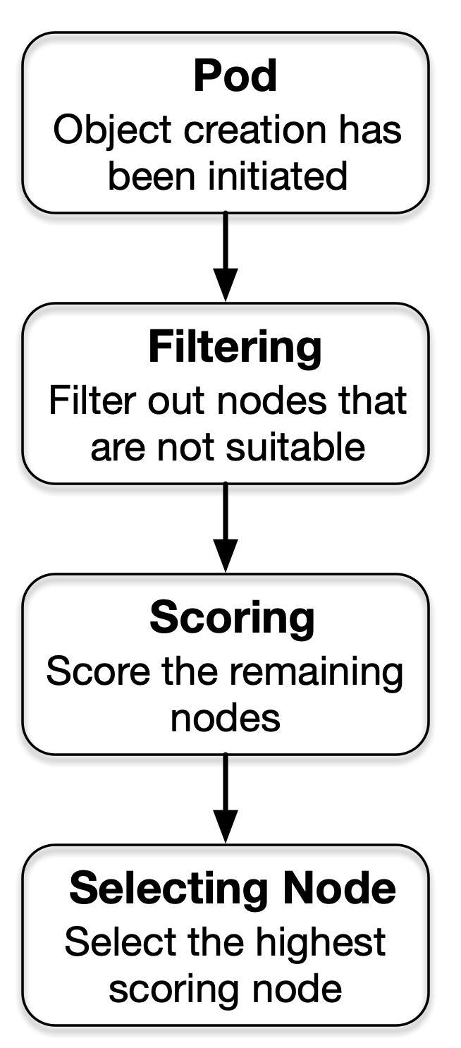
WHERE PODS LAND
Pod Scheduling Algorithm — Filter, Score, Select Node
Certified Kubernetes Administrator (CKA) · TGS-2025054612
© 2026 Tertiary Infotech Academy Pte Ltd
141

Slide 150
DAY 2 · SCHEDULING
Scheduling: nodeSelector, Node Affinity, Taints + Tolerations, Resource Requests
LAB 16
Scheduling
Control pod placement using nodeSelector for simple label matching, node affinity for flexible required/preferred placement rules, taints to repel pods from nodes, and tolerations to allow specific pods through taints.
You'll build
Label nodes, create pod with nodeSelector, add required/preferred node affinity, taint a node (NoSchedule), add toleration, demonstrate resource-based scheduling.
Key commands: kubectl label · kubectl taint · » Taint
Certified Kubernetes Administrator (CKA) · TGS-2025054612
© 2026 Tertiary Infotech Academy Pte Ltd
142

Slide 151
LAB 16 · COMMANDS
Scheduling: nodeSelector, Node Affinity, Taints + Tolerations, Resource Requests
Step 1 -- nodeSelector: simple label matching
kubectl label node worker01 disk=ssd
cat <<'EOF' | kubectl apply -f -
apiVersion: v1
kind: Pod
metadata:
name: ssd-pod
spec:
nodeSelector:
disk: ssd
containers:
- name: app
image: nginx
EOF
kubectl get pod ssd-pod -o wide
Certified Kubernetes Administrator (CKA) · TGS-2025054612
© 2026 Tertiary Infotech Academy Pte Ltd
143

Slide 152
LAB 16 · COMMANDS
Scheduling: nodeSelector, Node Affinity, Taints + Tolerations, Resource Requests (cont.)
Step 2 -- Node Affinity
# requiredDuringSchedulingIgnoredDuringExecution: hard constraint
# preferredDuringSchedulingIgnoredDuringExecution: soft preference
# Check: kubectl get pod affinity-pod -o wide
Step 3 -- Taints and Tolerations
kubectl taint node worker01 special=gpu:NoSchedule
kubectl run blocked --image=nginx
kubectl get pod blocked -o wide
# Stays Pending -- no toleration
# Add toleration:
tolerations:
- key: special
operator: Equal
value: gpu
effect: NoSchedule
Certified Kubernetes Administrator (CKA) · TGS-2025054612
© 2026 Tertiary Infotech Academy Pte Ltd
144

Slide 153
LAB 16 · COMMANDS
Scheduling: nodeSelector, Node Affinity, Taints + Tolerations, Resource Requests (cont.)
Step 4 -- Remove taint and clean up
kubectl taint node worker01 special=gpu:NoSchedule-
kubectl get pods
Note Taint effects: NoSchedule (hard reject), PreferNoSchedule (soft reject), NoExecute (evict existing pods). Tolerations do NOT guarantee placement on the tainted node.
Certified Kubernetes Administrator (CKA) · TGS-2025054612
© 2026 Tertiary Infotech Academy Pte Ltd
145

Slide 154
LAB 16 · TEST IT
Scheduling: nodeSelector, Node Affinity, Taints + Tolerations, Resource Requests
✅ Test it
nodeSelector pod lands on worker01 (disk=ssd). Tainted node rejects pods without toleration. Pod with matching toleration schedules on the tainted node.
Killercoda: https://killercoda.com/playgrounds/scenario/kubernetes
Certified Kubernetes Administrator (CKA) · TGS-2025054612
© 2026 Tertiary Infotech Academy Pte Ltd
146

Slide 155
TOPIC 6
Pod Connectivity & Services
How Pods communicate and are exposed
Certified Kubernetes Administrator (CKA) · TGS-2025054612
© 2026 Tertiary Infotech Academy Pte Ltd
147

Slide 156
NETWORKING BASICS
Pod-to-Pod Connectivity
• Every pod gets a unique IP from the pod CIDR; all pods can reach each other without NAT (flat network).
• The CNI plugin implements this — without it, cross-node pod traffic fails.
• Pod IPs are ephemeral — use a Service for stable addressing across restarts and scaling.
• kubectl exec <pod> -- curl <podIP>:<port> verifies direct pod-level connectivity bypassing the Service.
Certified Kubernetes Administrator (CKA) · TGS-2025054612
© 2026 Tertiary Infotech Academy Pte Ltd
148

Slide 157
DOMAIN 3 · CLUSTERIP NODEPORT LOADBALANCER
Service Types
ClusterIP
default — virtual IP only inside cluster
stable DNS + VIP for pod-to-pod; not reachable from outside
NodePort
exposes port 30000-32767 on every node
external access without a cloud LB; good for bare-metal
LoadBalancer
provisions cloud/MetalLB external IP
production external access; builds on NodePort
kubectl get endpoints <svc> — verify the Service is selecting the right pods.
Certified Kubernetes Administrator (CKA) · TGS-2025054612
© 2026 Tertiary Infotech Academy Pte Ltd
149

Slide 158
DAY 2 · POD CONNECTIVITY
Pod Connectivity: Flat Pod Network, ping, curl, DNS Discovery, netshoot
LAB 17
Pod networking
Verify pod-to-pod communication using ping and curl, test DNS-based service discovery, trace network paths with traceroute, and use nicolaka/netshoot as a network debugging toolkit. Pod networking fundamentals are the foundation for the 20% Services & Networking domain.
You'll build
Deploy server-pod and client-pod, ping by Pod IP, curl by Service DNS name, nslookup kubernetes.default, traceroute between pods.
Key commands: kubectl run · SERVER_IP=$(kubectl get · kubectl exec · » DNS
Certified Kubernetes Administrator (CKA) · TGS-2025054612
© 2026 Tertiary Infotech Academy Pte Ltd
150

Slide 159
LAB 17 · COMMANDS
Pod Connectivity: Flat Pod Network, ping, curl, DNS Discovery, netshoot
Step 1 -- Deploy test pods
kubectl run server-pod --image=nginx --labels='role=server'
kubectl expose pod server-pod --port=80 --name=server-svc
kubectl run client-pod --image=nicolaka/netshoot --command -- sleep 3600
kubectl get pods -o wide
Step 2 -- Ping by Pod IP
SERVER_IP=$(kubectl get pod server-pod -o jsonpath='{.status.podIP}')
kubectl exec client-pod -- ping -c 4 $SERVER_IP
Step 3 -- DNS-based service discovery
kubectl exec client-pod -- curl -s http://server-svc.default.svc.cluster.local
kubectl exec client-pod -- nslookup kubernetes.default.svc.cluster.local
kubectl exec client-pod -- cat /etc/resolv.conf
Certified Kubernetes Administrator (CKA) · TGS-2025054612
© 2026 Tertiary Infotech Academy Pte Ltd
151

Slide 160
LAB 17 · COMMANDS
Pod Connectivity: Flat Pod Network, ping, curl, DNS Discovery, netshoot (cont.)
Step 4 -- Network debugging with netshoot
kubectl exec client-pod -- traceroute $SERVER_IP
kubectl exec client-pod -- dig server-svc.default.svc.cluster.local
kubectl exec client-pod -- ss -tulpn
Note DNS pattern: <service>.<namespace>.svc.cluster.local. nicolaka/netshoot includes ping, curl, dig, traceroute, nmap, tshark, tcpdump.
Certified Kubernetes Administrator (CKA) · TGS-2025054612
© 2026 Tertiary Infotech Academy Pte Ltd
152

Slide 161
LAB 17 · TEST IT
Pod Connectivity: Flat Pod Network, ping, curl, DNS Discovery, netshoot
✅ Test it
Ping to server-pod IP returns 0% loss. curl to service DNS returns nginx HTML. nslookup kubernetes.default resolves to the ClusterIP of the kubernetes service.
Killercoda: https://killercoda.com/playgrounds/scenario/kubernetes
Certified Kubernetes Administrator (CKA) · TGS-2025054612
© 2026 Tertiary Infotech Academy Pte Ltd
153

Slide 162
DAY 2 · SERVICE TYPES
Service Types: ClusterIP, NodePort, LoadBalancer (MetalLB), EndpointSlices, Selector Debug
LAB 18
Service types
Create and test all three primary service types -- ClusterIP, NodePort, and LoadBalancer with MetalLB -- inspect EndpointSlice objects, and debug selector mismatches that cause services to have no endpoints. Service types are heavily tested (20% CKA domain).
You'll build
Create ClusterIP, NodePort with custom port, inspect EndpointSlices, create service with wrong selector and debug/fix it.
Key commands: kubectl create · kubectl expose · » EndpointSlices
Certified Kubernetes Administrator (CKA) · TGS-2025054612
© 2026 Tertiary Infotech Academy Pte Ltd
154

Slide 163
LAB 18 · COMMANDS
Service Types: ClusterIP, NodePort, LoadBalancer (MetalLB), EndpointSlices, Selector Debug
Step 1 -- ClusterIP service
kubectl create deployment webapp --image=nginx --replicas=3
kubectl expose deployment webapp --port=80 --type=ClusterIP
kubectl get svc webapp
kubectl get endpointslices -l kubernetes.io/service-name=webapp
Step 2 -- NodePort service
kubectl expose deployment webapp --port=80 --type=NodePort --name=webapp-np
NODE_PORT=$(kubectl get svc webapp-np -o jsonpath='{.spec.ports[0].nodePort}')
echo "NodePort: $NODE_PORT"
Certified Kubernetes Administrator (CKA) · TGS-2025054612
© 2026 Tertiary Infotech Academy Pte Ltd
155

Slide 164
LAB 18 · COMMANDS
Service Types: ClusterIP, NodePort, LoadBalancer (MetalLB), EndpointSlices, Selector Debug (cont.)
Step 3 -- Debug: selector mismatch causing no endpoints
# Create service with wrong selector
kubectl expose deployment webapp --port=80 --name=broken-svc
kubectl patch svc broken-svc -p '{"spec":{"selector":{"app":"wrong"}}}'
kubectl get endpoints broken-svc
# <none> -- no matching pods
# Fix: correct the selector
kubectl patch svc broken-svc -p '{"spec":{"selector":{"app":"webapp"}}}'
Note EndpointSlices replace Endpoints in Kubernetes v1.21+. A service with no endpoints usually means a selector label mismatch. Compare: kubectl describe svc vs kubectl get pods --show-labels.
Certified Kubernetes Administrator (CKA) · TGS-2025054612
© 2026 Tertiary Infotech Academy Pte Ltd
156

Slide 165
LAB 18 · TEST IT
Service Types: ClusterIP, NodePort, LoadBalancer (MetalLB), EndpointSlices, Selector Debug
✅ Test it
ClusterIP routes traffic to all 3 pods. NodePort is accessible from node IP. broken-svc has no endpoints; fixing selector restores them immediately.
Killercoda: https://killercoda.com/playgrounds/scenario/kubernetes
Certified Kubernetes Administrator (CKA) · TGS-2025054612
© 2026 Tertiary Infotech Academy Pte Ltd
157

Slide 166
WRAP-UP
Day 2 done — workloads, scheduling and basic services.
Tomorrow: Ingress, Gateway API, NetworkPolicy, Storage and Troubleshooting.
Certified Kubernetes Administrator (CKA) · TGS-2025054612
© 2026 Tertiary Infotech Academy Pte Ltd
158

Slide 167
COURSE SLIDES
Certified Kubernetes Administrator (CKA)
WSQ Course Code: TGS-2025054612
Conducted by Tertiary Infotech Academy Pte Ltd · UEN 201200696W
© 2026 Tertiary Infotech Academy Pte Ltd. All rights reserved. · www.tertiarycourses.com.sg

Slide 168
03
DAY 3
Networking, Storage & Troubleshooting
Domains 3, 4 & 5 — Labs 19–28
Certified Kubernetes Administrator (CKA) · TGS-2025054612
© 2026 Tertiary Infotech Academy Pte Ltd
159

Slide 169
TRAQOM · SSG DIGITAL ATTENDANCE
Digital Attendance (Mandatory)
• It is mandatory to take the AM, PM and Assessment digital attendance for WSQ-funded courses.
• The trainer displays the digital attendance QR code from the SSG portal.
• Scan the QR code with your phone camera and submit your attendance.
• A minimum of 75% attendance is required for assessment and funding.
Minimum 75%
attendance required
Certified Kubernetes Administrator (CKA) · TGS-2025054612
© 2026 Tertiary Infotech Academy Pte Ltd
160

Slide 170
DAY 3 OBJECTIVES
Recap & Today
• Yesterday: CRDs, extension interfaces, Deployments, ConfigMaps, Secrets, HPA, scheduling and Services.
• Morning — Domain 3 remaining (20%): Ingress, Gateway API, NetworkPolicy, CoreDNS.
• Afternoon — Domain 4 (10%): PV/PVC, StorageClass, dynamic provisioning.
• Late afternoon — Domain 5 start (30%): cluster component failures, node troubleshooting, pod debugging.
Certified Kubernetes Administrator (CKA) · TGS-2025054612
© 2026 Tertiary Infotech Academy Pte Ltd
161

Slide 171
TOPIC 1
Ingress & Gateway API
Layer-7 HTTP/HTTPS routing into the cluster
Certified Kubernetes Administrator (CKA) · TGS-2025054612
© 2026 Tertiary Infotech Academy Pte Ltd
162

Slide 172
HTTP ROUTING
Ingress — L7 Routing
• An Ingress defines host- and path-based HTTP/HTTPS rules that forward traffic to backend Services.
• An Ingress controller (e.g. ingress-nginx) must be running; ingressClassName selects it.
• TLS terminates at the controller — tls.secretName points at a kubernetes.io/tls Secret.
• pathType: Prefix matches a path and everything below it; Exact requires a literal match.
Certified Kubernetes Administrator (CKA) · TGS-2025054612
© 2026 Tertiary Infotech Academy Pte Ltd
163

Slide 173
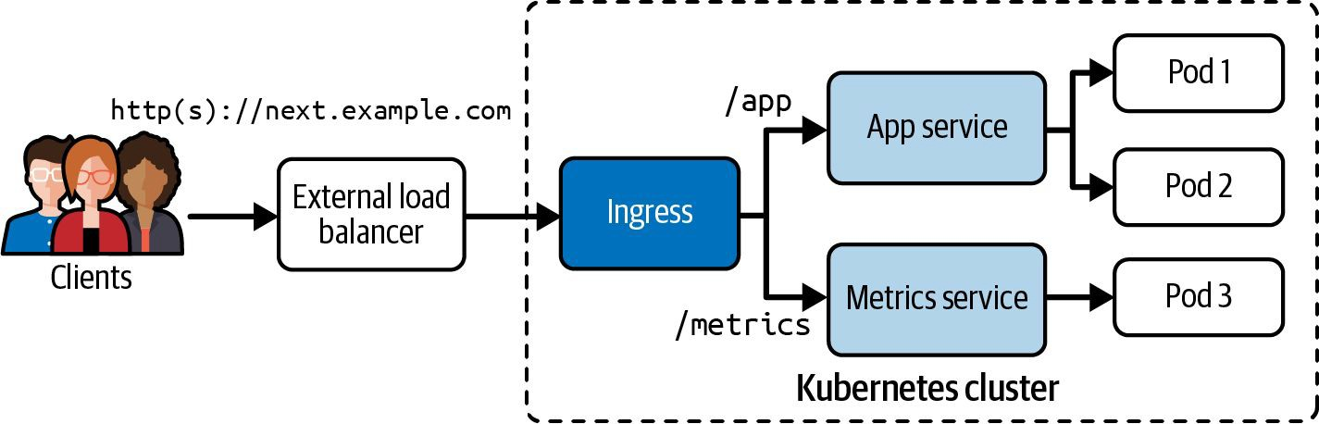
HTTP ROUTING
Ingress Traffic Routing — Host/Path to Service
Certified Kubernetes Administrator (CKA) · TGS-2025054612
© 2026 Tertiary Infotech Academy Pte Ltd
164

Slide 174
DOMAIN 3 · INGRESS CONTROLLER
Ingress — L7 HTTP/HTTPS Routing
TLS terminates
forwards plain HTTP
Client
HTTPS :443
Host: app.example.com
Ingress Controller
ingress-nginx · Traefik
reads Ingress rules
TLS termination here
Service → Pods
/app → svc-frontend
/api → svc-backend
ingressClassName: nginx · tls.secretName: tls-secret · pathType: Prefix | Exact
apiVersion: networking.k8s.io/v1 (extensions/v1beta1 removed in 1.22). A controller must be running — ingressClassName selects it.
Certified Kubernetes Administrator (CKA) · TGS-2025054612
© 2026 Tertiary Infotech Academy Pte Ltd
165

Slide 175
GATEWAY API
Gateway API — The Modern Alternative
• Gateway API is the successor to Ingress — role-oriented (infra / cluster-operator / app dev).
• GatewayClass defines the controller; Gateway binds a listener; HTTPRoute attaches rules.
• Supports HTTP, HTTPS, TCP, TLS and gRPC routing with cross-namespace route attachment.
• apiVersion: gateway.networking.k8s.io/v1 — install the CRDs separately before using it.
Certified Kubernetes Administrator (CKA) · TGS-2025054612
© 2026 Tertiary Infotech Academy Pte Ltd
166

Slide 176
DOMAIN 3 · THE SUCCESSOR TO INGRESS
Gateway API — Role-Oriented Routing
GatewayClass
provisioner: nginx
infra team manages
cluster-scoped
Gateway
binds a listener
HTTPS :443
cluster-operator owns
HTTPRoute
host + path rules
→ backend Services
app dev attaches
apiVersion: gateway.networking.k8s.io/v1 · install CRDs first → kubectl apply -f standard-install.yaml from the Gateway API releases.
Certified Kubernetes Administrator (CKA) · TGS-2025054612
© 2026 Tertiary Infotech Academy Pte Ltd
167

Slide 177
DAY 3 · INGRESS
Ingress Controller: Host Routing, TLS Termination, Path Rules, Debug
LAB 19
Ingress
Install ingress-nginx controller, configure host-based routing to multiple backends, terminate TLS using a Kubernetes Secret, and debug misconfigured Ingress resources. CKA 2026 tests installing ingress-nginx, host routing, and TLS termination.
You'll build
Install ingress-nginx via bare-metal manifest, create Ingress for two apps with host rules, add TLS block with secret, debug 404 by checking ingressClassName.
Key commands: kubectl apply · HTTP_PORT=$(kubectl -n · cat <<'EOF' · kubectl create · » ingressClassName:
Certified Kubernetes Administrator (CKA) · TGS-2025054612
© 2026 Tertiary Infotech Academy Pte Ltd
168

Slide 178
LAB 19 · COMMANDS
Ingress Controller: Host Routing, TLS Termination, Path Rules, Debug
Step 1 -- Install ingress-nginx
kubectl apply -f https://raw.githubusercontent.com/kubernetes/ingress-nginx/main/deploy/static/provider/baremetal/deploy.yaml
kubectl -n ingress-nginx wait --for=condition=Ready pod \
-l app.kubernetes.io/component=controller --timeout=180s
Step 2 -- Get NodePort for testing
HTTP_PORT=$(kubectl -n ingress-nginx get svc ingress-nginx-controller \
-o jsonpath='{.spec.ports[?(@.name=="http")].nodePort}')
echo "HTTP NodePort: $HTTP_PORT"
Certified Kubernetes Administrator (CKA) · TGS-2025054612
© 2026 Tertiary Infotech Academy Pte Ltd
169

Slide 179
LAB 19 · COMMANDS
Ingress Controller: Host Routing, TLS Termination, Path Rules, Debug (cont.)
Step 3 -- Create Ingress with host-based routing
cat <<'EOF' | kubectl apply -f -
apiVersion: networking.k8s.io/v1
kind: Ingress
metadata:
name: multi-host
annotations:
nginx.ingress.kubernetes.io/rewrite-target: /
spec:
ingressClassName: nginx
rules:
- host: app1.example.com
http:
paths:
- path: /
pathType: Prefix
backend:
service:
name: app1-svc
port:
number: 80
EOF
Certified Kubernetes Administrator (CKA) · TGS-2025054612
© 2026 Tertiary Infotech Academy Pte Ltd
170

Slide 180
LAB 19 · COMMANDS
Ingress Controller: Host Routing, TLS Termination, Path Rules, Debug (cont.)
Step 4 -- TLS termination
kubectl create secret tls tls-secret --cert=tls.crt --key=tls.key
# Add to Ingress spec:
# tls:
# - hosts: [app1.example.com]
# secretName: tls-secret
Note ingressClassName: nginx is required in Kubernetes 1.18+. Without it, the Ingress is ignored. Check ingress-nginx logs: kubectl logs -n ingress-nginx -l app.kubernetes.io/component=controller
Certified Kubernetes Administrator (CKA) · TGS-2025054612
© 2026 Tertiary Infotech Academy Pte Ltd
171

Slide 181
LAB 19 · TEST IT
Ingress Controller: Host Routing, TLS Termination, Path Rules, Debug
✅ Test it
curl -H 'Host: app1.example.com' http://NODE:PORT returns app1 content. Wrong ingressClassName causes 404. TLS ingress terminates HTTPS correctly.
Killercoda: https://killercoda.com/playgrounds/scenario/kubernetes
Certified Kubernetes Administrator (CKA) · TGS-2025054612
© 2026 Tertiary Infotech Academy Pte Ltd
172

Slide 182
DAY 3 · GATEWAY API
Gateway API: GatewayClass, Gateway, HTTPRoute (GA in v1.28, tested in CKA 2026)
LAB 20
Gateway API
Use the Kubernetes Gateway API (GA as of v1.28, tested in CKA 2026) to route traffic using GatewayClass, Gateway, and HTTPRoute objects. Gateway API is role-oriented: infrastructure providers manage GatewayClass/Gateway; developers manage HTTPRoutes.
You'll build
Install Gateway API CRDs and NGINX Gateway Fabric, create GatewayClass and Gateway, define HTTPRoutes with path-based routing.
Key commands: kubectl apply · cat <<'EOF' · » Three
Certified Kubernetes Administrator (CKA) · TGS-2025054612
© 2026 Tertiary Infotech Academy Pte Ltd
173

Slide 183
LAB 20 · COMMANDS
Gateway API: GatewayClass, Gateway, HTTPRoute (GA in v1.28, tested in CKA 2026)
Step 1 -- Install Gateway API CRDs
kubectl apply -f https://github.com/kubernetes-sigs/gateway-api/releases/download/v1.1.0/standard-install.yaml
kubectl get crds | grep gateway
Step 2 -- Install NGINX Gateway Fabric
kubectl apply -f https://raw.githubusercontent.com/nginxinc/nginx-gateway-fabric/v1.4.0/deploy/crds.yaml
kubectl apply -f https://raw.githubusercontent.com/nginxinc/nginx-gateway-fabric/v1.4.0/deploy/manifests/nginx-gateway.yaml
Certified Kubernetes Administrator (CKA) · TGS-2025054612
© 2026 Tertiary Infotech Academy Pte Ltd
174

Slide 184
LAB 20 · COMMANDS
Gateway API: GatewayClass, Gateway, HTTPRoute (GA in v1.28, tested in CKA 2026) (cont.)
Step 3 -- Create GatewayClass and Gateway
cat <<'EOF' | kubectl apply -f -
apiVersion: gateway.networking.k8s.io/v1
kind: GatewayClass
metadata:
name: nginx
spec:
controllerName: gateway.nginx.org/nginx-gateway-controller
---
apiVersion: gateway.networking.k8s.io/v1
kind: Gateway
metadata:
name: main-gateway
spec:
gatewayClassName: nginx
listeners:
- name: http
port: 80
protocol: HTTP
EOF
Certified Kubernetes Administrator (CKA) · TGS-2025054612
© 2026 Tertiary Infotech Academy Pte Ltd
175

Slide 185
LAB 20 · COMMANDS
Gateway API: GatewayClass, Gateway, HTTPRoute (GA in v1.28, tested in CKA 2026) (cont.)
Step 4 -- Create HTTPRoute
cat <<'EOF' | kubectl apply -f -
apiVersion: gateway.networking.k8s.io/v1
kind: HTTPRoute
metadata:
name: app-route
spec:
parentRefs:
- name: main-gateway
rules:
- matches:
- path:
type: PathPrefix
value: /api
backendRefs:
- name: api-svc
port: 80
EOF
Certified Kubernetes Administrator (CKA) · TGS-2025054612
© 2026 Tertiary Infotech Academy Pte Ltd
176

Slide 186
LAB 20 · COMMANDS
Gateway API: GatewayClass, Gateway, HTTPRoute (GA in v1.28, tested in CKA 2026) (cont.)
Note Three core Gateway API objects: GatewayClass (infra tier), Gateway (cluster operator tier), HTTPRoute (developer tier). Role separation enables multi-tenant traffic management.
Certified Kubernetes Administrator (CKA) · TGS-2025054612
© 2026 Tertiary Infotech Academy Pte Ltd
177

Slide 187
LAB 20 · TEST IT
Gateway API: GatewayClass, Gateway, HTTPRoute (GA in v1.28, tested in CKA 2026)
✅ Test it
kubectl get gatewayclass shows nginx as Accepted. kubectl get gateway shows Programmed=True. HTTP request to /api path routes to api-svc backend.
Killercoda: https://killercoda.com/playgrounds/scenario/kubernetes
Certified Kubernetes Administrator (CKA) · TGS-2025054612
© 2026 Tertiary Infotech Academy Pte Ltd
178

Slide 188
Tea Break
15 minutes

Slide 189
TOPIC 2
NetworkPolicy & CoreDNS
Network isolation and in-cluster DNS
Certified Kubernetes Administrator (CKA) · TGS-2025054612
© 2026 Tertiary Infotech Academy Pte Ltd
179

Slide 190
NETWORK ISOLATION
NetworkPolicy — Allow-List Firewalling
• By default every pod can talk to every other pod — NetworkPolicies apply an allow-list.
• Default-deny: podSelector: {} with policyTypes: [Ingress] and no ingress rules blocks all inbound.
• Allow by podSelector (pod label match) or namespaceSelector (whole namespaces) in the from/to block.
• Policies are additive (OR): multiple policies that match the same pod combine their allow rules.
Certified Kubernetes Administrator (CKA) · TGS-2025054612
© 2026 Tertiary Infotech Academy Pte Ltd
180

Slide 191
DOMAIN 3 · POD FIREWALL
NetworkPolicy — Default Deny + Allow
Default Deny (all pods)
Selective Allow (podSelector)
podSelector: {} + policyTypes: [Ingress]
ingress:
from:
- podSelector: {role: allowed}
ports: [{port: 80}]
Policies are additive (OR). Combined
default-deny + allow = allow-list model.
→ nothing reaches any pod
Certified Kubernetes Administrator (CKA) · TGS-2025054612
© 2026 Tertiary Infotech Academy Pte Ltd
181

Slide 192
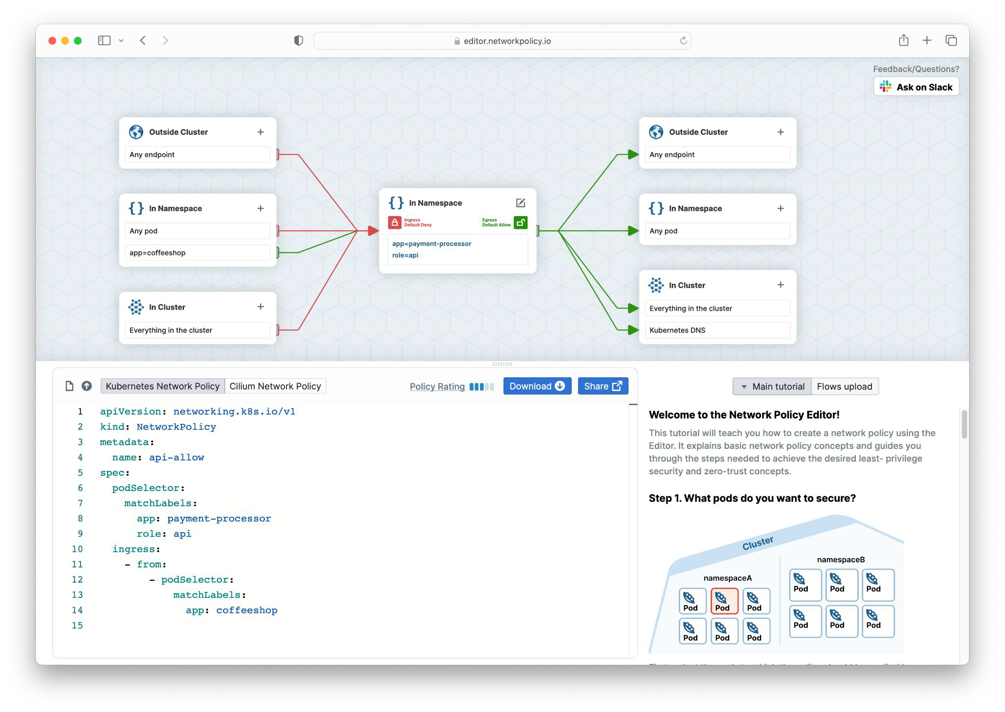
NETWORK ISOLATION
Visualising Network Policy Rules
Certified Kubernetes Administrator (CKA) · TGS-2025054612
© 2026 Tertiary Infotech Academy Pte Ltd
182

Slide 193
SERVICE DISCOVERY
CoreDNS — In-Cluster DNS
• Every pod's /etc/resolv.conf points to the kube-dns ClusterIP with a search list.
• FQDN format: <service>.<namespace>.svc.cluster.local — within the same namespace the short name resolves.
• Headless Service (clusterIP: None): DNS returns individual pod A records instead of a single virtual IP.
• Corefile ConfigMap controls CoreDNS behaviour — add stub zones, upstream forwarders or rewrite rules.
Certified Kubernetes Administrator (CKA) · TGS-2025054612
© 2026 Tertiary Infotech Academy Pte Ltd
183

Slide 194
DOMAIN 3 · SERVICE DISCOVERY
CoreDNS — In-Cluster DNS Resolution
DNS query
A / AAAA record
Pod
/etc/resolv.conf
nameserver: kube-dns IP
search: default.svc.cluster.local
CoreDNS
kube-dns Service
Corefile ConfigMap
kubernetes forward ready
Answer
short name → ClusterIP
full FQDN always works
headless → pod A records
Within ns: svc · cross-ns: svc.ns · full: svc.ns.svc.cluster.local
Headless Service (clusterIP: None) returns individual Pod A records instead of a single virtual IP.
Certified Kubernetes Administrator (CKA) · TGS-2025054612
© 2026 Tertiary Infotech Academy Pte Ltd
184

Slide 195
DAY 3 · NETWORK POLICY
NetworkPolicy: Default-Deny, Pod Selector, Namespace Selector, Egress Lockdown
LAB 21
Network Policies
Implement Pod-level firewall rules using NetworkPolicies. Kubernetes uses allow-lists: once any NetworkPolicy selects a pod, all traffic not explicitly allowed is blocked. CKA 2026 tests default-deny, pod/namespace selectors, and egress lockdown.
You'll build
Create server and client pods, apply default-deny-ingress policy, verify blocking, add allow rule for specific pod selector, test egress lockdown.
Key commands: kubectl create · cat <<'EOF' · » Empty
Certified Kubernetes Administrator (CKA) · TGS-2025054612
© 2026 Tertiary Infotech Academy Pte Ltd
185

Slide 196
LAB 21 · COMMANDS
NetworkPolicy: Default-Deny, Pod Selector, Namespace Selector, Egress Lockdown
Step 1 -- Create test workloads
kubectl create ns netpol
kubectl -n netpol run server --image=nginx --labels='app=server'
kubectl -n netpol run client-ok --image=nicolaka/netshoot \
--labels='role=allowed' --command -- sleep 3600
kubectl -n netpol run client-bad --image=nicolaka/netshoot \
--labels='role=denied' --command -- sleep 3600
kubectl -n netpol expose pod server --port=80
Certified Kubernetes Administrator (CKA) · TGS-2025054612
© 2026 Tertiary Infotech Academy Pte Ltd
186

Slide 197
LAB 21 · COMMANDS
NetworkPolicy: Default-Deny, Pod Selector, Namespace Selector, Egress Lockdown (cont.)
Step 2 -- Apply default-deny-ingress
cat <<'EOF' | kubectl apply -f -
apiVersion: networking.k8s.io/v1
kind: NetworkPolicy
metadata:
name: default-deny-ingress
namespace: netpol
spec:
podSelector: {}
policyTypes: ['Ingress']
EOF
kubectl -n netpol exec client-ok -- curl -m 3 http://server || echo BLOCKED
Certified Kubernetes Administrator (CKA) · TGS-2025054612
© 2026 Tertiary Infotech Academy Pte Ltd
187

Slide 198
LAB 21 · COMMANDS
NetworkPolicy: Default-Deny, Pod Selector, Namespace Selector, Egress Lockdown (cont.)
Step 3 -- Allow specific pod selector
cat <<'EOF' | kubectl apply -f -
apiVersion: networking.k8s.io/v1
kind: NetworkPolicy
metadata:
name: allow-from-allowed
namespace: netpol
spec:
podSelector:
matchLabels:
app: server
policyTypes: ['Ingress']
ingress:
- from:
- podSelector:
matchLabels:
role: allowed
EOF
kubectl -n netpol exec client-ok -- curl -s http://server
# OK
kubectl -n netpol exec client-bad -- curl -m 3 http://server || echo BLOCKED
Certified Kubernetes Administrator (CKA) · TGS-2025054612
© 2026 Tertiary Infotech Academy Pte Ltd
188

Slide 199
LAB 21 · COMMANDS
NetworkPolicy: Default-Deny, Pod Selector, Namespace Selector, Egress Lockdown (cont.)
Note Empty podSelector {} selects ALL pods in the namespace. NetworkPolicy requires a CNI that enforces it (Calico, Cilium -- NOT Flannel alone).
Certified Kubernetes Administrator (CKA) · TGS-2025054612
© 2026 Tertiary Infotech Academy Pte Ltd
189

Slide 200
LAB 21 · TEST IT
NetworkPolicy: Default-Deny, Pod Selector, Namespace Selector, Egress Lockdown
✅ Test it
default-deny blocks both clients. After allow policy, client-ok reaches server; client-bad (role=denied) is still blocked.
Killercoda: https://killercoda.com/playgrounds/scenario/kubernetes
Certified Kubernetes Administrator (CKA) · TGS-2025054612
© 2026 Tertiary Infotech Academy Pte Ltd
190

Slide 201
DAY 3 · COREDNS
CoreDNS: Corefile Inspection, Service DNS, Headless Services, Stub Zones
LAB 22
CoreDNS
Inspect CoreDNS configuration, query Service and Pod DNS records, understand headless service resolution (A records per pod), and customize CoreDNS with stub zones. CKA tests configuring CoreDNS via ConfigMap and diagnosing DNS failures.
You'll build
Inspect kube-dns service and coredns ConfigMap, test DNS from netshoot pod, create headless service, verify per-pod A records, add stub zone to Corefile.
Key commands: kubectl -n · kubectl run · kubectl expose · » Service
Certified Kubernetes Administrator (CKA) · TGS-2025054612
© 2026 Tertiary Infotech Academy Pte Ltd
191

Slide 202
LAB 22 · COMMANDS
CoreDNS: Corefile Inspection, Service DNS, Headless Services, Stub Zones
Step 1 -- Inspect CoreDNS
kubectl -n kube-system get svc kube-dns
kubectl -n kube-system get pods -l k8s-app=kube-dns
kubectl -n kube-system get configmap coredns -o yaml
Step 2 -- Query DNS from debug pod
kubectl run dnsdebug --image=nicolaka/netshoot --command -- sleep 3600
kubectl exec dnsdebug -- cat /etc/resolv.conf
kubectl exec dnsdebug -- nslookup kubernetes.default.svc.cluster.local
kubectl exec dnsdebug -- dig +short webapp.default.svc.cluster.local
Step 3 -- Headless service: per-pod A records
kubectl expose deployment webapp --port=80 --name=webapp-headless --cluster-ip=None
kubectl exec dnsdebug -- dig +short webapp-headless.default.svc.cluster.local
# Returns one IP per pod -- used by StatefulSets for stable identity
Certified Kubernetes Administrator (CKA) · TGS-2025054612
© 2026 Tertiary Infotech Academy Pte Ltd
192

Slide 203
LAB 22 · COMMANDS
CoreDNS: Corefile Inspection, Service DNS, Headless Services, Stub Zones (cont.)
Step 4 -- Add stub zone to Corefile
kubectl -n kube-system edit configmap coredns
# Add inside Corefile:
# example.internal:53 {
# forward . 10.10.0.1
# }
Note Service name is 'kube-dns' (legacy) even though pods run CoreDNS. Headless services have clusterIP: None. Stub zones forward specific domains to external DNS.
Certified Kubernetes Administrator (CKA) · TGS-2025054612
© 2026 Tertiary Infotech Academy Pte Ltd
193

Slide 204
LAB 22 · TEST IT
CoreDNS: Corefile Inspection, Service DNS, Headless Services, Stub Zones
✅ Test it
nslookup kubernetes.default resolves to 10.96.0.1. Headless service dig returns one IP per pod. CoreDNS ConfigMap has the Corefile visible.
Killercoda: https://killercoda.com/playgrounds/scenario/kubernetes
Certified Kubernetes Administrator (CKA) · TGS-2025054612
© 2026 Tertiary Infotech Academy Pte Ltd
194

Slide 205
TOPIC 3
Persistent Storage
PV, PVC, StorageClass and dynamic provisioning
Certified Kubernetes Administrator (CKA) · TGS-2025054612
© 2026 Tertiary Infotech Academy Pte Ltd
195

Slide 206
STORAGE LIFECYCLE
PersistentVolumes and Claims
• A PersistentVolume (PV) is a cluster-level storage resource with capacity, accessModes and reclaimPolicy.
• A PersistentVolumeClaim (PVC) is a namespaced request that binds to a matching PV.
• Access modes: ReadWriteOnce (node), ReadOnlyMany (many nodes), ReadWriteMany (many nodes).
• reclaimPolicy Retain keeps data after PVC deletion; Delete removes the underlying volume.
Certified Kubernetes Administrator (CKA) · TGS-2025054612
© 2026 Tertiary Infotech Academy Pte Ltd
196

Slide 207
DOMAIN 4 · PERSISTENT STORAGE
PV, PVC, and Pod
bound
mounted in
PersistentVolume
capacity, accessModes
reclaimPolicy, storageClass
hostPath / NFS / CSI
PersistentVolumeClaim
requests storage size
accessModes match
binds to best PV
Pod
volumes: [{pvc: claim}]
volumeMounts: [{mountPath}]
Dynamic: PVC → StorageClass → CSI provisioner creates PV on demand. Retain keeps data; Delete removes it.
Certified Kubernetes Administrator (CKA) · TGS-2025054612
© 2026 Tertiary Infotech Academy Pte Ltd
197

Slide 208
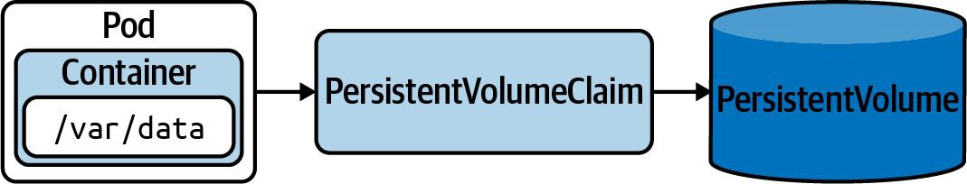
STORAGE LIFECYCLE
Persistent Volume — Lifecycle Architecture
Certified Kubernetes Administrator (CKA) · TGS-2025054612
© 2026 Tertiary Infotech Academy Pte Ltd
198

Slide 209
DYNAMIC STORAGE
StorageClass & Dynamic Provisioning
• A StorageClass references a CSI provisioner that creates PVs on demand when a PVC is submitted.
• The default StorageClass is annotated storageclass.kubernetes.io/is-default-class: 'true'.
• PVC without storageClassName uses the default class automatically.
• StatefulSet volumeClaimTemplates give each replica its own PVC — they are not auto-deleted on scale-down.
Certified Kubernetes Administrator (CKA) · TGS-2025054612
© 2026 Tertiary Infotech Academy Pte Ltd
199

Slide 210
DOMAIN 4 · DYNAMIC STORAGE
StorageClass — Dynamic Provisioning
references
calls
creates
PVC
storageClassName: fast
storage: 10Gi
accessModes: RWO
StorageClass
provisioner: ebs.csi.aws.com
reclaimPolicy: Delete
CSI Driver
creates volume on
cloud / NFS / hostPath
PV (auto)
bound to PVC
capacity matches request
PVC without storageClassName uses the default StorageClass. reclaimPolicy Delete removes PV on PVC deletion; Retain keeps data.
Certified Kubernetes Administrator (CKA) · TGS-2025054612
© 2026 Tertiary Infotech Academy Pte Ltd
200

Slide 211
DAY 3 · PV AND PVC
PersistentVolume and PVC: Static Provisioning, Access Modes, Reclaim Policies
LAB 23
PersistentVolumes and PersistentVolumeClaims
Create a PersistentVolume (static provisioning), bind it via a PVC, mount in a pod, and understand PV/PVC binding rules including access modes and reclaim policies. CKA tests static provisioning, access modes, and the fact that PVCs outlive pods.
You'll build
Create hostPath PV with ReadWriteOnce, create PVC that binds, mount in nginx pod, write data, delete pod and recreate to verify persistence.
Key commands: sudo mkdir · cat > · cat <<'EOF' · » Access
Certified Kubernetes Administrator (CKA) · TGS-2025054612
© 2026 Tertiary Infotech Academy Pte Ltd
201

Slide 212
LAB 23 · COMMANDS
PersistentVolume and PVC: Static Provisioning, Access Modes, Reclaim Policies
Step 1 -- Create a PersistentVolume
sudo mkdir -p /mnt/data && echo 'hello from host' | sudo tee /mnt/data/index.html
cat > pv.yaml <<'EOF'
apiVersion: v1
kind: PersistentVolume
metadata:
name: pv-host
spec:
capacity:
storage: 1Gi
accessModes: [ReadWriteOnce]
hostPath:
path: /mnt/data
persistentVolumeReclaimPolicy: Retain
EOF
kubectl apply -f pv.yaml && kubectl get pv
Certified Kubernetes Administrator (CKA) · TGS-2025054612
© 2026 Tertiary Infotech Academy Pte Ltd
202

Slide 213
LAB 23 · COMMANDS
PersistentVolume and PVC: Static Provisioning, Access Modes, Reclaim Policies (cont.)
Step 2 -- Create a PVC that binds to the PV
cat > pvc.yaml <<'EOF'
apiVersion: v1
kind: PersistentVolumeClaim
metadata:
name: pvc-host
spec:
accessModes: [ReadWriteOnce]
resources:
requests:
storage: 1Gi
EOF
kubectl apply -f pvc.yaml && kubectl get pvc
# STATUS: Bound
Certified Kubernetes Administrator (CKA) · TGS-2025054612
© 2026 Tertiary Infotech Academy Pte Ltd
203

Slide 214
LAB 23 · COMMANDS
PersistentVolume and PVC: Static Provisioning, Access Modes, Reclaim Policies (cont.)
Step 3 -- Mount PVC in a pod
cat <<'EOF' | kubectl apply -f -
apiVersion: v1
kind: Pod
metadata:
name: pvc-pod
spec:
containers:
- name: nginx
image: nginx
volumeMounts:
- name: data
mountPath: /usr/share/nginx/html
volumes:
- name: data
persistentVolumeClaim:
claimName: pvc-host
EOF
kubectl exec pvc-pod -- cat /usr/share/nginx/html/index.html
Certified Kubernetes Administrator (CKA) · TGS-2025054612
© 2026 Tertiary Infotech Academy Pte Ltd
204

Slide 215
LAB 23 · COMMANDS
PersistentVolume and PVC: Static Provisioning, Access Modes, Reclaim Policies (cont.)
Note Access modes: ReadWriteOnce (one node RW), ReadOnlyMany (many nodes R), ReadWriteMany (many nodes RW). Reclaim: Retain (manual cleanup), Delete (removes storage), Recycle (deprecated).
Certified Kubernetes Administrator (CKA) · TGS-2025054612
© 2026 Tertiary Infotech Academy Pte Ltd
205

Slide 216
LAB 23 · TEST IT
PersistentVolume and PVC: Static Provisioning, Access Modes, Reclaim Policies
✅ Test it
PVC shows STATUS=Bound. Pod reads 'hello from host' from the mounted volume. After pod deletion and recreation, data persists (Retain policy).
Killercoda: https://killercoda.com/playgrounds/scenario/kubernetes
Certified Kubernetes Administrator (CKA) · TGS-2025054612
© 2026 Tertiary Infotech Academy Pte Ltd
206

Slide 217
Lunch Break
1 hour

Slide 218
DAY 3 · STORAGECLASS
StorageClass: Dynamic Provisioning, Default Class, StatefulSet volumeClaimTemplates
LAB 24
StorageClass and dynamic provisioning
Use StorageClasses for dynamic PV creation, mark a class as default, and create a StatefulSet with volumeClaimTemplates that provisions one PVC per pod. CKA tests creating StorageClasses and dynamic provisioning.
You'll build
Install local-path-provisioner, mark StorageClass as default, create dynamically-provisioned PVC, create StatefulSet with volumeClaimTemplates.
Key commands: kubectl apply · kubectl patch · cat <<'EOF' · » StatefulSet
Certified Kubernetes Administrator (CKA) · TGS-2025054612
© 2026 Tertiary Infotech Academy Pte Ltd
207

Slide 219
LAB 24 · COMMANDS
StorageClass: Dynamic Provisioning, Default Class, StatefulSet volumeClaimTemplates
Step 1 -- Install local-path-provisioner
kubectl apply -f https://raw.githubusercontent.com/rancher/local-path-provisioner/master/deploy/local-path-storage.yaml
kubectl -n local-path-storage rollout status deploy/local-path-provisioner
kubectl get storageclass
Step 2 -- Mark StorageClass as default
kubectl patch storageclass local-path \
-p '{"metadata":{"annotations":{"storageclass.kubernetes.io/is-default-class":"true"}}}'
Certified Kubernetes Administrator (CKA) · TGS-2025054612
© 2026 Tertiary Infotech Academy Pte Ltd
208

Slide 220
LAB 24 · COMMANDS
StorageClass: Dynamic Provisioning, Default Class, StatefulSet volumeClaimTemplates (cont.)
Step 3 -- Dynamic PVC provisioning
cat <<'EOF' | kubectl apply -f -
apiVersion: v1
kind: PersistentVolumeClaim
metadata:
name: dynamic-pvc
spec:
accessModes: [ReadWriteOnce]
storageClassName: local-path
resources:
requests:
storage: 512Mi
EOF
kubectl get pvc dynamic-pvc && kubectl get pv
Certified Kubernetes Administrator (CKA) · TGS-2025054612
© 2026 Tertiary Infotech Academy Pte Ltd
209

Slide 221
LAB 24 · COMMANDS
StorageClass: Dynamic Provisioning, Default Class, StatefulSet volumeClaimTemplates (cont.)
Step 4 -- StatefulSet with volumeClaimTemplates
cat <<'EOF' | kubectl apply -f -
apiVersion: apps/v1
kind: StatefulSet
metadata:
name: db
spec:
serviceName: db
replicas: 3
selector:
matchLabels:
app: db
template:
metadata:
labels:
app: db
spec:
containers:
- name: postgres
image: postgres:16-alpine
env:
- name: POSTGRES_PASSWORD
value: example
volumeMounts:
- name: data
mountPath: /var/lib/postgresql/data
volumeClaimTemplates:
- metadata:
name: data
spec:
accessModes: [ReadWriteOnce]
resources:
requests:
storage: 1Gi
EOF
kubectl get pods -l app=db && kubectl get pvc -l app=db
Certified Kubernetes Administrator (CKA) · TGS-2025054612
© 2026 Tertiary Infotech Academy Pte Ltd
210

Slide 222
LAB 24 · COMMANDS
StorageClass: Dynamic Provisioning, Default Class, StatefulSet volumeClaimTemplates (cont.)
Note StatefulSet volumeClaimTemplates create one PVC per pod: data-db-0, data-db-1, data-db-2. PVCs are NOT deleted when the StatefulSet is deleted -- manual cleanup required.
Certified Kubernetes Administrator (CKA) · TGS-2025054612
© 2026 Tertiary Infotech Academy Pte Ltd
211

Slide 223
LAB 24 · TEST IT
StorageClass: Dynamic Provisioning, Default Class, StatefulSet volumeClaimTemplates
✅ Test it
dynamic-pvc is Bound. StatefulSet db has 3 pods each with their own PVC (data-db-0, etc).
Killercoda: https://killercoda.com/playgrounds/scenario/kubernetes
Certified Kubernetes Administrator (CKA) · TGS-2025054612
© 2026 Tertiary Infotech Academy Pte Ltd
212

Slide 224
DAY 3 · VOLUME TYPES
Volume Types: emptyDir, hostPath, projected, downwardAPI
LAB 25
Pod volume types
Explore pod-level volume types: emptyDir for shared scratch space, hostPath for node filesystem access, projected for combining multiple sources into one mount, and downwardAPI for exposing pod metadata to the application.
You'll build
Create pod with emptyDir shared between two containers, projected volume combining ConfigMap + Secret, downwardAPI volume exposing pod name/namespace/resource requests.
Key commands: cat <<'EOF' · kubectl exec · » emptyDir
Certified Kubernetes Administrator (CKA) · TGS-2025054612
© 2026 Tertiary Infotech Academy Pte Ltd
213

Slide 225
LAB 25 · COMMANDS
Volume Types: emptyDir, hostPath, projected, downwardAPI
Step 1 -- emptyDir: shared scratch space
cat <<'EOF' | kubectl apply -f -
apiVersion: v1
kind: Pod
metadata:
name: scratch
spec:
containers:
- name: writer
image: busybox
command: ['sh', '-c', 'echo hello-shared > /data/file; sleep 3600']
volumeMounts:
- name: tmp
mountPath: /data
- name: reader
image: busybox
command: ['sh', '-c', 'sleep 3600']
volumeMounts:
- name: tmp
mountPath: /data
volumes:
- name: tmp
emptyDir: {}
EOF
kubectl exec scratch -c reader -- cat /data/file
Certified Kubernetes Administrator (CKA) · TGS-2025054612
© 2026 Tertiary Infotech Academy Pte Ltd
214

Slide 226
LAB 25 · COMMANDS
Volume Types: emptyDir, hostPath, projected, downwardAPI (cont.)
Step 2 -- projected volume (ConfigMap + Secret)
# volumes:
# - name: combined
# projected:
# sources:
# - configMap:
# name: app-config
# - secret:
# name: app-secret
Certified Kubernetes Administrator (CKA) · TGS-2025054612
© 2026 Tertiary Infotech Academy Pte Ltd
215

Slide 227
LAB 25 · COMMANDS
Volume Types: emptyDir, hostPath, projected, downwardAPI (cont.)
Step 3 -- downwardAPI: pod metadata as files
# volumes:
# - name: podinfo
# downwardAPI:
# items:
# - path: 'pod-name'
# fieldRef:
# fieldPath: metadata.name
# - path: 'cpu-request'
# resourceFieldRef:
# resource: requests.cpu
kubectl exec downward-pod -- cat /podinfo/pod-name
Note emptyDir is deleted when the pod is deleted. hostPath ties the pod to a specific node. projected combines ConfigMap, Secret, serviceAccountToken, and downwardAPI into one mount.
Certified Kubernetes Administrator (CKA) · TGS-2025054612
© 2026 Tertiary Infotech Academy Pte Ltd
216

Slide 228
LAB 25 · TEST IT
Volume Types: emptyDir, hostPath, projected, downwardAPI
✅ Test it
reader container reads file written by writer via emptyDir. downwardAPI pod shows correct pod name from /podinfo/pod-name.
Killercoda: https://killercoda.com/playgrounds/scenario/kubernetes
Certified Kubernetes Administrator (CKA) · TGS-2025054612
© 2026 Tertiary Infotech Academy Pte Ltd
217

Slide 229
Tea Break
15 minutes

Slide 230
TOPIC 4
Troubleshooting Cluster Components
etcd, API server, scheduler and controller-manager
Certified Kubernetes Administrator (CKA) · TGS-2025054612
© 2026 Tertiary Infotech Academy Pte Ltd
218

Slide 231
CLUSTER COMPONENTS
Cluster Component Failures
• Static pod manifests live in /etc/kubernetes/manifests/ — kubelet watches this directory and auto-restarts them.
• API server down? kubectl will fail — switch to crictl ps -a / crictl logs and journalctl -u kubelet.
• etcdctl endpoint health verifies etcd before assuming the API server itself is broken.
• Fix a broken manifest, save it, and the kubelet restarts the static pod automatically within ~30 seconds.
Certified Kubernetes Administrator (CKA) · TGS-2025054612
© 2026 Tertiary Infotech Academy Pte Ltd
219

Slide 232
DOMAIN 5 · 7-STEP DEBUG CHAIN
Cluster Troubleshooting Triage
1. kubectl get/describe
Read Events — usually tells you the cause directly
2. kubectl logs (--previous)
Read container output; --previous for a crashed pod
3. systemctl / journalctl
On the node: status kubelet containerd; journalctl -u kubelet
4. crictl ps / logs
Use when kubectl is unavailable (API server down)
5. etcdctl endpoint health
Verify etcd is healthy before assuming API server bugs
6. kubectl get events -A
Cluster-wide event stream — sorted by lastTimestamp
7. kubectl auth can-i
Confirm RBAC allows the operation before blaming the app
Certified Kubernetes Administrator (CKA) · TGS-2025054612
© 2026 Tertiary Infotech Academy Pte Ltd
220

Slide 233
NODE HEALTH
Node Troubleshooting
• Five node conditions: Ready, MemoryPressure, DiskPressure, PIDPressure, NetworkUnavailable.
• kubelet stopped → node goes NotReady after ~40 s; systemctl start kubelet restores it.
• Disk pressure: df -h on the node — kubelet evicts pods when thresholds are hit; free space to recover.
• cordon = SchedulingDisabled (no new pods); drain = evict existing pods; uncordon restores scheduling.
Certified Kubernetes Administrator (CKA) · TGS-2025054612
© 2026 Tertiary Infotech Academy Pte Ltd
221

Slide 234
DAY 3 · CLUSTER COMPONENTS
Troubleshoot Cluster Components: API Server, Controller Manager, Scheduler, etcd
LAB 26
Control plane troubleshooting
Diagnose and fix broken control plane components. When kubectl is unresponsive, use crictl and journalctl instead. Troubleshooting is the highest-weighted CKA domain at 30%.
You'll build
Locate static pod manifests, introduce a break in kube-apiserver.yaml (wrong flag), diagnose with crictl and journalctl, fix manifest and verify recovery.
Key commands: ls /etc/kubernetes/manifests/ · crictl pods · sudo vi · kubectl get · » Static
Certified Kubernetes Administrator (CKA) · TGS-2025054612
© 2026 Tertiary Infotech Academy Pte Ltd
222

Slide 235
LAB 26 · COMMANDS
Troubleshoot Cluster Components: API Server, Controller Manager, Scheduler, etcd
Step 1 -- Know where control plane components live
ls /etc/kubernetes/manifests/
sudo systemctl status kubelet --no-pager | head -5
sudo systemctl status containerd --no-pager | head -5
Step 2 -- Diagnose API server failure
# If kubectl is unresponsive:
crictl pods
crictl ps -a
crictl logs $(crictl ps -a --name kube-apiserver -q)
journalctl -u kubelet --no-pager -n 50 | grep -i error
sudo cat /etc/kubernetes/manifests/kube-apiserver.yaml | head -50
Certified Kubernetes Administrator (CKA) · TGS-2025054612
© 2026 Tertiary Infotech Academy Pte Ltd
223

Slide 236
LAB 26 · COMMANDS
Troubleshoot Cluster Components: API Server, Controller Manager, Scheduler, etcd (cont.)
Step 3 -- Fix static pod manifest
# Wrong flag/image in manifest causes API server to not start
sudo vi /etc/kubernetes/manifests/kube-apiserver.yaml
# Kubelet detects change within 20 seconds
crictl ps | grep apiserver
kubectl get nodes
# Should work once apiserver recovers
Step 4 -- Diagnose controller manager and scheduler
kubectl get pods -n kube-system | grep -E 'controller|scheduler'
kubectl logs -n kube-system kube-controller-manager-controlplane | tail -20
kubectl logs -n kube-system kube-scheduler-controlplane | tail -20
Note Static pod manifests: changes cause automatic pod restart by kubelet -- no restart needed. Use crictl when API server is down: crictl pods, crictl logs, crictl ps -a.
Certified Kubernetes Administrator (CKA) · TGS-2025054612
© 2026 Tertiary Infotech Academy Pte Ltd
224

Slide 237
LAB 26 · TEST IT
Troubleshoot Cluster Components: API Server, Controller Manager, Scheduler, etcd
✅ Test it
Broken API server manifest is fixed; kubectl get nodes works again. journalctl shows the specific error. All kube-system pods are Running.
Killercoda: https://killercoda.com/playgrounds/scenario/kubeadm
Certified Kubernetes Administrator (CKA) · TGS-2025054612
© 2026 Tertiary Infotech Academy Pte Ltd
225

Slide 238
DAY 3 · NODE TROUBLESHOOTING
Troubleshoot Nodes: NotReady, kubelet Failure, cgroup Driver Mismatch, Drain
LAB 27
Node troubleshooting
Diagnose a node transition to NotReady by identifying common causes: kubelet service failure, cgroup driver mismatch between kubelet and containerd, and containerd failure. Practice safely draining a node for maintenance.
You'll build
Stop kubelet, observe NotReady, restart. Introduce cgroup mismatch, diagnose with journalctl, fix config.toml, drain and uncordon node.
Key commands: kubectl get · sudo systemctl · journalctl -u · kubectl drain · » After
Certified Kubernetes Administrator (CKA) · TGS-2025054612
© 2026 Tertiary Infotech Academy Pte Ltd
226

Slide 239
LAB 27 · COMMANDS
Troubleshoot Nodes: NotReady, kubelet Failure, cgroup Driver Mismatch, Drain
Step 1 -- Check node status baseline
kubectl get nodes -o wide
kubectl describe node node01 | grep -A10 Conditions
Step 2 -- Scenario: kubelet service stops
# On node01:
sudo systemctl stop kubelet
# On control plane (wait 40s):
kubectl get nodes
# node01: NotReady
# Fix (on node01):
sudo systemctl start kubelet && kubectl get nodes
Certified Kubernetes Administrator (CKA) · TGS-2025054612
© 2026 Tertiary Infotech Academy Pte Ltd
227

Slide 240
LAB 27 · COMMANDS
Troubleshoot Nodes: NotReady, kubelet Failure, cgroup Driver Mismatch, Drain (cont.)
Step 3 -- Scenario: cgroup driver mismatch
journalctl -u kubelet --no-pager -n 30
# Look for: 'failed to create containerd task' or 'cgroupDriver'
grep -i cgroup /var/lib/kubelet/config.yaml
grep -i SystemdCgroup /etc/containerd/config.toml
# Fix: ensure both use cgroupDriver: systemd / SystemdCgroup = true
sudo systemctl restart kubelet containerd
Step 4 -- Drain node for maintenance
kubectl drain node01 --ignore-daemonsets --delete-emptydir-data
kubectl get nodes
# node01: Ready,SchedulingDisabled
# After maintenance:
kubectl uncordon node01
Note After 40s without kubelet heartbeat, node controller marks NotReady. After 5 minutes, pods are evicted to healthy nodes. Drain before any maintenance.
Certified Kubernetes Administrator (CKA) · TGS-2025054612
© 2026 Tertiary Infotech Academy Pte Ltd
228

Slide 241
LAB 27 · TEST IT
Troubleshoot Nodes: NotReady, kubelet Failure, cgroup Driver Mismatch, Drain
✅ Test it
Stopped kubelet causes NotReady; starting it restores Ready within 1 minute. Drain evicts pods and cordons node; uncordon re-enables scheduling.
Killercoda: https://killercoda.com/playgrounds/scenario/kubeadm
Certified Kubernetes Administrator (CKA) · TGS-2025054612
© 2026 Tertiary Infotech Academy Pte Ltd
229

Slide 242
TOPIC 5
Application & Log Troubleshooting
Pods, logs and container debugging
Certified Kubernetes Administrator (CKA) · TGS-2025054612
© 2026 Tertiary Infotech Academy Pte Ltd
230

Slide 243
POD DEBUGGING
Pod Failure States
• ImagePullBackOff: wrong image name, tag or missing imagePullSecret — check Events in kubectl describe pod.
• CrashLoopBackOff: container exits non-zero repeatedly — read kubectl logs <pod> --previous.
• OOMKilled: container exceeded its memory limit — raise resources.limits.memory.
• kubectl get events --sort-by=.lastTimestamp -A gives a cluster-wide timeline — start here for unknown failures.
Certified Kubernetes Administrator (CKA) · TGS-2025054612
© 2026 Tertiary Infotech Academy Pte Ltd
231

Slide 244
DOMAIN 5 · POD DEBUGGING
Pod Failure States
ImagePullBackOff
wrong image name, tag or missing imagePullSecret
kubectl describe pod → Events → 'Failed to pull image'. Fix image ref and recreate.
CrashLoopBackOff
container exits non-zero repeatedly
kubectl logs <pod> --previous → read the crash output. Fix command / config / entrypoint.
OOMKilled
container exceeded memory limit
kubectl describe pod → Reason: OOMKilled → raise resources.limits.memory.
Fast triage: kubectl get events --sort-by=.lastTimestamp -A · kubectl debug (ephemeral container for distroless)
Certified Kubernetes Administrator (CKA) · TGS-2025054612
© 2026 Tertiary Infotech Academy Pte Ltd
232

Slide 245
DAY 3 · LOGS AND DEBUGGING
Application Logs: kubectl logs, --previous, Multi-Container, Raw Log Files on Disk
LAB 28
Application logs
Read logs from running containers, crashed containers (--previous), specific containers in multi-container pods, and raw log files on disk at /var/log/pods/. Log retrieval is the first step in every CKA application troubleshooting question.
You'll build
Run noisy pod, use kubectl logs with --tail --timestamps --follow. Create crashloop pod and read with --previous. Locate raw log file on disk.
Key commands: kubectl run · kubectl logs · ls /var/log/pods/ · » --previous
Certified Kubernetes Administrator (CKA) · TGS-2025054612
© 2026 Tertiary Infotech Academy Pte Ltd
233

Slide 246
LAB 28 · COMMANDS
Application Logs: kubectl logs, --previous, Multi-Container, Raw Log Files on Disk
Step 1 -- Basic log commands
kubectl run noisy --image=busybox --restart=Never -- \
sh -c 'i=0; while true; do echo "line $i"; i=$((i+1)); sleep 1; done'
kubectl logs noisy --tail=5
kubectl logs noisy --tail=10 --timestamps=true
Step 2 -- Crashed container logs with --previous
kubectl run crasher --image=busybox --restart=Always -- \
sh -c 'echo starting; sleep 2; echo crashing; exit 1'
kubectl get pod crasher -w
# Watch CrashLoopBackOff
kubectl logs crasher --previous
Step 3 -- Multi-container pod logs
kubectl logs multi-pod -c c1
kubectl logs multi-pod -c c2
kubectl logs multi-pod --all-containers
Certified Kubernetes Administrator (CKA) · TGS-2025054612
© 2026 Tertiary Infotech Academy Pte Ltd
234

Slide 247
LAB 28 · COMMANDS
Application Logs: kubectl logs, --previous, Multi-Container, Raw Log Files on Disk (cont.)
Step 4 -- Raw log files on disk
ls /var/log/pods/
find /var/log/pods/ -name '*.log' | head -5
tail -20 /var/log/pods/default_noisy_*/noisy/0.log
Note --previous reads the last terminated container instance -- essential for CrashLoopBackOff. Raw log files at /var/log/pods/ persist even if the pod is deleted.
Certified Kubernetes Administrator (CKA) · TGS-2025054612
© 2026 Tertiary Infotech Academy Pte Ltd
235

Slide 248
LAB 28 · TEST IT
Application Logs: kubectl logs, --previous, Multi-Container, Raw Log Files on Disk
✅ Test it
kubectl logs noisy shows incrementing lines. kubectl logs crasher --previous shows crash message. Raw log file found under /var/log/pods/default_noisy_*/.
Killercoda: https://killercoda.com/playgrounds/scenario/kubernetes
Certified Kubernetes Administrator (CKA) · TGS-2025054612
© 2026 Tertiary Infotech Academy Pte Ltd
236

Slide 249
WRAP-UP
Day 3 done — networking, storage and component troubleshooting.
Tomorrow morning: monitoring, service triage, RBAC/scheduling failures. Then mock exam and assessment.
Certified Kubernetes Administrator (CKA) · TGS-2025054612
© 2026 Tertiary Infotech Academy Pte Ltd
237

Slide 250
COURSE SLIDES
Certified Kubernetes Administrator (CKA)
WSQ Course Code: TGS-2025054612
Conducted by Tertiary Infotech Academy Pte Ltd · UEN 201200696W
© 2026 Tertiary Infotech Academy Pte Ltd. All rights reserved. · www.tertiarycourses.com.sg

Slide 251
04
DAY 4 (½ day)
Monitoring, Service Networking & Troubleshooting
Domain 5 final — Labs 29–31 · Then: 12PM lunch · 1PM mock exam · 3:30PM tea · 3:45PM assessment
Certified Kubernetes Administrator (CKA) · TGS-2025054612
© 2026 Tertiary Infotech Academy Pte Ltd
238

Slide 252
TRAQOM · SSG DIGITAL ATTENDANCE
Digital Attendance (Mandatory)
• It is mandatory to take the AM, PM and Assessment digital attendance for WSQ-funded courses.
• The trainer displays the digital attendance QR code from the SSG portal.
• Scan the QR code with your phone camera and submit your attendance.
• A minimum of 75% attendance is required for assessment and funding.
Minimum 75%
attendance required
Certified Kubernetes Administrator (CKA) · TGS-2025054612
© 2026 Tertiary Infotech Academy Pte Ltd
239

Slide 253
DAY 4 OBJECTIVES
Recap & Today
• Three days of training done — Cluster Architecture, Workloads, Networking, Storage and Troubleshooting.
• This morning — Domain 5 final: monitoring cluster usage, service networking triage, RBAC & scheduling failures.
• Labs 29–31 complete the 31-lab CKA curriculum.
• From 1:00 PM — mock-exam practice on Killercoda; final written assessment from 3:45 PM.
Certified Kubernetes Administrator (CKA) · TGS-2025054612
© 2026 Tertiary Infotech Academy Pte Ltd
240

Slide 254
TOPIC 1
Monitoring Cluster Usage
metrics-server, kubectl top and cluster events
Certified Kubernetes Administrator (CKA) · TGS-2025054612
© 2026 Tertiary Infotech Academy Pte Ltd
241

Slide 255
OBSERVABILITY
Cluster Metrics
• metrics-server scrapes each kubelet's cAdvisor and exposes the aggregated Metrics API (metrics.k8s.io).
• kubectl top nodes and kubectl top pods show live CPU and memory; --sort-by=cpu/memory ranks results.
• kubectl get events --sort-by=.lastTimestamp -A provides a ~1-hour cluster-wide event timeline.
• kubectl describe node shows capacity vs allocatable vs requested — essential for scheduling failures.
Certified Kubernetes Administrator (CKA) · TGS-2025054612
© 2026 Tertiary Infotech Academy Pte Ltd
242

Slide 256
DOMAIN 5 · OBSERVABILITY
Monitoring — Metrics, Events & Node Health
kubectl top nodes/pods
metrics-server → Metrics API (metrics.k8s.io)
Live CPU & memory usage. --sort-by=cpu/memory ranks results. Needs metrics-server running.
kubectl describe node
capacity vs allocatable vs requests + Taints + Conditions
First check for scheduling failures — shows resource headroom and all conditions.
kubectl get events -A
--sort-by=.lastTimestamp gives ~1h cluster-wide timeline
Find ImagePullErrors, OOMKills, probe failures and rescheduled pods at a glance.
kubectl describe pod
Events section — most failure causes appear directly here
Read the Events bottom section first — scheduling reason, pull errors, probe failures all here.
Start every session with kubectl get events --sort-by=.lastTimestamp -A — it tells you what happened and when, cluster-wide.
Certified Kubernetes Administrator (CKA) · TGS-2025054612
© 2026 Tertiary Infotech Academy Pte Ltd
243

Slide 257
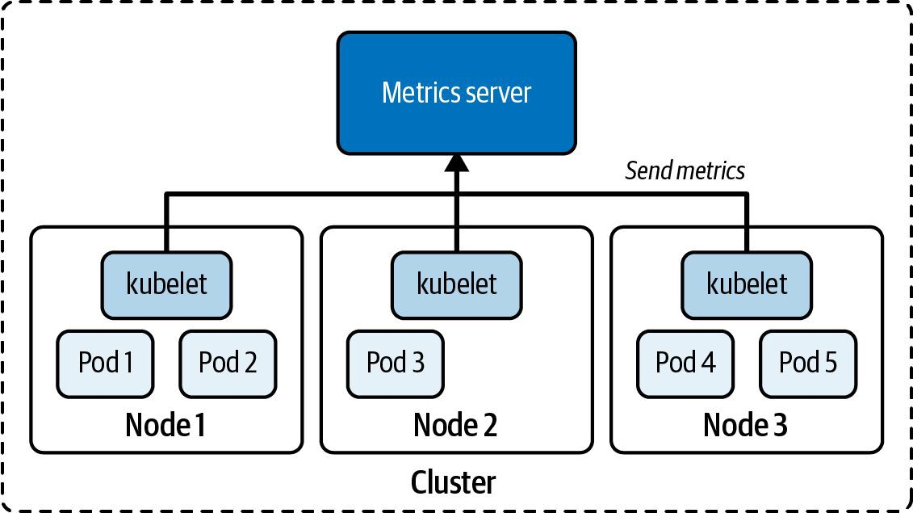
OBSERVABILITY
Metrics Server — Cluster-Wide Resource Metrics
Certified Kubernetes Administrator (CKA) · TGS-2025054612
© 2026 Tertiary Infotech Academy Pte Ltd
244

Slide 258
DAY 4 · MONITORING
Monitor Cluster and Application Usage: kubectl top, Events, Metrics Pipeline
LAB 29
Monitoring and observability
Use kubectl top to check CPU and memory usage for nodes and pods, inspect cluster events to identify recent warnings, and understand how metrics flow from cAdvisor through metrics-server to kubectl top and HPA.
You'll build
Install metrics-server, run kubectl top node and kubectl top pod (sorted by CPU/memory), inspect kubectl get events, use kubectl describe to surface warning events.
Key commands: kubectl apply · kubectl top · kubectl get · » Metrics
Certified Kubernetes Administrator (CKA) · TGS-2025054612
© 2026 Tertiary Infotech Academy Pte Ltd
245

Slide 259
LAB 29 · COMMANDS
Monitor Cluster and Application Usage: kubectl top, Events, Metrics Pipeline
Step 1 -- Install metrics-server
kubectl apply -f https://github.com/kubernetes-sigs/metrics-server/releases/latest/download/components.yaml
kubectl -n kube-system patch deploy metrics-server --type=json \
-p='[{"op":"add","path":"/spec/template/spec/containers/0/args/-","value":"--kubelet-insecure-tls"}]'
until kubectl top node 2>/dev/null; do echo 'waiting...'; sleep 5; done
Step 2 -- Resource usage
kubectl top node
kubectl top pod -A
kubectl top pod -A --sort-by=cpu | head -10
kubectl top pod -A --sort-by=memory | head -10
Step 3 -- Cluster events
kubectl get events -A --sort-by='.lastTimestamp'
kubectl get events -A --field-selector type=Warning
kubectl describe node worker01 | grep -A20 Events
Certified Kubernetes Administrator (CKA) · TGS-2025054612
© 2026 Tertiary Infotech Academy Pte Ltd
246

Slide 260
LAB 29 · COMMANDS
Monitor Cluster and Application Usage: kubectl top, Events, Metrics Pipeline (cont.)
Step 4 -- Metrics pipeline raw API
kubectl get --raw '/apis/metrics.k8s.io/v1beta1/nodes' | python3 -m json.tool | head -30
Note Metrics flow: cAdvisor (per node) -> kubelet Summary API -> metrics-server -> kubectl top + HPA. kubectl top requires metrics-server. Events are the first place to look when a pod fails to start.
Certified Kubernetes Administrator (CKA) · TGS-2025054612
© 2026 Tertiary Infotech Academy Pte Ltd
247

Slide 261
LAB 29 · TEST IT
Monitor Cluster and Application Usage: kubectl top, Events, Metrics Pipeline
✅ Test it
kubectl top node shows CPU and memory for all nodes. kubectl get events shows Warning events. Metrics API returns JSON with per-node data.
Killercoda: https://killercoda.com/playgrounds/scenario/kubernetes
Certified Kubernetes Administrator (CKA) · TGS-2025054612
© 2026 Tertiary Infotech Academy Pte Ltd
248

Slide 262
TOPIC 2
Service Networking Triage
Diagnose broken Services, DNS and kube-proxy
Certified Kubernetes Administrator (CKA) · TGS-2025054612
© 2026 Tertiary Infotech Academy Pte Ltd
249

Slide 263
SERVICE DEBUGGING
Service Connectivity Debugging
• Empty Endpoints (kubectl get endpoints <svc>) almost always means a selector/label mismatch.
• DNS failure: exec into a pod and run nslookup <service>; check CoreDNS pods are Running.
• kube-proxy programs iptables/IPVS rules — if it crashes, ClusterIP traffic stops routing.
• Bypass the Service to isolate it: curl http://<podIP>:<containerPort> from another pod.
Certified Kubernetes Administrator (CKA) · TGS-2025054612
© 2026 Tertiary Infotech Academy Pte Ltd
250

Slide 264
DOMAIN 5 · BROKEN SERVICE CHECKLIST
Service Connectivity Triage
DNS resolves?
kubectl exec probe -- nslookup <svc>
Service has endpoints?
kubectl get endpoints <svc> — non-empty?
Selector matches labels?
svc.spec.selector == pod.metadata.labels
targetPort matches?
svc.spec.ports[].targetPort == containerPort
Pod IP reachable?
curl http://<podIP>:<port> — bypasses Service
NetworkPolicy blocking?
kubectl get netpol -n <ns> — check podSelector
kube-proxy alive?
kubectl -n kube-system get pods -l k8s-app=kube-proxy
Certified Kubernetes Administrator (CKA) · TGS-2025054612
© 2026 Tertiary Infotech Academy Pte Ltd
251

Slide 265
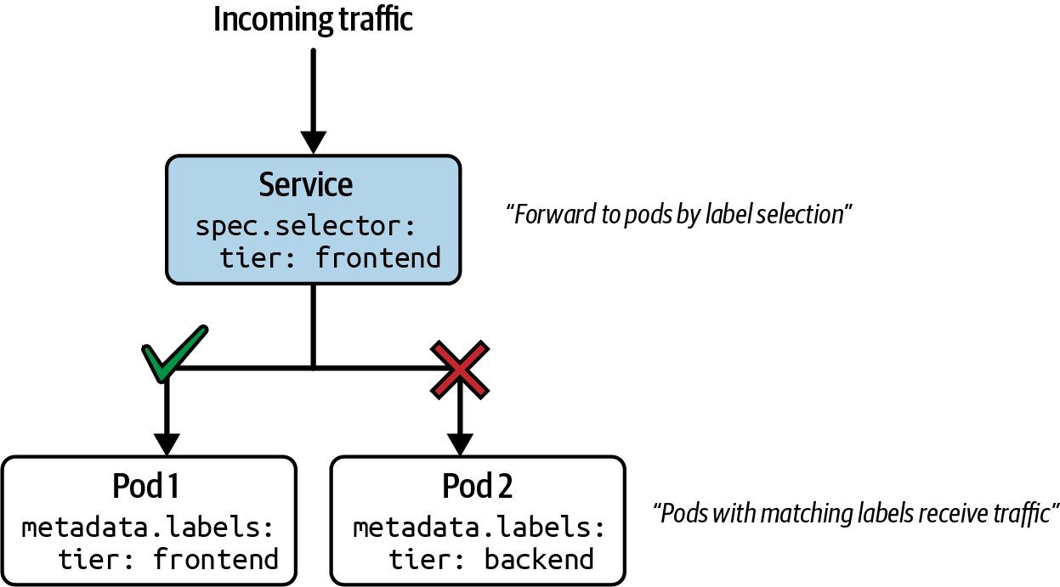
SERVICE DEBUGGING
Service Request Routing — How Traffic Reaches Pods
Certified Kubernetes Administrator (CKA) · TGS-2025054612
© 2026 Tertiary Infotech Academy Pte Ltd
252

Slide 266
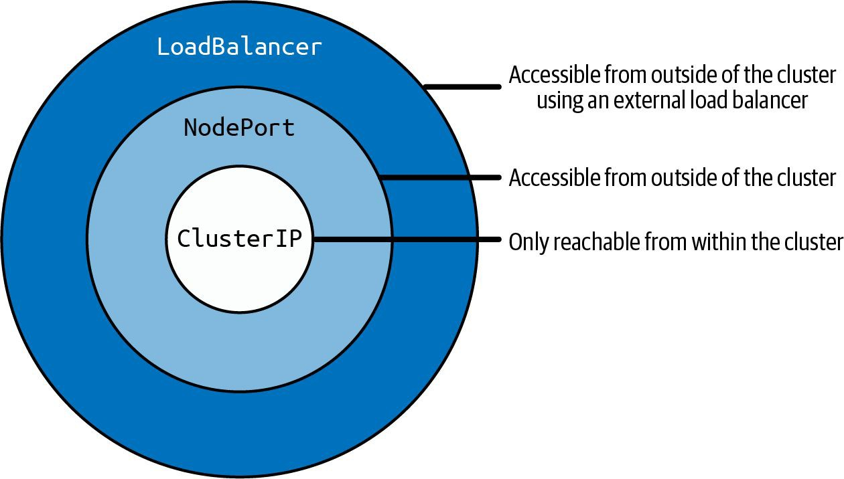
SERVICE DEBUGGING
Service Type Inheritance — ClusterIP to LoadBalancer
Certified Kubernetes Administrator (CKA) · TGS-2025054612
© 2026 Tertiary Infotech Academy Pte Ltd
253

Slide 267
DAY 4 · SERVICE NETWORKING
Troubleshoot Networking: DNS, Service Selector, Endpoints, CNI, NetworkPolicy
LAB 30
Network troubleshooting
Follow a structured 7-step triage chain for Kubernetes networking failures: DNS -> Service selector -> Endpoints -> CNI -> NetworkPolicy -> kube-proxy -> routing. CKA 2026 tests this methodical approach in multi-step troubleshooting questions.
You'll build
Deploy baseline app, break DNS by patching CoreDNS, break service selector, block traffic with NetworkPolicy, fix each layer and verify restoration.
Key commands: kubectl create · kubectl exec · kubectl get · » Always
Certified Kubernetes Administrator (CKA) · TGS-2025054612
© 2026 Tertiary Infotech Academy Pte Ltd
254

Slide 268
LAB 30 · COMMANDS
Troubleshoot Networking: DNS, Service Selector, Endpoints, CNI, NetworkPolicy
Step 1 -- Deploy baseline
kubectl create deployment app --image=nginx --replicas=2
kubectl expose deploy app --port=80 --name=app-svc
kubectl run dbg --image=nicolaka/netshoot --command -- sleep 3600
kubectl exec dbg -- curl -s http://app-svc
Step 2 -- Layer 1: DNS check
kubectl exec dbg -- nslookup app-svc.default.svc.cluster.local
kubectl -n kube-system get pods -l k8s-app=kube-dns
kubectl -n kube-system logs -l k8s-app=kube-dns | tail -20
Step 3 -- Layer 2: Service and Endpoints
kubectl get svc app-svc -o yaml | grep selector -A 5
kubectl get endpoints app-svc
kubectl get pods --show-labels
# Empty endpoints = selector mismatch -- compare and fix
Certified Kubernetes Administrator (CKA) · TGS-2025054612
© 2026 Tertiary Infotech Academy Pte Ltd
255

Slide 269
LAB 30 · COMMANDS
Troubleshoot Networking: DNS, Service Selector, Endpoints, CNI, NetworkPolicy (cont.)
Step 4 -- Layers 3-7: CNI, NetworkPolicy, kube-proxy
kubectl get pods -o wide
# Check pod IPs assigned (CNI OK)
kubectl get networkpolicy -A
# Check for blocking policies
kubectl -n kube-system get pods -l k8s-app=kube-proxy
Note Always start with DNS -- 80% of Kubernetes networking problems are DNS. If DNS works but curl fails: check Service selector vs pod labels. If endpoints exist but curl fails: check NetworkPolicy or kube-proxy.
Certified Kubernetes Administrator (CKA) · TGS-2025054612
© 2026 Tertiary Infotech Academy Pte Ltd
256

Slide 270
LAB 30 · TEST IT
Troubleshoot Networking: DNS, Service Selector, Endpoints, CNI, NetworkPolicy
✅ Test it
Baseline curl to app-svc works. Selector mismatch: endpoints empty, curl fails. After fixing selector: endpoints repopulated, curl works again.
Killercoda: https://killercoda.com/playgrounds/scenario/kubernetes
Certified Kubernetes Administrator (CKA) · TGS-2025054612
© 2026 Tertiary Infotech Academy Pte Ltd
257

Slide 271
Tea Break
15 minutes

Slide 272
TOPIC 3
RBAC & Scheduling Failures
Diagnose 403s, pending pods and node issues
Certified Kubernetes Administrator (CKA) · TGS-2025054612
© 2026 Tertiary Infotech Academy Pte Ltd
258

Slide 273
ACCESS CONTROL
RBAC Troubleshooting
• A 403 Forbidden response means the request was authenticated but not authorised.
• kubectl auth can-i <verb> <resource> --as=<identity> tests permissions without impersonating.
• Check the ServiceAccount's RoleBinding: kubectl get rolebindings,clusterrolebindings -A -o wide.
• Common mistake: Role + ClusterRoleBinding instead of Role + RoleBinding — access is then cluster-wide.
Certified Kubernetes Administrator (CKA) · TGS-2025054612
© 2026 Tertiary Infotech Academy Pte Ltd
259

Slide 274
SCHEDULING DEBUG
Scheduling Failures
• Pod stuck in Pending: kubectl describe pod → Events → 'Insufficient cpu/memory' or 'no nodes match'.
• Taint check: kubectl describe node <n> | grep Taint — pod needs a matching toleration.
• nodeSelector / nodeAffinity mismatch: compare spec.nodeSelector with actual node labels.
• Unschedulable node: kubectl get nodes — NotReady or SchedulingDisabled blocks all new pods.
Certified Kubernetes Administrator (CKA) · TGS-2025054612
© 2026 Tertiary Infotech Academy Pte Ltd
260

Slide 275
DAY 4 · RBAC & SCHEDULING
Troubleshoot RBAC (403 Forbidden) and Scheduling Failures (Pending Pod)
LAB 31
RBAC and scheduling troubleshooting
Diagnose and fix two of the most common CKA exam question types: a 403 Forbidden error caused by a missing ClusterRoleBinding, and a pod stuck in Pending due to a scheduling constraint (taint, node selector, or resource exhaustion).
You'll build
Create SA + pod that fails with Forbidden, diagnose with auth can-i, add missing binding. Create pod that is Pending, diagnose with kubectl describe, fix constraint.
Key commands: kubectl create · kubectl run · kubectl describe · » kubectl
Certified Kubernetes Administrator (CKA) · TGS-2025054612
© 2026 Tertiary Infotech Academy Pte Ltd
261

Slide 276
LAB 31 · COMMANDS
Troubleshoot RBAC (403 Forbidden) and Scheduling Failures (Pending Pod)
Part A -- RBAC: diagnose 403 Forbidden
kubectl create serviceaccount dev-sa
# Pod using dev-sa attempts to list pods:
kubectl exec sa-pod -- kubectl get pods
# Error from server (Forbidden)
kubectl auth can-i list pods --as=system:serviceaccount:default:dev-sa
# no
Part A -- Fix: create RoleBinding
kubectl create clusterrolebinding dev-sa-view \
--clusterrole=view \
--serviceaccount=default:dev-sa
kubectl auth can-i list pods --as=system:serviceaccount:default:dev-sa
# yes
kubectl exec sa-pod -- kubectl get pods
Certified Kubernetes Administrator (CKA) · TGS-2025054612
© 2026 Tertiary Infotech Academy Pte Ltd
262

Slide 277
LAB 31 · COMMANDS
Troubleshoot RBAC (403 Forbidden) and Scheduling Failures (Pending Pod) (cont.)
Part B -- Scheduling: diagnose Pending pod
kubectl run pending-pod --image=nginx
kubectl get pod pending-pod
# Pending
kubectl describe pod pending-pod | grep -A20 Events
# Look for: Insufficient cpu, node(s) had taint, MatchNodeSelector
Part B -- Fix scheduling constraints
# Taint causing failure:
kubectl describe node worker01 | grep Taints
kubectl taint node worker01 <key>-
# Remove taint
# Or add toleration to pod:
tolerations:
- key: <key>
operator: Exists
effect: NoSchedule
kubectl get pod pending-pod -o wide
# Now Running
Certified Kubernetes Administrator (CKA) · TGS-2025054612
© 2026 Tertiary Infotech Academy Pte Ltd
263

Slide 278
LAB 31 · COMMANDS
Troubleshoot RBAC (403 Forbidden) and Scheduling Failures (Pending Pod) (cont.)
Note kubectl describe pod is ALWAYS the first command for a Pending pod -- Events shows exactly why. kubectl auth can-i --as is the fastest way to test what a ServiceAccount can do.
Certified Kubernetes Administrator (CKA) · TGS-2025054612
© 2026 Tertiary Infotech Academy Pte Ltd
264

Slide 279
LAB 31 · TEST IT
Troubleshoot RBAC (403 Forbidden) and Scheduling Failures (Pending Pod)
✅ Test it
After adding ClusterRoleBinding: SA can list pods, no Forbidden error. After fixing taint/selector: pod transitions from Pending to Running.
Killercoda: https://killercoda.com/playgrounds/scenario/kubernetes
Certified Kubernetes Administrator (CKA) · TGS-2025054612
© 2026 Tertiary Infotech Academy Pte Ltd
265

Slide 280
COURSE COMPLETE
All five CKA domains complete.
Architecture · Workloads · Networking · Storage · Troubleshooting.
Certified Kubernetes Administrator (CKA) · TGS-2025054612
© 2026 Tertiary Infotech Academy Pte Ltd
266

Slide 281
Lunch Break
1 hour

Slide 282
PRACTICE EXAM
Take the Online CKA Practice Exams
•
Reinforce all five CKA domains with realistic, exam-style tasks before exam day.
T
Tertiary Exams
Practice Exams
Vendors
Get started
•
3 full practice exams · CKA-style tasks · 120-minute timer · 66% pass mark.
Certified Kubernetes Administrator (CKA)
All 3 CKA practice exams in one bundle, covering all five CKA domains.
2026 DETAILS
•
Practice mode shows answers and explanations; Exam mode mirrors the real timed test.
Exam code CKA Duration 120 min Pass score 66%
Questions
Duration
Pass score
CKA-style tasks
120 min
66%
•
Start free with the practice teaser, then sign in to unlock the full bundle.
Practice mode
Exam mode
Answers and explanations after each question.
Timed test flow that mirrors the real exam.
Sign up and practise at:
exams.tertiaryinfotech.com/practice-exams/ linuxfoundation/linuxfoundation-cka
FREE TEASER
Start free
Certified Kubernetes Administrator (CKA) · TGS-2025054612
© 2026 Tertiary Infotech Academy Pte Ltd
267

Slide 283
WARM-UP
Mock-Exam Practice (1:00 PM)
• Warm-up before the graded assessment — work through CKA-style hands-on tasks.
• Use killer.sh and Killercoda; rehearse alias k=kubectl and export do='--dry-run=client -o yaml'.
• The real CKA exam is 2 hours, 100% hands-on — time yourself on each question.
• Trainer is available for questions; the final assessment begins at 3:45 PM.
Certified Kubernetes Administrator (CKA) · TGS-2025054612
© 2026 Tertiary Infotech Academy Pte Ltd
268

Slide 284
Tea Break
15 minutes

Slide 285
ASSESSMENT
Final Assessment — from 3:45 PM
SAQ + Practical Performance on the LMS · open book · covers all five CKA domains
Certified Kubernetes Administrator (CKA) · TGS-2025054612
© 2026 Tertiary Infotech Academy Pte Ltd
269

Slide 286
FINAL ASSESSMENT
Assessment
Final Assessment
Funding & Competency
• Written Assessment (SAQ) and Practical Performance (PP) on the LMS
• Mock-exam practice from 1:00 PM; final assessment from 3:45 PM
• Covers all five CKA domains and the hands-on labs
• Open book — slides, Learner Guide & kubernetes.io
• Must be attempted for SSG funding
Minimum 75% attendance
Based on SSG digital attendance records.
Assessed as Competent
Complete both the SAQ and PP assessments.
Certified Kubernetes Administrator (CKA) · TGS-2025054612
© 2026 Tertiary Infotech Academy Pte Ltd
270

Slide 287
ASSESSMENT PROCESS
Assessment Flow
1
2
3
4
5
TRAQOM
Assessment Attendance
Sit WA then PP
Submit on LMS
Sign the Record
Scan the LMS QR code and submit attendance.
Complete the assessment digital attendance.
Complete the SAQ first, then the practical tasks.
Upload all required answers and evidence.
Sign the Assessment Summary Record.
Assessment is open book: use the course slides, Learner Guide, and approved Kubernetes documentation.
Certified Kubernetes Administrator (CKA) · TGS-2025054612
© 2026 Tertiary Infotech Academy Pte Ltd
271

Slide 288
TRAQOM · SSG DIGITAL ATTENDANCE
Digital Attendance (Mandatory)
• It is mandatory to take the AM, PM and Assessment digital attendance for WSQ-funded courses.
• The trainer displays the digital attendance QR code from the SSG portal.
• Scan the QR code with your phone camera and submit your attendance.
• A minimum of 75% attendance is required for assessment and funding.
Minimum 75%
attendance required
Certified Kubernetes Administrator (CKA) · TGS-2025054612
© 2026 Tertiary Infotech Academy Pte Ltd
272

Slide 289
THANK YOU
Thank you — and good luck with the CKA exam!
Keep practising on killer.sh and Killercoda; the CKA exam is 2 hours, 100% hands-on.
Certified Kubernetes Administrator (CKA) · TGS-2025054612
© 2026 Tertiary Infotech Academy Pte Ltd
273

