Slide 1
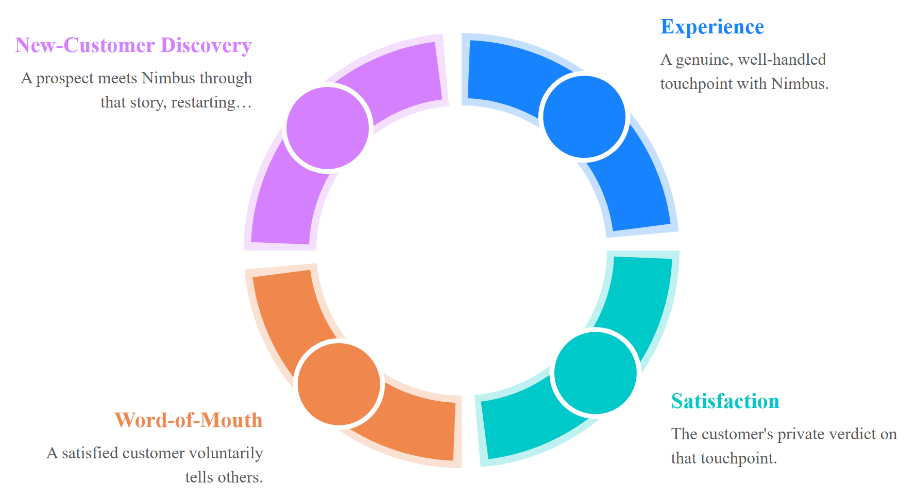
LO2 · LU2 · T2
The Advocacy Loop
Every satisfied customer becomes the next customer's discovery channel — advocacy is a loop, not a one-time win.
Source: customer advocacy loop, adapted from WebFX / Digital Silk 2024
TGS-2026061321 · © 2026 Tertiary Infotech Academy Pte Ltd

Slide 2
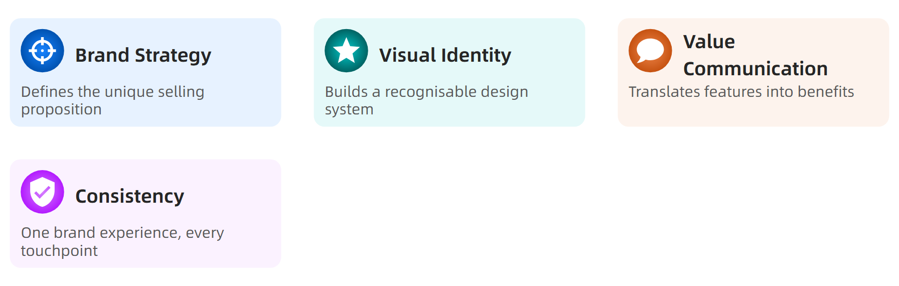
LO1 · LU1 · T3
Visual Identity Fundamentals
A brand isn't a logo — it's every one of these fundamentals working together, consistently.
Source: brand strategy & identity practice
TGS-2026061321 · © 2026 Tertiary Infotech Academy Pte Ltd

