Slide 1


LEARNER GUIDE · COURSE SLIDES
Agentic AI Automation with n8n
WSQ Course Code: TGS-2023035977
Conducted by Tertiary Infotech Academy Pte Ltd · UEN 201200696W
© 2026 Tertiary Infotech Academy Pte Ltd. All rights reserved. · www.tertiarycourses.com.sg

Slide 2
01
COURSE ADMINISTRATION
Welcome & Housekeeping
Agentic AI Automation with n8n · TGS-2023035977
© 2026 Tertiary Infotech Academy Pte Ltd
1

Slide 3
TRAQOM · SSG DIGITAL ATTENDANCE
Digital Attendance (Mandatory)
• It is mandatory to take the AM, PM and Assessment digital attendance for WSQ-funded courses.
• The trainer/administrator will display the digital attendance QR code generated from the SSG portal.
• Scan the QR code with your mobile phone camera and submit your attendance.
• A minimum of 75% attendance is required to be eligible for assessment and funding.
Agentic AI Automation with n8n · TGS-2023035977
© 2026 Tertiary Infotech Academy Pte Ltd
2

Slide 4
YOUR TRAINER
About the Trainer
• Dr. Alfred Ang — Principal Trainer, Tertiary Infotech Academy Pte. Ltd.
• PhD; specialises in Artificial Intelligence, automation and software engineering.
• Designs and delivers WSQ courses on AI agents, automation (n8n) and app development.
• Founder and lead instructor at Tertiary Infotech / Tertiary Courses.
Agentic AI Automation with n8n · TGS-2023035977
© 2026 Tertiary Infotech Academy Pte Ltd
3

Slide 5
ICE-BREAKER
Let's Know Each Other
• Your name and organisation / role.
• Your experience with automation or AI tools (if any).
• What you want to automate after this course.
Agentic AI Automation with n8n · TGS-2023035977
© 2026 Tertiary Infotech Academy Pte Ltd
4

Slide 6
Ground Rules
• Set your mobile phone to silent mode.
• Participate actively — no question is too small.
• Mutual respect: agree to disagree.
• One conversation at a time.
• Be punctual; return from breaks on time.
• Step out quietly for calls or toilet breaks.
• 75% attendance is required.
Agentic AI Automation with n8n · TGS-2023035977
© 2026 Tertiary Infotech Academy Pte Ltd
5

Slide 7
COURSE PORTAL
LMS / TMS
• Access your course materials, attendance and assessment on the LMS/TMS portal.
• Portal: https://lms-tms.tertiaryinfotech.com
• Download the slides and Learner Guide for reference during the open-book assessment.
Agentic AI Automation with n8n · TGS-2023035977
© 2026 Tertiary Infotech Academy Pte Ltd
6

Slide 8
SCHEDULE
Lesson Plan — 3 Days, 8 hours/day
Days 1–2
Day 3 & timing
• Day 1 — Workflow Automation + AI Agents
– Topic 1: n8n basics + Activities 1, 2, 3a, 3b
– Topic 2: AI Agents — Activities 4a, 4b
• Day 2 — RAG, Webhooks, APIs
– RAG (Activity 5)
– Webhooks (Activity 6) · APIs (Activity 7)
• Day 3 — Security & Capstone
– Human-in-the-loop + Guardrails (Activity 8)
– Mini Capstone + presentations
• Daily timing
– 9:30am–6:30pm · 1-hour lunch
– Short tea breaks within each day
Agentic AI Automation with n8n · TGS-2023035977
© 2026 Tertiary Infotech Academy Pte Ltd
7

Slide 9
WHAT YOU'LL ACHIEVE
Learning Outcomes
• LO1: Build automated workflows in n8n using triggers, actions, nodes and flows.
• LO2: Design AI agents with LLMs, memory and tools, triggered from chat / Telegram.
• LO3: Apply Retrieval-Augmented Generation (RAG) to ground agents in your documents.
• LO4: Integrate external systems via webhooks, APIs and HTTP requests.
• LO5: Apply human-in-the-loop and guardrails to secure agentic automations.
Agentic AI Automation with n8n · TGS-2023035977
© 2026 Tertiary Infotech Academy Pte Ltd
8

Slide 10
FINAL ASSESSMENT
Assessment
• Written Assessment (SAQ) — 1 hour.
• Practical Performance (PP) — 1 hour.
• Format: Open Book — slides, Learner Guide and approved materials only.
• A mini capstone project is presented on Day 3.
• An appeal process is available if required.
Agentic AI Automation with n8n · TGS-2023035977
© 2026 Tertiary Infotech Academy Pte Ltd
9

Slide 11
Briefing for Assessment
• Place phones and other materials under the table or on the floor.
• No photos or recording of assessment scripts.
• No discussion during the assessment.
• Use a black/blue pen for hard-copy assessments.
• No liquid paper / correction tape.
• Scripts are collected when time is up.
Agentic AI Automation with n8n · TGS-2023035977
© 2026 Tertiary Infotech Academy Pte Ltd
10

Slide 12
02
TOPIC 1
Workflow Automation with n8n
Triggers · Actions · Nodes · Flows
Agentic AI Automation with n8n · TGS-2023035977
© 2026 Tertiary Infotech Academy Pte Ltd
11

Slide 13
OVERVIEW
What is n8n?
• A workflow automation platform — connect apps and services with little or no code.
• Visual editor: drag nodes onto a canvas and wire them together.
• Runs in the cloud (trial) or self-hosted locally with Docker.
• 400+ integrations, HTTP/code nodes, and AI/LangChain nodes for agents.
Agentic AI Automation with n8n · TGS-2023035977
© 2026 Tertiary Infotech Academy Pte Ltd
12

Slide 14
MOTIVATION
Why Automate?
• Remove repetitive manual work and human error.
• Connect systems that don't normally talk to each other.
• React to events in real time (forms, webhooks, schedules).
• Add AI to make workflows understand language and make decisions.
Agentic AI Automation with n8n · TGS-2023035977
© 2026 Tertiary Infotech Academy Pte Ltd
13

Slide 15
GET READY
Setting Up n8n
• Option A — Cloud trial: sign up at n8n.io and start in the editor immediately.
• Option B — Local Docker Compose (persistent): docker compose up -d → http://localhost:5678.
• Trial Data Tables are not permanent — store anything you keep externally (Google Sheets).
• See labs/n8n-installation/docker-compose.yml in the course repo.
Agentic AI Automation with n8n · TGS-2023035977
© 2026 Tertiary Infotech Academy Pte Ltd
14

Slide 16
ACCOUNTS & KEYS
Credential Setup
• Add credentials once under Credentials → Add credential.
• Gmail / Outlook (OAuth2) for email; OpenAI / Gemini for AI.
• Telegram bot token (from @BotFather); Google Sheets (OAuth2).
• Imported workflows reference credential names — re-select your own after importing.
Agentic AI Automation with n8n · TGS-2023035977
© 2026 Tertiary Infotech Academy Pte Ltd
15

Slide 17
UI TOUR
The n8n Editor
• Canvas — where you place and connect nodes.
• Node panel — search 400+ nodes by name.
• Execute Workflow — run and inspect data at each step.
• Each node shows input and output data as JSON.
Agentic AI Automation with n8n · TGS-2023035977
© 2026 Tertiary Infotech Academy Pte Ltd
16

Slide 18
THE BUILDING BLOCKS
n8n Nodes
Triggers & Actions
Logic & AI
• Trigger nodes — start a workflow
– Form, Webhook, Telegram, Schedule, Manual
• Action nodes — do something
– Gmail, Google Sheets, HTTP Request, Data Table
• Logic nodes — control the flow
– IF, Switch, Merge, Split Out, Code, Edit Fields
• AI nodes — reason and act
– AI Agent, Chat Model, Memory, Vector Store, Tools
Agentic AI Automation with n8n · TGS-2023035977
© 2026 Tertiary Infotech Academy Pte Ltd
17

Slide 19
CORE CONCEPT
Triggers and Actions
• A Trigger is the first node — it decides WHEN a workflow runs.
• Manual & Schedule triggers for testing and time-based jobs.
• Form, Webhook and Telegram triggers respond to external events.
• Actions run after the trigger — send email, store data, call an API.
Agentic AI Automation with n8n · TGS-2023035977
© 2026 Tertiary Infotech Academy Pte Ltd
18

Slide 20
HOW IT RUNS
Execution Modes
• Test execution — run manually in the editor to inspect data.
• Production execution — runs automatically when Active.
• Each run is recorded in the Execution History for debugging.
Agentic AI Automation with n8n · TGS-2023035977
© 2026 Tertiary Infotech Academy Pte Ltd
19

Slide 21
DATA
Data Structure & JSON
• Data flows between nodes as a list of items, each a JSON object.
• Each item has a json field with key/value pairs.
• Nodes read the previous node's output and add to it.
Agentic AI Automation with n8n · TGS-2023035977
© 2026 Tertiary Infotech Academy Pte Ltd
20

Slide 22
DATA MAPPING
Expressions & Data Mapping
• Expressions pull data from earlier nodes: {{ $json.Name }}.
• Drag fields from the input panel to map them automatically.
• Use expressions in any field — subject lines, URLs, conditions.
Agentic AI Automation with n8n · TGS-2023035977
© 2026 Tertiary Infotech Academy Pte Ltd
21

Slide 23
DEBUGGING
Pin Data & Execution History
• Pin data to freeze a node's output while you build downstream nodes.
• Edit output to test different scenarios without re-running triggers.
• Execution History shows every run, its data, and any errors.
Agentic AI Automation with n8n · TGS-2023035977
© 2026 Tertiary Infotech Academy Pte Ltd
22

Slide 24
SHAPING DATA
Transforming Data
• Edit Fields (Set) — add, rename or reshape fields.
• Code node — run JavaScript/Python for custom logic.
• Split Out — turn one item with a list into many items.
• Merge — combine data from two branches (append, combine, choose).
Agentic AI Automation with n8n · TGS-2023035977
© 2026 Tertiary Infotech Academy Pte Ltd
23

Slide 25
DECISIONS
Conditional Logic — IF & Switch
• IF node — two outputs: true and false, based on a condition.
• Switch node — many outputs for multiple cases.
• Use them to route submissions, approvals, or message types.
Agentic AI Automation with n8n · TGS-2023035977
© 2026 Tertiary Infotech Academy Pte Ltd
24

Slide 26
STRUCTURE
Sub-Workflows
• Break big automations into reusable smaller workflows.
• Call a sub-workflow with the Execute Workflow node.
• Keeps workflows readable and lets you reuse common logic.
Agentic AI Automation with n8n · TGS-2023035977
© 2026 Tertiary Infotech Academy Pte Ltd
25

Slide 27
TOPIC 1 · WORKFLOW AUTOMATION
Activity 1 — Flyer with QR Code
ACT 1
Collect a visitor's details with an n8n Form and email them to an admin, then turn the form URL into a QR code on an event flyer (group activity).
You'll build
Form Trigger → Gmail (Send)
Key nodes: formTrigger, gmail
Agentic AI Automation with n8n · TGS-2023035977
© 2026 Tertiary Infotech Academy Pte Ltd
26

Slide 28
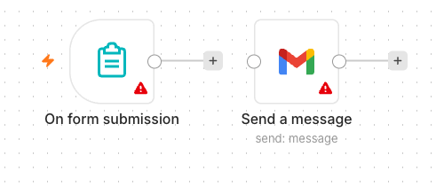
TOPIC 1 · WORKFLOW AUTOMATION
Activity 1 — Flyer with QR Code — Workflow
Form Trigger → Gmail
Agentic AI Automation with n8n · TGS-2023035977
© 2026 Tertiary Infotech Academy Pte Ltd
27

Slide 29
TOPIC 1 · WORKFLOW AUTOMATION
Activity 1 — Flyer with QR Code
STEP 1 OF 7
Create a new workflow and add an n8n Form Trigger; set a Form Title.
1
Agentic AI Automation with n8n · TGS-2023035977
© 2026 Tertiary Infotech Academy Pte Ltd
28

Slide 30
TOPIC 1 · WORKFLOW AUTOMATION
Activity 1 — Flyer with QR Code
STEP 2 OF 7
Add four fields: Name, Email, Phone, Message (mark Name & Email required).
2
Agentic AI Automation with n8n · TGS-2023035977
© 2026 Tertiary Infotech Academy Pte Ltd
29

Slide 31
TOPIC 1 · WORKFLOW AUTOMATION
Activity 1 — Flyer with QR Code
STEP 3 OF 7
Add a Gmail node (Send a Message) after the Form Trigger.
3
Agentic AI Automation with n8n · TGS-2023035977
© 2026 Tertiary Infotech Academy Pte Ltd
30

Slide 32
TOPIC 1 · WORKFLOW AUTOMATION
Activity 1 — Flyer with QR Code
STEP 4 OF 7
Set To = admin address, Subject = New RSVP from {{ $json.Name }}, and a body using the fields.
4
Agentic AI Automation with n8n · TGS-2023035977
© 2026 Tertiary Infotech Academy Pte Ltd
31

Slide 33
TOPIC 1 · WORKFLOW AUTOMATION
Activity 1 — Flyer with QR Code
STEP 5 OF 7
Select your Gmail credential, Save, and toggle the workflow Active.
5
Agentic AI Automation with n8n · TGS-2023035977
© 2026 Tertiary Infotech Academy Pte Ltd
32

Slide 34
TOPIC 1 · WORKFLOW AUTOMATION
Activity 1 — Flyer with QR Code
STEP 6 OF 7
Copy the Form's Production URL; paste it into the QR generator (alfredang.github.io/qrcodegenerator) and put the QR on a flyer.
6
Agentic AI Automation with n8n · TGS-2023035977
© 2026 Tertiary Infotech Academy Pte Ltd
33

Slide 35
TOPIC 1 · WORKFLOW AUTOMATION
Activity 1 — Flyer with QR Code
STEP 7 OF 7
Group activity: design an event flyer (e.g. bowling night) with the QR code, then present it.
7
Agentic AI Automation with n8n · TGS-2023035977
© 2026 Tertiary Infotech Academy Pte Ltd
34

Slide 36
TOPIC 1 · WORKFLOW AUTOMATION
Activity 1 — Flyer with QR Code
✅ Test it
Scan the QR code, submit the form, and confirm the admin inbox receives the email.
Agentic AI Automation with n8n · TGS-2023035977
© 2026 Tertiary Infotech Academy Pte Ltd
35

Slide 37
TOPIC 1 · WORKFLOW AUTOMATION
Activity 2 — Capture Data in a Data Table
ACT 2
Extend Activity 1 so every submission is also saved into an n8n Data Table — your first taste of storing data, not just forwarding it.
You'll build
Form Trigger → Gmail + Data Table (Insert row)
Key nodes: formTrigger, gmail, dataTable
Agentic AI Automation with n8n · TGS-2023035977
© 2026 Tertiary Infotech Academy Pte Ltd
36

Slide 38
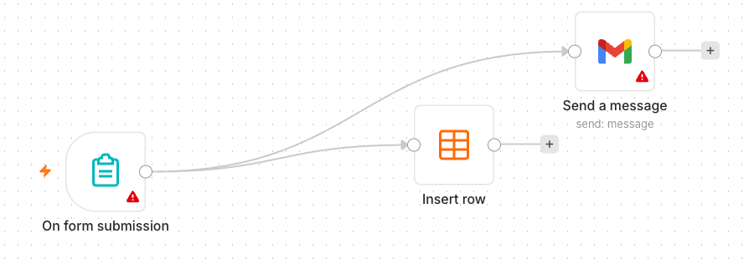
TOPIC 1 · WORKFLOW AUTOMATION
Activity 2 — Capture Data in a Data Table — Workflow
Form → Gmail + Data Table
Agentic AI Automation with n8n · TGS-2023035977
© 2026 Tertiary Infotech Academy Pte Ltd
37

Slide 39
TOPIC 1 · WORKFLOW AUTOMATION
Activity 2 — Capture Data in a Data Table
STEP 1 OF 5
In n8n open Data Tables and create a table 'RSVPs' with columns Name, Email, Phone, Message.
1
Agentic AI Automation with n8n · TGS-2023035977
© 2026 Tertiary Infotech Academy Pte Ltd
38

Slide 40
TOPIC 1 · WORKFLOW AUTOMATION
Activity 2 — Capture Data in a Data Table
STEP 2 OF 5
Continue from your Activity 1 workflow.
2
Agentic AI Automation with n8n · TGS-2023035977
© 2026 Tertiary Infotech Academy Pte Ltd
39

Slide 41
TOPIC 1 · WORKFLOW AUTOMATION
Activity 2 — Capture Data in a Data Table
STEP 3 OF 5
Add a Data Table node (Insert Row) connected after the Form Trigger, alongside Gmail.
3
Agentic AI Automation with n8n · TGS-2023035977
© 2026 Tertiary Infotech Academy Pte Ltd
40

Slide 42
TOPIC 1 · WORKFLOW AUTOMATION
Activity 2 — Capture Data in a Data Table
STEP 4 OF 5
Map each form field to its column with expressions, e.g. Name → {{ $json.Name }}.
4
Agentic AI Automation with n8n · TGS-2023035977
© 2026 Tertiary Infotech Academy Pte Ltd
41

Slide 43
TOPIC 1 · WORKFLOW AUTOMATION
Activity 2 — Capture Data in a Data Table
STEP 5 OF 5
Save and keep the workflow Active.
5
Agentic AI Automation with n8n · TGS-2023035977
© 2026 Tertiary Infotech Academy Pte Ltd
42

Slide 44
TOPIC 1 · WORKFLOW AUTOMATION
Activity 2 — Capture Data in a Data Table
✅ Test it
Submit the form and confirm a new row appears in the RSVPs Data Table and the email still sends.
Agentic AI Automation with n8n · TGS-2023035977
© 2026 Tertiary Infotech Academy Pte Ltd
43

Slide 45
TOPIC 1 · WORKFLOW AUTOMATION
Activity 3a — Conditional Response (Data Table)
ACT 3a
Add decision-making with an IF node. If the visitor is attending, save the date to the Data Table; if not, send a polite thank-you email.
You'll build
Form Trigger → IF → Data Table / Gmail
Key nodes: formTrigger, if, dataTable, gmail
Agentic AI Automation with n8n · TGS-2023035977
© 2026 Tertiary Infotech Academy Pte Ltd
44

Slide 46
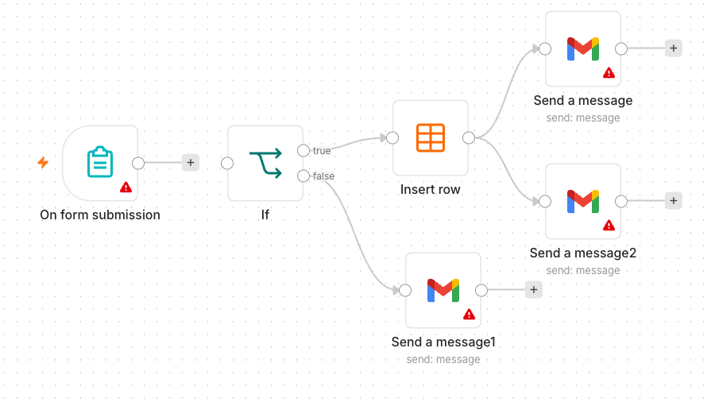
TOPIC 1 · WORKFLOW AUTOMATION
Activity 3a — Conditional Response (Data Table) — Workflow
IF routes to Data Table or a thank-you email
Agentic AI Automation with n8n · TGS-2023035977
© 2026 Tertiary Infotech Academy Pte Ltd
45

Slide 47
TOPIC 1 · WORKFLOW AUTOMATION
Activity 3a — Conditional Response (Data Table)
STEP 1 OF 5
Add an Attending? field (Yes/No dropdown) to the form.
1
Agentic AI Automation with n8n · TGS-2023035977
© 2026 Tertiary Infotech Academy Pte Ltd
46

Slide 48
TOPIC 1 · WORKFLOW AUTOMATION
Activity 3a — Conditional Response (Data Table)
STEP 2 OF 5
Add an IF node after the Form Trigger: condition {{ $json.Attending }} equals Yes.
2
Agentic AI Automation with n8n · TGS-2023035977
© 2026 Tertiary Infotech Academy Pte Ltd
47

Slide 49
TOPIC 1 · WORKFLOW AUTOMATION
Activity 3a — Conditional Response (Data Table)
STEP 3 OF 5
On the true output, add a Data Table → Insert Row to save the RSVP.
3
Agentic AI Automation with n8n · TGS-2023035977
© 2026 Tertiary Infotech Academy Pte Ltd
48

Slide 50
TOPIC 1 · WORKFLOW AUTOMATION
Activity 3a — Conditional Response (Data Table)
STEP 4 OF 5
On the false output, add a Gmail node sending a friendly thank-you.
4
Agentic AI Automation with n8n · TGS-2023035977
© 2026 Tertiary Infotech Academy Pte Ltd
49

Slide 51
TOPIC 1 · WORKFLOW AUTOMATION
Activity 3a — Conditional Response (Data Table)
STEP 5 OF 5
Save and keep the workflow Active.
5
Agentic AI Automation with n8n · TGS-2023035977
© 2026 Tertiary Infotech Academy Pte Ltd
50

Slide 52
TOPIC 1 · WORKFLOW AUTOMATION
Activity 3a — Conditional Response (Data Table)
✅ Test it
Submit once with Attending = Yes (new Data Table row) and once with No (thank-you email).
Agentic AI Automation with n8n · TGS-2023035977
© 2026 Tertiary Infotech Academy Pte Ltd
51

Slide 53
TOPIC 1 · WORKFLOW AUTOMATION
Activity 3b — Conditional Response (Google Sheets)
ACT 3b
Make data persistent by replacing the Data Table with Google Sheets (or Excel). Same logic — the Yes branch appends a row to a real spreadsheet you keep.
You'll build
Form Trigger → IF → Google Sheets / Gmail
Key nodes: formTrigger, if, googleSheets, gmail
Agentic AI Automation with n8n · TGS-2023035977
© 2026 Tertiary Infotech Academy Pte Ltd
52

Slide 54
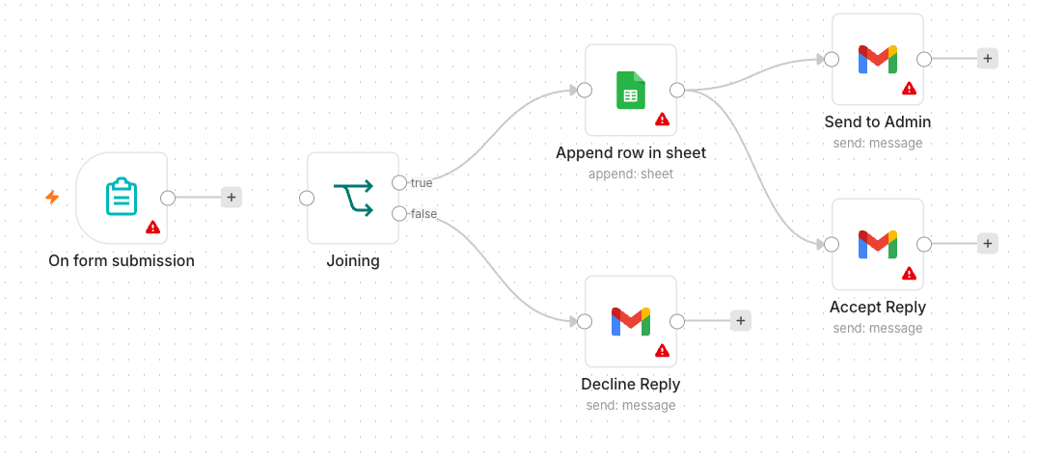
TOPIC 1 · WORKFLOW AUTOMATION
Activity 3b — Conditional Response (Google Sheets) — Workflow
IF routes to Google Sheets or a thank-you email
Agentic AI Automation with n8n · TGS-2023035977
© 2026 Tertiary Infotech Academy Pte Ltd
53

Slide 55
TOPIC 1 · WORKFLOW AUTOMATION
Activity 3b — Conditional Response (Google Sheets)
STEP 1 OF 5
Create a Google Sheet 'Event RSVPs' with a header row: Name, Email, Phone, Date.
1
Agentic AI Automation with n8n · TGS-2023035977
© 2026 Tertiary Infotech Academy Pte Ltd
54

Slide 56
TOPIC 1 · WORKFLOW AUTOMATION
Activity 3b — Conditional Response (Google Sheets)
STEP 2 OF 5
Add a Google Sheets credential (OAuth2) in n8n and authorise it.
2
Agentic AI Automation with n8n · TGS-2023035977
© 2026 Tertiary Infotech Academy Pte Ltd
55

Slide 57
TOPIC 1 · WORKFLOW AUTOMATION
Activity 3b — Conditional Response (Google Sheets)
STEP 3 OF 5
Take Activity 3a; on the true branch replace the Data Table with a Google Sheets → Append Row node.
3
Agentic AI Automation with n8n · TGS-2023035977
© 2026 Tertiary Infotech Academy Pte Ltd
56

Slide 58
TOPIC 1 · WORKFLOW AUTOMATION
Activity 3b — Conditional Response (Google Sheets)
STEP 4 OF 5
Select your spreadsheet and sheet, then map each column to the form fields.
4
Agentic AI Automation with n8n · TGS-2023035977
© 2026 Tertiary Infotech Academy Pte Ltd
57

Slide 59
TOPIC 1 · WORKFLOW AUTOMATION
Activity 3b — Conditional Response (Google Sheets)
STEP 5 OF 5
Leave the false branch (thank-you email) unchanged; Save and keep Active.
5
Agentic AI Automation with n8n · TGS-2023035977
© 2026 Tertiary Infotech Academy Pte Ltd
58

Slide 60
TOPIC 1 · WORKFLOW AUTOMATION
Activity 3b — Conditional Response (Google Sheets)
✅ Test it
Submit with Attending = Yes and confirm a new row is appended to your Google Sheet.
Agentic AI Automation with n8n · TGS-2023035977
© 2026 Tertiary Infotech Academy Pte Ltd
59

Slide 61
Lunch Break
1 hour · see you at 2:00 pm

Slide 62
03
TOPIC 2
AI Agents
LLM · Memory · Tools · System Instruction
Agentic AI Automation with n8n · TGS-2023035977
© 2026 Tertiary Infotech Academy Pte Ltd
61

Slide 63
CONCEPT
What is Agentic AI?
• Traditional automation follows fixed rules you wire by hand.
• An AI agent uses an LLM to understand language and decide what to do.
• It can call tools, remember context, and handle open-ended requests.
• Agentic = the AI takes actions toward a goal, not just answers once.
Agentic AI Automation with n8n · TGS-2023035977
© 2026 Tertiary Infotech Academy Pte Ltd
62

Slide 64
HOW IT WORKS
AI Agent Using an LLM
• The LLM is the 'brain' that interprets the user and plans a response.
• Tools give the agent abilities (look up data, search, call an API).
• Memory lets it hold a conversation across messages.
• A system instruction sets its role, tone and rules.
Agentic AI Automation with n8n · TGS-2023035977
© 2026 Tertiary Infotech Academy Pte Ltd
63

Slide 65
THE PIECES
AI Agent Concepts in n8n
Model & Memory
Tools & Instruction
• LLM — generates the replies
– OpenAI gpt-4.1-mini or Google Gemini
• Memory — recalls the conversation
– Simple / window buffer memory
• Tools — actions the agent can call
– Data Table, Vector Store, HTTP, sub-workflow
• System Instruction — role & rules
– Persona, scope, and do/don't guidance
Agentic AI Automation with n8n · TGS-2023035977
© 2026 Tertiary Infotech Academy Pte Ltd
64

Slide 66
INSTRUCTION DESIGN
Creating System Prompts
• State the agent's role: 'You are an HR admin assistant.'
• Give scope and limits: what it should and shouldn't answer.
• Tell it which tool to use for which kind of question.
• Keep it concise, specific and testable.
Agentic AI Automation with n8n · TGS-2023035977
© 2026 Tertiary Infotech Academy Pte Ltd
65

Slide 67
BEST PRACTICE
Agent Instruction Best Practices
• Be explicit about routing between multiple tools/sources.
• Ask for a clear format when you need structured output.
• Tell it to say 'I don't know' rather than invent answers.
• Iterate: test with real questions and refine the prompt.
Agentic AI Automation with n8n · TGS-2023035977
© 2026 Tertiary Infotech Academy Pte Ltd
66

Slide 68
EXTENDING THE AGENT
Memory & Tools
• Add memory so follow-up questions keep context.
• Attach tools to the agent's Tool input; describe each tool clearly.
• The agent decides when to call a tool based on your description.
• All agents in this course use OpenAI gpt-4.1-mini.
Agentic AI Automation with n8n · TGS-2023035977
© 2026 Tertiary Infotech Academy Pte Ltd
67

Slide 69
TOPIC 2 · AI AGENTS
Activity 4a — Telegram AI Agent (Customer Service)
ACT 4a
Build your first AI agent: a customer-service chatbot you talk to from Telegram, using an LLM, memory and a system instruction.
You'll build
Telegram Trigger → AI Agent (+ model + memory) → Telegram reply
Key nodes: telegramTrigger, agent, lmChatOpenAi, memory, telegram
Agentic AI Automation with n8n · TGS-2023035977
© 2026 Tertiary Infotech Academy Pte Ltd
68

Slide 70
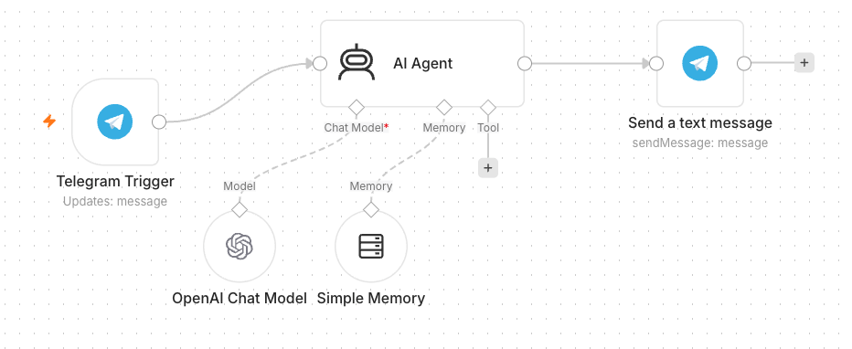
TOPIC 2 · AI AGENTS
Activity 4a — Telegram AI Agent (Customer Service) — Workflow
Telegram-triggered AI agent with model + memory
Agentic AI Automation with n8n · TGS-2023035977
© 2026 Tertiary Infotech Academy Pte Ltd
69

Slide 71
TOPIC 2 · AI AGENTS
Activity 4a — Telegram AI Agent (Customer Service)
STEP 1 OF 7
In Telegram, open @BotFather → /newbot, then copy the bot token.
1
Agentic AI Automation with n8n · TGS-2023035977
© 2026 Tertiary Infotech Academy Pte Ltd
70

Slide 72
TOPIC 2 · AI AGENTS
Activity 4a — Telegram AI Agent (Customer Service)
STEP 2 OF 7
Add a Telegram credential in n8n and paste the token.
2
Agentic AI Automation with n8n · TGS-2023035977
© 2026 Tertiary Infotech Academy Pte Ltd
71

Slide 73
TOPIC 2 · AI AGENTS
Activity 4a — Telegram AI Agent (Customer Service)
STEP 3 OF 7
Add a Telegram Trigger node (fires on each message).
3
Agentic AI Automation with n8n · TGS-2023035977
© 2026 Tertiary Infotech Academy Pte Ltd
72

Slide 74
TOPIC 2 · AI AGENTS
Activity 4a — Telegram AI Agent (Customer Service)
STEP 4 OF 7
Add an AI Agent node after the trigger.
4
Agentic AI Automation with n8n · TGS-2023035977
© 2026 Tertiary Infotech Academy Pte Ltd
73

Slide 75
TOPIC 2 · AI AGENTS
Activity 4a — Telegram AI Agent (Customer Service)
STEP 5 OF 7
Attach an OpenAI Chat Model (gpt-4.1-mini) and a Simple Memory node.
5
Agentic AI Automation with n8n · TGS-2023035977
© 2026 Tertiary Infotech Academy Pte Ltd
74

Slide 76
TOPIC 2 · AI AGENTS
Activity 4a — Telegram AI Agent (Customer Service)
STEP 6 OF 7
Write the system instruction (friendly customer-service assistant).
6
Agentic AI Automation with n8n · TGS-2023035977
© 2026 Tertiary Infotech Academy Pte Ltd
75

Slide 77
TOPIC 2 · AI AGENTS
Activity 4a — Telegram AI Agent (Customer Service)
STEP 7 OF 7
Add a Telegram → Send Message: Chat ID = {{ $json.message.chat.id }}, Text = the agent output. Save & Activate.
7
Agentic AI Automation with n8n · TGS-2023035977
© 2026 Tertiary Infotech Academy Pte Ltd
76

Slide 78
TOPIC 2 · AI AGENTS
Activity 4a — Telegram AI Agent (Customer Service)
✅ Test it
Message your bot in Telegram and confirm it replies.
Agentic AI Automation with n8n · TGS-2023035977
© 2026 Tertiary Infotech Academy Pte Ltd
77

Slide 79
TOPIC 2 · AI AGENTS
Activity 4b — Agent + Data Table Tool (HR Admin)
ACT 4b
Give the agent a tool: an employee Data Table it can query. The same bot now answers HR-admin questions from real data.
You'll build
Telegram → AI Agent + Data Table Tool → reply
Key nodes: agent, dataTableTool, telegram
Agentic AI Automation with n8n · TGS-2023035977
© 2026 Tertiary Infotech Academy Pte Ltd
78

Slide 80
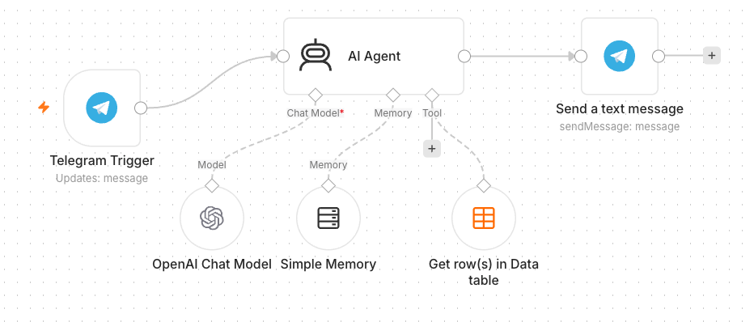
TOPIC 2 · AI AGENTS
Activity 4b — Agent + Data Table Tool (HR Admin) — Workflow
Agent with a Data Table tool
Agentic AI Automation with n8n · TGS-2023035977
© 2026 Tertiary Infotech Academy Pte Ltd
79

Slide 81
TOPIC 2 · AI AGENTS
Activity 4b — Agent + Data Table Tool (HR Admin)
STEP 1 OF 5
Create a Data Table 'Employees' and upload the provided employees.csv (100 records).
1
Agentic AI Automation with n8n · TGS-2023035977
© 2026 Tertiary Infotech Academy Pte Ltd
80

Slide 82
TOPIC 2 · AI AGENTS
Activity 4b — Agent + Data Table Tool (HR Admin)
STEP 2 OF 5
Open your Activity 4a workflow.
2
Agentic AI Automation with n8n · TGS-2023035977
© 2026 Tertiary Infotech Academy Pte Ltd
81

Slide 83
TOPIC 2 · AI AGENTS
Activity 4b — Agent + Data Table Tool (HR Admin)
STEP 3 OF 5
Add a Data Table Tool and attach it to the AI Agent's Tool input.
3
Agentic AI Automation with n8n · TGS-2023035977
© 2026 Tertiary Infotech Academy Pte Ltd
82

Slide 84
TOPIC 2 · AI AGENTS
Activity 4b — Agent + Data Table Tool (HR Admin)
STEP 4 OF 5
Point the tool at the Employees table and describe it (look up staff by name/department).
4
Agentic AI Automation with n8n · TGS-2023035977
© 2026 Tertiary Infotech Academy Pte Ltd
83

Slide 85
TOPIC 2 · AI AGENTS
Activity 4b — Agent + Data Table Tool (HR Admin)
STEP 5 OF 5
Update the system instruction to use the Employees tool for staff questions. Save & Activate.
5
Agentic AI Automation with n8n · TGS-2023035977
© 2026 Tertiary Infotech Academy Pte Ltd
84

Slide 86
TOPIC 2 · AI AGENTS
Activity 4b — Agent + Data Table Tool (HR Admin)
✅ Test it
Ask 'Which department is <a name from the CSV> in?' and confirm it answers from the table.
Agentic AI Automation with n8n · TGS-2023035977
© 2026 Tertiary Infotech Academy Pte Ltd
85

Slide 87
WRAP-UP
End of Day 1 — Recap
• You built form automations, conditional logic and data storage.
• You created a Telegram AI agent with memory and a Data Table tool.
• Tomorrow: RAG, Webhooks and external APIs.
Agentic AI Automation with n8n · TGS-2023035977
© 2026 Tertiary Infotech Academy Pte Ltd
86

Slide 88
04
TOPIC 3
Retrieval-Augmented Generation (RAG)
Tokenization · Embeddings · Vector Stores
Agentic AI Automation with n8n · TGS-2023035977
© 2026 Tertiary Infotech Academy Pte Ltd
87

Slide 89
CONCEPT
What is RAG?
• RAG lets an agent answer from YOUR documents, not just its training data.
• Documents are split, embedded and stored; relevant chunks are retrieved per question.
• Reduces hallucination and keeps answers grounded and current.
Agentic AI Automation with n8n · TGS-2023035977
© 2026 Tertiary Infotech Academy Pte Ltd
88

Slide 90
EMBEDDINGS
Text Embedding
• Tokenization splits text into tokens the model can process.
• An embedding turns a chunk of text into a vector (list of numbers).
• Similar meanings produce vectors that are close together.
Agentic AI Automation with n8n · TGS-2023035977
© 2026 Tertiary Infotech Academy Pte Ltd
89

Slide 91
VECTOR STORE
Vector Database
• Vectors are stored in a vector store (in-memory, Pinecone, etc.).
• At query time, the question is embedded and the closest chunks are retrieved.
• Those chunks are given to the LLM as context to answer.
Agentic AI Automation with n8n · TGS-2023035977
© 2026 Tertiary Infotech Academy Pte Ltd
90

Slide 92
TOPIC 3 · RAG
Activity 5 — Add RAG to the Telegram Agent
ACT 5
Upgrade the agent to answer from documents (policies/FAQs) AND the Data Table. It must route to the right source for each question — two knowledge sources, one agent.
You'll build
Telegram → AI Agent + Vector Store (RAG) + Data Table → reply
Key nodes: agent, vectorStoreInMemory, embeddingsOpenAi, dataTableTool
Agentic AI Automation with n8n · TGS-2023035977
© 2026 Tertiary Infotech Academy Pte Ltd
91

Slide 93
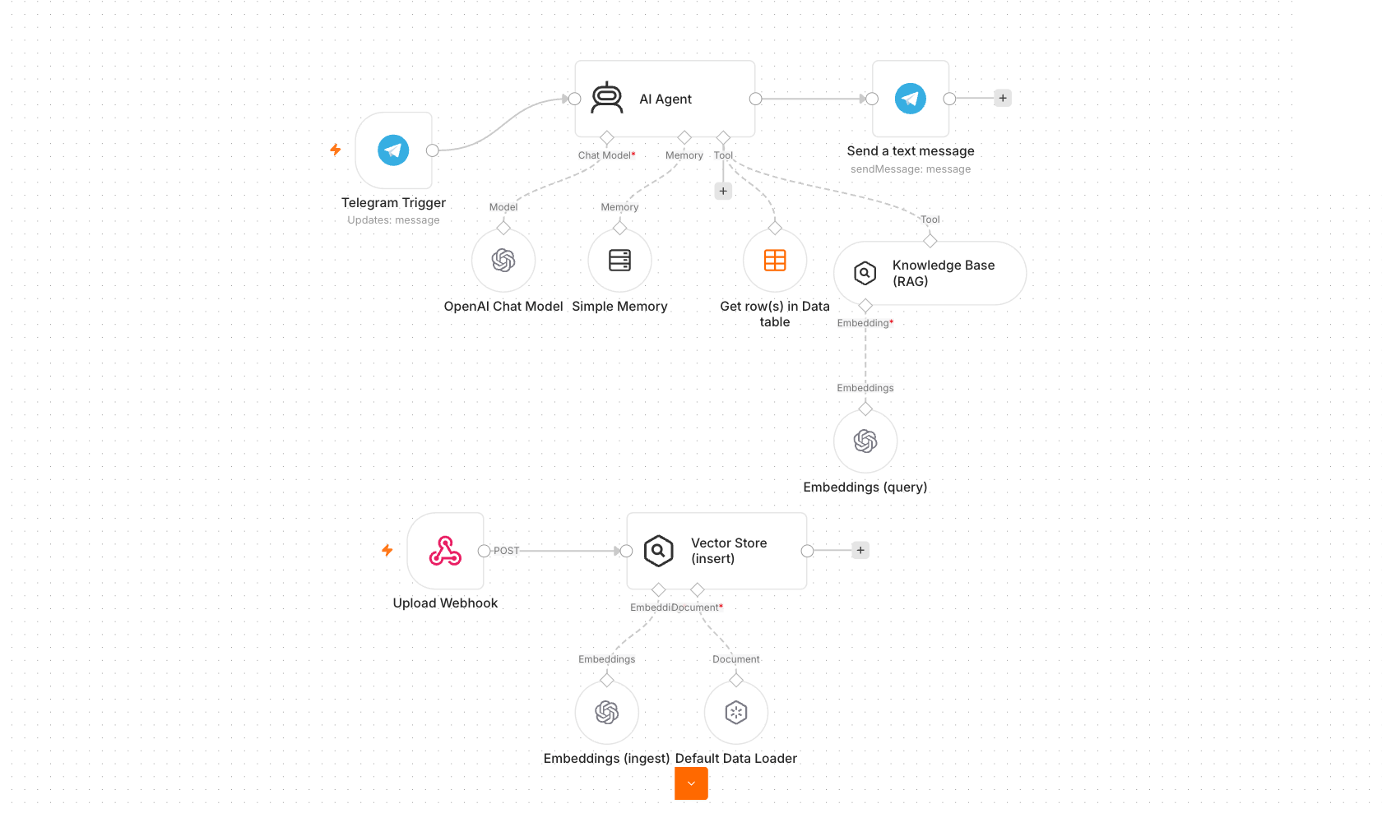
TOPIC 3 · RAG
Activity 5 — Add RAG to the Telegram Agent — Workflow
Agent routes between a RAG vector store and a Data Table
Agentic AI Automation with n8n · TGS-2023035977
© 2026 Tertiary Infotech Academy Pte Ltd
92

Slide 94
TOPIC 3 · RAG
Activity 5 — Add RAG to the Telegram Agent
STEP 1 OF 5
Prepare documents: use MyCompany-HR-SOP.docx / IT-Support-FAQ.docx, or generate FAQs with Claude Code.
1
Agentic AI Automation with n8n · TGS-2023035977
© 2026 Tertiary Infotech Academy Pte Ltd
93

Slide 95
TOPIC 3 · RAG
Activity 5 — Add RAG to the Telegram Agent
STEP 2 OF 5
Build the ingestion path: upload → Embeddings (OpenAI) → Vector Store (Insert) with a Default Data Loader.
2
Agentic AI Automation with n8n · TGS-2023035977
© 2026 Tertiary Infotech Academy Pte Ltd
94

Slide 96
TOPIC 3 · RAG
Activity 5 — Add RAG to the Telegram Agent
STEP 3 OF 5
In your Telegram agent, add a Vector Store retrieval tool alongside the Data Table tool.
3
Agentic AI Automation with n8n · TGS-2023035977
© 2026 Tertiary Infotech Academy Pte Ltd
95

Slide 97
TOPIC 3 · RAG
Activity 5 — Add RAG to the Telegram Agent
STEP 4 OF 5
Rewrite the system instruction to route: knowledge base for policy/FAQ, Data Table for staff records.
4
Agentic AI Automation with n8n · TGS-2023035977
© 2026 Tertiary Infotech Academy Pte Ltd
96

Slide 98
TOPIC 3 · RAG
Activity 5 — Add RAG to the Telegram Agent
STEP 5 OF 5
Save and keep Active; have a few learners present their chatbot.
5
Agentic AI Automation with n8n · TGS-2023035977
© 2026 Tertiary Infotech Academy Pte Ltd
97

Slide 99
TOPIC 3 · RAG
Activity 5 — Add RAG to the Telegram Agent
✅ Test it
Ask a policy question and a staff-record question; confirm each is answered from the correct source.
Agentic AI Automation with n8n · TGS-2023035977
© 2026 Tertiary Infotech Academy Pte Ltd
98

Slide 100
Lunch Break
1 hour

Slide 101
05
TOPIC 4
Webhooks
External triggers for your workflows
Agentic AI Automation with n8n · TGS-2023035977
© 2026 Tertiary Infotech Academy Pte Ltd
100

Slide 102
CONCEPT
What is a Webhook?
• A Webhook is a URL that external systems call to trigger your workflow.
• Use cases: website chat, form submissions, payments, app notifications.
• Pair the Webhook trigger with a Respond to Webhook node to reply.
Agentic AI Automation with n8n · TGS-2023035977
© 2026 Tertiary Infotech Academy Pte Ltd
101

Slide 103
DIRECTION OF THE CALL
HTTP Request vs Webhook
Outbound
Inbound
• HTTP Request node
– YOUR workflow CALLS an external service
– You pull data when you choose
• Webhook node
– An external service CALLS your workflow
– You react when an event happens
Agentic AI Automation with n8n · TGS-2023035977
© 2026 Tertiary Infotech Academy Pte Ltd
102

Slide 104
SETUP
Webhook Node & URL
• Each Webhook node has a Test URL and a Production URL.
• Set the HTTP method (GET/POST) and a path.
• Set Allowed Origins (CORS) to * so a browser page can call it.
Agentic AI Automation with n8n · TGS-2023035977
© 2026 Tertiary Infotech Academy Pte Ltd
103

Slide 105
SECURING WEBHOOKS
Webhook Authentication
• None — open endpoint (fine for demos).
• Basic Auth — username & password.
• Header Auth — a secret key in a request header.
• JWT — signed tokens for stronger security.
Agentic AI Automation with n8n · TGS-2023035977
© 2026 Tertiary Infotech Academy Pte Ltd
104

Slide 106
TOPIC 4 · WEBHOOKS
Activity 6 — Website Chatbot (Investment Advisor)
ACT 6
Expose an AI agent to a public website via a Webhook. The Investment Advisor page has an enquiry form and a floating chatbot; both post to one n8n webhook.
You'll build
Webhook → AI Agent → Respond to Webhook (+ email the advisor)
Key nodes: webhook, agent, respondToWebhook, gmail
Agentic AI Automation with n8n · TGS-2023035977
© 2026 Tertiary Infotech Academy Pte Ltd
105

Slide 107
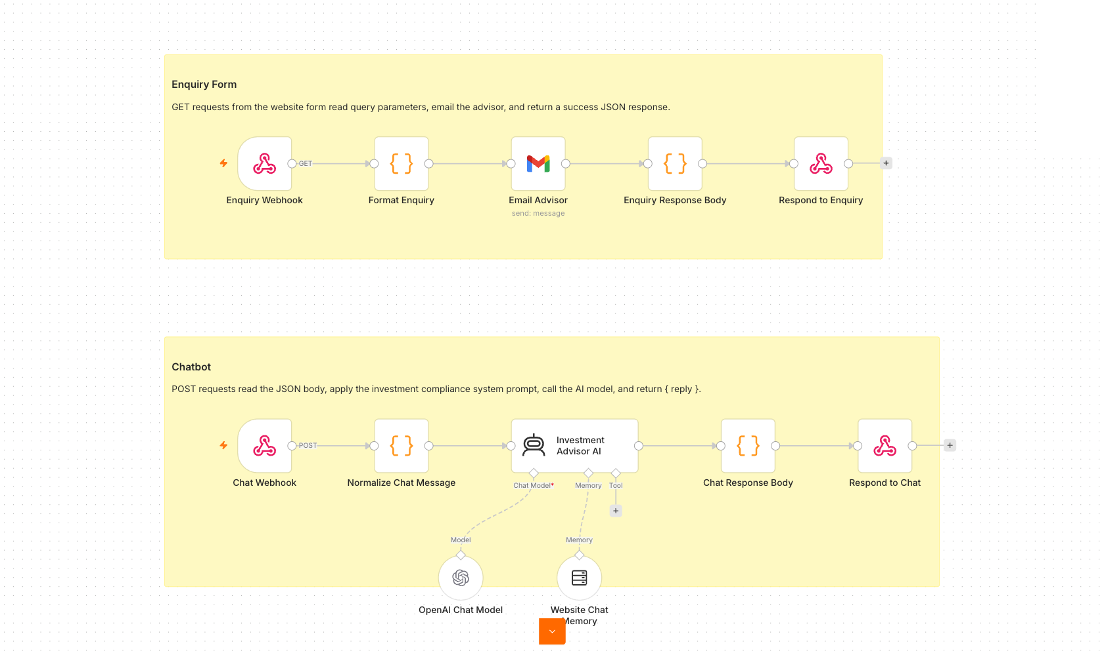
TOPIC 4 · WEBHOOKS
Activity 6 — Website Chatbot (Investment Advisor) — Workflow
One webhook, two paths: enquiry email + AI chat
Agentic AI Automation with n8n · TGS-2023035977
© 2026 Tertiary Infotech Academy Pte Ltd
106

Slide 108
TOPIC 4 · WEBHOOKS
Activity 6 — Website Chatbot (Investment Advisor)
STEP 1 OF 6
Import Activity6-Investment-Advisor.json into n8n.
1
Agentic AI Automation with n8n · TGS-2023035977
© 2026 Tertiary Infotech Academy Pte Ltd
107

Slide 109
TOPIC 4 · WEBHOOKS
Activity 6 — Website Chatbot (Investment Advisor)
STEP 2 OF 6
Open the Webhook node(s) and set Allowed Origins (CORS) to *.
2
Agentic AI Automation with n8n · TGS-2023035977
© 2026 Tertiary Infotech Academy Pte Ltd
108

Slide 110
TOPIC 4 · WEBHOOKS
Activity 6 — Website Chatbot (Investment Advisor)
STEP 3 OF 6
Re-select your OpenAI and Gmail credentials on the agent and email nodes.
3
Agentic AI Automation with n8n · TGS-2023035977
© 2026 Tertiary Infotech Academy Pte Ltd
109

Slide 111
TOPIC 4 · WEBHOOKS
Activity 6 — Website Chatbot (Investment Advisor)
STEP 4 OF 6
Review the compliance system instruction (no guaranteed returns, no personalised advice).
4
Agentic AI Automation with n8n · TGS-2023035977
© 2026 Tertiary Infotech Academy Pte Ltd
110

Slide 112
TOPIC 4 · WEBHOOKS
Activity 6 — Website Chatbot (Investment Advisor)
STEP 5 OF 6
Save, Activate, and copy the webhook Production URL.
5
Agentic AI Automation with n8n · TGS-2023035977
© 2026 Tertiary Infotech Academy Pte Ltd
111

Slide 113
TOPIC 4 · WEBHOOKS
Activity 6 — Website Chatbot (Investment Advisor)
STEP 6 OF 6
Open index.html, click the gear, and paste your webhook URL; have learners present their site.
6
Agentic AI Automation with n8n · TGS-2023035977
© 2026 Tertiary Infotech Academy Pte Ltd
112

Slide 114
TOPIC 4 · WEBHOOKS
Activity 6 — Website Chatbot (Investment Advisor)
✅ Test it
On the website, send a chat message and submit the enquiry form; confirm the bot replies and the advisor gets the email.
Agentic AI Automation with n8n · TGS-2023035977
© 2026 Tertiary Infotech Academy Pte Ltd
113

Slide 115
Tea Break
15 minutes

Slide 116
06
TOPIC 5
API & HTTP Request
Pull live data from external services
Agentic AI Automation with n8n · TGS-2023035977
© 2026 Tertiary Infotech Academy Pte Ltd
115

Slide 117
CONCEPT
What is an API?
• An API lets your workflow request data from another service over HTTP.
• You send a request; the service sends back a response (usually JSON).
• APIs power live data: prices, weather, news, CRM records.
Agentic AI Automation with n8n · TGS-2023035977
© 2026 Tertiary Infotech Academy Pte Ltd
116

Slide 118
ANATOMY
Components of an HTTP Request
• Method — GET (read), POST (send), PUT, DELETE.
• URL / endpoint — the address of the resource.
• Headers — metadata, including authentication.
• Query params / body — the inputs you send.
Agentic AI Automation with n8n · TGS-2023035977
© 2026 Tertiary Infotech Academy Pte Ltd
117

Slide 119
READING RESPONSES
HTTP Response & Status Codes
• Body — the data returned (often JSON).
• 200 OK — success; 201 Created.
• 401 Unauthorized — bad/missing API key; 429 — rate limited.
• 4xx = your request; 5xx = the server.
Agentic AI Automation with n8n · TGS-2023035977
© 2026 Tertiary Infotech Academy Pte Ltd
118

Slide 120
IN n8n
HTTP Request Node
• Configure method, URL, headers and query parameters.
• Store API keys in credentials, never hard-coded.
• Parse the JSON response and pass fields to the next node.
Agentic AI Automation with n8n · TGS-2023035977
© 2026 Tertiary Infotech Academy Pte Ltd
119

Slide 121
TOPIC 5 · API & HTTP
Activity 7 — Finance API → Telegram (Day Trader)
ACT 7
Ask the Telegram bot about a stock; it resolves the ticker, pulls candles from Twelve Data and headlines from NewsAPI, and replies with a Buy/Sell/Hold call and reasoning.
You'll build
Telegram → Extract ticker → HTTP (Twelve Data + NewsAPI) → AI Agent → reply
Key nodes: telegram, httpRequest, agent, lmChatOpenAi
Agentic AI Automation with n8n · TGS-2023035977
© 2026 Tertiary Infotech Academy Pte Ltd
120

Slide 122
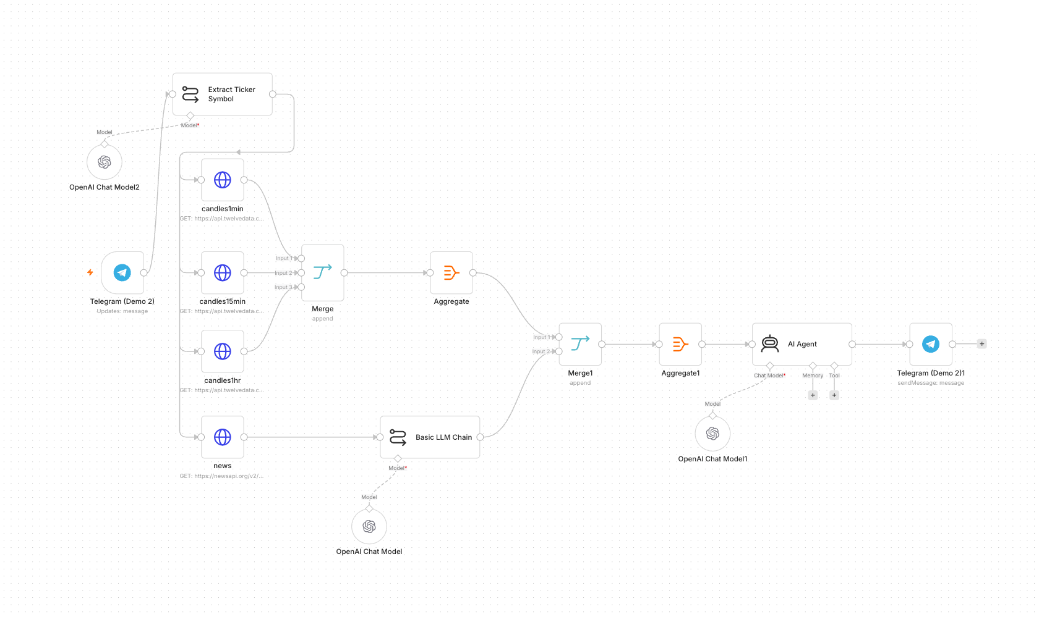
TOPIC 5 · API & HTTP
Activity 7 — Finance API → Telegram (Day Trader) — Workflow
Multi-timeframe candles + news → AI day-trading agent
Agentic AI Automation with n8n · TGS-2023035977
© 2026 Tertiary Infotech Academy Pte Ltd
121

Slide 123
TOPIC 5 · API & HTTP
Activity 7 — Finance API → Telegram (Day Trader)
STEP 1 OF 6
Get free API keys: Twelve Data (twelvedata.com/login) and NewsAPI (newsapi.org).
1
Agentic AI Automation with n8n · TGS-2023035977
© 2026 Tertiary Infotech Academy Pte Ltd
122

Slide 124
TOPIC 5 · API & HTTP
Activity 7 — Finance API → Telegram (Day Trader)
STEP 2 OF 6
Import Activity7-Finance-Advisor.json into n8n.
2
Agentic AI Automation with n8n · TGS-2023035977
© 2026 Tertiary Infotech Academy Pte Ltd
123

Slide 125
TOPIC 5 · API & HTTP
Activity 7 — Finance API → Telegram (Day Trader)
STEP 3 OF 6
Set your Twelve Data and NewsAPI keys (credentials or HTTP query params).
3
Agentic AI Automation with n8n · TGS-2023035977
© 2026 Tertiary Infotech Academy Pte Ltd
124

Slide 126
TOPIC 5 · API & HTTP
Activity 7 — Finance API → Telegram (Day Trader)
STEP 4 OF 6
Re-select your OpenAI and Telegram credentials.
4
Agentic AI Automation with n8n · TGS-2023035977
© 2026 Tertiary Infotech Academy Pte Ltd
125

Slide 127
TOPIC 5 · API & HTTP
Activity 7 — Finance API → Telegram (Day Trader)
STEP 5 OF 6
Review the flow: Telegram → Extract Ticker → HTTP candles (1m/15m/1h) + news → Aggregate → AI Agent → reply.
5
Agentic AI Automation with n8n · TGS-2023035977
© 2026 Tertiary Infotech Academy Pte Ltd
126

Slide 128
TOPIC 5 · API & HTTP
Activity 7 — Finance API → Telegram (Day Trader)
STEP 6 OF 6
Save, Activate; optionally open index.html and set your key + bot username.
6
Agentic AI Automation with n8n · TGS-2023035977
© 2026 Tertiary Infotech Academy Pte Ltd
127

Slide 129
TOPIC 5 · API & HTTP
Activity 7 — Finance API → Telegram (Day Trader)
✅ Test it
Message the bot 'Should I buy AAPL?' and confirm it returns a recommendation with reasoning.
Agentic AI Automation with n8n · TGS-2023035977
© 2026 Tertiary Infotech Academy Pte Ltd
128

Slide 130
WRAP-UP
End of Day 2 — Recap
• You grounded an agent with RAG over your own documents.
• You exposed an agent to a website via a webhook.
• You pulled live market + news data through APIs into a Telegram agent.
Agentic AI Automation with n8n · TGS-2023035977
© 2026 Tertiary Infotech Academy Pte Ltd
129

Slide 131
07
TOPIC 6
Security & Guardrails
Human-in-the-loop · Pre/Post guardrails
Agentic AI Automation with n8n · TGS-2023035977
© 2026 Tertiary Infotech Academy Pte Ltd
130

Slide 132
CONCEPT
Human in the Loop
• Some actions are too sensitive to fully automate — money, hiring, sending on behalf.
• A human-in-the-loop step pauses the workflow for a person to Approve or Reject.
• n8n's Send and Wait for Response captures that decision (email / Telegram).
Agentic AI Automation with n8n · TGS-2023035977
© 2026 Tertiary Infotech Academy Pte Ltd
131

Slide 133
TOPIC 6 · SECURITY
Activity 8a — Human-in-the-Loop Approval
ACT 8a
Model a leave-application approval: a request comes in, a manager is asked to approve, and the flow only continues — recording the leave and confirming — on approval.
You'll build
Form → Manager Approval (Send & Wait) → IF → confirm / decline
Key nodes: formTrigger, gmail (sendAndWait), if
Agentic AI Automation with n8n · TGS-2023035977
© 2026 Tertiary Infotech Academy Pte Ltd
132

Slide 134
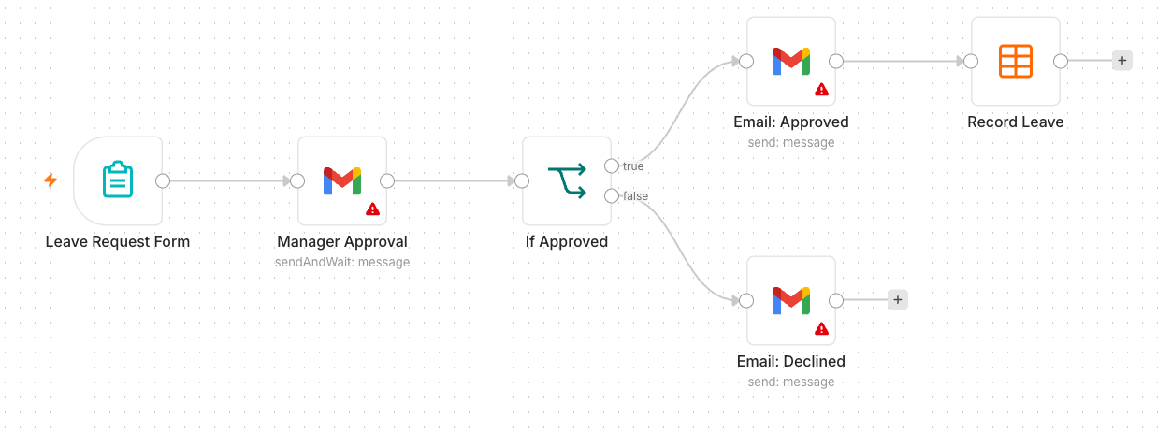
TOPIC 6 · SECURITY
Activity 8a — Human-in-the-Loop Approval — Workflow
Approval pauses the flow until a manager decides
Agentic AI Automation with n8n · TGS-2023035977
© 2026 Tertiary Infotech Academy Pte Ltd
133

Slide 135
TOPIC 6 · SECURITY
Activity 8a — Human-in-the-Loop Approval
STEP 1 OF 5
Start with a Form Trigger collecting Employee, Email, Dates, Reason.
1
Agentic AI Automation with n8n · TGS-2023035977
© 2026 Tertiary Infotech Academy Pte Ltd
134

Slide 136
TOPIC 6 · SECURITY
Activity 8a — Human-in-the-Loop Approval
STEP 2 OF 5
Add a Gmail → Send and Wait for Response (Approval) addressed to the manager.
2
Agentic AI Automation with n8n · TGS-2023035977
© 2026 Tertiary Infotech Academy Pte Ltd
135

Slide 137
TOPIC 6 · SECURITY
Activity 8a — Human-in-the-Loop Approval
STEP 3 OF 5
Add an IF node on the approval result.
3
Agentic AI Automation with n8n · TGS-2023035977
© 2026 Tertiary Infotech Academy Pte Ltd
136

Slide 138
TOPIC 6 · SECURITY
Activity 8a — Human-in-the-Loop Approval
STEP 4 OF 5
On Approved: record the leave (Data Table) and email a confirmation.
4
Agentic AI Automation with n8n · TGS-2023035977
© 2026 Tertiary Infotech Academy Pte Ltd
137

Slide 139
TOPIC 6 · SECURITY
Activity 8a — Human-in-the-Loop Approval
STEP 5 OF 5
On Rejected: email the employee that the request was declined. Save & Activate.
5
Agentic AI Automation with n8n · TGS-2023035977
© 2026 Tertiary Infotech Academy Pte Ltd
138

Slide 140
TOPIC 6 · SECURITY
Activity 8a — Human-in-the-Loop Approval
✅ Test it
Submit a leave request, approve it from the manager email, and confirm the employee gets a confirmation.
Agentic AI Automation with n8n · TGS-2023035977
© 2026 Tertiary Infotech Academy Pte Ltd
139

Slide 141
CONCEPT
Guardrails
• Pre-guardrail — validate/sanitise the input (block prompt-injection, PII) before the LLM.
• Post-guardrail — check the output (no secrets, no disallowed content) before sending.
• On a violation, route to a safe fallback or human review.
Agentic AI Automation with n8n · TGS-2023035977
© 2026 Tertiary Infotech Academy Pte Ltd
140

Slide 142
TOPIC 6 · SECURITY
Activity 8b — Pre & Post Guardrails
ACT 8b
Wrap an AI agent so unsafe input never reaches the model and unsafe output never reaches the user. Add a pre-check before the agent and a post-check after it.
You'll build
Webhook → Pre-check → AI Agent → Post-check → Respond / Blocked
Key nodes: webhook, if, agent, respondToWebhook
Agentic AI Automation with n8n · TGS-2023035977
© 2026 Tertiary Infotech Academy Pte Ltd
141

Slide 143
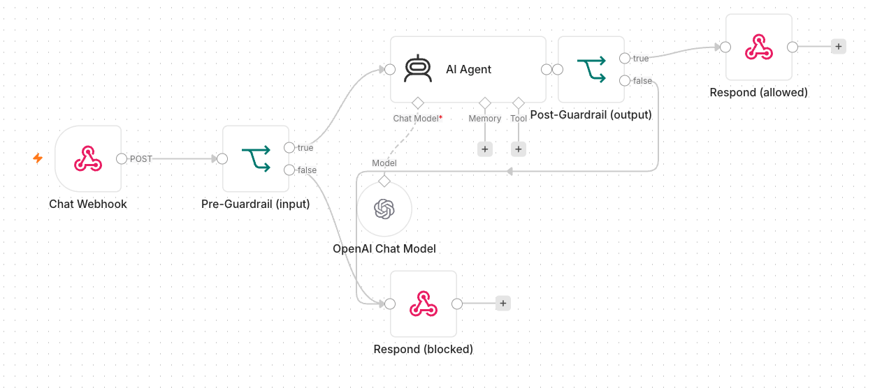
TOPIC 6 · SECURITY
Activity 8b — Pre & Post Guardrails — Workflow
Pre/post checks gate the agent
Agentic AI Automation with n8n · TGS-2023035977
© 2026 Tertiary Infotech Academy Pte Ltd
142

Slide 144
TOPIC 6 · SECURITY
Activity 8b — Pre & Post Guardrails
STEP 1 OF 5
Start from the Activity 6 webhook agent (or the Telegram agent).
1
Agentic AI Automation with n8n · TGS-2023035977
© 2026 Tertiary Infotech Academy Pte Ltd
143

Slide 145
TOPIC 6 · SECURITY
Activity 8b — Pre & Post Guardrails
STEP 2 OF 5
Before the AI Agent, add a check that inspects the user message; on a violation, branch to a safe canned response.
2
Agentic AI Automation with n8n · TGS-2023035977
© 2026 Tertiary Infotech Academy Pte Ltd
144

Slide 146
TOPIC 6 · SECURITY
Activity 8b — Pre & Post Guardrails
STEP 3 OF 5
After the AI Agent, add a check that scans the reply for secrets/policy violations.
3
Agentic AI Automation with n8n · TGS-2023035977
© 2026 Tertiary Infotech Academy Pte Ltd
145

Slide 147
TOPIC 6 · SECURITY
Activity 8b — Pre & Post Guardrails
STEP 4 OF 5
Only send the reply when both guardrails pass; otherwise return a safe message.
4
Agentic AI Automation with n8n · TGS-2023035977
© 2026 Tertiary Infotech Academy Pte Ltd
146

Slide 148
TOPIC 6 · SECURITY
Activity 8b — Pre & Post Guardrails
STEP 5 OF 5
Save and keep Active.
5
Agentic AI Automation with n8n · TGS-2023035977
© 2026 Tertiary Infotech Academy Pte Ltd
147

Slide 149
TOPIC 6 · SECURITY
Activity 8b — Pre & Post Guardrails
✅ Test it
Send a normal question (passes through) and a disallowed one (blocked by the pre-guardrail).
Agentic AI Automation with n8n · TGS-2023035977
© 2026 Tertiary Infotech Academy Pte Ltd
148

Slide 150
Lunch Break
1 hour

Slide 151
08
TOPIC 7
Mini Capstone Project
Design · Build · Present · Assess
Agentic AI Automation with n8n · TGS-2023035977
© 2026 Tertiary Infotech Academy Pte Ltd
150

Slide 152
BRING IT TOGETHER
Mini Capstone Project
• In small groups, design and build an end-to-end automation using what you learned.
• Include: a trigger, an AI agent with a tool or RAG source, an external API or storage, and a guardrail / human-in-the-loop step.
• A worked example — Issue Reporting (form + image → Postgres + gallery) — is provided.
• Deliverables: a working workflow, a short demo, and a 3–5 minute presentation.
Agentic AI Automation with n8n · TGS-2023035977
© 2026 Tertiary Infotech Academy Pte Ltd
151

Slide 153
WRAP-UP
Presentation & Assessment
• Present the problem, your design, and what you'd improve.
• Written Assessment (SAQ) — 1 hour · Practical Performance (PP) — 1 hour.
• Open book: slides, Learner Guide and approved materials.
• Remember to take the Assessment digital attendance (TRAQOM).
Agentic AI Automation with n8n · TGS-2023035977
© 2026 Tertiary Infotech Academy Pte Ltd
152

Slide 154
Thank You!
Keep your local n8n running and keep building your own agents.
Download all flows: github.com/tertiarycourses/TGS-2023035977-Agentic-AI-Automation-with-n8n
Powered by Tertiary Infotech Academy Pte Ltd · www.tertiarycourses.com.sg
Agentic AI Automation with n8n · TGS-2023035977
© 2026 Tertiary Infotech Academy Pte Ltd
153

