Slide 1


WSQ COURSE SLIDES
3D Modelling with Blender for Beginners
Course Code: TGS-2022015368
Tertiary Infotech Academy Pte. Ltd.
UEN 201200696W
Trainer: ____________________
Version v11.0 · 20 August 2026
© Tertiary Infotech Academy Pte. Ltd. · Concept visual generated for this course

Slide 2
00
COURSE ADMINISTRATION
Welcome, outcomes and assessment
Two days · 16 hours · Blender 5.2 LTS
3D Modelling with Blender for Beginners · TGS-2022015368
© Tertiary Infotech Academy Pte. Ltd.
2

Slide 3
TRAQOM · SSG
Digital Attendance (Mandatory)
1
AM
2
PM
Complete the SSG digital attendance at the start of each day.
Complete the afternoon attendance after lunch.
3
Assessment
4
Funding
Complete the assessment attendance before the WA and PP.
At least 75% attendance and a Competent result are required.
3D Modelling with Blender for Beginners · TGS-2022015368
© Tertiary Infotech Academy Pte. Ltd.
3

Slide 4
TRAINER PROFILE
About the Trainer
NAME
________________________________
?
TITLE / DESIGNATION
________________________________
QUALIFICATIONS
________________________________
General Trainer
AREAS OF EXPERTISE
________________________________
Complete this profile before class
________________________________
TRAINING AND INDUSTRY EXPERIENCE
CONTACT
________________________________
3D Modelling with Blender for Beginners · TGS-2022015368
© Tertiary Infotech Academy Pte. Ltd.
4

Slide 5
TRAINER PROFILE
About the Trainer
ROLE
Principal Trainer and courseware lead
AA
CERTIFICATION
Adult education and applied technology training
DELIVERS
AI, automation, data and digital design programmes
Dr Alfred Ang
FOUNDER
Tertiary Infotech / Tertiary Courses
Principal Trainer · Tertiary Infotech Academy
Concept-led teaching with evidence-based practice
APPROACH
CONTACT
enquiry@tertiaryinfotech.com
3D Modelling with Blender for Beginners · TGS-2022015368
© Tertiary Infotech Academy Pte. Ltd.
5

Slide 6
LEARNER INTRODUCTION
Let’s know each other
1
You
2
Experience
Name, role and organisation.
Your exposure to Blender or 3D design.
3
Use case
4
Outcome
A model or workflow you want to improve.
One capability you want to demonstrate by Day 2.
3D Modelling with Blender for Beginners · TGS-2022015368
© Tertiary Infotech Academy Pte. Ltd.
6

Slide 7
LEARNING ENVIRONMENT
Ground rules
1
Participate
2
Respect
Ask questions and explain your decisions.
Give constructive feedback on work, not people.
3
Protect
4
Verify
Use only authorised, non-confidential inputs.
Treat generated output as unverified until checked.
5
Version
6
Evidence
Save incremental copies before risky operations.
Capture the process, not only the final render.
3D Modelling with Blender for Beginners · TGS-2022015368
© Tertiary Infotech Academy Pte. Ltd.
7

Slide 8
TWO-DAY JOURNEY
Course architecture
1
Topic 1
2
Topic 2
Analyse the brief, budget geometry and control Blender.
Model, sculpt, inspect and refine a prototype.
3
Topic 3
4
Topic 4
Rig, animate, surface and present the prototype.
Light, render, optimise and export the asset.
5
Labs
6
Assessment
Eight connected, evidence-led Blender labs.
Nine SAQs and four integrated practical tasks.
3D Modelling with Blender for Beginners · TGS-2022015368
© Tertiary Infotech Academy Pte. Ltd.
8

Slide 9
SCHEDULE
Lesson plan — two-day journey
DAY 1
DAY 2
Creative briefs and polygon budgets
Materials, rigging and animation
Blender interface and scene control
Cameras, lighting and rendering
Modelling, sculpting and topology
Optimisation and export
Labs 1–4
Labs 5–8 · WA + PP
3D Modelling with Blender for Beginners · TGS-2022015368
© Tertiary Infotech Academy Pte. Ltd.
9

Slide 10
BY THE END OF THE COURSE
Learning outcomes
1
LO1
2
LO2
Analyse a creative brief and establish a suitable polygon budget.
Develop 3D models and prototypes in Blender.
3
LO3
4
LO4
Animate 3D models using suitable rigging, keyframe and presentation methods.
Optimise, light, render and export 3D models for the intended use.
3D Modelling with Blender for Beginners · TGS-2022015368
© Tertiary Infotech Academy Pte. Ltd.
10

Slide 11
MEDIA PRODUCTION · MED-MPN-3057-1.1
TSC alignment
1
K1–K2
2
K3–K4
Creative brief, budgets, interface and scene control.
Modelling, sculpting, topology and modifiers.
3
K5–K9
4
A1–A8
Animation, materials, review, rendering and export.
Brief, build, animate, present, optimise and deliver.
3D Modelling with Blender for Beginners · TGS-2022015368
© Tertiary Infotech Academy Pte. Ltd.
11

Slide 12
READ BEFORE ASSESSMENT
Briefing for assessment
1
Individual
2
Open book
No discussion; complete your own submission.
Use slides, Learner Guide and approved materials only.
3
Devices
4
Integrity
Place phones and other unapproved materials under the table.
No photography or recording of assessment scripts.
5
Writing
6
Submission
Use black/blue pen where hard copy is used; no correction fluid.
Upload the completed document to the LMS.
3D Modelling with Blender for Beginners · TGS-2022015368
© Tertiary Infotech Academy Pte. Ltd.
12

Slide 13
LIVE INSTRUMENT PARITY
Final assessment
Written Assessment
Practical Performance
Competency
9 open-ended SAQs
4 integrated Blender tasks
Assessment attendance
K1–K9 coverage
A1–A8 coverage
Competent / Not Yet Competent
60 minutes · open book
90 minutes · open book
Appeal and reassessment available
3D Modelling with Blender for Beginners · TGS-2022015368
© Tertiary Infotech Academy Pte. Ltd.
13

Slide 14
ON ASSESSMENT DAY
Assessment flow
1
2
3
4
5
TRAQOM / SSG attendance
Written Assessment (SAQ)
Practical Performance (PP)
Upload answers to LMS
Sign Assessment Summary Record
3D Modelling with Blender for Beginners · TGS-2022015368
© Tertiary Infotech Academy Pte. Ltd.
14

Slide 15
SELF-CONTAINED FOLDERS
Access the lab packs
Option A
Option B
Evidence
Open the GitHub repository
GitHub Code menu
Follow INSTRUCTIONS.md
Clone with Git
Download ZIP
Use CHECKLIST.md
Work from labs/NN-title
Extract before opening files
Update Example-Presentation.pptx
Open the GitHub lab repository
3D Modelling with Blender for Beginners · TGS-2022015368
© Tertiary Infotech Academy Pte. Ltd.
15

Slide 16
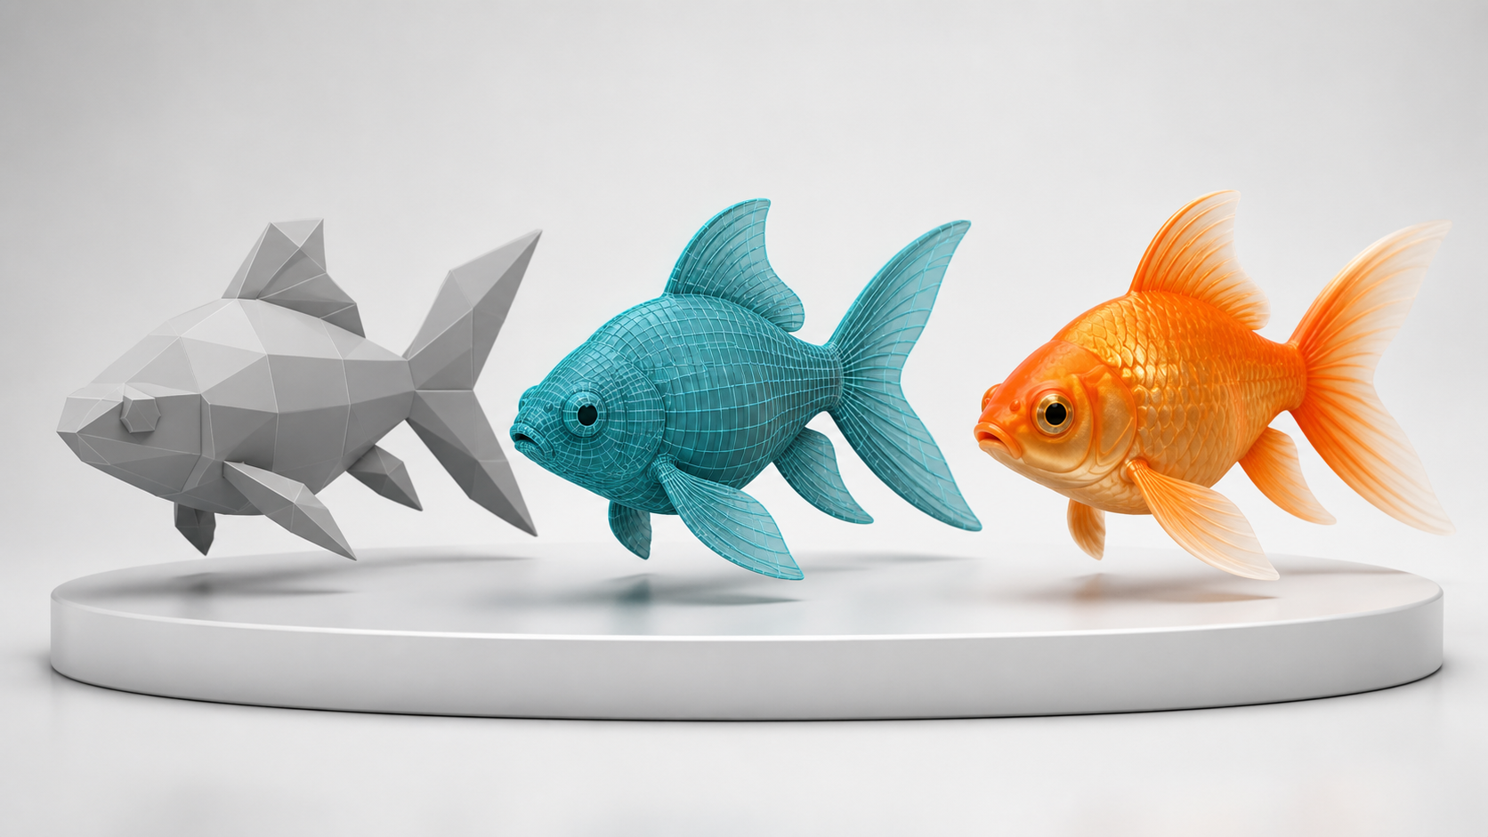
3D DESIGN MATURITY
From blockout to production-ready asset
Compare the same design at three maturity levels: blockout, topology-controlled model and finished material render. Each level answers a different review question.
Concept visual — validate against the editable Blender file.
3D Modelling with Blender for Beginners · TGS-2022015368
© Tertiary Infotech Academy Pte. Ltd.
16

Slide 17
PROGRESS IS EARNED THROUGH EVIDENCE, NOT UNSUPPORTED PERCENTAGES
Production-readiness gates
1
2
3
4
5
Recognisable blockout
Controlled topology
Validated materials and motion
Target render and export
Clean round-trip handoff
3D Modelling with Blender for Beginners · TGS-2022015368
© Tertiary Infotech Academy Pte. Ltd.
17

Slide 18
COVERAGE AND MODERNISATION
Source-informed build
1
Legacy v10
2
Course page
Preserved Blender foundations, modelling, sculpting, materials, animation and rendering.
Aligned the verified two-day structure and four learning outcomes.
3
Reference labs
4
Blender Manual
Reused the supplied editable Blender sample files as hands-on inputs.
Updated terminology and workflow for Blender 5.2 LTS.
3D Modelling with Blender for Beginners · TGS-2022015368
© Tertiary Infotech Academy Pte. Ltd.
18

Slide 19
01
TOPIC 1
Get Started with Blender and the Creative Brief
Analyse requirements · establish budgets · control the scene
3D Modelling with Blender for Beginners · TGS-2022015368
© Tertiary Infotech Academy Pte. Ltd.
19

Slide 20
PROGRESSIVE LEARNING
Topic 1 — capability map
1
Understand
2
Apply
Analyse requirements
establish budgets
3
Review
4
Demonstrate
LO1 · K1–K2 · A1–A2
Labs 1–2
3D Modelling with Blender for Beginners · TGS-2022015368
© Tertiary Infotech Academy Pte. Ltd.
20

Slide 21
TOPIC 1 · CONCEPT 1
Read the creative brief as a production contract
1
Purpose
2
Form
Audience, platform and viewing distance
Silhouette, proportion and reference views
3
Constraints
4
Evidence
Time, dimensions, format and budget
Named checks, views and approval owner
3D Modelling with Blender for Beginners · TGS-2022015368
© Tertiary Infotech Academy Pte. Ltd.
21

Slide 22
TOPIC 1 · ANALYSIS
Decisions and risks — Read the creative brief as a production contract
DECISIONS THAT IMPROVE QUALITY
FAILURE MODES TO CONTROL
Separate must-haves from preferences
Starting from an attractive image instead of requirements
Resolve missing dimensions before modelling
Conflicting units or target platforms
Name the final approver
No measurable acceptance rule
Freeze a versioned brief
3D Modelling with Blender for Beginners · TGS-2022015368
© Tertiary Infotech Academy Pte. Ltd.
22

Slide 23
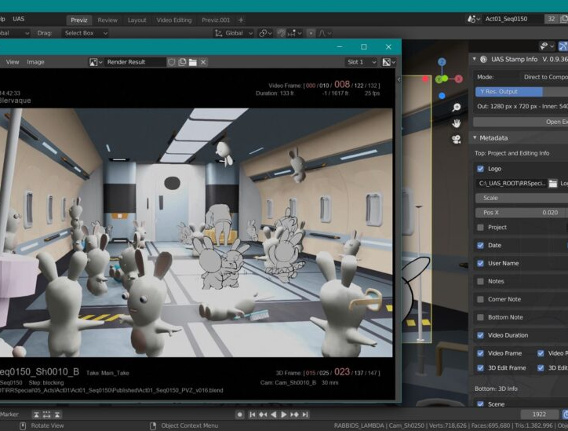
TOPIC 1 · VISUAL REFERENCE
Read the creative brief as a production contract
PRINCIPLE
Turn subjective intent into testable form, function and delivery criteria.
APPLIED EXAMPLE
A goldfish hero asset needs a readable silhouette, animated fins, a 500-polygon target and a GLB handoff.
EVIDENCE TO TRACK
1
All mandatory fields resolved
2
Polygon target recorded
LEGACY BLENDER REFERENCE · CURRENT WORKFLOW EXPLAINED AT RIGHT
3
Approver and evidence named
3D Modelling with Blender for Beginners · TGS-2022015368
© Tertiary Infotech Academy Pte. Ltd.
23

Slide 24
TOPIC 1 · CONCEPT 2
Set a polygon budget that matches the use
1
Target
2
Density
Mobile, web, film, still or print
Allocate loops to visible and moving regions
3
LOD
4
Measure
Plan variants for different viewing conditions
Use statistics and triangulated counts
3D Modelling with Blender for Beginners · TGS-2022015368
© Tertiary Infotech Academy Pte. Ltd.
24

Slide 25
TOPIC 1 · ANALYSIS
Decisions and risks — Set a polygon budget that matches the use
DECISIONS THAT IMPROVE QUALITY
FAILURE MODES TO CONTROL
Define whether the limit is faces or triangles
Counting before unapplied modifiers
Reserve loops around eyes, mouth and fin roots
Uniform density wastes geometry
Keep a budget margin for revisions
Budget reduction destroys silhouette
Check after modifiers
3D Modelling with Blender for Beginners · TGS-2022015368
© Tertiary Infotech Academy Pte. Ltd.
25

Slide 26
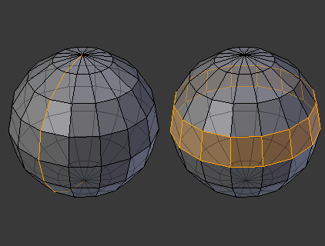
TOPIC 1 · VISUAL REFERENCE
Set a polygon budget that matches the use
PRINCIPLE
Spend geometry where it changes silhouette, deformation or shading.
APPLIED EXAMPLE
A 500-polygon fish keeps loops around the eye and tail while the body uses broad, clean quads.
EVIDENCE TO TRACK
1
Triangle count within target
2
Silhouette passes key views
LEGACY BLENDER REFERENCE · CURRENT WORKFLOW EXPLAINED AT RIGHT
3
Deformation zones retain support
3D Modelling with Blender for Beginners · TGS-2022015368
© Tertiary Infotech Academy Pte. Ltd.
26

Slide 27
TOPIC 1 · CONCEPT 3
Understand Blender workspaces and editors
1
3D Viewport
2
Outliner
Select, transform and inspect objects
Control hierarchy, collections and visibility
3
Properties
4
Timeline
Edit object, data, modifier and render settings
Navigate frames and keyframes
3D Modelling with Blender for Beginners · TGS-2022015368
© Tertiary Infotech Academy Pte. Ltd.
27

Slide 28
TOPIC 1 · ANALYSIS
Decisions and risks — Understand Blender workspaces and editors
DECISIONS THAT IMPROVE QUALITY
FAILURE MODES TO CONTROL
Choose a workspace for the current task
Editing the wrong active object
Keep the Outliner visible on complex scenes
Hidden collection mistaken for missing work
Confirm active object and mode
Wrong editor or mode causes commands to fail
Save layout changes only when useful
3D Modelling with Blender for Beginners · TGS-2022015368
© Tertiary Infotech Academy Pte. Ltd.
28

Slide 29
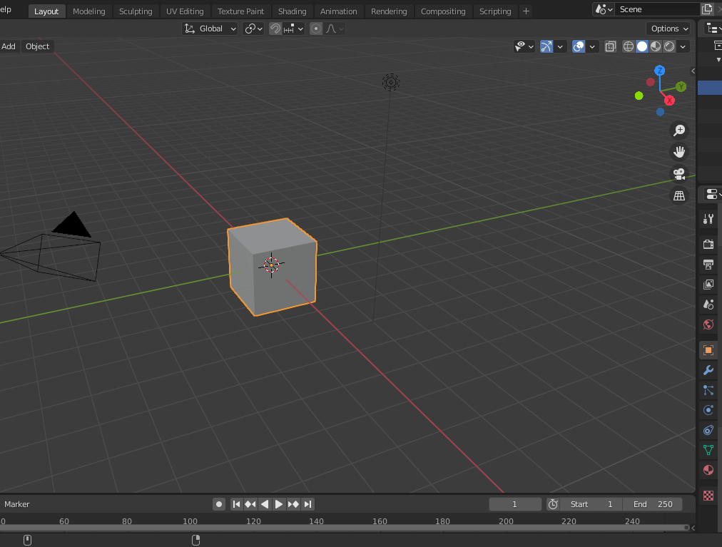
TOPIC 1 · VISUAL REFERENCE
Understand Blender workspaces and editors
PRINCIPLE
Workspaces arrange editors; editors expose different views of the same data.
APPLIED EXAMPLE
The Layout workspace supports blockout; Sculpting and Shading workspaces expose specialised controls without changing the model data.
EVIDENCE TO TRACK
1
Correct object active
2
Correct mode visible
LEGACY BLENDER REFERENCE · CURRENT WORKFLOW EXPLAINED AT RIGHT
3
Scene hierarchy understandable
3D Modelling with Blender for Beginners · TGS-2022015368
© Tertiary Infotech Academy Pte. Ltd.
29

Slide 30
TOPIC 1 · CONCEPT 4
Navigate, select and transform with intent
1
View
2
Select
Orbit, pan, zoom and frame selection
Object, component and hierarchy selection
3
Transform
4
Pivot
Move, rotate and scale on constrained axes
Median, cursor and individual origins
3D Modelling with Blender for Beginners · TGS-2022015368
© Tertiary Infotech Academy Pte. Ltd.
30

Slide 31
TOPIC 1 · ANALYSIS
Decisions and risks — Navigate, select and transform with intent
DECISIONS THAT IMPROVE QUALITY
FAILURE MODES TO CONTROL
Use orthographic views for proportion checks
Unapplied non-uniform scale
Constrain transformations to an axis
Accidental proportional editing
Apply scale before scale-sensitive tools
Origin placement breaks rotation
Place origins deliberately
3D Modelling with Blender for Beginners · TGS-2022015368
© Tertiary Infotech Academy Pte. Ltd.
31

Slide 32
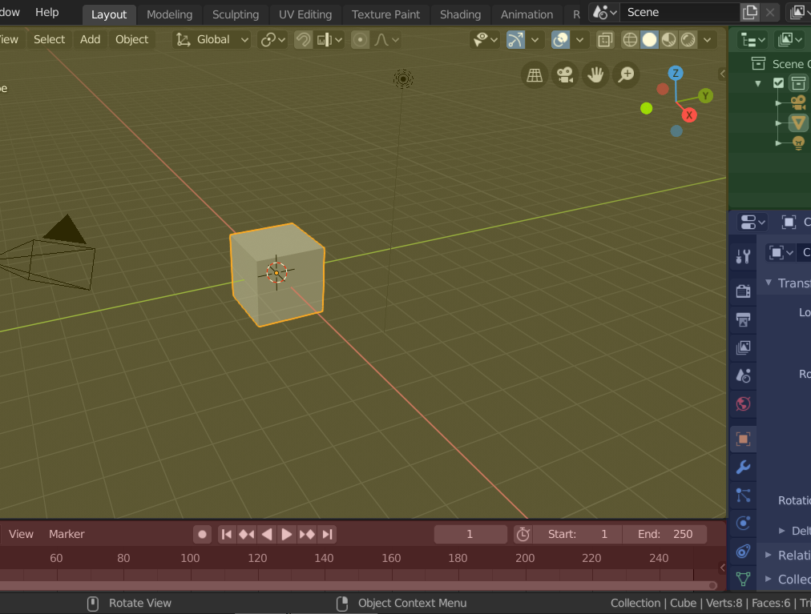
TOPIC 1 · VISUAL REFERENCE
Navigate, select and transform with intent
PRINCIPLE
Reliable modelling begins with controllable views, pivots and transforms.
APPLIED EXAMPLE
Block a fish from side and top orthographic views, then inspect perspective for volume and proportion.
EVIDENCE TO TRACK
1
Transforms documented
2
Reference views aligned
LEGACY BLENDER REFERENCE · CURRENT WORKFLOW EXPLAINED AT RIGHT
3
No accidental offsets
3D Modelling with Blender for Beginners · TGS-2022015368
© Tertiary Infotech Academy Pte. Ltd.
32

Slide 33
TOPIC 1 · CONCEPT 5
Organise objects, data and modifiers
1
Objects
2
Collections
Transform containers that reference data
Logical groups for visibility and export
3
Names
4
Modifiers
Role-based, consistent object/material labels
Ordered, non-destructive operations
3D Modelling with Blender for Beginners · TGS-2022015368
© Tertiary Infotech Academy Pte. Ltd.
33

Slide 34
TOPIC 1 · ANALYSIS
Decisions and risks — Organise objects, data and modifiers
DECISIONS THAT IMPROVE QUALITY
FAILURE MODES TO CONTROL
Name objects before duplication
Unclear Cube.001 naming
Group exportable assets in one collection
Modifier order changes the result
Keep a baseline before applying modifiers
Applying too early removes editability
Order Mirror before Subdivision where appropriate
3D Modelling with Blender for Beginners · TGS-2022015368
© Tertiary Infotech Academy Pte. Ltd.
34

Slide 35
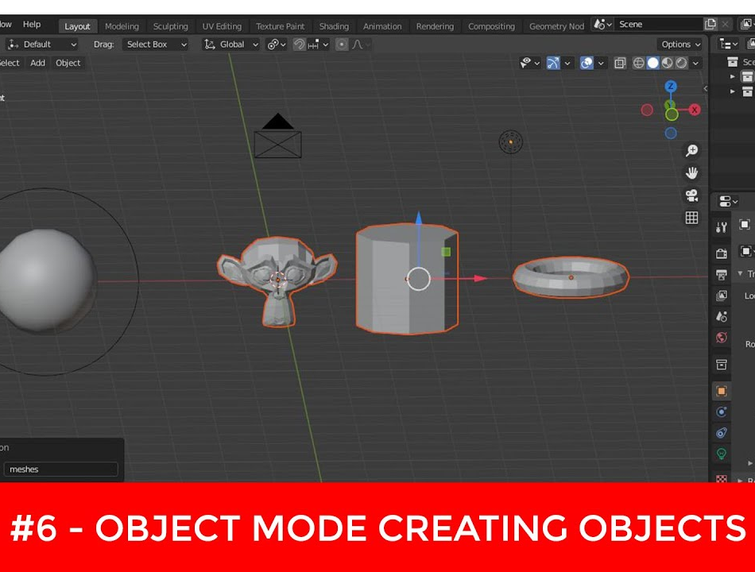
TOPIC 1 · VISUAL REFERENCE
Organise objects, data and modifiers
PRINCIPLE
A clean scene makes decisions reversible and handoffs understandable.
APPLIED EXAMPLE
The fish body, eyes and fins are named, collected and mirrored non-destructively before detail is added.
EVIDENCE TO TRACK
1
Zero ambiguous names
2
Hierarchy matches deliverable
LEGACY BLENDER REFERENCE · CURRENT WORKFLOW EXPLAINED AT RIGHT
3
Modifier intent recorded
3D Modelling with Blender for Beginners · TGS-2022015368
© Tertiary Infotech Academy Pte. Ltd.
35

Slide 36
HANDS-ON PRACTICE
Topic 1 labs
Lab 1
Lab 2
Progression
Navigate Blender and organise a production scene
Interpret a fish brief, budget polygons and build a blockout
Inspect and plan
A named, organised scene with a short evidence presentation.
A brief, scorecard and editable goldfish blockout within the stated budget.
Build and refine
Verify and present
3D Modelling with Blender for Beginners · TGS-2022015368
© Tertiary Infotech Academy Pte. Ltd.
36

Slide 37
LAB 1 · FOUNDATION
Navigate Blender and organise a production scene
LAB 1
ALIGNMENT
You are onboarding to a small studio and must turn an unfamiliar Blender file into a controlled working scene.
K2 · A1
OBJECTIVE
DELIVERABLE
Navigate the interface, distinguish Object and Edit modes, organise objects and preserve a clean baseline.
A named, organised scene with a short evidence presentation.
3D Modelling with Blender for Beginners · TGS-2022015368
© Tertiary Infotech Academy Pte. Ltd.
37

Slide 38
LAB VISUAL · DETAILED STEPS ARE IN THE LEARNER GUIDE
Lab 1 — example evidence
Use this as a visual benchmark, then replace it with your own Blender view. Your submission must show the editable source, measured checks and acceptance result—not only a polished render.
Concept visual — validate against the editable Blender file.
3D Modelling with Blender for Beginners · TGS-2022015368
© Tertiary Infotech Academy Pte. Ltd.
38

Slide 39
ACCEPTANCE CRITERIA
Lab 1 — quality gates
Form
Structure
Delivery
Required editors and modes are correctly identified
Transforms are intentional and recorded
Saved file reopens without missing data
Objects and collections use meaningful names
Original starter remains unchanged
A named, organised scene with a short evidence presentation.
3D Modelling with Blender for Beginners · TGS-2022015368
© Tertiary Infotech Academy Pte. Ltd.
39

Slide 40
VERIFY, DOCUMENT, SUBMIT
Lab 1 — acceptance evidence
ACCEPTANCE CHECKS
EVIDENCE TO SUBMIT
Required editors and modes are correctly identified
Interface screenshot
Objects and collections use meaningful names
Perspective and orthographic comparison
Outliner hierarchy
Transforms are intentional and recorded
Transform panel
Original starter remains unchanged
Saved-version confirmation
Saved file reopens without missing data
3D Modelling with Blender for Beginners · TGS-2022015368
© Tertiary Infotech Academy Pte. Ltd.
40

Slide 41
LAB 2 · FOUNDATION
Interpret a fish brief, budget polygons and build a blockout
LAB 2
ALIGNMENT
A client needs a recognisable goldfish prototype for a lightweight interactive scene.
K1–K2 · A1–A2
OBJECTIVE
DELIVERABLE
Translate the brief into criteria, allocate a polygon budget and create a modifier-led blockout.
A brief, scorecard and editable goldfish blockout within the stated budget.
3D Modelling with Blender for Beginners · TGS-2022015368
© Tertiary Infotech Academy Pte. Ltd.
41

Slide 42
LAB VISUAL · DETAILED STEPS ARE IN THE LEARNER GUIDE
Lab 2 — example evidence
Use this as a visual benchmark, then replace it with your own Blender view. Your submission must show the editable source, measured checks and acceptance result—not only a polished render.
Concept visual — validate against the editable Blender file.
3D Modelling with Blender for Beginners · TGS-2022015368
© Tertiary Infotech Academy Pte. Ltd.
42

Slide 43
ACCEPTANCE CRITERIA
Lab 2 — quality gates
Form
Structure
Delivery
Brief contains measurable requirements
Blockout silhouette matches the concept
Recorded count is within target or has a justified action
Budget definition and allocation are explicit
Modifier workflow remains editable
A brief, scorecard and editable goldfish blockout within the stated budget.
3D Modelling with Blender for Beginners · TGS-2022015368
© Tertiary Infotech Academy Pte. Ltd.
43

Slide 44
VERIFY, DOCUMENT, SUBMIT
Lab 2 — acceptance evidence
ACCEPTANCE CHECKS
EVIDENCE TO SUBMIT
Brief contains measurable requirements
Creative brief
Budget definition and allocation are explicit
Polygon allocation table
Three key views
Blockout silhouette matches the concept
Modifier stack
Modifier workflow remains editable
Viewport statistics
Recorded count is within target or has a justified action
3D Modelling with Blender for Beginners · TGS-2022015368
© Tertiary Infotech Academy Pte. Ltd.
44

Slide 45
WHAT YOU CAN NOW DEMONSTRATE
Topic 1 recap
1
Concepts
2
Labs
5 decision-ready frameworks
Labs 1–2 completed
3
Evidence
4
Alignment
Editable Blender files, metrics and presentations
LO1 · K1–K2 · A1–A2
3D Modelling with Blender for Beginners · TGS-2022015368
© Tertiary Infotech Academy Pte. Ltd.
45

Slide 46
02
TOPIC 2
Develop 3D Models and Prototypes
Block out form · sculpt detail · refine topology
3D Modelling with Blender for Beginners · TGS-2022015368
© Tertiary Infotech Academy Pte. Ltd.
46

Slide 47
PROGRESSIVE LEARNING
Topic 2 — capability map
1
Understand
2
Apply
Block out form
sculpt detail
3
Review
4
Demonstrate
LO2 · K3–K4, K7 · A3–A4
Labs 3–4
3D Modelling with Blender for Beginners · TGS-2022015368
© Tertiary Infotech Academy Pte. Ltd.
47

Slide 48
TOPIC 2 · CONCEPT 1
Translate concept art into three-dimensional form
1
Views
2
Landmarks
Front, side, top and perspective references
Eye line, widest body, fin roots and tail
3
Volume
4
Review
Primary, secondary and tertiary forms
Compare silhouette before detail
3D Modelling with Blender for Beginners · TGS-2022015368
© Tertiary Infotech Academy Pte. Ltd.
48

Slide 49
TOPIC 2 · ANALYSIS
Decisions and risks — Translate concept art into three-dimensional form
DECISIONS THAT IMPROVE QUALITY
FAILURE MODES TO CONTROL
Choose a dominant reference view
Perspective distortion in concept art
Mark proportion landmarks
Detail hides proportion errors
Resolve contradictions explicitly
Reference planes misaligned
Review at intended camera distance
3D Modelling with Blender for Beginners · TGS-2022015368
© Tertiary Infotech Academy Pte. Ltd.
49

Slide 50
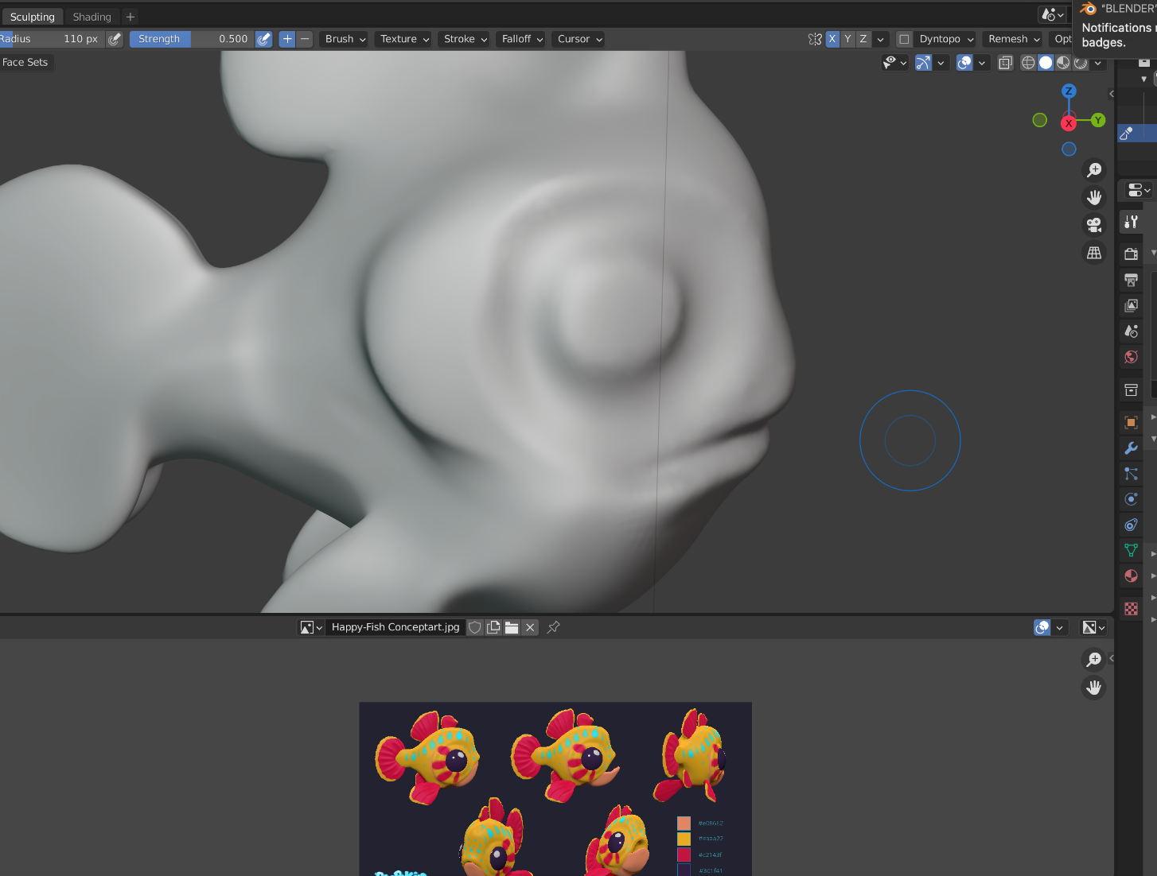
TOPIC 2 · VISUAL REFERENCE
Translate concept art into three-dimensional form
PRINCIPLE
Use multiple views and landmark proportions; do not copy a single perspective literally.
APPLIED EXAMPLE
A fish blockout begins with body mass, tail plane and eye landmarks before scales or surface detail.
EVIDENCE TO TRACK
1
Landmarks align in key views
2
Silhouette recognisable
LEGACY BLENDER REFERENCE · CURRENT WORKFLOW EXPLAINED AT RIGHT
3
Primary volumes complete
3D Modelling with Blender for Beginners · TGS-2022015368
© Tertiary Infotech Academy Pte. Ltd.
50

Slide 51
TOPIC 2 · CONCEPT 2
Model with mesh anatomy and edge flow
1
Components
2
Loops
Vertices, edges, faces and normals
Continuous paths around forms and joints
3
Topology
4
Normals
Quad-led structure with intentional poles
Face direction and smooth shading behaviour
3D Modelling with Blender for Beginners · TGS-2022015368
© Tertiary Infotech Academy Pte. Ltd.
51

Slide 52
TOPIC 2 · ANALYSIS
Decisions and risks — Model with mesh anatomy and edge flow
DECISIONS THAT IMPROVE QUALITY
FAILURE MODES TO CONTROL
Add loops only for form or deformation
Non-manifold edges
Place poles away from bending areas
Flipped normals
Inspect face orientation
Dense, irregular topology
Prefer clean local repairs
3D Modelling with Blender for Beginners · TGS-2022015368
© Tertiary Infotech Academy Pte. Ltd.
52

Slide 53
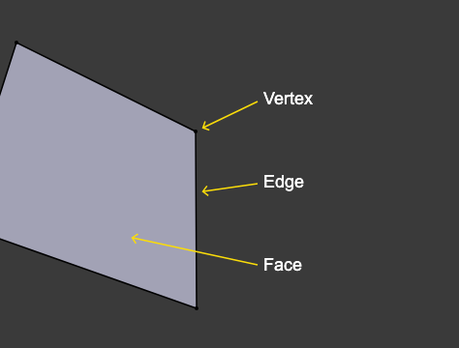
TOPIC 2 · VISUAL REFERENCE
Model with mesh anatomy and edge flow
PRINCIPLE
Vertices, edges and faces form loops that support silhouette, shading and deformation.
APPLIED EXAMPLE
Concentric eye loops support expression while longitudinal body loops preserve a smooth fish silhouette.
EVIDENCE TO TRACK
1
Manifold target met
2
Normals outward
LEGACY BLENDER REFERENCE · CURRENT WORKFLOW EXPLAINED AT RIGHT
3
Loops support animation
3D Modelling with Blender for Beginners · TGS-2022015368
© Tertiary Infotech Academy Pte. Ltd.
53

Slide 54
TOPIC 2 · CONCEPT 3
Use Edit Mode tools as a controlled vocabulary
1
Extrude
2
Inset
Extend connected form
Create an inner boundary
3
Bevel
4
Loop Cut
Control edge width and highlights
Add resolution around a continuous loop
3D Modelling with Blender for Beginners · TGS-2022015368
© Tertiary Infotech Academy Pte. Ltd.
54

Slide 55
TOPIC 2 · ANALYSIS
Decisions and risks — Use Edit Mode tools as a controlled vocabulary
DECISIONS THAT IMPROVE QUALITY
FAILURE MODES TO CONTROL
Extrude along a constrained direction
Duplicate faces from cancelled moves
Avoid stacked accidental extrusions
Bevel pinching
Use bevel width consistently
Loop cut stops at poles
Add cuts where curvature needs support
3D Modelling with Blender for Beginners · TGS-2022015368
© Tertiary Infotech Academy Pte. Ltd.
55

Slide 56
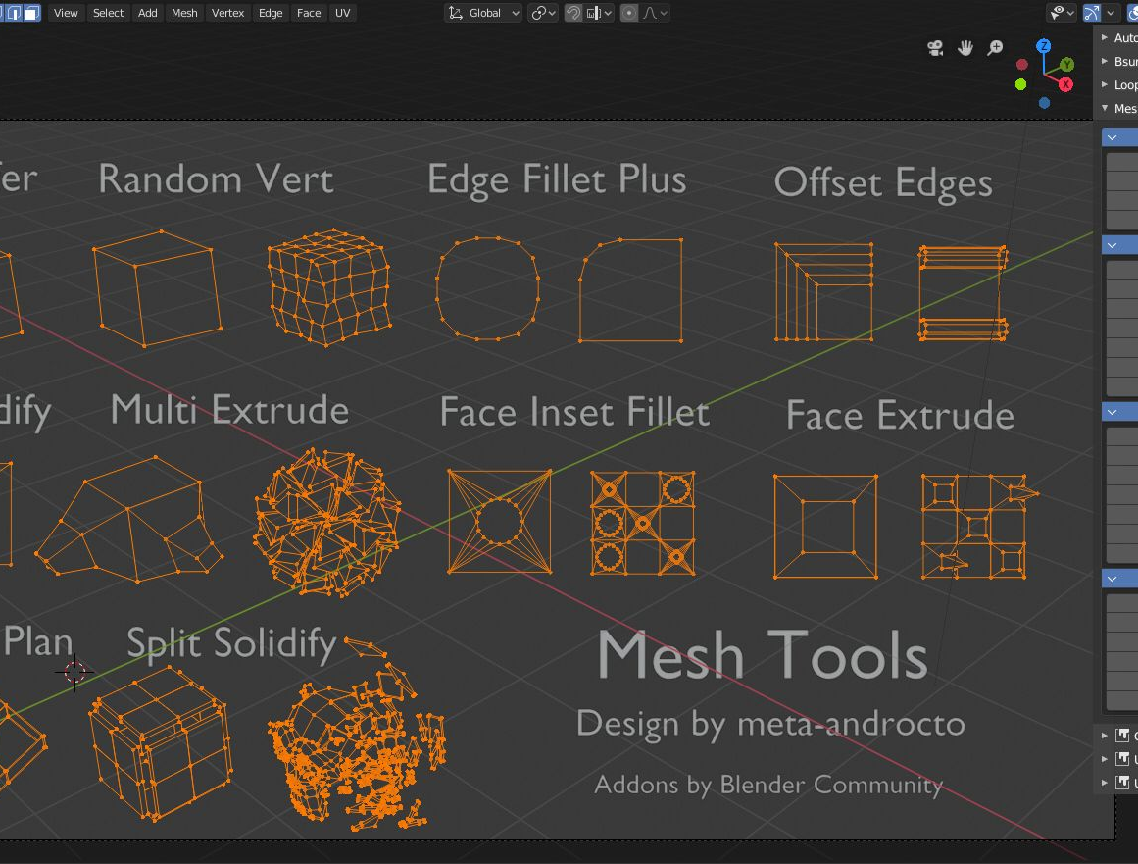
TOPIC 2 · VISUAL REFERENCE
Use Edit Mode tools as a controlled vocabulary
PRINCIPLE
Extrude, inset, bevel and loop cut should each answer a form or topology need.
APPLIED EXAMPLE
The tail grows from an extrusion, while a small bevel produces a readable highlight without excessive subdivision.
EVIDENCE TO TRACK
1
No duplicate geometry
2
Curvature reads cleanly
LEGACY BLENDER REFERENCE · CURRENT WORKFLOW EXPLAINED AT RIGHT
3
Budget remains controlled
3D Modelling with Blender for Beginners · TGS-2022015368
© Tertiary Infotech Academy Pte. Ltd.
56

Slide 57
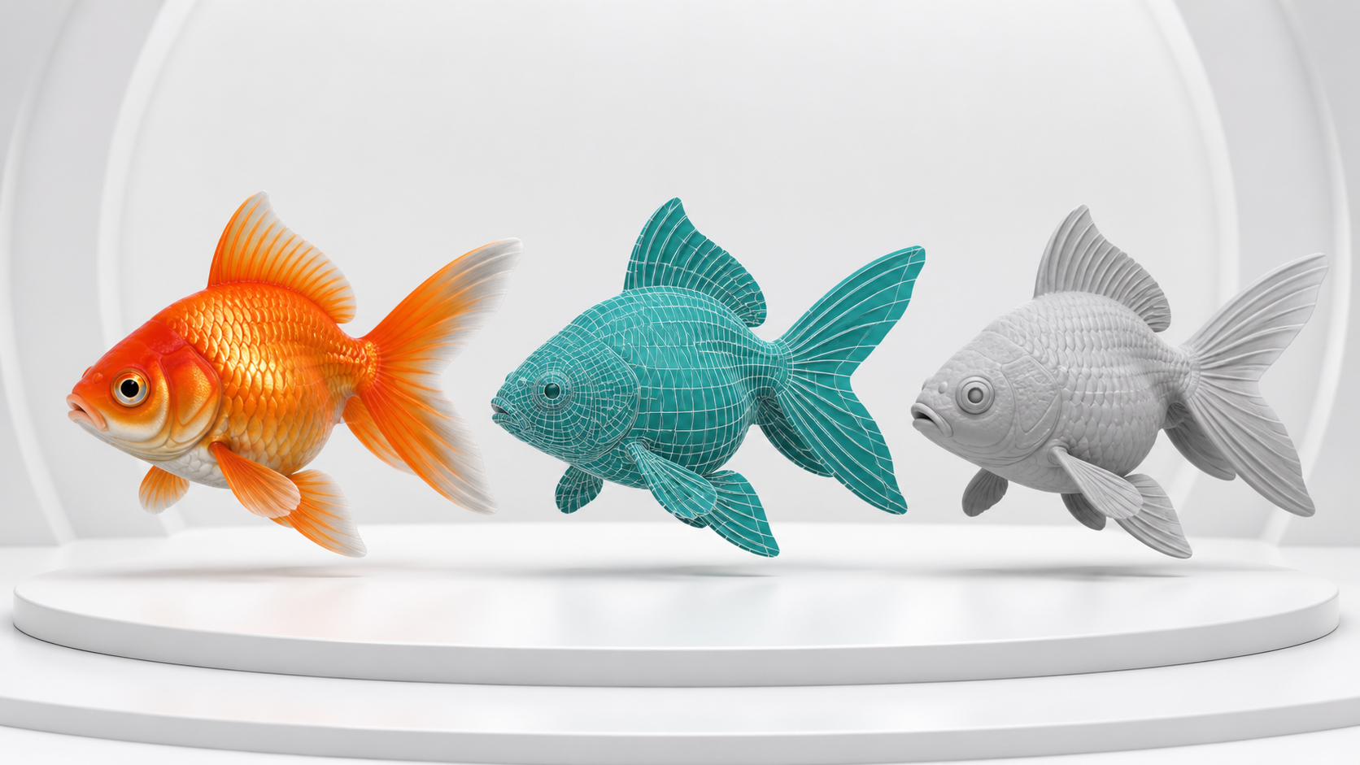
CONCEPT VISUAL
Mesh quality — before and after
The same conceptual object can look similar in silhouette while differing radically in topology. Validate manifold status, edge flow and shading before approval.
Concept visual — validate against the editable Blender file.
3D Modelling with Blender for Beginners · TGS-2022015368
© Tertiary Infotech Academy Pte. Ltd.
57

Slide 58
TOPIC 2 · CONCEPT 4
Sculpt from broad forms to controlled detail
1
Brushes
2
Symmetry
Grab, clay, smooth and crease for distinct jobs
Preserve paired form while blocking
3
Dyntopo
4
Remesh
Local dynamic detail with topology cost
Redistribute resolution for sculpting
3D Modelling with Blender for Beginners · TGS-2022015368
© Tertiary Infotech Academy Pte. Ltd.
58

Slide 59
TOPIC 2 · ANALYSIS
Decisions and risks — Sculpt from broad forms to controlled detail
DECISIONS THAT IMPROVE QUALITY
FAILURE MODES TO CONTROL
Lock primary forms before detail
Detail added at the wrong scale
Choose resolution for the current stage
Dyntopo destroys planned topology
Save before remesh
Over-smoothing removes landmarks
Retopologise if animation demands it
3D Modelling with Blender for Beginners · TGS-2022015368
© Tertiary Infotech Academy Pte. Ltd.
59

Slide 60
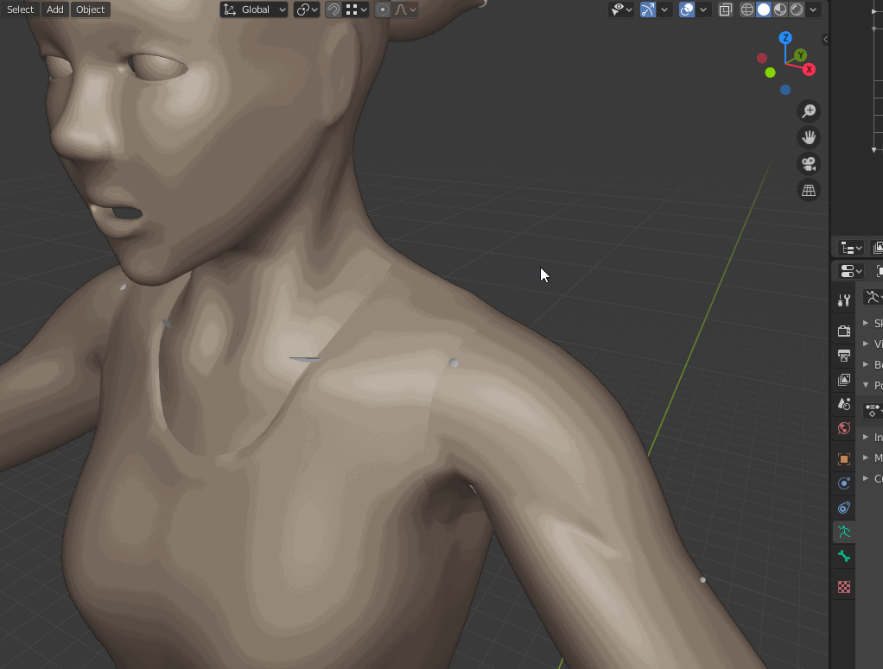
TOPIC 2 · VISUAL REFERENCE
Sculpt from broad forms to controlled detail
PRINCIPLE
Sculpting is most predictable when resolution, symmetry and brush purpose are managed.
APPLIED EXAMPLE
Grab establishes the fish belly and tail arc; Smooth removes noise; Crease defines the mouth only after proportions pass.
EVIDENCE TO TRACK
1
Primary form approved
2
Symmetry intentional
LEGACY BLENDER REFERENCE · CURRENT WORKFLOW EXPLAINED AT RIGHT
3
Topology plan stated
3D Modelling with Blender for Beginners · TGS-2022015368
© Tertiary Infotech Academy Pte. Ltd.
60

Slide 61
TOPIC 2 · CONCEPT 5
Review and refine the prototype
1
Compare
2
Measure
Overlay reference and inspect key views
Dimensions, transforms and polygon statistics
3
Inspect
4
Decide
Normals, manifold status and modifier result
Accept, repair or escalate with reasons
3D Modelling with Blender for Beginners · TGS-2022015368
© Tertiary Infotech Academy Pte. Ltd.
61

Slide 62
TOPIC 2 · ANALYSIS
Decisions and risks — Review and refine the prototype
DECISIONS THAT IMPROVE QUALITY
FAILURE MODES TO CONTROL
Preserve a baseline
Changing many variables at once
Review one failure class at a time
Review only the beauty render
Capture before/after evidence
No trace of rejected versions
Record remaining limitations
3D Modelling with Blender for Beginners · TGS-2022015368
© Tertiary Infotech Academy Pte. Ltd.
62

Slide 63
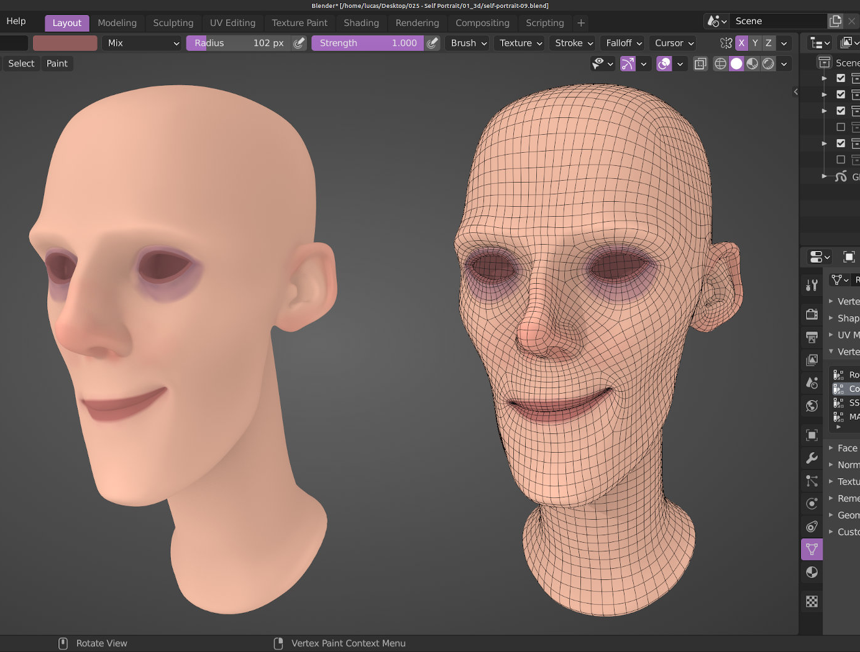
TOPIC 2 · VISUAL REFERENCE
Review and refine the prototype
PRINCIPLE
A prototype is accepted through criteria, evidence and iteration—not appearance alone.
APPLIED EXAMPLE
The goldfish passes silhouette and 500-polygon criteria after a local tail repair and reduction of hidden underside loops.
EVIDENCE TO TRACK
1
Acceptance checklist complete
2
Defects closed or owned
LEGACY BLENDER REFERENCE · CURRENT WORKFLOW EXPLAINED AT RIGHT
3
Version and reviewer recorded
3D Modelling with Blender for Beginners · TGS-2022015368
© Tertiary Infotech Academy Pte. Ltd.
63

Slide 64
HANDS-ON PRACTICE
Topic 2 labs
Lab 3
Lab 4
Progression
Model and sculpt the production goldfish
Repair topology, normals and deformation zones
Inspect and plan
A recognisable goldfish model with intentional form, topology and saved milestones.
A repaired, review-ready mesh with a defect log and before/after evidence.
Build and refine
Verify and present
3D Modelling with Blender for Beginners · TGS-2022015368
© Tertiary Infotech Academy Pte. Ltd.
64

Slide 65
LAB 3 · INTERMEDIATE
Model and sculpt the production goldfish
LAB 3
ALIGNMENT
The approved blockout needs clearer anatomy and controlled detail without losing its low-cost structure.
K3–K4 · A3
OBJECTIVE
DELIVERABLE
Develop primary and secondary forms with suitable Edit Mode and sculpting tools.
A recognisable goldfish model with intentional form, topology and saved milestones.
3D Modelling with Blender for Beginners · TGS-2022015368
© Tertiary Infotech Academy Pte. Ltd.
65

Slide 66
LAB VISUAL · DETAILED STEPS ARE IN THE LEARNER GUIDE
Lab 3 — example evidence
Use this as a visual benchmark, then replace it with your own Blender view. Your submission must show the editable source, measured checks and acceptance result—not only a polished render.
Concept visual — validate against the editable Blender file.
3D Modelling with Blender for Beginners · TGS-2022015368
© Tertiary Infotech Academy Pte. Ltd.
66

Slide 67
ACCEPTANCE CRITERIA
Lab 3 — quality gates
Form
Structure
Delivery
Primary and secondary forms are readable
Detail level matches the stage
Milestone files and metrics are preserved
Symmetry is intentional
Topology plan supports later animation
A recognisable goldfish model with intentional form, topology and saved milestones.
3D Modelling with Blender for Beginners · TGS-2022015368
© Tertiary Infotech Academy Pte. Ltd.
67

Slide 68
VERIFY, DOCUMENT, SUBMIT
Lab 3 — acceptance evidence
ACCEPTANCE CHECKS
EVIDENCE TO SUBMIT
Primary and secondary forms are readable
Landmark view
Symmetry is intentional
Sculpting before/after
Wireframe view
Detail level matches the stage
Polygon statistics
Topology plan supports later animation
Decision explanation
Milestone files and metrics are preserved
3D Modelling with Blender for Beginners · TGS-2022015368
© Tertiary Infotech Academy Pte. Ltd.
68

Slide 69
LAB 4 · INTERMEDIATE
Repair topology, normals and deformation zones
LAB 4
ALIGNMENT
A review finds shading defects, dense areas and weak edge flow around the tail.
K4, K7 · A4
OBJECTIVE
DELIVERABLE
Diagnose and repair the supplied mesh, then prove the revised prototype meets its criteria.
A repaired, review-ready mesh with a defect log and before/after evidence.
3D Modelling with Blender for Beginners · TGS-2022015368
© Tertiary Infotech Academy Pte. Ltd.
69

Slide 70
LAB VISUAL · DETAILED STEPS ARE IN THE LEARNER GUIDE
Lab 4 — example evidence
Use this as a visual benchmark, then replace it with your own Blender view. Your submission must show the editable source, measured checks and acceptance result—not only a polished render.
Concept visual — validate against the editable Blender file.
3D Modelling with Blender for Beginners · TGS-2022015368
© Tertiary Infotech Academy Pte. Ltd.
70

Slide 71
ACCEPTANCE CRITERIA
Lab 4 — quality gates
Form
Structure
Delivery
No unintended non-manifold geometry remains
Silhouette remains approved
Defect log links each issue to evidence and result
Normals face outward
Tail deformation holds volume
A repaired, review-ready mesh with a defect log and before/after evidence.
3D Modelling with Blender for Beginners · TGS-2022015368
© Tertiary Infotech Academy Pte. Ltd.
71

Slide 72
VERIFY, DOCUMENT, SUBMIT
Lab 4 — acceptance evidence
ACCEPTANCE CHECKS
EVIDENCE TO SUBMIT
No unintended non-manifold geometry remains
Baseline wireframe
Normals face outward
Face-orientation view
Defect log
Silhouette remains approved
Deformation test
Tail deformation holds volume
Final statistics
Defect log links each issue to evidence and result
3D Modelling with Blender for Beginners · TGS-2022015368
© Tertiary Infotech Academy Pte. Ltd.
72

Slide 73
WHAT YOU CAN NOW DEMONSTRATE
Topic 2 recap
1
Concepts
2
Labs
5 decision-ready frameworks
Labs 3–4 completed
3
Evidence
4
Alignment
Editable Blender files, metrics and presentations
LO2 · K3–K4, K7 · A3–A4
3D Modelling with Blender for Beginners · TGS-2022015368
© Tertiary Infotech Academy Pte. Ltd.
73

Slide 74
03
TOPIC 3
Animate and Present the 3D Prototype
Rig movement · keyframe action · surface and present
3D Modelling with Blender for Beginners · TGS-2022015368
© Tertiary Infotech Academy Pte. Ltd.
74

Slide 75
PROGRESSIVE LEARNING
Topic 3 — capability map
1
Understand
2
Apply
Rig movement
keyframe action
3
Review
4
Demonstrate
LO3 · K5–K8 · A5–A6
Labs 5–6
3D Modelling with Blender for Beginners · TGS-2022015368
© Tertiary Infotech Academy Pte. Ltd.
75

Slide 76
TOPIC 3 · CONCEPT 1
Apply animation principles to readable motion
1
Timing
2
Spacing
Frames allocated to an action
Distance travelled between frames
3
Arcs
4
Overlap
Natural curved motion paths
Fins and tail follow the body
3D Modelling with Blender for Beginners · TGS-2022015368
© Tertiary Infotech Academy Pte. Ltd.
76

Slide 77
TOPIC 3 · ANALYSIS
Decisions and risks — Apply animation principles to readable motion
DECISIONS THAT IMPROVE QUALITY
FAILURE MODES TO CONTROL
Block key poses first
Even spacing feels robotic
Choose frame rate before animation
No anticipation
Exaggerate only for readability
Secondary motion competes with the action
Review motion at real speed
3D Modelling with Blender for Beginners · TGS-2022015368
© Tertiary Infotech Academy Pte. Ltd.
77

Slide 78
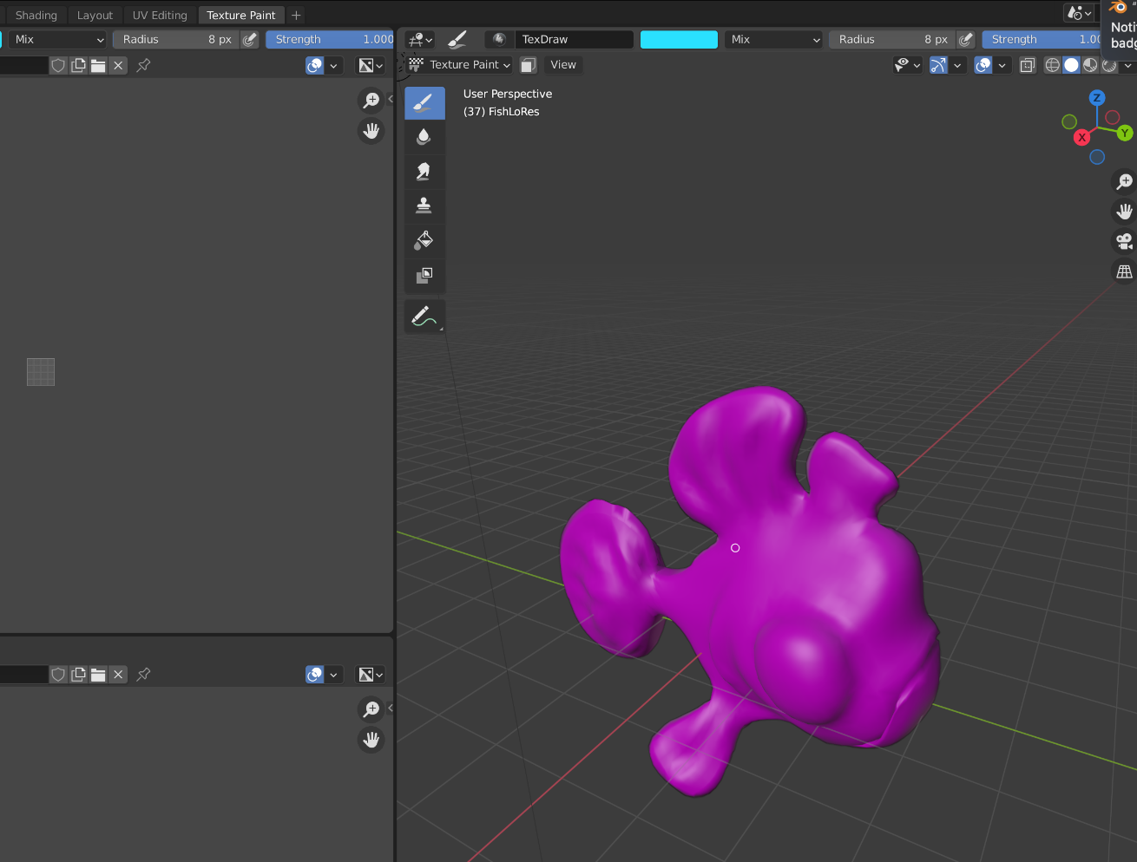
TOPIC 3 · VISUAL REFERENCE
Apply animation principles to readable motion
PRINCIPLE
Timing, spacing, anticipation and follow-through make mechanical keyframes feel intentional.
APPLIED EXAMPLE
A swim cycle leads with the body, then offsets the tail and fins to create overlap and a continuous arc.
EVIDENCE TO TRACK
1
Cycle loops cleanly
2
Pose silhouette readable
LEGACY BLENDER REFERENCE · CURRENT WORKFLOW EXPLAINED AT RIGHT
3
Timing matches brief
3D Modelling with Blender for Beginners · TGS-2022015368
© Tertiary Infotech Academy Pte. Ltd.
78

Slide 79
TOPIC 3 · CONCEPT 2
Rig with armatures and controlled weights
1
Bones
2
Hierarchy
Joint chain and local axes
Parent-child motion relationships
3
Skinning
4
Weights
Bind mesh to the armature
Control vertex influence
3D Modelling with Blender for Beginners · TGS-2022015368
© Tertiary Infotech Academy Pte. Ltd.
79

Slide 80
TOPIC 3 · ANALYSIS
Decisions and risks — Rig with armatures and controlled weights
DECISIONS THAT IMPROVE QUALITY
FAILURE MODES TO CONTROL
Place joints at meaningful bend zones
Bone axes inconsistent
Check bone roll
Weights leak across the body
Test extreme poses
Topology collapses at a bend
Repair weights locally
3D Modelling with Blender for Beginners · TGS-2022015368
© Tertiary Infotech Academy Pte. Ltd.
80

Slide 81
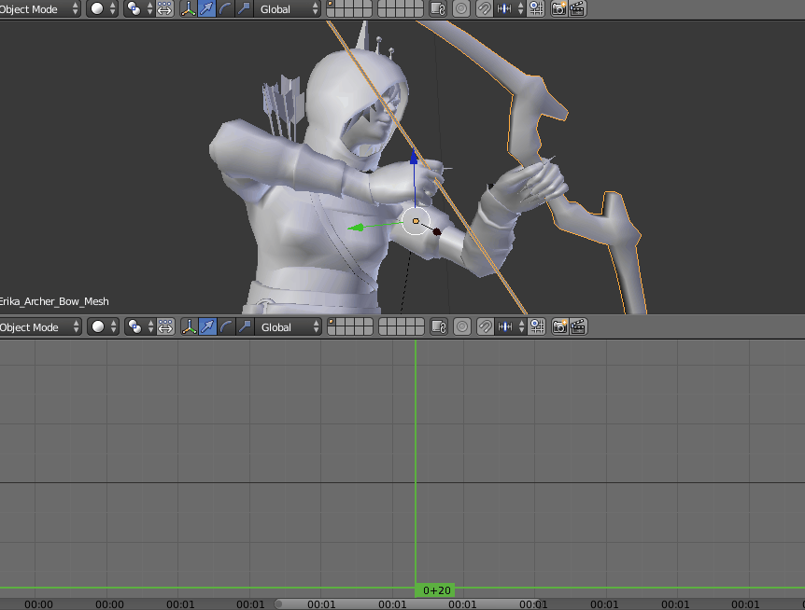
TOPIC 3 · VISUAL REFERENCE
Rig with armatures and controlled weights
PRINCIPLE
A rig is a deformation system whose hierarchy and weights must match intended movement.
APPLIED EXAMPLE
A simple body-to-tail bone chain bends the fish while fin bones provide subtle independent motion.
EVIDENCE TO TRACK
1
Extreme poses hold volume
2
No unintended vertices move
LEGACY BLENDER REFERENCE · CURRENT WORKFLOW EXPLAINED AT RIGHT
3
Hierarchy is named
3D Modelling with Blender for Beginners · TGS-2022015368
© Tertiary Infotech Academy Pte. Ltd.
81

Slide 82
TOPIC 3 · CONCEPT 3
Control keyframes, interpolation and curves
1
Keyframes
2
Interpolation
Location, rotation, scale or property states
Constant, linear or Bézier transitions
3
F-Curves
4
Dope Sheet
Editable value-over-time graphs
Timing and keyframe organisation
3D Modelling with Blender for Beginners · TGS-2022015368
© Tertiary Infotech Academy Pte. Ltd.
82

Slide 83
TOPIC 3 · ANALYSIS
Decisions and risks — Control keyframes, interpolation and curves
DECISIONS THAT IMPROVE QUALITY
FAILURE MODES TO CONTROL
Key only intended channels
Unwanted channels keyed
Use linear for constant motion
Bézier overshoot
Edit handles to remove overshoot
Loop boundary jumps
Cycle only seamless channels
3D Modelling with Blender for Beginners · TGS-2022015368
© Tertiary Infotech Academy Pte. Ltd.
83

Slide 84
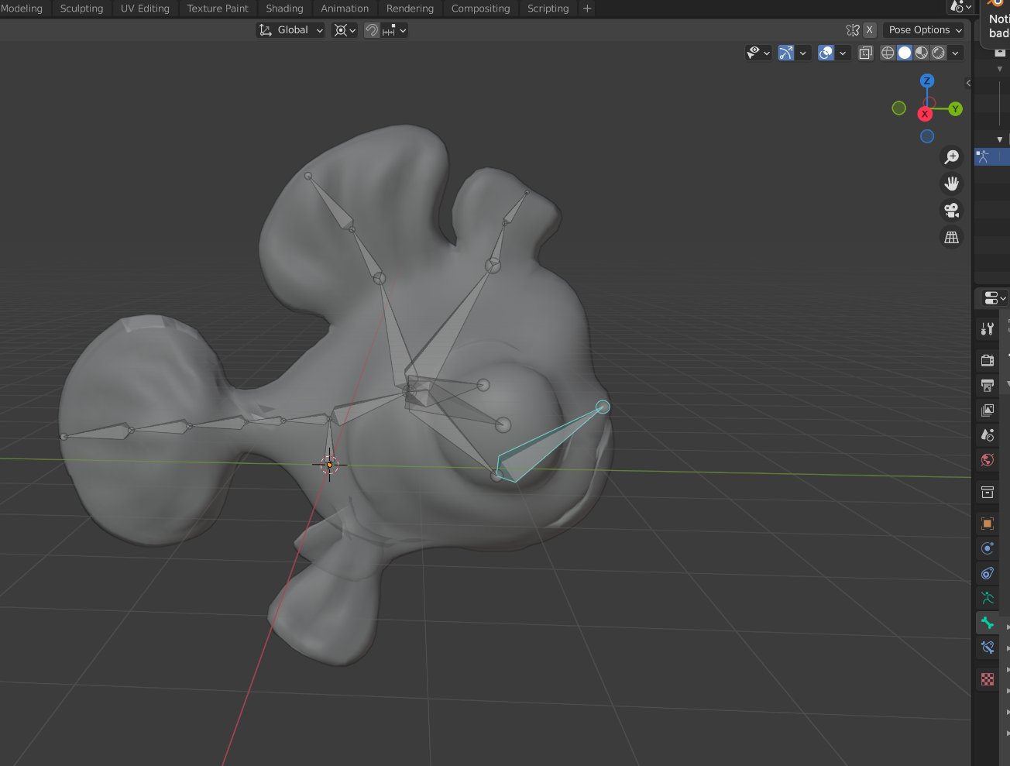
TOPIC 3 · VISUAL REFERENCE
Control keyframes, interpolation and curves
PRINCIPLE
Keyframes store states; interpolation and F-curves define how the values change.
APPLIED EXAMPLE
The fish translates linearly across the bowl while tail rotation uses smooth cyclic curves with offset timing.
EVIDENCE TO TRACK
1
No accidental keys
2
Curve shape justified
LEGACY BLENDER REFERENCE · CURRENT WORKFLOW EXPLAINED AT RIGHT
3
Loop boundary matches
3D Modelling with Blender for Beginners · TGS-2022015368
© Tertiary Infotech Academy Pte. Ltd.
84

Slide 85
TOPIC 3 · CONCEPT 4
Build materials from shaders, UVs and textures
1
Shader
2
Channels
Principled BSDF response to light
Base colour, roughness, metallic and normal
3
UV
4
Texture
2D coordinates with seams and islands
Image data with colour-space choices
3D Modelling with Blender for Beginners · TGS-2022015368
© Tertiary Infotech Academy Pte. Ltd.
85

Slide 86
TOPIC 3 · ANALYSIS
Decisions and risks — Build materials from shaders, UVs and textures
DECISIONS THAT IMPROVE QUALITY
FAILURE MODES TO CONTROL
Set scale before unwrapping
Overlapping UVs unintentionally
Place seams in low-visibility areas
Wrong colour space
Use Non-Color for data maps
Material judged under dramatic light only
Test under neutral light
3D Modelling with Blender for Beginners · TGS-2022015368
© Tertiary Infotech Academy Pte. Ltd.
86

Slide 87
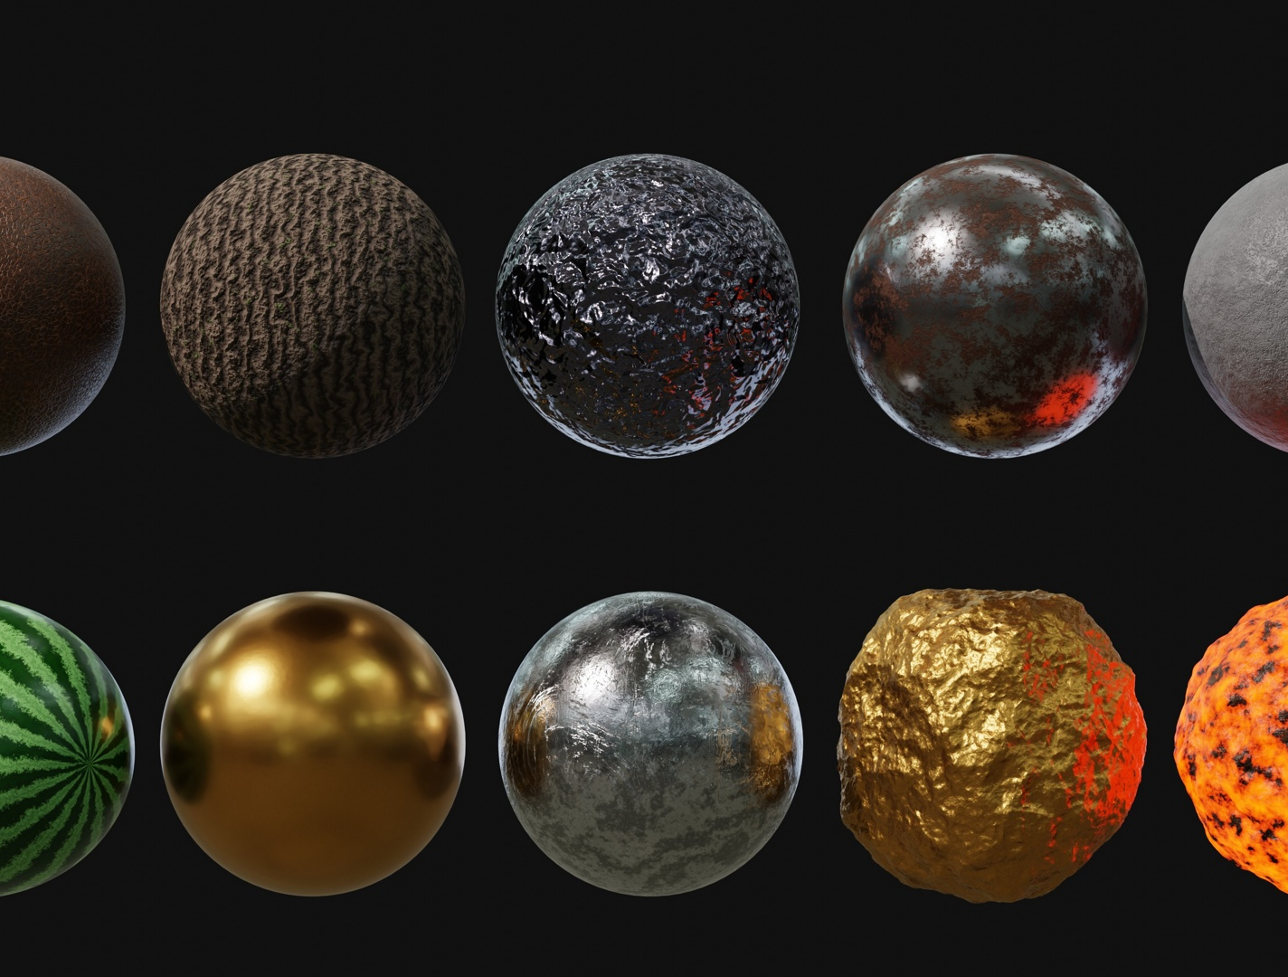
TOPIC 3 · VISUAL REFERENCE
Build materials from shaders, UVs and textures
PRINCIPLE
Materials describe surface response; textures provide mapped data; UVs define how 2D data reaches the mesh.
APPLIED EXAMPLE
The fish uses a clean body UV, colour texture, moderate roughness and a subtle normal map that holds under rotation.
EVIDENCE TO TRACK
1
No unintended overlaps
2
Texel density consistent
LEGACY BLENDER REFERENCE · CURRENT WORKFLOW EXPLAINED AT RIGHT
3
Channels connected correctly
3D Modelling with Blender for Beginners · TGS-2022015368
© Tertiary Infotech Academy Pte. Ltd.
87

Slide 88
TOPIC 3 · CONCEPT 5
Present the prototype for useful feedback
1
Context
2
Views
Brief and target use
Neutral orthographic and perspective evidence
3
Motion
4
Decision
Short loop at intended speed
Pass, limitation and requested approval
3D Modelling with Blender for Beginners · TGS-2022015368
© Tertiary Infotech Academy Pte. Ltd.
88

Slide 89
TOPIC 3 · ANALYSIS
Decisions and risks — Present the prototype for useful feedback
DECISIONS THAT IMPROVE QUALITY
FAILURE MODES TO CONTROL
Use comparable before/after views
Only a beauty render
Show statistics and version
No version identification
State open risks
Feedback request too broad
Ask a specific review question
3D Modelling with Blender for Beginners · TGS-2022015368
© Tertiary Infotech Academy Pte. Ltd.
89

Slide 90
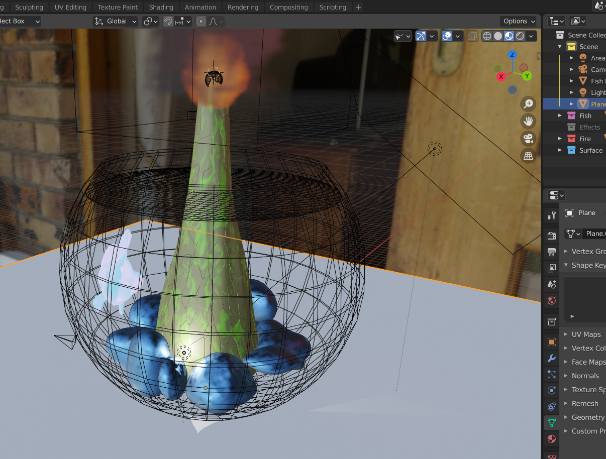
TOPIC 3 · VISUAL REFERENCE
Present the prototype for useful feedback
PRINCIPLE
A review presentation should expose intent, process, evidence and the decision required.
APPLIED EXAMPLE
The review pack shows the concept, wireframe, UV/material view and swim cycle, then requests approval to proceed to final lighting.
EVIDENCE TO TRACK
1
All required views present
2
Decision owner named
LEGACY BLENDER REFERENCE · CURRENT WORKFLOW EXPLAINED AT RIGHT
3
Feedback logged
3D Modelling with Blender for Beginners · TGS-2022015368
© Tertiary Infotech Academy Pte. Ltd.
90

Slide 91
HANDS-ON PRACTICE
Topic 3 labs
Lab 5
Lab 6
Progression
UV unwrap and surface the goldfish
Rig and animate a looping swim cycle
Inspect and plan
A surfaced fish with validated UV layout, material channels and texture dependencies.
A rigged fish with a looped swim animation and deformation evidence.
Build and refine
Verify and present
3D Modelling with Blender for Beginners · TGS-2022015368
© Tertiary Infotech Academy Pte. Ltd.
91

Slide 92
LAB 5 · INTERMEDIATE
UV unwrap and surface the goldfish
LAB 5
ALIGNMENT
The approved mesh needs a stable PBR material for close review and animation.
K6–K7 · A5
OBJECTIVE
DELIVERABLE
Create controlled UVs, textures and a Principled BSDF material that remains readable under neutral light.
A surfaced fish with validated UV layout, material channels and texture dependencies.
3D Modelling with Blender for Beginners · TGS-2022015368
© Tertiary Infotech Academy Pte. Ltd.
92

Slide 93

LAB VISUAL · DETAILED STEPS ARE IN THE LEARNER GUIDE
Lab 5 — example evidence
Use this as a visual benchmark, then replace it with your own Blender view. Your submission must show the editable source, measured checks and acceptance result—not only a polished render.
Concept visual — validate against the editable Blender file.
3D Modelling with Blender for Beginners · TGS-2022015368
© Tertiary Infotech Academy Pte. Ltd.
93

Slide 94
ACCEPTANCE CRITERIA
Lab 5 — quality gates
Form
Structure
Delivery
UVs have no unintended overlaps
Material channels use correct colour spaces
Texture dependencies are included
Checker distortion is controlled
Surface reads under neutral lighting
A surfaced fish with validated UV layout, material channels and texture dependencies.
3D Modelling with Blender for Beginners · TGS-2022015368
© Tertiary Infotech Academy Pte. Ltd.
94

Slide 95
VERIFY, DOCUMENT, SUBMIT
Lab 5 — acceptance evidence
ACCEPTANCE CHECKS
EVIDENCE TO SUBMIT
UVs have no unintended overlaps
UV layout
Checker distortion is controlled
Checker test
Shader node graph
Material channels use correct colour spaces
Neutral render
Surface reads under neutral lighting
Dependency inventory
Texture dependencies are included
3D Modelling with Blender for Beginners · TGS-2022015368
© Tertiary Infotech Academy Pte. Ltd.
95

Slide 96
LAB 6 · INTERMEDIATE
Rig and animate a looping swim cycle
LAB 6
ALIGNMENT
The surfaced fish must perform a short, readable swim cycle for stakeholder review.
K5–K6 · A5–A6
OBJECTIVE
DELIVERABLE
Build a simple armature, validate deformation and animate a clean loop using controlled curves.
A rigged fish with a looped swim animation and deformation evidence.
3D Modelling with Blender for Beginners · TGS-2022015368
© Tertiary Infotech Academy Pte. Ltd.
96

Slide 97

LAB VISUAL · DETAILED STEPS ARE IN THE LEARNER GUIDE
Lab 6 — example evidence
Use this as a visual benchmark, then replace it with your own Blender view. Your submission must show the editable source, measured checks and acceptance result—not only a polished render.
Concept visual — validate against the editable Blender file.
3D Modelling with Blender for Beginners · TGS-2022015368
© Tertiary Infotech Academy Pte. Ltd.
97

Slide 98
ACCEPTANCE CRITERIA
Lab 6 — quality gates
Form
Structure
Delivery
Rig hierarchy and bones are named
No unintended vertices move
Timing and interpolation match the brief
Extreme poses hold volume
Animation loop is seamless
A rigged fish with a looped swim animation and deformation evidence.
3D Modelling with Blender for Beginners · TGS-2022015368
© Tertiary Infotech Academy Pte. Ltd.
98

Slide 99
VERIFY, DOCUMENT, SUBMIT
Lab 6 — acceptance evidence
ACCEPTANCE CHECKS
EVIDENCE TO SUBMIT
Rig hierarchy and bones are named
Armature hierarchy
Extreme poses hold volume
Weight-paint view
Extreme-pose test
No unintended vertices move
F-curve view
Animation loop is seamless
Loop playback or frame comparison
Timing and interpolation match the brief
3D Modelling with Blender for Beginners · TGS-2022015368
© Tertiary Infotech Academy Pte. Ltd.
99

Slide 100
WHAT YOU CAN NOW DEMONSTRATE
Topic 3 recap
1
Concepts
2
Labs
5 decision-ready frameworks
Labs 5–6 completed
3
Evidence
4
Alignment
Editable Blender files, metrics and presentations
LO3 · K5–K8 · A5–A6
3D Modelling with Blender for Beginners · TGS-2022015368
© Tertiary Infotech Academy Pte. Ltd.
100

Slide 101
04
TOPIC 4
Optimise, Render and Export the Model
Frame the asset · validate quality · deliver reliably
3D Modelling with Blender for Beginners · TGS-2022015368
© Tertiary Infotech Academy Pte. Ltd.
101

Slide 102
PROGRESSIVE LEARNING
Topic 4 — capability map
1
Understand
2
Apply
Frame the asset
validate quality
3
Review
4
Demonstrate
LO4 · K8–K9 · A7–A8
Labs 7–8
3D Modelling with Blender for Beginners · TGS-2022015368
© Tertiary Infotech Academy Pte. Ltd.
102

Slide 103
TOPIC 4 · CONCEPT 1
Use cameras to control what the audience sees
1
Projection
2
Lens
Perspective or orthographic
Field of view and spatial compression
3
Composition
4
DOF
Focal point, balance and negative space
Focus plane and controlled blur
3D Modelling with Blender for Beginners · TGS-2022015368
© Tertiary Infotech Academy Pte. Ltd.
103

Slide 104
TOPIC 4 · ANALYSIS
Decisions and risks — Use cameras to control what the audience sees
DECISIONS THAT IMPROVE QUALITY
FAILURE MODES TO CONTROL
Choose projection for the deliverable
Wide lens distorts form
Avoid lens distortion that changes review judgement
Clipped geometry
Lock approved cameras
Beauty DOF hides defects
Use DOF sparingly in evidence views
3D Modelling with Blender for Beginners · TGS-2022015368
© Tertiary Infotech Academy Pte. Ltd.
104

Slide 105
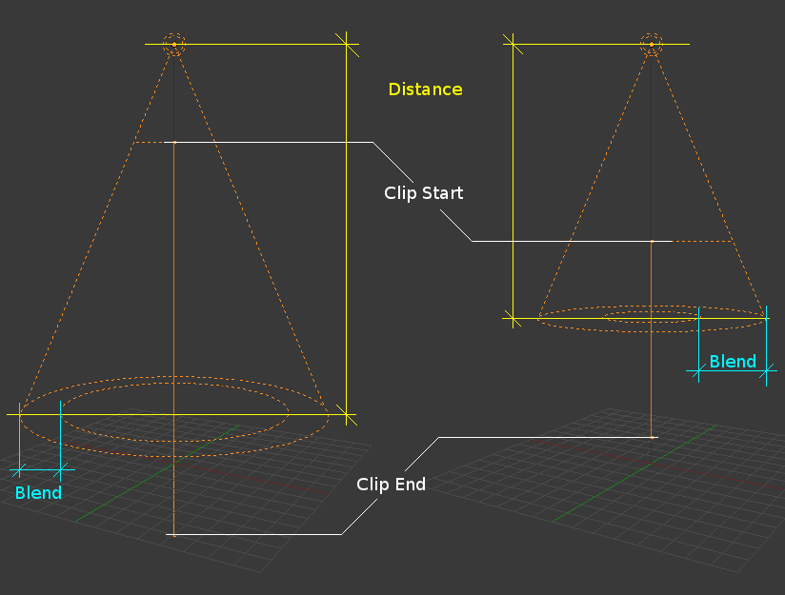
TOPIC 4 · VISUAL REFERENCE
Use cameras to control what the audience sees
PRINCIPLE
Camera projection, lens, composition and depth of field must serve the communication goal.
APPLIED EXAMPLE
A 50 mm perspective camera presents the fish naturally; orthographic cameras remain for proportion evidence.
EVIDENCE TO TRACK
1
Subject fully framed
2
Evidence views distortion-free
LEGACY BLENDER REFERENCE · CURRENT WORKFLOW EXPLAINED AT RIGHT
3
Camera named and locked
3D Modelling with Blender for Beginners · TGS-2022015368
© Tertiary Infotech Academy Pte. Ltd.
105

Slide 106
TOPIC 4 · CONCEPT 2
Light form with purpose
1
Key
2
Fill
Primary form-defining light
Controls shadow contrast
3
Rim
4
World
Separates silhouette from background
Ambient environment contribution
3D Modelling with Blender for Beginners · TGS-2022015368
© Tertiary Infotech Academy Pte. Ltd.
106

Slide 107
TOPIC 4 · ANALYSIS
Decisions and risks — Light form with purpose
DECISIONS THAT IMPROVE QUALITY
FAILURE MODES TO CONTROL
Start with one light
Flat multi-light setup
Use large sources for soft highlights
Blown highlights
Check colour management
Lighting masks surface problems
Separate presentation from diagnostic lighting
3D Modelling with Blender for Beginners · TGS-2022015368
© Tertiary Infotech Academy Pte. Ltd.
107

Slide 108
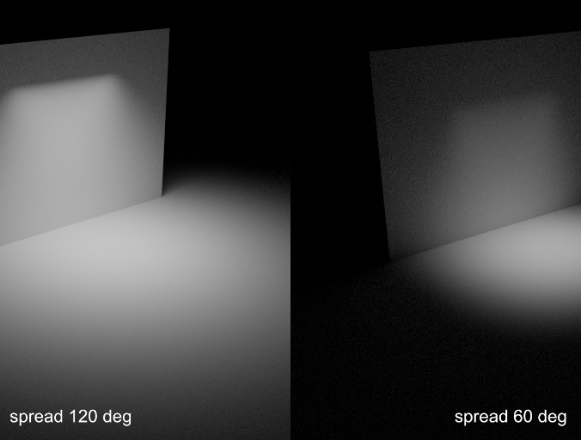
TOPIC 4 · VISUAL REFERENCE
Light form with purpose
PRINCIPLE
Light direction, size, intensity and colour reveal shape while controlling contrast and render cost.
APPLIED EXAMPLE
A large area key reveals the body curve, a soft fill retains eye detail and a rim separates the tail.
EVIDENCE TO TRACK
1
Silhouette separated
2
Highlights retain detail
LEGACY BLENDER REFERENCE · CURRENT WORKFLOW EXPLAINED AT RIGHT
3
Neutral check render passes
3D Modelling with Blender for Beginners · TGS-2022015368
© Tertiary Infotech Academy Pte. Ltd.
108

Slide 109
TOPIC 4 · CONCEPT 3
Choose a render engine and settings
1
Workbench
2
Eevee
Fast geometry and studio-light review
Real-time rasterised presentation
3
Cycles
4
Output
Path-traced lighting accuracy
Resolution, samples, format and colour
3D Modelling with Blender for Beginners · TGS-2022015368
© Tertiary Infotech Academy Pte. Ltd.
109

Slide 110
TOPIC 4 · ANALYSIS
Decisions and risks — Choose a render engine and settings
DECISIONS THAT IMPROVE QUALITY
FAILURE MODES TO CONTROL
Use Workbench for topology evidence
Engine chosen by habit
Use Eevee for fast iteration
Unbounded samples
Use Cycles when light transport matters
Wrong colour or alpha output
Set output before final render
3D Modelling with Blender for Beginners · TGS-2022015368
© Tertiary Infotech Academy Pte. Ltd.
110

Slide 111
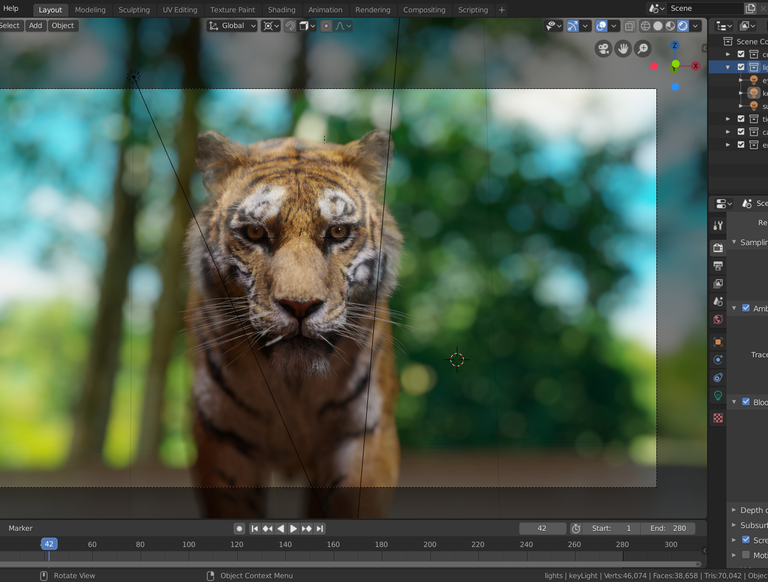
TOPIC 4 · VISUAL REFERENCE
Choose a render engine and settings
PRINCIPLE
Workbench, Eevee and Cycles trade speed, realism and diagnostic value.
APPLIED EXAMPLE
The review uses Workbench wireframes, Eevee previews and a limited-sample Cycles final render.
EVIDENCE TO TRACK
1
Render purpose stated
2
Time within budget
LEGACY BLENDER REFERENCE · CURRENT WORKFLOW EXPLAINED AT RIGHT
3
Output settings verified
3D Modelling with Blender for Beginners · TGS-2022015368
© Tertiary Infotech Academy Pte. Ltd.
111

Slide 112
TOPIC 4 · CONCEPT 4
Optimise the complete asset
1
Geometry
2
Transforms
Delete hidden or duplicate elements
Apply scale and confirm origin
3
Data
4
Performance
Remove unused materials and orphan data
Measure triangles, textures and render time
3D Modelling with Blender for Beginners · TGS-2022015368
© Tertiary Infotech Academy Pte. Ltd.
112

Slide 113
TOPIC 4 · ANALYSIS
Decisions and risks — Optimise the complete asset
DECISIONS THAT IMPROVE QUALITY
FAILURE MODES TO CONTROL
Optimise against a measured baseline
Destructive decimation
Protect deformation loops
Missing texture dependency
Test after each material change
Optimisation changes animation
Keep the editable master
3D Modelling with Blender for Beginners · TGS-2022015368
© Tertiary Infotech Academy Pte. Ltd.
113

Slide 114
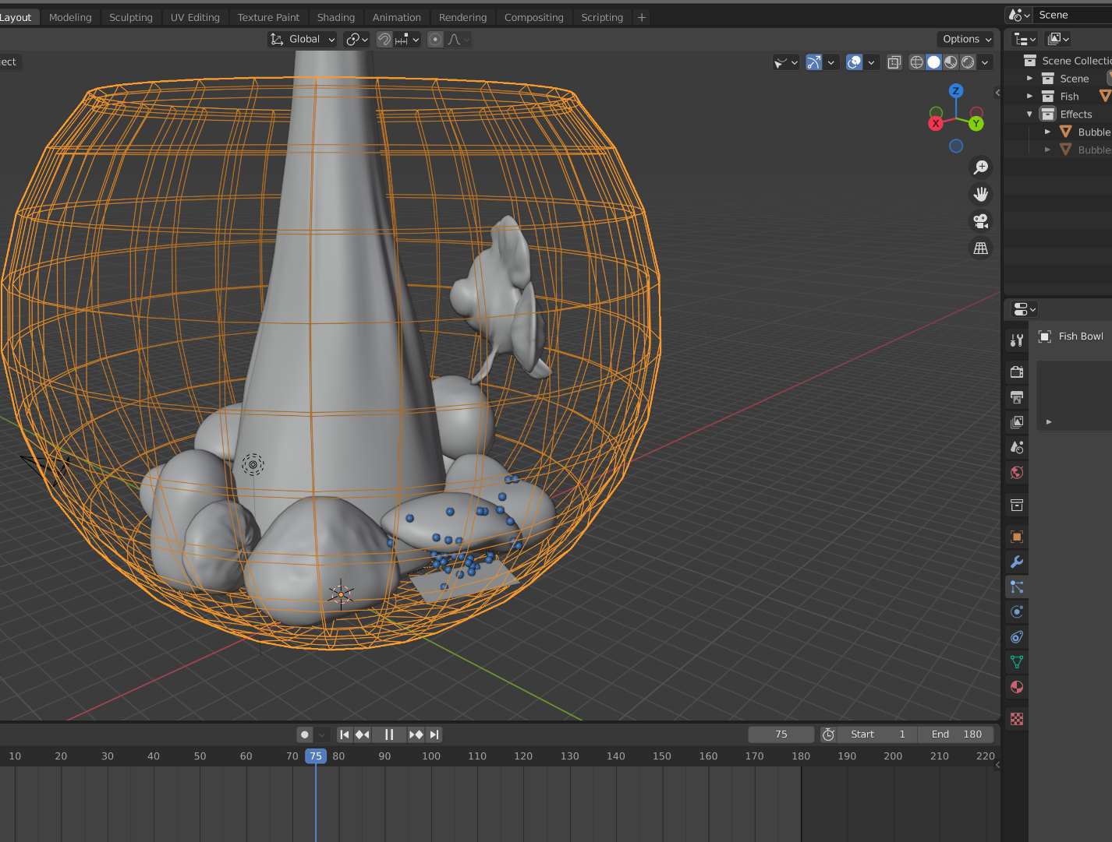
TOPIC 4 · VISUAL REFERENCE
Optimise the complete asset
PRINCIPLE
Optimisation removes cost without breaking silhouette, deformation, shading or required data.
APPLIED EXAMPLE
The final fish meets its target after hidden interior faces and redundant tail loops are removed, then the animation is retested.
EVIDENCE TO TRACK
1
Target budget met
2
Visual delta acceptable
LEGACY BLENDER REFERENCE · CURRENT WORKFLOW EXPLAINED AT RIGHT
3
Animation regression-free
3D Modelling with Blender for Beginners · TGS-2022015368
© Tertiary Infotech Academy Pte. Ltd.
114

Slide 115
TOPIC 4 · CONCEPT 5
Export and verify the delivery package
1
GLB/glTF
2
FBX
Web and real-time PBR delivery
Animation and pipeline interchange
3
OBJ
4
STL
Simple static mesh interchange
Geometry-only fabrication workflow
3D Modelling with Blender for Beginners · TGS-2022015368
© Tertiary Infotech Academy Pte. Ltd.
115

Slide 116
TOPIC 4 · ANALYSIS
Decisions and risks — Export and verify the delivery package
DECISIONS THAT IMPROVE QUALITY
FAILURE MODES TO CONTROL
Match axes, units and scale
Correct-looking source but broken export
Export only intended objects
Missing textures
Embed or package dependencies
Wrong axes or scale
Re-import and compare
3D Modelling with Blender for Beginners · TGS-2022015368
© Tertiary Infotech Academy Pte. Ltd.
116

Slide 117
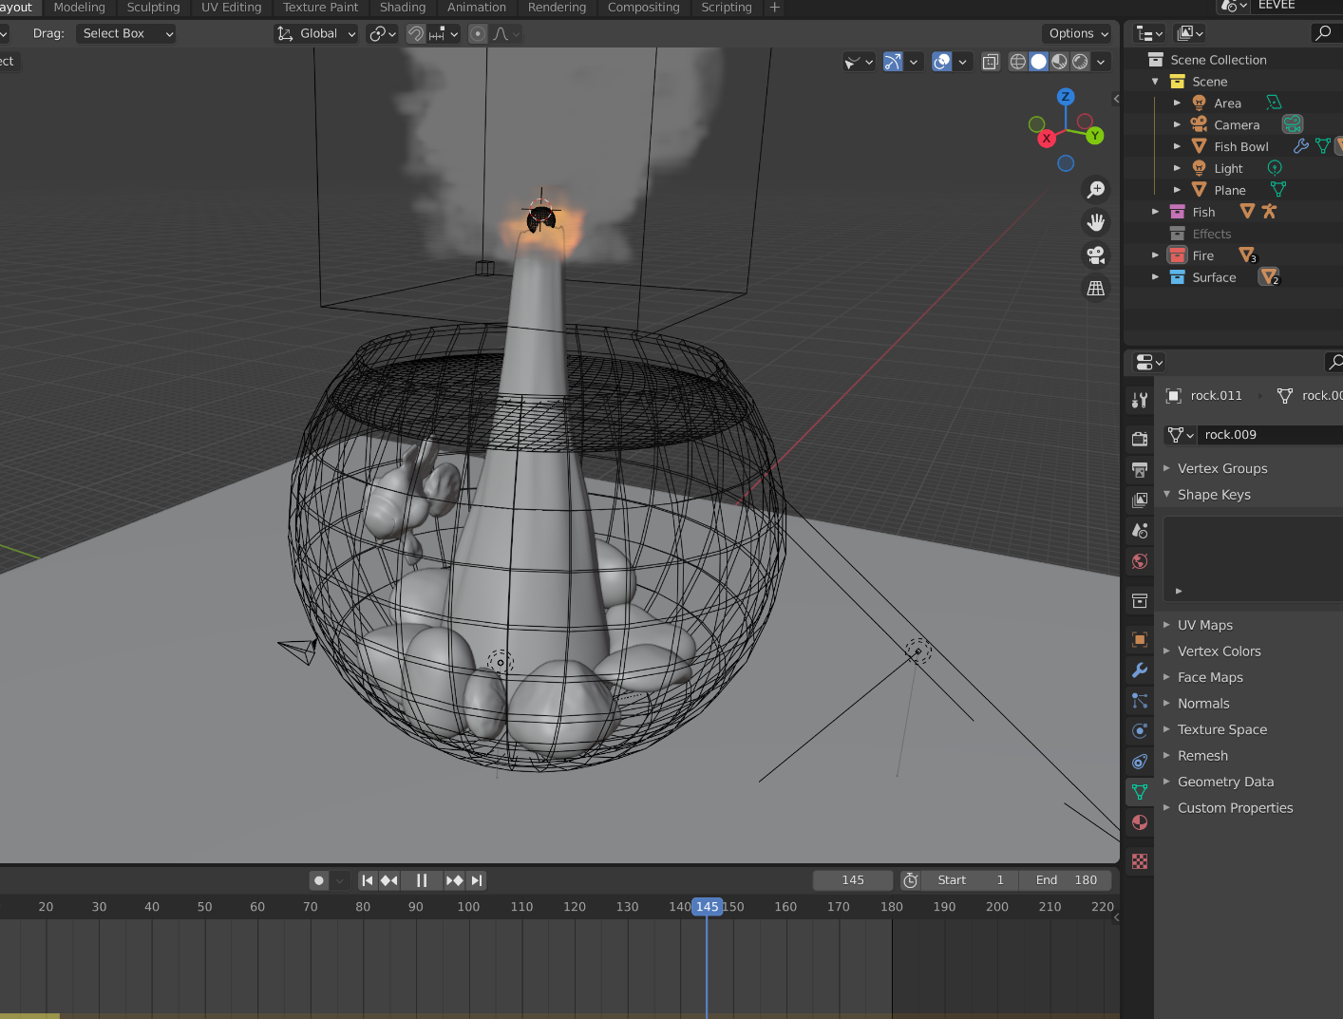
TOPIC 4 · VISUAL REFERENCE
Export and verify the delivery package
PRINCIPLE
An export is complete only after round-trip validation in a clean environment.
APPLIED EXAMPLE
The approved fish is exported as GLB, reopened in a clean file and checked for dimensions, materials, hierarchy and animation.
EVIDENCE TO TRACK
1
Clean re-import passes
2
Dependencies present
LEGACY BLENDER REFERENCE · CURRENT WORKFLOW EXPLAINED AT RIGHT
3
Release manifest complete
3D Modelling with Blender for Beginners · TGS-2022015368
© Tertiary Infotech Academy Pte. Ltd.
117

Slide 118
HANDS-ON PRACTICE
Topic 4 labs
Lab 7
Lab 8
Progression
Create bubbles, light the scene and present for review
Optimise, render and export the fish-bowl capstone
Inspect and plan
A review scene with bubbles, three-point lighting and a decision-ready presentation.
A release package containing editable source, GLB/FBX export, preview and validation manifest.
Build and refine
Verify and present
3D Modelling with Blender for Beginners · TGS-2022015368
© Tertiary Infotech Academy Pte. Ltd.
118

Slide 119
LAB 7 · ADVANCED
Create bubbles, light the scene and present for review
LAB 7
ALIGNMENT
Stakeholders need a short aquarium presentation that keeps the fish readable and demonstrates controlled secondary motion.
K8 · A6–A7
OBJECTIVE
DELIVERABLE
Add a lightweight bubble/force effect, build purposeful lighting and present a review decision.
A review scene with bubbles, three-point lighting and a decision-ready presentation.
3D Modelling with Blender for Beginners · TGS-2022015368
© Tertiary Infotech Academy Pte. Ltd.
119

Slide 120
LAB VISUAL · DETAILED STEPS ARE IN THE LEARNER GUIDE
Lab 7 — example evidence
Use this as a visual benchmark, then replace it with your own Blender view. Your submission must show the editable source, measured checks and acceptance result—not only a polished render.
Concept visual — validate against the editable Blender file.
3D Modelling with Blender for Beginners · TGS-2022015368
© Tertiary Infotech Academy Pte. Ltd.
120

Slide 121
ACCEPTANCE CRITERIA
Lab 7 — quality gates
Form
Structure
Delivery
Secondary motion supports rather than hides the fish
Lighting reveals silhouette and material
Feedback and decision are recorded
Simulation range is reproducible
Review evidence includes version and metrics
A review scene with bubbles, three-point lighting and a decision-ready presentation.
3D Modelling with Blender for Beginners · TGS-2022015368
© Tertiary Infotech Academy Pte. Ltd.
121

Slide 122
VERIFY, DOCUMENT, SUBMIT
Lab 7 — acceptance evidence
ACCEPTANCE CHECKS
EVIDENCE TO SUBMIT
Secondary motion supports rather than hides the fish
Particle settings
Simulation range is reproducible
Simulation frame
Lighting diagram or view
Lighting reveals silhouette and material
Review slide
Review evidence includes version and metrics
Decision log
Feedback and decision are recorded
3D Modelling with Blender for Beginners · TGS-2022015368
© Tertiary Infotech Academy Pte. Ltd.
122

Slide 123
LAB 8 · ADVANCED
Optimise, render and export the fish-bowl capstone
LAB 8
ALIGNMENT
The approved animated fish must be packaged for a lightweight viewer and handed off with verification evidence.
K8–K9 · A7–A8
OBJECTIVE
DELIVERABLE
Optimise the full scene, render final evidence, export the intended asset and validate the package by round trip.
A release package containing editable source, GLB/FBX export, preview and validation manifest.
3D Modelling with Blender for Beginners · TGS-2022015368
© Tertiary Infotech Academy Pte. Ltd.
123

Slide 124
LAB VISUAL · DETAILED STEPS ARE IN THE LEARNER GUIDE
Lab 8 — example evidence
Use this as a visual benchmark, then replace it with your own Blender view. Your submission must show the editable source, measured checks and acceptance result—not only a polished render.
Concept visual — validate against the editable Blender file.
3D Modelling with Blender for Beginners · TGS-2022015368
© Tertiary Infotech Academy Pte. Ltd.
124

Slide 125
ACCEPTANCE CRITERIA
Lab 8 — quality gates
Form
Structure
Delivery
Final source remains editable
Final renders use verified settings
Manifest and package contain all dependencies
Geometry and performance targets are met
Clean round-trip import passes
A release package containing editable source, GLB/FBX export, preview and validation manifest.
3D Modelling with Blender for Beginners · TGS-2022015368
© Tertiary Infotech Academy Pte. Ltd.
125

Slide 126
VERIFY, DOCUMENT, SUBMIT
Lab 8 — acceptance evidence
ACCEPTANCE CHECKS
EVIDENCE TO SUBMIT
Final source remains editable
Before/after statistics
Geometry and performance targets are met
Neutral and final renders
Export settings
Final renders use verified settings
Clean re-import checks
Clean round-trip import passes
Release manifest
Manifest and package contain all dependencies
3D Modelling with Blender for Beginners · TGS-2022015368
© Tertiary Infotech Academy Pte. Ltd.
126

Slide 127
WHAT YOU CAN NOW DEMONSTRATE
Topic 4 recap
1
Concepts
2
Labs
5 decision-ready frameworks
Labs 7–8 completed
3
Evidence
4
Alignment
Editable Blender files, metrics and presentations
LO4 · K8–K9 · A7–A8
3D Modelling with Blender for Beginners · TGS-2022015368
© Tertiary Infotech Academy Pte. Ltd.
127

Slide 128
05
COURSE WRAP-UP
Review, assessment and release
From creative brief to verified Blender asset
3D Modelling with Blender for Beginners · TGS-2022015368
© Tertiary Infotech Academy Pte. Ltd.
128

Slide 129
LEARNING OUTCOMES
What you achieved
1
Analyse
2
Develop
Translate the creative brief into a polygon budget and criteria.
Model, sculpt and refine a structured Blender prototype.
3
Animate
4
Optimise
Rig, surface, keyframe and present a readable sequence.
Light, render, export and verify the delivery package.
3D Modelling with Blender for Beginners · TGS-2022015368
© Tertiary Infotech Academy Pte. Ltd.
129

Slide 130
END-TO-END CAPABILITY
Production workflow
1
2
3
4
5
Brief and acceptance criteria
Blender blockout
Model, surface and animate
Validate and target export
Release package and approval
3D Modelling with Blender for Beginners · TGS-2022015368
© Tertiary Infotech Academy Pte. Ltd.
130

Slide 131
WHY IT MATTERS
The accountable workflow
A creative idea becomes production-ready through modelling decisions, evidence and repeatable checks.
Release only what you can explain, validate and reproduce.
3D Modelling with Blender for Beginners · TGS-2022015368
© Tertiary Infotech Academy Pte. Ltd.
131

Slide 132

COURSE PORTAL
Login to LMS and Download Course Material
Log in at lms-tms.tertiaryinfotech.com with your registered email and the OTP sent to your inbox, then open this course to download the slides and Learner Guide.
3D Modelling with Blender for Beginners · TGS-2022015368
© Tertiary Infotech Academy Pte. Ltd.
132

Slide 133
VISUAL ACCESS PATH · TRAINER-ONLY ANSWER KEYS ARE NEVER LEARNER-LINKED
Download course materials
1
2
3
4
5
Open LMS-TMS
Select this course
Download learner slides and guide
Open the Activities folder
Complete WA then PP
Open course materials on LMS-TMS
3D Modelling with Blender for Beginners · TGS-2022015368
© Tertiary Infotech Academy Pte. Ltd.
133

Slide 134
DAY 2 · 3:30 PM–6:00 PM
Assessment reminder
WA
PP
Complete
9 SAQs · K1–K9
4 Blender tasks · A1–A8
Assessment attendance
60 minutes
90 minutes
Upload to LMS
Open book
Open book
Sign summary record
3D Modelling with Blender for Beginners · TGS-2022015368
© Tertiary Infotech Academy Pte. Ltd.
134

Slide 135
FINAL REMINDER
Assessment flow
1
2
3
4
5
TRAQOM / SSG attendance
Written Assessment (SAQ)
Practical Performance (PP)
Upload answers to LMS
Sign Assessment Summary Record
3D Modelling with Blender for Beginners · TGS-2022015368
© Tertiary Infotech Academy Pte. Ltd.
135

Slide 136
TRAQOM · SSG
Digital Attendance (Mandatory)
1
Scan
2
Submit
Use the QR code shown by the trainer or administrator.
Confirm the assessment attendance is recorded.
3
Complete
4
Retain
Sit the WA and PP within the declared timing.
Follow trainer instructions for assessment records.
3D Modelling with Blender for Beginners · TGS-2022015368
© Tertiary Infotech Academy Pte. Ltd.
136

Slide 137
WHY IT MATTERS
Thank you
You are ready to model, animate, optimise and deliver 3D assets with Blender.
Build deliberately. Validate rigorously.
3D Modelling with Blender for Beginners · TGS-2022015368
© Tertiary Infotech Academy Pte. Ltd.
137

