Slide 1
02
LAB 2
Interpret a fish brief, budget polygons and build a blockout
K1–K2 · A1–A2
Lab 2 · Interpret a fish brief, budget polygons and build a blockout · TGS-2022015368
© Tertiary Infotech Academy Pte. Ltd.
1

Slide 2
LAB 2 · FOUNDATION
Interpret a fish brief, budget polygons and build a blockout
LAB 2
ALIGNMENT
A client needs a recognisable goldfish prototype for a lightweight interactive scene.
K1–K2 · A1–A2
OBJECTIVE
DELIVERABLE
Translate the brief into criteria, allocate a polygon budget and create a modifier-led blockout.
A brief, scorecard and editable goldfish blockout within the stated budget.
Lab 2 · Interpret a fish brief, budget polygons and build a blockout · TGS-2022015368
© Tertiary Infotech Academy Pte. Ltd.
2

Slide 3
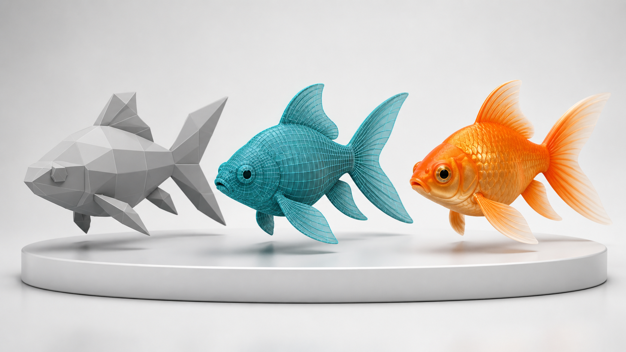
SAMPLE PRESENTATION
Example evidence view
Replace this concept visual with your own Blender screenshot or render. Keep the camera, version and acceptance result visible in the slide notes or caption.
Concept visual — validate against the editable Blender file.
Lab 2 · Interpret a fish brief, budget polygons and build a blockout · TGS-2022015368
© Tertiary Infotech Academy Pte. Ltd.
3

Slide 4
VERIFY, DOCUMENT, SUBMIT
Lab 2 — acceptance evidence
ACCEPTANCE CHECKS
EVIDENCE TO SUBMIT
Brief contains measurable requirements
Creative brief
Budget definition and allocation are explicit
Polygon allocation table
Three key views
Blockout silhouette matches the concept
Modifier stack
Modifier workflow remains editable
Viewport statistics
Recorded count is within target or has a justified action
Lab 2 · Interpret a fish brief, budget polygons and build a blockout · TGS-2022015368
© Tertiary Infotech Academy Pte. Ltd.
4

