Slide 1
03
LAB 3
Model and sculpt the production goldfish
K3–K4 · A3
Lab 3 · Model and sculpt the production goldfish · TGS-2022015368
© Tertiary Infotech Academy Pte. Ltd.
1

Slide 2
LAB 3 · INTERMEDIATE
Model and sculpt the production goldfish
LAB 3
ALIGNMENT
The approved blockout needs clearer anatomy and controlled detail without losing its low-cost structure.
K3–K4 · A3
OBJECTIVE
DELIVERABLE
Develop primary and secondary forms with suitable Edit Mode and sculpting tools.
A recognisable goldfish model with intentional form, topology and saved milestones.
Lab 3 · Model and sculpt the production goldfish · TGS-2022015368
© Tertiary Infotech Academy Pte. Ltd.
2

Slide 3
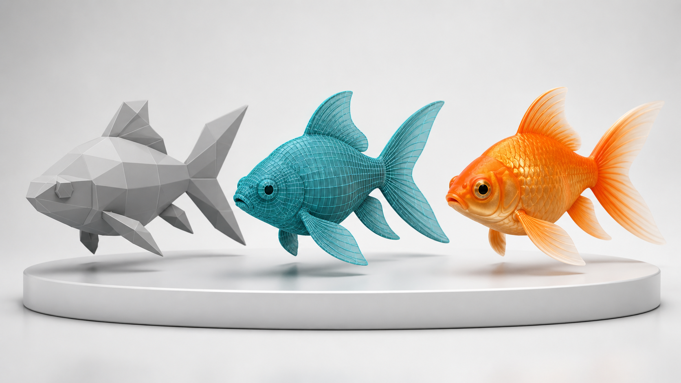
SAMPLE PRESENTATION
Example evidence view
Replace this concept visual with your own Blender screenshot or render. Keep the camera, version and acceptance result visible in the slide notes or caption.
Concept visual — validate against the editable Blender file.
Lab 3 · Model and sculpt the production goldfish · TGS-2022015368
© Tertiary Infotech Academy Pte. Ltd.
3

Slide 4
VERIFY, DOCUMENT, SUBMIT
Lab 3 — acceptance evidence
ACCEPTANCE CHECKS
EVIDENCE TO SUBMIT
Primary and secondary forms are readable
Landmark view
Symmetry is intentional
Sculpting before/after
Wireframe view
Detail level matches the stage
Polygon statistics
Topology plan supports later animation
Decision explanation
Milestone files and metrics are preserved
Lab 3 · Model and sculpt the production goldfish · TGS-2022015368
© Tertiary Infotech Academy Pte. Ltd.
4

