Slide 1
04
LAB 4
Repair topology, normals and deformation zones
K4, K7 · A4
Lab 4 · Repair topology, normals and deformation zones · TGS-2022015368
© Tertiary Infotech Academy Pte. Ltd.
1

Slide 2
LAB 4 · INTERMEDIATE
Repair topology, normals and deformation zones
LAB 4
ALIGNMENT
A review finds shading defects, dense areas and weak edge flow around the tail.
K4, K7 · A4
OBJECTIVE
DELIVERABLE
Diagnose and repair the supplied mesh, then prove the revised prototype meets its criteria.
A repaired, review-ready mesh with a defect log and before/after evidence.
Lab 4 · Repair topology, normals and deformation zones · TGS-2022015368
© Tertiary Infotech Academy Pte. Ltd.
2

Slide 3
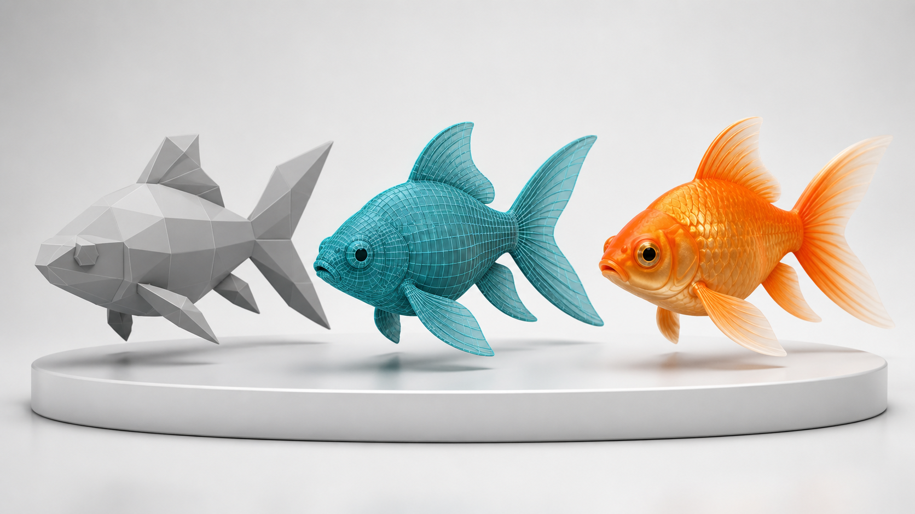
SAMPLE PRESENTATION
Example evidence view
Replace this concept visual with your own Blender screenshot or render. Keep the camera, version and acceptance result visible in the slide notes or caption.
Concept visual — validate against the editable Blender file.
Lab 4 · Repair topology, normals and deformation zones · TGS-2022015368
© Tertiary Infotech Academy Pte. Ltd.
3

Slide 4
VERIFY, DOCUMENT, SUBMIT
Lab 4 — acceptance evidence
ACCEPTANCE CHECKS
EVIDENCE TO SUBMIT
No unintended non-manifold geometry remains
Baseline wireframe
Normals face outward
Face-orientation view
Defect log
Silhouette remains approved
Deformation test
Tail deformation holds volume
Final statistics
Defect log links each issue to evidence and result
Lab 4 · Repair topology, normals and deformation zones · TGS-2022015368
© Tertiary Infotech Academy Pte. Ltd.
4

