Slide 1
05
LAB 5
UV unwrap and surface the goldfish
K6–K7 · A5
Lab 5 · UV unwrap and surface the goldfish · TGS-2022015368
© Tertiary Infotech Academy Pte. Ltd.
1

Slide 2
LAB 5 · INTERMEDIATE
UV unwrap and surface the goldfish
LAB 5
ALIGNMENT
The approved mesh needs a stable PBR material for close review and animation.
K6–K7 · A5
OBJECTIVE
DELIVERABLE
Create controlled UVs, textures and a Principled BSDF material that remains readable under neutral light.
A surfaced fish with validated UV layout, material channels and texture dependencies.
Lab 5 · UV unwrap and surface the goldfish · TGS-2022015368
© Tertiary Infotech Academy Pte. Ltd.
2

Slide 3
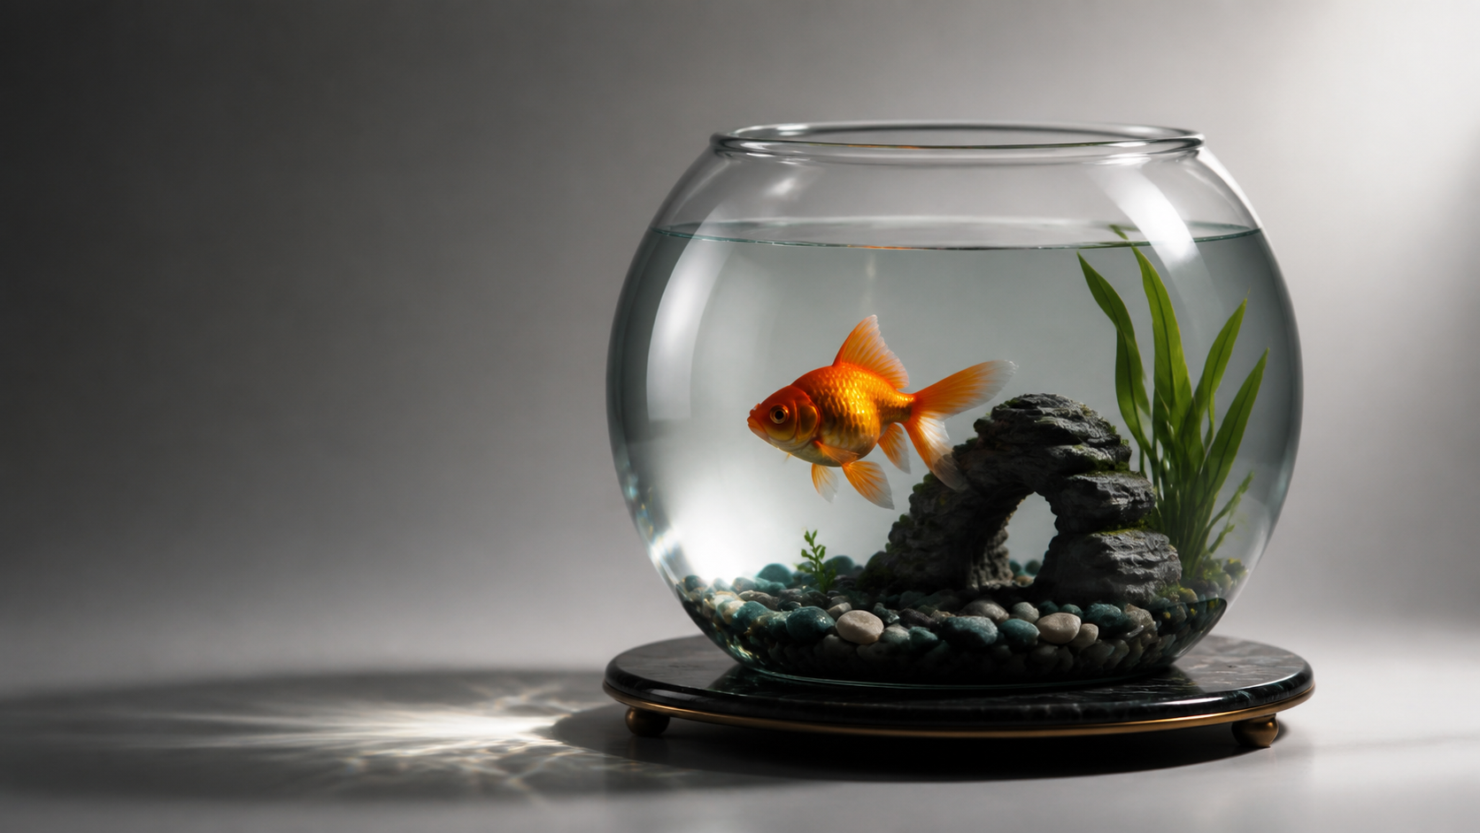
SAMPLE PRESENTATION
Example evidence view
Replace this concept visual with your own Blender screenshot or render. Keep the camera, version and acceptance result visible in the slide notes or caption.
Concept visual — validate against the editable Blender file.
Lab 5 · UV unwrap and surface the goldfish · TGS-2022015368
© Tertiary Infotech Academy Pte. Ltd.
3

Slide 4
VERIFY, DOCUMENT, SUBMIT
Lab 5 — acceptance evidence
ACCEPTANCE CHECKS
EVIDENCE TO SUBMIT
UVs have no unintended overlaps
UV layout
Checker distortion is controlled
Checker test
Shader node graph
Material channels use correct colour spaces
Neutral render
Surface reads under neutral lighting
Dependency inventory
Texture dependencies are included
Lab 5 · UV unwrap and surface the goldfish · TGS-2022015368
© Tertiary Infotech Academy Pte. Ltd.
4

