Slide 1
07
LAB 7
Create bubbles, light the scene and present for review
K8 · A6–A7
Lab 7 · Create bubbles, light the scene and present for review · TGS-2022015368
© Tertiary Infotech Academy Pte. Ltd.
1

Slide 2
LAB 7 · ADVANCED
Create bubbles, light the scene and present for review
LAB 7
ALIGNMENT
Stakeholders need a short aquarium presentation that keeps the fish readable and demonstrates controlled secondary motion.
K8 · A6–A7
OBJECTIVE
DELIVERABLE
Add a lightweight bubble/force effect, build purposeful lighting and present a review decision.
A review scene with bubbles, three-point lighting and a decision-ready presentation.
Lab 7 · Create bubbles, light the scene and present for review · TGS-2022015368
© Tertiary Infotech Academy Pte. Ltd.
2

Slide 3
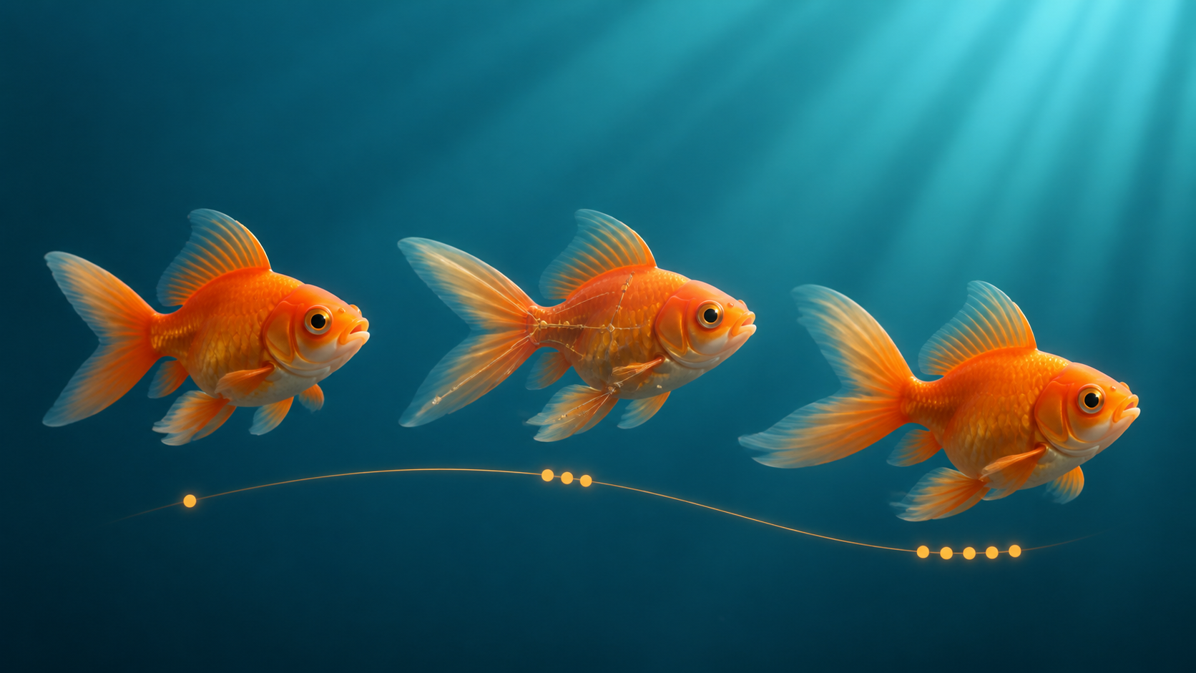
SAMPLE PRESENTATION
Example evidence view
Replace this concept visual with your own Blender screenshot or render. Keep the camera, version and acceptance result visible in the slide notes or caption.
Concept visual — validate against the editable Blender file.
Lab 7 · Create bubbles, light the scene and present for review · TGS-2022015368
© Tertiary Infotech Academy Pte. Ltd.
3

Slide 4
VERIFY, DOCUMENT, SUBMIT
Lab 7 — acceptance evidence
ACCEPTANCE CHECKS
EVIDENCE TO SUBMIT
Secondary motion supports rather than hides the fish
Particle settings
Simulation range is reproducible
Simulation frame
Lighting diagram or view
Lighting reveals silhouette and material
Review slide
Review evidence includes version and metrics
Decision log
Feedback and decision are recorded
Lab 7 · Create bubbles, light the scene and present for review · TGS-2022015368
© Tertiary Infotech Academy Pte. Ltd.
4

