Slide 1
08
LAB 8
Optimise, render and export the fish-bowl capstone
K8–K9 · A7–A8
Lab 8 · Optimise, render and export the fish-bowl capstone · TGS-2022015368
© Tertiary Infotech Academy Pte. Ltd.
1

Slide 2
LAB 8 · ADVANCED
Optimise, render and export the fish-bowl capstone
LAB 8
ALIGNMENT
The approved animated fish must be packaged for a lightweight viewer and handed off with verification evidence.
K8–K9 · A7–A8
OBJECTIVE
DELIVERABLE
Optimise the full scene, render final evidence, export the intended asset and validate the package by round trip.
A release package containing editable source, GLB/FBX export, preview and validation manifest.
Lab 8 · Optimise, render and export the fish-bowl capstone · TGS-2022015368
© Tertiary Infotech Academy Pte. Ltd.
2

Slide 3
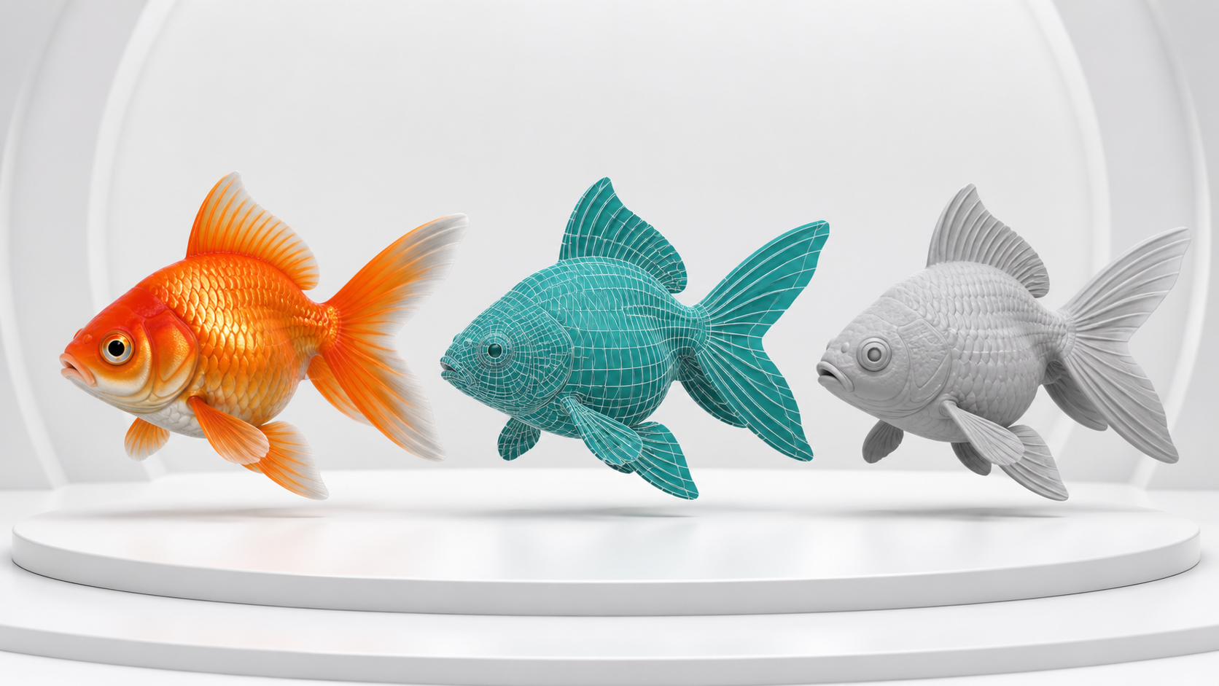
SAMPLE PRESENTATION
Example evidence view
Replace this concept visual with your own Blender screenshot or render. Keep the camera, version and acceptance result visible in the slide notes or caption.
Concept visual — validate against the editable Blender file.
Lab 8 · Optimise, render and export the fish-bowl capstone · TGS-2022015368
© Tertiary Infotech Academy Pte. Ltd.
3

Slide 4
VERIFY, DOCUMENT, SUBMIT
Lab 8 — acceptance evidence
ACCEPTANCE CHECKS
EVIDENCE TO SUBMIT
Final source remains editable
Before/after statistics
Geometry and performance targets are met
Neutral and final renders
Export settings
Final renders use verified settings
Clean re-import checks
Clean round-trip import passes
Release manifest
Manifest and package contain all dependencies
Lab 8 · Optimise, render and export the fish-bowl capstone · TGS-2022015368
© Tertiary Infotech Academy Pte. Ltd.
4

