Slide 1
Wild Edibles - Basics
A Beginner Guide to Foraging Safely and Sustainable
Joshua Putman
Alabama Vikings
6.15.24

Slide 2
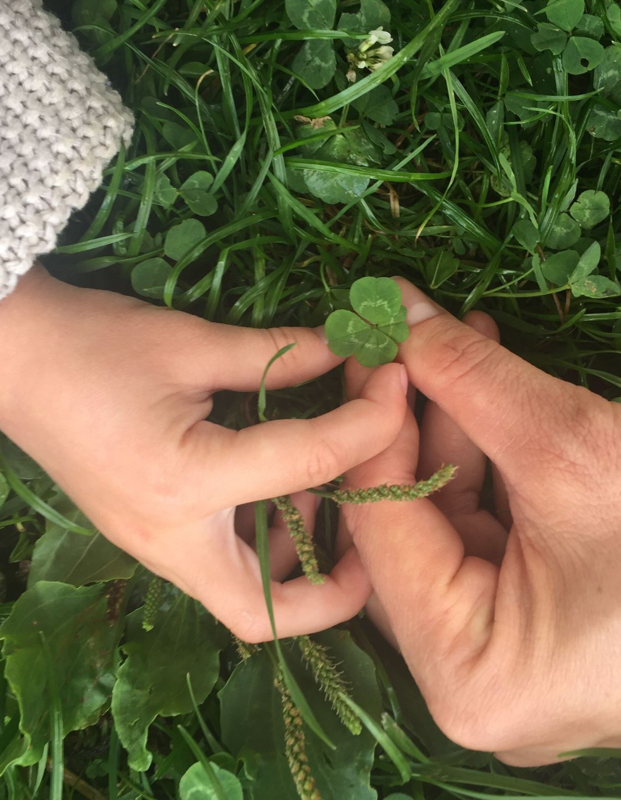
Sources:
https://www.eattheweeds.com/
https://thesouthernherbalist.com/
http://www.alabamawildflower.org/
https://bbgardens.org/
Peterson, Lee Allen. Peterson Field Guide to Edible Wild Plants. Boston: Houghton Mifflin Harcourt, 1977.
Canterbury, Dave. Advanced Bushcraft: An Expert Field Guide to the Art of Wilderness Survival. Avon, MA: Adams Media, 2015.
Wigginton, Eliot, ed. Foxfire 2. New York: Anchor Books, 1973
Wigginton, Eliot, ed. Foxfire 3. New York: Anchor Books, 1975

Slide 3
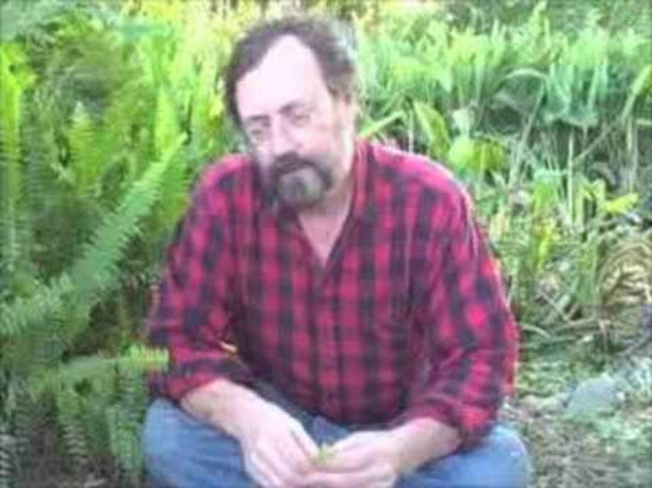
Green Deane – Video #2 ITEMizing

Slide 4
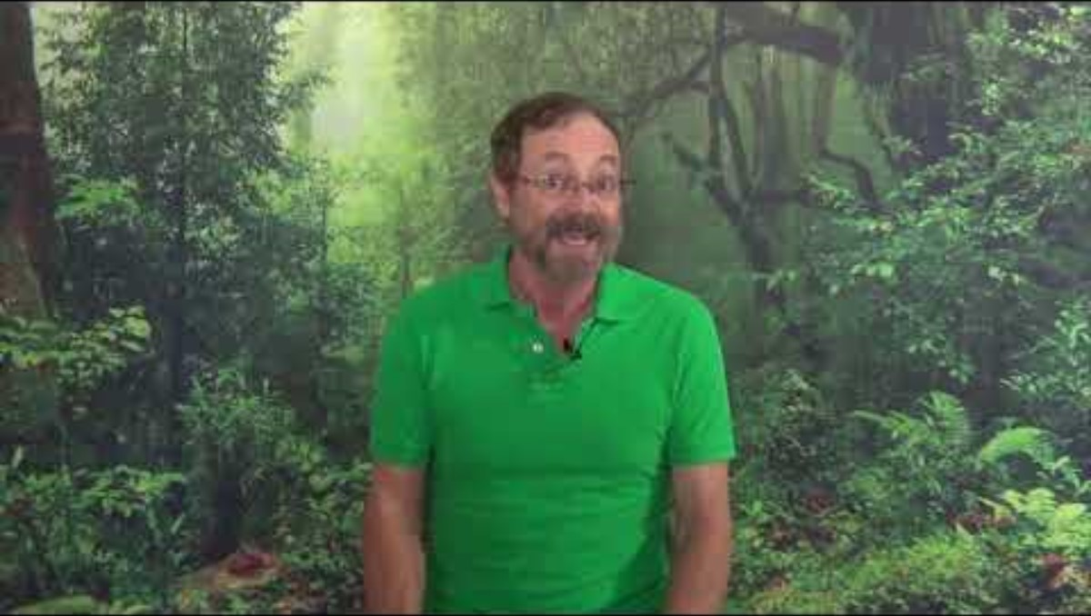
Green Deane – Video #147 Transition Zones

Slide 5
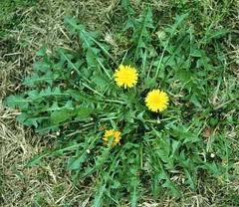
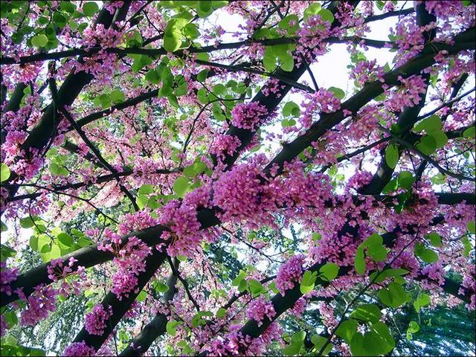
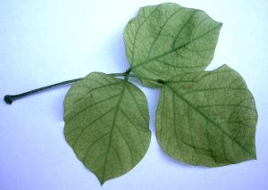
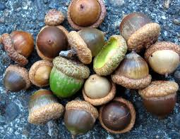
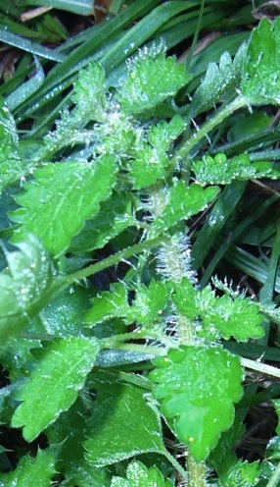
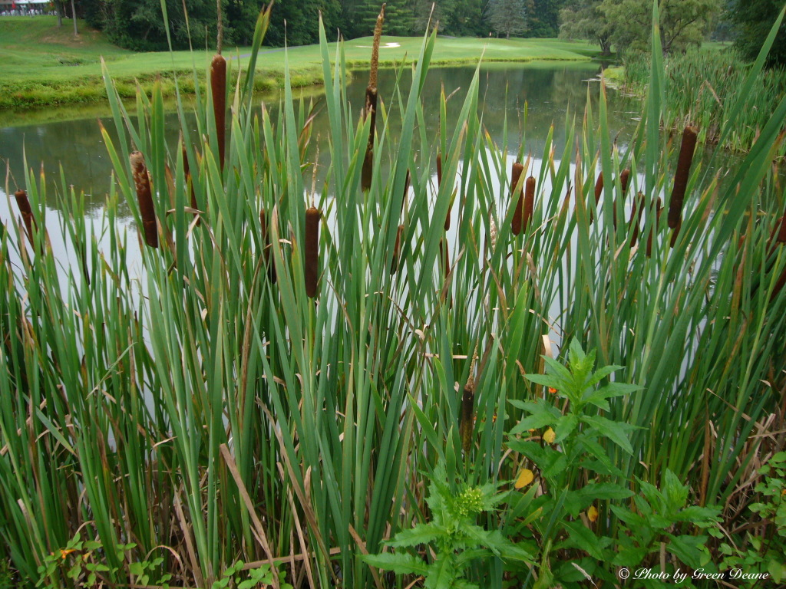
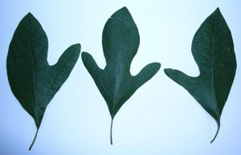
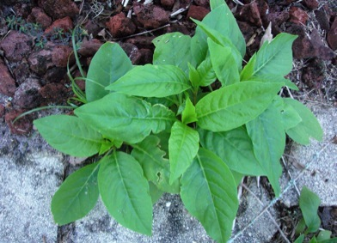
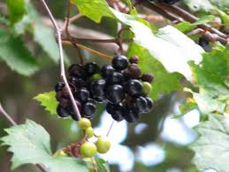
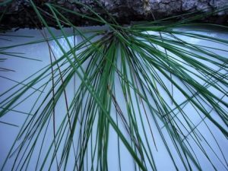
Redbud Tree
Sassafras
Kudzu
Poke
Cattail
Pine
Acorn
Stinging Nettle
Muscadine

