Slide 1
NASA Robotic Mining
Milestone Six Progress Evaluation

Slide 2
Members:
Taylor Ertrachter - tertrachter2017@my.fit.edu
Bailey Hamant - bhamant2017@my.fit.edu
James Spies - jspies2017@my.fit.edu
Faculty Advisor:
Dr. Marius Silaghi - msilaghi@fit.edu

Slide 3
Current Progress Matrix
Task | Completion % | James | Bailey | Taylor | To do
1. Investigate tools | 100% | 33% | 33% | 33% | none
2. Hello World demos | 100% | 33% | 33% | 33% | none
3. Implement, test & demo Make robot manually controllable | 100% | 20% | 20% | 40% | Lead screw movement
4. Implement, test & demo Take accurate measurements with camera | 90% | 30% | 30% | 30% | Depth measurement

Slide 4
01
Task One
Make Robot Manually Controllable

Slide 5
Make Robot Manually Controllable
Robot can be operated via a bluetooth Xbox controller
Can be moved forward and backward and it’s bucket ladder rotated
Wheels are moved by setting the rotation angle and adjusting the rotation speed

Slide 6
Make Robot Manually Controllable
Contrasting rotation angles are set to the front left and back right wheels for left turning, and the front right and back left wheels for right turning
There are a total of four motors on the robot which we’ve written control code for:
  One controls the left side wheels (front and back)
  One controls the right side wheels
  One controls the bucket ladder
  One controls the up and down movement of the lead screws

Slide 7
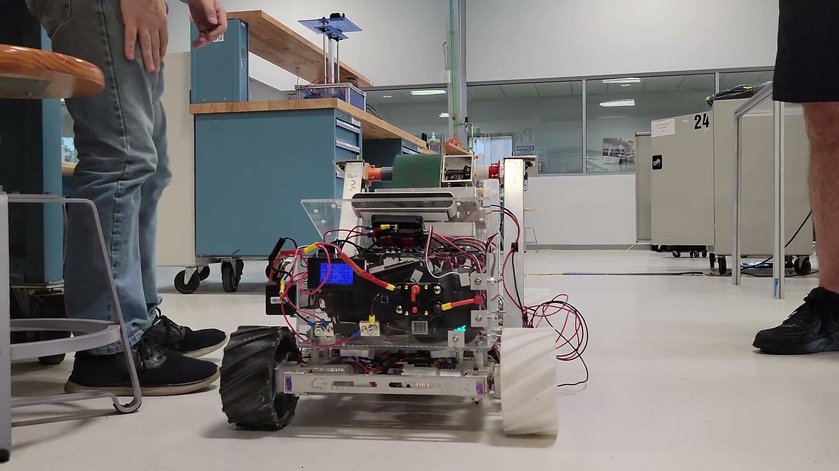
Make Robot Manually Controllable

Slide 8
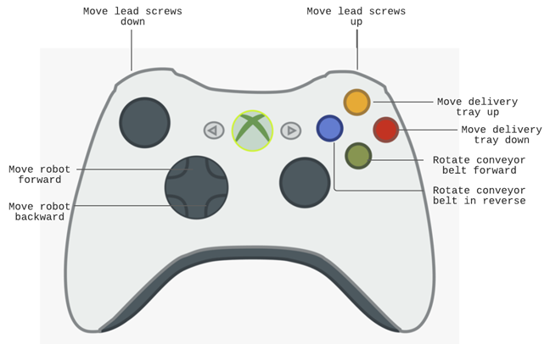
Make Robot Manually Controllable

Slide 9
02
Task Two
Take Accurate Measurements with ZED Camera

Slide 10
Take Accurate Measurements with Camera
Currently takes accurate measurements of distance
  Most important perception for autonomous movement and mining
Would be ideal to include other perceptions such as width, height, and depth
The focus of this milestone was on getting manual control
  Would be useful for future teams working toward full autonomy

Slide 11
Thanks!

