Slide 1
Who Buys Travel Insurance?
Keying in on Travel Assured’s Target Audience

Slide 2
Why we need to know
Travel Assured has taken a hit during the COVID pandemic
Marketing budget was cut by over 50%
Travel Assured can’t afford to create a blanket ad campaign that just targets all potential air travelers
Travel Assured needs to fine tune its marketing towards those who are already likely to buy travel insurance

Slide 3
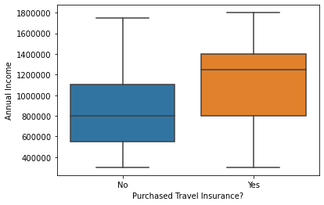
The Big Earners
Those who purchased travel insurance earned more than those who didn’t purchase.
56% higher for buyers
Median income for buyers: 1,250,000
Median income for non-buyers: 800,000

Slide 4
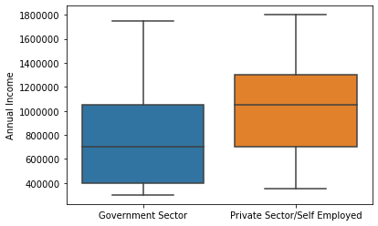
Who Earns the Big Money?
Those who work in the private sector or are self-employed earn more than those who work in the public sector
Private-sector/self-employed customers earned 50% higher
Median incomes
Private-sector/self-employed customers: 1,050,000
Public-sector customers: 700,000

Slide 5
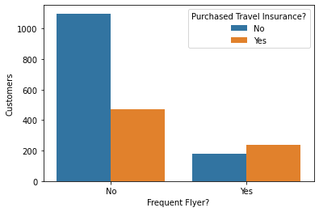
Frequent Flyers
Frequent flyers tend to buy travel insurance policies more than non-frequent flyers do
57% of frequent flyers
30% of non-frequent flyers

Slide 6
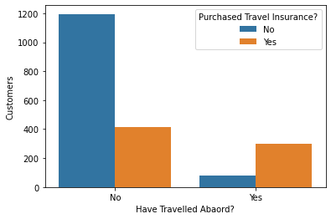
Foreign Travel
Those who have travelled abroad tend to by travel insurance more than those who haven’t travelled abroad
Have travelled abroad and purchased insurance: 78%
Haven’t travelled abroad and purchased insurance: 25%

Slide 7
Key Takeaways
In general, customers who buy travel insurance earn more than those who don’t buy
Those who work in the private sector or are self employed earn more than those in the public sector
Frequent flyers are more likely to buy than non-frequent flyers
Those who have travelled abroad are much more likely to purchase insurance policies than those who haven’t travelled abroad

Slide 8
Further Exploration What Else Should We Look At?
Customers’ ages and years of employment: Do customers who are older and further in their careers tend to buy insurance more?
Reason for travel: Do those who buy insurance do so for work travel or for personal travel?
Nature of work/industry: What type of work or industry do frequent flyers work in the most?

