Slide 1
Who Buys Travel Insurance?
Keying in on Travel Assured’s Target Audience

Slide 2
Why we need to know
Target Assured has taken a hit during the COVID pandemic
Marketing budget was cut by over 50%
Can’t afford to create a blanket ad campaign that just targets all potential air travellers

Slide 3
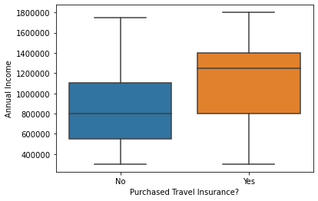
Main Target: The Big Earners
Those who purchased travel insurance earned more than those who didn’t purchase.
56% higher for buyers
Median income for buyers: 1,250,000
Median income for non-buyers: 800,000

Slide 4
Key Takeaways
In general, customers who buy travel insurance earn more than those who don’t buy
Hard to discern who earns more
Those who work in the private sector or are self employed earn more than those in the public sector
Frequent flyers are more likely to buy than non-frequent flyers
Those who have travelled abroad are much more likely to purchase insurance policies than those who haven’t travelled abroad

Slide 5
Further Exploration – What More Data Do We Need?
Customers’ ages and years of employment:
Reason for travel: Do those who buy insurance do so for work travel or for leisurely travel?
Nature of work/industry: What type of work or industry do frequent flyers work in the most?

