Slide 1
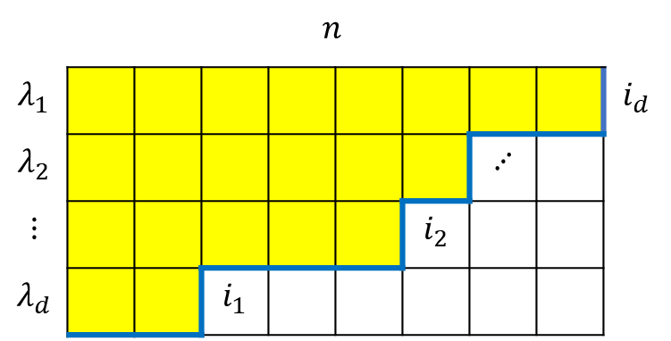
 |  |  |  | $$n$$
$$λ_{1}$$ |  |  |  |  |  |  |  |  | $$i_{d}$$
$$λ_{2}$$ |  |  |  |  |  |  | $$⋰$$
$$⋮$$ |  |  |  |  |  | $$i_{2}$$
$$λ_{d}$$ |  |  | $$i_{1}$$

