Slide 1
Problem Statement
Problem
Predict if a customer will enroll for a Term Deposit in a marketing campaign
Why is it important to predict potential cross-sell customers for a bank?
Huge customer base, limited cross-sell opportunities
Limited marketing budget
Critical in providing quality customer experience
Who will it benefit?
Bank majorly, but also customers.
How?
Selecting a subset of customers who are highly likely to respond to a call and sign up will reduce operational costs.
Lift analysis – Managers can choose the number of customers they wish to contact based on costs and diminishing returns in conversion
Helps customer get the right financial services

Slide 2
Data Overview
About the dataset:
Contains direct marketing campaigns data of a Portuguese Bank Institution
Client Data: Age, Employment Status, Loans and Default history, Marital Status
Campaign Data: Times Contacted, Contacted in previous campaigns, Previous campaign outcome
Last Contact Data: Duration, Number of days prior, Contact month and day
Social and Economic Attributes: Euro Interbank offer rate, Consumer confidence index, Employment variation rate
To be predicted:
Whether a customer will enroll for a Term Deposit or Not

Slide 3
Literature
A Data-Driven Approach to Predict the Success of Bank Telemarketing - Sergio Moro, Paulo Cortez, Paulo Rita
*Dataset used has more columns than our project dataset
Feature Engineering
Feature selection
Business Knowledge
Forward Selection
Combined use of a black box and white-box approach
Models – Logistic Regression, Decision Trees, Neural Networks, Support Vector Machines
Knowledge extraction – Decision tree, Sensitivity Analysis
Model Comparison – Rolling window evaluation, AUC

Slide 4

Project Overview
Explore Data
Apply Methods
Evaluate performance
Revise Models
Choose the best method /model

Slide 5
Methods and Models
For all Methods
Variable Transformation, Basic Feature Engineering
Method 1
No Feature Selection, No Class Balancing
Method 2
Feature Selection only
Method 3
Feature Selection + Class Balancing
3 Models Under Each Method
Logistic Regression
Random Forest
SVM

Slide 6



Data Pre-processing
Raw Data
Cleaning
Treating Class Imbalance
Transformation
45211 rows
21 columns
Missing values – 0
Outliers - 0
Variables with only 1 value
Resampling with 50-50 split in target
Tracking Recall, Precision and AUC for performance
Applied log transformation
Created buckets to reduce the levels

Slide 7
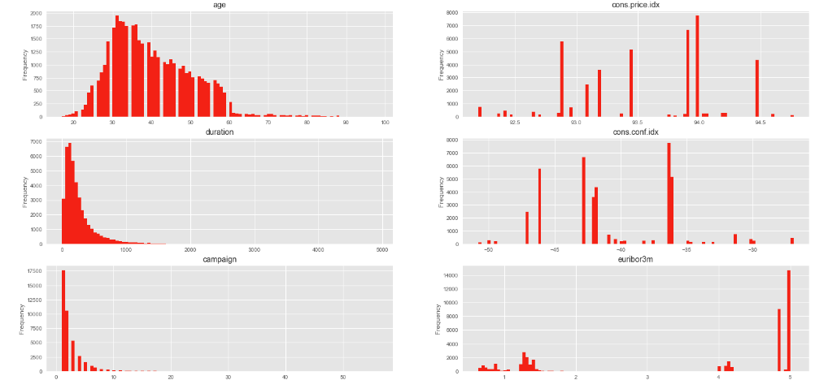
Data Exploration – Distribution of Continuous variables

Slide 8
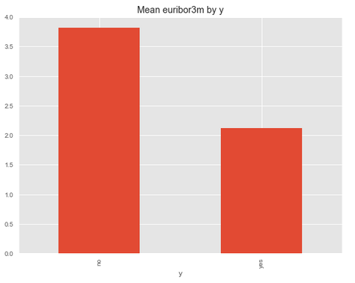
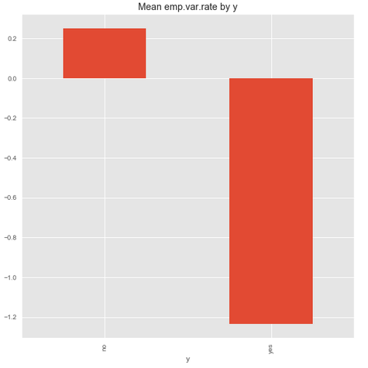
Data EXPLORATION – Relationship with X Variables

Slide 9
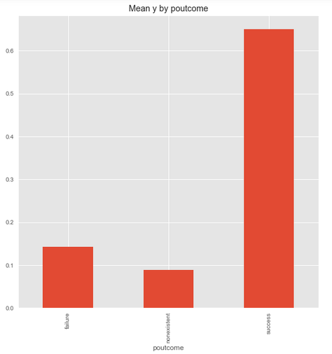
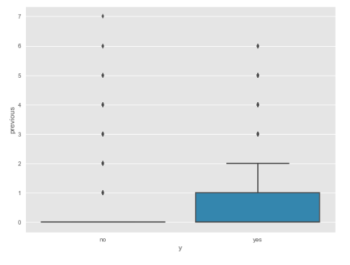
Data EXPLORATION – Relationship with X Variables

Slide 10
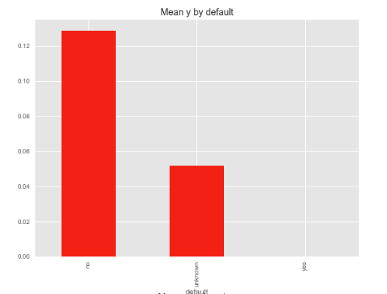
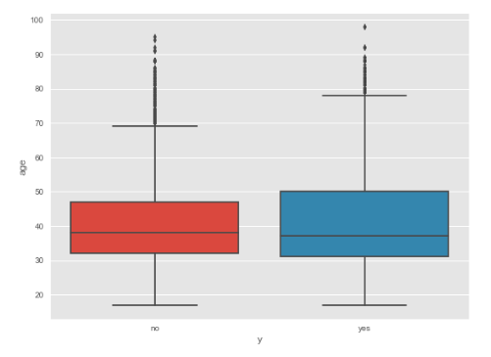
Data EXPLORATION – Relationship with X Variables

Slide 11
Method 1 Results
Model | Train AUC | Test AUC | Train Accuracy | Test Accuracy | Test – Precision of 1 | Test- Recall of 1 | Test - F-1 Score of 1
Logistic Regression | 0.68 | 0.69 | 0.90 | 0.91 | 0.68 | 0.40 | 0.51
Random Forest | 0.79 | 0.73 | 0.94 | 0.91 | 0.65 | 0.49 | 0.56
SVM | 0.71 | 0.70 | 0.92 | 0.91 | 0.67 | 0.43 | 0.53
High Accuracy
Poor Recall, F1 and AUC

Slide 12
Method 2 Results
Model | Train AUC | Test AUC | Train Accuracy | Test Accuracy | Test – Precision of 1 | Test- Recall of 1 | Test - F-1 Score of 1
Logistic Regression | 0.67 | 0.67 | 0.91 | 0.91 | 0.66 | 0.37 | 0.48
Random Forest | 0.74 | 0.75 | 0.91 | 0.91 | 0.61 | 0.54 | 0.57
SVM | 0.69 | 0.69 | 0.91 | 0.91 | 0.68 | 0.42 | 0.52
High Accuracy
Poor Recall, F1 and AUC

Slide 13
Method 3 Results
Model | Train AUC | Test AUC | Train Accuracy | Test Accuracy | Test – Precision of 1 | Test- Recall of 1 | Test - F-1 Score of 1
Logistic Regression | 0.85 | 0.85 | 0.85 | 0.83 | 0.39 | 0.88 | 0.54
Random Forest | 0.87 | 0.87 | 0.87 | 0.84 | 0.4 | 0.92 | 0.56
SVM | 0.88 | 0.87 | 0.88 | 0.83 | 0.39 | 0.93 | 0.55
High Accuracy
High Recall and AUC, Precision can still be improved

Slide 14
findings
While method 1 and method 2 give good accuracy estimates, the AUC, Precision, and Recall for both methods is not satisfactory.
Method 3 is the best method for this problem. Doing feature selection and addressing class imbalance improves Recall significantly for class 1 and overall AUC Score.
While the Moro paper emphasizes on the importance of a data mining approach to solve telemarketing problem, we recommend data mining with appropriate feature engineering, feature selection and sampling to account for the imbalance in the dataset.
Previous contact data is as important as some client features and social and economic parameters
Notes:
Home prices below 500k have less thann 2.5k sqft living area and less than 3 bathrooms.

Slide 15
conclusion
The following features are important in prediction:
Age: Higher Age, Higher chances of cross-sell
No Loan and No Default: Higher chances of cross-sell
Lower Euribor Rate: Higher chances of cross-sell, Intuitively doesn’t makes sense. Financial crises in 2008 explains the anomaly
Contact of Mid Week Days: Higher chances of cross-sell
Previous contact data: Duration, Previous Outcome affect chances of cross-sell
Employment Rate Variation: Lower variation, Higher chances of cross-sell
Business Value:
Focus on older Age group with no personal or housing loan and no default history
Focus on customers who have been contacted previously and show evidence of success

