Slide 1
Agenda
Business context
Literature
Data Description
Data Exploration
Model Comparison
Findings
Conclusion

Slide 2
Business Problem
Can we predict if a customer signs up for a long-term deposit depending on his contact with the call center?
How can analytics help the business?
Selecting a subset of customers who are highly likely to respond to a call and sign up will reduce operational costs.
Lift analysis – Managers can choose the number of customers they wish to contact based on costs and diminishing returns in conversion

Slide 3
Literature
A Data-Driven Approach to Predict the Success of Bank Telemarketing
Sergio Moro, Paulo Cortez, Paulo Rita
Combined use of a black box and white-box approach
Feature Engineering
Models – Logistic Regression, Decision Trees, Neural Networks and Support Vector Machines
Rule extraction and Sensitivity Analysis

Slide 4
Literature
Feature selection (larger dataset)
Business Knowledge
Forward Selection
Model comparison
Rolling windows evaluation and classification metrics
ROC Tradeoff – based on domain knowledge

Slide 5
Data description
Customer Variables | Campaign Variables | Socio-Economic Variables
age | Contact – Inbound or Outbound | emp.var.rate – Quarterly
job | month | cons.price.idx – Monthly
marital | day_of_week | cons.conf.idx – Monthly
education | duration | Euribor3m – Daily
default | campaign | nr.employed - Quarterly
housing | pdays
loan | previous
 | poutcome

Slide 6
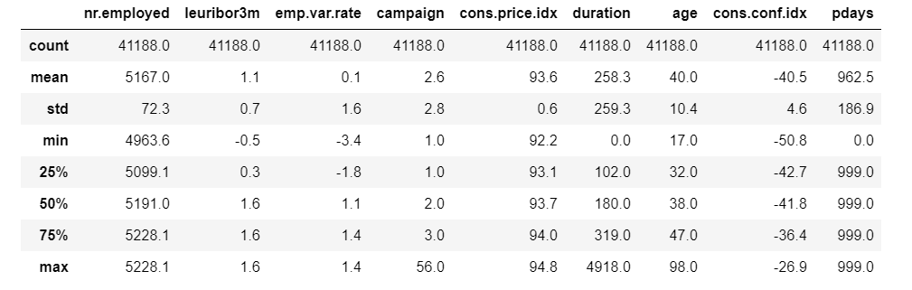
Basic Statistics
Highlights

Slide 7
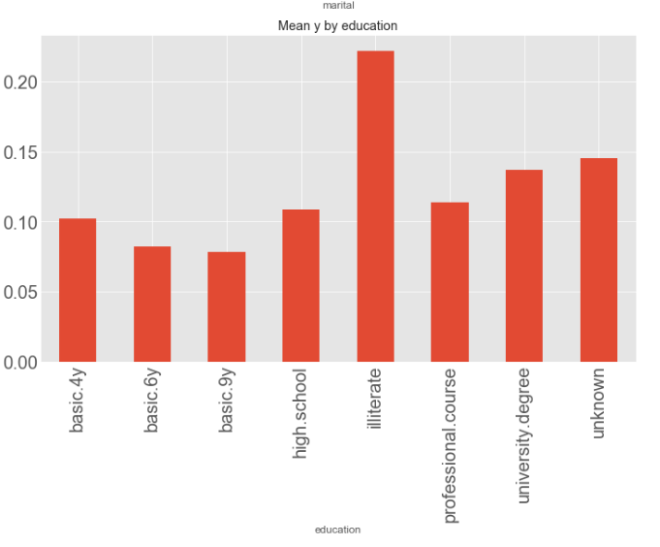
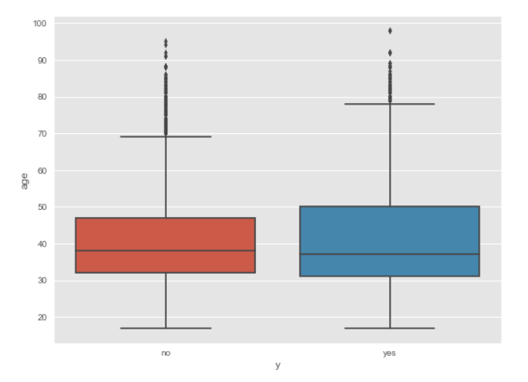
Visualization Customer Infor
Notes:
Euribor rate

Slide 8
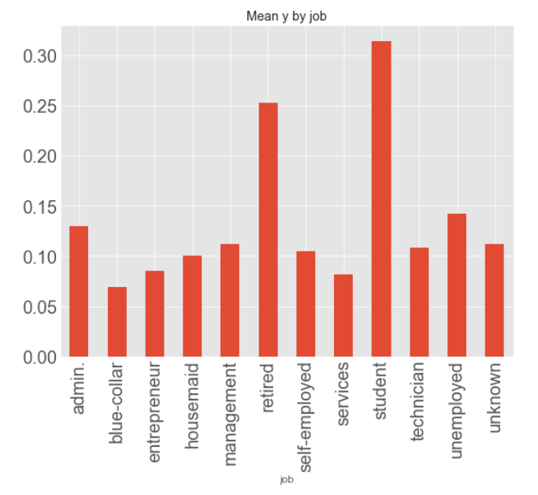
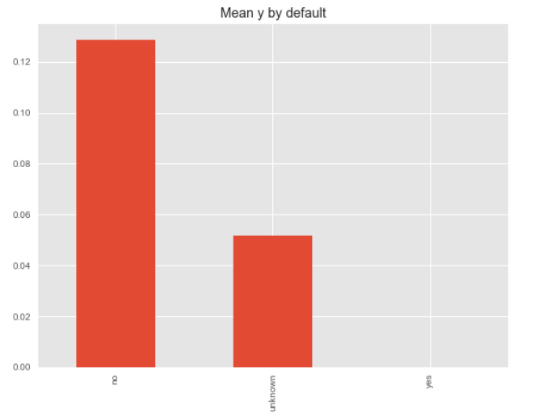
Visualization
Notes:
Euribor rate

Slide 9
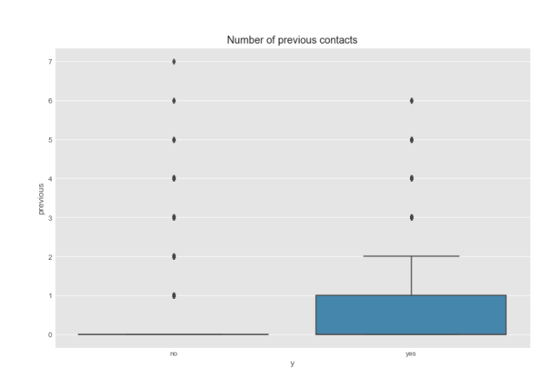
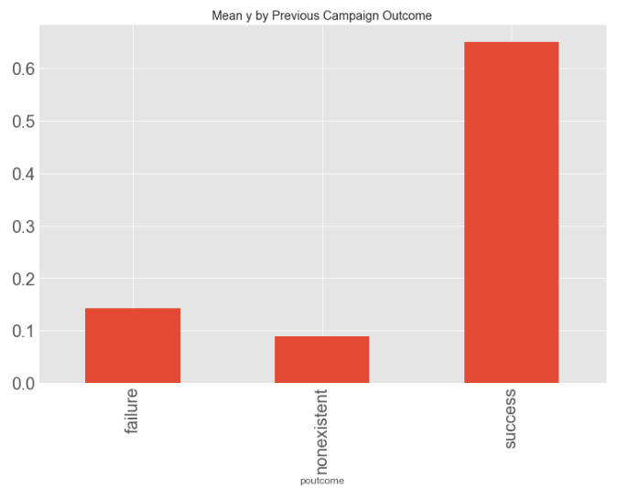
Campaign Information

Slide 10
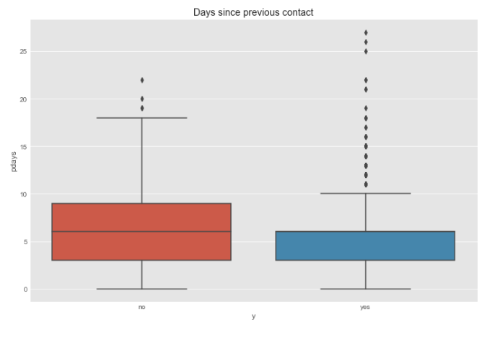

Slide 11
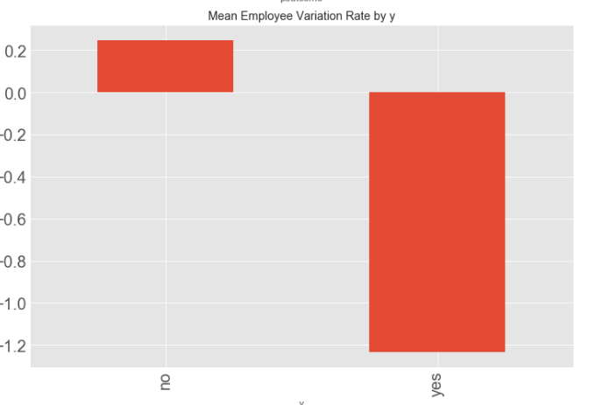
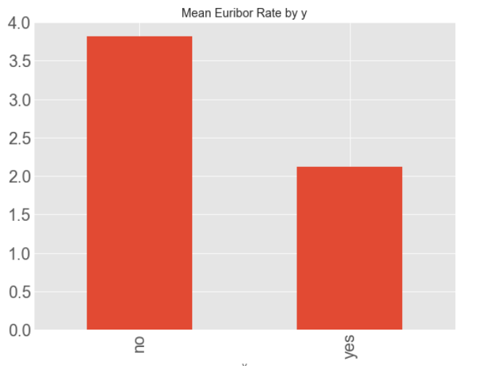
Socio economic variables

Slide 12
Approach
Variable Transformation
Log-transform call duration, campaign duration
Standardize distributions
Feature Engineering
Pdays
Job – Unemployed vs Student, retired
Marital status – Married once vs others
Education – Illiterate vs some education

Slide 13
Approach
Dataset Balancing
Specify Ratio of 1’s to 0’s
Feature Selection
Selected using ExtraTrees Classifier
Variables with importance >0.005
Campaign Duration, Age, Euribor Rate, Campaign contacts etc (Update by highest importance - )

Slide 14
Methods and Models
Method 1
Dataset Balancing only
Method 2
Feature Selection only
Method 3
Dataset Balancing + Feature Selection
3 Models under each method
Logistic Regression
Random Forest
SVM
Notes:
Why are we using these models?

Slide 15
Method 1 Results
Model | Train Auc | Test AUC | Test Accuracy | Precision | Recall | F-1 Score
Logistic Regression | 0.67 | 0.68 | 0.91 | 0.9 | 0.91 | 0.9
Random Forest | 0.78 | 0.72 | 0.91 | 0.9 | 0.91 | 0.9
SVM | 0.71 | 0.7 | 0.91 | 0.9 | 0.91 | 0.9
Overfitting in the case of Random Forest here
Why SVM so low?
Should we have or keep test accuracy??
Notes:
REMOVE OR

Slide 16
Method 2 Results
Model | Train Auc | Test AUC | Precision | Recall | F-1 Score
Logistic Regression | 0.66 | 0.67 | 0.89 | 0.91 | 0.9
Random Forest | 0.74 | 0.74 | 0.9 | 0.91 | 0.9
SVM | 0.5 | 0.5 | 0.79 | 0.89 | 0.93
Random Forest model fits decently. AUC on train and test is best so far. Overall, feature selection helped.
Why SVM so low and decreased from previous method?

Slide 17
Method 3 Results
Model | Train Auc | Test AUC | Precision | Recall | F-1 Score
Logistic Regression | 0.85 | 0.85 | 0.92 | 0.83 | 0.86
Random Forest | 0.87 | 0.87 | 0.92 | 0.84 | 0.86
SVM | 0.87 | 0.87 | 0.92 | 0.83 | 0.86
The logistic model performs much better after feature selection and addressing class imbalance – however we see a drop in recall.
Drop due to balanced sampling of the dataset?

Slide 18
Findings
While method 1 and method 2 gives good accuracy estimates, the AUC for both methods is not satisfactory.
Method 3 is the best method for this problem. Doing feature selection and addressing class imbalance improves model predictions significantly.
While the paper emphasizes on the importance of a data mining approach to solve telemarketing problem, we recommend data mining with appropriate feature engineering, feature selection and sampling to account for the imbalance in the dataset.
Accuracy is much better than what is reported in the paper after performing feature selection and sampling.

Slide 19
Conclusions
Address drop in recall and how to choose a model (looking at precision, recall tradeoff ) with business context
By evaluating such campaign information and customer metrics, we can aim to use data analytics to maximize customer lifetime value
Notes:
Important features identified by the model include last contact duration, age of customer, Euribor 3-month rate, outcome of previous marketing campaign, number of employees, whether customer has housing loan or personal loan, whether customer was contacted previously, day of week, quarterly employment variation rate and credit default of customers.

