Slide 1
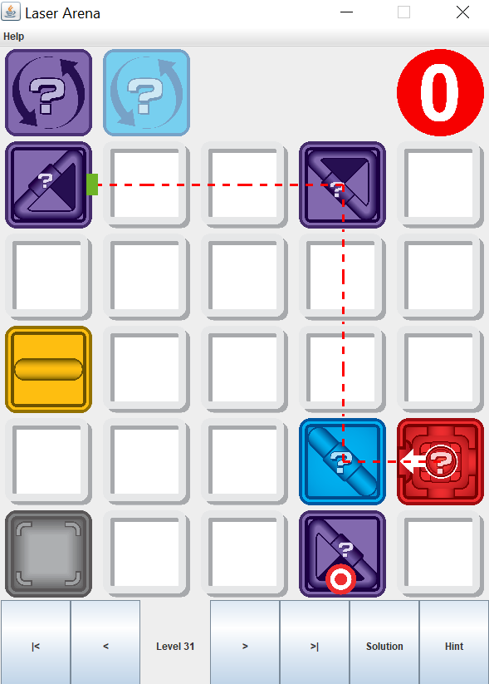
Waiting List
Targets Left
Game Area

