Slide 1
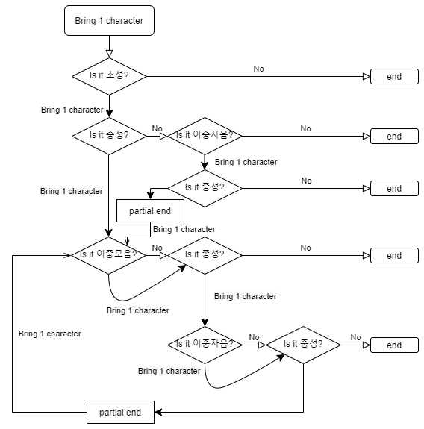
①
④
②
⑤
③
⑥
⑦
⑧

Slide 2
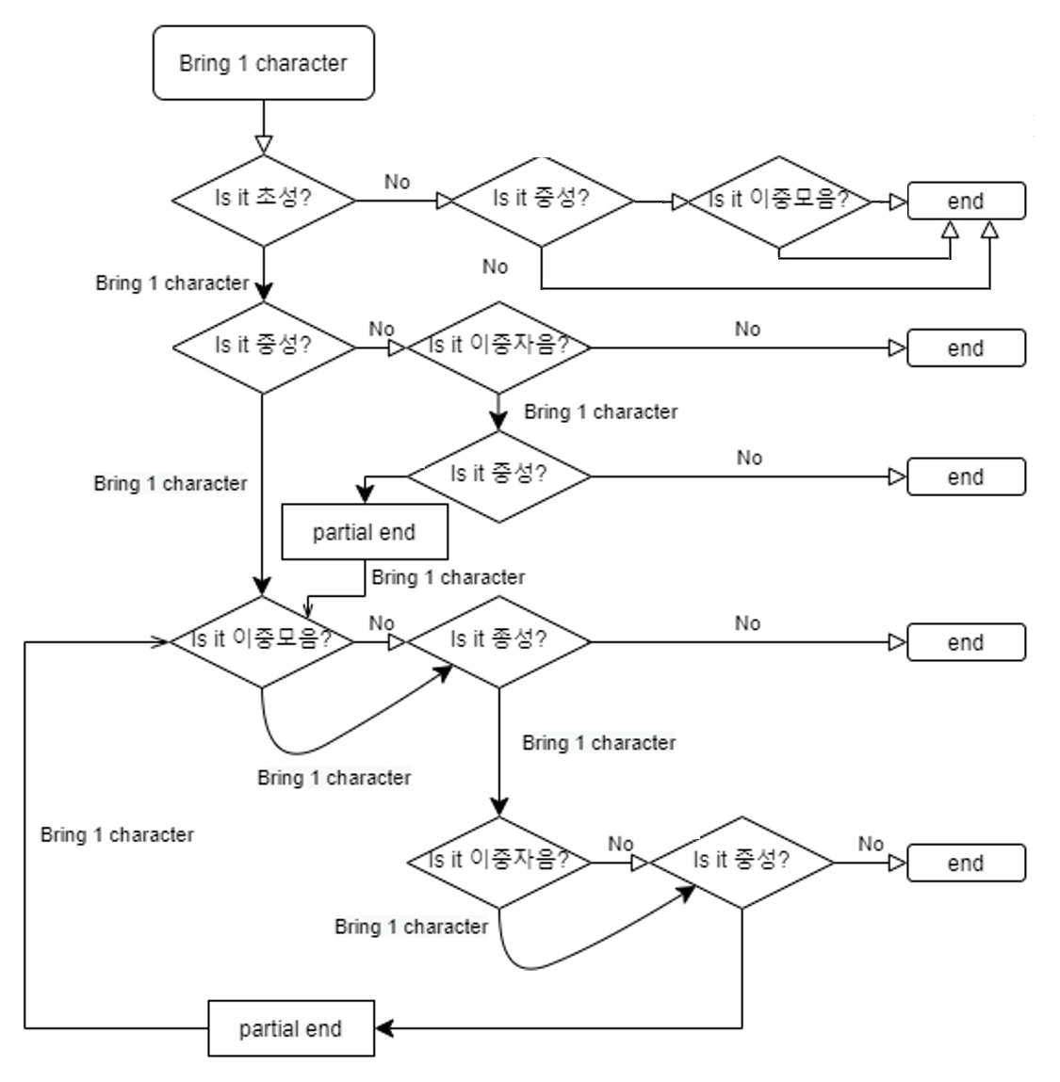
①
②
③
⑥
④
⑦
⑤
⑧
⑨
⑩

