Slide 1


Car Rental
By Abel Nedi

Slide 2

containts
Introduction
useCase Diagram
Some useCase Discription
System Architecture
Class Diagram
Sequence Diagram
Collaboration Diagram
conclution
Demo code

Slide 3
Introduction
This project is designed so as to be used by Car Rental Company specializing in renting cars to customers. It is an online system through which customers can view available cars, detail of car and book car.

Slide 4
problem statement table
The problem of | Rent car from this company, where ever you are you can rent whatever available cars.
Affects | Getting a rental car helps people get around despite the fact they do not have access to their own personal vehicle or don't own a vehicle at all.
a successful solution would be | This system increases customer retention and simplify vehicle and staff management.

Slide 5
Goals of the Project
The main objective of this web app is to provide convenience to the user/client by developing a wep app to make car rental process easier, faster and data driven.
In distinctive, the goals of Car rental system are:
*To create conveniences, availability and quality service the clients.
*To build data driven web app that has direct access to admin through web application system.

Slide 6
There are six modules in the car rental web. The modules are:
Client Information User can register, login, view and update client information.
2. Staff Information There are two users that are admin and client. Admin can add, view, update and delete client information,
3. Car Information can add, view, update and delete car information.
4. admin will update booking information.
5. Returning User can update rental information status to return and system will record the time and record the car is being returned.
6.Report Producing the reports associated with the renting car. The system is a multi-user system since it is used by different groups of users. It is developed to be used on any operating system platform.

Slide 7
Stake Holders
Name | Description | Responsibility
Admin | Add car, view list of car, edit car, delete car, login , view detail of the car and return the car on the system | Admins are responsible for check out the car and check in the car, if there is new car add that car to database, if the company want to trash the old car the admin will be delete that car.
User | List of car view, view car detail and to the system the user have to give information of specific time and if the user do not have account they have to be sign up Account else log in on the system | The user responsibility is first sign up, specify time or how long take that car,
Developer | Developers develop system on the basis of given document. | Developers are responsible for developing system feature, fixing bug, and maintain the system’s availability.

Slide 8
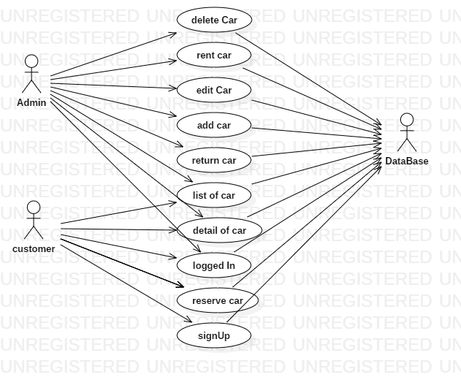
Use Case Diagram

Slide 9
UseCase Discription
Use Case Number: 1
Brief description This use case allows the admin to add car, view car, delete ,and edit car
Actors Admin
Preconditions
The admin must logged in to the system
Flows of Events:
1. Basic Flows
1.1.0 Add Car
Step | User Actions | System Actions
1 | Click addCar button | The system display add car form
2 | The Admin fills out the form and requests the system to save the details | The system verifies that there’s no other car in the database with the same vin number and saves the car and returns the success message on success or a fail message in case of failure.
Postconditions
The Car is persisted in the system
Business Rules
No the same Cars. A unique profile is identified by vin number.

Slide 10
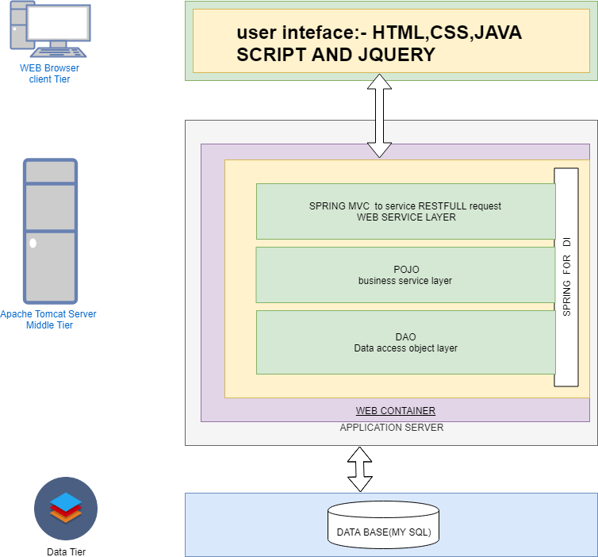
Car Rental System Architecture

Slide 11
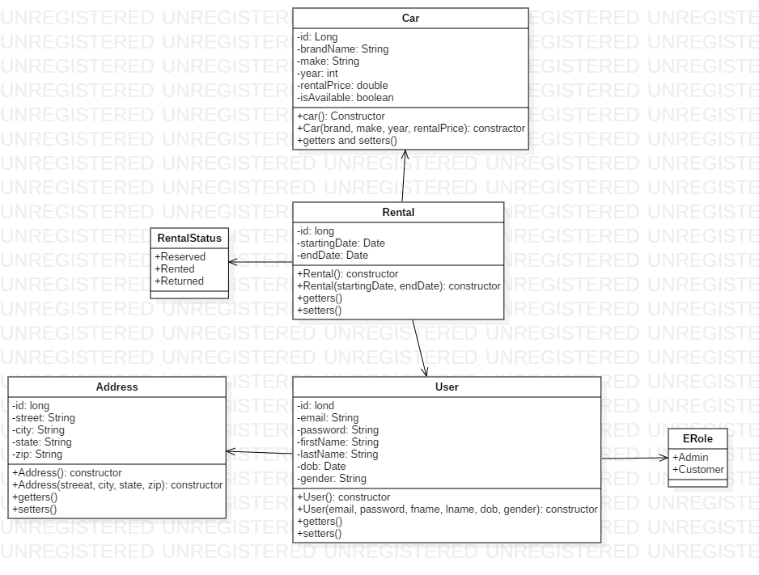
Class Diagram

Slide 12
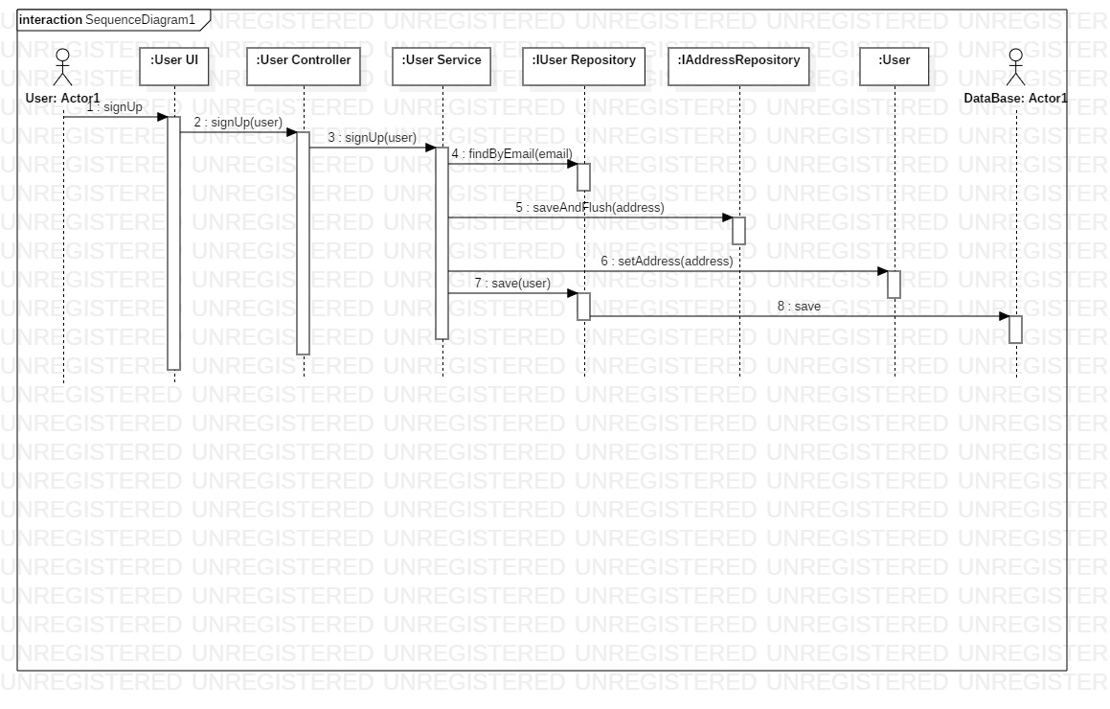
Sequence Diagram

Slide 13
Collaboration Diagram

Slide 14
Conclution
Future explanation
As the starting project the car rental system fulfils the basic structure of the client admin connection. But for the future this web app can be expand to give more convenient service for the client. The following are the basic system to be added in the current app
1. payment
2. add reviews of the client experience
3. Authentication system
4. more front end development …etc

Slide 15
Main Point
Sequence diagram document the sequence of calls different object make to accomplish a specific task.
Likewise, harmony exists in diversity: even though each object is specialized to only perform tasks related to itself, object harmoniously collaborate to create functionality far beyond each object’s individual scope.

