Slide 1
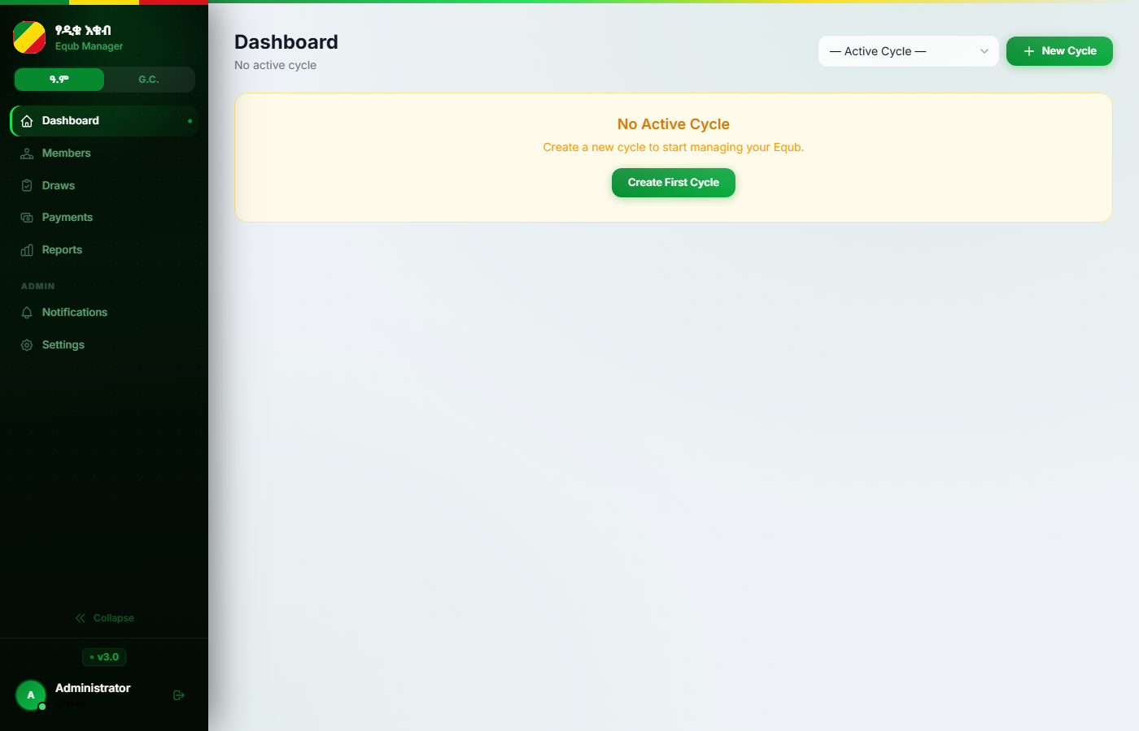
እ
እቁብ
Equb Management Platform
User & Administrator Manual
Covers all roles: Superadmin · Admin · Cashier
Version
Platform
Hosted on
v3.0
FastAPI + PostgreSQL
Railway.app

Slide 2
Table of Contents
This manual covers all 8 functional areas of the platform
1
Getting Started
2
Managing Members
3
Cycles & Draws
4
Payments
Login · Dashboard · Navigation
Add · Edit · Spots · Lifecycle
Create cycle · Run draws · Sell pot
Record · Batch · Auto-status rules
5
Disbursements
6
Reports & Analytics
7
SMS Notifications
8
Settings & Admin
Cheques · Guarantors · Vouchers
Financial · Ledger · Export
Templates · Auto-send · Log
Roles · Permissions · Security · 2FA

Slide 3
1
Section 1
Getting Started
Login · Dashboard · Navigation

Slide 4
1.1 — Logging In
Superadmin
Admin
Cashier
Authentication · Rate Limiting · Two-Factor Authentication
1
Open the app URL in your browser
2
Enter your username
Rate Limit: After 5 failed login attempts within 5 minutes, your account is locked for 10 minutes.
Navigate to the Equb platform link. Default local: http://localhost:8000
Case-sensitive. Set by the Superadmin when your account was created.
2FA (Optional): If enabled, after password verification you will be asked for a 6-digit TOTP code from your authenticator app (Google Authenticator, Authy, etc.).
3
Enter your password
4
Click Sign In
Forgot your password? Contact your Superadmin to reset it. Superadmins can reset any user's password from Settings → Users.
Minimum 8 characters. Cannot be all numbers or a common phrase.
You will be redirected to the Dashboard. If 2FA is enabled, you will first see the code entry screen.
Password Rules
• Minimum 8 characters
• Cannot be all numbers (e.g. 12345678)
• Cannot be common phrases ("password", "equb1234")
• Set by Superadmin; user can change in Settings

Slide 5
1.2 — Dashboard Overview
Superadmin
Admin
Cashier
Real-time snapshot of the active cycle
Sidebar Navigation
Links to all modules: Dashboard · Members · Draws Payments · Reports · Notifications · Settings
Active Cycle Info
Shows which cycle is selected and the current draw phase
Next Draw Card
Week number, draw date, and net pot amount
Association Fund Balance
Running total of ማህበር fund from weekly deductions

Slide 6
2
Section 2
Managing Members
Add · Edit · Spots · Lifecycle

Slide 7
2.1 — Member Concepts
Superadmin
Admin
Spots · Full Share vs Half Share · Weekly Contribution
What is a Spot?
Weekly Contribution — Example
• Each spot is a numbered slot in the Equb (e.g. Spot #1 to #113)
• One spot = one draw entry per cycle
Setting
Default Value
• Member spots: #1 – 113 | Association spots: #114 – 118
Full spot amount
21,000 ETB / week
• Association (ማህበር) spots generate profit for the group fund
Half spot amount
10,500 ETB / week
• A member can hold more than one spot
Association deduction
1,000 ETB / person / week
Full Share
Half Share
Full voucher rate
80 ETB / card
• One member occupies the spot exclusively
• Two members share ONE spot
Half voucher rate
40 ETB / card
• Weekly contribution: 21,000 ETB (default)
• Each pays 10,500 ETB/week (half)
Member spots
113
• Receives the full pot when drawn
• When drawn, pot is split between two
Association spots
5
• Cannot be split with another member
• Max 2 members per half-share spot
Group week interval
Every 4th week
Settings can be changed in Settings → Financial Settings (Superadmin only). Each cycle takes an independent snapshot of these values.

Slide 8
2.2 — Adding & Editing Members
Superadmin
Admin
Members page → Add Member button
1
Go to Members
2
Fill in member details
3
Assign a Spot
Click Members in the sidebar. Click the + Add Member button (top right).
Name (required) Phone number (optional, for SMS) Notes (optional)
Select spot number from the available list. Choose share type: Full or Half. Click Assign Spot.
4
Save
5
Add more spots (optional)
6
Bulk import
Click Save Member. Member appears in the list immediately.
Open the member record. Click Add Spot to assign an additional spot.
Click Import to upload a CSV/Excel file with columns: Name, Phone, Spot, Share, Notes.
Important: You cannot add or edit spot assignments once the cycle moves to the Draw phase. Complete all member registrations during the Collection phase.

Slide 9
2.3 — Member Lifecycle & Status
Superadmin
Admin
Active → Received → Left | Mid-cycle exit · Spot transfer
ACTIVE
RECEIVED
LEFT
Member is currently participating and paying weekly
Member has won the pot and collected cheque
Member has departed or stopped paying during the cycle
Mid-Cycle Exit (Member Leaves)
Spot Transfer (Mid-Cycle)
• Go to Members → open member → click Exit Member
• Go to Members → click Spot Transfer
• Enter the exit week number and reason (left / stopped paying)
• Select the spot, the current member (seller), and new member (buyer)
• All pending/late payments AFTER the exit week are auto-marked missed
• Specify the effective week (first week new member is responsible)
• A financial summary is shown: weeks paid, owed, whether they won
• Past payments stay with original member; future assigned to new member
Soft deletes: Members marked Left are never permanently deleted. All payment, draw, and guarantor records are preserved for audit.

Slide 10
3
Section 3
Cycles & Draws
Create cycle · Run draws · Sell pot

Slide 11
3.1 — Creating & Managing a Cycle
Superadmin
Admin
Draws page → Cycles tab
1
Go to Draws → Cycles
2
Fill in cycle details
3
Create the cycle
Click Draws in sidebar. Select the Cycles tab. Click "+ New Cycle".
Name (e.g. Equb 2025), Start date, Notes (optional). Override financial settings if needed.
Click Create. All weeks are generated automatically. Status: Collection phase.
4
Register all members
5
Start Draws phase
6
Recalculate pot (if needed)
Add members and assign spots during the Collection phase. No draws happen yet.
Click "Start Draws" on the cycle. Specify first week number and total association spots.
If members are added or changed, click Recalculate Pot to update all pending week amounts.
Only one cycle can be active at a time. Creating a new cycle automatically closes the previous active cycle. Completed cycles are locked and preserved.

Slide 12
3.2 — Running Weekly Draws
Superadmin
Admin
Draws page → Weeks tab → Draw Winner
1
Select the week
Pot On Hold
Go to Draws → Weeks. Find the current week row.
If the winning member has unpaid weeks:
• The pot is placed ON HOLD
2
Click Draw Winner
• An SMS is sent: pay outstanding weeks to receive pot
• Member must clear all outstanding payments
Click the "Draw" button. Select or confirm the winning spot.
• Admin then releases the pot manually
• Cheque is issued the following week after confirmation
3
System checks eligibility
Winner must have no pending/ late/missed payments.
Group Week (Buyer Week) — Every 4th Week
4
Winner confirmed
• Any member can buy the pot on a group week
• Goes to Draws → sell this week's pot → Group sale
Spot status → Received. Week status → Drawn. SMS sent to winner.
• Buyer pays the net pot amount; seller receives their fee
• Association spot weeks: profit goes to ማህበር fund
Batch Draw: You can draw multiple weeks at once from Draws → Batch Draw. Each week is validated independently.

Slide 13
4
Section 4
Payments
Record · Batch · Auto-status rules

Slide 14
4.1 — Recording Payments
Superadmin
Admin
Cashier
Payments page → Select week → Record payment
Record a Single Payment
Record a Batch Payment (Multiple Weeks)
• Go to Payments in sidebar
• Go to Payments → Batch Record
• Select the week from the dropdown
• Select the member from the dropdown
• Find the member in the payment list
• Tick the week checkboxes you are recording for
• Click Record Payment next to their name
• Enter payment date, method, and reference
• Fill in: Status, Payment date, Method (cash/bank/cheque), Reference, Notes
• Click Save — all selected weeks are marked paid
• Click Save — SMS confirmation is sent automatically if SMS is enabled
• One SMS is sent summarising all weeks covered
Payment Fields Reference
Status
pending / paid / late / missed
Payment date
Date cash/cheque was received
Payment method
cash · bank_transfer · cheque
Reference
Cheque number or bank transaction reference
Penalty amount
ETB surcharge for late payment (optional)
Notes
Any additional remarks

Slide 15
4.2 — Payment Status Rules
Superadmin
Admin
Cashier
Automatic transitions · Scheduled jobs · Manual override
PENDING
PAID
LATE
MISSED
Payment created but not yet recorded
Payment confirmed by cashier / admin
Draw date passed (within 3-day grace period)
More than 3 days past draw date without payment
Automatic Nightly Job (midnight EAT)
Daily Reminder Job (9 PM EAT)
• pending → late: if draw date passed but within 3-day grace period
• Checks for all unpaid members with draws within 48 hours
• late → missed: if 3 or more days past draw date
• Sends SMS payment reminder to each member
• pending → missed: if pending and more than 3 days past draw date
• Encourages payment to maintain draw eligibility
• SMS alert sent to each newly missed member
• Can be triggered manually: Payments → Send Reminders
Manual override: Any admin can change a payment status manually at any time. Go to Payments → select week → click the status badge next to the member.

Slide 16
5
Section 5
Disbursements
Cheques · Guarantors · Vouchers

Slide 17
5.1 — Issuing a Disbursement Cheque
Superadmin
Admin
Cashier
Disbursements page → New Disbursement
1
Verify winner is paid
2
Go to Disbursements
3
Select the week
Member must have no pending/late/ missed payments before issuing cheque.
Click Disbursements in sidebar. Click New Disbursement.
Choose the draw week from the dropdown. The gross pot amount auto-fills.
4
Get voucher info
5
Add 3 guarantors
6
Enter cheque details
Click "Get Voucher Info" to see the full deduction breakdown (assoc + service + voucher).
Select 3 different members who guarantee the disbursement. All 3 must be different people.
Cheque number, cheque date. Adjust deductions if needed. Click Save.
3 Guarantors Required: All three must be different members. The system will reject if any two guarantors are the same person. Guarantor records are preserved permanently for audit.

Slide 18
5.2 — Voucher Deduction & Net Pot Calculation
Superadmin
Admin
How the net cheque amount is calculated
Net Pot = Gross Pot − Association Deduction − Service Fee − Voucher Deduction
Gross Pot
113 members × 21,000 ETB
2,373,000 ETB
Association Deduction
113 members × 1,000 ETB (association rate)
− 113,000 ETB
Service Fee
1 × 21,000 ETB (worker-week contribution)
− 21,000 ETB
Voucher Deduction
1 winner × 80 ETB/card × 120 weeks
− 9,600 ETB
NET CHEQUE AMOUNT
2,229,400 ETB
Voucher Returns
• Physical vendor voucher cards are tracked per week
• Go to Disbursements → Voucher Returns → Add Return
• Enter full_count and half_count of cards returned
• Mark vendor_paid when the vendor has been reimbursed
• Voucher return records are per-week and cannot be duplicated

Slide 19
6
Section 6
Reports & Analytics
Financial · Ledger · Export

Slide 20
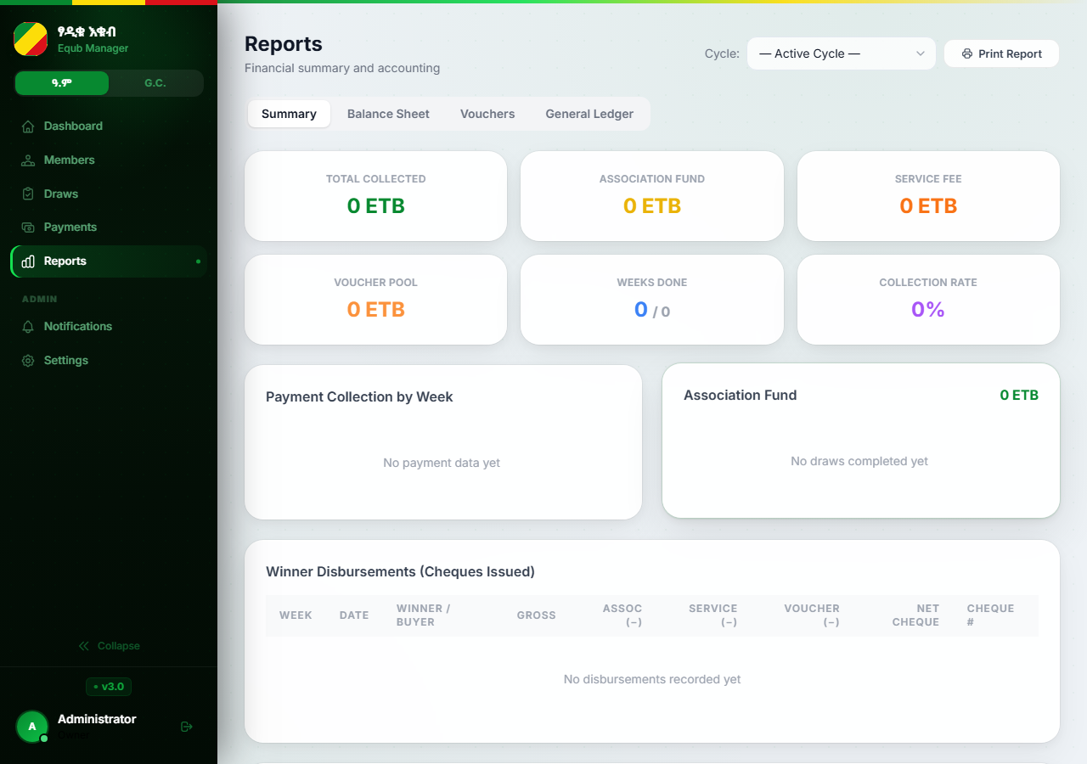
6.1 — Reports & Analytics
Superadmin
Admin
Reports page — Admin/Superadmin access required
Financial Summary
Tabs: Summary · Balance Sheet · Vouchers · General Ledger Shows: total collected, assoc fund, service fee, collection rate
Payment Report
Per-member: weeks paid/missed, total amounts. Full payment history with date, method, collector
Draw Report
All completed draws: winner, buyer (if sold), pot amounts, draw date, pot-sale details
Disbursement Report
All cheques: gross/net/deductions, cheque #, guarantors, status, void reasons
Association Fund Report
Export: All reports can be downloaded as CSV or formatted Excel. Click Print Report to open a print-ready summary in a new browser tab.
Inflows (deductions + ማህበር profits) minus expenses. Running balance; end-of-cycle distribution

Slide 21
7
Section 7
SMS Notifications
Templates · Auto-send · Log

Slide 22
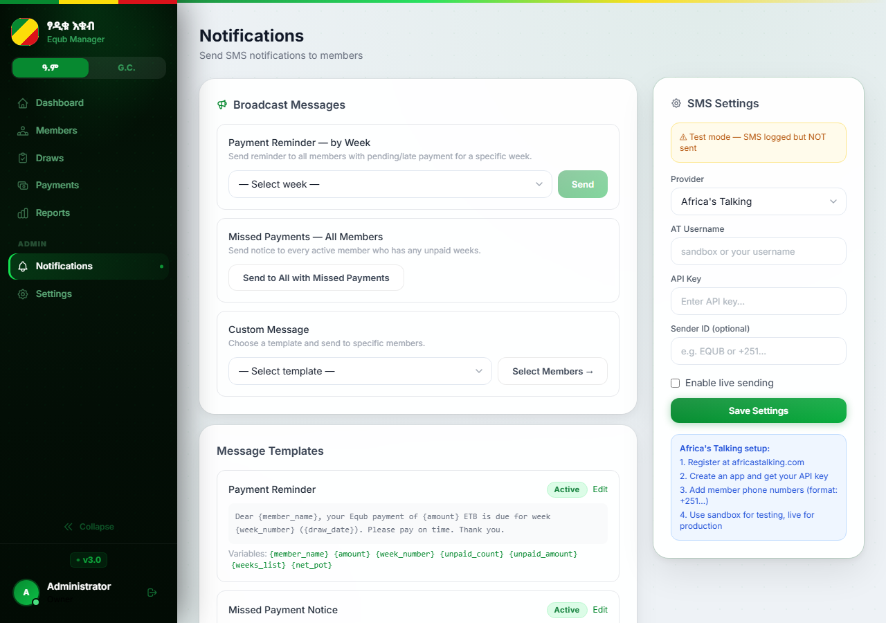
7.1 — SMS Notifications Setup
Superadmin
Admin
Notifications page → Settings tab
1
Open Notifications → Settings
Click Notifications in sidebar. Click the Settings tab.
2
Enter Africa's Talking credentials
API Key, Username (sandbox or live). Sender ID (your SMS display name).
3
Enable SMS
Toggle "Enable SMS" to ON. Leave OFF for testing (mock mode).
4
Save settings
Click Save Settings. Test with a sample send.
Mock Mode: When SMS is disabled, all notifications are logged as 'mock' — you can see exactly what would be sent without spending SMS credits.

Slide 23
7.2 — SMS Templates
Superadmin
Admin
6 built-in templates — editable, individually toggleable
payment_confirmed
payment_reminder
missed_payment
Sent when cashier marks a payment as paid.
Sent daily for unpaid members with draws within 48 hours.
Sent when a payment auto-transitions to missed.
Variables: {member_name}, {amount}, {week_number}, {draw_date}, {payment_method}
Variables: {member_name}, {amount}, {week_number}, {draw_date}
Variables: {member_name}, {unpaid_count}, {unpaid_amount}, {weeks_list}
draw_winner
pot_on_hold
pot_sold
Sent to the winning member after the draw.
Sent when winner is drawn but has outstanding payments.
Sent when a pot is sold instead of directly disbursed.
Variables: {member_name}, {week_number}, {net_pot}
Variables: {member_name}, {week_number}, {net_pot}, {unpaid_count}, {unpaid_amount}
Variables: {member_name}, {week_number}, {seller_fee}, {buyer_receives}
Edit templates in Notifications → Templates tab. Toggle any template off to stop that type of SMS from being sent.

Slide 24
8
Section 8
Settings & Administration
Roles · Permissions · Security · 2FA

Slide 25
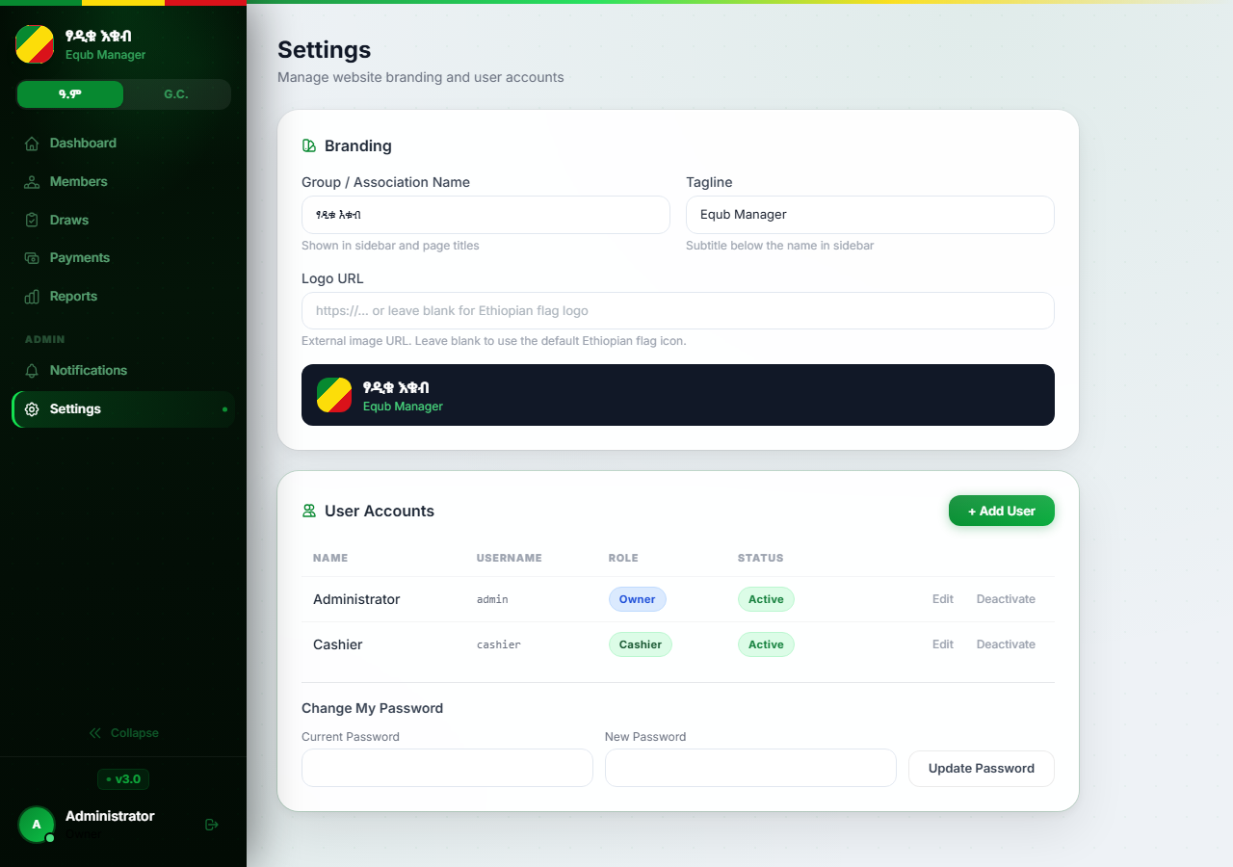
8.1 — Financial Settings
Superadmin
Settings page → Financial tab (Superadmin only)
full_spot_amount
21,000 ETB
Weekly payment for a full-share member
half_spot_amount
10,500 ETB
Weekly payment for a half-share member
association_deduction
1,000 ETB
Deducted per person per week for ማህበር fund
full_spot_voucher
80 ETB
Vendor voucher reimbursement per full-spot card
half_spot_voucher
40 ETB
Vendor voucher reimbursement per half-spot card
group_week_interval
4
Every Nth week is a buyer/group week
total_member_spots
113
Total regular member spots per cycle
group_name
እቁብ
Displayed in the app header and reports
group_tagline
Equb Manager
Subtitle shown under the group name
Important: Changing financial settings affects NEW cycles only. Each cycle takes a snapshot of these values at creation time. Use 'Apply Settings to Cycle' to push changes into an active cycle.

Slide 26
8.2 — User Roles & Permission Matrix
Superadmin
Settings page → Users tab | Who can do what
Superadmin
Admin
Cashier
• Full access to every feature
• Manage members, draws, payments
• Record and update payments
• Manage all user accounts and roles
• Issue and void disbursements
• View member list (read-only)
• Configure financial settings and branding
• View reports and export data
• Record disbursements
• Reset the entire system
• Configure notifications / SMS
• Cannot manage members or run draws
• Cannot create a second Superadmin
• Manage Cashier accounts
• Cannot access reports or settings
• Permissions configurable by Superadmin
• Permissions configurable by Superadmin
Permission Matrix — configurable by Superadmin in Settings → Permissions
Permission
Superadmin
Admin
Cashier
manage_members
✓
✓
—
run_draws
✓
✓
—
disbursements
✓
✓
✓
view_reports
✓
✓
—
manage_users
✓
✓
—
notifications
✓
✓
—

Slide 27
8.3 — Security Features
Superadmin
Admin
Cashier
2FA · Audit Log · Sessions · Password Policy
Setting Up Two-Factor Authentication (2FA)
Audit Trail (Immutable Log)
• Go to Settings → Your Account → Enable 2FA
• Every financial change is recorded automatically
• A QR code and secret key are displayed
• Logged: user, timestamp, action (create/update/delete/void)
• Scan the QR code with Google Authenticator or Authy
• Before and after values stored as JSON
• Enter the 6-digit TOTP code to confirm and activate
• Cannot be altered or deleted — permanent record
• From now on, every login requires both password + code
• Covers: payments, draws, disbursements, member exits, voids
• To disable: enter current TOTP code in Settings → Disable 2FA
Rate Limiting
Password Policy
Session Timeout
5 failed logins → 10-minute account lockout
Min 8 chars, no all-numbers, no common phrases
1-hour server-side session; re-login required
CSRF Protection
CSP Headers
HTTPS Enforcement
All state-changing forms include CSRF tokens
Content Security Policy prevents XSS attacks
All traffic forced to HTTPS in production

Slide 28
Glossary
Key terms used throughout this manual
Equb (እቁብ)
Ethiopian rotating savings & credit association (ROSCA)
Group/Buyer Week
Every 4th week — any member can buy the pot
Cycle
One complete round of the Equb (all spots drawn once)
Guarantor
Member who vouches for the draw winner (3 required)
Spot
A numbered entry slot (#1–113 member, #114–118 assoc.)
Disbursement
Physical cheque payment issued to the draw winner
Full Share
One member exclusively holds a spot; pays 21,000 ETB/week
Collection Phase
Early cycle stage when members register; no draws yet
Half Share
Two members share one spot; each pays 10,500 ETB/week
Draw Phase
Active stage when weekly draws are held
Gross Pot
Total weekly contributions from all members
Pot On Hold
Winner drawn but cannot receive pot due to unpaid weeks
Net Pot
Gross − Association deduction − Service fee − Voucher
Void
Cancellation of a disbursement cheque (soft delete)
Association (ማህበር)
Community fund built from weekly deductions
TOTP / 2FA
Time-based one-time password for two-factor authentication
Voucher
Physical vendor discount card; reimbursed by assoc. fund

Slide 29
Equb Management Platform
User & Administrator Manual
Support:
Contact your Superadmin for account issues or password resets
Version:
v3.0 | FastAPI · PostgreSQL · Railway.app
Coverage:
All roles: Superadmin · Admin · Cashier
እቁብ

