Slide 1
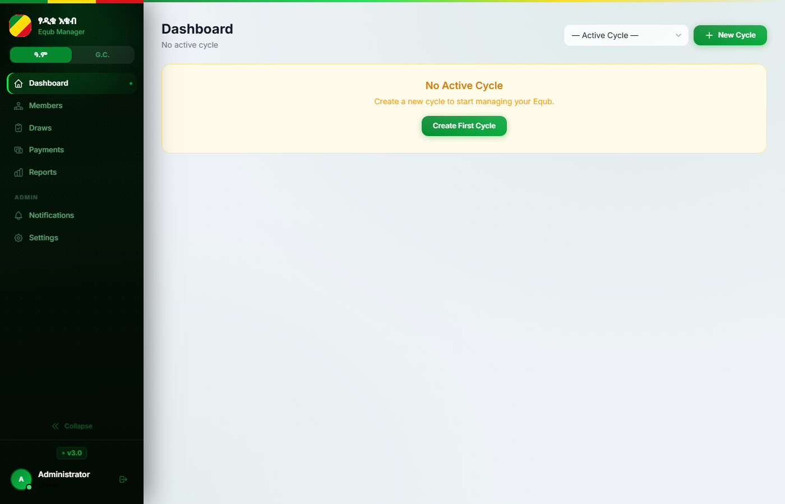
እ
እቁብ
Equb Management Platform
User & Administrator Manual
Covers all roles: Superadmin · Admin · Cashier
v3.0
FastAPI + PostgreSQL
Railway.app
30 Slides

Slide 2
Table of Contents
This manual covers all 8 functional areas of the Equb platform
1
Getting Started
2
Managing Members
3
Cycles & Draws
4
Payments
Login · Dashboard · Navigation
Add · Edit · Spots · Lifecycle
Create cycle · Run draws · Sell pot
Record · Batch · Auto-status rules
5
Disbursements
6
Reports & Analytics
7
SMS Notifications
8
Settings & Admin
Cheques · Guarantors · Vouchers
Financial · Ledger · Export
Templates · Auto-send · Log
Roles · Permissions · Security · 2FA

Slide 3
1
Section 1
Getting Started
Login · Dashboard · Navigation

Slide 4
1.1 Logging In
Superadmin
Admin
Cashier
Authentication · Rate Limiting · Two-Factor Authentication
1
Open the app URL
2
Enter your username
3
Enter your password
4
Click Sign In
Navigate to the Equb platform link. Default local: http://localhost:8000
Case-sensitive. Set by the Superadmin when your account was created.
Min 8 characters. Cannot be all numbers or a common phrase.
Redirected to Dashboard. If 2FA is enabled, a 6-digit code screen appears next.
Rate Limit: After 5 failed login attempts in 5 minutes, the account is locked for 10 minutes. Contact Superadmin if you are stuck.
Password Rules
• Minimum 8 characters
• Not all numbers (e.g. "12345678")
2FA (Optional): If enabled, after password verification you will be prompted for a 6-digit TOTP code from your authenticator app (Google Authenticator, Authy, etc.).
Forgot your password? Ask your Superadmin — they can reset any user password from Settings → Users.
• Not common phrases ("password", "equb1234")
First login: Your Superadmin will give you a username and temporary password. Change your password immediately via Settings → Change Password.

Slide 5
1.2 Dashboard Overview
Superadmin
Admin
Cashier
Real-time snapshot of the active cycle — visible to all roles
Sidebar Navigation
Links: Dashboard · Members Draws · Payments · Reports Notifications · Settings
Active Cycle Info
Shows which cycle is selected and the current draw phase (Collection or Active)
Next Draw Card
Week number, scheduled draw date, and net pot amount for that week
Association Fund
Running ማህበር fund balance built from weekly member deductions

Slide 6
2
Section 2
Managing Members
Add · Edit · Spots · Lifecycle

Slide 7
2.1 Member Concepts
Superadmin
Admin
Spots · Full Share vs Half Share · Weekly Contribution
What is a Spot?
Default Financial Settings
full_spot_amount
21,000 ETB / week
• Each spot is a numbered slot in the Equb (e.g. #1 to #113)
• One spot = one draw entry per cycle
half_spot_amount
10,500 ETB / week
• Member spots: #1–113 | Association (ማህበር) spots: #114–118
association_deduction
1,000 ETB / person / week
• Association spots generate profit for the group fund
full_spot_voucher
80 ETB / card
• A member can hold more than one spot
half_spot_voucher
40 ETB / card
Full Share — 21,000 ETB / week
Half Share — 10,500 ETB / week
group_week_interval
Every 4th week is a buyer week
• One member occupies the spot exclusively
• Two members share ONE spot
total_member_spots
113 regular member spots
• Receives the full pot when drawn
• Each pays 10,500 ETB per week
total_assoc_spots
5 association spots
• Cannot be split with another member
• When drawn, pot is split between both
• Maximum 2 members per half-share spot
Each cycle takes a snapshot of these values at creation. Settings changes only affect NEW cycles unless you use 'Apply Settings to Cycle'.

Slide 8
2.2 Adding & Editing Members
Superadmin
Admin
Members page → + Add Member button
1
Go to Members page
2
Enter member details
3
Assign a spot
Click Members in the sidebar. Click the + Add Member button at the top right.
Name (required) Phone number (optional, for SMS) Notes (optional)
Select spot number from the available list. Choose share type: Full or Half.
4
Save the member
5
Add more spots (optional)
6
Bulk import
Click Save Member. Member appears in the list immediately.
Open the member record. Click Add Spot to assign an additional spot.
Click Import to upload a CSV or Excel file. Columns: Name, Phone, Spot, Share, Notes.
Important: Spot assignments cannot be added or edited once the cycle moves to the Draw phase. Complete all member registrations during the Collection phase.

Slide 9
2.3 Member Lifecycle & Status
Superadmin
Admin
Active → Received → Left | Mid-cycle exit | Spot transfer
ACTIVE
RECEIVED
LEFT
Member is currently participating and paying weekly
Member has won the pot and collected the cheque
Member has departed or stopped paying during the cycle
Mid-Cycle Exit (Member Leaves)
Spot Transfer (Mid-Cycle)
• Go to Members → open member → click Exit Member
• Go to Members → click Spot Transfer
• Enter the exit week number and reason (left / stopped paying)
• Select spot, current member (outgoing), new member (incoming)
• All pending/late payments AFTER exit week → auto-marked missed
• Specify effective week (first week new member pays)
• A financial summary is shown: paid, owed, whether they won
• Past payments stay with original member
• Soft delete — all records preserved for audit
• Future pending payments reassigned to new member
Members marked Left are never permanently deleted. All payment, draw, and guarantor records are preserved for audit trail.

Slide 10
3
Section 3
Cycles & Draws
Create cycle · Run draws · Sell pot

Slide 11
3.1 Creating & Managing a Cycle
Superadmin
Admin
Draws page → Cycles tab → + New Cycle
1
Go to Draws → Cycles
2
Fill cycle details
3
Override settings (optional)
Click Draws in sidebar. Select the Cycles tab. Click "+ New Cycle".
Name (e.g. Equb 2025) Start date Notes (optional)
Per-cycle override of: spot amounts, assoc. deduction, voucher rates, total member spots.
4
Create the cycle
5
Register all members
6
Start Draws phase
Click Create. All weeks are generated automatically. Status: Collection phase.
Add members & assign spots during Collection phase. No draws happen yet.
Click "Start Draws". Specify first week number and total association spots.
Only one cycle can be active at a time. Creating a new cycle automatically closes the previous active cycle. Completed cycles are locked and preserved for audit.

Slide 12
3.2 Running Weekly Draws & Selling the Pot
Superadmin
Admin
Draws page → Weeks tab
1
Go to Draws → Weeks
Pot On Hold
Find the current week row in the weeks list.
• Winner has unpaid weeks → pot placed ON HOLD
• SMS sent: 'Pay outstanding weeks to receive pot'
2
Click Draw Winner
• Member clears all outstanding payments
• Admin releases the pot manually
Click the "Draw" button. Select or confirm the winning spot.
• Cheque issued the following week
3
Eligibility check
Pot Sales — 3 Options
Winner must have no pending, late, or missed payments.
• Group Week (every 4th week): any member can buy the pot
• Member Sale: winning member sells their pot to another member
4
Draw confirmed
• Association Spot Sale: ማህበር spot sold; profit → assoc fund
• Go to Draws → select week → Sell Pot
Spot → Received. Week → Drawn. SMS confirmation sent to winner.
Batch Draw: Draw multiple weeks at once from Draws → Batch Draw. Each week is validated independently.

Slide 13
4
Section 4
Payments
Record · Batch · Auto-status rules

Slide 14
4.1 Recording Payments
Superadmin
Admin
Cashier
Payments page → Select week → Record payment
Record a Single Payment
Record a Batch Payment (Multiple Weeks)
• Go to Payments → select the week from dropdown
• Go to Payments → Batch Record
• Find the member in the payment list
• Select the member from the dropdown
• Click Record Payment next to their name
• Tick the week checkboxes you are recording for
• Fill in: Status, Date, Method, Reference, Notes
• Enter payment date, method, and reference
• Click Save — SMS confirmation sent automatically
• Click Save — all selected weeks are marked paid
• One SMS sent summarising all weeks covered
Payment Fields Reference
Status
pending · paid · late · missed
Payment date
Date cash / cheque was physically received
Payment method
cash · bank_transfer · cheque
Reference
Cheque number or bank transaction reference
Penalty amount
ETB surcharge for late payment (optional)
Notes
Any additional remarks

Slide 15
4.2 Payment Status Rules
Superadmin
Admin
Cashier
Automatic transitions · Scheduled jobs · Manual override
PENDING
PAID
LATE
MISSED
Payment created but not yet recorded
Payment confirmed by cashier or admin
Draw date passed (within 3-day grace period)
3+ days past draw date without payment
Nightly Automated Job (midnight EAT)
Daily Reminder Job (9 PM EAT)
• pending → late: draw date passed, within 3-day grace period
• Checks all unpaid members with draws within 48 hours
• late → missed: 3 or more days past draw date
• Sends payment_reminder SMS to each member
• pending → missed: pending and more than 3 days past draw
• Encourages payment to maintain draw eligibility
• SMS alert sent to each newly missed member
• Can also be triggered manually from Payments page
Manual override: Any admin or cashier can change a payment status manually at any time. Go to Payments → select the week → click the status badge.

Slide 16
5
Section 5
Disbursements
Cheques · Guarantors · Vouchers

Slide 17
5.1 Issuing a Disbursement Cheque
Superadmin
Admin
Cashier
Disbursements page → New Disbursement
1
Verify winner is paid
2
Go to Disbursements
3
Select the week
Member must have no pending, late, or missed payments before issuing the cheque.
Click Disbursements in sidebar. Click New Disbursement.
Choose the draw week. The gross pot amount auto-fills.
4
Get voucher info
5
Add 3 guarantors
6
Enter cheque details
Click "Get Voucher Info" to see the full deduction breakdown: assoc + service + voucher.
Select 3 different members. All 3 must be different people (system validates).
Cheque number and date. Adjust deductions if needed. Click Save.
3 Guarantors Required — all three must be different members. The system rejects if any two guarantors are the same person. Guarantor records are preserved permanently in the audit trail.

Slide 18
5.2 Net Pot Calculation & Voucher Deductions
Superadmin
Admin
How the winner's cheque amount is calculated
Net Pot = Gross Pot − Association Deduction − Service Fee − Voucher Deduction
Worked Example — Full-spot winner, 113 members, 120-week cycle
Gross Pot
113 members × 21,000 ETB/week
2,373,000 ETB
− Association Deduction
113 members × 1,000 ETB (assoc. rate)
− 113,000 ETB
− Service Fee
1 worker-week × 21,000 ETB
− 21,000 ETB
− Voucher Deduction
1 winner × 80 ETB/card × 120 weeks
− 9,600 ETB
NET CHEQUE AMOUNT
2,229,400 ETB
Voucher Returns (Physical Cards)
Void a Disbursement
• Go to Disbursements → Voucher Returns → Add Return
• Open the disbursement record → click Void
• Enter full_count and half_count of cards returned by vendor
• Enter a reason (minimum 5 characters)
• Mark vendor_paid when vendor is reimbursed
• Status changes to Voided — soft delete only
• One record per week — cannot be duplicated
• All original data preserved for audit trail
• Records who voided it and when

Slide 19
6
Section 6
Reports & Analytics
Financial · Ledger · Export

Slide 20
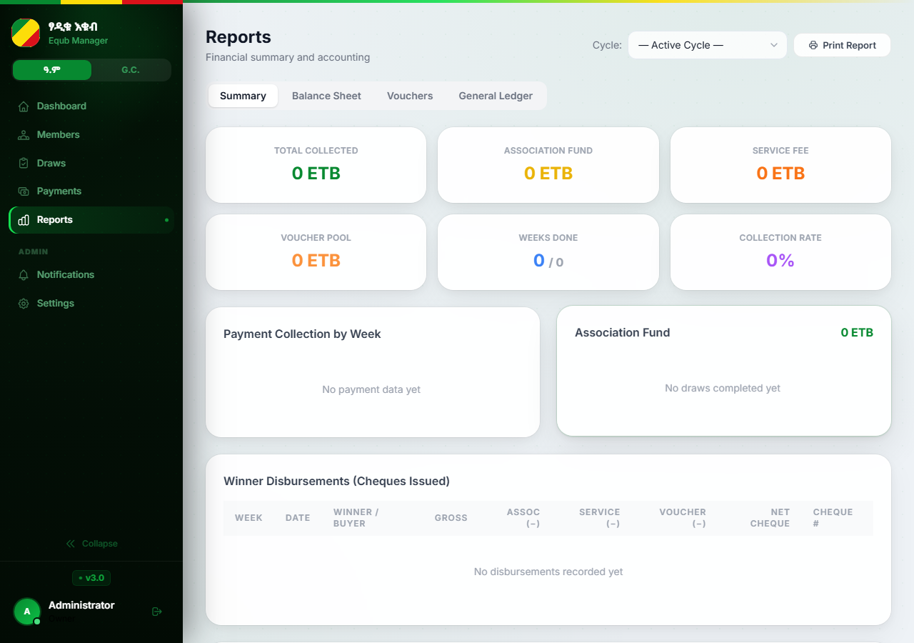
6.1 Reports & Analytics
Superadmin
Admin
Reports page — Admin / Superadmin access required
Financial Summary
Tabs: Summary · Balance Sheet · Vouchers · General Ledger. Total collected, assoc fund, service fee, collection rate.
Payment Report
Per-member: weeks paid/missed, total amounts. Full payment history with date, method, and collector name.
Draw Report
All completed draws — winner, buyer (if sold), pot amounts, draw date, and pot-sale details.
Disbursement Report
All cheques: gross/net/deductions, cheque #, guarantors, status (issued/collected/voided), void reasons.
Association Fund Report
Inflows (deductions + ማህበር profits) minus expenses. Running balance and end-of-cycle distribution.
Export: All reports download as CSV or formatted Excel. Click Print Report to open a print-ready PDF summary.

Slide 21
7
Section 7
SMS Notifications
Templates · Auto-send · Log

Slide 22
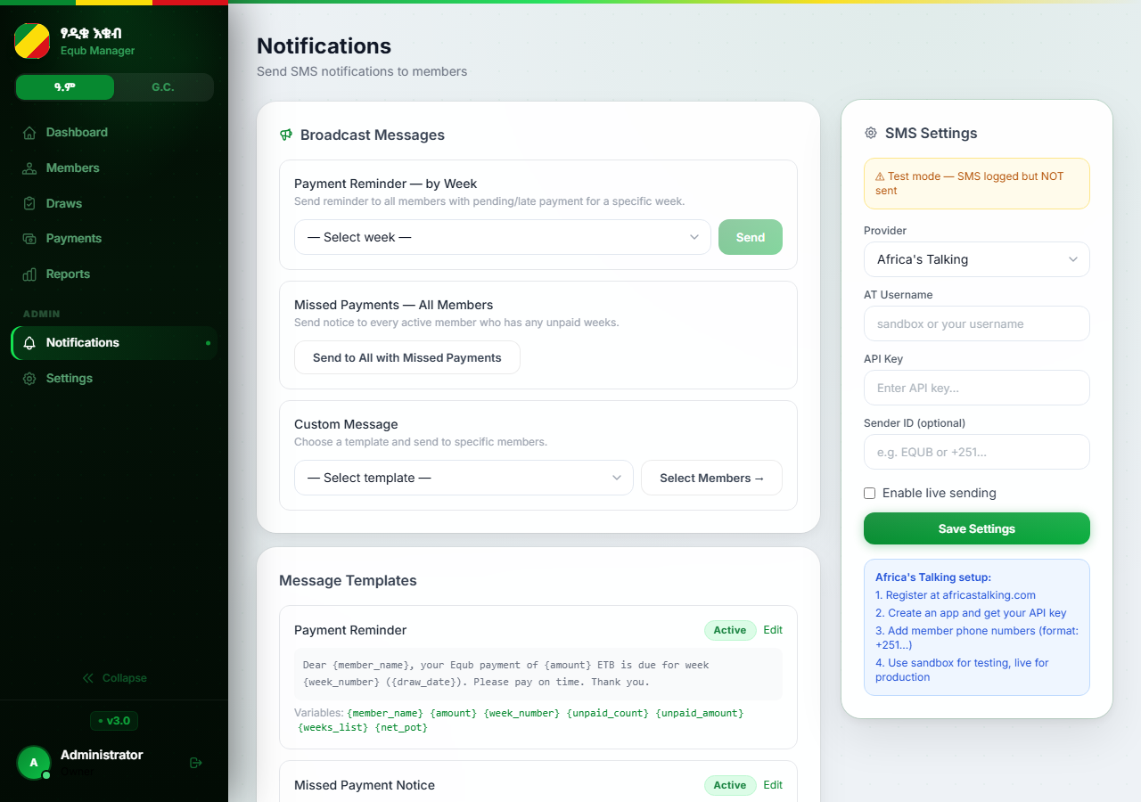
7.1 SMS Notifications Setup
Superadmin
Admin
Notifications page → Settings tab | Africa's Talking API
1
Open Notifications → Settings
Click Notifications in sidebar. Click the Settings tab.
2
Enter Africa's Talking credentials
API Key, Username (sandbox or live). Sender ID (your SMS display name).
3
Enable SMS
Toggle "Enable SMS" to ON. Leave OFF for testing (mock mode — logs without sending).
4
Save & test
Click Save Settings. Use the test send button to verify delivery.
Mock Mode: SMS disabled → notifications logged as 'mock'. See exactly what would be sent without using credits.

Slide 23
7.2 SMS Templates
Superadmin
Admin
6 built-in templates — editable, individually toggleable
payment_confirmed
payment_reminder
missed_payment
Sent when cashier marks a payment paid.
Daily reminder — unpaid members with draw within 48 h.
Sent when payment auto-transitions to missed.
Variables: {member_name} {amount} {week_number} {draw_date} {payment_method}
Variables: {member_name} {amount} {week_number} {draw_date}
Variables: {member_name} {unpaid_count} {unpaid_amount} {weeks_list}
draw_winner
pot_on_hold
pot_sold
Congratulations SMS to the draw winner.
Winner drawn but has outstanding unpaid weeks.
Sent when a pot is sold instead of directly disbursed.
Variables: {member_name} {week_number} {net_pot}
Variables: {member_name} {week_number} {net_pot} {unpaid_count} {unpaid_amount}
Variables: {member_name} {week_number} {seller_fee} {buyer_receives}
Edit any template in Notifications → Templates tab. Toggle a template off to stop that specific SMS type from being sent.

Slide 24
8
Section 8
Settings & Admin
Roles · Permissions · Security · 2FA

Slide 25
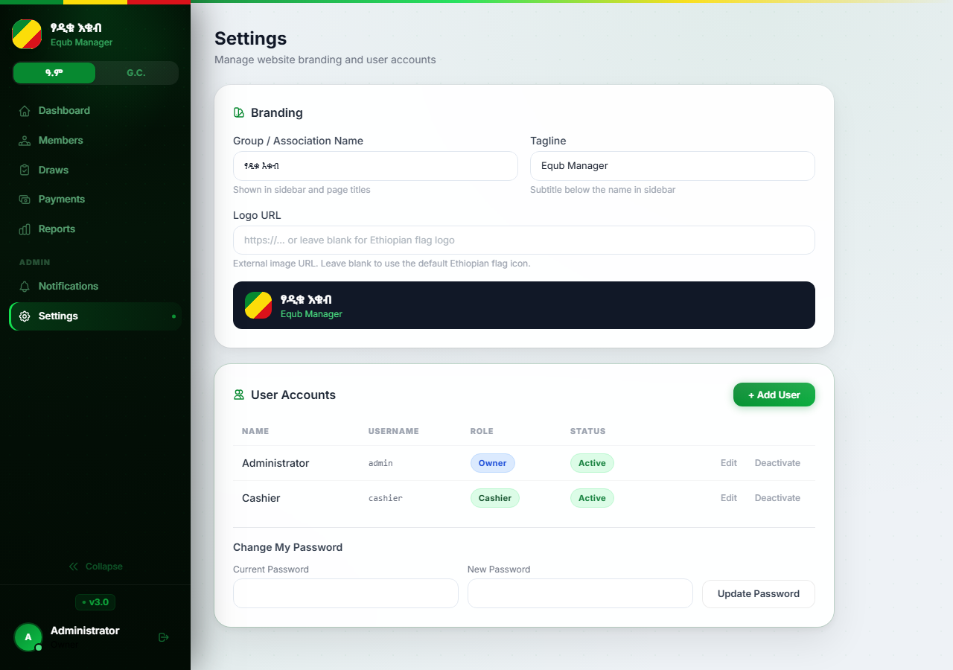
8.1 Financial Settings
Superadmin
Settings page → Financial tab (Superadmin only)
Configurable Fields
full_spot_amount
21,000 ETB — full-share weekly payment
half_spot_amount
10,500 ETB — half-share weekly payment
association_deduction
1,000 ETB — per person per week → ማህበር fund
full_spot_voucher
80 ETB — vendor voucher per full-spot card
half_spot_voucher
40 ETB — vendor voucher per half-spot card
group_week_interval
4 — every 4th week is a buyer/group week
total_member_spots
113 — regular member spots per cycle
group_name
Displayed in app header and all reports
group_tagline
Subtitle shown under the group name
logo_url
HTTPS URL for the group logo image
Changes affect NEW cycles only. Each cycle takes a snapshot at creation. To push changes into an active cycle, use Members → Apply Settings to Cycle.

Slide 26
8.2 User Roles & Permission Matrix
Superadmin
Settings page → Users tab | Who can do what
Superadmin
Admin
Cashier
• Full access to every feature
• Manage members, draws, payments
• Record and update payments
• Manage all user accounts and roles
• Issue and void disbursements
• Record disbursements
• Configure financial settings & branding
• View reports and export data
• View member list (read-only)
• Reset the entire system
• Configure SMS notifications
• Cannot manage members or run draws
• Cannot create a second Superadmin
• Manage Cashier accounts
• Cannot access reports or settings
• Permissions customisable by Superadmin
• Permissions customisable by Superadmin
Permission Matrix — configurable by Superadmin in Settings → Permissions
Permission
Superadmin
Admin
Cashier
manage_members
✓
✓
—
run_draws
✓
✓
—
disbursements
✓
✓
✓
view_reports
✓
✓
—
manage_users
✓
✓
—
notifications
✓
✓
—

Slide 27
8.3 Security Features
Superadmin
Admin
Cashier
2FA · Audit Log · Sessions · Password Policy
Two-Factor Authentication (2FA) Setup
Audit Trail (Immutable Log)
• Go to Settings → Your Account → Enable 2FA
• Every financial change is recorded automatically
• A QR code and secret key are displayed
• Logged: user, timestamp, action (create / update / delete / void)
• Scan the QR code with Google Authenticator or Authy
• Before and after values stored as JSON snapshots
• Enter the 6-digit TOTP code to confirm and activate
• Cannot be altered or deleted — permanent record
• Every future login requires password + TOTP code
• Covers: payments, draws, disbursements, member exits, voids
• To disable: enter current TOTP code in Settings → Disable 2FA
• Viewable by Superadmin only
Rate Limiting
Password Policy
Session Timeout
5 failed logins → 10-minute account lockout
Min 8 chars · no all-numbers · no common phrases
1-hour server-side session; re-login required
CSRF Protection
CSP Headers
HTTPS Enforced
All forms include CSRF tokens against forgery
Content Security Policy blocks XSS attacks
All traffic forced to HTTPS in production

Slide 28
Glossary
Key terms used throughout this manual
Equb (እቁብ)
Ethiopian rotating savings & credit association (ROSCA)
Group/Buyer Week
Every 4th week — any member can buy the pot
Cycle
One complete round of the Equb — all spots drawn once
Guarantor
Member vouching for the draw winner (3 required)
Spot
A numbered entry slot (#1–113 member, #114–118 assoc.)
Disbursement
Physical cheque payment issued to the draw winner
Full Share
One member holds a spot exclusively; pays 21,000 ETB/week
Collection Phase
Early cycle stage — members register, no draws yet
Half Share
Two members share one spot; each pays 10,500 ETB/week
Draw Phase
Active stage — weekly draws are held
Gross Pot
Total weekly contributions from all members
Pot On Hold
Winner drawn but cannot receive pot due to unpaid weeks
Net Pot
Gross − Association deduction − Service fee − Voucher
Void
Cancellation of a disbursement cheque (soft delete)
Association (ማህበር)
Community fund from weekly deductions
TOTP / 2FA
Time-based one-time password for two-factor authentication
Voucher
Physical vendor discount card; reimbursed by assoc. fund

Slide 29
Equb Management Platform
User & Administrator Manual
Version:
v3.0 | FastAPI · PostgreSQL · Railway.app
Coverage:
All roles: Superadmin · Admin · Cashier
Support:
Contact your Superadmin for account or access issues
እቁብ

