Slide 1
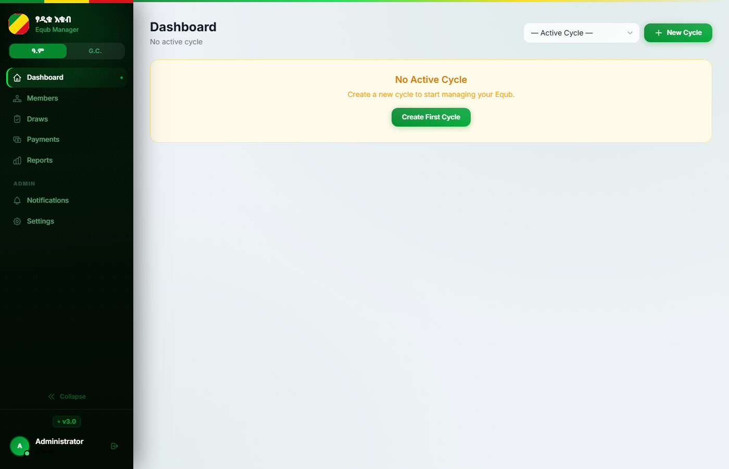
እ
እቁብ
Equb Management Platform
Digital infrastructure for Ethiopia's rotating savings & credit groups
113+
6
3
v3.0
Member Spots
SMS Templates
Access Roles
Live on Railway

Slide 2
How Equb Works
A centuries-old Ethiopian savings tradition — now digital and transparent
1
2
3
4
Members Join
Weekly Contributions
Draw Held
Winner Paid
Each member buys a spot in the cycle
Every member pays their weekly share
A winner is drawn from open spots
Full pot disbursed by cheque
Every member wins exactly once per cycle — guaranteed, transparent, and recorded

Slide 3
By the Numbers
The scale of the Equb platform at a glance
113
118
6
Member Spots per Cycle
Total Spots (incl. Association)
SMS Templates for Automation
+5 Association spots
Full + half-share splits
Powered by Africa's Talking
3
48h
5
User Roles (Superadmin/Admin/Cashier)
Before Draw Reminder Sent
Failed Logins before Lockout
Granular permission matrix
Auto-scheduled by APScheduler
5-minute rate-limit ban

Slide 4
The Platform — Dashboard
Role-based interface for Superadmin, Admin, and Cashier
Sidebar Navigation
Dashboard · Members · Draws Payments · Reports · Notifications · Settings
Ethiopian Flag Branding
Green / Gold / Red stripe always visible in the app header for every user
Active Cycle Selector
Switch cycles from any page without losing context
User Role Badge
Current role shown in sidebar footer Admin / Cashier / Superadmin

Slide 5
Core Features
Everything a growing Equb association needs
M
Members
$
Payments
D
Draws
Track 113+ spots with full/half-share splitting, status flags, and member notes
Weekly payment entry with automatic late/missed transitions after 3 days
Scheduled weekly draws — hold logic, winner selection, spot-sale override
C
Disbursements
R
Reports
S
SMS Alerts
Cheque payouts with 3 required guarantors, voucher deductions, net calc
Financial summary, balance sheet, vouchers, general ledger, print-to-PDF
6 templates via Africa's Talking: reminders, winner, missed, pot sold…

Slide 6
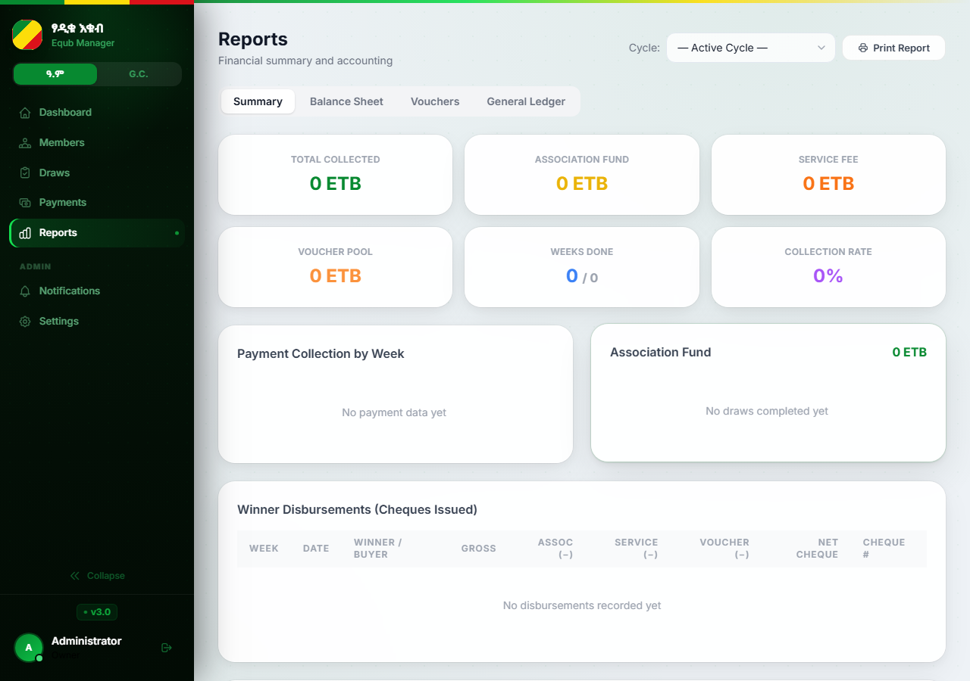
Reports & Analytics
Real-time financial visibility with print-to-PDF export
Financial Summary
Total collected · Association fund Service fee · Collection rate · Voucher pool
Balance Sheet
Full accounting view of all ETB movements across the cycle
General Ledger
Itemised week-by-week transaction breakdown for audits
Disbursement Table
Winner, date, gross, deductions, net cheque, guarantor names
Print Report → exports formatted financial PDF directly from browser

Slide 7
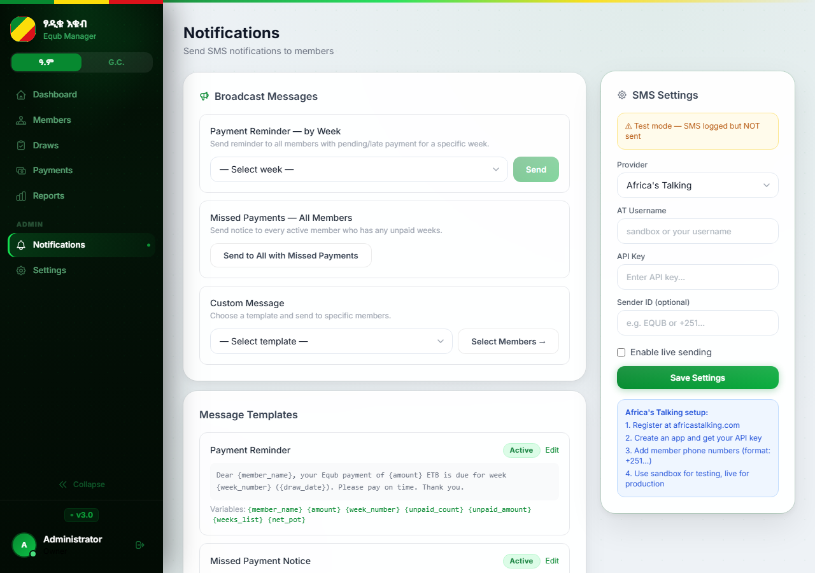
SMS Notifications
Automated member communication via Africa's Talking API
Payment Reminder
Auto-sent 48 hours before every weekly draw
Missed Payment
All members with missed payments notified
Draw Winner
Winner receives personal confirmation SMS
Payment Confirmed
Receipt sent after cashier records payment
Pot On Hold
Draw postponed — all members informed
Pot Sold
Spot sale completed — buyer/seller notified

Slide 8
Technology Stack
Production-grade Python stack, deployed on Railway.app
FRONTEND
BACKEND
DATABASE
SECURITY
Jinja2 HTML templates
FastAPI · Uvicorn
PostgreSQL (production)
PBKDF2 password hashing
Tailwind CSS
APScheduler (cron jobs)
SQLite (local dev)
CSRF protection
Chart.js charts
SQLAlchemy ORM
Railway managed DB
CSP + HTTPS headers
Vanilla JavaScript
Africa's Talking SMS
Alembic migrations
Rate-limiting & sessions
Deployed on Railway.app | Auto-deploy from Git | Managed PostgreSQL add-on

Slide 9
Built for
Ethiopia's Financial Communities
Transparent · Automated · Scalable · Secure
Transparent
Automated
Scalable
Secure
Equb Management Platform · v3.0 · FastAPI + PostgreSQL + Railway

