Slide 1

Classification and Regression
Machine Learning 1/Projects
Tesfahun Tegene Boshe Cynara Nyahoda June 2021, UW

Slide 2
Index
1. Regression
2. Classification
Problem statement
Results and comparison
Conclusion
Methods applied
Problem statement
Methods applied
Results and comparison
Conclusion

Slide 3
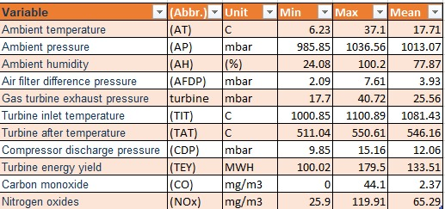

Regression
Predicting the net hourly electrical energy output of a combined cycle power plant

Slide 4
Regression/Steps followed
Treating missing and outlying values.
Variable selection:
1 level variables
Collinear variables
linear combinations
Insignificant variables
3. Training the models
Simple linear regression
Ridge regression
Lasso regression
Elastic net regression
4. Testing the models
Accuracy measurement

Slide 5
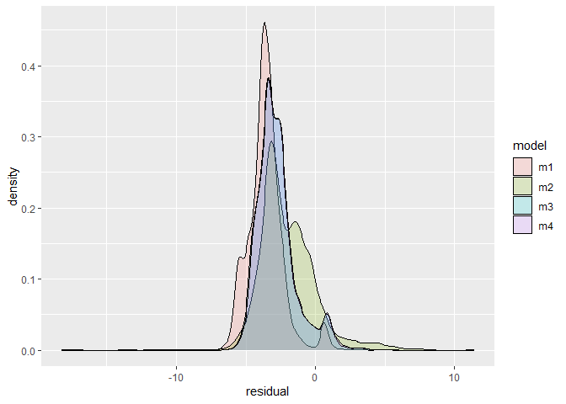
1. Regression
Methods
Residual plot
Simple linear regression
Ridge regression
Lasso regression
Elastic net regression

Slide 6
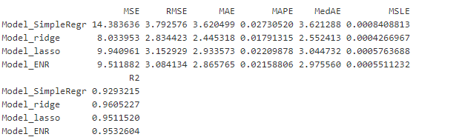
Regression/Comparison of results
Conclusion:

Slide 7
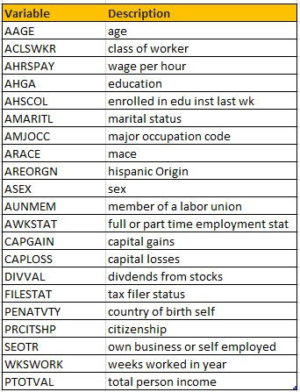

Classification
Classification of Census Income

Slide 8
Classification/Steps followed
Treating missing and outlying values.
Variable selection:
Selecting from numeric variables
1 level variables
Collinear variables
linear combinations
Selecting from numeric variables
- Insignificant variables
3. Training the models
4. Testing the models
Accuracy measurement

Slide 9
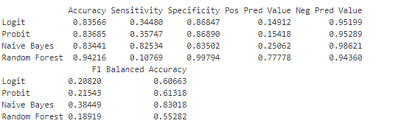
1. Classification
Methods
Comparison
Logistic regression
A. Logit
B. Probit
Naive Bayes
Random Forest

Slide 10
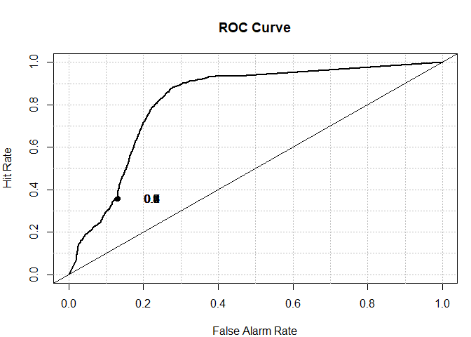
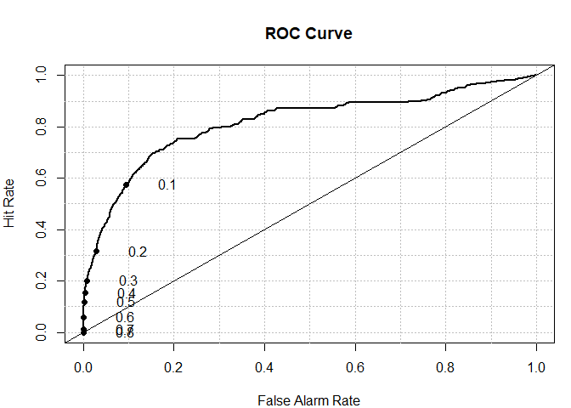
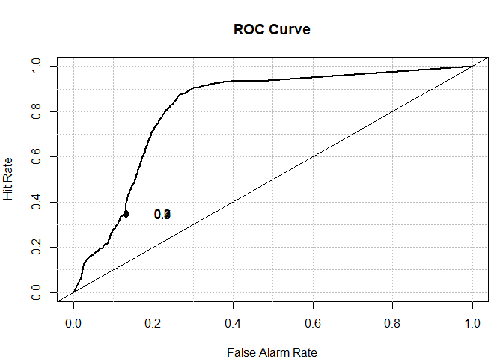
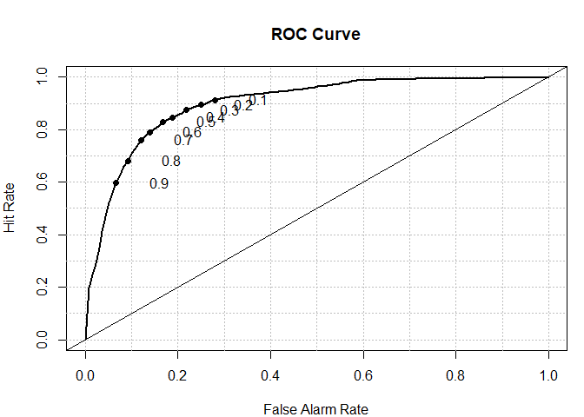
Classification/comparison by ROC|AUC
Logit AUC: 0.81
Random Forest AUC: 0.83
Probit AUC: 0.82
Naive Bayes AUC: 0.89

