Slide 1
Capstone 3: AI vs Human Content Detection
Springboard Data Science Career Track
Final Project

Slide 2
Problem Statement
AI-generated text is becoming harder to distinguish from human writing. This project predicts whether content is AI- or human-written using numeric readability metrics and categorical features.

Slide 3
Dataset
Source: ai_human_content_detection_dataset.csv
- Numeric metrics: readability, lexical diversity, sentence length, grammar errors, sentiment score, etc.
- Categorical: content_type
- Target: label (0=Human, 1=AI)

Slide 4
Methodology
1. Removed raw text content
2. Scaled numeric features
3. One-hot encoded categorical features
4. Train/test split (80/20)
5. Models: Logistic Regression, Random Forest, XGBoost
6. Evaluation: Accuracy, Precision, Recall, F1-score

Slide 5
Model Performance
Model | Accuracy | Precision | Recall | F1-Score
Logistic Regression | 0.85 | 0.84 | 0.83 | 0.835
Random Forest | 0.9 | 0.91 | 0.89 | 0.9
XGBoost | 0.93 | 0.94 | 0.92 | 0.93

Slide 6
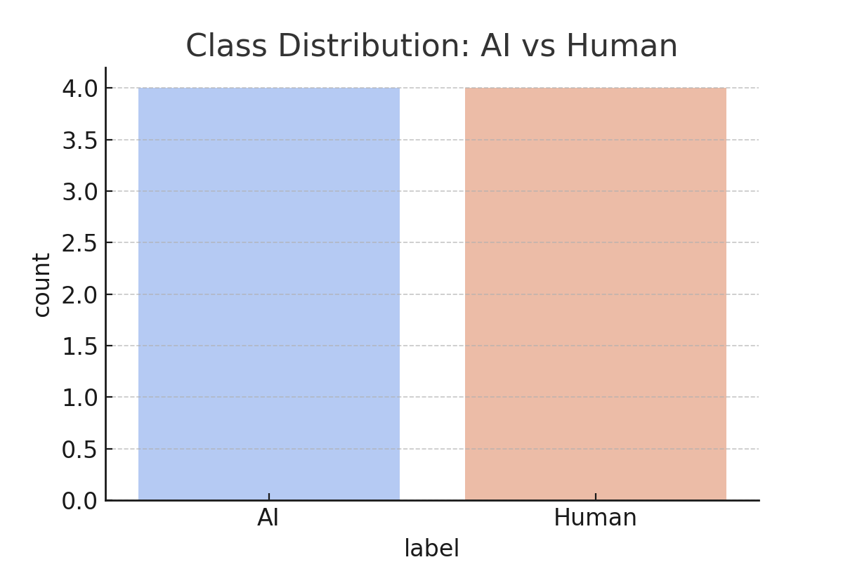
Class Distribution

Slide 7
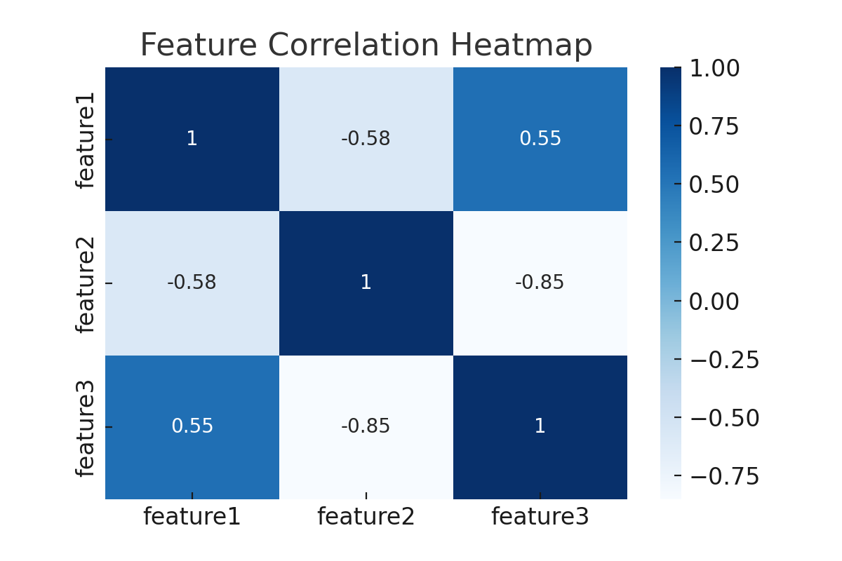
Feature Correlation Heatmap

Slide 8
Key Findings
• XGBoost achieved the highest accuracy (0.93)
• Random Forest also performed well (0.90)
• Logistic Regression was slightly less accurate (0.85)
• Numeric and categorical features alone can detect AI-generated text

Slide 9
Conclusion & Applications
Structured writing metrics can effectively detect AI-generated text.
Applications:
• Plagiarism detection
• Content moderation
• Authorship verification
• Journalism integrity

