Slide 1

Internet Programming (CoSc3211)
Chapter 4
Java script

Slide 2

Content
Introduction to JavaScript
Variables, Expression, Control Structure, Array
Java script Functions
Handling Events and Exception Handling
User Inputs: Form Processing

Slide 3
Introduction to JavaScript
What is JavaScript?
[Simply] JavaScript (often abbreviated as JS): is an object-oriented computer programming language commonly used to create interactive effects within web browsers.

Slide 4
Introduction to JavaScript (cont...)
What is JavaScript? (cont...)
JavaScript was initially created to “make web pages alive”.
The programs in this language are called scripts. They can be written right in a web page’s HTML and executed automatically as the page loads.
Scripts are provided and executed as plain text. They don’t need special preparation or compilation to run.
In this aspect, JavaScript is very different from another language called Java.
When JavaScript was created, it initially had another name: “LiveScript”. But Java was very popular at that time, so it was decided that positioning a new language as a “younger brother” of Java would help.
But as it evolved, JavaScript became a fully independent language with its own specification called ECMAScript, and now it has no relation to Java at all.
Notes:
Engine: V8 – Chrome SpiderMonkey – Firefox
Chakra – Edge
ECMA – European Computer Manufacturer’s Association

Slide 5
Introduction to JavaScript (cont...)
What is JavaScript? (cont...)
JavaScript: the first Web scripting language, developed by Netscape in 1995 syntactic similarities to Java/C++,
but simpler & more flexible
loose typing, dynamic variables, simple objects.
An object-oriented scripting language that is designed primarily for people who are building web pages using HTML.
HTML to define the content of web pages
CSS to specify the layout of web pages
JavaScript to program the behavior of web pages

Slide 6
Introduction to JavaScript (cont...)
JavaScript programs are embedded within HTML documents in source code form which is interpreted by the browser.
Platform independence
Recall:
HTML is good for developing static pages.
Can specify text/image layout, presentation, links.
Web page looks the same each time it is accessed
In order to develop interactive/reactive pages, we must integrate different programming

Slide 7
Introduction to JavaScript (cont...)
JavaScript code can be embedded in a Web page using SCRIPT tags
the output of JavaScript code is displayed as if directly entered in HTML
JavaScript can be placed in the <body> and the <head> sections of an HTML page.
In HTML, JavaScript code must be inserted between <script> and </script> tags.
<script type="text/javascript">
…
</script>
The browser executes the program as it loads the page, integrating the dynamic output of the program with the static content of HTML

Slide 8
Introduction to JavaScript (cont...)
JavaScript can perform the following task:
Decision making (switch and if statements)
Used in input data validation
Submitting forms(document.forms["myform"].submit();)
Performing complex mathematical calculations.
Adding dynamic features to Web pages
Image rollovers
Time-sensitive or random page elements
Handling cookies (Cookies are data, stored in small text files, on your computer)
utilize buttons, text boxes, clickable images, prompts, frames
Can Change HTML Content
Can Change the value of HTML Attributes
Can Change HTML styles for a given element

Slide 9
Introduction to JavaScript (cont...)
Limitations of client-side scripting
Since script code is embedded in the page, viewable to the world
For security reasons, scripts are limited in what they can do
e.g., can't access the client's hard drive
Since designed to run on any machine platform, scripts do not contain platform specific commands
Script languages are not full-featured (didn’t support all features which is supported by java)

Slide 10
Introduction to JavaScript (cont...)
// Java script code inside the head part of our code
<head> <script type="text/javascript"> function myFunction() { --- }
</script>
</head>
/ * Javascript code inside the body part of our html code */
// starts a single line comment
/*…*/ enclose multi-line comments

Slide 11
Introduction to JavaScript (cont...)
External JavaScript
Scripts can also be placed in external files.
External scripts are practical when the same code is used in many different web pages.
JavaScript files have the file extension .js
To use an external script, put the name of the script file in the src (source) attribute of the <script> tag:
<script src=“firstscript.js” type="text/javascript">
</script>
Behaves exactly as if the contents of the specified JavaScript file appeared directly between the tags

Slide 12
Introduction to JavaScript (cont...)
Advantages:
Separation of HTML code from JavaScript code
It makes HTML and JavaScript easier to read and maintain
Less code has to be written, and stored.
Commonly used JavaScript code can be shared among a number of pages.
Only a single copy needs to be stored on the web server.
Such JavaScript files can be cached by the browser, thereby allowing faster loading of the pages.
The URL specified in the src attribute can refer to other web servers also.

Slide 13
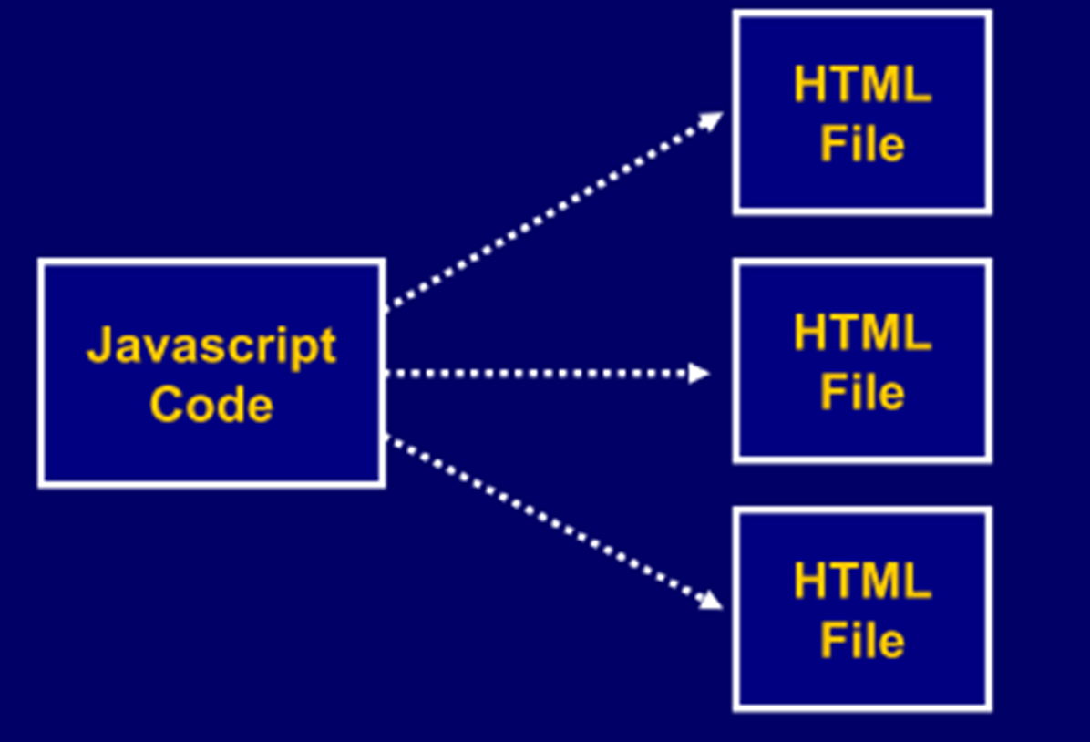
Introduction to JavaScript (cont...)

Slide 14
Introduction to JavaScript (cont...)
JavaScript does not have any built-in print or display functions.
JavaScript can "display" data in different ways:
Writing into an alert box, using window.alert() or simply alert().
<script> window.alert(“ Please fill the form!!”); </script>

Slide 15
Introduction to JavaScript (cont...)
Writing into the HTML output using document.write()
<script> document.write(5 + 6); </script>
Writing into an HTML element, using innerHTML
<p id="demo"></p>
<script> document.getElementById("demo").innerHTML =“Hello Javascript”;
</script>
Writing into the browser console, using console.log()
<script> console.log(5 + 6); </script>

Slide 16
Introduction to JavaScript (cont...)
<html>
<head>
<title>JavaScript Page</title>
</head>
<body>
<script type="text/javascript">
// silly code to demonstrate output
document.write("Hello world!");
document.write("<p>How are <br />" +"<i>you</i>?</p>");
</script>
<p>Here is some static text as well.
</p></body>
</html>
Hello world!
How are
you?
Here is some static text as well.

Slide 17
Introduction to JavaScript (cont...)
JavaScript Syntax
JavaScript syntax is the rules, how JavaScript programs are constructed.
JavaScript statements are separated by semicolon (;)
var x = 5; var y = 6; var z = x + y;
JavaScript uses the var keyword to define variables.
JavaScript statements are composed of: Values, Operators, Expressions, Keywords, and Comments.
The JavaScript syntax defines two types of values: Fixed values and variable values.
Fixed values are called literals. Variable values are called variables.
In HTML, JavaScript programs can be executed by the browser.

Slide 18
JavaScript Variables (cont...)
The general rules for constructing names for variables (unique identifiers) are:
Names can contain letters, digits, underscores, and dollar signs.
Names must begin with a letter , $ (dollar sign) or _(underscore)
Names are case sensitive (y and Y are different variables)
Reserved words (like JavaScript keywords) cannot be used as names

Slide 19
Introduction to JavaScript (cont...)
JavaScript Syntax (cont...)
JavaScript uses an assignment operator ( = ) to assign values to variables:
var x = 5; var y = 6;
JavaScript uses arithmetic operators ( + - * / ) to compute values:
(5 + 6) * 10
JavaScript Keywords - are used to identify actions to be performed.
Example: The var keyword tells the browser to create a new variable:
var x = 5 + 6; var y = x * 10;

Slide 20
Introduction to JavaScript (cont...)
JavaScript Syntax (cont...)
Not all JavaScript statements are "executed".
Code after double slashes // or between /* and */ is treated as a comment.
Comments are ignored, and will not be executed:
var x = 5; // I will be executed // var x = 6; I will NOT be executed
JavaScript is Case Sensitive - all JavaScript identifiers are case sensitive.
The variables lastName and lastname, are two different variables.
lastName = "Abel"; lastname = "Selam";
JavaScript does not interpret VAR or Var as the keyword var.

Slide 21
JavaScript Data Types
In programming, data types is an important concept.
To be able to operate on variables, it is important to know something about the type.
Without data types, a computer cannot safely solve this: var x = 16 + "Volvo"
Does it make any sense to add "Volvo" to sixteen? Will produce an error or a result?
JavaScript has three primitive data types
strings : "foo" 'howdy do' "I said 'hi’." ""
numbers : 12 3.14159 1.5E6
booleans : true false
JavaScript variables can hold numbers like 100, and text values like “Hello JS".

Slide 22
JavaScript Data Types (cont...)
In programming, text values are called text strings.
Strings are written inside double or single quotes.
Example:
var carName = "Volvo XC60"; // Using double quotes var carName = 'Volvo XC60'; // Using single quotes
You can use quotes inside a string, as long as they don't match the quotes surrounding the string:
Example:
var answer = "It's alright"; // Single quote inside double quotes var answer = "He is called 'Johnny'"; // Single quotes inside double quotes var answer = 'He is called "Johnny"'; // Double quotes inside single quotes

Slide 23
JavaScript Data Types (cont...)
JavaScript has only one type of numbers which can be written with, or without decimals:
Example:
var x1 = 34.00; // Written with decimals var x2 = 34; // Written without decimals
Extra large or extra small numbers can be written with scientific (exponential) notation:
Example:
var y = 123e5; // 12300000 var z = 123e-5; // 0.00123
JavaScript has dynamic types. This means that the same variable can be used as different types:
Example:
var x; // Now x is undefined var x = 5; // Now x is a Number var x = "John"; // Now x is a String

Slide 24
JavaScript Data Types (cont...)
JavaScript Booleans have two values: true or false.
Example:
var x = true; var y = false;
Booleans are often used in conditional testing.
JavaScript Arrays are written with square brackets in which the items are separated by comma;
The following code declares (creates) an array called cars, containing three items (car names):
Example:
var cars = ["Saab", "Volvo", "BMW"];

Slide 25
JavaScript Data Types (cont...)
JavaScript Objects are written with curly braces.
Object properties are written as name:value pairs, separated by commas.
Example:
var person = {firstName:"John", lastName:"Doe", age:50, eyeColor:"blue"};
The object (person) in the example above has 4 properties: firstName, lastName, age, and eyeColor.

Slide 26
JavaScript Data Types (cont...)
In JavaScript we can use the JavaScript typeof Operator to find the type of a JavaScript variable:
Example:
typeof "John" // Returns string typeof 3.14 // Returns number typeof false // Returns boolean typeof [1,2,3,4] // Returns object typeof {name:'John', age:34} // Returns object
In JavaScript, a variable without a value is undefined.
Example:
var person; // Value is undefined, typeof is also undefined

Slide 27
JavaScript Operators & Control Statements
standard C++/Java operators & control statements are provided in JavaScript
Arithmetic operators +, -, *, /, %, ++, --,
Comparison ==, !=, <, >, <=, >=
Logical &&, ||, !
Conditional Operators if , if-else, switch while, for, do-while, …

Slide 28
JavaScript Arithmetic Operators
<html>
<head><title>Arithmetic Operator Example</title></head>
<body>
<script type="text/javascript">
var num1=15;
var num2=5;
var sum=num1+num2;
var diff=num1-num2;
var prod=num1*num2;
var quo=num1/num2;
var rem=num1%num2;
document.write("Sum="+sum);
document.write("</br>");
document.write("difference="+diff);
document.write("</br>");
document.write("Product="+prod);
document.write("</br>");
document.write("Quotient="+quo);
document.write("</br>");
document.write("Remainder="+rem);
document.write("</br>");
</script>
</body>

Slide 29
JavaScript if..., else if..., else Statement (cont...)
<html><body>
<p>This example demonstrates the If statement.</p>
<script type="text/javascript">
var d = new Date();
var time = d.getHours();
if (time < 10)
{
document.write("<b>Good morning</b>");
}
</script>
<p>If the time on your browser is less than 10, you will get a "Good morning" greeting. </p>
</body>
</html>

Slide 30
JavaScript if-else Statement (cont...)
Example 1:
<html><body>
<p>This example demonstrates the If…else statement.</p>
<script type="text/javascript">
var d = new Date();
var time = d.getHours();
if (time < 10){
document.write("<b>Good morning</b>");}
else{
document.write("<b>Good Afternoon</b>");}
</script>
<p>If the time on your browser is less than 10, you will get a "Good morning" greeting.
Otherwise you will get a "Good Afternoon" greeting</p>
</body></html>

Slide 31
JavaScript if..., else if..., else Statement (cont...)
Example:
<html><body>
<script type="text/javascript">
var d = new Date();
var time = d.getHours();
if (time<10)
document.write("<b>Good morning</b>");
else if (time>=10 && time<16)
document.write("<b>Good Afternoon</b>");
else
document.write("<b>Hello World!</b>");
</script>
<p>This example demonstrates the if..else if...else statement.</p>
</body></html>

Slide 32
JavaScript for Loop (cont...)
Example 2:
<html>
<body>
<p id="demo"></p>
<script>
var cars = ["BMW", "Volvo", "Saab", "Ford"];
text = "";
for (var i = 0; i < cars.length; i++) {
text += cars[i] + "<br>";
}
document.write(text);
</script>
</body>
</html>
Example:
<html>
<body>
<script type="text/javascript">
for (i = 1; i <= 6; i++){
document.write("<h" + i + ">This is heading " + i);
document.write("</h" + i + ">");
}
</script>
</body>
</html>

Slide 33
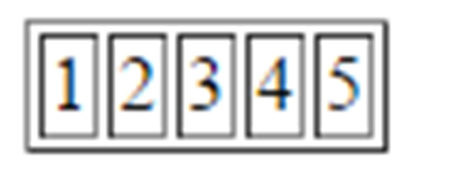
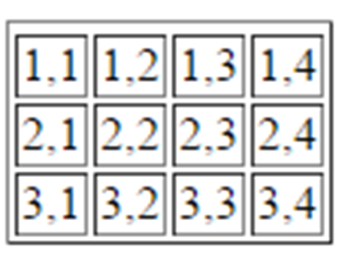
JavaScript for Loop (cont...)
Example 3:
<html><body>
<table border="1px">
<tr>
<script>
for(var num=1; num<=5; num++)
{
document.write("<td>"+ num +"</td>");
}
</script>
</tr>
</table>
</body></html>
Example 4: (nested for)
<html>
<body><table border="1px"><tr>
<script>
var rownum, colnum;
for(rownum=1; rownum<=3; rownum++)
{
document.write("<tr>");
for(colnum=1; colnum<=4; colnum++)
{
document.write("<td>"+ rownum + "," + colnum +"</td>");
}
document.write("</tr>");
}
</script></tr></table></body>
</html>

Slide 34
Cont.…
JavaScript Switch Statement.
JavaScript while Loop
Java script do while Loop
Reading Assignment

Slide 35
Using Arrays
JavaScript arrays are used to store multiple values in a single variable(an ordered collection of values referenced by a single variable name).
Syntax:
Using the JavaScript new keyword
var array-name = new Array(size);
Size is the number of elements in the array (optional)
To assign value to array elements, use:
array-name[i] = value;
Where i is the index of the array item. The 1st item has an index value of 0.
Or
Using array literal(easiest and fast way)
var array-name = [item1, item2, ...];

Slide 36
Using Arrays (cont...)
Example 1:
<html><head><title> Javascript array</title>
</head><body><script>
var fruits= new Array();
fruits[0]="Apple"; fruits[1]="Mango"; fruits[2]="Orange";
document.write("<h3>"+" The fruits I like most:"+"</h3>");
document.write("<ul>");
for (var i = 0; i < fruits.length; i++) {
document.write("<li>"+fruits[i] + "</li>");
}
document.write("</ul>");
</script>
</body></html>

Slide 37
Array declaration and assignment within one line
<body>
<script>
var MonthTxt = ["January", "February", "March", "April", "May","June", "July", "August", "September", "October", "November", "December“];
document.write("<h3>"+" Months of the year are:"+"</h3>");
document.write("<ul>");
for (var i = 0; i < MonthTxt.length; i++) {
document.write("<li>"+MonthTxt[i] + "</li>");
}
document.write("</ul>");
</script>
</body>
// we can use array() or array[] in array declaration and assignment

Slide 38
Functions
A JavaScript function is a block of code designed to perform a particular task.
A JavaScript function is executed when "something" invokes it.
A JavaScript function is defined with the function keyword, followed by a name, followed by parentheses ().
The parentheses may include parameter names separated by commas: (parameter1, parameter2, ...)
The code to be executed, by the function, is placed inside curly brackets.
Example :
Code
function myFunction(p1, p2) {
return p1 * p2;
}

Slide 39
Functions (Cont.)
When JavaScript reaches a return statement, the function will stop executing.
If the function was invoked from a statement, JavaScript will "return" to execute the code after the invoking statement.
The code inside the function will execute when "something" invokes (calls) the function:
When an event occurs (when a user clicks a button)
When it is invoked (called) from JavaScript code
Automatically (self invoked)

Slide 40
Placing a Function in an HTML File
The function definition must be placed before the command that calls the function.
One convention is to place all of the function definitions in the
<head> section.
A function is executed only when called by another JavaScript command.
It’s common practice for JavaScript programmers to create libraries of functions located in external files.

Slide 41
Function con…
<html> <head> <script type="text/javascript">
function sayHello() //function definition {
alert("Hello there!");
}
</script> </head> <body> <p>Click the following button to call the function</p> <form> <input type="button" onclick="sayHello()" value="Say Hello"> //sayhello() is function calling </form> <p>Use different text in alert box and then try...</p> </body> </html>

Slide 42
Function con…
<html>
<head> <script type="text/javascript"> function sayHello(name, age) { alert( name + " is " + age + " years old."); } </script> </head> <body> <p>Click the following button to call the function</p> <form> <input type="button" onclick="sayHello('Amanuel ', 12)" value="Say Hello"> </form> <p>Use different parameters inside the function and then try...</p> </body></html>

Slide 43
Pop up Boxes
Popup boxes can be used to raise an alert, or to get confirmation on any input or to have a kind of input from the users.
JavaScript supports three types of popup boxes.
Alert box
Confirm box
Prompt box

Slide 44
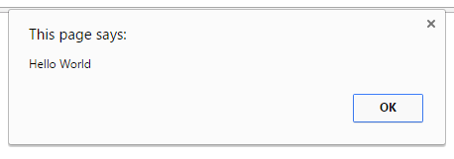
Alert Box
An alert box is used if you want to make sure information comes through to the user.
When an alert box pops up, the user will have to click "OK" to proceed.
It can be used to display the result of validation.
Code
<html>
<head>
<title>Alert Box</title>
</head>
<body>
<script>
alert("Hello World");
</script>
</body>
</html>

Slide 45
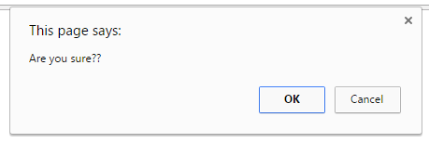
Confirm Box
A confirm box is used if you want the user to accept something.
When a confirm box pops up, the user will have to click either "OK" or "Cancel" to proceed, If the user clicks "OK", the box returns true. If the user clicks "Cancel", the box returns false.
Example :
Code
<script>
var a = confirm(“Are you sure??");
if(a==true) {
alert(“User Accepted”);
}
else {
alert(“User Cancled”);
}
</script>

Slide 46
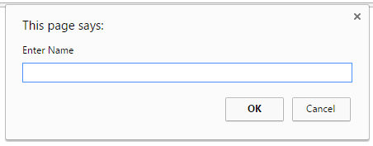
Prompt Box
A prompt box is used if you want the user to input a value.
When a prompt box pops up, user have to click either "OK" or "Cancel" to proceed, If the user clicks "OK" the box returns the input value, If the user clicks "Cancel" the box returns null.
Code
<script>
var a = prompt(“Enter Name");
alert(“User Entered ” + a);
</script>

Slide 47
Prompt con..
<html><head><title>Interactive page</title></head>
<body>
<script type="text/javascript">
var userName = prompt("What is your name?", "");
var userAge = prompt("Your age?", "");
var userAge = parseFloat(userAge);
document.write("Hello " + userName + ".")
if (userAge < 18) {
document.write(" Do your parents know " +"you are online?");
}
else {
document.write(" Welcome friend!");
}
</script> <p>The rest of the page...</p></body></html>

Slide 48
External JavaScript
We can create external JavaScript file and embed it in many html pages.
It provides code reusability because single JavaScript file can be used in several html pages.
An external JavaScript file must be saved by .js extension.
To embed the External JavaScript File to HTML we can use script tag with src attribute in the head section to specify the path of JavaScript file.
For Example :
<script type="text/javascript" src="message.js"></script>

Slide 49
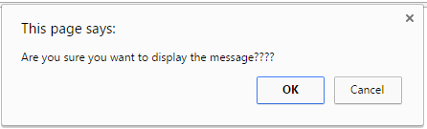
External JavaScript (Example)
message.js
function myAlert(msg) {
if(confirm("Are you sure you want to display the message????")) {
alert(msg);
}
else {
alert("Message not Displayed as User Cancled Operation");
}
}
myHtml.html
<html>
<head>
<script src=“message.js”></script>
</head>
<body>
<script> myAlert(“Hello World”); </script>
</body>
</html>

Slide 50
JavaScript Objects
An object is just a special kind of data, with properties and methods.
Accessing Object Properties
Properties are the values associated with an object.
The syntax for accessing the property of an object is below
objectName.propertyName
This example uses the length property of the Javascript’s inbuilt object(String) to find the length of a string:
var message="Hello World!"; var x=message.length;

Slide 51
JavaScript Objects (Cont.)
Accessing Object Methods
Methods are the actions that can be performed on objects.
You can call a method with the following syntax. objectName.methodName()
This example uses the toUpperCase method of the String object to convert string to upper case:
var message="Hello World!"; var x=message.toUpperCase();

Slide 52
User Defined Objects
JavaScript allows you to create your own objects.
The first step is to use the new operator.
var myObj= new Object();
This creates an empty object.
This can then be used to start a new object that you can then give new properties and methods.
In object- oriented programming such a new object is usually given a constructor to initialize values when it is first created.

Slide 53
User - Defined Objects (Cont.)
However, it is also possible to assign values when it is made with literal values.
example
<script>
person={
firstname: "Darshan",
lastname: "College",
age: 50,
eyecolor: "blue"
}
alert(person.firstname + " is " + person.age + " years old.");
</script>

Slide 54
User - Defined Objects (Cont.)
A constructor is pre defined method that will initialize your object.
To do this in JavaScript a function is used that is invoked through the new operator.
Any properties inside the newly created object are assigned using this keyword, referring to the current object being created.
example
<script>
function person(firstname, lastname, age){
this.firstname = firstname;
this.lastname = lastname;
this. changeFirstName = function (name){ this.firstname = name };
}
var person1=new person("Narendra","Modi",50);
person1.changeFirstName(“NAMO”);
alert(person1.firstname + “ ”+ person1.lastname);
</script>

Slide 55
Document Object Model (DOM)
The Document Object Model is a platform and language neutral interface that will allow programs and scripts to dynamically access and update the content, structure and style of documents.
The window object is the primary point from which most other objects come.
From the current window object access and control can be given to most aspects of the browser features and the HTML document.
When we write :
document.write(“Hello World”);
We are actually writing :
window.document.write(“Hello World”);
The window is just there by default

Slide 56
DOM (Cont)
This window object represents the window or frame that displays the document and is the global object in client side programming for JavaScript.
All the client side objects are connected to the window object.
window
self,
parent,
window,
top
frames[]
navigator
location
history
document
screen

Slide 57
Document Object Properties
Property | Description
anchors | Returns a collection of all the anchors in the document
applets | Returns a collection of all the applets in the document
body | Returns the body element of the document
cookie | Returns all name/value pairs of cookies in the document
domain | Returns the domain name of the server that loaded the document
forms | Returns a collection of all the forms in the document
images | Returns a collection of all the images in the document
links | Returns a collection of all the links in the document (CSSs)
referrer | Returns the URL of the document that loaded the current document
title | Sets or returns the title of the document
URL | Returns the full URL of the document

Slide 58
Document Object Methods
Method | Description
write() | Writes HTML expressions or JavaScript code to a document
writeln() | Same as write(), but adds a newline character after each statement
open() | Opens an output stream to collect the output from document.write() or document.writeln()
close() | Closes the output stream previously opened with document.open()
getElementById() | Accesses element with a specified id
getElementsByName() | Accesses all elements with a specified name
getElementsByTagName() | Accesses all elements with a specified tag name
setTimeout(), clearTimeout() | Set a time period for calling a function once; or cancel it.

Slide 59
getElementById()
When we suppose to get the reference of the element from HTML in JavaScript using id specified in the HTML we can use this method.
Example :
HTML
<html>
<body>
<input type=“text” id=“myText”>
</body>
</html>
JavaScript
<script>
function myFunction()
{
var txt = document.getElementById(“myText”);
alert(txt.value);
}
</script>

Slide 60
getElementsByName()
When we suppose to get the reference of the elements from HTML in JavaScript using name specified in the HTML we can use this method.
It will return the array of elements with the provided name.
Example :
HTML
<html>
<body>
<input type=“text” name=“myText”>
</body>
</html>
JavaScript
<script>
function myFunction()
{
a=document.getElementsByName(“myText”)[0];
alert(a.value);
}
</script>

Slide 61
Forms using DOM
We can access the elements of form in DOM quite easily using the name/id of the form.
Example :
JS
function f()
{
var a = document.forms[“myForm”];
var u = a.uname.value;
var p = a.pword.value;
if(u==“admin” && p==“123”)
{
alert(“valid”);
}
else
{
alert(“Invalid”);
}
}
HTML
<html>
<body>
<form name=“myForm”>
<input type=“text” name=“uname”>
<input type=“text” name=“pword”>
<input type=“button” onClick=“f()”>
</form>
</body>
</html>

Slide 62
Data Validation
JavaScript can be used for client-side validation of data entered in HTML forms.
Data entered can be extracted and accessed.
Checks can be made on the data entered.
Non-alphabetic characters in name.
Non-numeric characters in roll number, age, etc.
Bid amount less than minimum permissible.
A data validation example:
A student registration form.
A function checks whether the roll number is a 7-digit numeric value.
Invoked when the form is submitted.
Check performed before form data are transmitted to server-side application.

Slide 63
HTML forms
most event-handling in JavaScript is associated with form elements
an HTML form is a collection of elements for handling input, output, and events in a page
<form id="FormName">
…
</form>
form elements might include:
for input: button, selection list, radio button, check box, password, …
for input/output: text box, text area, …
we will also encounter forms when we consider CGI programming and PHP
a form groups together elements, whose contents can be submitted together to a server for further processing on the server

Slide 64
HTML forms (cont.)
document.forms[ ] is an (associative) array that will contain elements for each form on the webpage, using the "id" associated with the form as the array index (assuming that a "id" is defined).
One can also use the syntax
document.forms[0]
for the first form on the page (and higher indices if there is more than one
form on the same webpage).
Using the "dotted" syntax, we can then access other HTML elements of the form (using their ids given to those elements). HTML pages are stored as a hierarchy of parent/child relationships, and this defines the way to access the elements. (More examples to come...)

Slide 65
the simplest form element is a button analogous to a real-world button, a click can be used to trigger events
for complex tasks, we can define function(s) and have the onclick event trigger a function call
<head><title>Fun with Buttons</title>
<script type="text/javascript">
function Greeting()
// Results: displays a time-sensitive greeting
{
var now = new Date();
if (now.getHours() < 12) {
alert("Good morning");
}
else if (now.getHours() < 18) {
alert("Good afternoon");
}
else {
alert("Good evening");
}
}
</script> </head>
<body>
<form id="ButtonForm">
<p> <input type="button" value="Greeting"
onclick="Greeting();" /> </p>
</form>
</body>
</html>

Slide 66
Form validation
<html><head><title>Form Validation</title>
<script type="text/javascript">
function validate()
{
if( document.myForm.Name.value == "" )
{ alert( "Please provide your name!" ); }
if( document.myForm.EMail.value == "" )
{ alert( "Please provide your Email!" ); }
if( document.myForm.Country.value == "-1" )
{ alert( "Please provide your country!" ); }
else
{ alert("register successfully"); }
}
</script> </head>
<body>
<form action="" name="myForm" ;">
Name: <input type="text" name="Name" /></br>
EMail: <input type="text" name="EMail" /></br></br>
Country:<select name="Country">
<option value="-1" selected>[choose yours]</option>
<option value="1">Ethiopia</option>
<option value="2">Sudan</option>
<option value="3">Kenya</option>
</select> </br></br></br>
<input type="submit" value="Submit" onclick="validate()"/>
</form>
</body>
</html>

Slide 67
password match
<html>
<head>
<script type="text/javascript">
function matchpass(){
var firstpassword=document.f1.password.value;
var secondpassword=document.f1.password2.value;
if(firstpassword==secondpassword){
alert("well came to my page!!!")
return true;
}
else{
alert("password must be same!");
return false;
}
}
</script>
</head>
<body>
<form name="f1" action="" >
Password:<input type="password" name="password" /><br/>
Re-enter Password:<input type="password" name="password2"/><br/>
<input type="submit" onclick= "matchpass()">
</form>
</body>
</html>

Slide 68
Page Redirection
Commonly used feature.
A previously existing web site might have moved to a new location.
You may want the request to be redirected to a site depending on the browser type and version.
Manipulate the window.location attribute.
An example follows.
Will take us to a page after 5 seconds.
Example:
<script>
function getgoing (){
window.location = "http://www.bdu.edu.et";
}
alert( "You will be redirected in five seconds.");
setTimeout ('getgoing()', 5000);
</script >

Slide 69
Creating New Browser Window
To open a new window, we need to call the window.open() method.
window.open (‘url to open’, ‘window name’, attribute1, attribute2, …);
Window attributes:
width = 300
height = 200
resizable = yes or no
scrollbars = yes or no
toolbars = yes or no
status = yes or no
menubar = yes or no
copyhistory = yes or no
An example is shown with some of the attributes.

Slide 70
Creating New Browser Window (cont...)
Example:
<FORM>
<INPUT type="button" value="New Window!" onClick="window.open('http://www.bdu.edu.et’, 'mywindow’, 'width=400', 'height=200', 'toolbar=yes', 'status=yes')">
</FORM>

Slide 71
Thank u!!!

