Slide 1
Chapter 3
Conventional Encryption
3.1. Classical Techniques
3.2. Modern Techniques
3.3. Algorithms
3.4. Confidentiality

Slide 2
Conventional Encryption
Cryptography – is the design of algorithms for encryption and decryption.
Encryption – is the process of converting data into meaningless form.
Decryption – the translation of encrypted data into original text.
Conventional encryption – symmetric encryption (single-key encryption)
  The only type of encryption before public-key encryption.

Slide 3
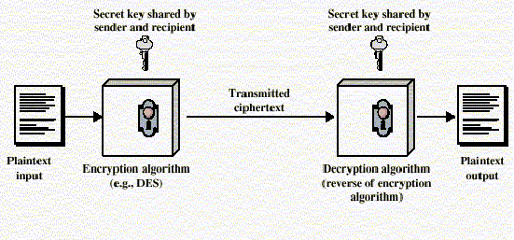
Cont…
  The most widely used.
Conventional encryption model

Slide 4
Cont…
plaintext is the original intelligible message.
Ciphertext is the converted nonsense text.
The encryption process consists of an algorithm and a key.
The key is a value independent of plaintext.
The algorithm produces different outputs depending on the specific key used at the time.
Changing the key changes the output of the algorithm.

Slide 5
Cont…
Upon reception, the ciphertext can be transformed back to the original plaintext by using a decryption algorithm and the same key that was used for encryption.
Security of conventional encryption depends on:
  Powerfulness of the encryption algorithm
  Secrecy of the key

Slide 6
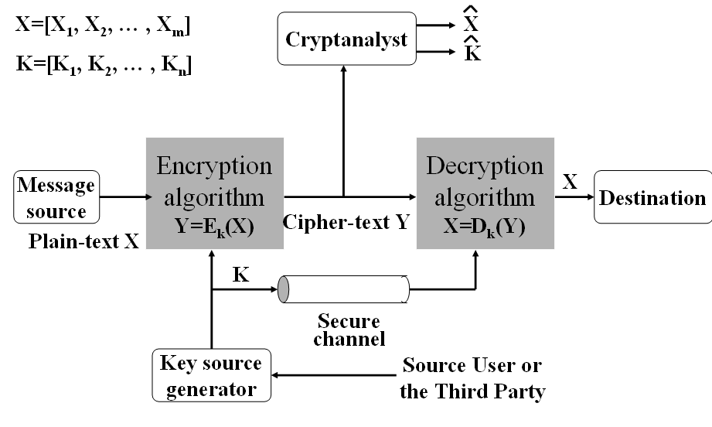
Cont…
Conventional cryptosystem model

Slide 7
Cont…
Conventional encryption scheme
  A source produces a message in plaintext, X = [x₁,x₂,…,x_{M}]
  The M elements of X are letters in some finite alphabet.
  For encryption key K = [K₁,K₂,…,K_{J}] is generated.
  The key should be provided to receiver by means of some secure channel.
  The third party can generate and securely deliver the key for both.

Slide 8
Cont…
With the message X and key K ciphertext Y = [Y₁,Y₂,…,Y_{N}]
Y = E_{K}(X), where Y is ciphertext, E is encryption algorithm.
Receiver inverts X = D_{K}(Y), where D is decryption algorithm.
An opponent attempts to recover X or K or both.

Slide 9
Cont…
It is assumed that the opponent knows encryption (E) and decryption (D) algorithms.
The focus of the opponent is to recover X or K by generating estimates and .
X
K

Slide 10
Cryptography
Cryptographic systems are generically classified along three independent dimensions.
  The type of operations
  The number of keys
  The way in which the plaintext is processed
The type of operations used for transforming plaintext to ciphertext
    All encryption algorithms are based on two general principles
      Substitution
      Transposition
    Fundamental requirement is that no information be lost.

Slide 11
Cont…
The number of keys used
    If both sender and receiver use the same key, the system is:
      Symmetric
      single key
      Secret key
      Conventional encryption
    If the sender and receiver each uses a different key, the system is:
      Asymmetric
      Two-key
      Public key encryption

Slide 12
Cont…
The way in which the plaintext is processed
    A block cipher processes the input one block of elements at a time, producing an output block for each input block.
    A stream cipher processes the input elements continuously, producing output one element at a time.
Cryptanalysis – the process of attempting to discover X or K or both.
  The following Table summarizes various types of cryptanalytic attacks.

Slide 13
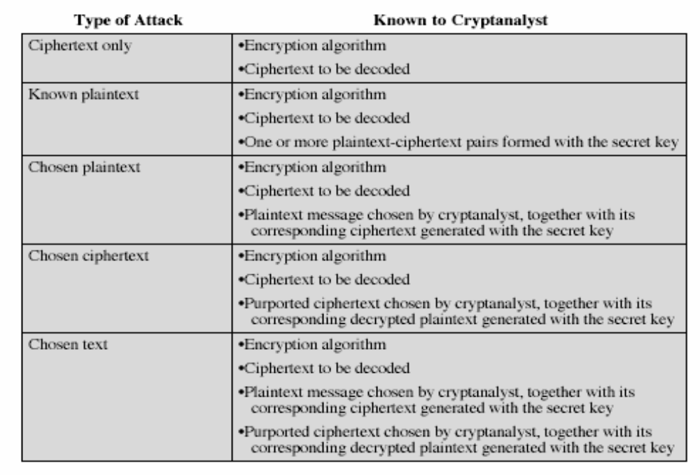
Cont…

Slide 14
Cont…
Only relatively weak algorithms fail to withstand a known plaintext attack.
Generally an encryption algorithm is designed to withstand a known-plaintext attack.
An encryption algorithm meets one or both of the following:
  The cost of breaking the cipher exceeds the value of the encrypted information.
  The time required to break the cipher exceeds the useful lifetime of the information.

Slide 15
Cont…
An encryption scheme is:
  Unconditionally secure
    If the ciphertext does not contain enough information to determine uniquely the corresponding plaintext.
    The required information doesn’t exist.
  Computationally secure
    The amount of cost and time exceeds the value and lifetime of the information required to cryptanalyze ciphertext successfully.

Slide 16
Steganography
Act of writing in code or cipher
It is not an encryption technique
It hides the existence of message
Techniques
  Character marking
  Invisible ink
  Pin punctures
  Typewriter correction ribbon
  Arrangement of words or letters

Slide 17
3.1. Classical encryption techniques
Two basic building blocks of all encryption techniques.
  Substitution
  Transposition
Substitution techniques
  Letters of plaintext are replaced by other letters or by numbers or symbols.
Caesar Cipher
  Earliest known substitution cipher
  Simplest
  developed by Julius Caesar

Slide 18
Cont…
  Involves replacing each letter of alphabet with letter standing three places further down the alphabet.
  Secret key = 3
  example:
  meet me after the toga party
  PHHW PH DIWHU WKH WRJD SDUWB
  Alphabet is wrapped around so the letter following Z is A.

Slide 19
Cont…
  transformation can be defined as:
  a b c d e f g h i j k l m n o p q r s t u v w x y z
  D E F G H I J K L M N O P Q R S T U V W X Y Z A B C
  mathematically give each letter a number
  a b c d e f g h i j k l m n o p q r s t u v w x y z
  0 1 2 3 4 5 6 7 8 9 10 11 12 13 14 15 16 17 18 19 20 21 22 23 24 25
  The Algorithm is expressed as follows:
c = E(p) = (p+3) mod (26)
  c = E(p) = (p + k) mod (26) (encryption)

Slide 20
Cont…
  p = D(c) = (c – k) mod (26) (decryption)
  Where p = plaintext, c = ciphertext, k takes a value in the range 1 to 25.
  Cryptanalysis of Caesar Cipher
    Simply try all the 25 possible keys
    a brute-force cryptanalysis
    The encryption and decryption algorithms are known
    Solution-using compressed text

Slide 21
Cont…
Monoalphabetic Ciphers
  With only 25 possible keys, the Cesar cipher is far from secure.
  An arbitrary substitution increases the key space.
  There are 26! Possible keys = 4x10²⁶
  This eliminates brute-force techniques of cryptanalysis.
  attack – if the cryptanalyst knows the nature of the plaintext, then analyst can exploit the regularities of the language.

Slide 22
Cont…
  Monoalphabetic ciphers are easy to break they reflect the frequency data of the original alphabet.
  Countermeasure is to provide multiple substitutes, homophones for a single letter.
Playfair Cipher
  Best-known multiple-letter encryption
  Algorithm is based on the use of a 5 x 5 matrix of letters
  Constructed by using keyword
  Example

Slide 23
Cont…
  Example
M
O
N
A
R
C
H
Y
B
D
E
F
G
I/J
K
L
P
Q
S
T
U
V
W
X
Z

Slide 24
Cont…
    The keyword is monarchy.
    the matrix is constructed by filling in the letters of the keyword minus duplicates from left to right and from top to bottom.
    Filling other letters with alphabetic order.
    Letters I and J count as one letter
    Plaintext is encrypted two letters at a time according to the following rules:
      Repeating plaintext letters that would fall in the same pair are separated with a filter letter, such as x, so that balloon would be enciphered as ba lx lo on.

Slide 25
Cont…
    Plaintext letters that fall in the same row of the matrix are each replaced by the letter to the right, with the first element of the row circularly following the last. Ex. ar is encrypted as RM.
    Plaintext letters that fall in the same column are each replaced by the letter beneath, with the top element of the row circularly following the last. Ex. mu is encrypted as CM.
    Otherwise, each plaintext letter is replaced by the letter that lies in its own row and the column occupied by the other plaintext letter. Ex. hs becomes BP and ea as IM or JM.

Slide 26
Cont…
  Great advance over monoalphabetic cipher.
  There are about 26 x 26 = 676 diagrams.
  More difficult to identify individual diagrams and relative frequencies of letters, so the playfair cipher was unbreakable for a long.
Hill Cipher
  Multiletter cipher
  The algorithm takes m successive plaintext letters and substitutes for them m ciphertext letters.

Slide 27
Cont…
  The substitution is determined by m linear equations in which each character is assigned a numerical value (a = 0, b = 1, … z = 25).
  For m = 3 the system can be described as follows:
  C₁ = (k₁₁p₁ + k₁₂p₂ + k₁₃p₃)mod 26
  C₂ = (k₂₁p₁ + k₂₂p₂ + k₂₃p₃)mod 26
  C₃ = (k₃₁p₁ + k₃₂p₂ + k₃₃p₃)mod 26

Slide 28
Cont…
  Expressed as
  where C and P are column vectors of length 3, representing the plaintext and ciphertext, and k is 3 x 3 matrix, representing the encryption key.
C₁
C₂ =
C₃
k₁₁ k₁₂ k₁₃
k₂₁ k₂₂ k₂₃
k₃₁ k₃₂ k₃₃
p₁
p₂ or C = E_{K}(P) = KP
p₃

Slide 29
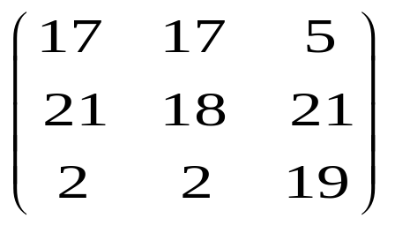
Cont…
  Example: consider the plaintext “paymoremoney”, and encryption key
  K =
  The first three letters of the plaintext are represented by the vector (15 0 24).
  Then K (15 0 24) = (375 819 486) mod 26
  = (11 13 18) = LNS
  The cipher for entire plaintext is LNSHDLEWMTRW

Slide 30
Cont…
  Decryption requires the inverse of the matrix K.
  K⁻¹ of the matrix K is defined by the equation
  KK⁻¹ = K⁻¹K = I, where K⁻¹ is inverse and I is an identity matrix.
  Generally the Hill system is expressed as:
    C = E_{k}(P) = KP
    P = D_{k}(C) = K⁻¹C = K⁻¹KP = P
  The strength of the Hill Cipher completely hides single – letter frequencies.
  The use of a larger matrix hides more frequencies.

Slide 31
Cont…
Polyalphabetic Ciphers
  Vigenere Cipher
    Best – known
    Simplest
    The set of monoalphabetic substitution rules consists of the 26 Caesar ciphers.
    each cipher is denoted by a key letter.
    Key letter identifies row

Slide 32
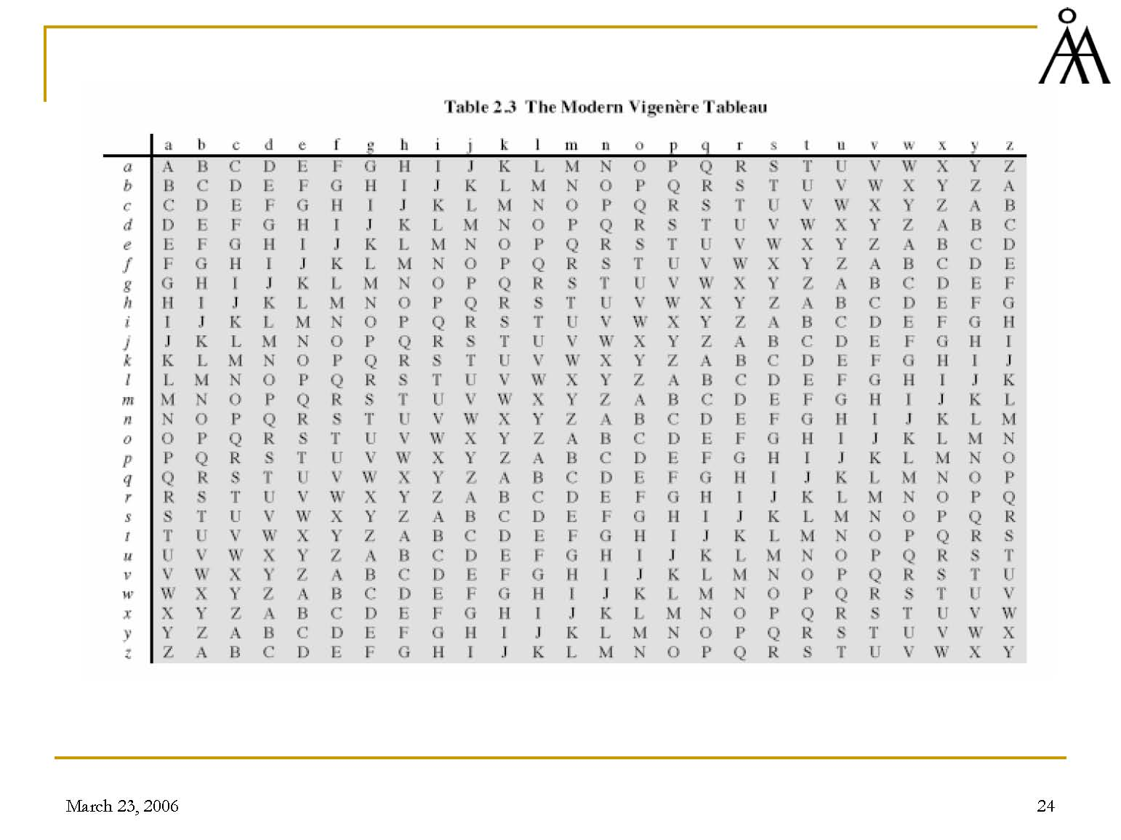
Cont…

Slide 33
Cont…
Example
  Key – deceptivedeceptivedeceptive
  Plaintext – wearediscoveredsaveyourself
  Ciphertext - ZICVTWQNGRZGVTWAVZHCQYGLMGJ

Slide 34
cont…
Transposition Techniques
  Performing some sort of permutation on the plaintext letters.
  Rail fence technique with depth 2
    Plaintext – meet me after the toga party.
    m e m a t r h t g p r y
    e t e f e t e o a a t
    Encrypted message is MEMATRHTGPRYETEFETEOAAT

Slide 35
Cont…
Block (Columnar) Transposition Ciphers
  Message is written in rectangle, row by row, but read off column by column; The order of columns read off is the key
  Example:
Key: 4 3 1 2 5 6 7
Plaintext: a t t a c k p
o s t p o n e
d u n t i l t
w o a m x y z
Ciphertext: TTNAAPTMTSUOAODWCOIXKNLYPETZ

Slide 36
3.2. Modern Techniques
DES (data encryption standard)
  Most widely used conventional encryption algorithm
Simplified DES (S - DES)
  Overall structure of simplified DES is shown Below

Slide 37
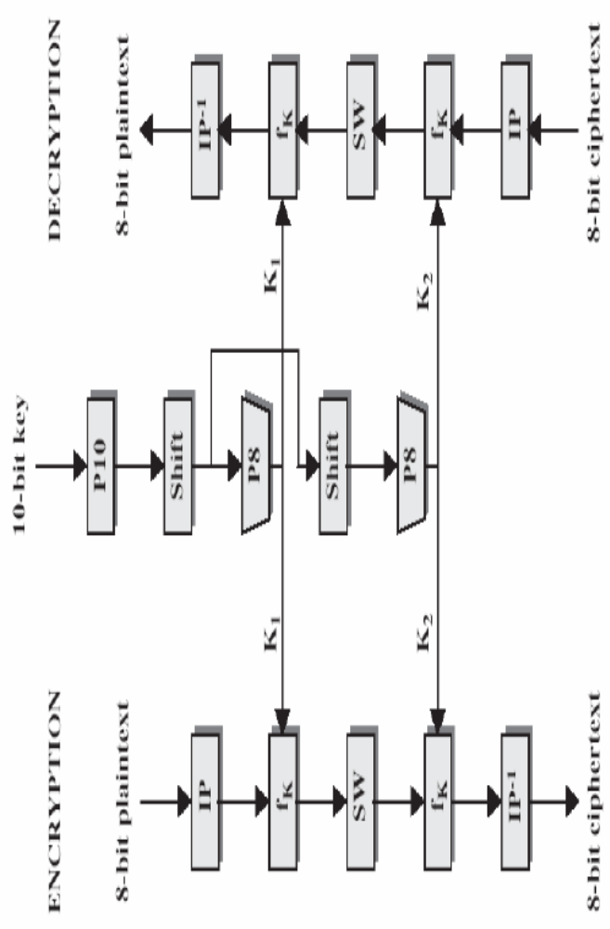
Cont..

Slide 38
Cont…
Encryption algorithm takes 8-bit plaintext and 10-bit key as input and Produces 8-bit block of ciphertext as output.
Decryption algorithm takes 8-bit block of ciphertext and the same 10-bit key as input and produces the original 8-bit block of plaintext.
The encryption algorithm involves five functions
  Initial permutation (IP)
  Complex function f_{k,} which involves both permutation and substitution operations and depends on key input.

Slide 39
Cont…
  Simple permutation function that switches (SW) the two halves of the data
  The function f_{k} again
  The inverse of initial permutation (IP⁻¹)
Multiple stages of permutation and substitution results in a more complex algorithm, which increases the difficulty of cryptanalysis.
The function f_{k} takes as input not only the data passing through the encryption algorithm, but also an 8-bit key.
The algorithm could have been designed to work with a 16-bit key, consisting of two 8-bit subkeys, one used for each occurrence of f_{k}.
Alternatively a single 8-bit key could have been used, with the same key used twice in the algorithm.

Slide 40
Cont…
A compromise is to use a 10-bit key from which two 8-bit subkeys are generated.
The key is first subjected to a permutation (P10)
Then the shift operation is performed
The output of the shift operation passes through a permutation function that produces an 8-bit output (P8) for the first subkey (k₁).
The output of the shift operation also feeds into another shift and another instance of P8 to produce the second subkey (k₂).

Slide 41
Cont…
The encryption algorithm is expressed as composition of functions:
  IP⁻¹ o f_{k2} o SW o f_{k1} o IP
  ciphertext = IP⁻¹(f_{k2}(SW(f_{k1}(IP(plaintext)))))
  where
  k1 = P8(shift(P10(key)))
  k2 = P8(shift(shift(P10(key))))
Decryption is the reverse of encryption
    plaintext = IP⁻¹(f_{k1}(SW(f_{k2}(IP(ciphertext)))))

Slide 42
Cont…
S-DES key Generation
  10-bit key shared between sender and receiver
  Let 10-bit key be designated as
    (k₁, k₂, k₃, k₄, k₅, k₆, k₇, k₈, k₉, k₁₀)
  Permutation P10 is defined as
    P10(k₁, k₂, k₃, k₄, k₅, k₆, k₇, k₈, k₉, k₁₀) = (k₃, k₅, k_{2,} k₇, k₄, k₁₀ k₁, k₉, k₈, k₆)
  Figure below shows key generation stages
P10
3 5 2 7 4 10 1 9 8 6

Slide 43
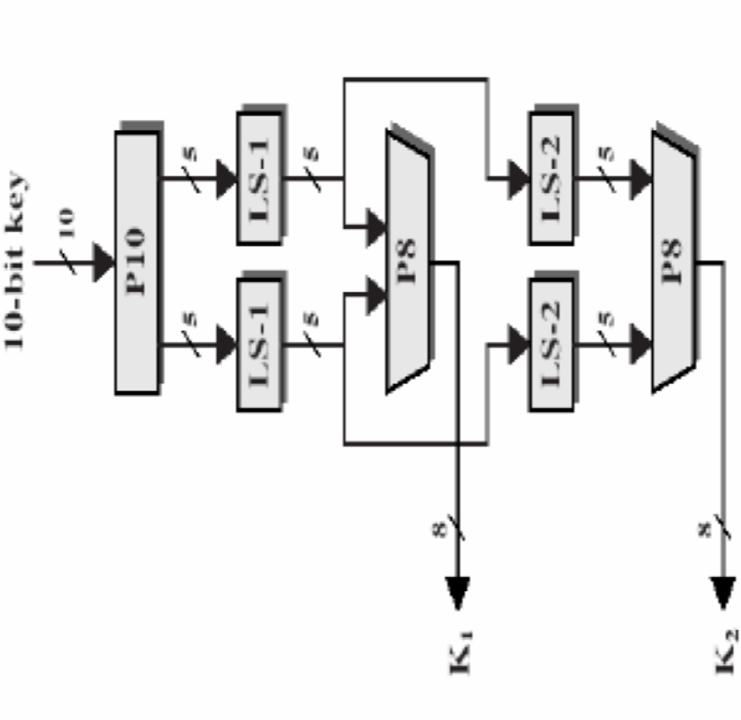
Cont…

Slide 44
Cont…
  Ex the key 1010000010 is permuted to 1000001100.
  Next a circular left shift (LS-1) separately on the five bits.
  The result is 00001 11000
  Next P8 which picks out and permutes 8 of the 10 bits according to the following rule.
  The result is subkey k₁. i.e 10100100
P8
6 3 7 4 8 5 10 9

Slide 45
Cont…
  Pair of 5-bit strings produced by the two LS-2 functions and perform a circular left shift of 2 bit positions on each string.
  The result is 00100 00011.
  P8 is applied again to produce k_{2.} i.e 01000011.
S-DES Encryption
  The following figure shows S-DES encryption algorithm in detail.

Slide 46
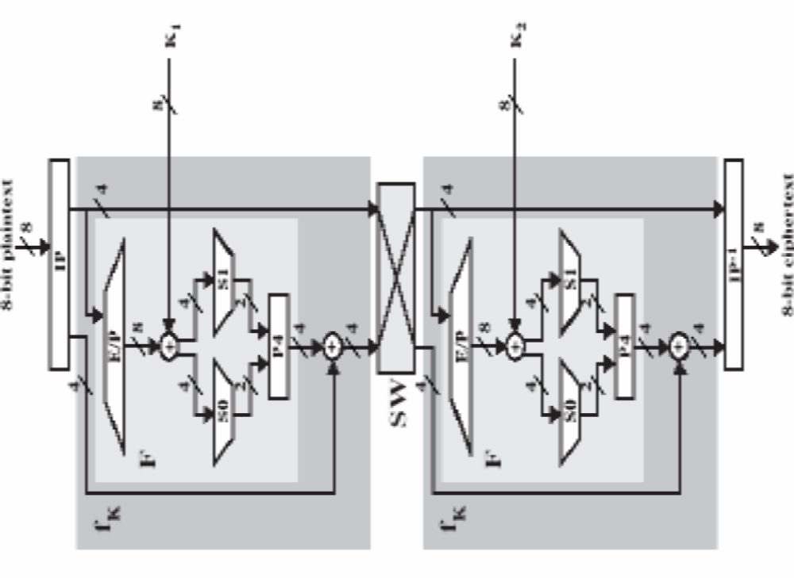
Cont…

Slide 47
Cont…
Initial and final permutations
  The input is an 8-bit block of plaintext
  IP function
  The inverse permutation
IP
2 6 3 1 4 8 5 7
IP⁻¹
4 1 3 5 7 2 8 6

Slide 48
Cont…
  IP⁻¹(IP(X)) = X.
The function f_{k}
  the most complex component
  Consists of a combination of permutation and substitution functions.
  Let L and R be the leftmost 4 bits and rightmost 4 bits of the 8-bit input to f_{k}.
  Let F be a mapping from 4 bit strings to 4 bit strings
  Then f_{k} (L, R) = (L + F(R, S_{K}), R)
    Where S_{K} is a subkey and + is the bit-by-bit exclusive-OR function.
    Ex. Suppose the output of the IP stage is 10111101 and F (1101, S_{K}) = (1110) for some key S_{K}.
    Then f_{k} (10111101) = (01011101) because (1011) + (1110) =(0101)

Slide 49
Cont…
  For mapping F the input is a 4-bit number (n₁n₂n₃n₄)
  The first operation is an expansion/permutation operation.
  Follows
  n₄ n₁ n₂ n₃
  n₂ n₃ n₄ n₁
  8-bit subkey k₁ = (k₁₁, k₁₂, k₁₃, k₁₄, k₁₅, k₁₆, k₁₇, k₁₈) is added to this value using exclusive-OR.
E/P
4 1 2 3 2 3 4 1

Slide 50
Cont…
  n₄ + k₁₁ n₁ + k₁₂ n₂ + k₁₃ n₃ + k₁₄
  n₂ + k₁₅ n₃ + k₁₆ n₄ + k₁₇ n₁ + k₁₈
  These 8 bits are renamed as follows
  P_{0,0} P_{0,1} P_{0,2} P_{0,3}
  P_{1,0} P_{1,1} P_{1,2} P_{1,3}
  The first 4 bits (first row) are fed into the S-box S_{O} to produce a 2-bit output.
  The remaining 4 bits (second row) are fed into S₁ to produce another 2-bit output.
  The two boxes are defined as follows:

Slide 51
Cont…
0 1 2 3 0 1 2 3
  S₀ = 0 1 0 3 2 S₁ = 0 0 1 2 3
1 3 2 1 0 1 2 0 1 3
2 0 2 1 3 2 3 0 1 0
3 3 1 3 2 3 2 1 0 3
  S-boxes operate as follows:
    P_{0,0} P_{0,3} and P_{1,0} P_{1,3} indicates Row and treated as 2 bit numbers
    P_{0,1} P_{0,2} and P_{1,1} P_{1,2} indicates Column and treated as 2 bit numbers

Slide 52
Cont…
    The entry in row and column, in base 2, is the 2-bit output.
    Ex. If (P_{0,0}P_{0,3}) = (00) and (P_{0,1}P_{0,2}) = (10), then the output is from row 0, column 2 of SO, which is 3, or (11) in binary.
  Next the 4 bits produced by S_{O} and S₁ undergo further permutation as follows:
  The output of P4 is the output of F.
Switch function
  The function f_{k} only alters the leftmost 4 bits of the input.
P4
2 4 3 1

Slide 53
Cont…
  The switch function interchanges the left and the right 4 bits so that the second instance of f_{k} operates on a different 4 bits.
  The E/P, S_{O}, S₁, and P4 functions are the same as the first instance.
  The key input is k₂.

Slide 54
Data Encryption Standard (DES)
DES operates on 64-bit blocks of input.
The encryption scheme is defined as
IP⁻¹ o f_{k16} o SW o f_{k15} o SW o … o SW o f_{k1} o IP
A 56-bit key is used, from which 48-bit subkeys are calculated.
Initial permutation of 56 bits followed by a sequence of shifts and permutations of 48 bits.
Within encryption algorithm, instead of F acting on 4 bits (n₁n₂n₃n₄), it acts on 32 bits (n₁n₂…n₃₂).

Slide 55
Cont…
After initial expansion/permutation, the output of 48 bits can be diagrammed as:
n₃₂ n₁ n₂ n₃ n₄ n₅
n₄ n₅ n₆ n₇ n₈ n₉
. . .
. . .
. . .
n₂₈ n₂₉ n₃₀ n₃₁ n₃₂ n₁

Slide 56
Cont…
This matrix is added (exclusive-OR) to a 48-bit subkey.
There are 8 rows, corresponding to 8 S-boxes.
Each S-box has 4 rows and 16 columns.
The first and the last bit of a row picks out a row of S-box, and the middle 4 bits pick out a column.
The overall scheme for DES is shown below.

Slide 57
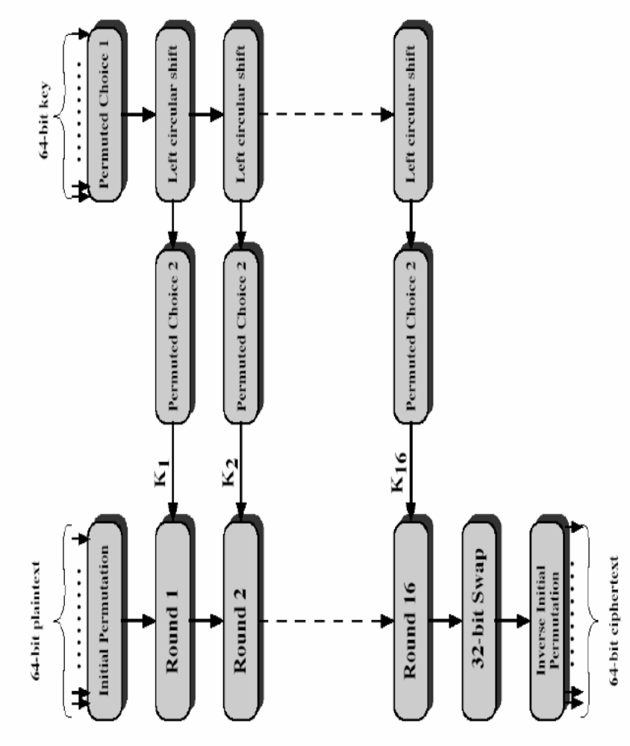
Cont…

Slide 58
Cont…
Initial permutation (IP) that rearranges the bits to produce the permuted input.
There are 16 rounds of the same function, which involves both permutation and substitution functions.
The output of the last (sixteenth) round consists of 64 bits that are a function of the input plaintext and the key.
The left and right halves of the output are swapped to produce the preoutput.

Slide 59
Cont…
Preoutput is passed through a permutation (IP⁻¹) that is the inverse of the initial permutation function, to produce the 64 bit ciphertext.
56-bit key is initially passed through a permutation function.
For each of the 16 rounds a subkey (k_{i}) is produced by the combination of a left circular shift and a permutation.
The permutation function is the same for each round, but a different subkey is produced due to the repeated iteration of the key bits.

Slide 60
The Feistel Cipher
The inputs to the encryption algorithms are a plaintext block of length 2w bits and a key K.
The plaintext block is divided into two halves, L_{o} and R_{o}.
The two halves of the data pass through n rounds of processing and then combine to produce the ciphertext block.
The structure of the Feistel Cipher is shown below.

Slide 61
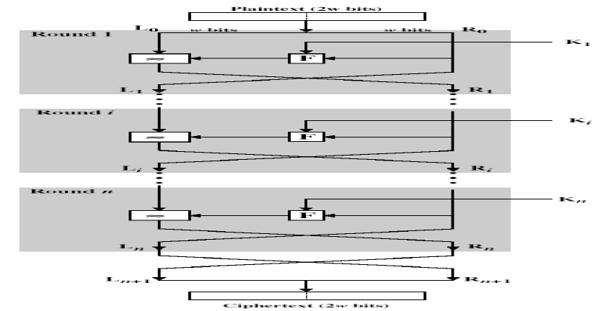
Cont…

Slide 62
Cont…
Each round i has as inputs L_{i-1} and R_{i-1}, derived from the previous round, as well as a subkey k_{i}, derived from overall K.
In general the subkeys k_{i} are different from K and from each other.
With the exception of the initial and final permutations, DES has the exact structure of a Feistel cipher.
All rounds have the same structure.

Slide 63
Cont…
A substitution is performed on the left half of the data.
Round function F is applied to the right half of the data and then taking the exclusive-OR of the output of that function and the left half of the data.
The exact realization of a Feistel network depends on the choice of the following parameters and design features:
  Block size:
    larger block size means greater security.
    Reduced encryption/decryption speed
  Key size
    Larger key size greater security

Slide 64
Cont…
    Decreases encryption/decryption speed
  Number of rounds
    Multiple rounds offer increasing security
    A typical size is 16 rounds
  Subkey generation algorithm
    Greater complexity in this algorithm leads to greater difficulty of cryptanalysis.
  round function
    greater complexity can make analysis harder, but slows cipher
Feistel Decryption Algorithm
  It is the same as the encryption process
  Uses ciphertext as input
  Uses subkeys k_{i} in reverse order

Slide 65
Cont…
Uses k_{n} in the first round.
K_{n-1} in the second round, and so on until k₁ is used in the last round.
Feistel encryption and decryption scheme is shown below.

Slide 66
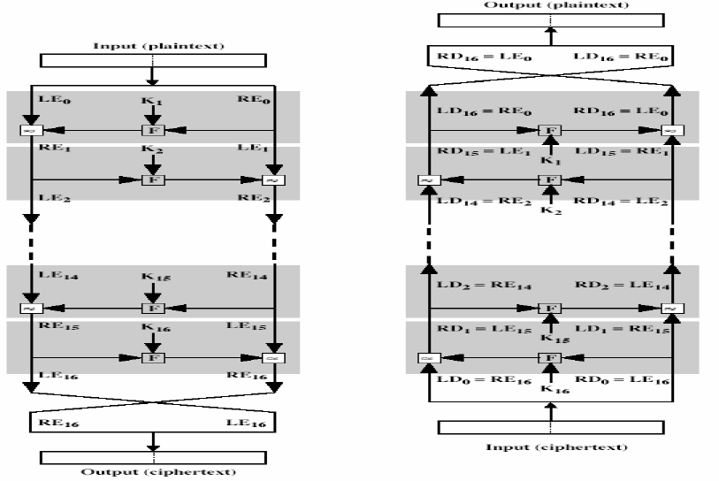
Cont…

Slide 67
3.3. Algorithms
Triple DES
  Multiple encryption with DES
  replacement for DES
    theoretical attacks that can break it
    demonstrated exhaustive key search attacks
  no current known practical attacks for triple DES
  Used with Three-Keys

Slide 68
Cont…
International Data Encryption Algorithm (IDEA)
  A symmetric block cipher
  Recently proposed to replace DES
  Uses 128 – bit key to encrypt data in blocks of 64 bits.
  Characteristics of IDEA
    Block length – long to be strong
    Key length – long, 128 bits

Slide 69
Cont…
    Confusion – ciphertext depends on the plaintext and key in a complicated way. The objective is to complicate the determination.
    Diffusion – each plaintext bit and key bit should influence every ciphertext bit. The spreading out of a single plaintext bit over many ciphertext bits hides the statistical structure of the plaintext.
Blowfish
  Symmetric block cipher
  Characteristics
    Fast – encrypt data at a very fast rate on 32-bit CPU

Slide 70
Cont…
    Compact – can run in less than 5K of memory
    Simple
    Variably secure – the key length is variable and can be 448 bits. Tradeoff between higher speed and security.
  Encrypts 64-bit block of plaintext into 64-bit ciphertext.
  The security is unchallenged.
RC5
  Developed by Ron Rivest.
  Symmetric encryption algorithm

Slide 71
Cont…
  Characteristics
    Suitable for hardware or software
    Fast
    Adaptable to processors of different word lengths
    Variable number of rounds
    Variable length key
    Simple
    Low memory requirement
    High security
    Data-dependent rotations

Slide 72
Cont…
CAST – 128
  Developed by Carlisle Adams and Stafford Tavares
  Symmetric encryption algorithm
  Uses key that varies from 40 bits to 128 bits in 8-bit increments.
RC2
  Developed by Ron Rivest.
  Symmetric encryption algorithm
  Uses plaintext and ciphertext blocks of 64 bits and a key size that varies from 8 to 1024 bits.

Slide 73
3.4. Confidentiality
traditionally symmetric encryption is used to provide message confidentiality
Potential Locations for Confidentiality attacks
  LANs interconnected with bridges and routers
  The wiring closet (interconnection of internal data and phones line)
  Any of communication links
    Twisted pair
    Coaxial
    Optical fiber
    Microwave links
    Satellite channels
  Memory of the processor.

Slide 74
Cont…
Confidentiality using Symmetric Encryption
  have two major placement alternatives
    link encryption
    end-to-end encryption
link encryption
  Every communication link is equipped on both ends with an encryption device.
  Disadvantage is that the message must be decrypted each time to read the IP address.
  The message is vulnerable at each switch.

Slide 75
Cont…
End-to-end encryption
  encryption occurs between original source and final destination
  need devices at each end with shared keys
Placement of Encryption
  encryption function can be placed at various layers in OSI Reference Model
    link encryption occurs at layers 1 or 2
    end-to-end can occur at layers 3, 4, 6, 7

Slide 76
Cont…
Key distribution
  Key distribution can be achieved by in a number of ways
    Physical delivery
    Third party physically deliver for both
    One party can transmit the encrypted new key by using old key.
    If both parties have encrypted connection to a third party, then it can deliver a key on the encrypted links.

Slide 77
Summary
Classical Techniques
Modern Techniques
Algorithms
Confidentiality

