Slide 1
Introduction to LTSpice
EDA Wing Tesla

Slide 2
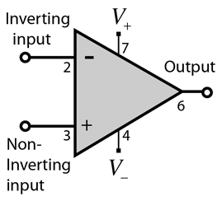
Operational Amplifier
A Specialised Circuit made up of transistors, resistors and capacitor fabricated on to a single chip
Applications
Amplifier
Active filters
Analog computer

Slide 3
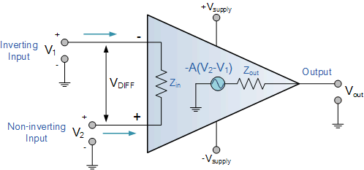
Equivalent Circuit of OP-AMP
Vout = Av(V1-V2)

Slide 4
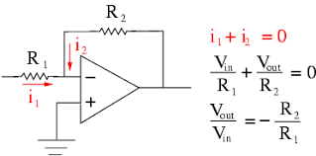
Inverting Amplifier

Slide 5
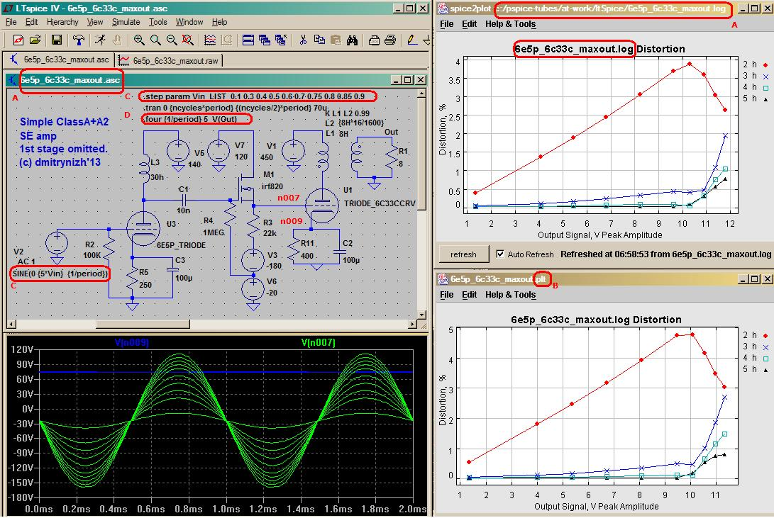
Simulation in LTSpice

Slide 6
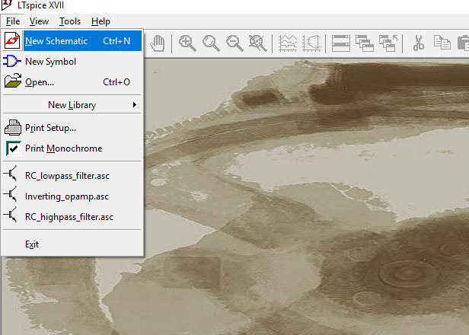
Create New Schematic Window

Slide 7
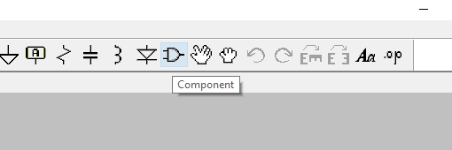
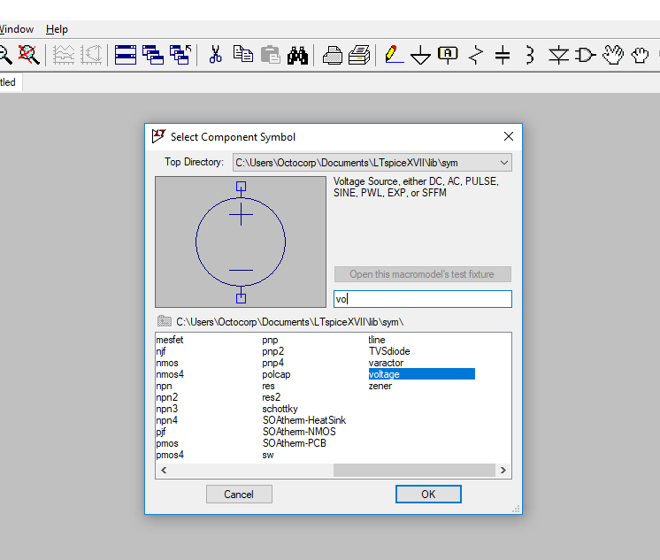
Select components

Slide 8
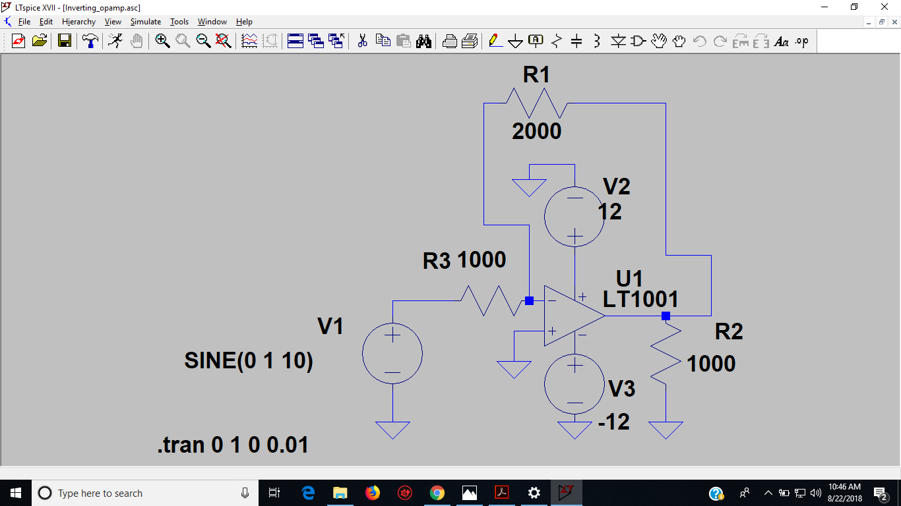
Make Circuit using Digital Inventor

Slide 9
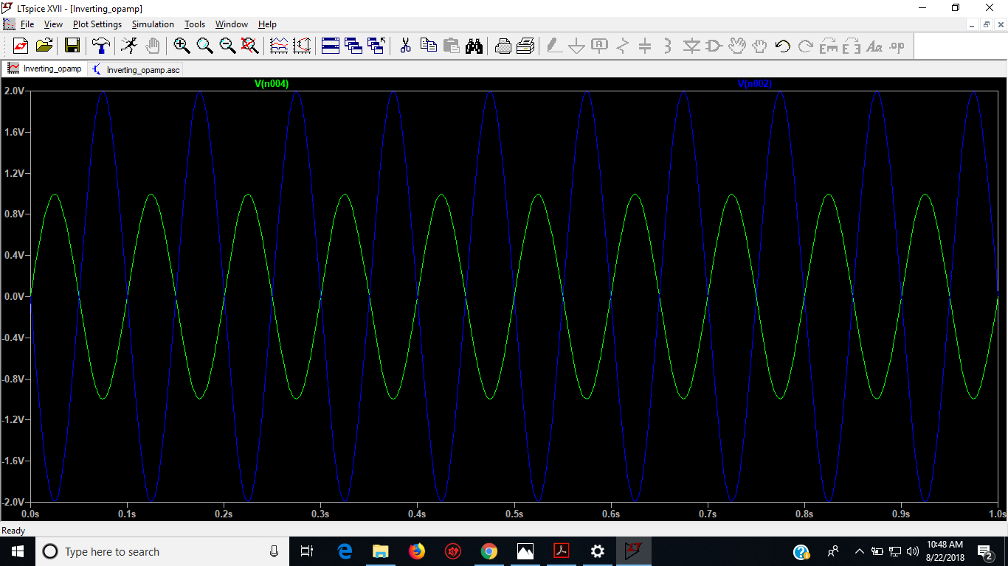
Transient AC analysis

Slide 10
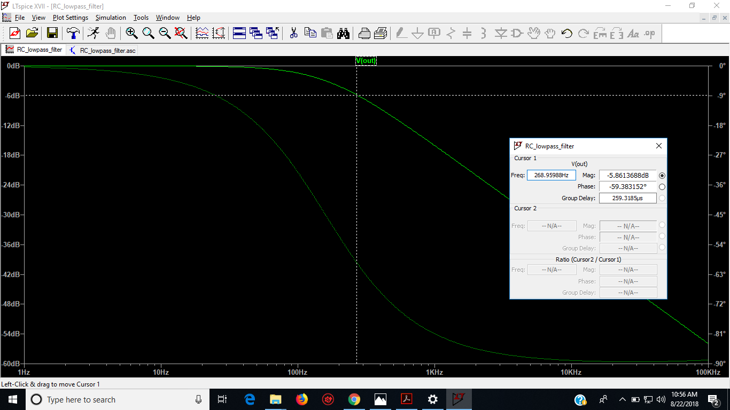
Frequency Analysis in LTSpice

