Slide 1
Introduction to MATLAB
EDA Wing Tesla

Slide 2
What is MATLAB
High level language for technical computing
Stands for MATrix LABoratory
Everything is a matrix - easy to do linear algebra

Slide 3
The MATLAB System
Development Environment
Mathematical Function Library
MATLAB language
Application Programming Language

Slide 4
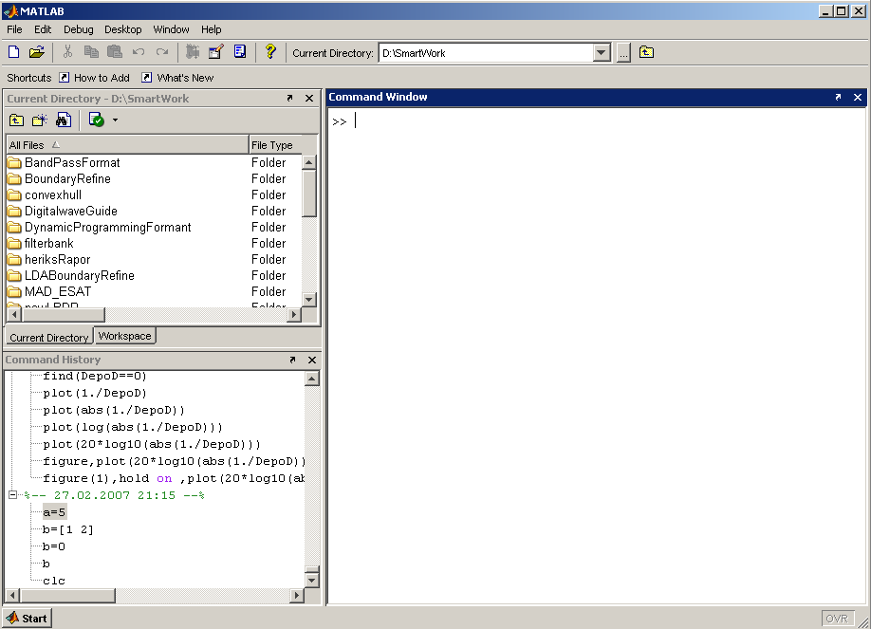
Matlab Screen
Command Window
  type commands
Current Directory
  View folders and m-files
Workspace
  View program variables
  Double click on a variable
  to see it in the Array Editor
Command History
  view past commands
  save a whole session
  using diary

Slide 5
Variables
No need for types. i.e.,
All variables are created with double precision unless specified and they are matrices.
After these statements, the variables are 1x1 matrices with double precision
int a;
double b;
float c;
Example:
>>x=5;
>>x1=2;

Slide 6
Matrices & Vectors
All (almost) entities in MATLAB are matrices
Easy to define:
Use ‘,’ or ‘ ’ to separate row elements -- use ‘;’ to separate rows
>> A = [16 3; 5 10]
A = 16 3
5 10

Slide 7

Matrices & Vectors - II
Order of Matrix -
  m=no. of rows, n=no. of columns
Vectors - special case
  n = 1 column vector
  m = 1 row vector

Slide 8
Creating Vectors and Matrices
Define
Transpose
>> A = [16 3; 5 10]
A = 16 3
5 10
>> B = [3 4 5
6 7 8]
B = 3 4 5
6 7 8
Matrix:
>> A=[1 2; 3 4];
>> A'
ans =
1 3
2 4
Vector :
>> a=[1 2 3];
>> a'
1
2
3

Slide 9

Creating Vectors
Create vector with equally spaced intervals
>> x=0:0.5:pi
x =
0 0.5000 1.0000 1.5000 2.0000 2.5000 3.0000
Create vector with n equally spaced intervals
>> x=linspace(0, pi, 7)
x =
0 0.5236 1.0472 1.5708 2.0944 2.6180 3.1416
Equal spaced intervals in logarithm space
>> x=logspace(1,2,7)
x =
10.0000 14.6780 21.5443 … 68.1292 100.0000
Note: MATLAB uses pi to represent , uses i or j to represent imaginary unit

Slide 10
Variables — Scalars, Vectors, and Matrices
Real scalar >> x = 5
Complex scalar >> x = 5+10j (or >> x = 5+10i)
Row vector >> x = [1 2 3] (or x = [1, 2, 3])
Column vector >> x = [1; 2; 3]
3 × 3matrix >> x = [1 2 3; 4 5 6; 7 8 9]
Caution (Complex elements of a matrix should not be typed with spaces, i.e., ‘-1+2j’ is fine as a matrix element, ‘-1 + 2j’ is not. Also, ‘-1+2j’ is interpreted correctly whereas ‘-1+j2’ is not)
Complex scalar >> x = 3+4j
Real part of x >> real(x) ⇒ 3
Imaginary part of x >> imag(x) ⇒ 4
Magnitude of x >> abs(x) ⇒ 5
Angle of x >> angle(x) ⇒ 0.9273
Complex conjugate of x >> conj(x) ⇒ 3 - 4i

Slide 11
Creating Matrices
zeros(m, n): matrix with all zeros
ones(m, n): matrix with all ones.
eye(m, n): the identity matrix
rand(m, n): uniformly distributed random
randn(m, n): normally distributed random
magic(m): square matrix whose elements have the same sum, along the row, column and diagonal.

Slide 12
Concatenation of Matrices
x = [1 2], y = [4 5], z=[ 0 0]
A = [ x y]
1 2 4 5
B = [x ; y]
1 2
4 5

Slide 13
Matrix operations
^: exponentiation
*: multiplication
/: division
\: left division. The operation A\B is effectively the same as INV(A)*B, although left division is calculated differently and is much quicker.
+: addition
-: subtraction

Slide 14
Array Operations
Evaluated element by element
    .' : array transpose (non-conjugated transpose)
    .^ : array power
    .* : array multiplication
    ./ : array division
Very different from Matrix operations
>> A=[1 2;3 4];
>> B=[5 6;7 8];
>> A*B
19 22
43 50
But:
>> A.*B
5 12
21 32

Slide 15
Some Built-in functions
mean(A):mean value of a vector
max(A), min (A): maximum and minimum.
sum(A): summation.
sort(A): sorted vector
median(A): median value
std(A): standard deviation.
det(A) : determinant of a square matrix
dot(a,b): dot product of two vectors
Cross(a,b): cross product of two vectors
Inv(A): Inverse of a matrix A

Slide 16
Adding Elements to a Vector or a Matrix
>> A=1:3
A=
1 2 3
>> A(4:6)=5:2:9
A=
1 2 3 5 7 9
>> B=1:2
B=
1 2
>> B(5)=7;
B=
1 2 0 0 7
>> C=[1 2; 3 4]
C=
1 2
3 4
>> C(3,:)=[5 6];
C=
1 2
3 4
5 6
>> D=linspace(4,12,3);
>> E=[C D’]
E=
1 2 4
3 4 8
5 6 12

Slide 17
Operators (relational, logical)
== Equal to
~= Not equal to
< Strictly smaller
> Strictly greater
<= Smaller than or equal to
>= Greater than equal to
& And operator
| Or operator

Slide 18
Flow Control
if
for
while
break
….

Slide 19
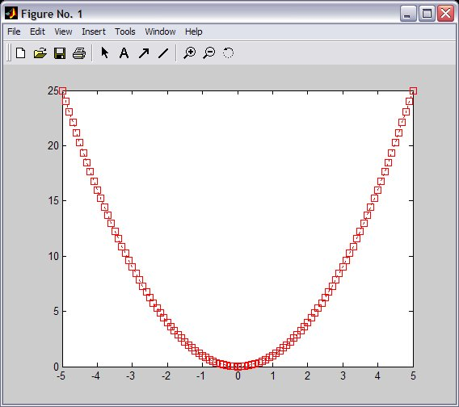
Graphics - 2D Plots
plot(xdata, ydata, ‘marker_style’);
For example: Gives:
>> x=-5:0.1:5;
>> sqr=x.^2;
>> pl1=plot(x, sqr, 'r:s');

Slide 20
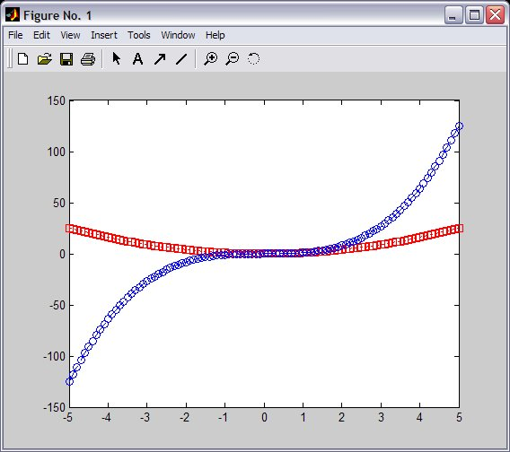
Graphics - Overlay Plots
Use hold on for overlaying graphs
So the following: Gives:
>> hold on;
>> cub=x.^3;
>> pl2=plot(x, cub,'b:o')

Slide 21
Graphics - Annotation
Use title, xlabel, ylabel and legend for annotation
>> title('Demo plot');
>> xlabel('X Axis');
>> ylabel('Y Axis');
>> legend([pl1, pl2], 'x^2', 'x^3');

Slide 22
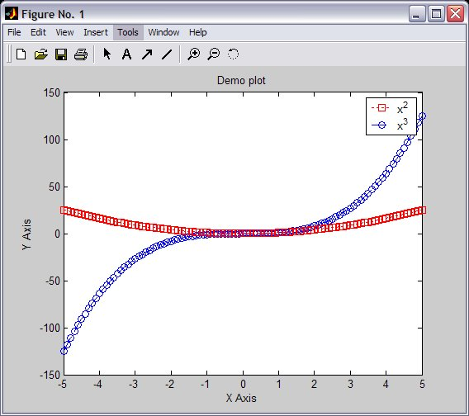
Graphics - Annotation

Slide 23
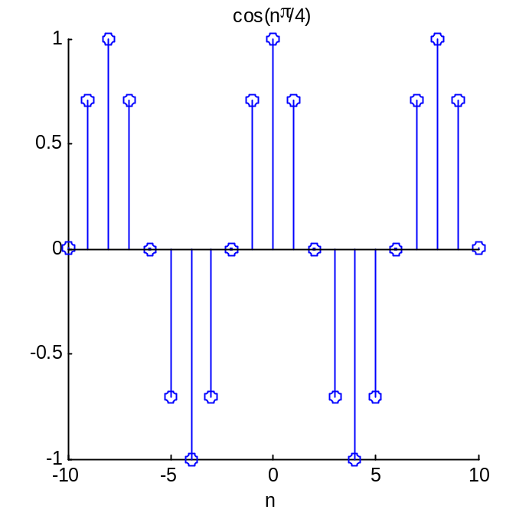
Graphics-Stem()
stem()is to plot discrete sequence data
The usage of stem() is very similar to plot()
>> n=-10:10;
>> f=stem(n,cos(n*pi/4))
>> title('cos(n\pi/4)')
>> xlabel('n')

Slide 24
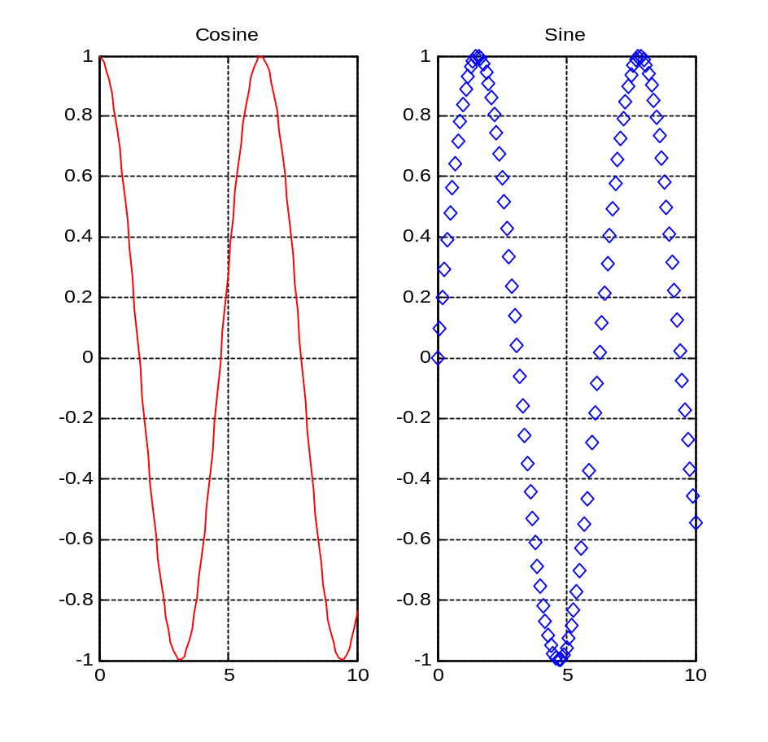
subplots
Use subplots to divide a plotting window into several panes.
>> x=0:0.1:10;
>> f=figure;
>> f1=subplot(1,2,1);
>> plot(x,cos(x),'r');
>> grid on;
>> title('Cosine')
>> f2=subplot(1,2,2);
>> plot(x,sin(x),'d');
>> grid on;
>> title('Sine');

Slide 25
Save plots
Use saveas(h,'filename.ext') to save a figure to a file.
Useful extension types:
bmp: Windows bitmap
emf: Enhanced metafile
eps: EPS Level 1
fig: MATLAB figure
jpg: JPEG image
m: MATLAB M-file
tif: TIFF image, compressed
>> f=figure;
>> x=-5:0.1:5;
>> h=plot(x,cos(2*x+pi/3));
>> title('Figure 1');
>> xlabel('x');
>> saveas(h,'figure1.fig')
>> saveas(h,'figure1.eps')

Slide 26
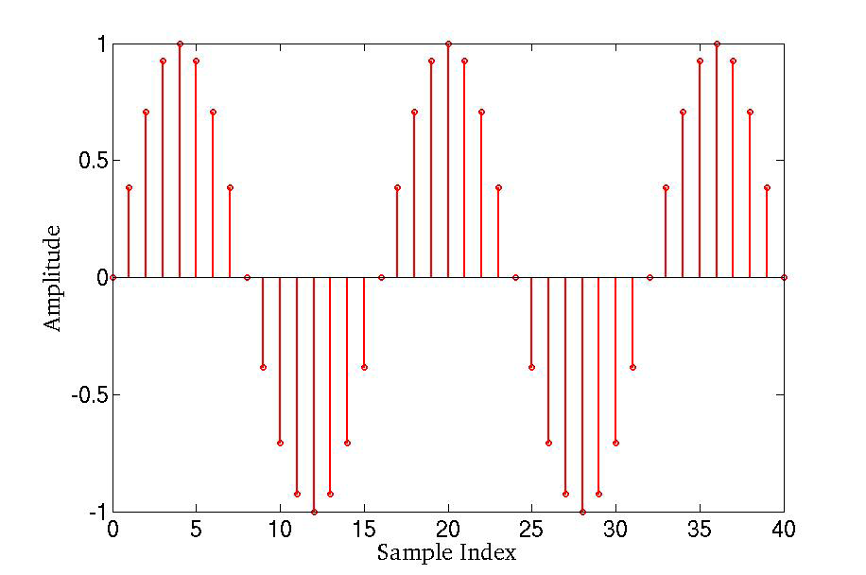
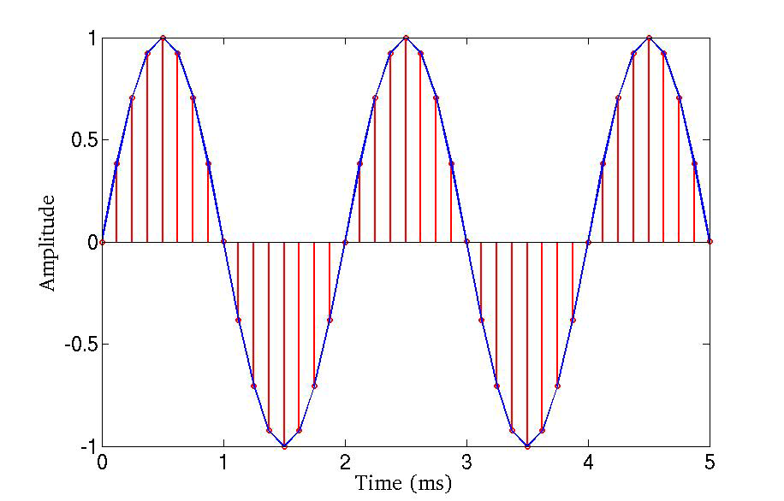
Sine Wave in Matlab
t = [ 0 : 1 : 40 ]; % Time Samples
f = 500; % Input Signal Frequency
fs = 8000; % Sampling Frequency
x = sin(2*pi*f/fs*t); % Generate Sine Wave
figure(1);
stem(t,x,'r'); % View the samples
figure(2);
stem(t*1/fs*1000,x,'r'); % View the samples
hold on;
plot(t*1/fs*1000,x); % Plot Sine Wave

Slide 27
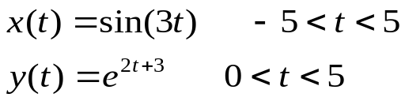


Practice Problems
Plot the following signals in linear scale
Plot the following signals, use log scale for y-axis
Plot the real part and imaginary part of the following signal
For the signal in previous question, plot its phase and magnitude

Slide 28
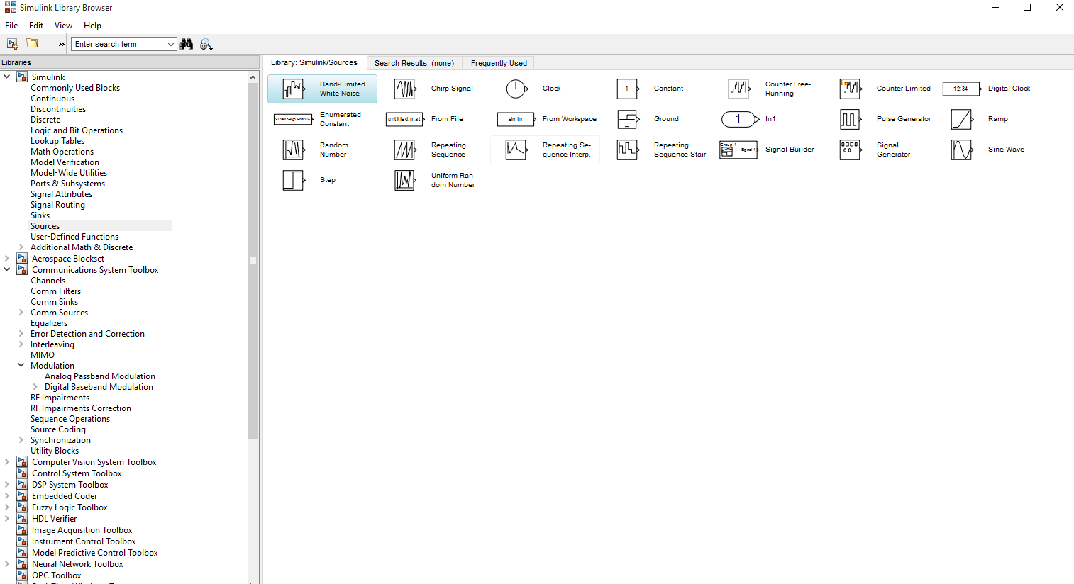

Slide 29
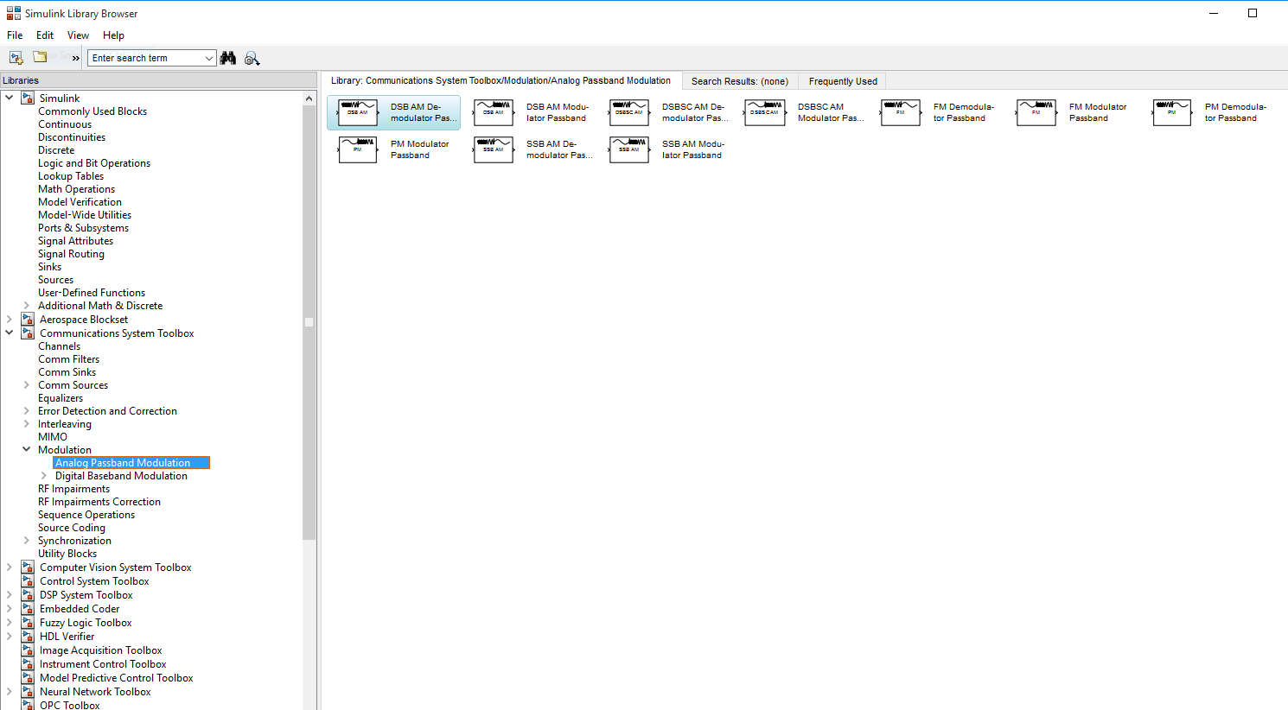

Slide 30
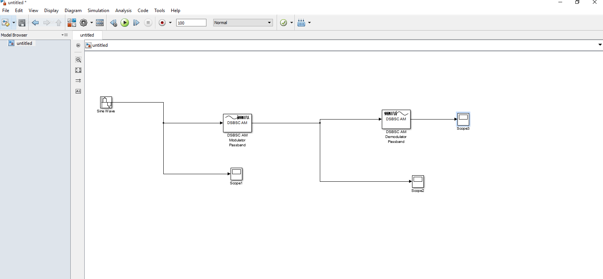

Slide 31
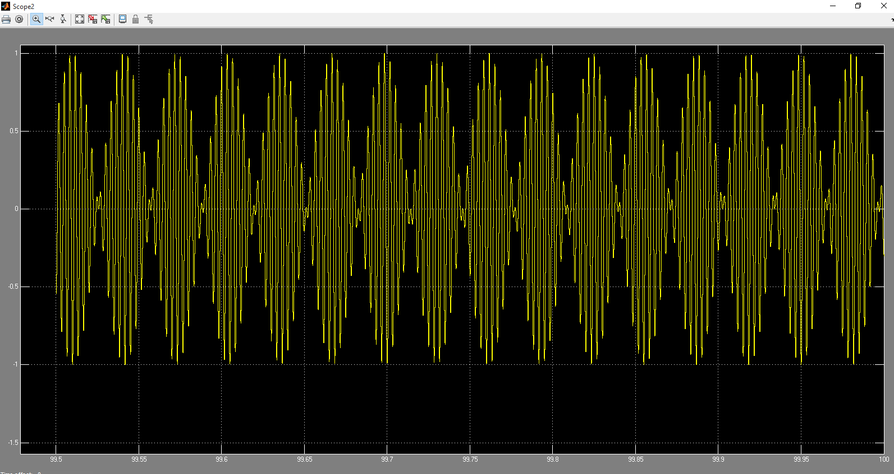

Slide 32
