Slide 1
DEEP LEARNING BASED SIGN LANGUAGE TO TAMIL SPEECH
MCA
2019202061(R)
Vinothkumar S
Guide name
Dr. P Geetha

Slide 2
PROBLEM STATEMENT
The problem statement is to translate sign language to Tamil Speech
Existing system is only available for American Sign Language

Slide 3
MOTIVATION
Ultimate aim to Translate sign to tamil.
Analyzes the real time video frame by frame
To Translate the sign to letter
To translate letter to word and speech

Slide 4
OBJECTIVE
To extract frame from Video
To detect the object.
To recognise action using Convolutional Nueral Network (CNN).
To classify the letters
To translate to Tamil Speech

Slide 5
LITERATURE REVIEW
S.No | Author name & Paper title | Concept in the paper | Paper details
1. | Author: Ankit Ojha, Ayush Pandey, Shubham Maurya Title: Sign Language to Text and Speech Translation in Real Time Using Convolutional Neural Network” | Algorithm: Convolutional Neural Network Long Short Term Memory(LSTM) | Publish: IEEE Issue: April-2020

Slide 6
S. No | Author name & Paper title | Concept in the paper | Paper details
2. | Author: Shruti Chavan, Xinrui Yu and Jafar Saniie Title: Gesture Recognition for American Sign Language” | Algorithm: LeNet-5, AlexNet , Vgg16 and MobileNet v2 | Publish: IEEE Issue : August- 2021

Slide 7
S. No | Author name & Paper title | Concept in the paper | Paper details
3. | Author: Amrita Thakur, Pujan Budhathoki, Sarmila Upreti, Shirish Shrestha, Subarna Shakya. Title: Real Time Sign Language Recognition and Speech Generation” | Algorithm: Neural Network ,Hidden Markov Model Limitations: Three classes of weapons Handguns, Knives, and heavy guns | Publish :irojournal Issue:APRIL2020

Slide 8
S.No | Author name & Paper title | Concept in the paper | Paper details
4. | Author : Brandon Garcia, Sigberto Alarcon Viesca. Title: American Sign Language Recognition with Convolutional Neural Networks | Algorithm: Convolution Neural Network(CNN) | Publish:Stanford Issue : March-2020

Slide 9
IMPLEMENTATION FRAMEWORK
Development Platform: JUPYTER NOTEBOOK,VSCODE
Language: Python
Dataset: Sign Image dataset
Notes:
https://dasci.es/transferencia/open-data/24705/
https://www.kaggle.com/datasets/mohamedmustafa/real-life-violence-situations-dataset

Slide 10
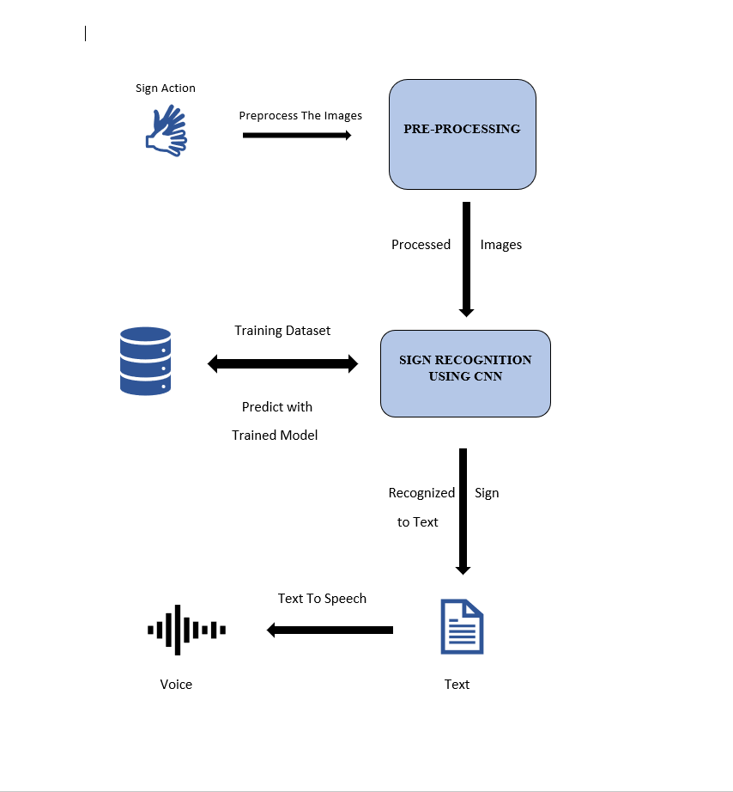
ARCHITECTURE DIAGRAM

Slide 11
Work Flow Diagram

Slide 12
MODULES
1. Image Acquisition
2. Preprocessing
3. Model Training
4. Sign Recognition
5. Conversion
6.Translation

Slide 13
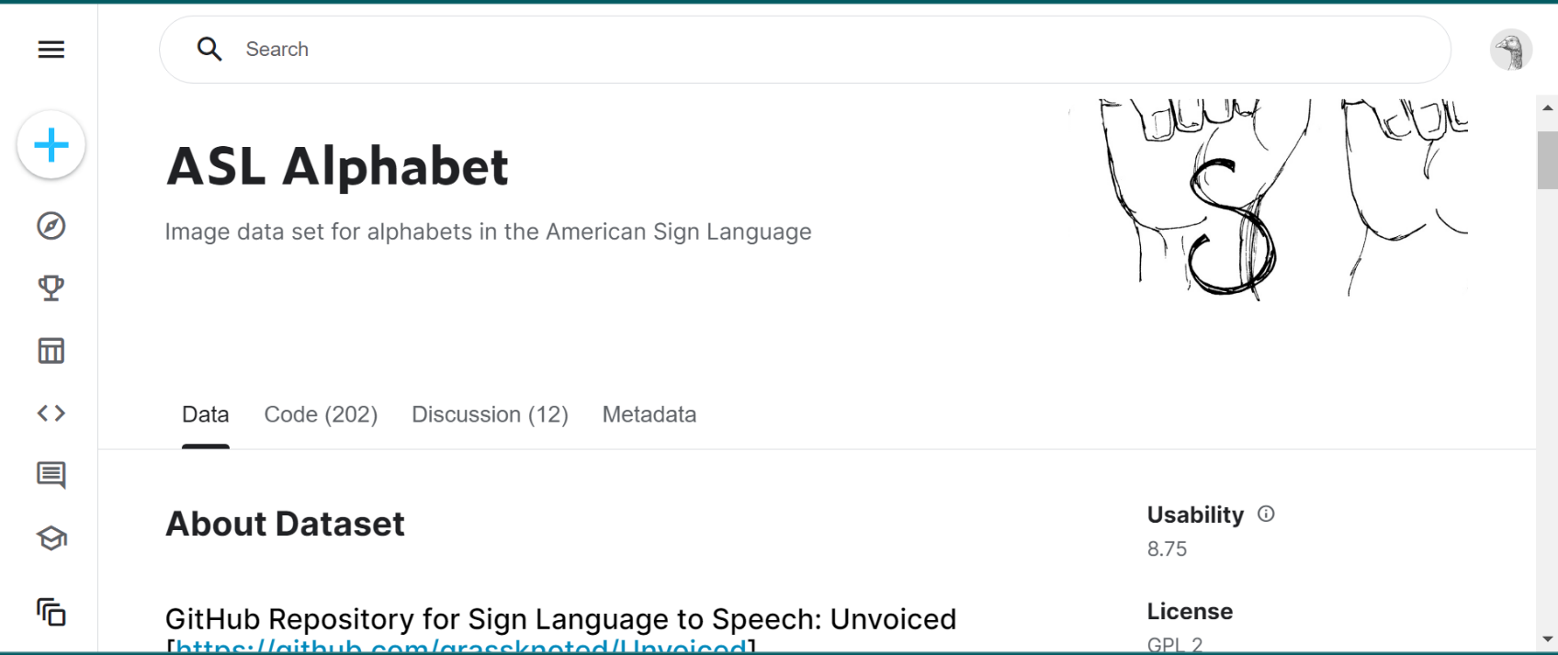
IMAGE ACQUISITION
Acquisition is the process of collection of images.
These images are get from the online datasets

Slide 14
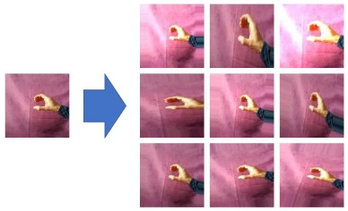
PRE-PROCESSING
Image Augmentation:
input: Dataset Image
output: Augmented image dataset
Step 1: start
Step 2: Load image folder
Step3:Augment the image
train_datagen = ImageDataGenerator()
Step 4: Feed the augmented image to CNN

Slide 15

Image Augmentation
Image Augmentation
Augmented Images
Image Data Set

Slide 16
PRE-PROCESSING
Image Preprocessing:
input: Frame Image
output: Grayscale image
Step 1: start
Step2:Capture Image
Step 3: Preprocess the image
Step 4: Feed image to Trained Model

Slide 17

Image Preprocessing
Video To Image
Image Color Conversion and Resize
Real Time Video
Image Normalization
Image Blurring

Slide 18
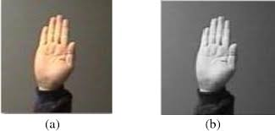
RGB to Gray scale image
im= imread(Fig1.jpg);
gs= rgb2gray(im);
imshow(gs);

Slide 19
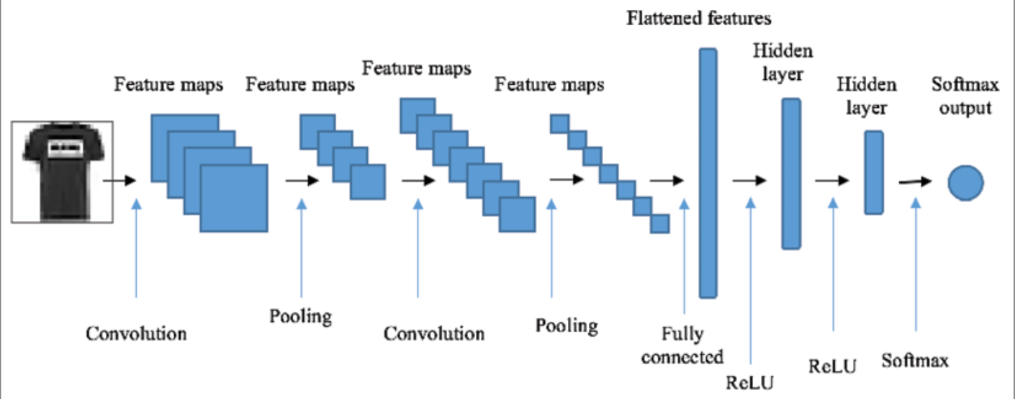

CNN Architecture

Slide 20
Model Training:
Model Training :
input:Augmented Image
output:Model json file and Weight file
Step 1: Load the Image
Step 2: Generate the activation map
Step3:Remove negative values
Step 4: reduce the map size
Step 5: Convolute the map
Step 6: Reduce the map

Slide 21
Model Training:
Step 6: flatten the map
Step 7:dropout the random map
Step 8: dense the map
Step 9:Generate 27 class labels
Step 10: store the model and weights

Slide 22
Sign Recognition
Input : Frame image
Output: Classified Sign
Step 1: start
Step 2: Capture frame
Step 3 :Preprocess The Image
Step 4:Load the image into model
Step 5:Find the corresponding letter
Step 6:Feed it to next module

Slide 23

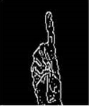
Sign Classification
Trained Model
Preprocessed Image
Classified Sign

Slide 24
SIGN CLASSIFICATION
Input:Classified Sign
Output:text
Step1:Get corresponding letter
Step2:Convert the letters to text
TRANSLATION
Input:Text
Output:Voice
Step1:Text From coversion Module
Step2:Translate the text to tamil
Step3:Covert the text to Voice

Slide 25
Algorithm steps
Step 1: Start
Step 2:Capture Video
Step 3: frame extraction
Step 4:Preprocess the frame image
Step 5:Feed the image to trained model
Step 6: Predict the Sign
Step 7: Covert to text
Step 8: Translate to Tamil and the speech
Step 9:Stop

Slide 26
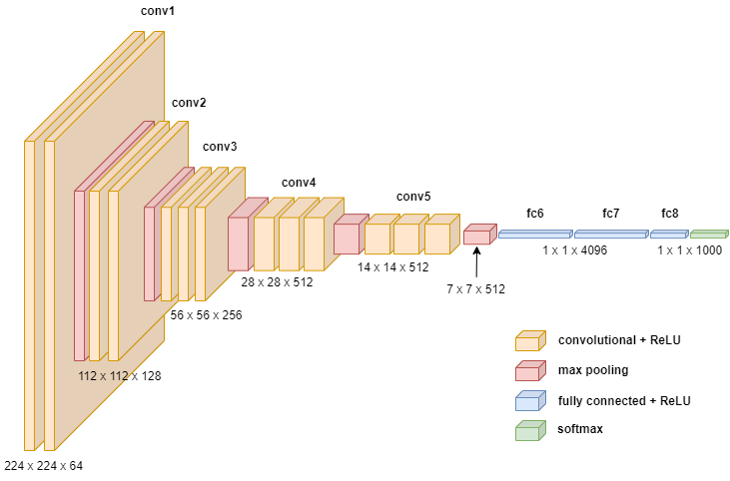

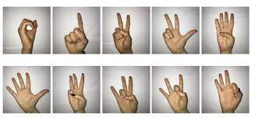
Flow Diagram
Flow Diagram

Slide 27
References
Ankit Ojha, Ayush Pandey, Shubham Maurya. “Sign Language to Text and Speech Translation in Real Time Using Convolutional Neural Network” IEEE Xplore , Issue 20 April 2020
Shruti Chavan, Xinrui Yu and Jafar Saniie. “Convolutional Neural Network Hand Gesture Recognition for American Sign Language” , IEEE , 2021
Amrita Thakur, Pujan Budhathoki, Sarmila Upreti, Shirish Shrestha, Subarna Shakya.”Real Time Sign Language Recognition and Speech Generation” , irojournals , 2020
Chandhini Grandhi, Sean Liu, Divyank Rahoria. “American Sign Language Using Deep Learing” Recognition”,noiselab(http://noiselab.ucsd.edu/).
Brandon Garcia, Sigberto Alarcon Viesca. “Real-time American Sign Language Recognition with Convolutional Neural Networks” ,

Slide 28

5

