Slide 1
Introduction: AI and Creative Poetry Writing
Exploring Human-AI Collaboration in Creative Writing and Language Learning

Slide 2
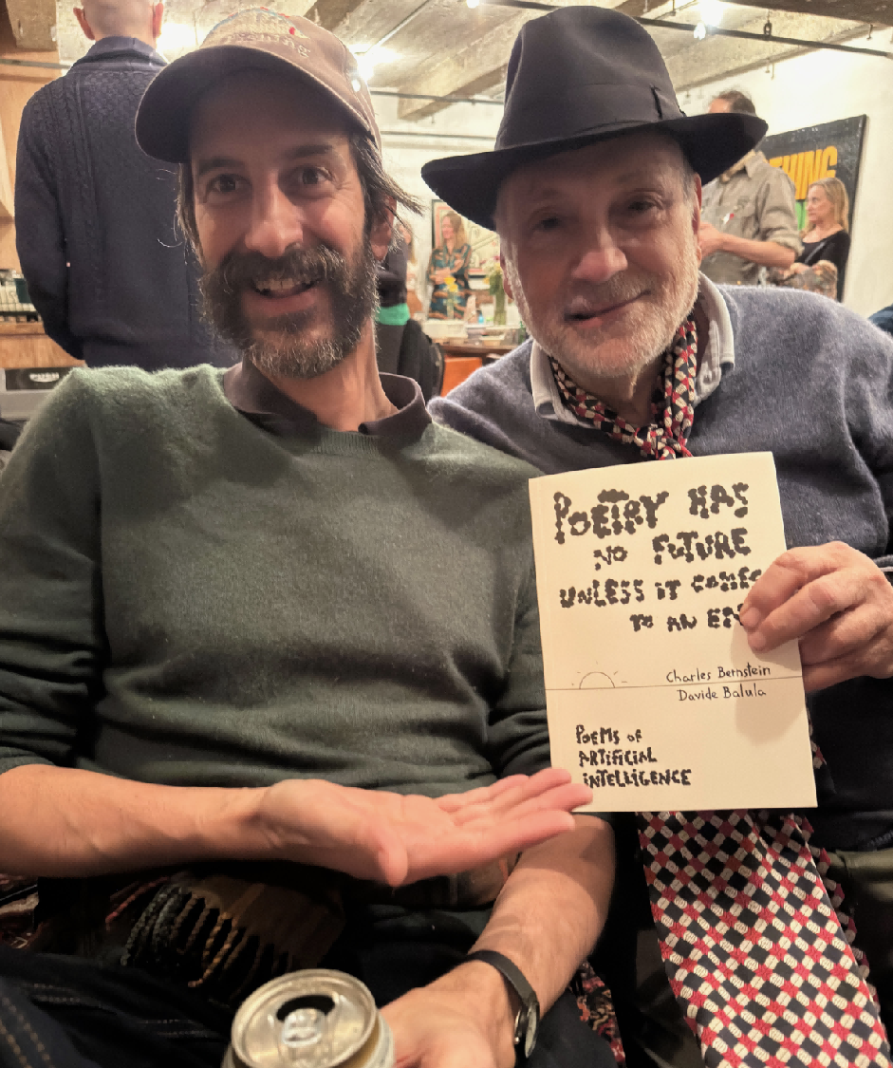
The Story of Charles Bernstein
• 2019: Publication of Poetry Has No Future Unless It Comes to an End
• Co-created with AI trained on Bernstein's own poetry
• Yet, when the book was published, only Bernstein and the programmer were listed as authors, the AI remained uncredited
• This erasure reveals our ambivalence about AI creativity
Charles Bernstein & Davide Balula （the programmer）

Slide 3
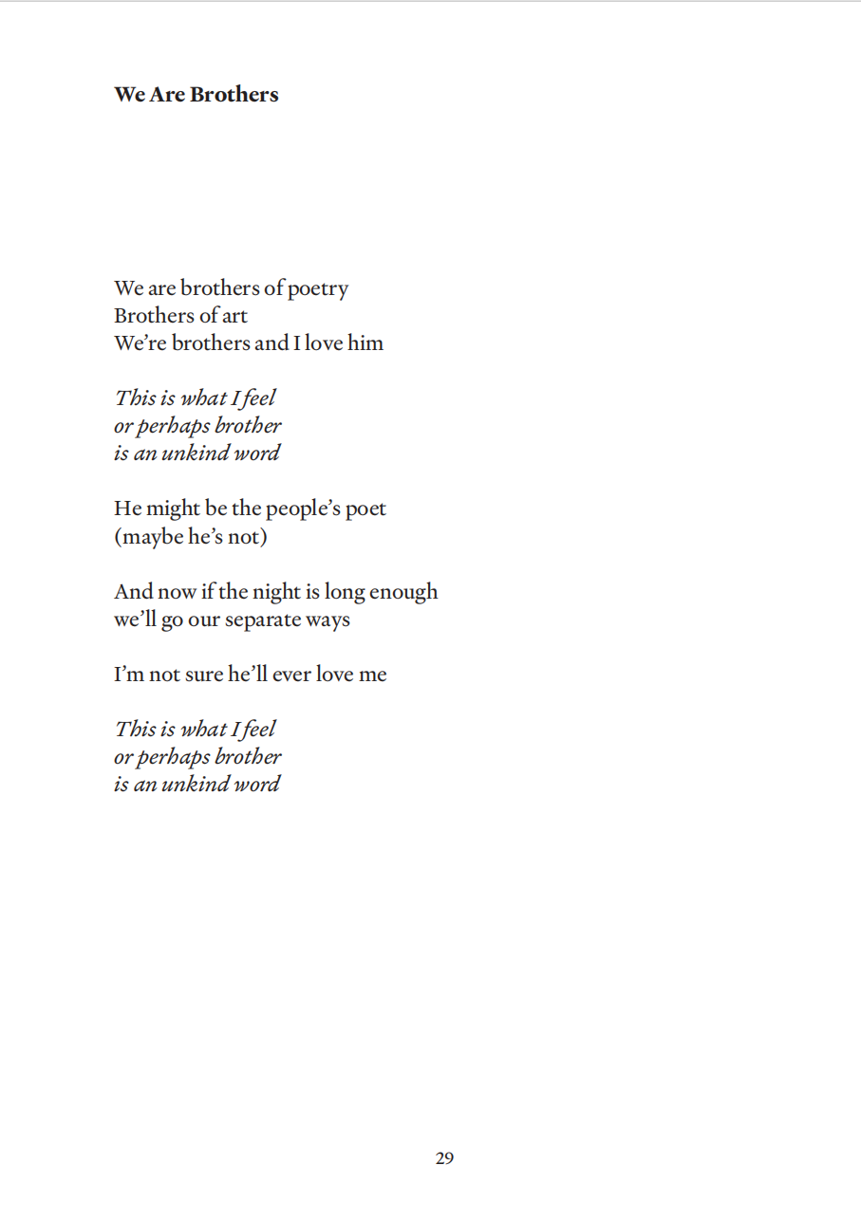

Slide 4
Our Era of Ambivalence
• AI brings exciting new possibilities to creative fields
• Yet we face urgent questions:
- What happens to human originality?
- What does authorship mean anymore?
- Can machines replace human creativity?

Slide 5
"In an age of technological advancement, where exactly do we humans stand?"
— Central Question

Slide 6
The Academic Skepticism
• AI-generated poetry often lacks genuine emotion
• Missing contextual depth and nuanced understanding
• Human bias against machine-created work
• Fear of losing human creativity: 'anxiety of machine influence'

Slide 7
"What if AI isn't a threat, but a catalyst for creativity?"
— The Emerging Perspective

Slide 8
What Can AI Bring to the Table?
1. Idea Prompt & Diversity Explorer
- Draw from thousands of poems across centuries
- Fresh perspectives unconstrained by human bias
2. Democratization & Personalization
- Make poetry creation accessible to everyone
3. Mastery Imitator
- Simulate styles and approaches of great poets

Slide 9
Why Poetry (and Not Prose)?
• Poetry tolerates ambiguity and formal flexibility
• Grammar and syntax are not strictly enforced
• Readers expect uncertainty and abstraction
• Lower technical barrier than fiction or prose
• BUT: Technical possibility ≠ Capturing true poetry

Slide 10
Human Decisions Matter!!!
• A poem's power emerges from interplay, not single elements
• Nuance lives in how poets make choices
• Selecting one word from many synonyms
• Embracing unexpected AI suggestions creatively
• These micro-decisions are where poetry becomes poetry
• These decisions must be documented and studied

Slide 11
"The incommunicable, deeply private aspects of human expression cannot be reduced to algorithms."
— The Irreducible Humanity

Slide 12
The Path Forward: Collaboration
• Human-Machine In-A-Loop methodology
• Genuine partnership, not human editing machine output
• Humans continuously add interpretive layers
• Requires Human-Centered Mindset:
- AI must serve human development

Slide 13
Questions Before Us
• In an era when machines generate poetry in seconds,
what is the irreducible value of human creativity?
• What will poetry become when humans and machines
collaborate thoughtfully and intentionally?
• How can we design technologies that strengthen
human capacity and amplify human voice?

Slide 14
The Answer Lies in Partnership
Not choosing between human or machine, but understanding how to strengthen both

